Slide 1
Project 1 presentation

Slide 2
agenda
Project Dsi (American College Testing & Scholastic Assessment Test) Research
==> Import
==> Read in data
==> Data Cleansing
==> Data Formatting
==> Data exploration

Slide 3

Find questions to gain insights into historical data. Leading Questions for Finding Answers from the Data - If your scores are above average in several areas, this may indicate a higher chance of applying to a competitive college. - If your GPA is high but your ACT scores are low, focusing on improving your ACT scores may be a good way to increase your chances of applying to colleges. - If your essay scores are high, this may help to impress colleges with your writing skills. - If students in a particular region score higher on science than in other areas, this may be a good way to focus on areas where students can improve. - If past exams are found to have the most impact on improving their Math scores, then focus on practicing the same test format.

Slide 4

Find state trends and average test scores.
Predict which student are likely to cancel their admission in the near future.

Slide 5
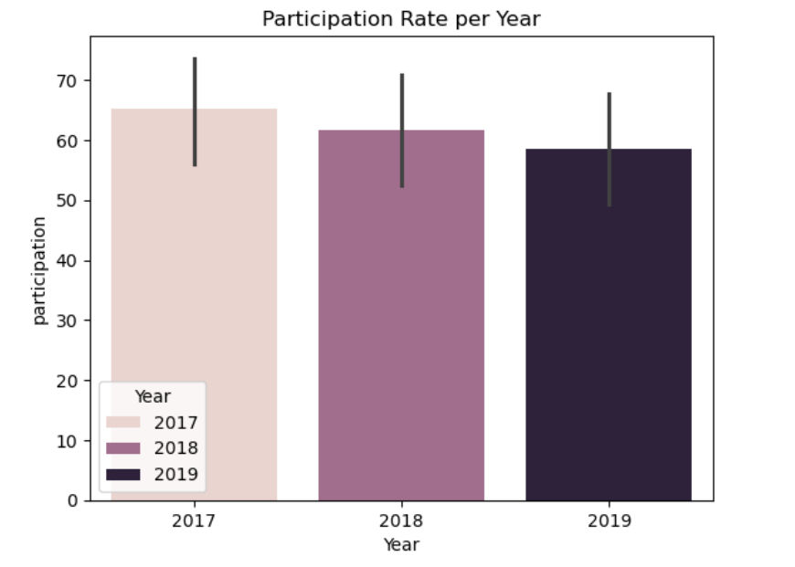
Engaging the audience

Slide 6
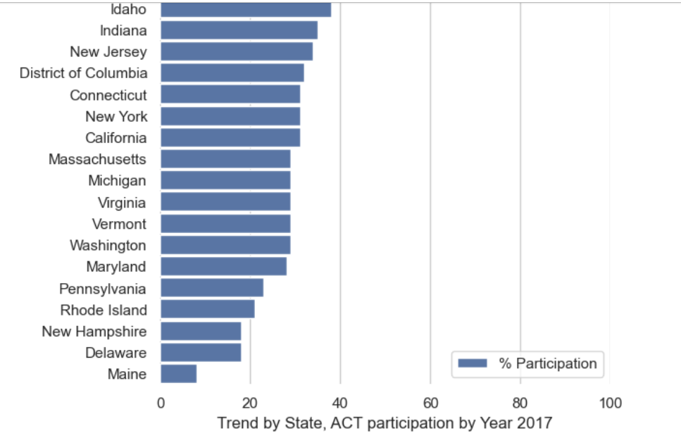
2017 Participation by State < 40%

Slide 7
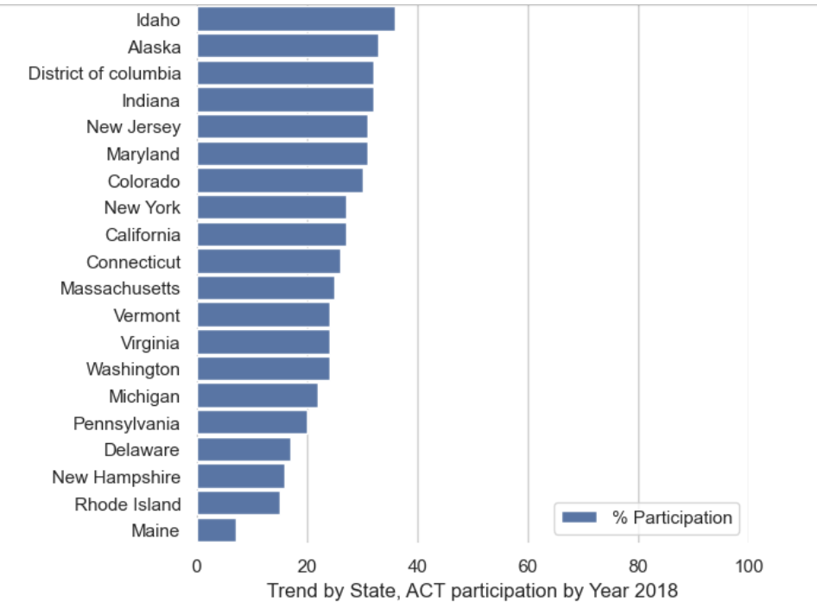
2018

Slide 8
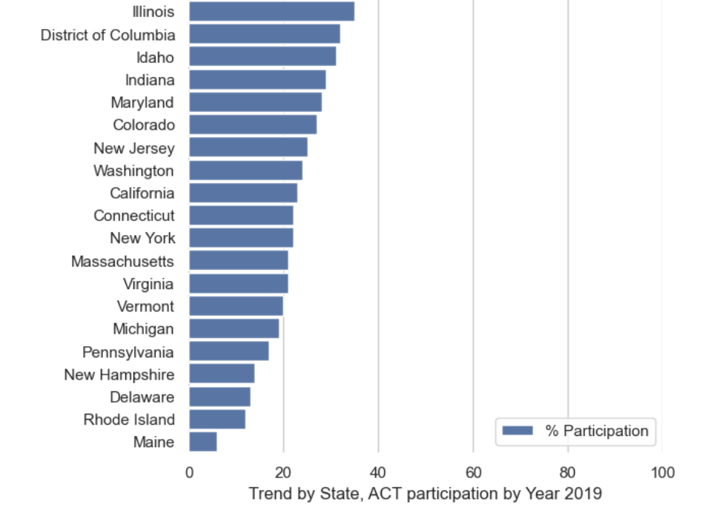
2019

Slide 9

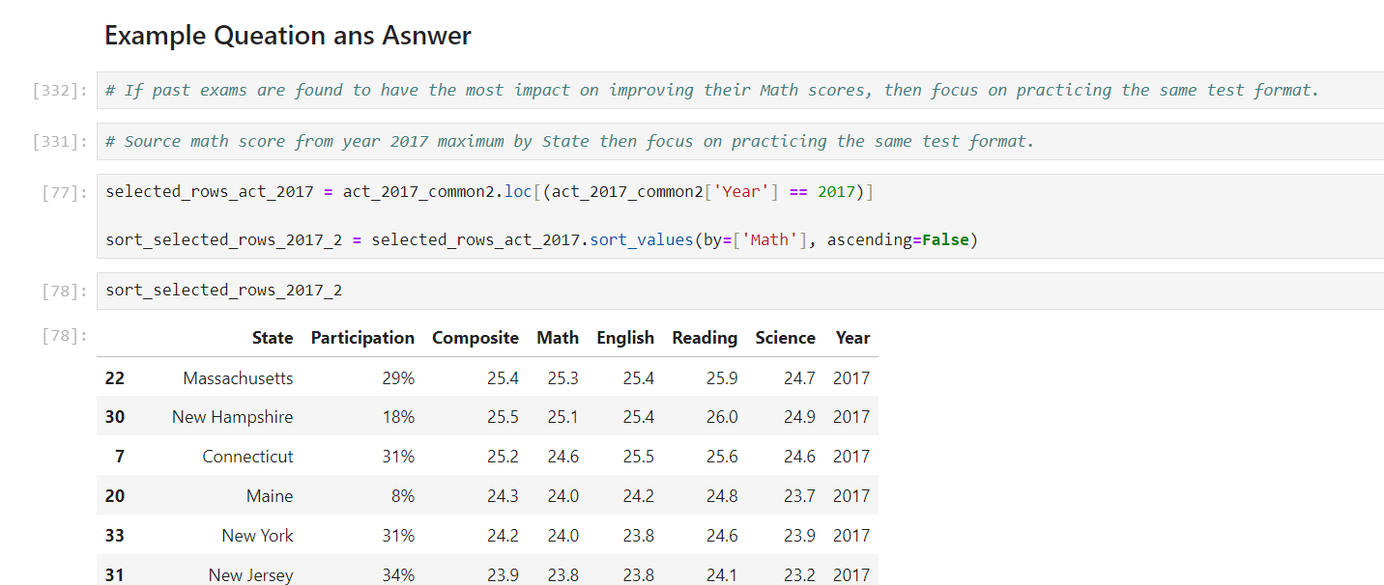
Navigating Q&A sessions

Slide 10
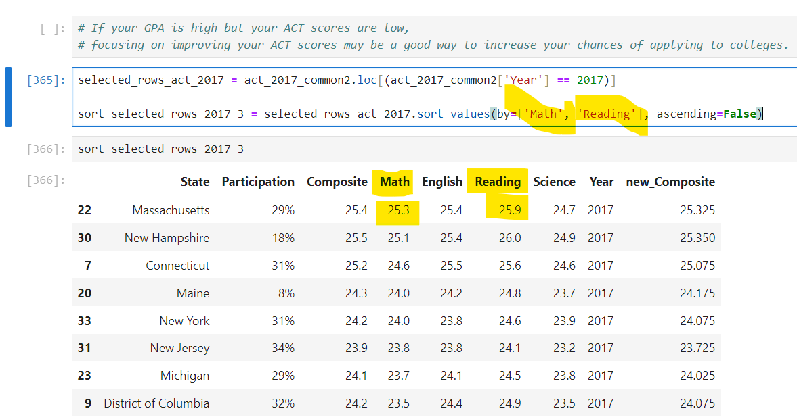

Speaking impact

Slide 11
Final tips & takeaways
A composite score of 28 may place you in the 88th percentile, meaning you scored higher than 88% of test-takers.
High scores in Math and Science suggest strength in quantitative and analytical reasoning.
A score of 32 in Reading might indicate strong verbal comprehension skills.
A score of 26 in Science might suggest areas where more practice in interpreting scientific data could help.
A composite score of 29 might place you in the 91st percentile, meaning you scored higher than 91% of test-takers.
A composite score of 24 might place you in the 74th percentile.
Seek feedback
Reflect on performance
Explore new techniques
Set personal goals
Iterate and adapt

Slide 12
ACT publishes benchmarks that represent scores associated with college success:
Impact factor | Measurement | Target | Achieved
English | Percentage (%) | 18 | >=18
Math | Percentage (%) | 22 | >=22
Reading | Percentage (%) | 22 | >=22
Science | Percentage (%) | 23 | >=23
Composite | Average rating | 36 | >=21.2

Slide 13
Thank you
Taweewattana Prhomkotara (Wee)
0909275573
promakotara@gmail.com

