Slide 1
Project 1 presentation

Slide 2
PROBLEM STATEMENT
Analyzing participation rates in ACT (American College Testing) exams can provide insights into several factors, such as demographic trends, educational access, and student preferences over time. Here's a general approach for analyzing ACT participation rates:
Data Collection Analyze each year's data
Identify Key Metrics Participation Rate Participation Trends
Data Segmentation By State/Region, Impact of Policies
Trend Analysis Changes in Participation Over Time
Statistical Analysis Geographical Differences
Visualization Graphs, Heat Maps

Slide 3
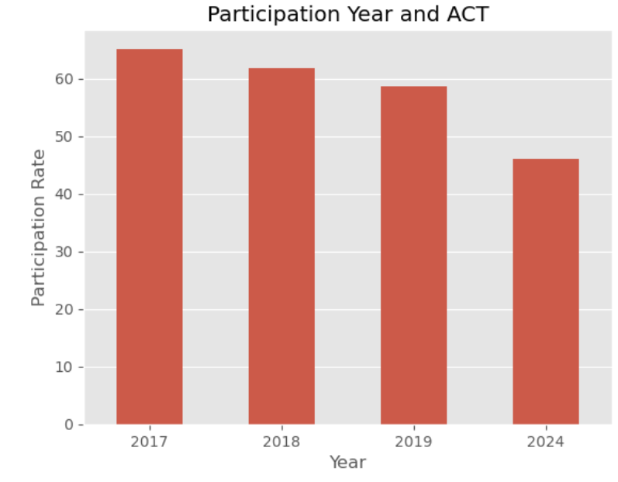
Participation rate trend by year

Slide 4
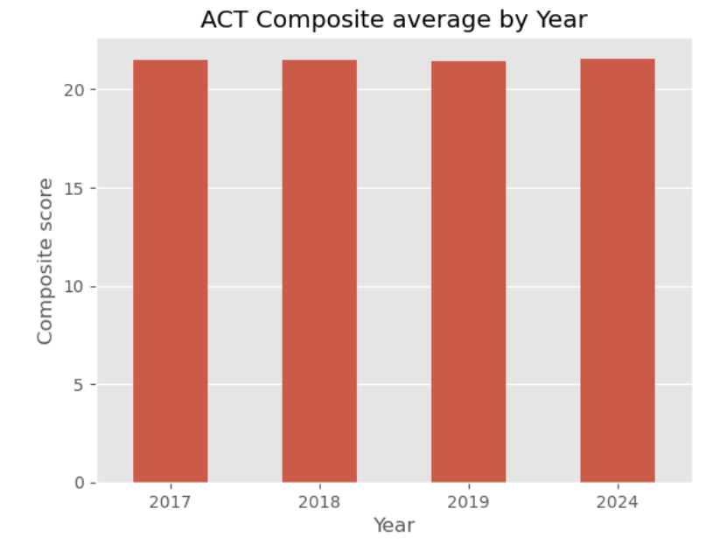
Composite score average trend by year

Slide 5
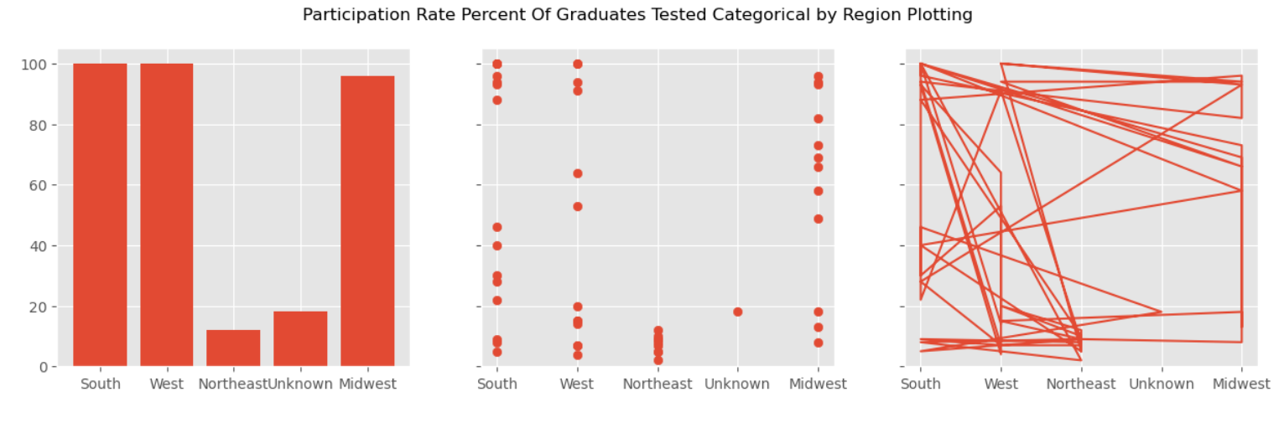
Trend Analysis Changes in Participation trend by region

Slide 6
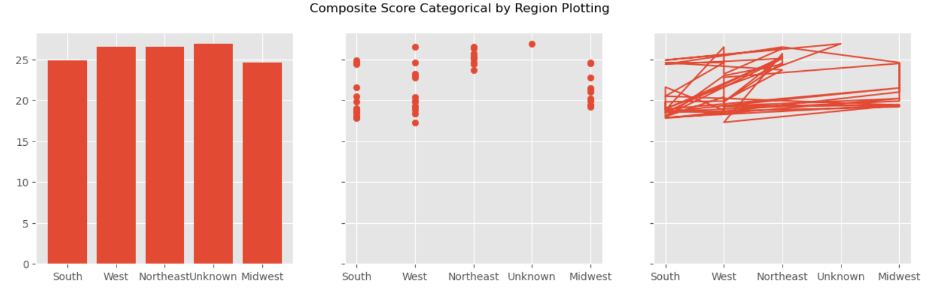
Trend Analysis Changes in composite trend by region

Slide 7
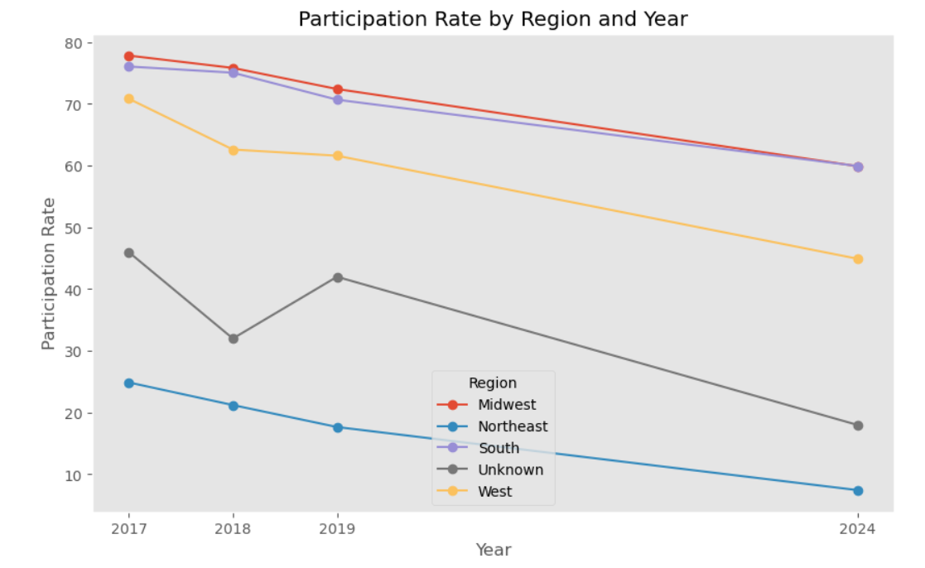
Trend Analysis Changes in Participation Over Time

Slide 8
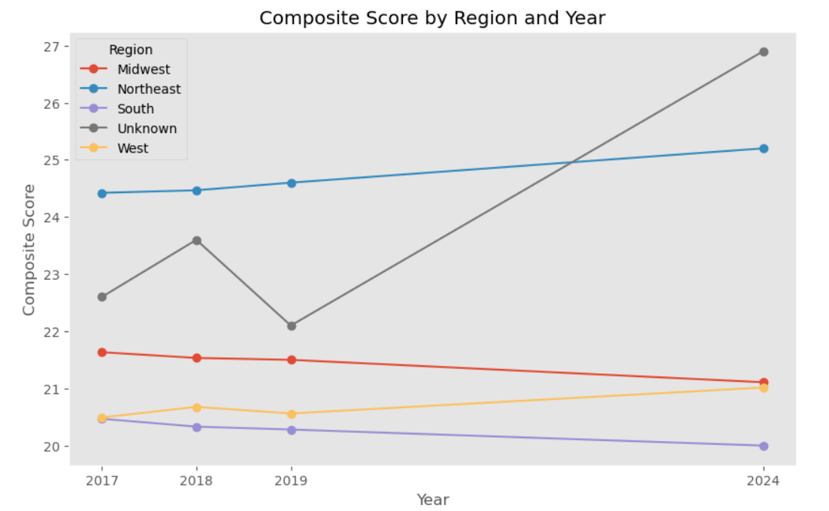
Trend Analysis Changes in composite score Over Time

Slide 9
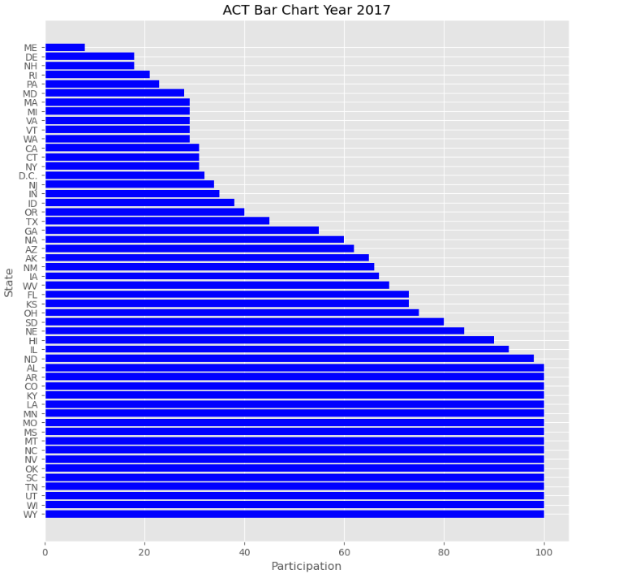
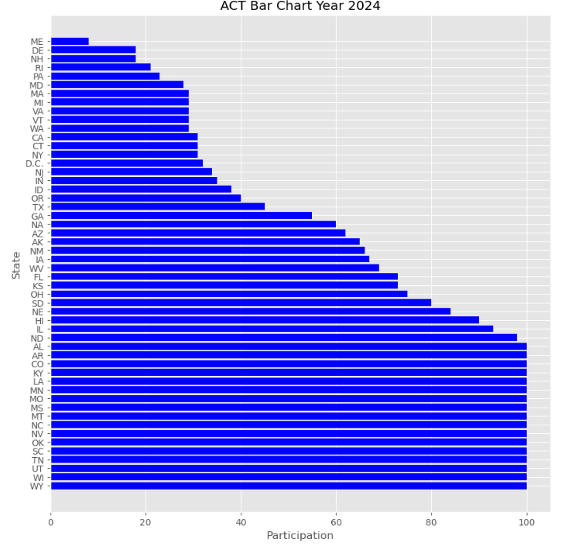
bar charts for participation rates across states or demographic groups.

Slide 10
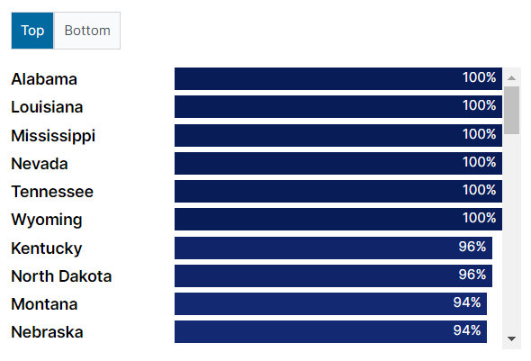
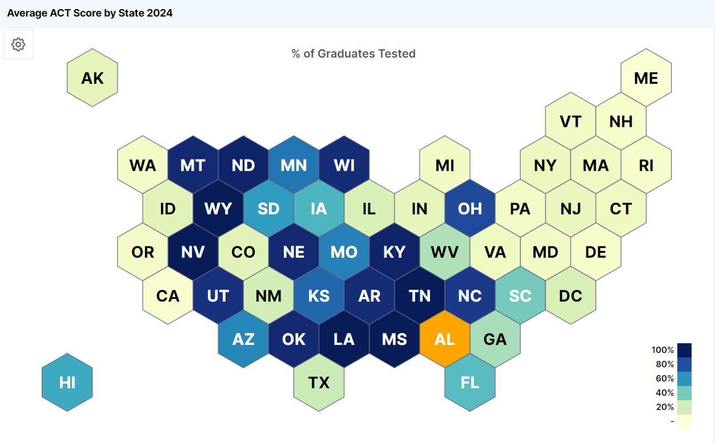
Data Segmentation Participation By State/Region, Impact of Policies

Slide 11
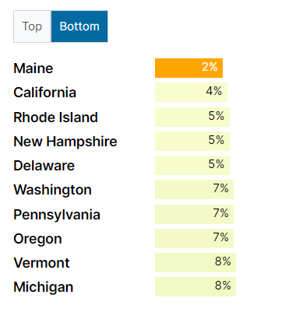
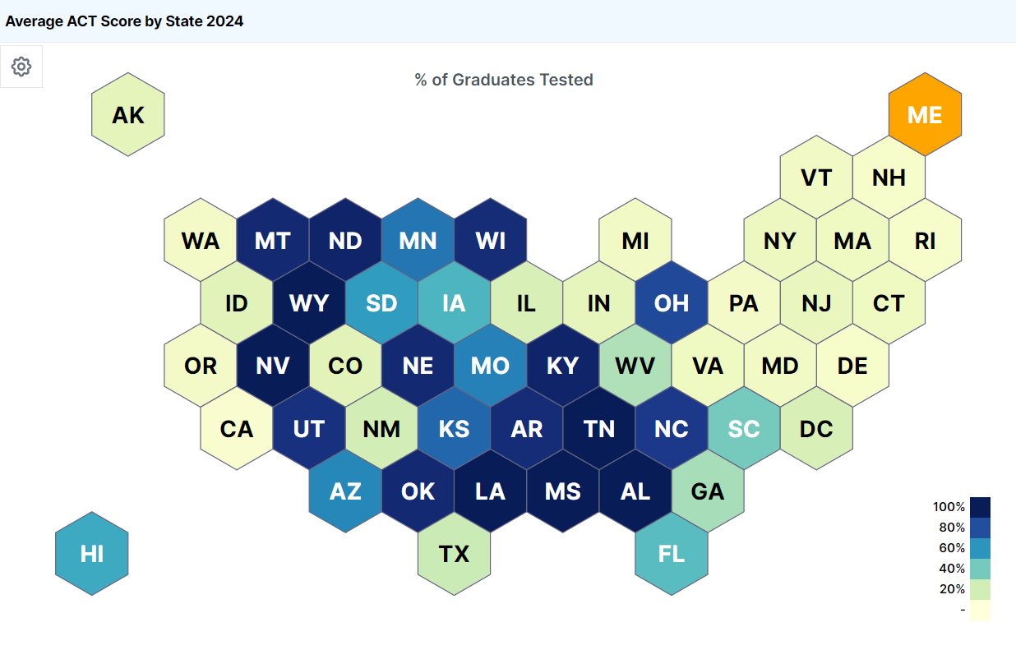
Data Segmentation Participation By State/Region, Impact of Policies

Slide 12
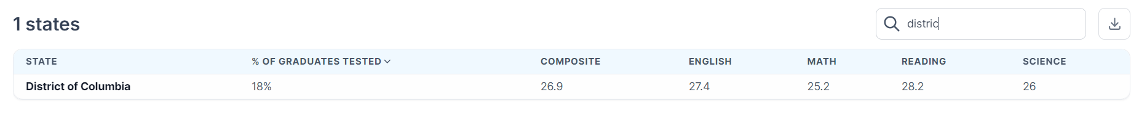
Navigating Q&A sessions
Which state has the highest ACT score? (2024)
The state with the highest composite ACT score is District of Columbia, with a score of 26.9.
The lowest average score was Nevada, with an average score of only 17.3, as Nevada has a statewide ACT test, resulting in a lower average since all students are required to take the test.

Slide 13
Speaking impact
Summarizing what was obtained from studying the data to find insights in the data, it was known that the differences in average scores in each state, some states have regulations that make students in the entire state join the competitive exam, and the popularity values ​​are high and low, and can be further explored for decision-making in choosing to continue studying or compete in the exam to enter the university level.

Slide 14
Thank you

