Slide 1

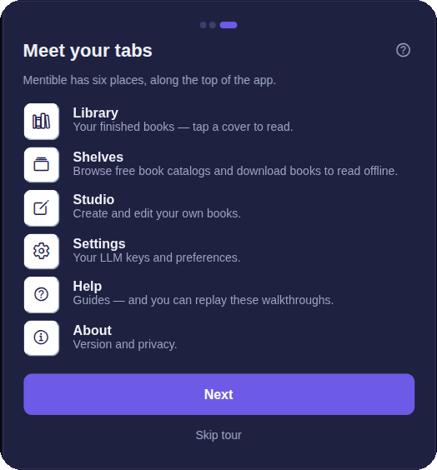
Mentible
New User Guide
Author Yourself — from your first sign-in to publishing your first book.
A six-part walkthrough, with screenshots from the live app.

Slide 2
What you'll learn
1
Sign in & get set up
2
Tour the menus
Account + your AI key — read vs. author.
The six tabs and what each one does.
3
Load the books you need
4
Compile your first book
Free catalogs, downloads, importing EPUBs.
From an outline to a generated book.
5
Edit your book
6
Publish your release
Refine topics, add figures, get feedback.
Save privately or publish for readers.
Mentible · New User Guide
2

Slide 3
01
Sign in & get set up
STEP
Two things unlock authoring: an account and your own AI key.
Mentible · New User Guide
3

Slide 4
SECTION 1 · SIGN IN
First run — three quick steps
1
Create your account
Email + password, or “Continue with Google”. Optional to read — required to author or sync.
2
Add an LLM key (BYOK)
Pick a provider (Claude recommended), follow “How to get your key”, paste it. Stays on your device.
3
Meet your tabs
A quick tour, then “Open my Library”. Replay any time from Help.
You don't need an account to start
Read the included books with no sign-in and no key. Sign in + add a key only when you want to author your own book.
Mentible · New User Guide
4

Slide 5
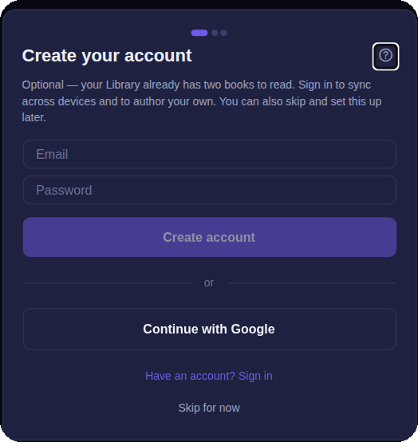
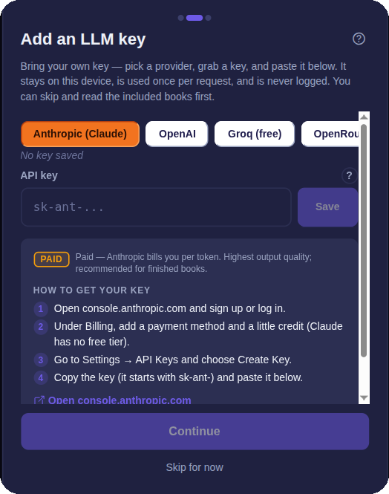
SECTION 1 · SIGN IN
The first-run wizard — from the live app
Step 1 — create your account (or skip).
Step 2 — pick a provider and paste your key.
Mentible · New User Guide
5

Slide 6
02
Tour the menus
STEP
Six tabs across the top bar. Here's what each one is for.
Mentible · New User Guide
6

Slide 7
SECTION 2 · MENUS
The six tabs
▣
Library
❒
Shelves
Your finished books. Tap a cover for details, then Read. Import an EPUB or make a New shelf.
Free book catalogs (OPDS). Browse curated Gutenberg shelves, add a source, Download books.
✎
Studio
⚙
Settings
Author your own books. “+ New book” or “Import a book”. (Requires sign-in.)
Account, your API keys (BYOK), generation defaults, plans & usage, dyslexia-friendly font.
?
Help
ⓘ
About
Searchable how-to guides. “?” buttons across the app jump here.
App version, the default AI model, and your privacy.
Mentible · New User Guide
7

Slide 8
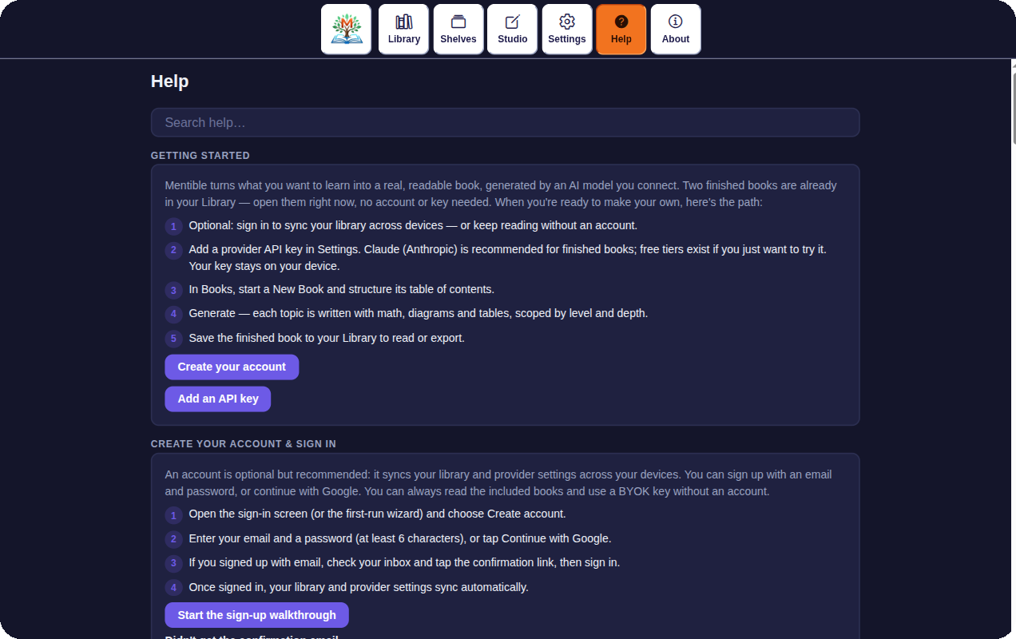
SECTION 2 · MENUS
One bar, six places — and a Help tab full of guides
The in-app tour names all six tabs.
Help is searchable, with a step-by-step “Getting started”.
Mentible · New User Guide
8

Slide 9
03
Load the books you need
STEP
Get reading material in — from free catalogs or your own files.
Mentible · New User Guide
9

Slide 10
SECTION 3 · LOAD BOOKS
Two ways to get books to read
1
Download a free book (Shelves tab)
Open a starter shelf (Popular · Science · Children's · History from Project Gutenberg) or paste an OPDS URL, then Download.
2
Find it under Downloads
Downloaded EPUBs land on Shelves → Downloads and open in the reader.
3
Or import your own EPUB
“Import an EPUB” (Library or Shelves) opens any EPUB you already have.
Reading books ≠ source material
Downloaded and imported books open read-only. Authoring your own book starts from an outline you write (next section).
Mentible · New User Guide
10

Slide 11
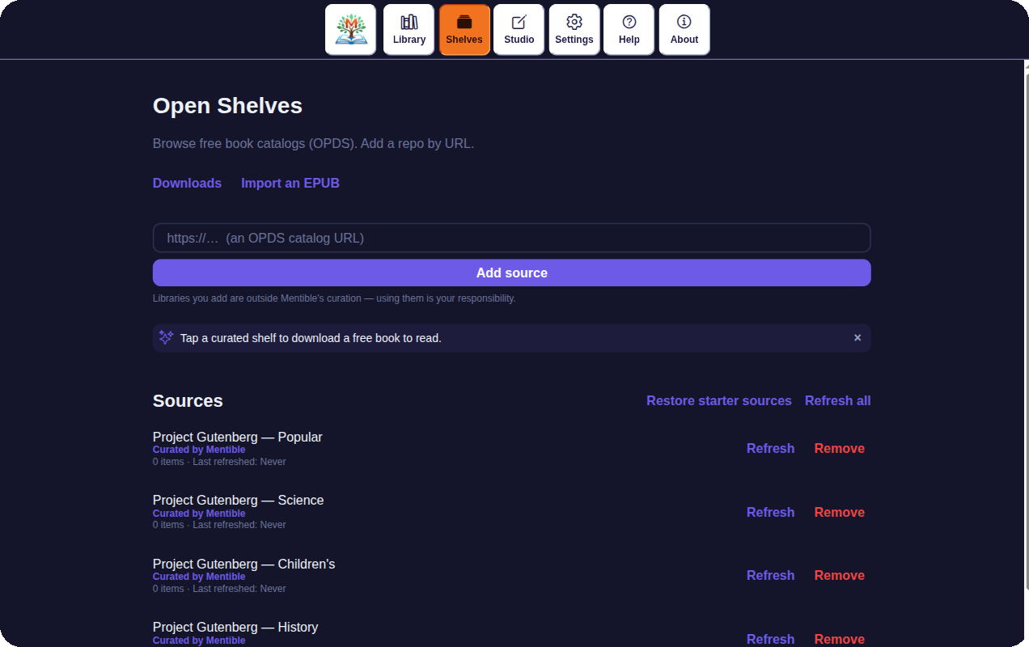
SECTION 3 · LOAD BOOKS
The Shelves tab — live, with curated starter shelves
Curated shelves
Four Project Gutenberg shelves, seeded for you.
“Curated by Mentible”
Owner-vouched, vs. sources you add yourself.
One-tap hint
A gentle nudge to grab your first free book.
Mentible · New User Guide
11

Slide 12
04
Compile your first book
STEP
From a plain outline to a generated, saved book.
Mentible · New User Guide
12

Slide 13
SECTION 4 · COMPILE
The authoring pipeline
1
Studio → “+ New book”
Add a title and paste your Table of Contents — or “Load from a Markdown file”, or download a blank template.
2
Tap “Structure →”
The AI turns your outline into an editable topic tree. (Needs your saved API key.)
3
Review in the Book Editor → “Save book”
Adjust title, description, tags, and the topic tree.
4
“Generate all topics →”
On the Generate screen, tap “Generate all topics”. One topic at a time — watch ○ → ✓.
5
“Save to Library (EPUB3)”
Compile the generated topics into an EPUB3 and add it to your Library.
Mentible · New User Guide
13

Slide 14
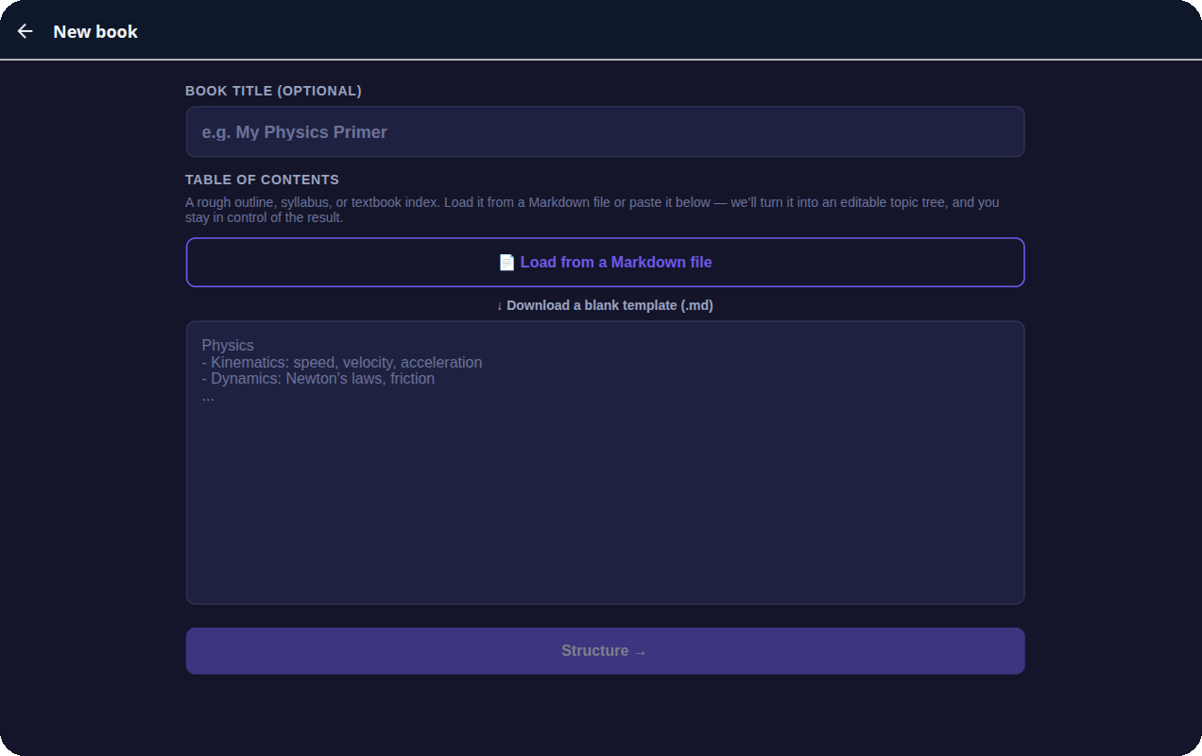
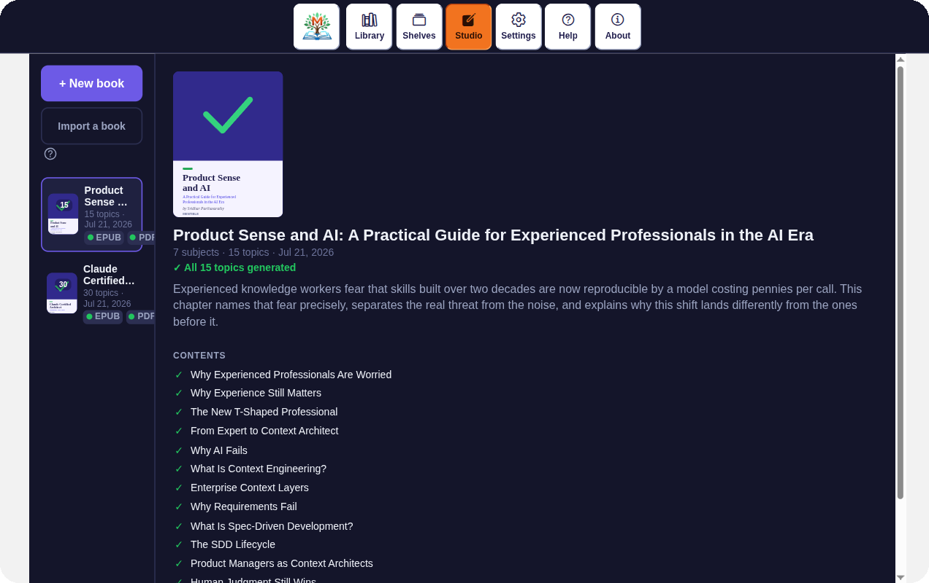
SECTION 4 · COMPILE
Start a book — Studio and the New Book form
“+ New book” — paste your Table of Contents, then Structure.
Studio lists your books; a finished one shows its contents.
Mentible · New User Guide
14

Slide 15
05
Edit your book
STEP
Refine the structure and content until it's right.
Mentible · New User Guide
15

Slide 16
SECTION 5 · EDIT
Four ways to refine
✎
Structure & details
↻
Refine one topic
Re-open → Book Editor. Add, remove, reorder subjects, topics, subtopics; edit title, description, tags.
Open a topic → “Regenerate”. Add “Enhancement instructions” — they stick for every future regenerate.
＋
Add figures
👤
Get feedback
“Add figure” → choose from library or take a photo, then add Caption + Alt text. Figures stay on your device.
“Share draft” invites reviewers by email to comment before you publish.
Mentible · New User Guide
16

Slide 17
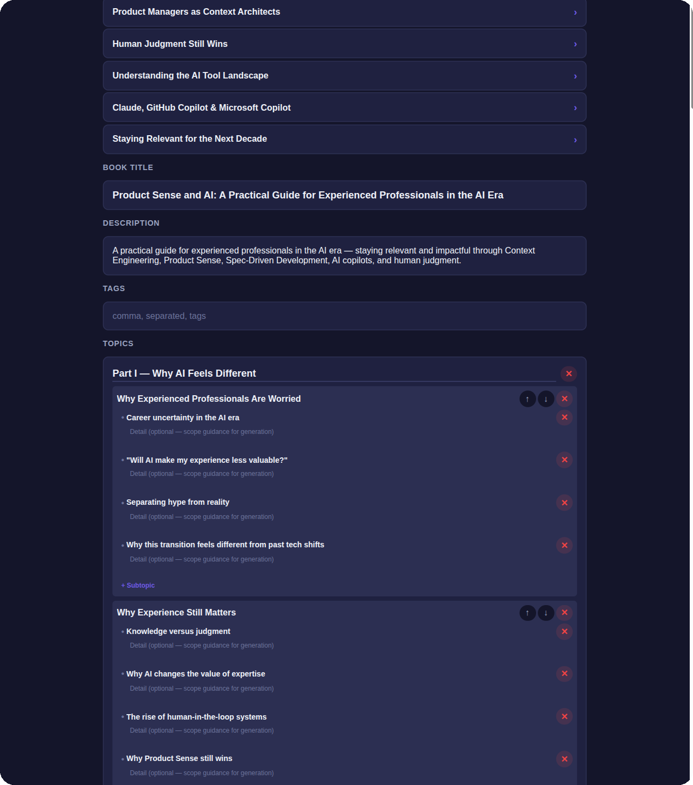
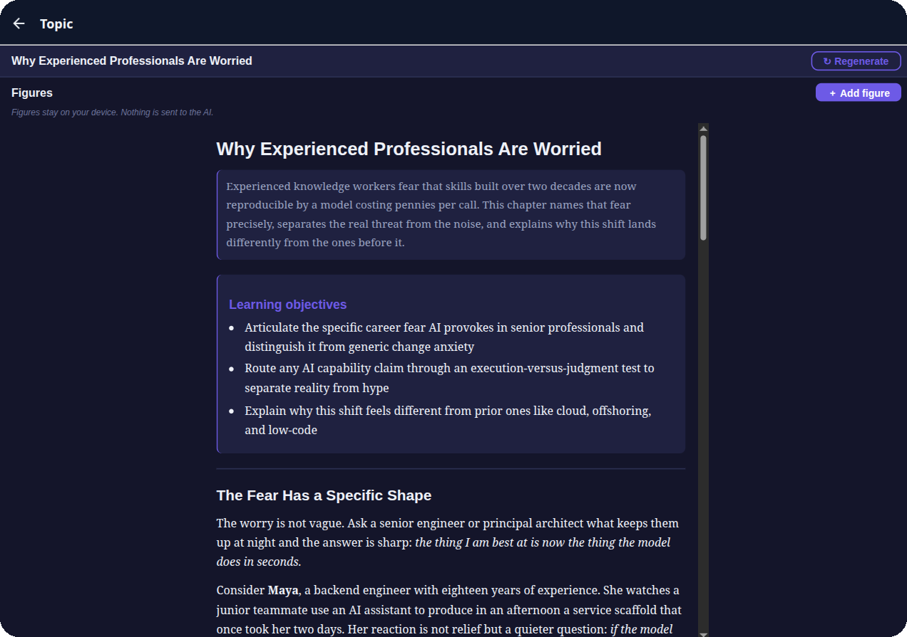
SECTION 5 · EDIT
The Book Editor and a topic — from the live app
Editable topic tree: subjects → topics → subtopics.
A topic: “Regenerate”, “Add figure”, generated content.
Mentible · New User Guide
17

Slide 18
06
Publish your release
STEP
Keep it private, or share it with every reader.
Mentible · New User Guide
18

Slide 19
SECTION 6 · PUBLISH
Two ways to finish
🔒
Save to Library (EPUB3)
🌐
Publish to Library (EPUB + PDF)
The everyday “finish & keep”. Compiles your book privately and adds it to your own Library.
Shares to the open Library so any reader can download it. Signed-in authors only; compiles EPUB + PDF.
1
Download anytime — “Check out”
From a book's reader, Check out gives you EPUB3 (instant) or PDF (compiled on demand).
2
Formats today: EPUB3 + PDF
Those are the release formats. (MOBI is planned for later.)
Mentible · New User Guide
19

Slide 20
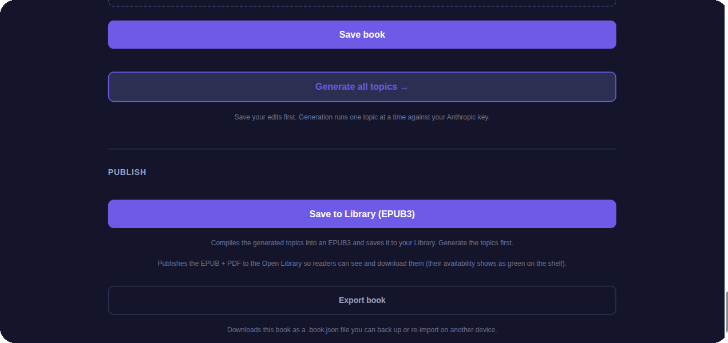
SECTION 6 · PUBLISH
The finish line — Save, Generate, Publish, Export
Generate all topics
Runs one topic at a time against your key.
Save to Library
Compiles a private EPUB3 to your Library.
Publish / Export
Share EPUB+PDF to readers, or back up a .book.json.
Mentible · New User Guide
20

Slide 21
Stuck? Open Help
The Help tab has searchable guides, and “?” buttons across the app jump right to the relevant topic.
Your six-step journey
1
Sign in & add your AI key
read free, author with your own key
2
Tour the six tabs
Library · Shelves · Studio · Settings · Help · About
3
Load books
download free catalogs or import an EPUB
4
Compile
outline → Structure → Generate → Save to Library
5
Edit
regenerate topics, add figures, share a draft
6
Publish
keep private, or publish EPUB + PDF for readers

