Slide 1


Can vibrotactile stimulation drive brain clearance?
Wearable vibrotactile stimulation, brain rhythms, and glymphatic clearance — rationale, plan, and first electrophysiology (in the mouse)
Pardis Miri · a Snyder Lab (Stanford) × Buzsáki Lab (NYU) collaboration
Notes:
The program question: can a wearable, vibrotactile stimulus engage brain rhythms in a way that helps the brain clear waste (the glymphatic system), with Alzheimer's relevance? I'll motivate it from the literature, lay out what to test, then show a first electrophysiology study testing the premise. I separate 'plausible mechanism' from 'proven' throughout. ~35 min — please interrupt.

Slide 2
2 / 33
Part 1 · The vision — clearing the brain with vibrotactile stimulation

Slide 3
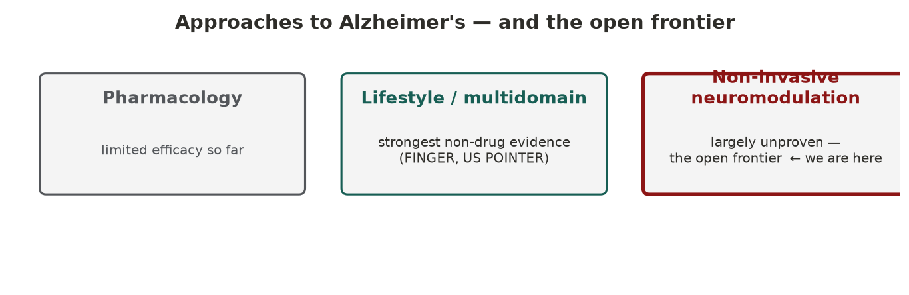
3 / 33
THE PROBLEM
Alzheimer's resists drugs — non-invasive neuromodulation is an open frontier
The strongest non-drug clinical evidence today is multidomain lifestyle (FINGER, Ngandu 2015; US POINTER, Baker 2025; synthesis: Lancet Commission 2024). Single domains alone underperform. Non-invasive stimulation is largely unproven — which is the opportunity.
Notes:
Framing the gap. Pharmacology for Alzheimer's has struggled — anti-amyloid drugs give small effects and carry safety costs. The most credible non-drug clinical evidence is multidomain lifestyle intervention: FINGER (Ngandu, Lancet 2015) — a 2-year diet + exercise + cognitive-training + vascular-care RCT that slowed cognitive decline — and its U.S. replication, U.S. POINTER (Baker, JAMA 2025). The Lancet Commission (Livingston 2024) estimates ~45% of dementia is tied to modifiable risk factors. The operative word is *multidomain*: when a single domain is isolated — e.g. the MIND diet alone (Barnes, NEJM 2023) — the benefit largely disappears. The takeaway: the best non-drug evidence today is a multidomain lifestyle package, not a device or any single change. Non-invasive neuromodulation — light, sound, vibrotactile — is an emerging but mostly unproven frontier; the question is what a wearable, vibrotactile approach could add, held to the bar those lifestyle trials set.

Slide 4
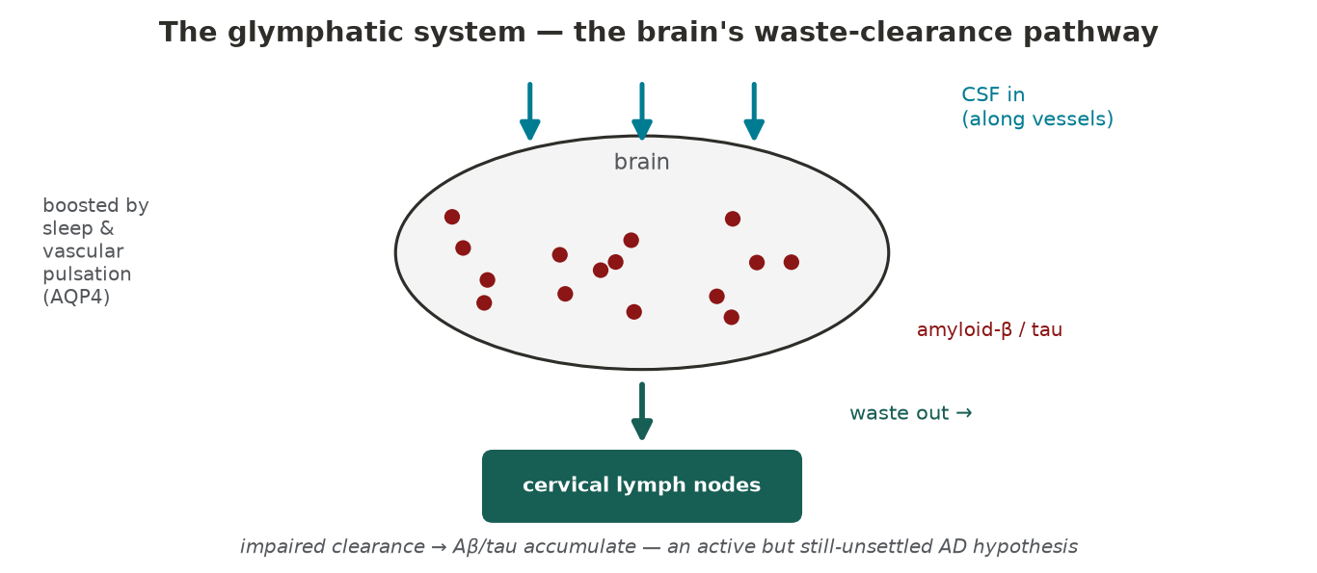
4 / 33
WHY CLEARANCE
A leading hypothesis: failing glymphatic clearance lets amyloid build up
The brain clears amyloid-β / tau via CSF–interstitial exchange (the glymphatic system), boosted by sleep and vascular pulsation. Impaired clearance is a leading — but still-unsettled — explanation for AD (Iliff 2012; Xie 2013; DTI-ALPS, ADNI 2024).
Notes:
The mechanistic bridge — why stimulating the brain might help at all. One leading hypothesis is that AD is partly a clearance failure. The glymphatic system (Iliff 2012) moves CSF along perivascular spaces to wash amyloid-β and tau out toward the cervical lymph nodes; it is strongly boosted during sleep (Xie 2013) and by vascular pulsation, and depends on the AQP4 water channel. In AD, amyloid is cleared more slowly (Mawuenyega 2010), and impaired glymphatic flow on DTI-ALPS imaging appears to precede amyloid deposition (ADNI 2024). Important caveat for this audience: it remains contested — DTI-ALPS may index vascular rather than glymphatic function (Mayo 2025), and some studies find clearance reduced rather than increased in sleep. So present it as an active, plausible contributor, not the proven sole cause.

Slide 5
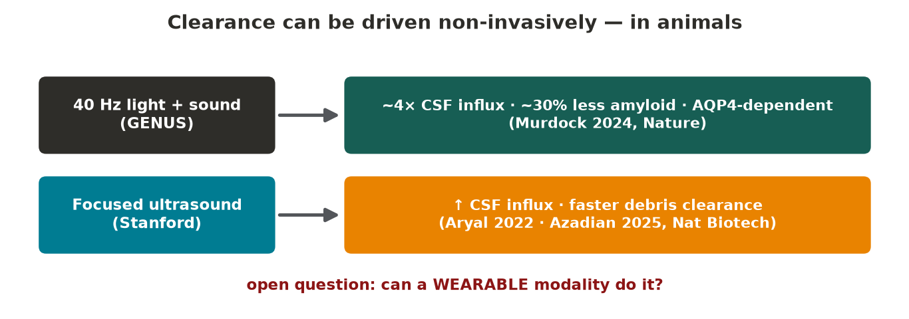
5 / 33
AND IT CAN BE DRIVEN
And clearance can be driven non-invasively — 40 Hz in mice, focused ultrasound at Stanford
40 Hz sensory stimulation drove ~4× CSF influx and ~30% less cortical amyloid, abolished when AQP4 is blocked (Murdock 2024, Nature). Focused ultrasound enhances CSF influx and clearance (Aryal 2022; Azadian 2025). The open question: can a wearable modality do the same?
Notes:
The proof-of-principle that motivates the program. Murdock et al. (2024, Nature) showed 40 Hz multisensory (light + sound) stimulation in AD-model mice increased CSF tracer influx ~4-fold, lowered frontal-cortex amyloid ~30%, and pushed more amyloid into the deep cervical lymph nodes — and blocking the AQP4 water channel abolished it, tying the effect directly to the glymphatic route. Separately, Stanford's focused-ultrasound work (Aryal 2022, J Control Release; Azadian 2025, Nat Biotech) shows another non-invasive route to drive CSF influx and clear debris. Together they say clearance is drivable from outside the skull. The gap none fills: a comfortable, wearable, sleep-compatible modality — the case for vibrotactile, and the bridge to the proposal.

Slide 6
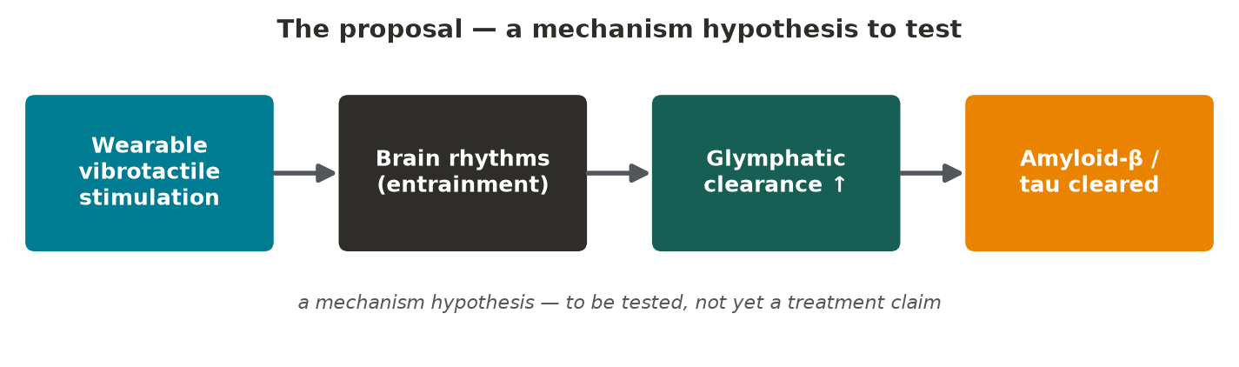
6 / 33
THE THESIS
The proposal: use vibrotactile stimulation to engage brain rhythms and drive clearance
Wearable vibrotactile stimulation → entrain brain rhythms → engage glymphatic clearance of amyloid-β / tau. A mechanism hypothesis — explicitly not yet a treatment claim.
Notes:
The core chain. The glymphatic system is the brain's waste-clearance pathway — CSF/interstitial-fluid exchange that removes amyloid-β and tau. The hypothesis: if we can drive the right rhythms or brain-states from the skin, we may enhance that clearance. This is a mechanism hypothesis to test, not a clinical claim — I'll be explicit about that distinction the whole way through.

Slide 7
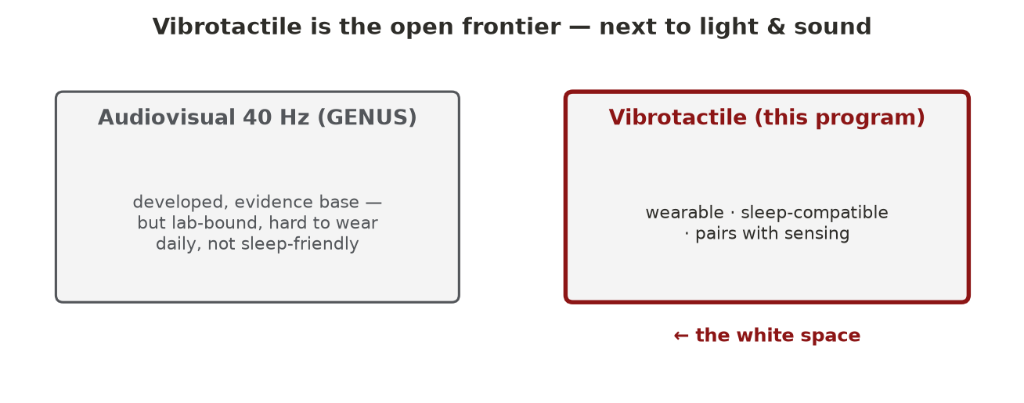
7 / 33
WHY VIBROTACTILE
Why vibrotactile, and why wearable: the white space next to light and sound
40 Hz light/sound (GENUS) is the developed approach but hard to wear daily. Vibrotactile stimulation is the open frontier — wearable, sleep-compatible, and pairs naturally with sensing.
Notes:
The niche. The established sensory-stimulation approach is audiovisual 40 Hz (GENUS). Its practical limits are daily wearability, comfort, and sleep use — exactly when clearance peaks. Vibrotactile stimulation is comparatively unexplored, is wearable, can run during sleep, and integrates with the wearable-sensing ecosystem (the Snyder-lab angle). That combination is the white space this program targets.

Slide 8
8 / 33
Part 2 · What the literature says — and what to test

Slide 9
9 / 33
EVIDENCE · 40 HZ GAMMA
40 Hz sensory stimulation lowers amyloid and drives clearance — animals, and early humans
GENUS / Tsai 2016: 40 Hz light/sound lowers amyloid. Murdock 2024 (Nature): 40 Hz gamma drives glymphatic Aβ clearance. Human gamma-sensory is safe with target engagement (Chan 2022).
Notes:
The anchor evidence chain. In mice, 40 Hz visual/auditory stimulation (GENUS, Tsai lab 2016) reduces amyloid and engages microglia; Murdock 2024 in Nature shows 40 Hz gamma drives CSF influx and amyloid clearance, AQP4-dependent — the gamma-to-glymphatic bridge. Early human trials (Chan 2022) report safety, neural entrainment, and good compliance. This is why 40 Hz is the canonical frequency to start from.

Slide 10
10 / 33
THE KEY CAVEAT
But a steady-state response is not the same as entraining the brain's own rhythm
A driven 40 Hz response ≠ engaging native gamma (Buzsáki/Soula; some studies find 40 Hz light fails to entrain native gamma in AD-model mice). We separate target engagement from disease modification.
Notes:
Essential for credibility — especially at Stanford. The Buzsáki lab and others caution that an evoked steady-state response at the stimulus frequency is not the same as entraining the brain's endogenous oscillator; some studies find 40 Hz light does not entrain native gamma in AD models. So the program holds two questions apart: did we engage the circuit, versus did we change the disease. Building that discipline in is part of the design, not a footnote.

Slide 11
11 / 33
EVIDENCE · CLEARANCE
Clearance is actively driven by neural, vascular & sleep dynamics — so 'brain-state' stimulation is plausible
CSF flow tracks NREM slow waves (Fultz 2019) and EEG delta (Hablitz 2019); neuronal dynamics actively direct CSF perfusion (Jiang-Xie–Kipnis 2024, Nature); human sleep clearance moves plasma Aβ/tau (Dagum 2026).
Notes:
Why targeting clearance via brain-state is reasonable. Glymphatic/CSF flow isn't passive: it's driven by neural activity, vascular pulsation, and especially sleep slow waves — Fultz 2019 (human, NREM slow waves drive CSF oscillations), Hablitz 2019 (influx tracks EEG delta), Mestre 2018 (arterial pulsation), and Jiang-Xie–Kipnis 2024 in Nature (neuronal ionic waves actively direct CSF perfusion). In humans, sleep clearance raises morning plasma Aβ/tau (Dagum 2026). So if stimulation can shape brain state, engaging clearance is mechanistically plausible — and this points to slow / sleep-band stimulation, not only 40 Hz.

Slide 12
12 / 33
EVIDENCE · VIBROTACTILE
The vibrotactile anchor: 40 Hz vibration helps in mouse AD models, and cortex codes vibration frequency
40 Hz whole-body vibration reduces pathology and improves function in AD-model mice (Suk 2023). Somatosensory cortex faithfully encodes vibration frequency (Romo, Mountcastle) — vibrotactile input can carry a frequency code.
Notes:
The vibrotactile-specific evidence. Suk 2023 (Tsai lab) showed 40 Hz whole-body vibration reduces pathology and improves motor function in mouse AD models — the central vibrotactile anchor, though not yet a human AD trial. And classic somatosensory physiology (Romo, Mountcastle flutter coding) shows primary somatosensory cortex faithfully encodes vibration frequency — so a frequency-specific tactile drive is biologically grounded, not wishful.

Slide 13
13 / 33
→ WHAT TO TEST
So which vibrotactile parameters should we test?
40 Hz (gamma) · ~50 Hz (our electrophysiology, Part 3) · slow ~1 Hz / sleep-band (clearance biology) · steady vs coordinated-reset patterning · controls: 20 Hz, sham, matched salience.
Notes:
The payoff of Part 2. The literature defines a parameter space: 40 Hz (the GENUS anchor); ~50 Hz (where our own single-unit data peak — coming in Part 3); slow ~1 Hz / sleep-band (because clearance tracks slow waves); patterning — steady single-site versus spatiotemporal 'coordinated reset', which produces lasting plasticity rather than transient entrainment in Parkinson's (Tass vibrotactile glove); and rigorous controls — a non-40 frequency like 20 Hz, sham, and perceptually matched salience to exclude pure arousal. This is the experimental program the current study begins to ground.

Slide 14
14 / 33
Part 3 · Does vibrotactile stimulation reach the brain? A first study
Foundational electrophysiology in the mouse — before any clearance claim

Slide 15
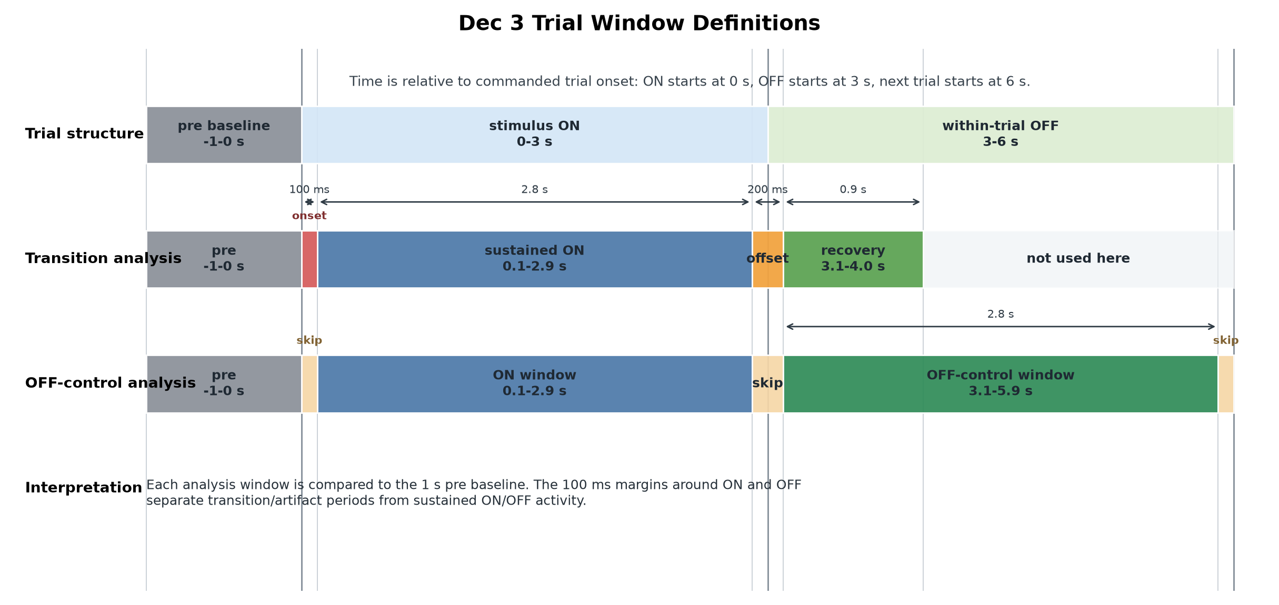
15 / 33
Design: parametric vibrotactile stimulation with simultaneous electrophysiology
3 s ON / 3 s OFF blocks across four carrier frequencies (5/10/26/50 Hz) and three amplitudes; ~200 repeats/condition; dual-region linear-probe recording (hippocampus + entorhinal cortex).
Notes:
A tactor delivers a sinusoidal vibration in 3 s ON / 3 s OFF blocks (figure: trial structure + analysis windows). We vary carrier frequency (5, 10, 26, 50 Hz) and amplitude, ~200 trials/condition, recording extracellularly with linear silicon probes in two connected regions at once: hippocampus (spatial/memory) and entorhinal cortex (its principal cortical input). Each window is referenced to the 1 s pre-stimulus baseline; 100 ms margins isolate onset/offset transients.

Slide 16
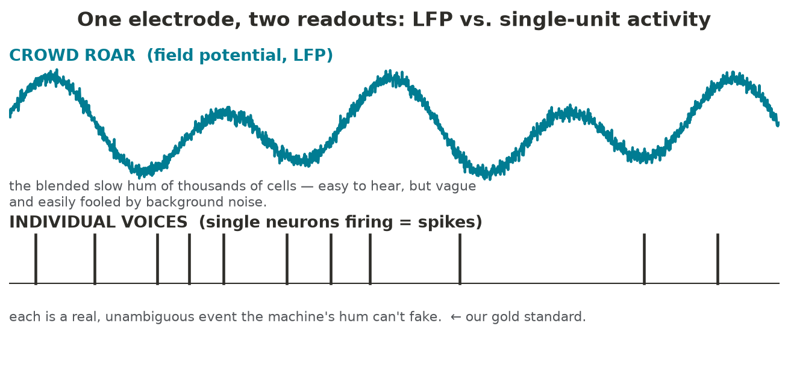
16 / 33
KEY METHODOLOGICAL DISTINCTION
One electrode yields two readouts: LFP and single-unit activity
LFP = low-frequency aggregate field (many cells). A single unit = one individual neuron's firing (spikes), isolated by spike sorting. They differ in what can fake them — spikes are the conservative readout.
Notes:
The crux of the whole study. An extracellular electrode captures two regimes. The local field potential (LFP) is the low-frequency aggregate of synaptic/transmembrane currents from many neurons — large, but non-specific and susceptible to volume-conducted or instrumental noise. A 'single unit' is one individual neuron's spiking, isolated by spike sorting (clustering spikes by waveform). Stadium intuition: the crowd's roar (LFP) versus one identified shout (a single unit). The asymmetry that matters: an electrical artifact can add power to the LFP, but it cannot make a sorted neuron fire — so single-unit rate changes are the conservative, artifact-resistant evidence.

Slide 17
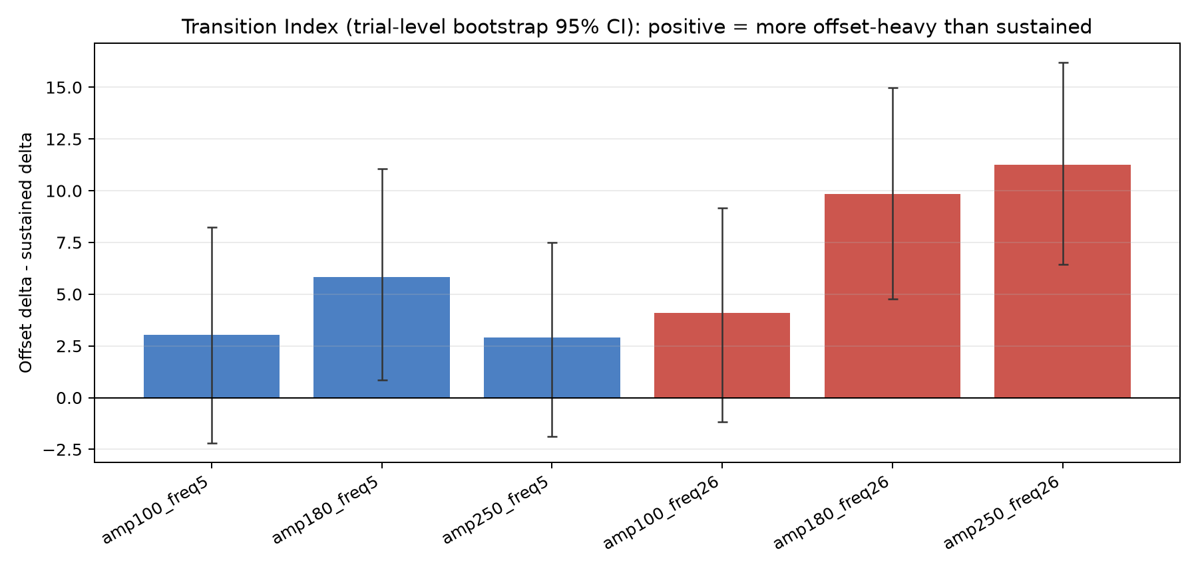
17 / 33
FINDING 1
A robust LFP response — transition-weighted, not a sustained oscillation
The broadband LFP responds at stimulus onset/offset (an evoked transient), not as a sustained rhythm at the carrier frequency.
Notes:
The broadband LFP shows a clear, amplitude-graded response — but concentrated at the ON and OFF transitions: an evoked transient, not a sustained oscillation at the drive frequency. The difference between responding to the event of stimulation versus tracking its rhythm. So there is a response — but not yet frequency-following.

Slide 18
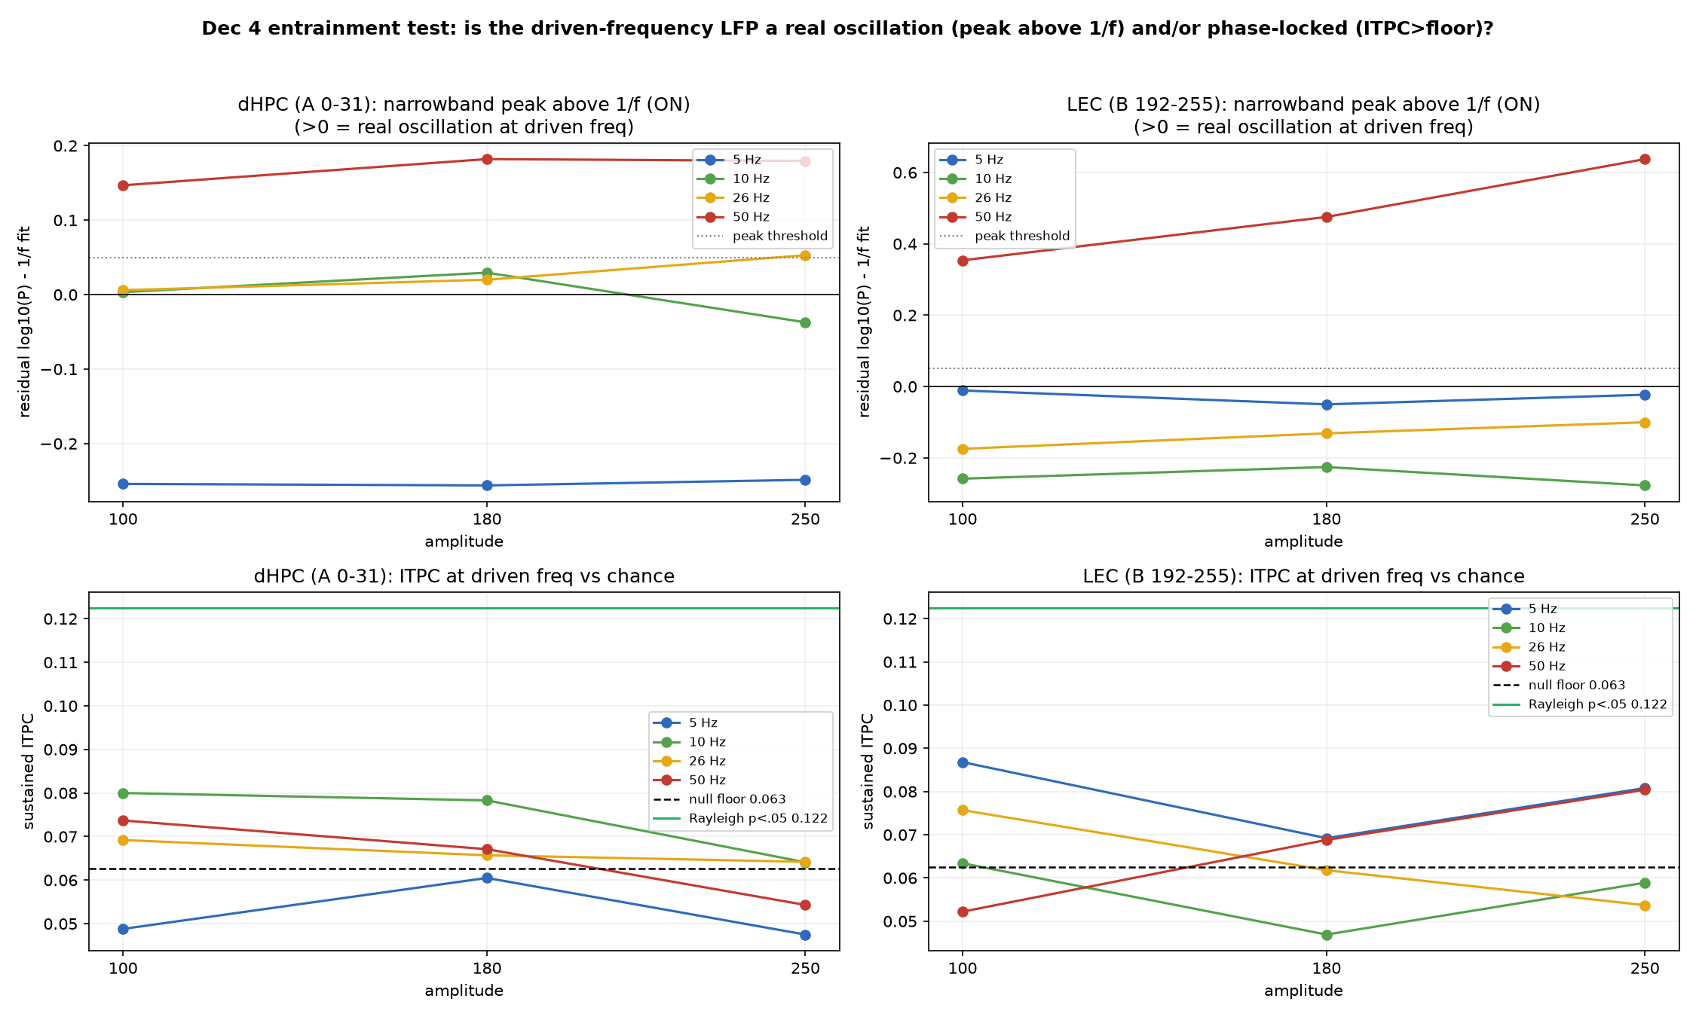
18 / 33
FINDING 2
No frequency-following in hippocampus at any carrier
No narrowband spectral peak above the 1/f background, and inter-trial phase consistency at chance — across 5/10/26/50 Hz, replicated across sessions.
Notes:
The entrainment test (recall Part 2's definition). Frequency-following predicts a narrowband peak at the carrier above the 1/f background plus above-chance inter-trial phase consistency. We see neither, at any carrier, replicated across two sessions — no power- or phase-based frequency-following in hippocampus.

Slide 19
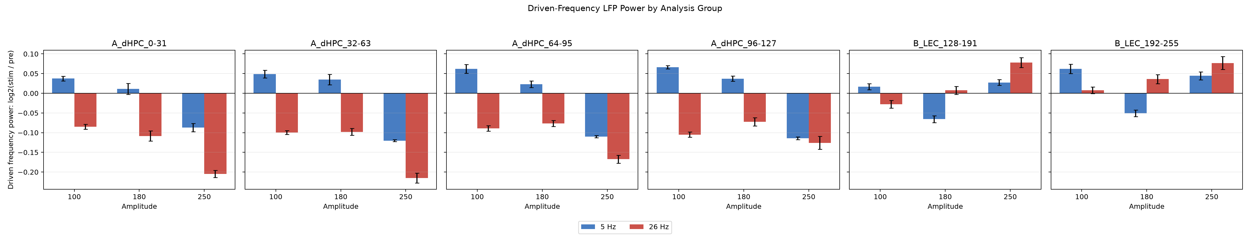
19 / 33
FINDING 3
Entorhinal cortex shows an amplitude-graded 50 Hz LFP increase
A narrowband 50 Hz LFP power increase, scaling with amplitude — the candidate entrainment signal. But the LFP is exactly the readout most vulnerable to artifact.
Notes:
In entorhinal cortex there is a narrowband 50 Hz LFP power increase that scales with amplitude — superficially the entrainment signal we want. But the LFP is precisely the readout electrical pickup can mimic, so before interpreting it as neural we must exclude a stimulator-coupled artifact.

Slide 20
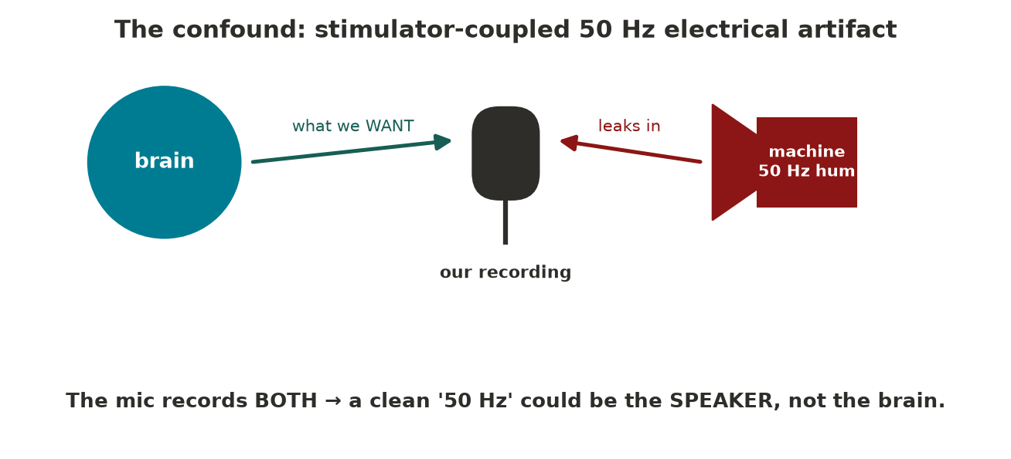
20 / 33
THE CONFOUND
The confound: stimulator-coupled 50 Hz electrical artifact
An electromechanical actuator can inject a 50 Hz electrical artifact directly into the recording — indistinguishable from a neural 50 Hz in the LFP alone.
Notes:
The actuator and its drive electronics can couple a 50 Hz signal into the recording — volume-conducted or via wiring. In the LFP that's indistinguishable from a neural 50 Hz. We need a discriminator the artifact can't fool.

Slide 21
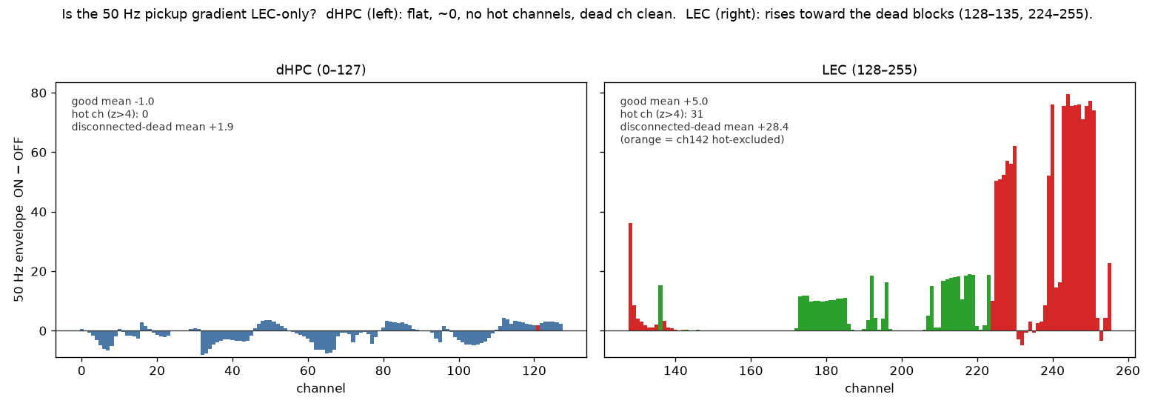
21 / 33
FINDING 3, CONTROLLED
Disconnected channels carry the 50 Hz — so it is largely pickup
Disconnected electrodes (which cannot record neural signal) show ~6× more 50 Hz than in-tissue channels. The entorhinal 50 Hz LFP is substantially artifact.
Notes:
The discriminator: broken/disconnected channels cannot record neurons but still act as antennas for pickup. If they carry the 50 Hz, it's instrumental. They do — ~6× the in-tissue channels — so the entorhinal 50 Hz LFP is largely stimulator artifact. The headline LFP result is mostly the machine. This is the central twist, and exactly the 'steady-state response ≠ real engagement' caution from Part 2, caught in our own data.

Slide 22
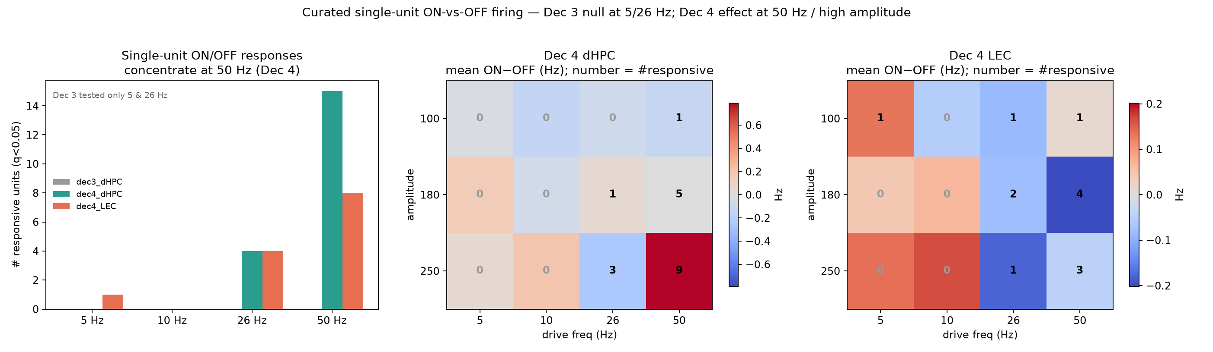
22 / 33
FINDING 4 — THE ROBUST RESULT
Frequency-specific single-unit rate modulation at 50 Hz
Sorted single units change firing rate during 50 Hz / high-amplitude stimulation, in both regions — an effect electrical pickup cannot produce.
Notes:
The artifact-resistant readout: sorted single units change firing rate during the high-amplitude 50 Hz condition, in both regions, and far more than at lower carriers. Pickup cannot drive a sorted neuron's spike train, so this is the clean evidence — and it answers the program's hardest objection: vibrotactile stimulation does reach and frequency-specifically drive these neurons.

Slide 23
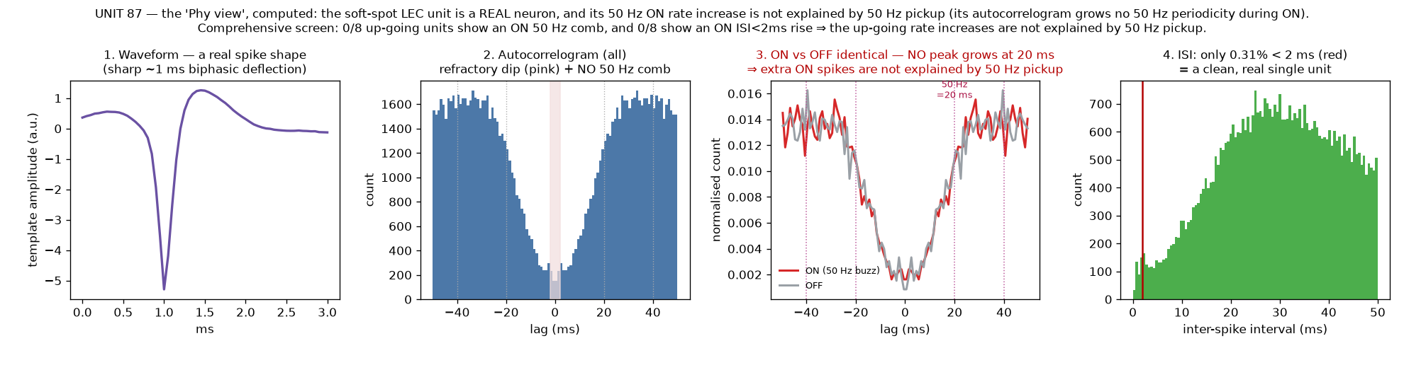
23 / 33
CONTROLS
Controls: high-pass separation + autocorrelogram / ISI screens
Spikes are detected >~300 Hz (50 Hz pickup is removed pre-detection); units show no stimulus-locked 50 Hz periodicity and no ON-rise in refractory violations.
Notes:
Two controls. Spike detection operates above ~300 Hz, so 50 Hz pickup is filtered out before a spike is detected. And were pickup injecting spurious spikes at 50 Hz, the autocorrelogram would develop 20 ms periodicity during stimulation — it does not, and is identical ON vs OFF; refractory-violation rates don't rise either. So the rate modulation is genuine single-unit activity.

Slide 24
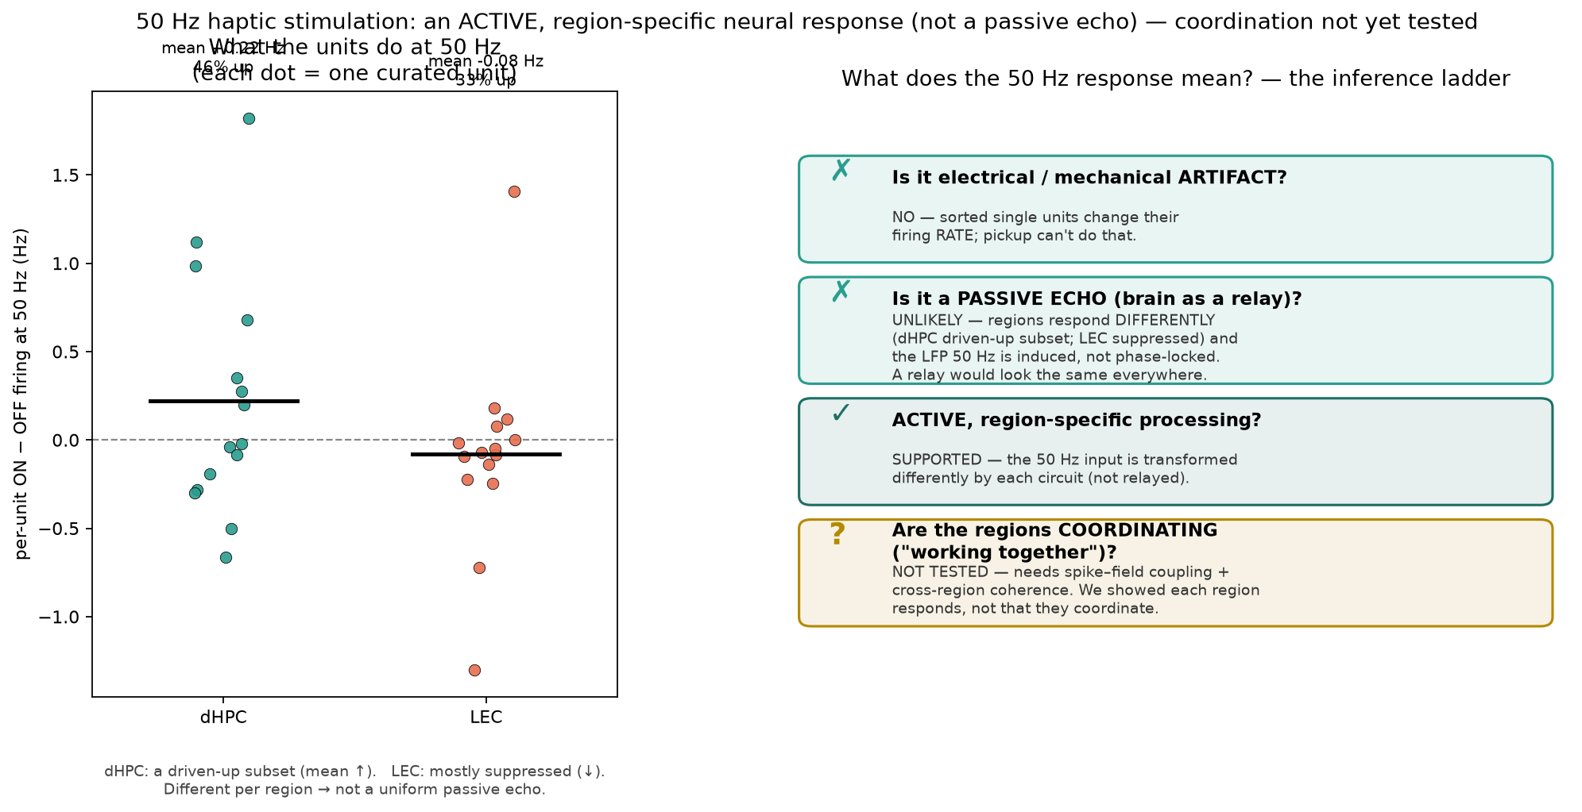
24 / 33
FINDING 5
Region-specific, bidirectional modulation — not a passive relay
Hippocampus: a driven-up subset. Entorhinal cortex: net-suppressed. Opposite transformations of identical input argue for active, circuit-specific processing.
Notes:
The two regions transform the same input in opposite directions: a hippocampal subset increases firing while entorhinal cortex is net-suppressed. Opposite-signed responses to identical input are inconsistent with a passive relay and consistent with circuit-specific processing — and the suppression is itself artifact-resistant (pickup adds, it can't remove, spikes).

Slide 25
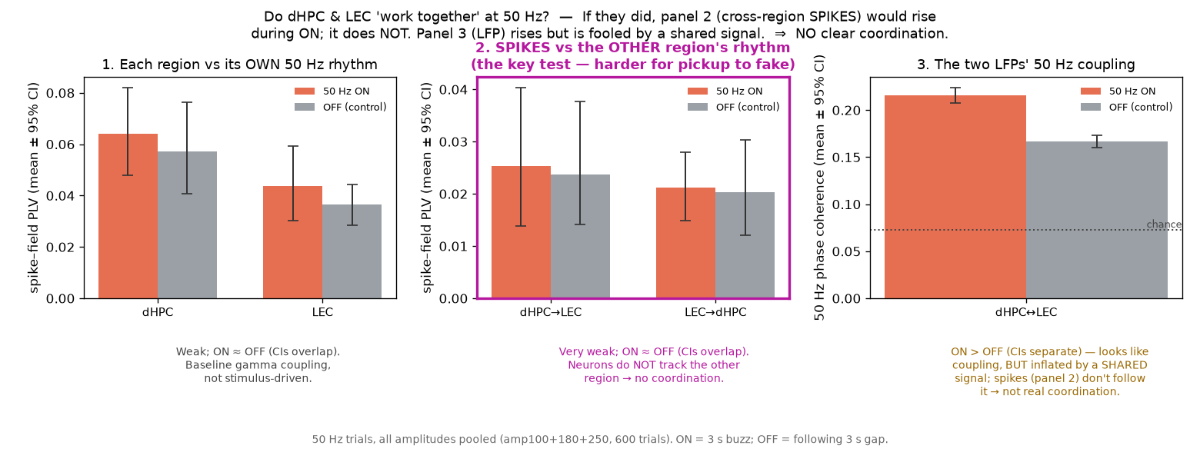
25 / 33
FINDING 6
No clear cross-regional coordination at 50 Hz
LFP–LFP coherence rises, but the artifact-resistant cross-region spike–field measure does not — parsimoniously a shared signal, not interaction.
Notes:
LFP–LFP coherence increases, but a shared pickup inflates coherence. The spike–field measure (one region's spikes vs the other's LFP phase), which a shared artifact can't fake as easily, does not increase — so the apparent coupling is most parsimoniously a shared signal, not genuine coordination.

Slide 26
26 / 33
Part 4 · Limits, and the next study

Slide 27
27 / 33
THE LIMITATION
Entrainment was untestable — a measurement gap, not a null
Our acquisition was not equipped to test entrainment: no time-aligned stimulus-phase reference was recorded — so phase-following is untestable here, not negative.
Notes:
Testing entrainment (phase-locking) requires a time-aligned reference for the stimulus phase. We didn't record a usable one — so 'no entrainment shown' is a measurement gap, not evidence of absence. The power/periodicity negatives are real; only the phase-locking claim is gated by the missing reference. Separately, we found post hoc that the lower-frequency stimuli (5/10/26 Hz) were not clean sine waves — so the 50 Hz frequency-specificity is partly confounded with stimulus quality; recording the delivered waveform fixes that too.

Slide 28
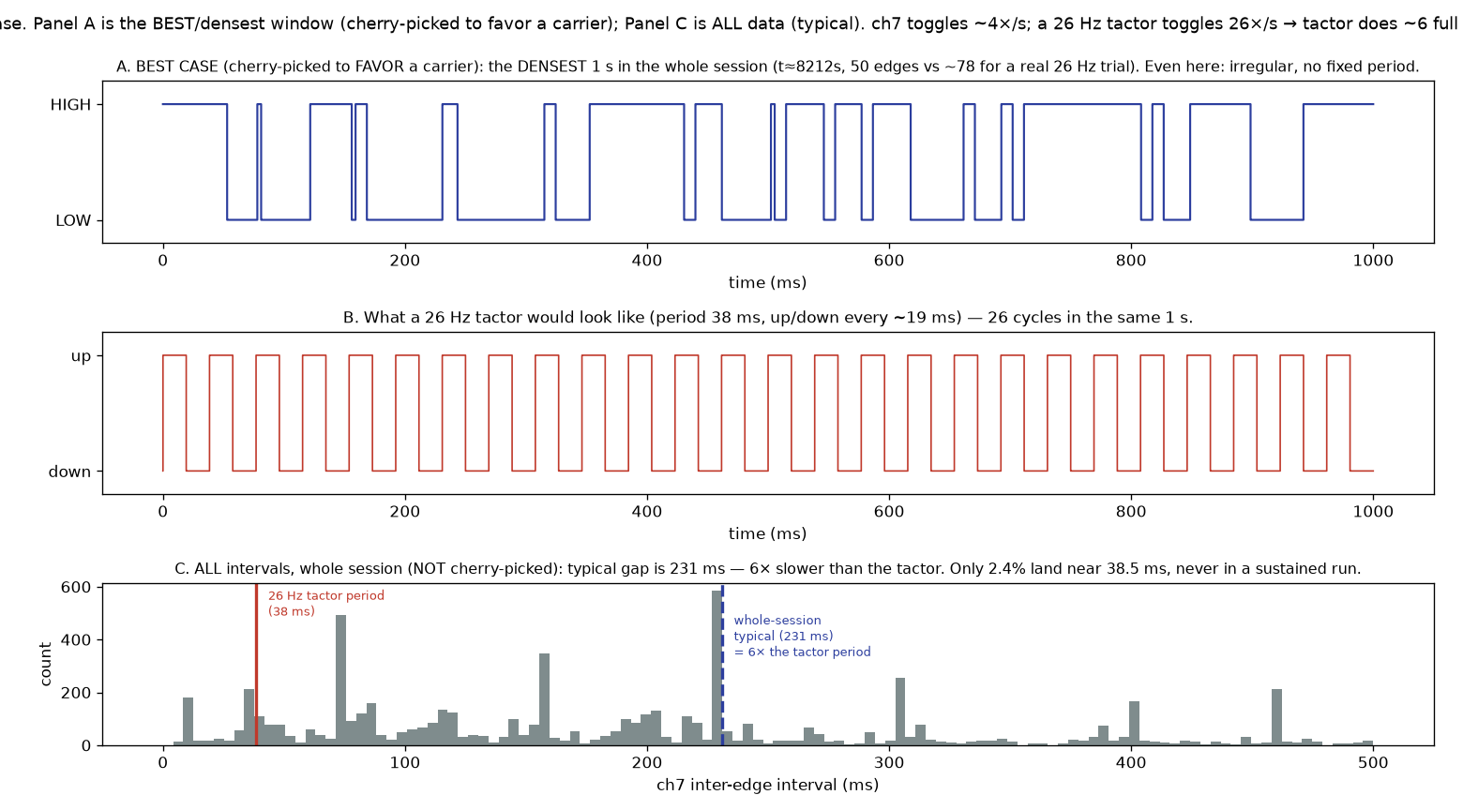
28 / 33
DIAGNOSIS
The digital sync channel never captured the carrier
The recorded sync line updated at ~4 Hz, independent of carrier (identical pulse counts at 5 vs 26 Hz; ~78 expected at 26 Hz). No phase reference exists in the data.
Notes:
Verified from the raw digital stream: the sync channel updated at ~4 Hz irrespective of carrier (same ~6 pulses/trial for 5 and 26 Hz; ~78 expected at 26 Hz), never sustained a run at the carrier period, and was misaligned with the schedule. Undersampled and decoupled — phase unrecoverable. A ~4 Hz observer can't resolve a 26 Hz oscillation.

Slide 29
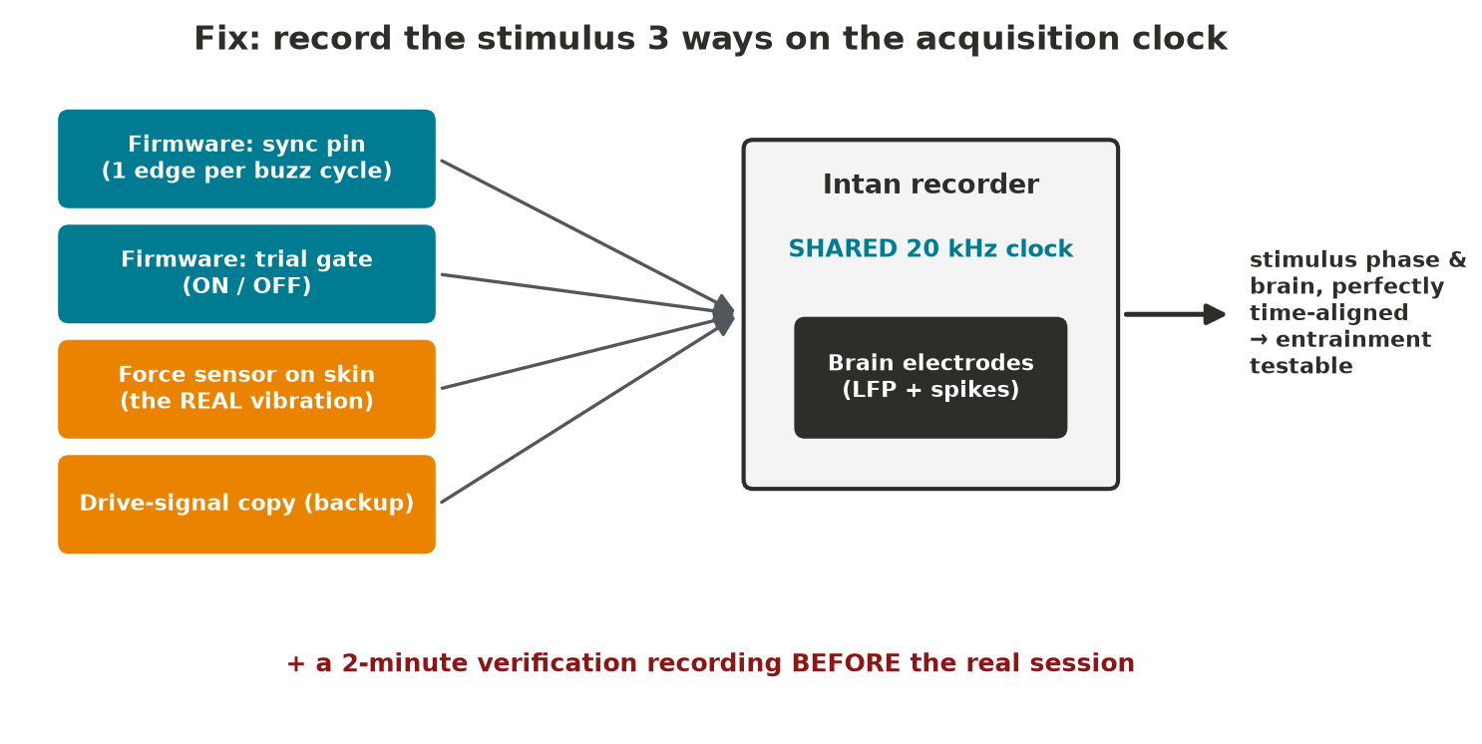
29 / 33
THE FIX
Fix: redundant, clock-shared stimulus references
Firmware per-cycle sync + a transduced force/accelerometer signal + a drive-signal copy, all on the acquisition clock — cross-checked, with pre-session verification.
Notes:
Design, not analysis: record the stimulus three ways on the acquisition clock — a firmware per-cycle marker (implemented), a transduced measurement of the delivered vibration (PVDF or accelerometer, which also verifies delivery), and a drive-signal copy — then cross-validate, plus a short verification recording before the session. With redundancy on a shared clock, a failed reference is caught immediately rather than months later. This is what makes entrainment — and eventually clearance readouts — testable.

Slide 30
30 / 33
Part 5 · How it fits the program

Slide 31
31 / 33
THE ROLE OF THIS STUDY
This study de-risks the program's core premise
It shows peripheral vibration reaches AD-relevant medial-temporal circuits and that those neurons are frequency-tuned (peak ~50 Hz) — directly answering the 'steady-state ≠ engagement' objection.
Notes:
How it fits. The program's hardest objection (Part 2) is whether sensory stimulation engages the relevant circuits or just produces a surface steady-state. This study answers it for vibrotactile stimulation: peripheral vibration drives frequency-specific single-unit responses in hippocampus and entorhinal cortex — AD-relevant medial-temporal circuits — and they're frequency-tuned, peaking near 50 Hz. That converts 'vibrotactile 40 Hz' from an assumption into a measured, tunable target-engagement parameter — the prerequisite before any clearance or clinical claim, and it sharpens the parameter list (40 vs 50 vs slow) for the next studies.

Slide 32
32 / 33
KEY REFERENCES
Key references
Lifestyle: Ngandu 2015 (FINGER) · Baker 2025 (US POINTER) · Livingston 2024 (Lancet Commission) · Barnes 2023 (MIND diet — single-domain null). Clearance: Iliff 2012 · Xie 2013 · Mawuenyega 2010 · Murdock 2024 (40 Hz → glymphatic) · Aryal 2022 / Azadian 2025 (focused ultrasound). Stimulation: Tsai 2016 (GENUS) · Suk 2023 (40 Hz tactile) · Jiang-Xie–Kipnis 2024 (neural dynamics → CSF). Guardrail: Buzsáki / Soula (steady-state ≠ entrainment).
Notes:
Grouped anchors. Lifestyle bar — FINGER (Ngandu, Lancet 2015), U.S. POINTER (Baker, JAMA 2025), the Lancet Commission synthesis (Livingston 2024, ~45% modifiable risk), and the single-domain counterpoint (MIND diet alone null; Barnes, NEJM 2023). Clearance hypothesis & drivers — glymphatic discovery (Iliff, Sci Transl Med 2012), sleep clearance (Xie, Science 2013), slowed Aβ clearance in AD (Mawuenyega, Science 2010), 40 Hz → glymphatic clearance, AQP4-dependent (Murdock, Nature 2024), and Stanford focused ultrasound (Aryal, J Control Release 2022; Azadian, Nat Biotech 2025). Stimulation — origin of sensory-gamma (Tsai 2016), the vibrotactile anchor (Suk 2023), and the mechanism legitimizing brain-state stimulation of clearance (Jiang-Xie–Kipnis 2024). Guardrail — Buzsáki/Soula: a steady-state response is not entrainment. Full lit-review repository available on request.

Slide 33
33 / 33
Thank you — questions
Happy to go into any figure, the artifact controls, the parameter plan, or the next-round instrumentation.
Notes:
Anticipated questions. 'Is 50 Hz special or just strongest?' — strongest clean single-unit effect of the carriers tested; the LFP transient was largest at 26 Hz but that's the artifact-prone measure. 'Could it be arousal?' — possible, but frequency-specific (50 ≫ 26 at matched amplitude); an indirect sensory/state pathway isn't excluded. 'Why distrust the 50 Hz LFP?' — disconnected channels carry it at ~6× tissue. 'Is this a treatment?' — no; this is target-engagement evidence for a mechanism hypothesis, deliberately separated from any clinical claim.

