Slide 1

BYOD
Risks and Rewards
wehackpeople.com

Slide 2

BYOD
What are the risks?

Slide 3

BYOD
What are the pros of BYOD?
Convenience
Less work for Systems dept.

Slide 4
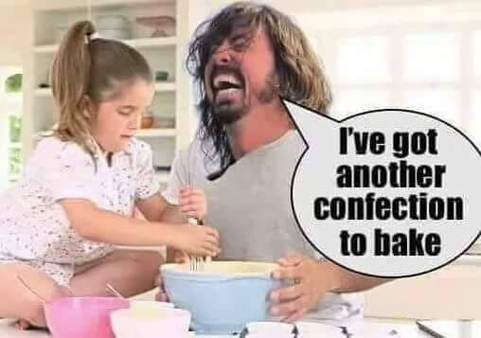

BYOD
Cons
Let’s hackers just walk right on in!
People try to lie and hide things
They are horrible liars by nature!
You can’t trust anyone!

Slide 5
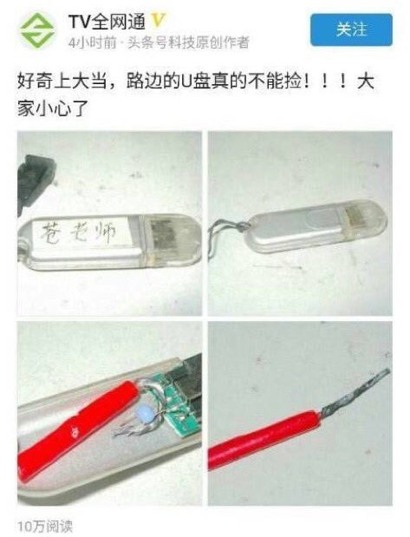
BYOD
You never know what you’re going to get!

Slide 6

Following The Rules
You need rules for ALL to follow.
Otherwise, bad things happen!

Slide 7

Save Yourselves!
Because they don’t follow rules, you must create your own!
What’s the best way?

Slide 8

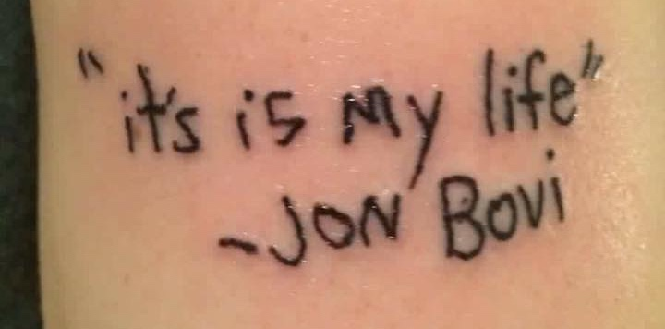
Keep Your Network Beautiful!
Beauty comes through pain!
Make your system beautiful!
Don’t have an ’ugly baby’!
This is your only shot to fix your ugly baby!

Slide 9
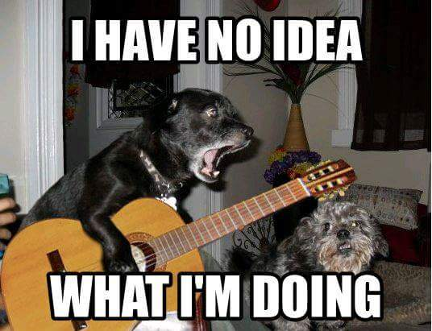
Baseline Configurations
Remember that all employees must be treated as children.
Assuming low intelligence is standard practice.

Slide 10

Reap the Rewards!
Once you’ve set the guidelines & enforced the rules,
How does it feel to be totally safe now?
Nice work!

Slide 11
Questions?

