Slide 1
Basic UNIX Commands

Slide 2
File and Directory manipulations
Description | Commands
Files Listing | ls
Creating Files | touch
Displaying File Contents | cat / more / less / head / tail
Copying a File | cp
Moving / Renaming a File | mv
Deleting a File | rm
Moving in the Directory | cd
Print working Directory | pwd
Create a Directory | mkdir
Remove a Directory | rmdir
File and directory management:
Unix commands like ls, touch, cat, more, cp, mv, rm, cd, pwd, mkdir, and rmdir are used for managing files and directories.
These commands allow users to create, delete, copy, move and rename files and directories.

Slide 3
Users manipulation commands
Description | Commands
Change password | passwd
Add new user | useradd
Delete existing user | userdel
Copying a File | groupadd
Print all groups | getend group
Delete existing group | groupdel
Print logged users (actions) | w
Print logged users (locations) | who
Print all users that ever been logged in (location & time) | last (-l)
Print a user’s username that wrote this | whoami
User management:
Unix commands like passwd, useradd, userdel, and groupadd are used for managing user accounts and groups.
These commands allow system administrators to add or delete user accounts, change user passwords, and manage group memberships.

Slide 4
Text manipulation commands
Description | Commands
Read data from File(s) | cat
Global in-File Search | grep
Manipulations with in-File data | awk
Versatile command | sed
Displays text | echo
Text manipulation:
Unix commands like cat, grep, awk, sed and echo are used for manipulating text files.
These commands allow users to view, search, replace, and format text files.

Slide 5
1. AWK Operations:
(a) Scans a file line by line
(b) Splits each input line into fields
(c) Compares input line/fields to pattern
(d) Performs action(s) on matched lines
2. Useful For:
(a) Transform data files
(b) Produce formatted reports
3. Programming Constructs:
(a) Format output lines
(b) Arithmetic and string operations
(c) Conditionals and loops
Syntax:
awk options 'selection _criteria {action }' input-file > output-filet
Example:
awk '{print}' test.txt

Slide 6
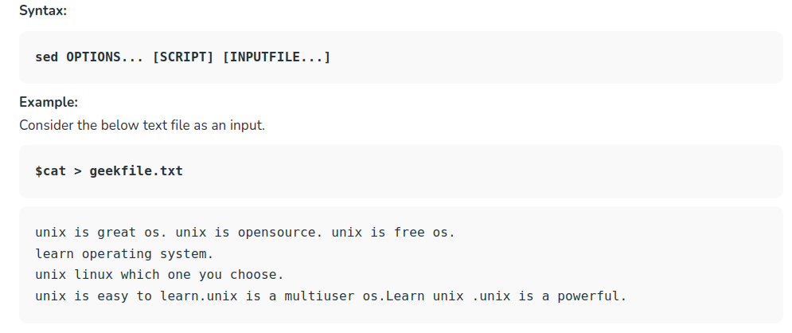
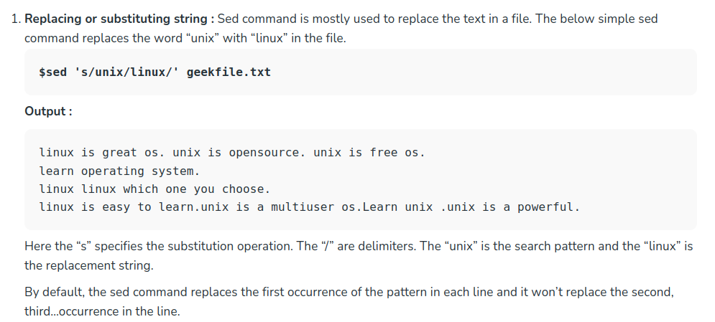
SED is a powerful text stream editor. Can do insertion, deletion, search and replace(substitution).
SED command in unix supports regular expression which allows it perform complex pattern matching.

