Slide 1
MACHINE LEARNING METHODS FOR SPAM E-MAIL CLASSIFICATION
W.A. Awad₁ and S.M. ELseuofi₂
¹Math.&Comp.Sci.Dept., Science faculty, Port Said University
²Inf. System Dept.,Ras El Bar High inst.
International Journal of Computer Science & Information Technology (IJCSIT), Vol 3, No 1, Feb 2011
資科工一 游庭瑋

Slide 2
INTRODUCTION

Slide 3
Introduction
40% of all mails are spam
About 15.4 billion spam email/day
Cost $355 million/year

Slide 4
Introduction
Spam-filtering method v.s. spammer
In the past: blocking emails from certain addresses or with certain subject line
Spammer:
Random email address
Append random characters
Knowledge and ML

Slide 5
ML method
Naïve Bayes
SVM
NN
KNN
Artificial Immune System
Rough set

Slide 6
RELATED WORK

Slide 7
Related Work
[2] naïve bayes e-mall content classification on layer-3 processing
[1] hardware architecture of naïve bayes email classification
117 millions features/s
Can be on gateway
[3] SVM email classification, faster and more accurate than Random Forest
[11] developed personalize email prioritization method
[4] innate and adaptive artificial immune system (IA-AIS)
IA-AIS has greater ability to identify SPAM then naïve bayes
Notes:
[2] 第三層即可達到跟第七層差不多的效果(-0.7%)

Slide 8
MACHINE LEARNING IN E-MAIL CLASSIFICATION

Slide 9
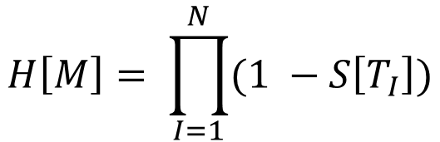
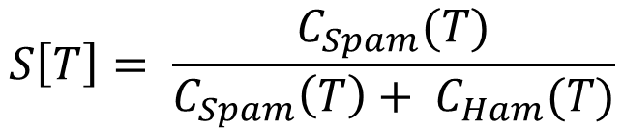
Naïve Bayes classifier method
1.
$$S\left[T\right]= \frac{C_{Spam}(T)}{C_{Spam}\left(T\right)+ C_{Ham}(T)}$$
$$H\left[M\right]= \prod_{I=1}^{N}{(1 −S\left[T_{I}\right])}$$
2.

Slide 10
Naïve Bayes classifier method - Training
Parse email into tokens
For each token W
S[W] = C_{spam}(W) / (C_{ham}(W) + C_{spam}(W))
Store S to database

Slide 11
Naïve Bayes classifier method - Filtering
For each message M
while (M not end) do
scan T_{i} in M
query S(T_{i})
calculate S[M] and H[M]
Calculate I[M] = (1 + S[M] – H[M]) / 2
if I[M] > threshold
msg mark as spam
else
msg mark as non-spam

Slide 12
K-nearest neighbor classifier method
Training
Store message
Filtering
Check k nearest neighbor, if more spam, classify as spam, otherwise classify as ham

Slide 13
K-nearest neighbor classifier method
Consider cost, how to lower false positive?
l/k rule
l or more message among the k nearest neighbor of x are spam, classify as spam, otherwise classify as legitimate

Slide 14
NN classifier(Perceptron) - Training
w, b := random value
Find a training example (x, c) where sign(w^{T}x + b) != c
If no, training completed. Store w and b and stop
Otherwise
Update (w, b):
w := w + cx
b := b + c, Go to Find training example

Slide 15
NN classifier(Perceptron) - Filtering
For message x,
c = sign(w^{T}x + b)

Slide 16
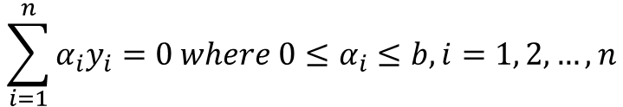
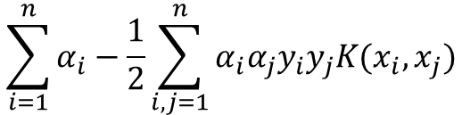

SVM classifier method
Find an optimal hyperplane with the maximal margin to separate two classes
In math:
radial basis function (RBF) kernel function
$$K\left(x_{i}, x_{j}\right)=\exp\left(−γ{\left\|x_{i}−x_{j}\right\|}^{2}\right), γ>0$$
$$\sum_{i=1}^{n}{α_{i}}−\frac{1}{2}\sum_{i,j=1}^{n}{α_{i}α_{j}y_{i}y_{j}K(x_{i},x_{j})}$$
Maximize:
$$\sum_{i=1}^{n}{α_{i}y_{i}}=0 where 0≤α_{i}≤b, i=1, 2, …, n$$
Subject to:

Slide 17
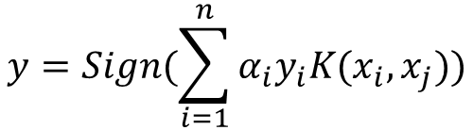
SVM classifier method
test sample x classified by
$$y=Sign(\sum_{i=1}^{n}{α_{i}y_{i}K(x_{i}, x_{j})})$$

Slide 18

SVM classifier method
Hyperparameter $\left\langle γ, b\right\rangle$: use K-fold cross validation

Slide 19
Artificial Immune System
Inspired by biological immune system
example of a massively-parallel, adaptive, information-processing system

Slide 20
Biological immune system
Innate immunity and adaptive immunity
when a pathogen crosses Innate(intrinsic) immunity and two conditions are met:
a certain amount of antigen is produced
a "dissident" or "danger" signal of activated dendritic cells is generated
Self/nonself recognition, diversity, specificity, and memory
Notes:
Antigen抗原
Dissident異己
識別性（self/nonself recognition）、多樣性（diversity）、專一性（specificity）、記憶性（memory）
activated dendritic cells: 活化樹突細胞

Slide 21
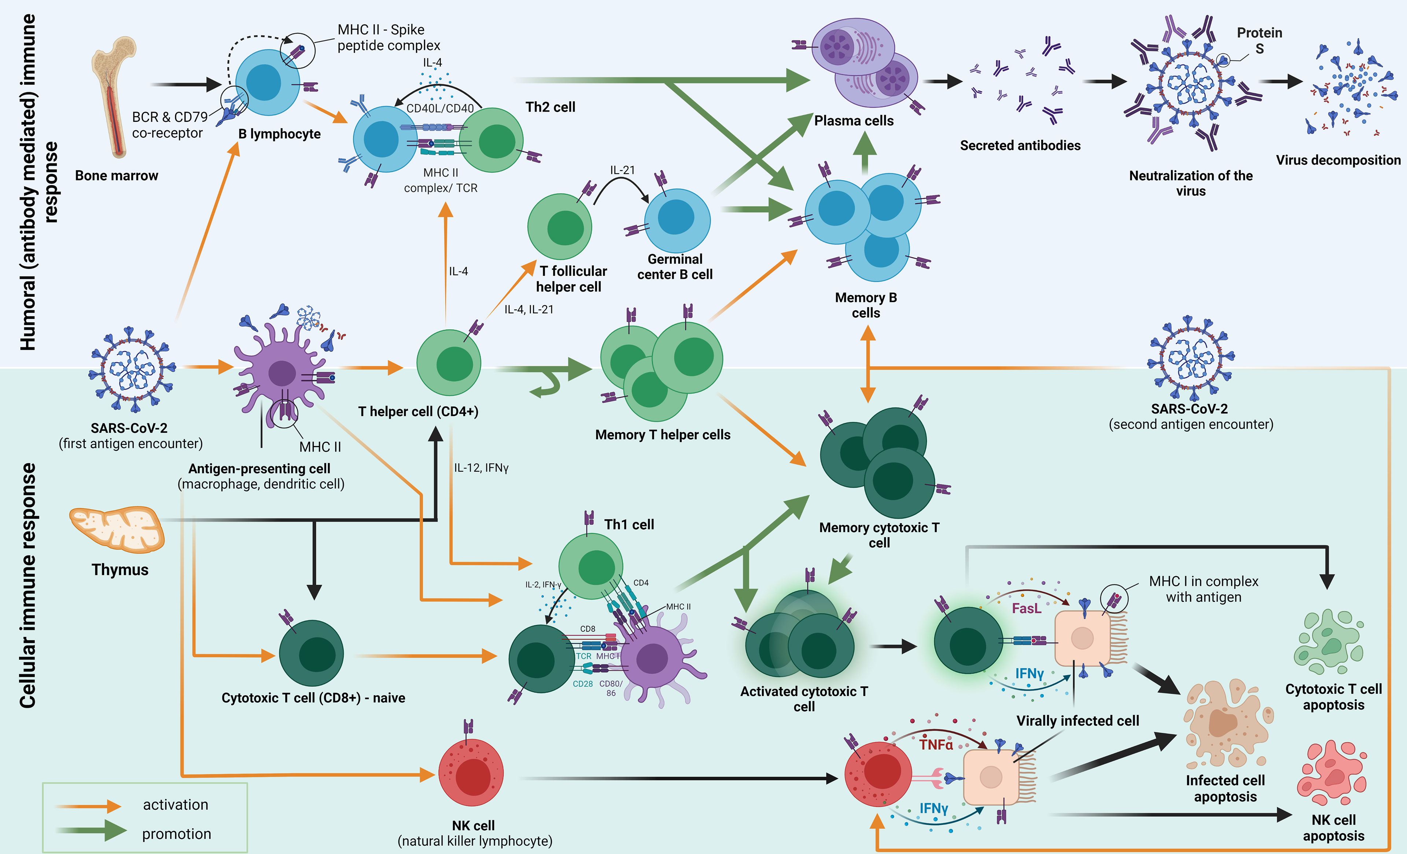
Biological immune system
Notes:
thymus: 胸腺
cytotoxic: 胞毒
lymphocyte: 淋巴細胞
plasma cell: 漿細胞
apoptosis: 凋亡
dendritic cells: 樹突細胞
macrophages cells: 巨嗜細胞

Slide 22
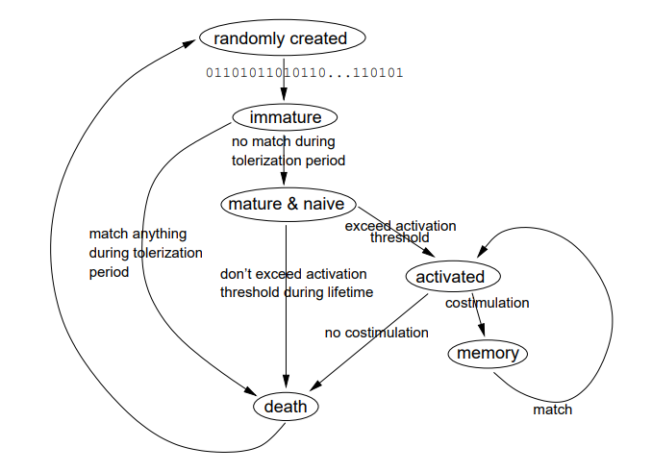
Biological immune system
https://www.researchgate.net/publication/12197865_Architecture_for_an_Artificial_Immune_System
Notes:
Costimulation: 共刺激是輔助信號，在抗原呈遞細胞存在下，免疫細胞依靠該信號激活免疫應答。在T細胞的情況下，需要兩種刺激才能完全激活其免疫應答。在淋巴球的活化過程中，共同刺激對於有效免疫應答的發展通常是至關重要的。除了來自其抗原受體的抗原特異性信號外，還需要共刺激。
即前述危險訊號

Slide 23
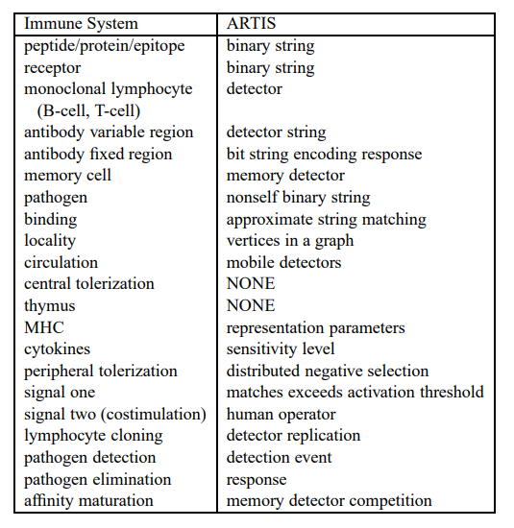
Biological immune system

Slide 24
Artificial Immune System
Artificial Immune System algorithm (an email message m)
For (each term t in the message) do {
If (there exists a detector p, based on base
String r, matches with t) then {
If (m is spam) then {
Increase r’s spam score by s-rate;
} else {
Increase r’s ham score by ns-rate;
}
} else{
if (m is spam) then {
if(detector p recognizes t and edmf(p,t) > threshold) then {
The differing characters are added to its corresponding entry in the library of character generalization rules;
} else{
A new base string t is added into the library of base strings;
}
}
}
Decrease the age of every base string by a-rate;
}

Slide 25
Rough sets classifier method
Polish computer scientist Zdzisław Pawlak, 1982
It is often impossible to precisely classify objects into distinct sets or categories
Lower approximation(possibly belong to the target set) and upper approximation(positively belong to the target set)

Slide 26






Rough sets classifier method
test
train
Notes:
Email -> 選特徵 -> train-test-split
training set 離散化 -> 基因演算法 -> 產出rule
test set 離散化 -> 用rule檢查 <a href="https://www.flaticon.com/free-icons/email" title="email icons">Email icons created by kornkun - Flaticon</a>
<a href="https://www.flaticon.com/free-icons/attribute" title="attribute icons">Attribute icons created by noomtah - Flaticon</a>
<a href="https://www.flaticon.com/free-icons/discrete-math" title="discrete math icons">Discrete math icons created by Freepik - Flaticon</a>
<a href="https://www.flaticon.com/free-icons/genetic" title="genetic icons">Genetic icons created by Eucalyp - Flaticon</a>
<a href="https://www.flaticon.com/free-icons/rules" title="rules icons">Rules icons created by Freepik - Flaticon</a>
<a href="https://www.flaticon.com/free-icons/decision" title="decision icons">Decision icons created by Flat Icons - Flaticon</a>

Slide 27
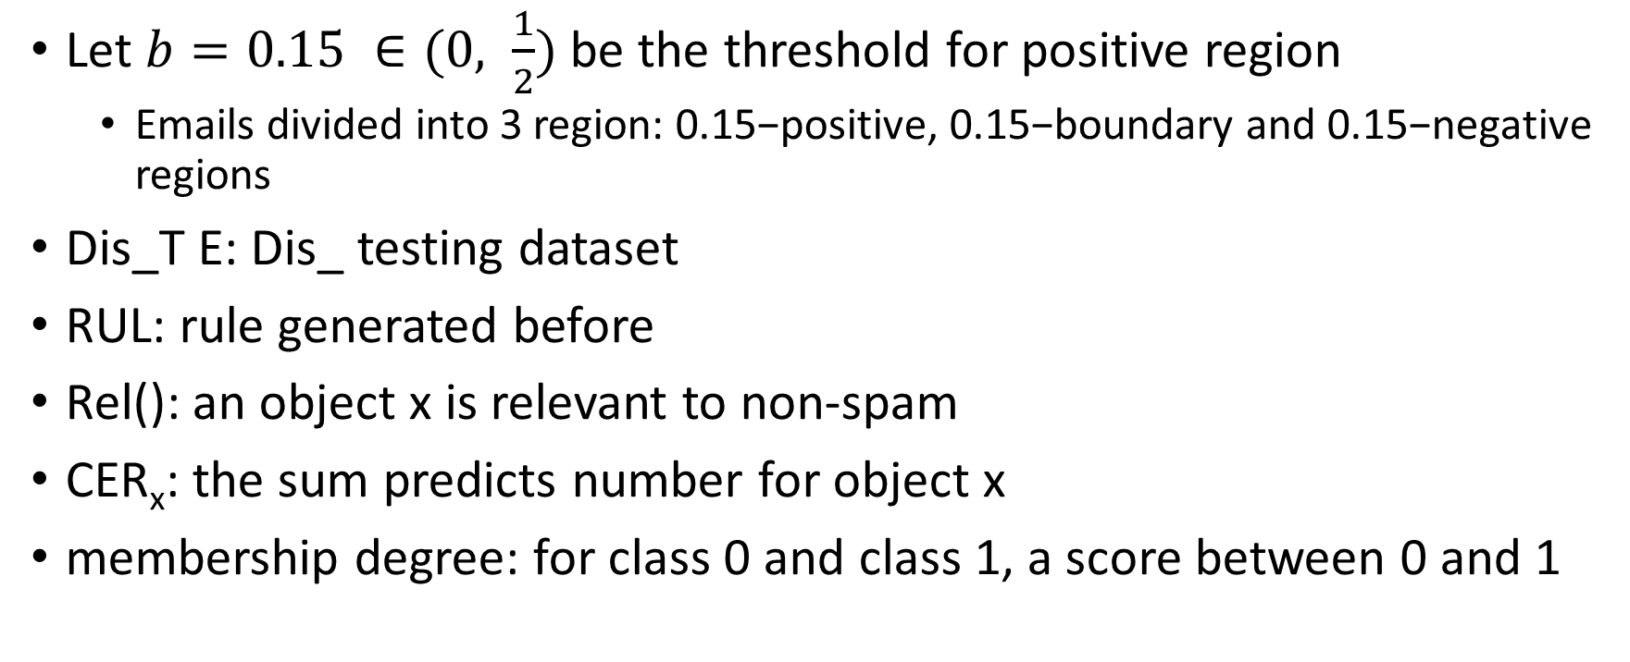
Rough sets classifier method
Let $b=0.15 ∈(0, \frac{1}{2})$ be the threshold for positive region
Emails divided into 3 region: 0.15−positive, 0.15−boundary and 0.15−negative regions
Dis_T E: Dis_ testing dataset
RUL: rule generated before
Rel(): an object x is relevant to non-spam
CER_{x}: the sum predicts number for object x
membership degree: for class 0 and class 1, a score between 0 and 1
Notes:
Rel: x 與非垃圾郵件的相關性

Slide 28
Rough sets classifier method
spam
not sure
non-spam
-1
0
1

Slide 29
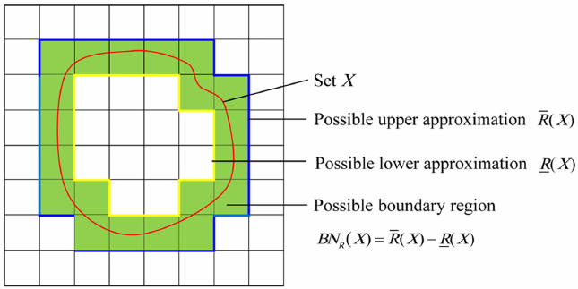
https://www.geeksforgeeks.org/rough-set-theory-an-introduction/

Slide 30
Rough sets classifier method - classify
for x ∈ Dis_T E do
while RUL (x) = 0 do
suspicious = suspicious ∪ {x};
end
Let all r ∈ RUL (x) cast a number in favor of the non-spam class. The number of
predicts a rule gets to cast is actually the membership degree based on the decision rules;
R = r ∈ RUL (x)|r predicts non-spam;
Estimate Rel(Dis_T E | x ∈ non-spam);
Rel(Dis_T E | x ∈ non-spam) = ∑r ∈ R Predicts(non-spam);
Certainty_{x} = 1/cer × Rel(Dis_T E | x ∈ non-spam);
while Certainty_{x} ≥ 1 – b do
suspicious = suspicious ∪ {x};
end
spam = spam ∪ {x};
end

Slide 31
MACHINE LEARNING METHODS PERFORMANCE

Slide 32
Experiment Implementation
Some corpora of spam and legitimate emails had to be compiled
Dataset: Apache SpamAssassin
6000 emails: 37.04% are spam
Split corpora into 62.96%: 37.04% for training set and test set
each set have 62.96% ham message and 37.04% spam message

Slide 33
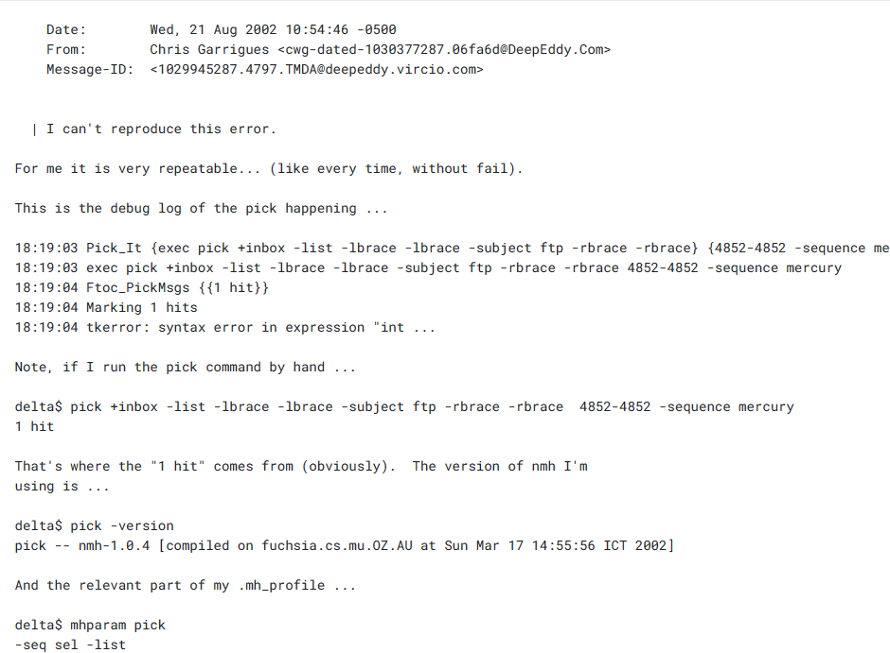

Slide 34
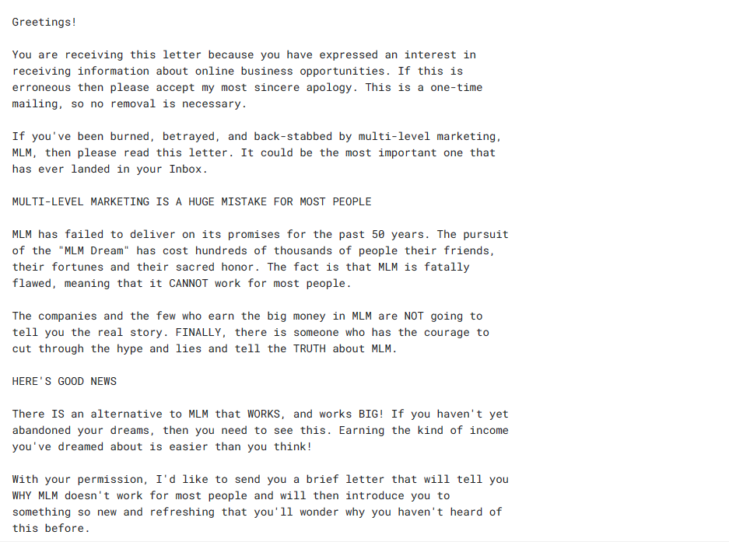

Slide 35
Experiment Implementation
Email has 3 part:
subject
from
body
For body:
stop word removal
case change
Select top 100 frequent words in the spam mail as feature

Slide 36
Detailed algorithm steps
Preprocessing:
each message convert to a vector(21700 dimension, one hot encoding)
Feature extracted
choose the words’ appearance is more than 3 times
Spam classification
Performance evaluation
Spam Precision (SP), Spam Recall (SR), Accuracy (A)

Slide 37
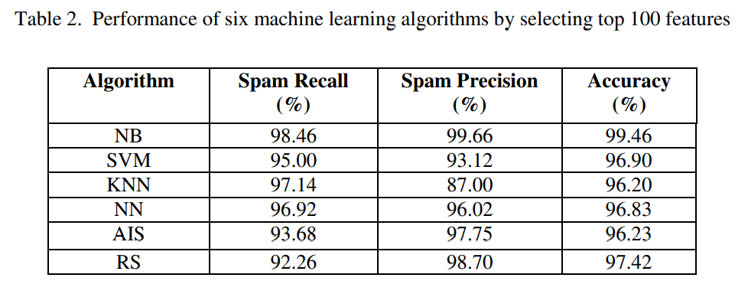
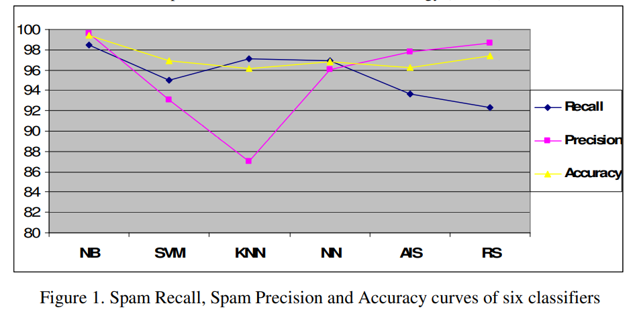
Performance Comparison
Notes:
accuracy: nb最好, ais, knn最差
precision: nb最好, knn最差, rs出乎意料的好
recall: nb最好, rs最差
knn基本上跟k值無關，都很差
nn又簡單又快
rs最複雜，需混合基因演算法
ais給出十分滿意的結果，跟rs混合後可能會有更好的表現

Slide 38
CONCLUSION

Slide 39
Conclusion
Review some ML method and their applicability to the problem of spam e-mail classification
On SpamAssassin spam corpus, Naïve bayes and rough set has a very satisfying performance
Escalate the performance of Naïve bayes and AIS
by hybrid system or by resolve the feature dependence issue in Naïve bayes
by hybrid with rough set in AIS
Hybrid system will be the most efficient way to combat spam mail

Slide 40
Opinion
提出與一般用於分類垃圾郵件不同的分類器
實驗過程講述完整
AIS和RS的篇幅較短，pseudo code內部份參數及函數沒有解釋
pseudo code的格式不統一

Slide 41
Reference
Hofmeyr, Steven & Forrest, Stephanie. (2000). Architecture for an Artificial Immune System. Evolutionary computation. 8. 443-73. 10.1162/106365600568257.
Primorac D, Vrdoljak K, Brlek P, Pavelić E, Molnar V, Matišić V, Erceg Ivkošić I, Parčina M. Adaptive Immune Responses and Immunity to SARS-CoV-2. Front Immunol. 2022 May 4;13:848582. doi: 10.3389/fimmu.2022.848582. PMID: 35603211; PMCID: PMC9114812.

Slide 42
Reference
[1] M. N. Marsono, M. W. El-Kharashi, and F. Gebali, “Binary LNS-based naïve Bayes inference engine for spam control: Noise analysis and FPGA synthesis”, IET Computers & Digital Techniques, 2008
[2] Muhammad N. Marsono, M. Watheq El-Kharashi, Fayez Gebali “Targeting spam control on middleboxes: Spam detection based on layer-3 e-mail content classification” Elsevier Computer Networks, 2009
[3] Yuchun Tang, Sven Krasser, Yuanchen He, Weilai Yang, Dmitri Alperovitch ”Support Vector Machines and Random Forests Modeling for Spam Senders Behavior Analysis” IEEE GLOBECOM, 2008 International Journal of Computer Science & Information Technology (IJCSIT), Vol 3, No 1, Feb 2011 184
[4] Guzella, T. S. and Caminhas, W. M. ”A review of machine learning approaches to Spam filtering.” Expert Syst. Appl., 2009
[5] Wu, C. ”Behavior-based spam detection using a hybrid method of rule-based techniques and neural networks” Expert Syst., 2009
[6] Khorsi. “An overview of content-based spam filtering techniques”, Informatica, 2007
[7] Hao Zhang, Alexander C. Berg, Michael Maire, and Jitendra Malic. "SVM-KNN: Discriminative nearest neighbour classification for visual category recognition", IEEE Computer Society Conference on Computer Vision and Pattern Recognition, 2006
[8] Carpinteiro, O. A. S., Lima, I., Assis, J. M. C., de Souza, A. C. Z., Moreira, E. M., & Pinheiro, C. A. M. "A neural model in anti-spam systems.", Lecture notes in computer science.Berlin, Springer, 2006
[9] El-Sayed M. El-Alfy, Radwan E. Abdel-Aal "Using GMDH-based networks for improved spam detection and email feature analysis"Applied Soft Computing, Volume 11, Issue 1, January 2011
[10] Li, K. and Zhong, Z., “Fast statistical spam filter by approximate classifications”, In Proceedings of the Joint international Conference on Measurement and Modeling of Computer Systems. Saint Malo, France, 2006
[11] Cormack, Gordon. Smucker, Mark. Clarke, Charles " Efficient and effective spam filtering and re-ranking for large web datasets" Information Retrieval, Springer Netherlands. January 2011
[12] Almeida,tiago. Almeida, Jurandy.Yamakami, Akebo " Spam filtering: how the dimensionality reduction affects the accuracy of Naive Bayes classifiers" Journal of Internet Services and Applications, Springer London , February 2011
[13] Yoo, S., Yang, Y., Lin, F., and Moon, I. “Mining social networks for personalized email prioritization”. In Proceedings of the 15th ACM SIGKDD international Conference on Knowledge Discovery and Data Mining (Paris, France), June 28 - July 01, 2009

