Slide 1
(semi)Automatic Methods for Security Bug
Detection
Tal Garfinkel
Stanford/VMware

Slide 2

Fuzzing Basics
Automaticly generate test cases
Many slightly anomalous test cases are input into a target interface
Application is monitored for errors
Inputs are generally either file based (.pdf, .png, .wav, .mpg)
Or network based
  http

Slide 3
Trivial Example
Standard HTTP GET request
  GET /index.html HTTP/1.1
Anomalous requests
  AAAAAA...AAAA /index.html HTTP/1.1
  GET ///////index.html HTTP/1.1
  GET %n%n%n%n%n%n.html HTTP/1.1
  GET /AAAAAAAAAAAAA.html HTTP/1.1
  GET /index.html HTTTTTTTTTTTTTP/1.1
  GET /index.html HTTP/1.1.1.1.1.1.1.1

Slide 4

Mutation Based Fuzzing
Little or no knowledge of the structure of the inputs is assumed
Anomalies are added to existing valid inputs
Anomalies may be completely random or follow some heuristics (e.g. remove NUL, shift character forward)
Examples:
  Taof, GPF, ProxyFuzz, FileFuzz, Filep, etc.

Slide 5
Example: fuzzing a pdf viewer
Google for .pdf (about 1 billion results)
Crawl pages to build a corpus
Use fuzzing tool (or script to)
  Grab a file
  Mutate that file
  Feed it to the program
  Record if it crashed (and input that crashed it)

Slide 6
Dumb Fuzzing In Short
Strengths
  Super easy to setup and automate
  Little to no protocol knowledge required
Weaknesses
  Limited by initial corpus
  May fail for protocols with checksums, those which depend on challenge response, etc.

Slide 7

Generation Based Fuzzing
Test cases are generated from some description of the format: RFC, documentation, etc.
Anomalies are added to each possible spot in the inputs
Knowledge of protocol should give better results than random fuzzing

Slide 8
Example: Protocol Description
//png.spk
//author: Charlie Miller
// Header - fixed.
s_binary("89504E470D0A1A0A");
// IHDRChunk
s_binary_block_size_word_bigendian("IHDR"); //size of data field
s_block_start("IHDRcrc");
s_string("IHDR"); // type
s_block_start("IHDR");
// The following becomes s_int_variable for variable stuff
// 1=BINARYBIGENDIAN, 3=ONEBYE
s_push_int(0x1a, 1); // Width
s_push_int(0x14, 1); // Height
s_push_int(0x8, 3); // Bit Depth - should be 1,2,4,8,16, based on colortype
s_push_int(0x3, 3); // ColorType - should be 0,2,3,4,6
s_binary("00 00"); // Compression || Filter - shall be 00 00
s_push_int(0x0, 3); // Interlace - should be 0,1
s_block_end("IHDR");
s_binary_block_crc_word_littleendian("IHDRcrc"); // crc of type and data
s_block_end("IHDRcrc");
...
PNG specification: https://www.w3.org/TR/PNG-Structure.html

Slide 9
Generation Based Fuzzing In Short
Strengths
  completeness
  Can deal with complex dependencies e.g. checksums
Weaknesses
  Have to have spec of protocol
    Often can find good tools for existing protocols e.g. http, Writing generator can be labor intensive for complex protocols
  The spec is not the code

Slide 10

Fuzzing Tools

Slide 11
Input Generation
Existing generational fuzzers for common protocols (ftp, http, SNMP, etc.)
  Mu-4000, Codenomicon, PROTOS, FTPFuzz
Fuzzing Frameworks: You provide a spec, they provide a fuzz set
  SPIKE, Peach, Sulley
Dumb Fuzzing automated: you provide the files or packet traces, they provide the fuzz sets
  Filep, Taof, GPF, ProxyFuzz, PeachShark
Many special purpose fuzzers already exist as well
  ActiveX (AxMan), regular expressions, etc.

Slide 12
Input Inject
Simplest
  Run program on fuzzed file
  Replay fuzzed packet trace
Modify existing program/client
  Invoke fuzzer at appropriate point
Use fuzzing framework
  e.g., learn all about the peach fuzzing framework: https://www.peach.tech/resources/datasheets/

Slide 13
When program fails?
See if program crashed
  Type of crash can tell a lot (SEGV vs. assert fail)
Run program under dynamic memory error detector (valgrind/purify)
  Catch more bugs, but more expensive per run.
See if program locks up
Assertions

Slide 14
Workflow Automation
Sulley, Peach, Mu-4000 all provide tools to aid setup, running, recording, etc.
Virtual machines can help create reproducable workload
Some assembly still required

Slide 15
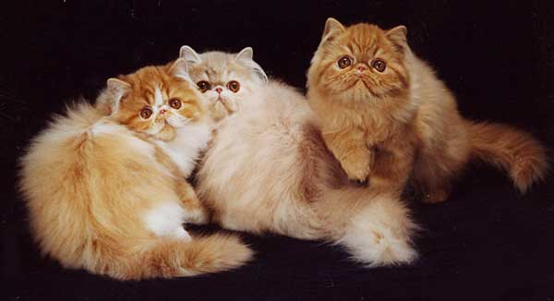
How Much Fuzz Is Enough?
Mutation based fuzzers can generate an infinite number of test cases... When has the fuzzer run long enough?
Generation based fuzzers generate a finite number of test cases. What happens when they’re all run and no bugs are found?

Slide 16
Example: PDF
I have a PDF file with 248,000 bytes
There is one byte that, if changed to particular values, causes a crash
  This byte is 94% of the way through the file
Any single random mutation to the file has a probability of .00000392 of finding the crash
On average, need 127,512 test cases to find it
At 2 seconds a test case, thats just under 3 days...
It could take a week or more...

Slide 17
Code Coverage
Some of the answers to these questions lie in code coverage
Code coverage is a metric which can be used to determine how much code has been executed.
Data can be obtained using a variety of profiling tools. e.g. gcov

Slide 18
Types of Code Coverage
Line coverage
  Measures how many lines of source code have been executed.
Branch coverage
  Measures how many branches in code have been taken (conditional jmps)
Path coverage
  Measures how many paths have been taken

Slide 19
Example
Requires
  1 test case for line coverage
  2 test cases for branch coverage
  4 test cases for path coverage
    i.e. (a,b) = {(0,0), (3,0), (0,3), (3,3)}
if( a > 2 )
a = 2;
if( b > 2 )
b = 2;

Slide 20
Problems with Code Coverage
Code can be covered without revealing bugs
Error checking code mostly missed (and we don’t particularly care about it)
Only “attack surface” reachable
  i.e. the code processing user controlled data
  No easy way to measure the attack surface
    Interesting use of static analysis?
mySafeCpy(char *dst, char* src){
if(dst && src)
strcpy(dst, src);
}
ptr = malloc(sizeof(blah));
if(!ptr)
ran_out_of_memory();

Slide 21
Code Coverage Good For Lots of Things
How good is this initial file?
Am I getting stuck somewhere?
if(packet[0x10] < 7) { //hot path
} else { //cold path
}
How good is fuzzer X vs. fuzzer Y
Am I getting benefits from running a different fuzzer?
See Charlie Miller’s work for more: Fuzzing for Software Security Testing and Quality Assurance

Slide 22
Fuzzing Rules of Thumb
Protocol specific knowledge very helpful
  Generational tends to beat random, better spec’s make better fuzzers
More fuzzers is better
  Each implementation will vary, different fuzzers find different bugs
The longer you run, the more bugs you find
Best results come from guiding the process
  Notice where your getting stuck, use profiling!
Code coverage can be very useful for guiding the process

Slide 23

The Future of Fuzz

Slide 24
Outstanding Problems
What if we don’t have a spec for our protocol/How can we avoid writing a spec.
How do we select which possible test cases to generate

Slide 25

Whitebox Fuzzing
Infer protocol spec from observing program execution,then do generational fuzzing
Potentially best of both worlds
Bleeding edge

Slide 26
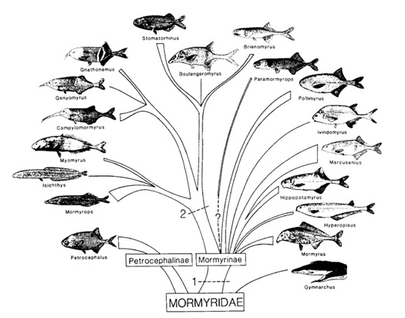
Greybox Techniques
Evolutionary Fuzzing
Guided mutations based on fitness metrics
Prefer mutations that give
  Better code coverage
  Modify inputs to potentially dangerous
  functions (e.g. memcpy)

Slide 27
Summary
To find bugs, use the tools and tactics of an attacker
Fuzzing and static analysis belong in every developers toolbox
Field is rapidly evolving
If you don’t apply these tools to your code, someone else will

