Slide 1
Abstract Interpretation

Slide 2
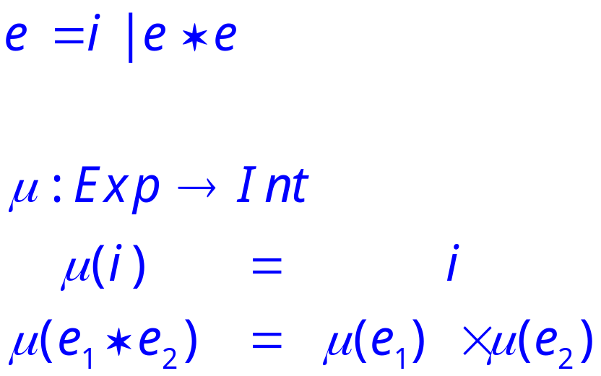
A Tiny Language
Consider a language with only integers and multiplication.

Slide 3
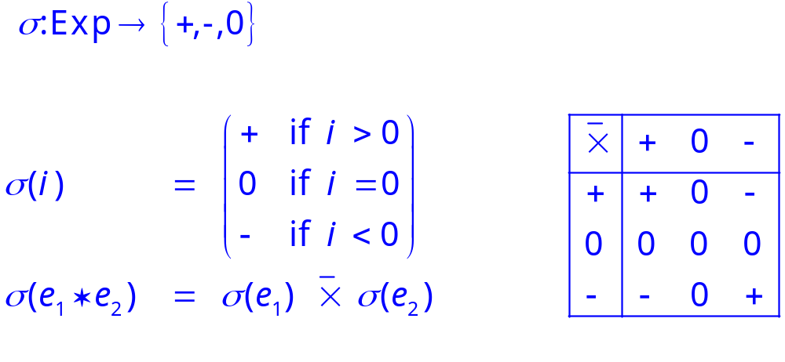
An Abstraction
Define an abstract semantics that computes only the sign of the result.

Slide 4
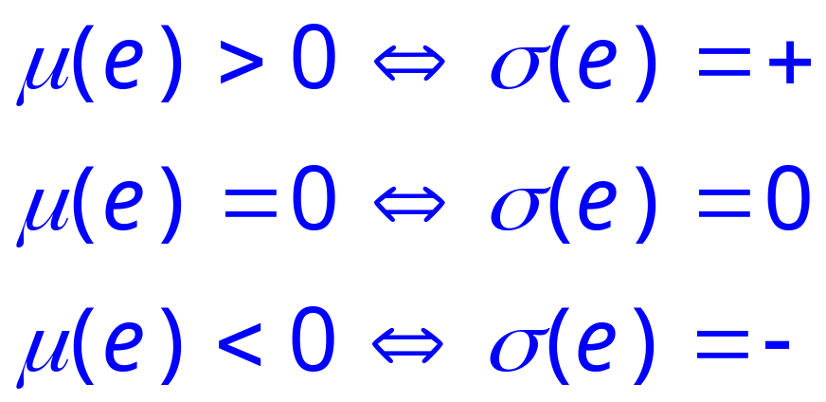
Soundness
We can show that this abstraction is correct in the sense that it correctly predicts the sign of an expression.
Proof is by structural induction on e.

Slide 5
Abstract Interpretation
This is an abstract interpretation.
  Computation in an abstract domain
  In this case {+,0,-}.
The abstract semantics is sound
  approximates the standard semantics.
The concretization function establishes the connection between the two domains.

Slide 6
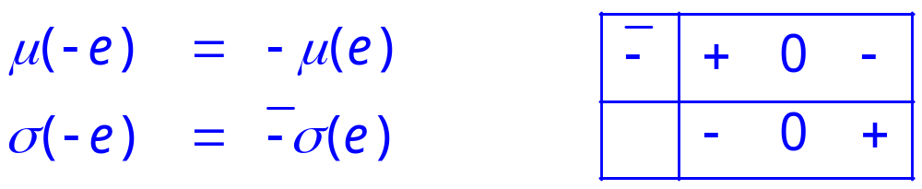
Adding -
Extend our language with unary -

Slide 7
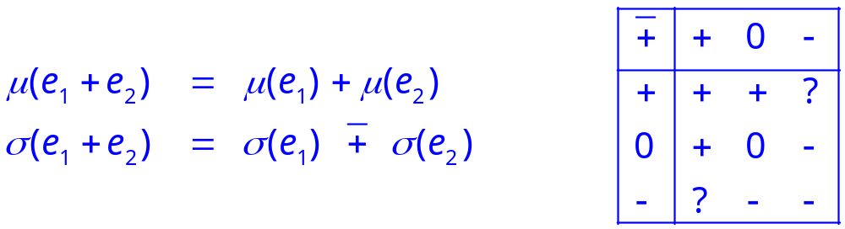
Adding +
Adding addition is not so easy.
The abstract values are not closed under addition.

Slide 8
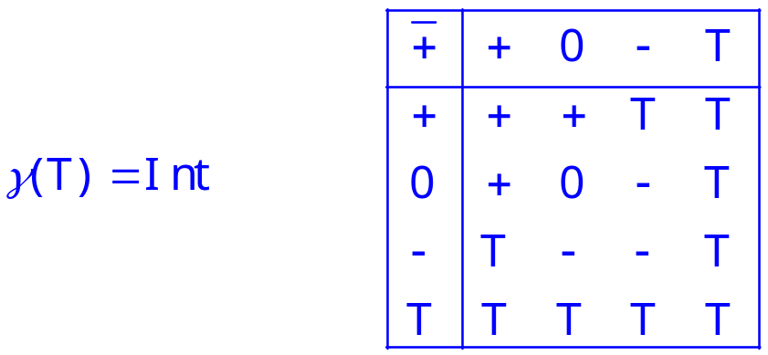
Solution
We need another abstract value to represent a result that can be any integer.
Finding a domain closed under all the abstract operations is often a key design problem.

Slide 9
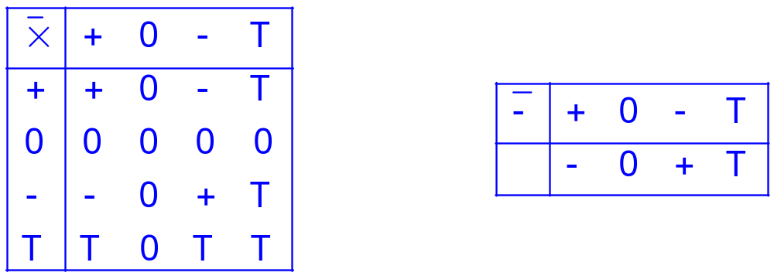
Extending Other Operations
We also need to extend the other abstract operations to work with T.

Slide 10
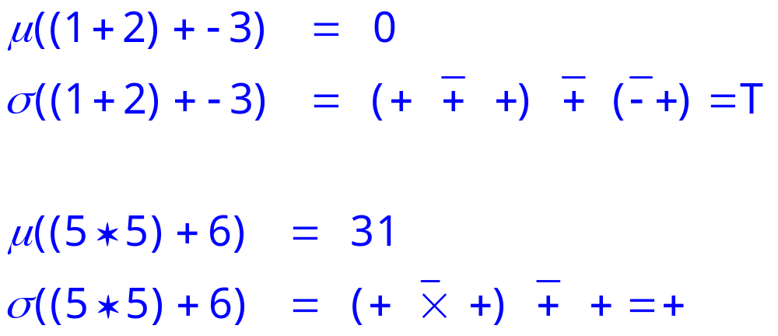
Examples
Abstract computation loses information
No loss of information

