Slide 1
1. Reaching Definitions
Definition d of variable v: a statement d that assigns a value to v.
Use of variable v: reference to value of v in an expression evaluation.
Definition d of variable v reaches a point p if there exists a path from immediately after d to p such that definition d is not killed along the path.
Definition d is killed along a path between two points if there exists an assignment to variable v along the path.
1

Slide 2
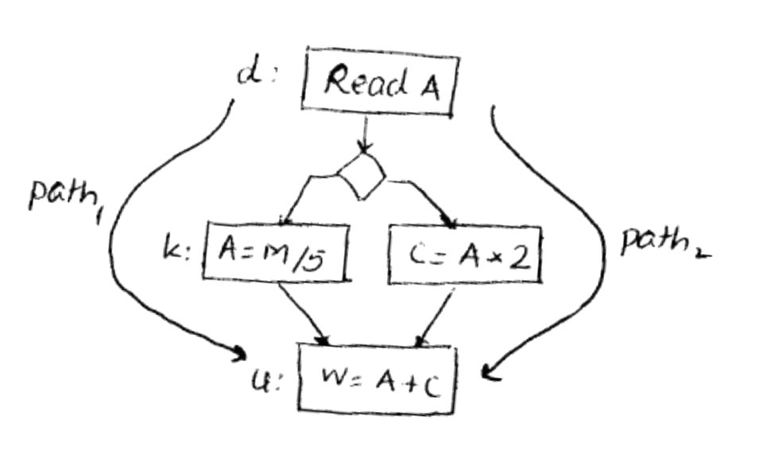
Example
d reaches u along path₂ & d does not reach u along path₁
Since there exists a path from d to u along which d is not
killed (i.e., path₂), d reaches u.

Slide 3
Reaching Definitions Contd.
Unambiguous Definition: X = ….;
Ambiguous Definition: *p = ….; p may point to X
For computing reaching definitions, typically we only consider kills by unambiguous definitions.
X=..
*p=..
Does definition of X reach here ? Yes

Slide 4
Computing Reaching Definitions
At each program point p, we compute the set of definitions that reach point p.
Reaching definitions are computed by solving a system of equations (data flow equations).
d2: X=…
d3: X=…
IN[B]
GEN[B] ={d1}
d1: X=…
OUT[B]
KILL[B]={d2,d3}

Slide 5
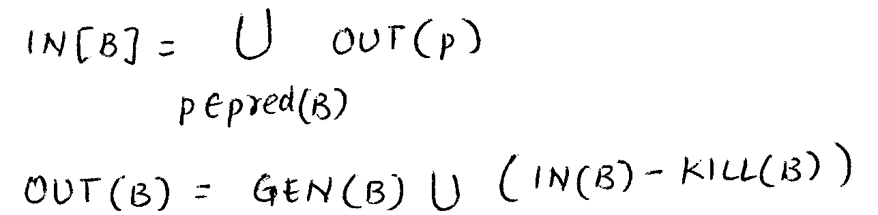
Data Flow Equations
IN[B]: Definitions that reach B’s entry.
OUT[B]: Definitions that reach B’s exit.
GEN[B]: Definitions within B that reach the end of B.
KILL[B]: Definitions that never reach the end of B due
to redefinitions of variables in B.

Slide 6
Reaching Definitions Contd.
Forward problem – information flows forward in the direction of edges.
May problem – there is a path along which definition reaches a point but it does not always reach the point.
Therefore in a May problem the meet operator is the Union operator.

Slide 7
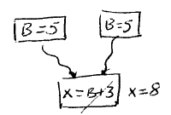
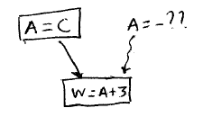
Applications of Reaching Definitions
Constant Propagation/folding
Copy Propagation
Null pointer dereference

Slide 8
2. Available Expressions
An expression is generated at a point if it is computed at that point.
An expression is killed by redefinitions of operands of the expression.
An expression A+B is available at a point if every path from the start node to the point evaluates A+B and after the last evaluation of A+B on each path there is no redefinition of either A or B (i.e., A+B is not killed).

Slide 9
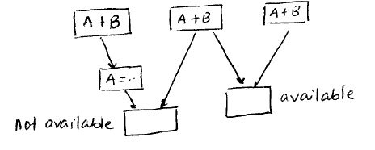
Available Expressions
Available expressions problem computes: at each program point the set of expressions available at that point.

Slide 10
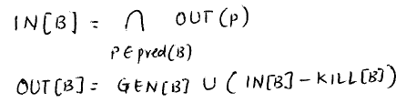
Data Flow Equations
IN[B]: Expressions available at B’s entry.
OUT[B]: Expressions available at B’s exit.
GEN[B]: Expressions computed within B that are
available at the end of B.
KILL[B]: Expressions whose operands are redefined in B.

Slide 11
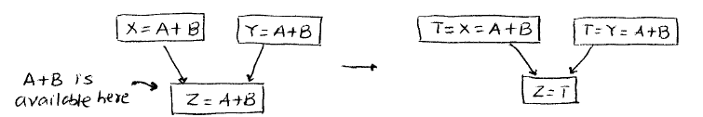
Available Expressions Contd.
Forward problem – information flows forward in the direction of edges.
Must problem – expression is definitely available at a point along all paths.
Therefore in a Must problem the meet operator is the Intersection operator.
Application:
A

Slide 12
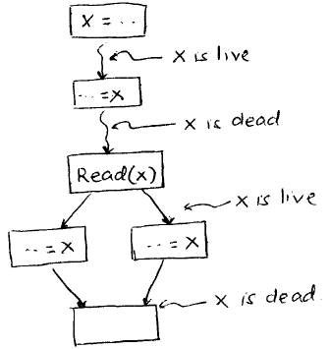
3. Live Variable Analysis
A path is X-clear if it contains no definition of X.
A variable X is live at point p if there exists a X-clear path from p to a use of X; otherwise X is dead at p.
Live Variable Analysis Computes:
At each program point p identify the set of variables that are live at p.

Slide 13
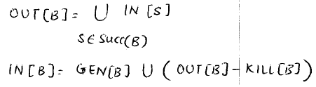
Data Flow Equations
IN[B]: Variables live at B’s entry.
OUT[B]: Variables live at B’s exit.
GEN[B]: Variables that are used in B prior to their
definition in B.
KILL[B]: Variables definitely assigned value in B before
any use of that variable in B.

Slide 14
Live Variables Contd.
Backward problem – information flows backward in reverse of the direction of edges.
May problem – there exists a path along which a use is encountered.
Therefore in a May problem the meet operator is the Union operator.

Slide 15
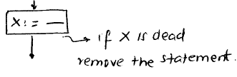
Applications of Live Variables
Register Allocation
Dead Code Elimination
Memory leak detection

Slide 16
Summary
 | May/Union | Must/Intersection
Forward | Reaching Definitions | Available Expressions
Backward | Live Variables

