Slide 1
Abstract Interpretation

Slide 2
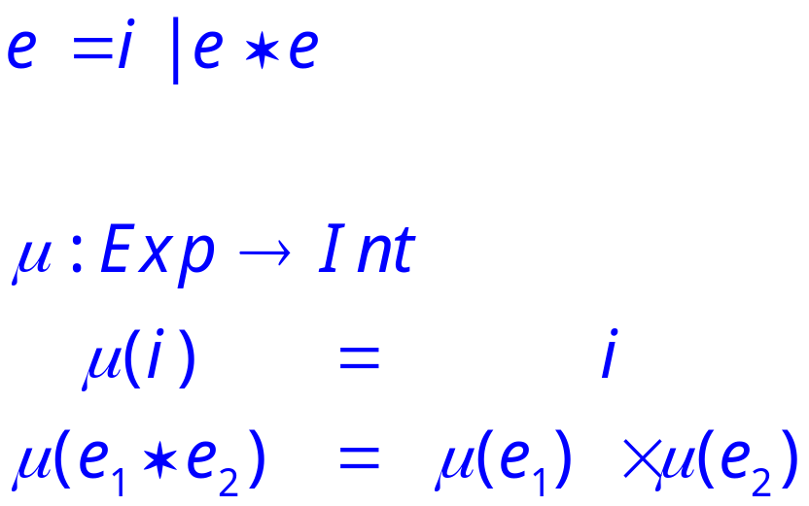
A Tiny Language
Consider a language with only integers and multiplication.

Slide 3
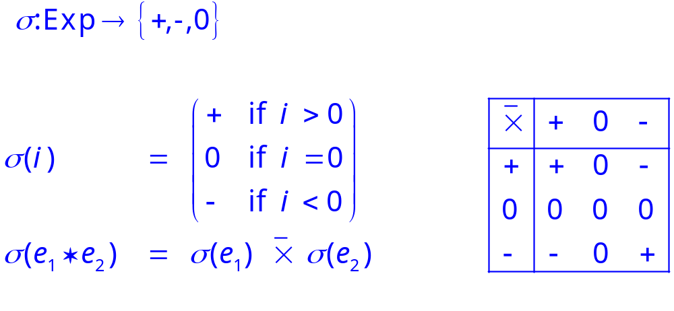
An Abstraction
Define abstract domain
Define an abstract semantics that computes only the sign of the result.

Slide 4
Soundness
Goal: predicts the sign of an expression in the concrete domain
Challenge: Cannot enumerate all the inputs in the concrete domain
Soundness:
  Map concrete values to abstract domain in this case {+,0,-}
  Perform computation using abstract semantics
  Compare conclusions reached from abstract interpretation and concrete interpretation
  Soundness: is the conclusion from abstract interpretation correct?

Slide 5
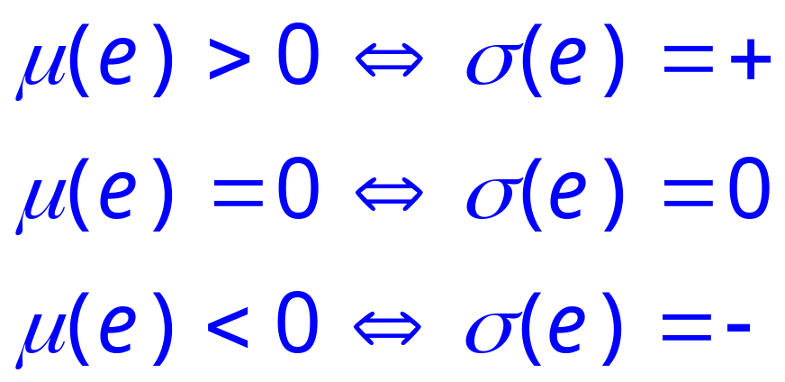
Soundness
We can show that this abstraction is correct in the sense that it correctly predicts the sign of an expression in the concrete domain

Slide 6
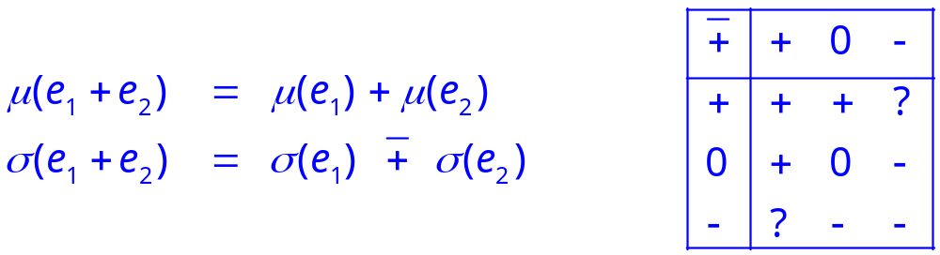
Adding +
Adding addition is not so easy.
The abstract values are not closed under addition.

Slide 7
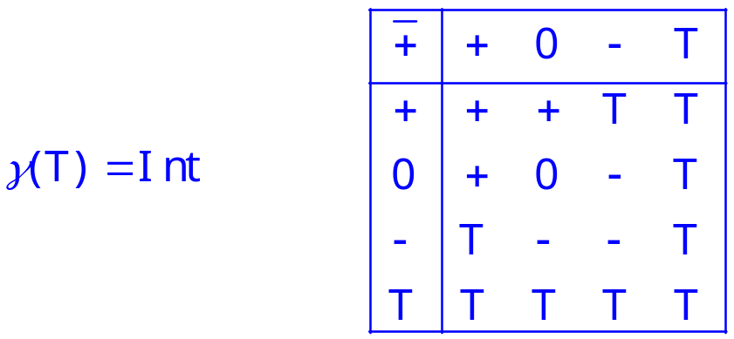
Solution
We need another abstract value to represent a result that can be any integer.
Finding a domain closed under all the abstract operations is often a key design problem.

Slide 8
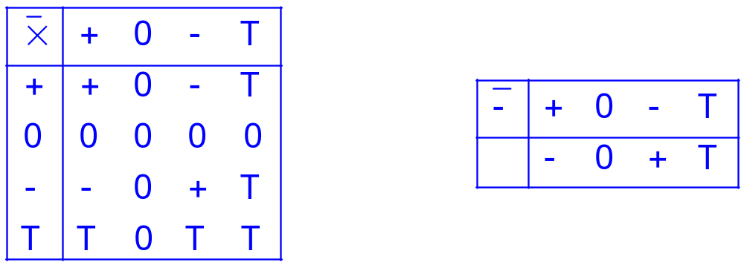
Extending Other Operations
We also need to extend the other abstract operations to work with T.

Slide 9
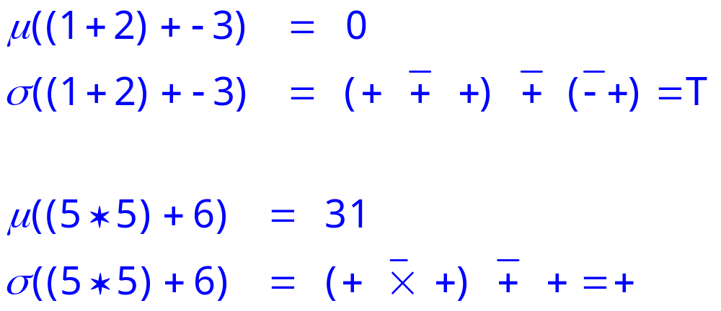
Examples
Abstract computation loses information – some property is true in concrete domain but we cannot prove it in abstract domain
No loss of information

