Slide 1
Abstract Interpretation

Slide 2
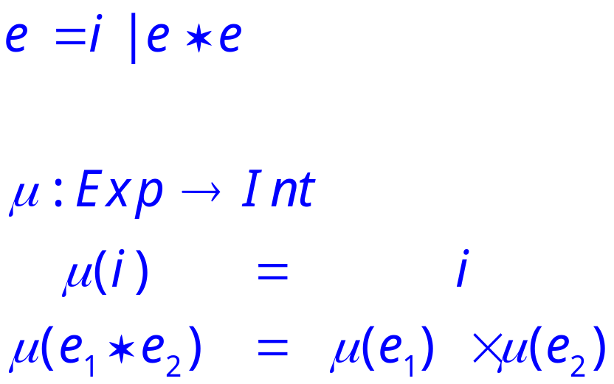
A Tiny Language
Consider a language with only integers and multiplication.

Slide 3
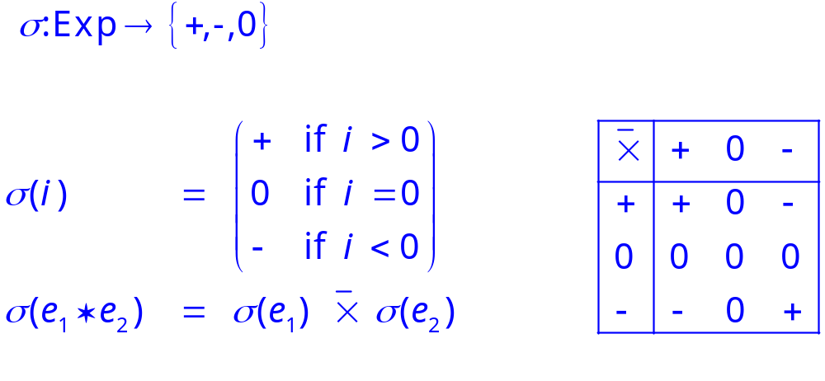
An Abstraction
Define an abstract semantics that computes only the sign of the result.

Slide 4
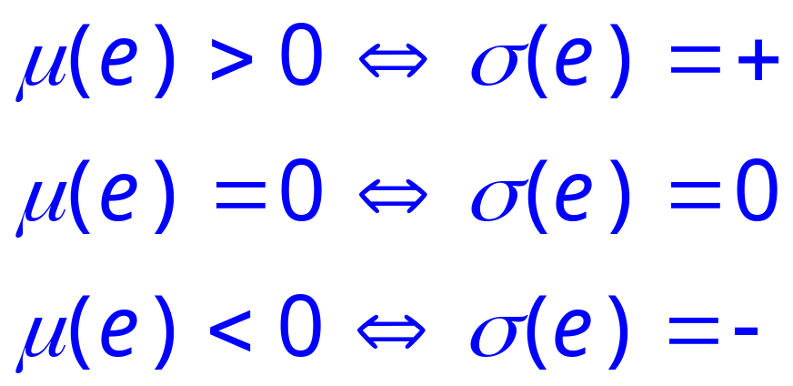
Soundness
We can show that this abstraction is correct in the sense that it correctly predicts the sign of an expression.
Proof is by structural induction on e.

Slide 5
Soundness
Map to abstract domain
Perform computation using abstract semantics
Compare conclusions reached from abstract interpretation and concrete interpretation
Soundness: is the conclusion from abstract interpretation correct?

Slide 6
Abstract Interpretation
This is an abstract interpretation.
  Computation in an abstract domain
  In this case {+,0,-}.
The abstract semantics is sound
  approximates the standard semantics.
The concretization function establishes the connection between the two domains.

Slide 7
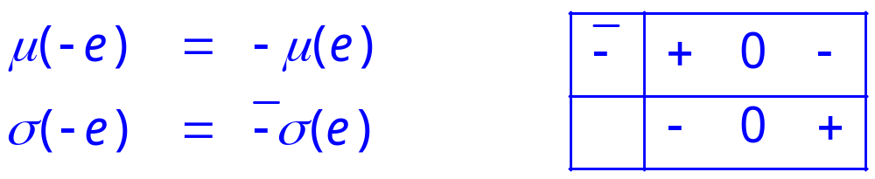
Adding -
Extend our language with unary -

Slide 8
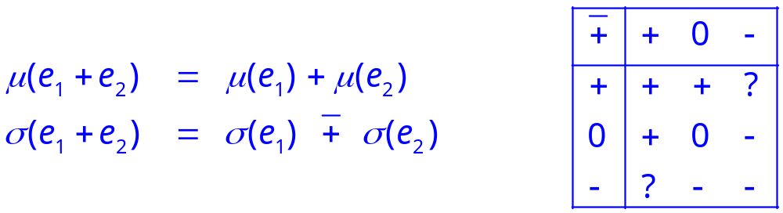
Adding +
Adding addition is not so easy.
The abstract values are not closed under addition.

Slide 9
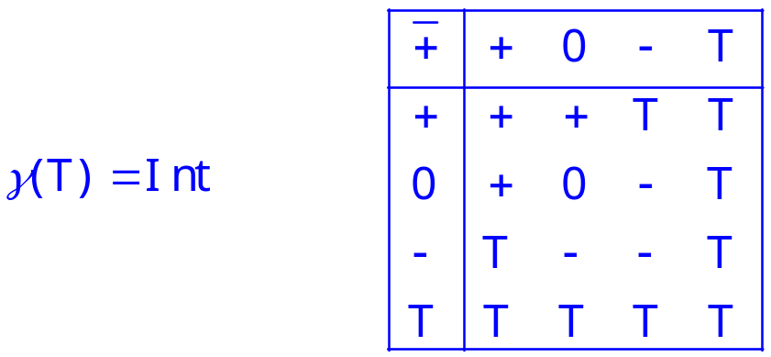
Solution
We need another abstract value to represent a result that can be any integer.
Finding a domain closed under all the abstract operations is often a key design problem.

Slide 10
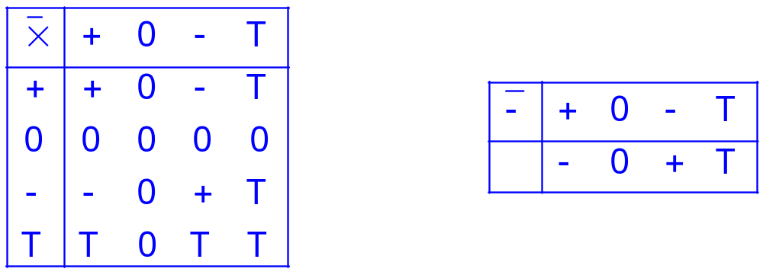
Extending Other Operations
We also need to extend the other abstract operations to work with T.

Slide 11
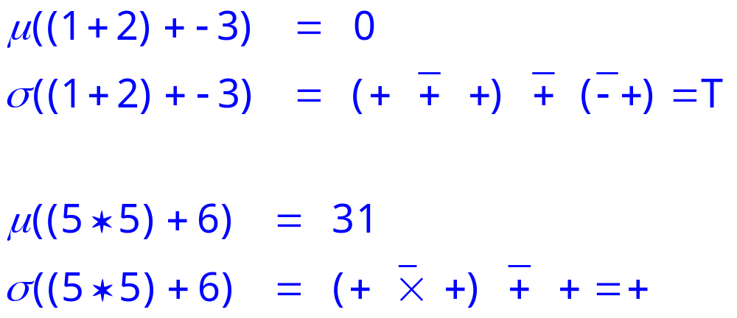
Examples
Abstract computation loses information
No loss of information

