Slide 1

Patch Verification via Multiversion
Interprocedural Control Flow Graphs
Wei Le
Iowa State University
Shannon D. Pattison
Rochester Institute of Technology

Slide 2
Verifying Evolving Software in a Timely Fashion
Software development is inherently incremental
Many software companies employ an agile process and a short release cycle _{[Khomh12]}
Delaying new features can lose millions of dollars in opportunity costs _{[Humble11]}
It is urgent to patch critical fixes

Slide 3
Problem and Challenges
Do new changes break the old code?
Do new changes contain new bugs?
Did patches fix the bugs correctly?
14.4%-24.4% of bug fixes are erroneous _{[Yin11]}
Does bug impact multiple releases?
Can patch fix all the releases?

Slide 4
Previous Solutions and Drawbacks
Analyzing entire new version of software
  Slow, difficult to compare results with old versions
Differential symbolic analysis _{[Person08]}
  Analyze two versions separately, intra-procedural
Regression model checking _{[Yang09]}
Directed incremental symbolic execution _{[Person11]}
  - Exhaustive on changed code, only handle two versions

Slide 5
Hydrogen: Goals and Overall Approaches
Multiversion Interprocedural Control Flow Graphs (MVICFG)
  A control-flow based program representation to specify semantic commonalities and differences
  A general framework to enable program analyses and testing on changes and multiple versions
Demand-Driven Symbolic Analysis on MVICFGs
  Only collect information pertinent to the goal
  Analyzing only changed paths and versions of interest
  Targeting potentially buggy code in the changes

Slide 6
MVICFG Example: Evolving Code
1. get_privilege();
2. char a[20];
3. strcpy(a, b);
4. drop_privilege();
V₂
2,4c2
< char* a;
< len = strlen(b);
< a= (char*)malloc(l*8);
---
> char a[20];
V₁
1. get_privilege();
2. char* a;
l = strlen(b);
a= (char*)malloc(l*8);
strcpy(a, b);
drop_privilege();
1. get_privilege();
2. char* a;
len = strlen(b);
a = (char*)malloc(l*8);
if (a == NULL) {
print “out of memory”;
return; }
strcpy(a, b);
drop_privilege();
1. get_privilege();
2. char* a;
len = strlen(b)+1 ;
a = (char*)malloc(l*8);
if (a == NULL) {
print “out of memory”;
drop_priviledge();
return; }
strcpy(tempMail, secret);
drop_privilege();
V₃
V₄

Slide 7
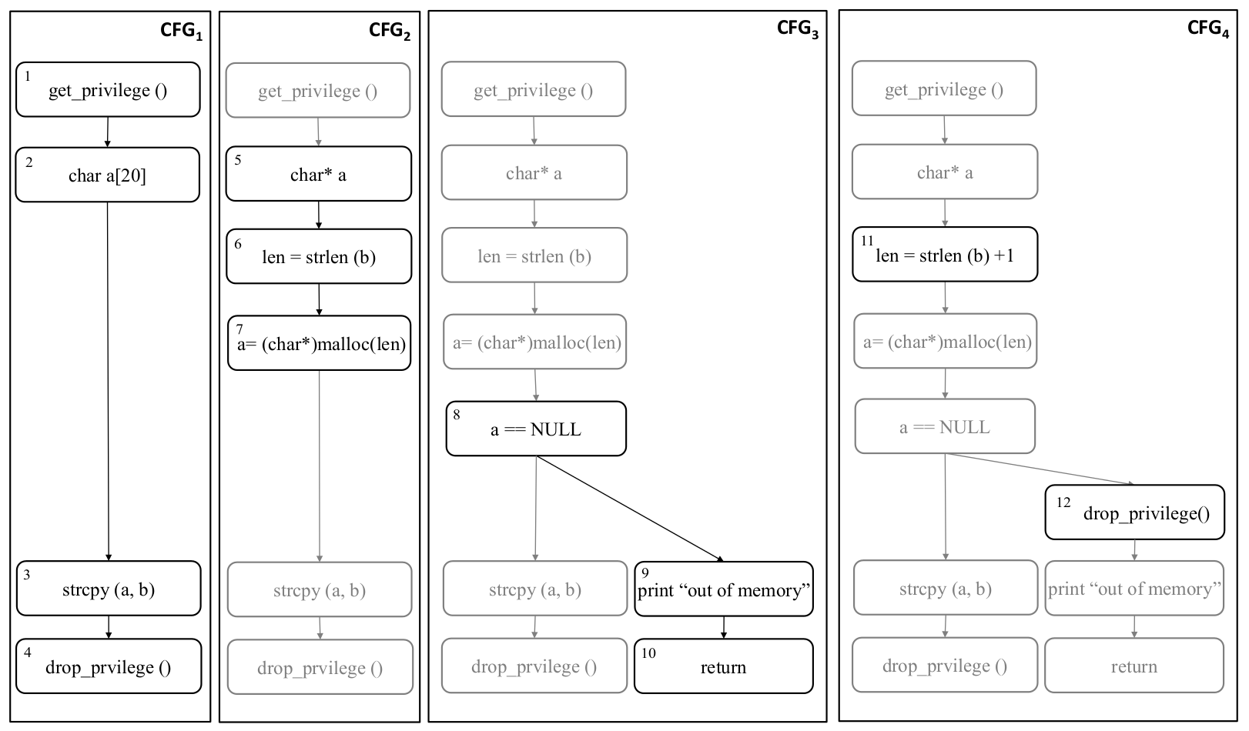
MVICFG Example: an Intuitive Understanding
Wei Le

Slide 8
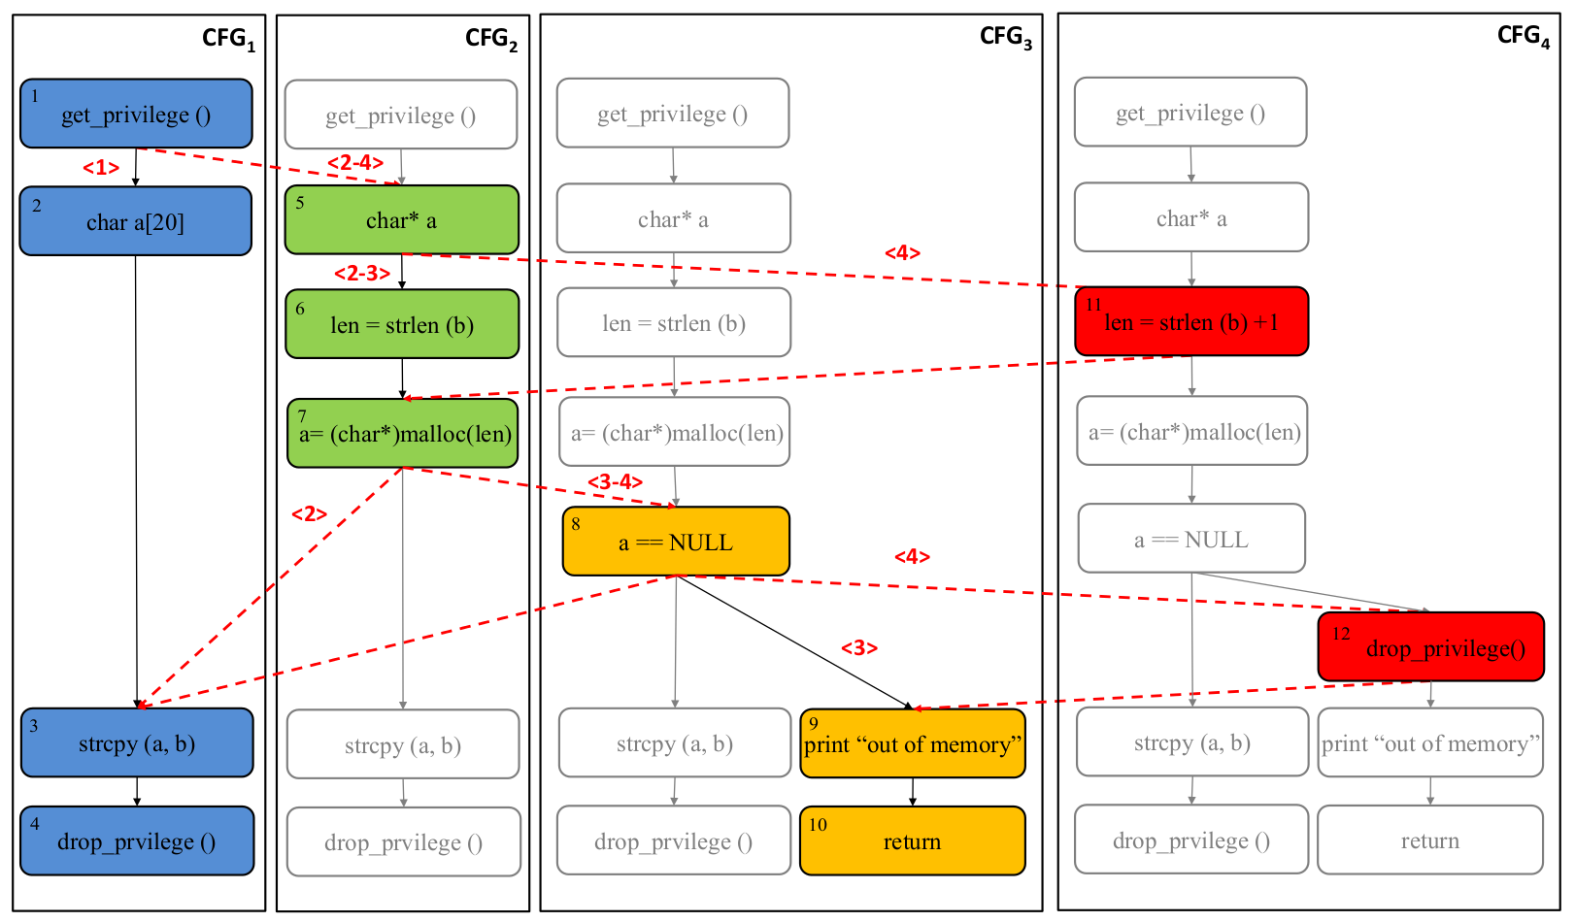
MVICFG Example: an Intuitive Understanding
Wei Le

Slide 9
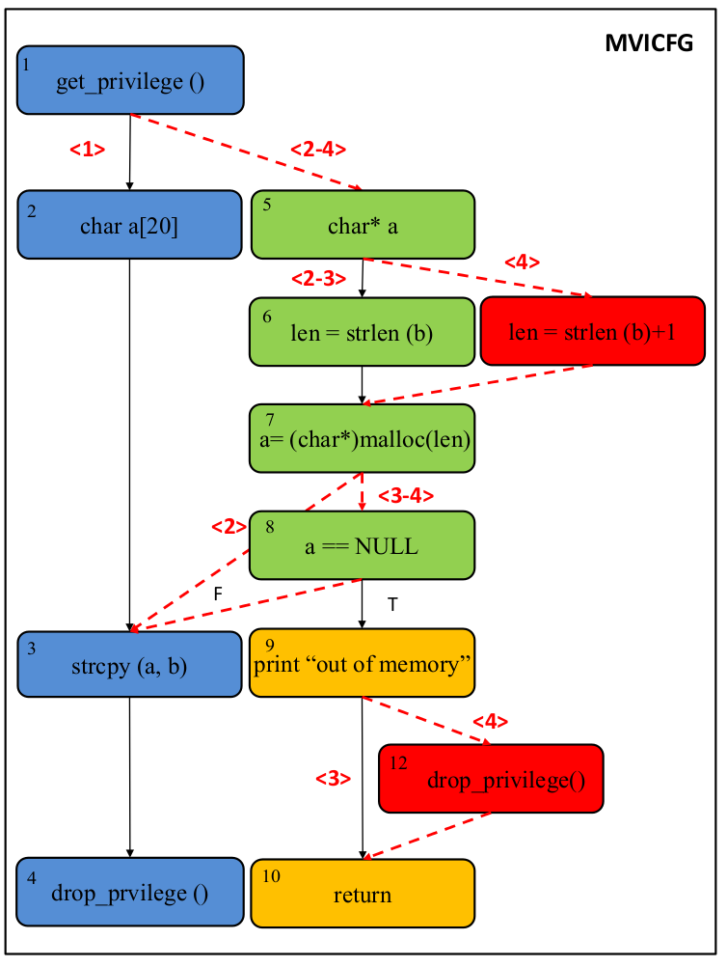
Changed Path
MVICFG Definition
A graph union of ICFGs (Inter-Procedural Control Flow Graphs) for a set program versions
Each statement and edge can belong to more than a version
Versions are marked on nodes/edges

Slide 10
Information Available on MVICFG
  Differences and commonalities of control flow and program paths between program versions
  A subgraph of the MVICFG for any m(1 ≤ m ≤ n) versions of programs
  Control, data and value flow as well as variable dependencies that originally belong to each version
  History information of program versions

Slide 11
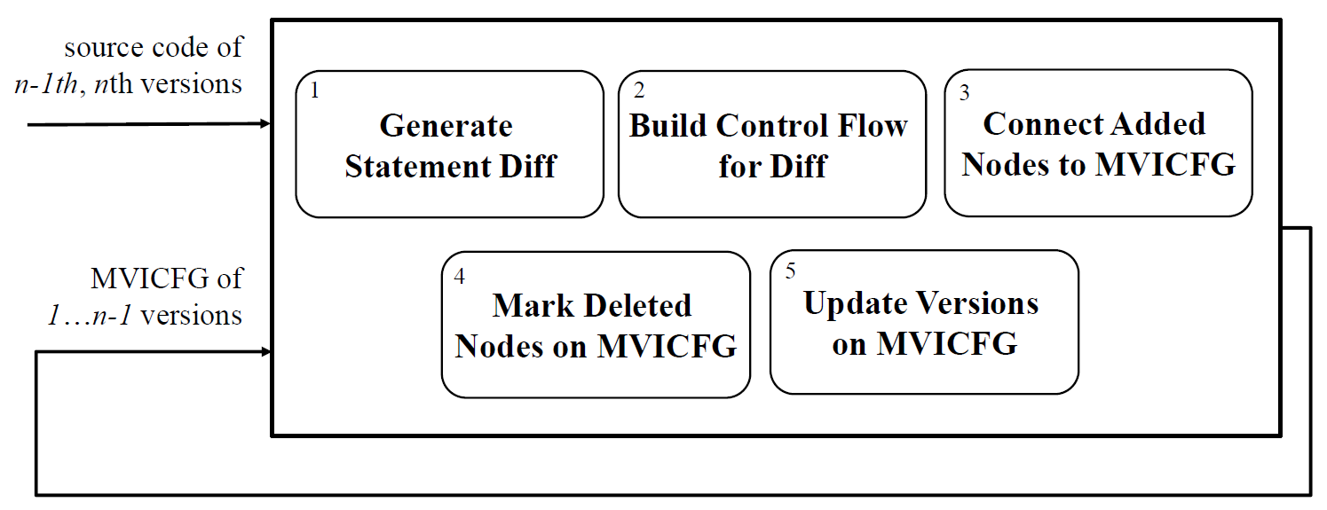
MVICFG Construction

Slide 12
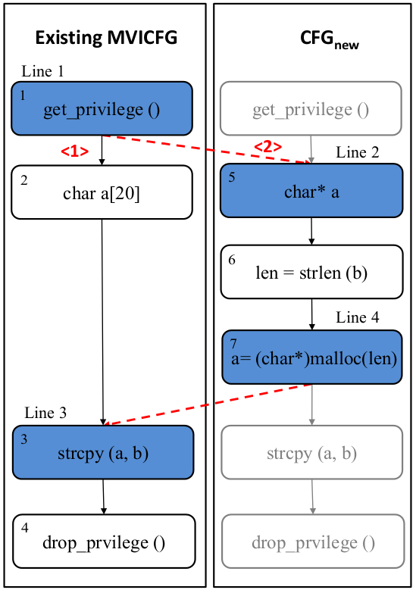
MVICFG Construction
    Step 1: Generate node (statement) diffs
    Classify changes: add/delete/update a function
    Normalize code
    Run longest common sequence (LCS) algorithm on old and new versions of functions
  Steps 2-5
diff v₂ v₁
2,4c2
< char* a;
< len = strlen(b);
< a= (char*)malloc(len);
---
> char a[20];

Slide 13
MVICFG Applications:
Demand-Driven Symbolic Analysis on MVICFG
Incremental Analysis
  Detecting Bugs in Changes
  Verifying Bug Fixes
Multiversion Analysis
  Determining Bug Impact for Multiple Releases
  Verifying Patches for Multiple Releases

Slide 14
Demand-Driven Symbolic Analysis on Single Versions
Resolution
bar();
s = (char*)malloc(80);
x[10] = ‘\0’;
if(strlen(t)<8)
strcpy(s,t);
else
strcat(x,t);
bar()
1
Info1
80/8>=len(t) len(t)<8 : safe
s = (char*)malloc(80)
2
Info2
size(s)>= len(t) len(t) < 8
x[10] = ‘0’
3
Info3
Safe
size(s)>= len(t) len(t) < 8
strlen(t) < 8
4
Info4
yes
no
5
strcpy(s,t)
Info5
strcat(x,t)
Info6
6
buffer overflow | buffer access | size(buf) >= len(str)
Query
size(s)>= len(t)

Slide 15
Demand-Driven Symbolic Analysis on Multiversion
Incremental Analysis: Does the Change Fix the Bug?
char a[20]
5
2
char* a
Still Buffer Overflow
<2-3>
Q [2]
l = strlen (b)
len(b)-1>=len(b)
6
{2} ∩ {2,3} = {2}
<2-3>
<1>
a= (char*)malloc(l*8)
Q[2]
7
value(l)>=len(b)
{2} ∩ {1} = ∅
{2} ∩ {2} = {2}
<3-4>
8
a == NULL
<2>
size(a)>=len(b)
Q [2]
{2} ∩ {3} = ∅
<3>
3
strcpy (a, b)

Slide 16
Does the Change Contain Bugs?
potentially faulty
Q[3] drop privilege?
Q[3] drop privilege?
Q[3] drop privilege?
Q[3] drop privilege?
Q[3] drop privilege?
V3
Fail dropping privilege

Slide 17
Multiversion Analysis:
Does the Bug Impact Multiple Releases
char a[20]
5
2
char* a
Impact V1-3
Impact V1
Impact V2
Q[1] 20>=len(b)
<2-3>
Q[2,3] len(b)-1>=len(b)
Q[2] len(b)-1>=len(b)
Q[1]
Q[2]
l = strlen (b)
6
{2} ∩ {2,3} = {2}
<2-3>
Q[2,3] value(l)>=len(b)
Q[2] value(l)>=len(b)
<1>
a= (char*)malloc(l*8)
Q[2]
7
{1, 2, 3} ∩ {1} = {1}
{1, 2, 3} ∩ {2} = {2}
<3-4>
8
a == NULL
<2>
Q[1, 2, 3]
{1, 2, 3} ∩ {3} = {3}
Q[3]
Q[1,2,3] size(a)>=len(b)
<3>
3
Q[3] size(a)>=len(b)
strcpy (a, b)

Slide 18
Multiversion Analysis:
Does the Patch correctly fix the bug
len(b)>=len(b) success
char a[20]
5
2
char* a
Q [4→3]
Q [4→2]
Q[1] 20>=len(b) not applicable
<2-3>
<4>
l = strlen (b)
9
6
len = strlen (b) +1
{4→2}
{4→3}
<1>
<2-3>
<4>
a= (char*)malloc(l*8)
Q [3]
Q [2]
7
{1,2,3} ∩ {2} = {2}
<3-4>
{3} ∩ {3,4} = {3}
Q[1,2,3] size(a)>=len(b)
8
a == NULL
<2>
Q [1,2,3]
{1,2,3} ∩ {3} =
Q [3]
<3>
3
strcpy (a, b)
Correctly Fixed Versions 2 and 3

Slide 19
MVICFG: Implementation and Results
  Goals: Demonstrate MVICFG can be built and useful
Experiments: 4 scenarios of patch verification
  Does patch correctly fix the bug?
  Does the change contain a bug?
  How many versions the bug can impact?
  Does the patch fix all the versions?
Benchmarks: gzip (5), putty (5), tightvnc(5), libpng (9), sir benchmarks (maximum 40 versions)

Slide 20
Constructing MVICFGs
Benchmark | V | LOC | Ave Churn | ICFGs | MVICFGs | T(s) | M(mb)
tcas | 40 | 81 | 4.5 | 6.6 k | 476 | 2.8 | 43.4
schedule | 9 | 134 | 6 | 2.4 k | 298 | 3.6 | 43.0
printtokens | 7 | 198 | 3 | 2.7 k | 413 | 0.5 | 43.3
gzip | 5 | 5.0 k | 242 | 6.8 k | 2.1 k | 15.1 | 60.9
tightvnc | 5 | 6.3 k | 457.3 | 10.3 k | 2.4 k | 30.3 | 106.1
libpng | 9 | 9.2 k | 1.4 k | 35.3 k | 8.4 k | 90.1 | 128.0
putty | 5 | 34.5 k | 8.2 k | 28.3 k | 13.3 k | 1844.5 | 310.5

Slide 21
Patch Verification on MVICFGs
Buggy-Version | Incremental Analysis |  |  |  | Multi-Version Analysis
 | Bugs | T(s) | Fixed | T(s) | Releases | Doc | Impacted | T(s) | Fixed | T(s)
gzip-1.2.4 | BO | 0.12 | Yes | 0.08 | 4 | 1 | 4 | 0.13 | 4 | 0.69
libpng-1.5.14 | IO | 0.28 | No | 0.24 | 6 | 2 | 6 | 0.48 | 0 | 1.45
libpng-1.5.14 | IO | 0.24 | Yes | 0.18 | 6 | 2 | 6 | 1.45 | 5 | 1.22
tighvnc- 1.3.9 | IS | 2.6 | Yes | 0 | 4 | 1 | 4 | 4.8 | 4 | 0
putty-0.55 | NULL-PTR | 20.0 | Yes | 0.07 | 3 | 1 | 1 | 26.1 | 1 | 0.09

Slide 22
Summary
MVICFG: a union of a set of ICFGs of multiple versions
Algorithm of constructing the MVICFG: identifying and integrating control flow differences
Applications of the MVICFG: patch verification
Tool Hydrogen and experimental results

Slide 23
Novelty and Importance of MVICFG
Representing differences and commonalities of control flow and program paths
Enabling easy applications of existing program analyses designed for single versions to detect semantics of changes and to verify changes
Making feasible longitudinal program analyses _{[Notkin02]} to correlate multiple program versions and to detect software evolution information, e.g., history slicing _{[Servant13]} bug origin
Facilitating online comparisons to determine changes and history of program properties

Slide 24
Thank you and Questions?

Slide 25
Detecting Bugs in Changes
Program | Total PFS | Change-based Demand-Driven Analysis |  |  | Cache-based Demand-Driven Analysis
 |  | PFS | T(s) | W | PFS | T(s) | W
tcas | 21 | 3 | 0.37 | 0 | 3 | 0.17 | 0
schedule | 68 | 8 | 10.9 | 0 | 1 | 0.67 | 0
printtokens | 56 | 6 | 0.85 | 0 | 3 | 0.005 | 0
gzip | 184 | 160 | 26.9 | 16 | 15 | 0.08 | 0
tightvnc | 1449 | 9 | 0.8 | 0 | 1 | 0.09 | 0
libpng | 3187 | 316 | 352.8 | 42 | 8 | 1.87 | 4
putty | 8127 | 1587 | - | - | 19 | 187.1 | 2

