Slide 1
HW2: Paper Abstract Generation
Start Date: 2025/03/18 now Deadline: 2025/04/08 23:59 [TA] Tzu-Ling Lin (林子淩)

Slide 2
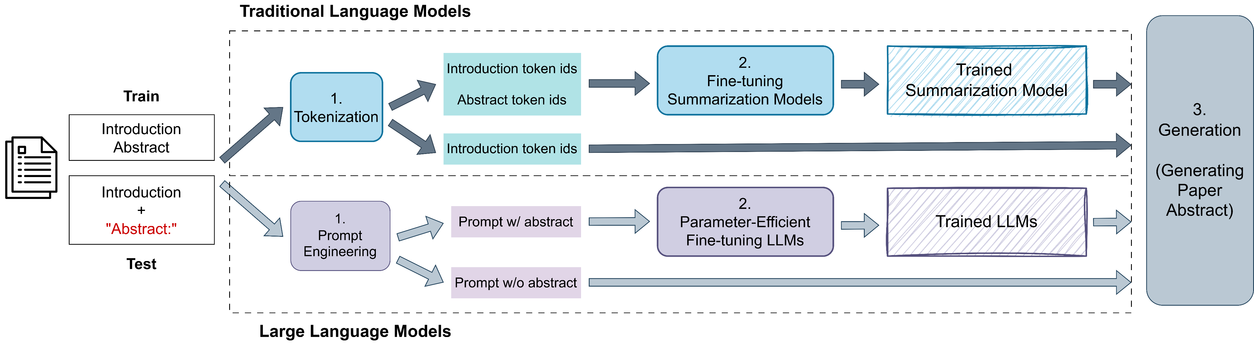
Task Overview

Slide 3
Lab Objective
In this homework, we aim to generate paper abstracts from paper introduction bodies. You should try to improve the quality of generated abstract to increase the performance.
The data files can be found in the E3 homework section.
We will have a two-stages submission. The first stage is optional and is to check the current performance. The final result should be submitted to the second stage submission, which will be used to calculate your final score.

Slide 4
Dataset Files
train.json: a text file with 408 json lines, where each line represents an individual row of data as follows:
paper_id: the index of paper.
introduction: parsed paper introduction in string format.
abstract: parsed paper abstract in string format.
test.jsonl: a text file with 103 json lines, where each line represents an individual row of data as follows:
paper_id: the index of paper.
introduction: parsed paper introduction in string format.
sample_submission.json: a sample submission file with 103 json lines, where there is a header and 103 rows of predictions.
paper_id: the index of paper.
abstract: parsed paper abstract in string format.

Slide 5
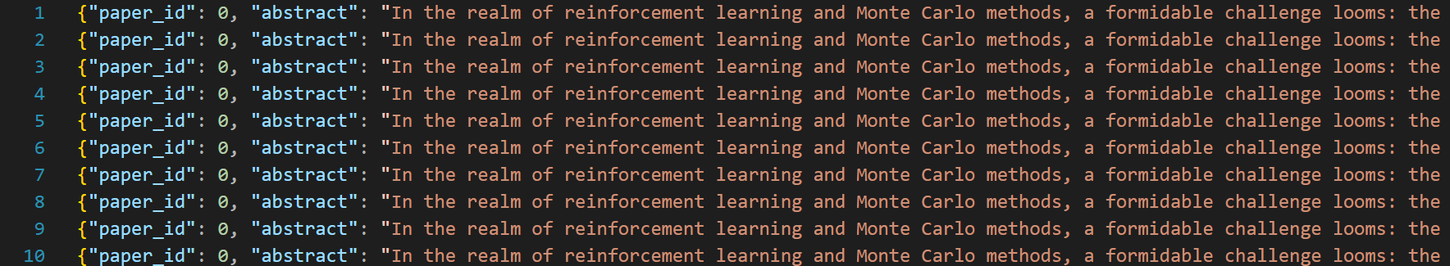
Submissions for first-stage (Optional) hard deadline: 03/25, 03/28, 04/01, 04/04, 04/06 23:59
Submit the prediction result named ‘{student_id}.json’ to E3. Please ensure the format follows the sample_submission.json.
It is recommended to submit the prediction within two checkpoint deadlines to check the current performance.

Slide 6
Submissions for 04/08 23:59 (Deadline)
Submit the prediction result named ‘{student_id}.json’ to E3. Please ensure the format follows the sample_submission.json or you will get zero point.
Submit ‘{student_id}.zip’ to E3. After unzipping, it should appear a folder {student_id} with the following structure:
{student_id}.zip
{student_id}_code (folder with codes that can reproduce your final result)
Model_checkpoint: provide the model checkpoint that can reproduce the test result.
requirements.txt: list the required libraries.
readme.md: explain how to reproduce your final .json result.
{student_id}.json: your final result (generated abstracts)
No need to include the datasets. Therefore, please clearly specify the expected location of the datasets. (if included, -5 points)

Slide 7
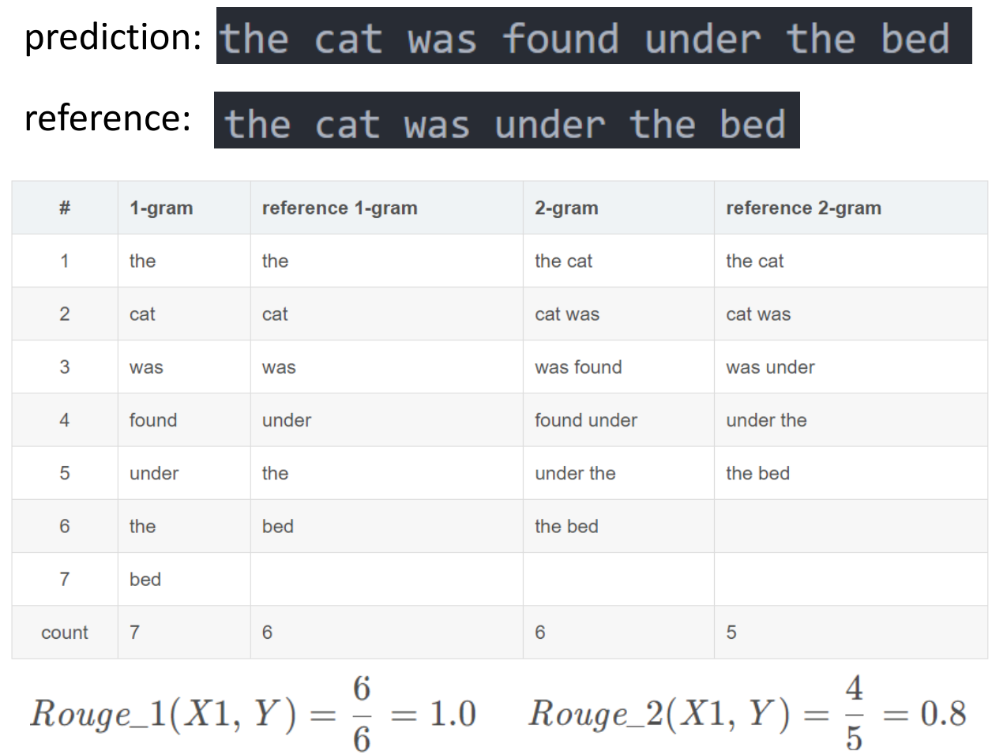
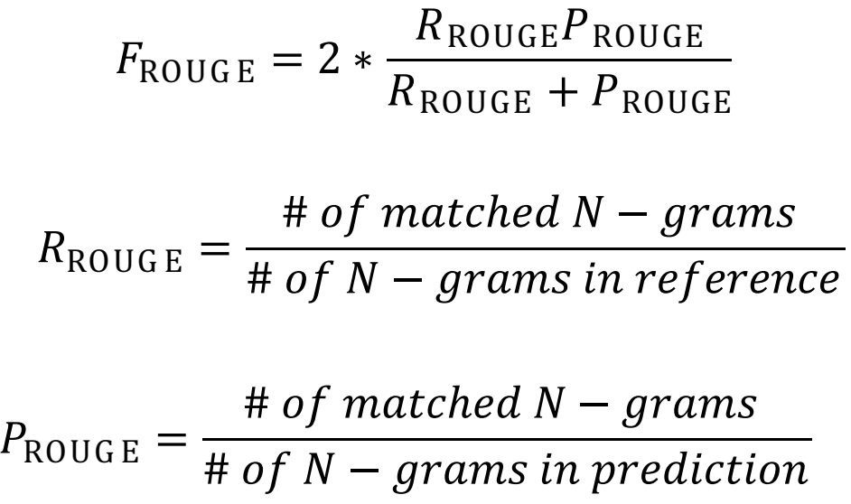
Evaluation Metrics – Rouge Score
ROUGE counts the number of overlapping units such as n-gram, word sequences, and word pairs between the computer-generated text to be evaluated and the references created by humans.

Slide 8
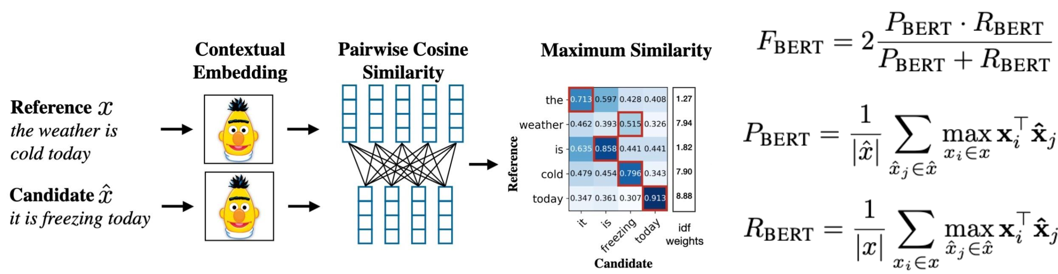
Evaluation Metrics – BERTScore
BERTScore computes a similarity score for each token in the candidate sentence with each token in the reference sentence using contextual embeddings.

Slide 9
Grading Policy
ROUGE (50 points) / BERTScore (50 points)
Top 10%: 100%
Top 25%: 90%
Top 50%: 80%
Top 75%: 75%
Other: 70%
Below baseline: 0%

Slide 10
Baseline
Here is the baseline performance. Please try to beat it!
Metric | Score
ROUGE-1 | 0.47
ROUGE-2 | 0.12
ROUGE-L | 0.22
BERTScore F1 | 0.85

Slide 11
Reference
Huggingface: https://huggingface.co/docs
BART summarization: https://medium.com/@sandyeep70/demystifying-text-summarization-with-deep-learning-ce08d99eda97
LoRA & QLoRA finetuning Llama: https://www.llama.com/docs/how-to-guides/fine-tuning/
PEFT finetuning: https://github.com/huggingface/peft
Unsloth finetuning guide: https://docs.unsloth.ai/get-started/fine-tuning-guide

Slide 12
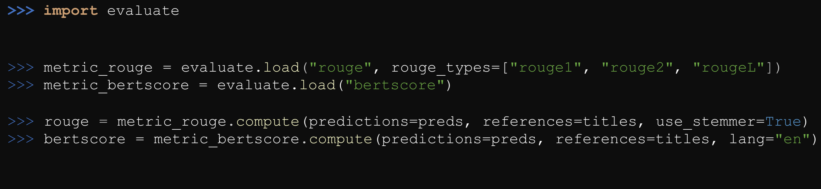
Reference
Evaluate: https://huggingface.co/docs/evaluate/a_quick_tour

Slide 13
Rules
Model Restriction:
To ensure ease of evaluation and fairness, you are only allowed to finetune models with fewer than 15 billion parameters. This helps us reproduce your results more conveniently and prevents model size from dominating performance comparisons.
Do not plagiarize. Write your own codes.
Do not use additional datasets.
Do not use API in this homework, train by your own.
Please follow the required submission format; otherwise will result in point deductions.
No late submission for first-stage submission.
Late submission for final submission: score*0.8

Slide 14
Contact & Information
Deadline: 2025/04/08 23:59
Please post you question on the E3 forum
[TA] Tzu-Ling Lin (林子淩): tzulinglin.11@nycu.edu.tw
[TA hours] 14:00-15:00 Wed. (Please make an appointment through email first.)

