Slide 1
Make an automatic pipeline to download and inport sequencs

Slide 2
Background
We have done RNA sequencing and selected 100 significant genes for further experiment validation
The cDNA clone of the 100 genes were bought from OriGene company
We will sub-clone the genes into our expression vector using a universal primer pair
Usually we copy the gene sequence and paste into the expression vector manually
This project is to make an automatic pipeline to download the sequence and export into word file with original vector and sub-cloned vector information

Slide 3
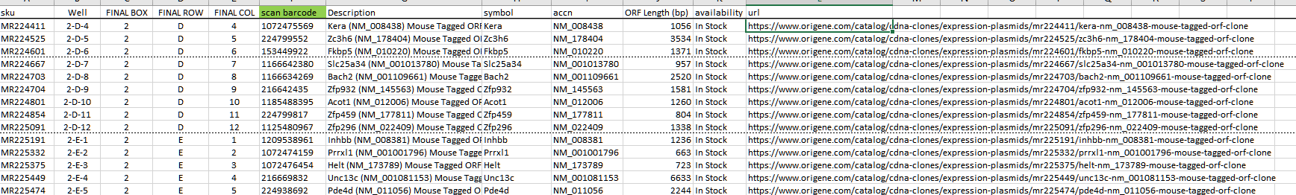
Excel file with cDNA clone information
https://www.origene.com/catalog/cdna-clones/expression-plasmids/mr224411/kera-nm_008438-mouse-tagged-orf-clone

Slide 4
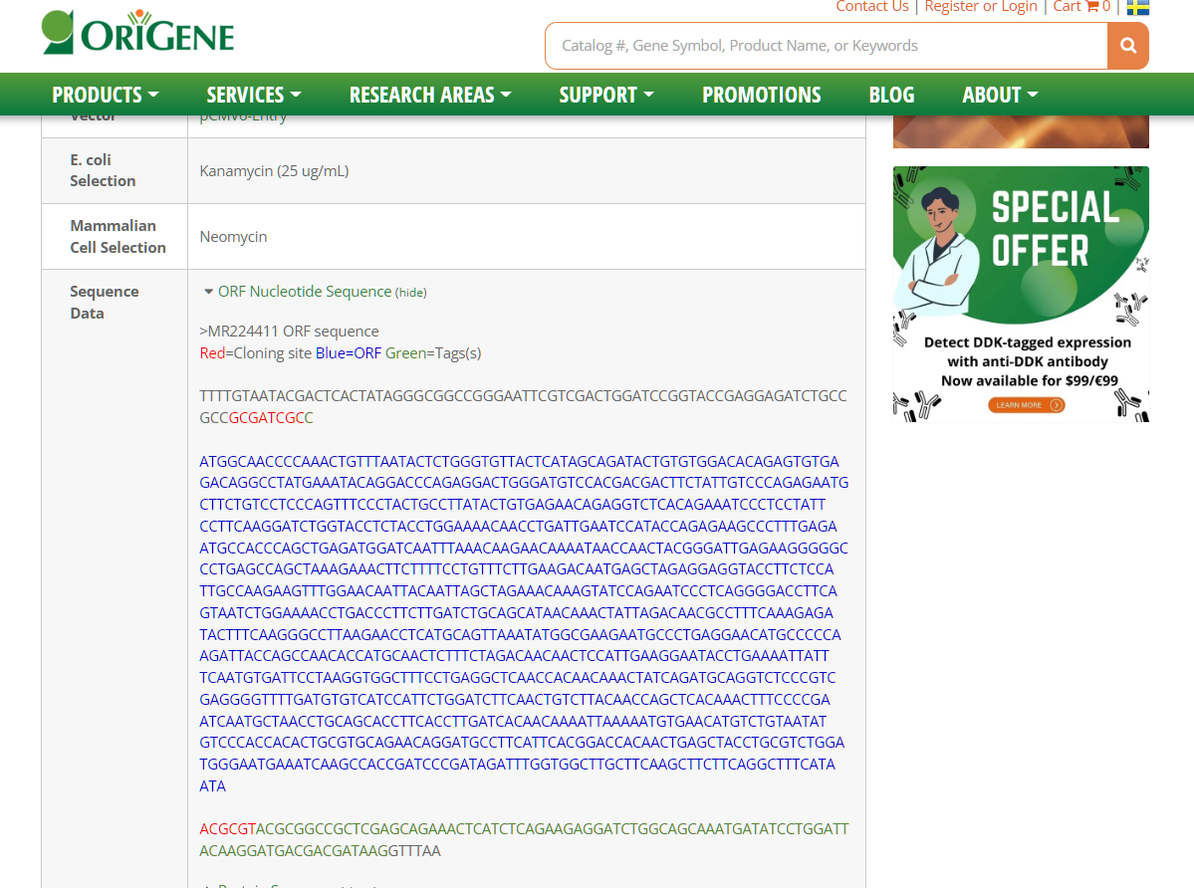
https://www.origene.com/catalog/cdna-clones/expression-plasmids/mr224411/kera-nm_008438-mouse-tagged-orf-clone
Webpage with sequence information

Slide 5
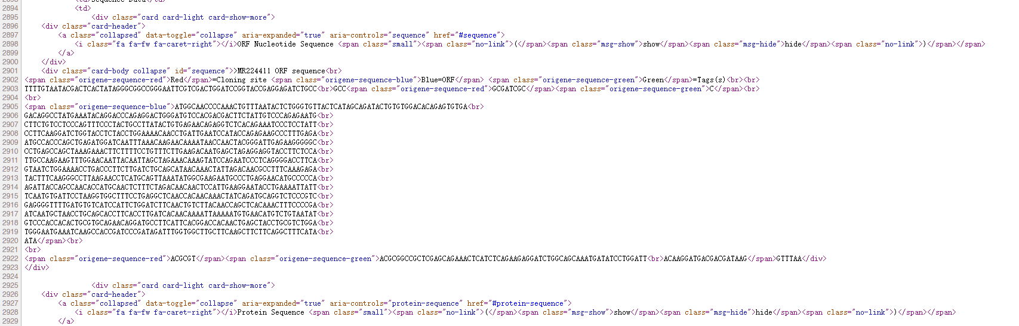
Source page of the information

Slide 6
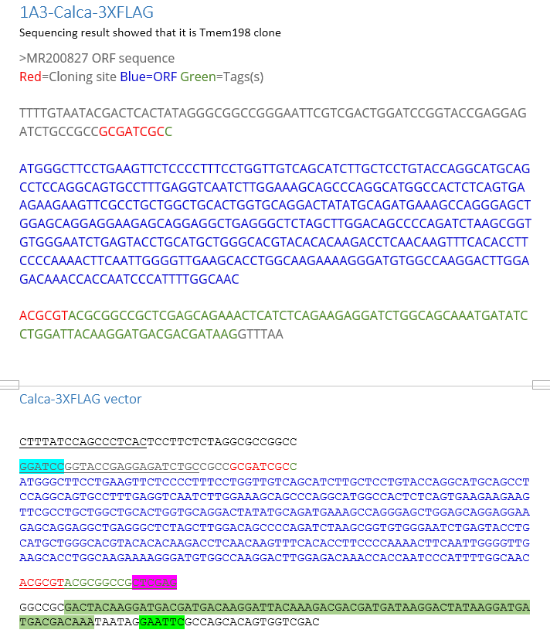
Export to word file or text file
Copy the original sequence
from the webpage
Export the sequence into cloned vector

Slide 7
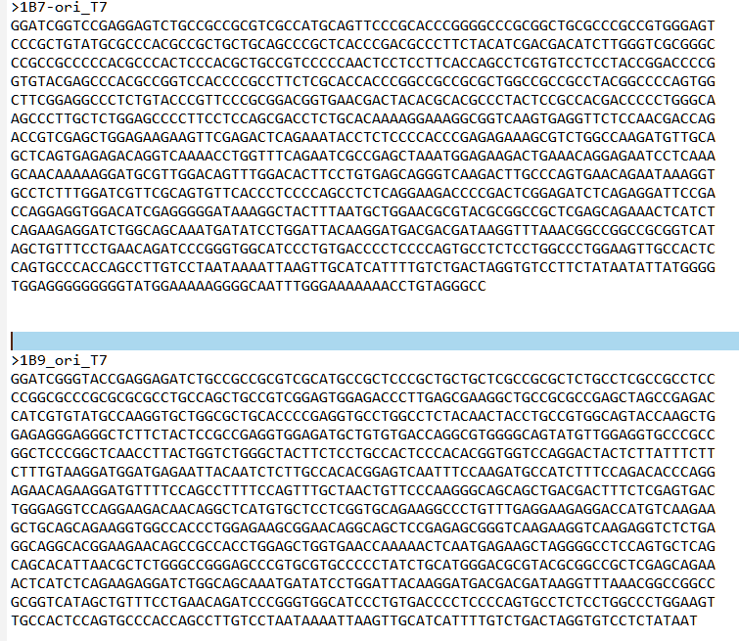
Further function if possible
We will sequence the sub-cloned vector and do sequence alignment to verify this vector
Write a program to do the alignment automatically

