Slide 1
Code and Paper
The code mainly investigates the effect of Field of view, channel range, Bit rate, pointing errors on BER, so the independent variables are field of view, channel range, bit rate and pointing error, and the dependent variable is the average BER.
The paper provided model to calculate the instantaneous BER and the average BER.
The bit power need to improve when the channel range increasing.
Pointing error :Tx position displacement and angular misalignments
Noise: solar radiation, thermal noise (related variables: field of view, temperature, Spectral radiance)
Channel loss: diffuse coefficient of atenuation for clear waters
There is a trade off between geometric loss and concentrator gain(related to Tx FoV)

Slide 2
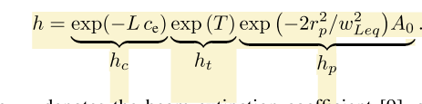
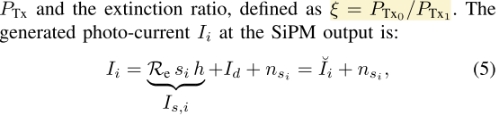


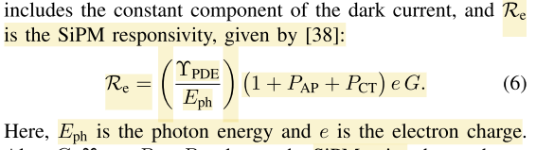

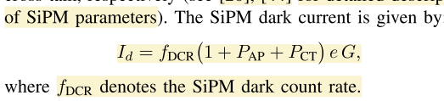
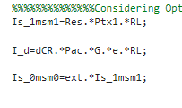
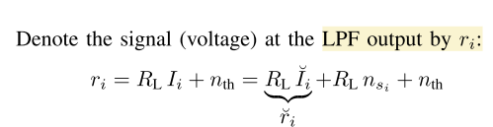

Main function and related code

Slide 3
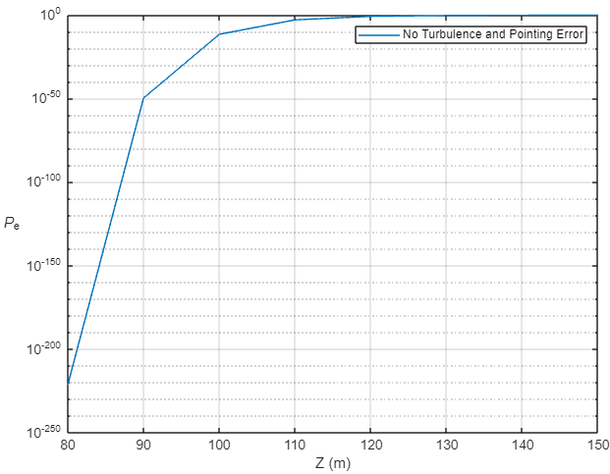
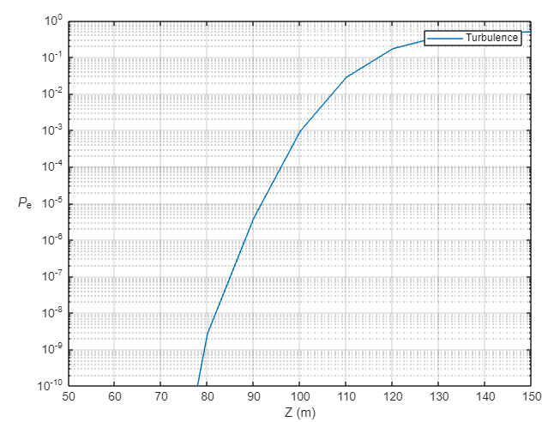
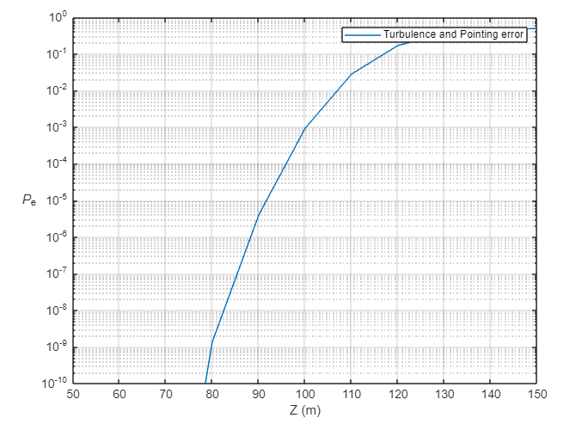
The effect of channel range
The effect of Channel range on BER,
If don’t considering the effect of turbulence and point error, the BER will increase rapidly with channel range increasing.

Slide 4
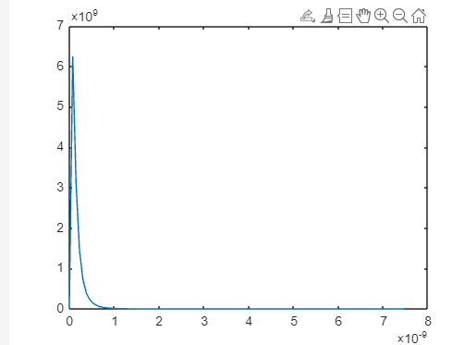
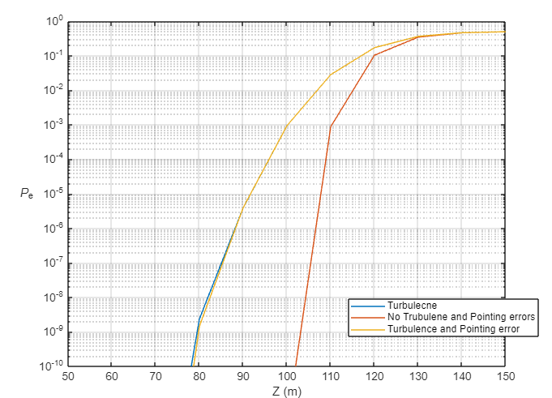
The effect of channel range
When the channel range increase, pointing error increase, need to increase the beam width or increase the field of view.
But when we increase the field of view, the received solar radiation is increased two
Distribution of the channel attenuation
coefﬁcient (without pointing error)
When the channel range increase, the BER increased rapidly because of channel loss, turbulence and misalignment

Slide 5
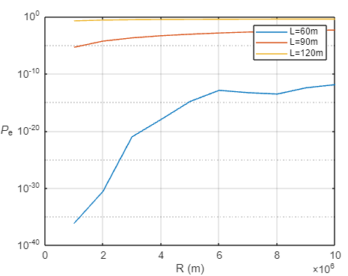
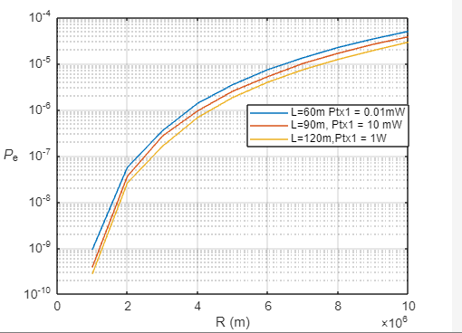
The effect of bit rate
Here, I didn’t increase the bit power when channel range increase.
When L =120, the BER is bad
There is another mistake: For different range, the affect of turbulence should be different.
Mistake: For different length, the power should be different.
If power is fixed, the beam can’t arrive the Rx when the range increase.

Slide 6
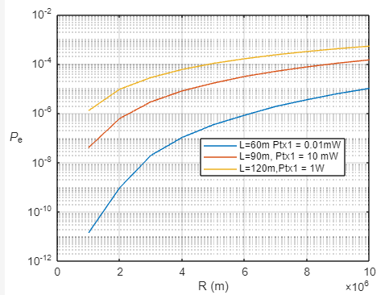
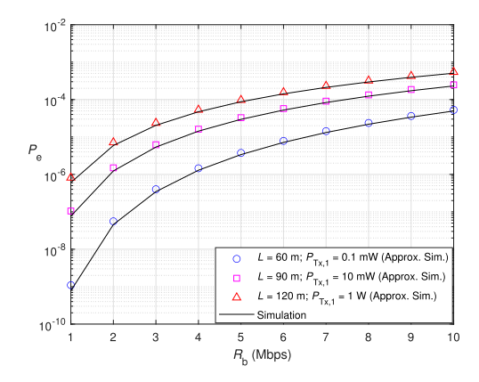
Notes: For L = 60, 90 and 120 m, we have, σ2T = 0.7032, 0.9872, and 1.21 respectively
Reproduce
origin
Effect of data rate Rb and link range L on BER.
negligible PEs and solar noise.

Slide 7
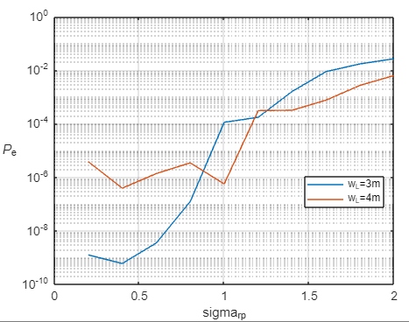
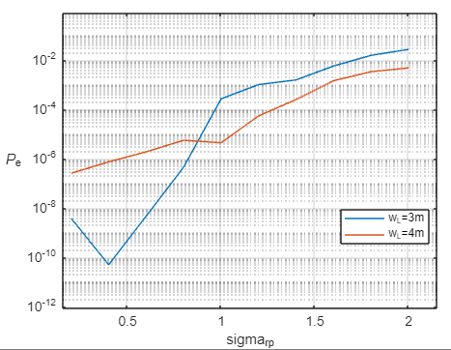
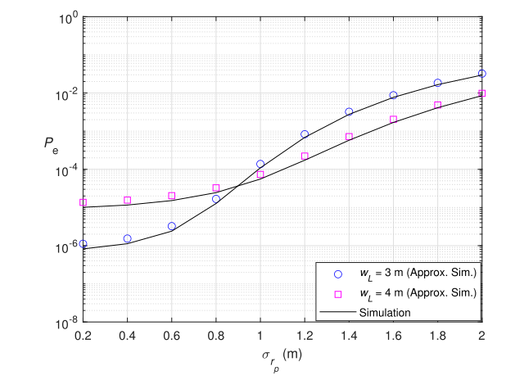
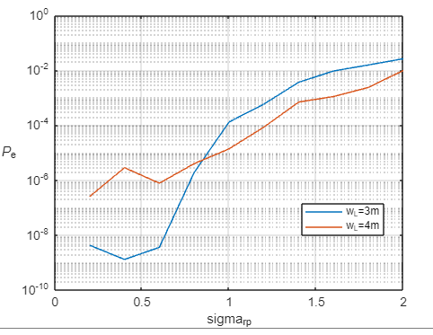
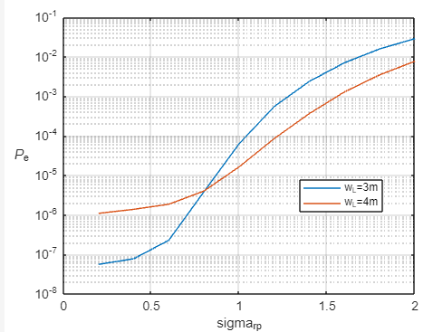
Length = 10^4
When signal length is short, the simulation would be unstable, but it has a trend
Length = 10^7
Origin
Reproduce
Effect of jitter variance σrp(displacement) and beam width wL on BER
Wide beam width can reduce the effect of pointing errors

Slide 8
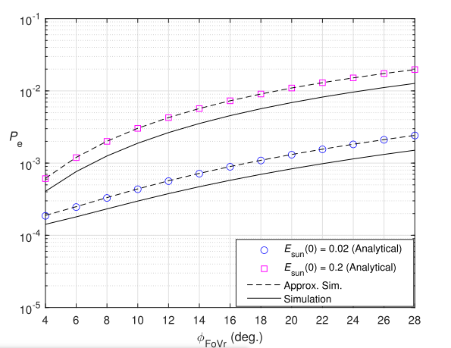
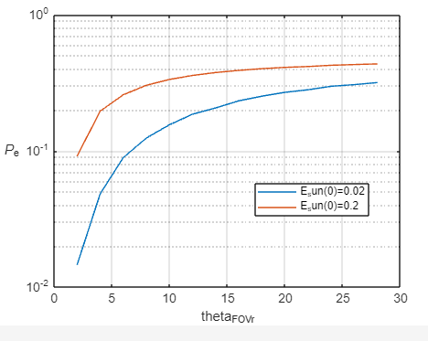
Effect of field of view
Fixed parameters: Wavelength, OOK extinction ratio…
There is something wrong with the simulation
Reproduce
Origin
Field-of-view mainly affect the background radiations: background noise
Taking into account solar radiation

