Slide 1















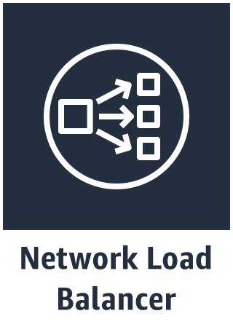
AWS User Account
AWS-Managed Account
Region
VPC
Internet Gateway
EKS Control Plane
Availability Zone 1
Subnet 1
Auto-Scaling Group
Availability Zone
Elastic Network Interface
Worker Nodes
Master Node 1
Availability Zone
Worker Nodes Security Group
Availability Zone 2
Control Plane Security Group
EKS API Server Endpoint
Subnet 2
Master Node 2
Availability Zone
Worker Nodes
Elastic Network Interface
Master Node 3

