Slide 1
Iteration | Task ID | Name | Duration | Predecessor
1 | 1 | Plan Project | 1 | -
1 | 2 | SQL Scripts | 1 | 1
1 | 3 | Login function (+ CSS) | 1 | 1
1 | 4 | 6 CSV DAOs & Classes | 2 | 1, 2
1 | 5 | Student & Admin index.php | 1 | 3, 4
1 | 6 | Bootstrap function | 6 | -
1 | 6_1 | Student.csv validation Course.csv validation | 2 | 5
1 | 6_2 | Section.csv validation Prerequisite.csv validation | 2 | 5, 6_1
1 | 6_3 | Course_completed.csv validation Bid.csv validation | 2 | 5, 6_1, 6_2
1 | 7 | Combine bootstrap function | 1 | 6_1, 6_2, 6_3
1 | 8 | Logout function | 1 | 4, 5
1 | 9 | Prepare bug metrics & test plan | 3 | 7, 8
1 | 10 | Prepare PM review deliverables | 2 | 9

Slide 2
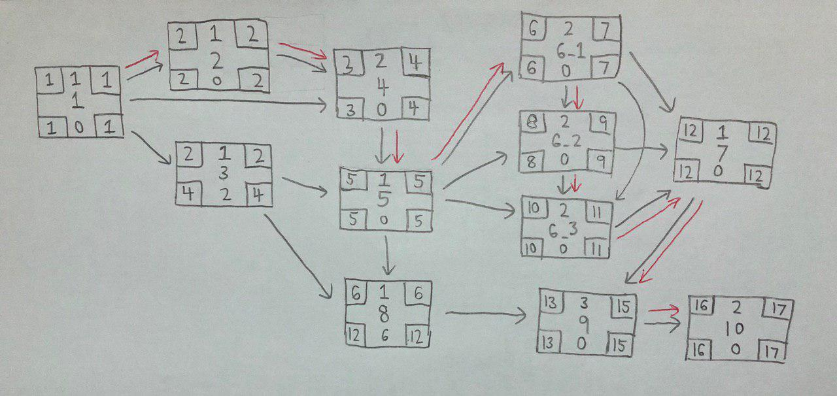

Slide 3
Iteration | Task ID | Name | Duration | Predecessor
2 | 1 | Place bid function | 3 | -
2 | 1_1 | Check active bidding round Check invalid inputs Check bidding round number Check for clash in class & exam timetables | 3 | -
2 | 1_2 | Check if student has fulfilled pre-requisite courses Check e-credits for students Check if student has bid for same course | 3 | -
2 | 2 | Combine place bid function | 1 | 1_1, 1_2
2 | 3 | Drop bid function Check active bidding round Check if student has existing bid | 3 | 2
2 | 4 | Drop section function Check active bidding round Check if student has enrolled in section Check for valid section input | 3 | 3
2 | 5 | Prepare bug metrics & test plan | 3 | 2, 3, 4
2 | 6 | Prepare App Demo deliverables | 2 | 5

Slide 4
