Slide 1
Iteration | Task ID | Name | Duration | Predecessor
1 | 1 | Plan Project | 1 | -
1 | 2 | SQL Scripts | 1 | 1
1 | 3 | Login function (+ CSS) | 1 | 1
1 | 4 | 6 CSV DAOs & Classes | 2 | 1, 2
1 | 5 | Student & Admin index.php | 1 | 3, 4
1 | 6 | Bootstrap function | 6 | -
1 | 6_1 | Student.csv validation Course.csv validation | 2 | 5
1 | 6_2 | Section.csv validation Prerequisite.csv validation | 2 | 5, 6_1
1 | 6_3 | Course_completed.csv validation Bid.csv validation | 2 | 5, 6_1, 6_2
1 | 7 | Combine bootstrap function | 1 | 6_1, 6_2, 6_3
1 | 8 | Logout function | 1 | 4, 5
1 | 9 | Prepare bug metrics & test plan | 3 | 7, 8
1 | 10 | Prepare PM review deliverables | 2 | 9

Slide 2
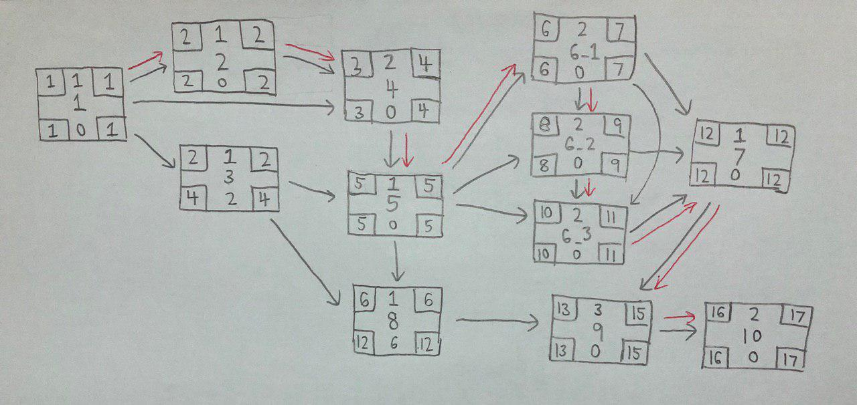

Slide 3
Iteration | Task ID | Name | Duration | Predecessor
2 | 1 | Place bid function | 3 | -
2 | 1_1 | Check active bidding round Check invalid inputs Check bidding round number Check for clash in class & exam timetables | 3 | -
2 | 1_2 | Check if student has fulfilled pre-requisite courses Check e-credits for students Check if student has bid for same course | 3 | -
2 | 2 | Combine place bid function | 1 | 1_1, 1_2
2 | 3 | Drop bid function Check active bidding round Check if student has existing bid | 3 | 2
2 | 4 | Drop section function Check active bidding round Check if student has enrolled in section Check for valid section input | 3 | 3
2 | 5 | Prepare bug metrics & test plan | 3 | 2, 3, 4
2 | 6 | Prepare App Demo deliverables | 2 | 5

Slide 4
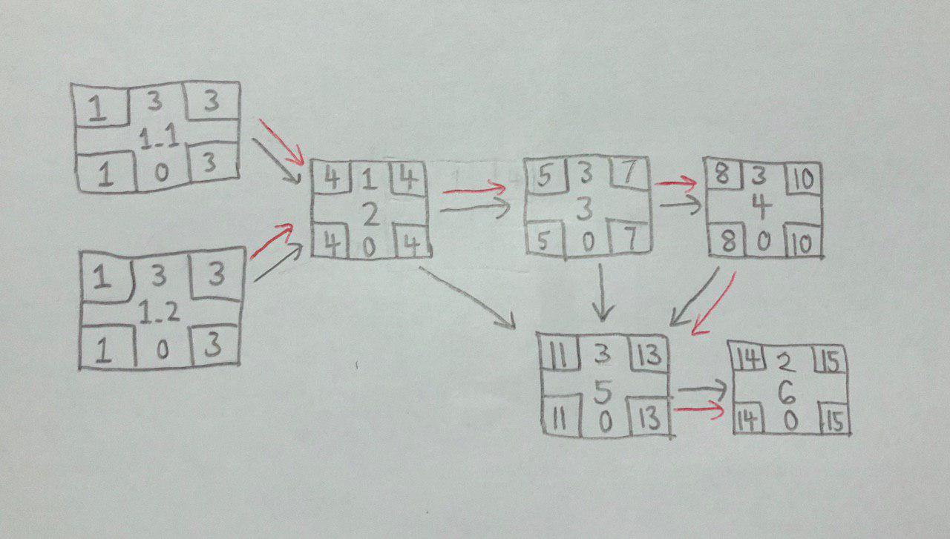

Slide 5
Week 9-11
Iteration | Task ID | Name | Duration | Predecessor
3 | 1 | Start round function Check bidding round Check active bidding round
3 | 2 | Clearing rounds function
3 | 2_1 | Round 1 clearing function Sort bids from highest to lowest Derive minimum clearing price
3 | 2_2 | Round 2 clearing function Sort bids from highest to lowest Total available seats Find out minimum bid value Re-compute minimum bid value
3 | 3 | Prepare bug metrics & test plan
3 | 4 | Prepare for UAT

Slide 6
Critical Path Analysis – Iteration 3

Slide 7
Week 11-13
Iteration | Task ID | Name | Duration | Predecessor
4 | 1 | Prepare more test cases
4 | 2 | Debug
4
4
4
4

Slide 8
Critical Path Analysis – Iteration 4

Slide 9
Iteration | Task ID | Name | Duration | Predecessor
5 | 1 | Prepare slides for final presentation
5
5

Slide 10
Critical Path Analysis – Iteration 5

Slide 11
Roles & Responsibility | Iteration 1 (Week 5 - 7) | Iteration 2 (Week 7 - 9) | Iteration 3 (Week 9 - 11) | Iteration 4 (Week 11 - 13) | Iteration 5 (Week 14)
Project Manager | Jiayu | Wei Chen | Shermin | Wei Ling | Geralyn
Pair 1 | Wei Chen, Shermin | Jiayu, Shermin | Wei Chen, Wei Ling | Wei Chen, Shermin | Wei Chen, Wei Ling
Pair 2 | Geralyn, Wei Ling | Geralyn, Wei Ling | Geralyn, Jiayu | Geralyn, Jiayu | Jiayu, Shermin
Pair 3 | - | (SPECIAL PAIR) | - | - | -
Dates | 16/09 – 03/10 | 04/10 – 17/10 | 18/10 – 31/10 | 1/11 – 14/10 | 15/11 – 21/11
Milestones | 03/10: PM Review | 17/10: App Demo & Progress Update | 31/10: UAT | Week 13: Final Submission | Week 14: Final Presentation

