Slide 1

Optimizing Energy Efficiency in Modern Computing Systems through Advanced Architectural Techniques
by Yu-Yang Ting and Wei Chen
Notes:
Good afternoon guys. Today we gonna introduce how to improve energy efficiency in modern computing system

Slide 2
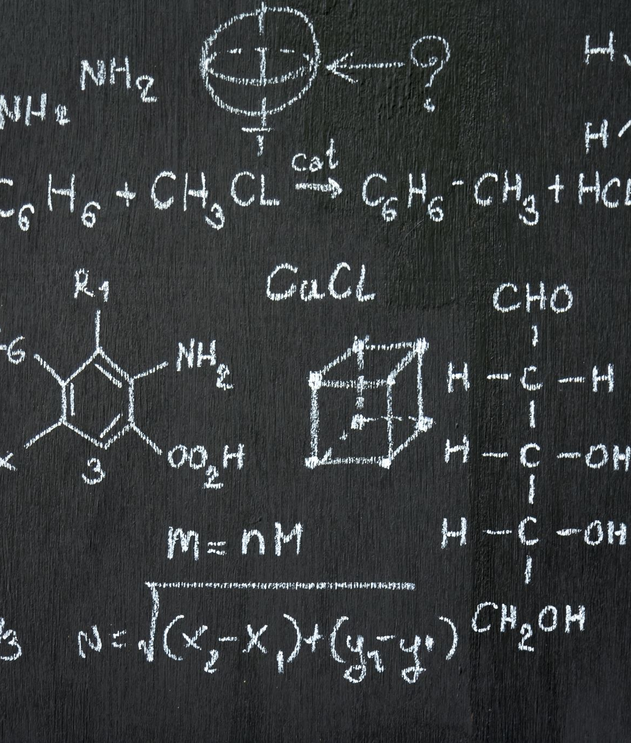
Outline
Introduction
NUMA Optimizations
NUMA Background
NVMe SSDs on NUMA
Energy-efficient I/O Scheduler (ESN)
DVFS Optimization
Mechanism of DVFS
Factor Affecting DVFS
Effectiveness of DVFS
Prediction Modeling – Mechanism & Effectiveness
Discussion & Conclusion
Notes:
Today, we're going through these two topics, which is NUMA optimization and DVFS Optimization. I will cover the first half part, and my partner will cover the rest of parts.

Slide 3
Introduction

Slide 4


Why we care about energy?
Environmental Impact
Economic Costs
Notes:
Environmental Impact: The most immediate concern is the environmental footprint of high energy consumption. Powering data centers, computers, and other tech gadgets emits a significant amount of greenhouse gases if the energy comes from fossil fuels. Reducing energy use helps combat climate change
Economic Costs: Energy isn't free. The cost to power servers, data centers, and personal devices adds up quickly for businesses and individuals. More energy-efficient systems mean lower electricity bills and operational costs, In today's world, where tech is booming and we're crunching more data than ever, figuring out how to make computers use less energy without slowing them down is a big deal. Everyone's looking into how to do computing better and less power but still speedy.
So, our project is a survey on papers aiming to improve energy efficiency. Compared with the techniques we've learned in this class, the following techniques we're going to introduce stand out due to their innovative approaches to reducing power consumption while maintaining or even improving computational speed and efficiency. Let's dive into these cutting-edge methods

Slide 5
NUMA Optimizations
NUMA Background
NVMe SSDs on NUMA
Energy-efficient I/O Scheduler (ESN)
Notes:
Now, I wanna introduce the NUMA Optimization. But before that, let's talk about NUMA

Slide 6
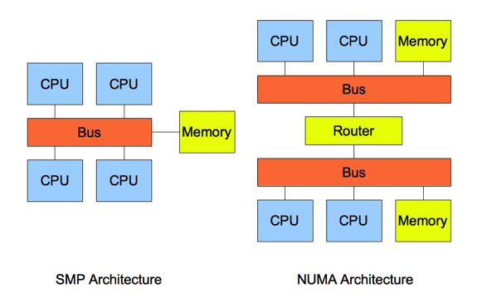
What is NUMA?
SMP:
SMP systems have CPUs sharing the same memory resources via a single memory bus.
Ensures equal memory access speeds for all processors, hence "symmetric."
Memory access conflicts increase with the number of CPUs, reducing efficiency and performance.
Non-Uniform Memory Access (NUMA) :
NUMA divides CPUs into multiple nodes, each with its own independent memory space.
Allows for high-speed interconnect communication between nodes.
CPU memory access speed varies depending on the node: local node access is fastest, remote node access is slower.
Efficiency suffers when accessing memory from remote nodes due to slower speeds.
Notes:
We have learned the SMP in this class,right? Remember that? all techniques we've learned are trying to reduce Memory access conflicts, but the modern computing system having more and more cpus, so the access conflicts rate getting higher. To fix the problem, NUMA comes out.
NUMA refers to Non-Uniform Memory Access, it divides CPUs into multiple nodes. Each node with it's own memory space. Also, it allows for high speed communication between nodes.
But efficiency suffers when accessing memory from remote nodes due to the slower speeds

Slide 7
NUMA Optimizations
NUMA Background
NVMe SSDs on NUMA
Energy-efficient I/O Scheduler (ESN)
Notes:
After knowing the basic concept about NUMA, let's dive into NVMe SSD on NUMA.

Slide 8
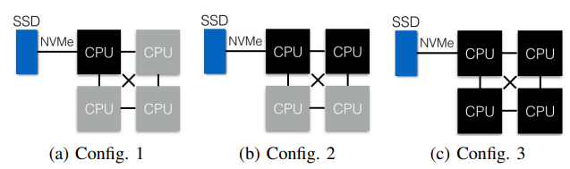
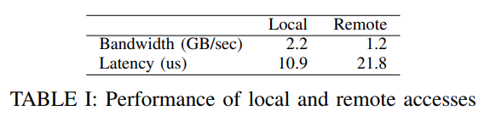
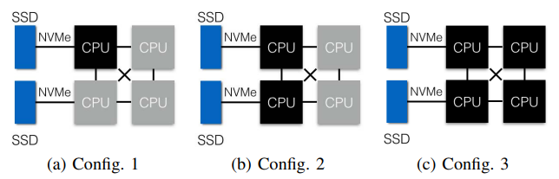
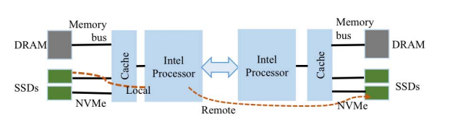
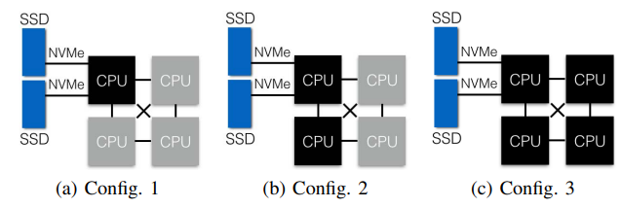
Different NUMA configurations
Slower!
Notes:
In this slide, you can see 3 different topologies of NUMA-SSD .
In first topology, we connect single SSD to 1 CPU node.
Second one is connect two SSD seperately to 2 CPU nodes.
The last one is two SSDs attached to single CPU node.
Also, the remote access will take longer time to access the data, and cause more mem access conflicts.
If we want better performance and efficiency , we must reduce the contention and mem access conflicts.

Slide 9
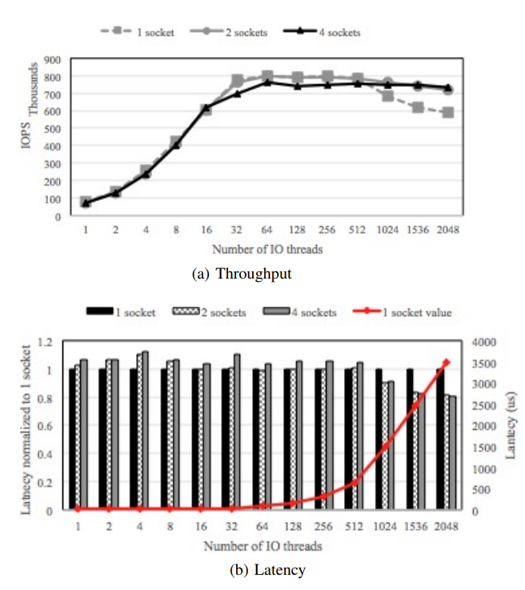
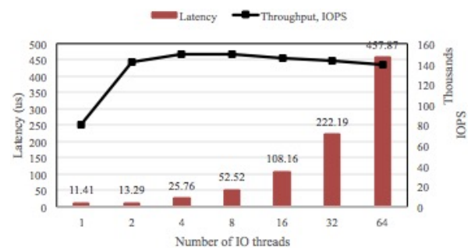
Single NVMe SSD System
I/O threads exceeding 512
Higher contention penalties than remote access penalties.
Utilizing neighboring CPU sockets
Reducing contention by supporting additional I/O threads.
Notes:
Let's see single SSD on NUMA.
In these two charts , you can see that when I/O threads exceed 512 threads, the throughput is lower and the lantency is higher in the fist conf.

Slide 10
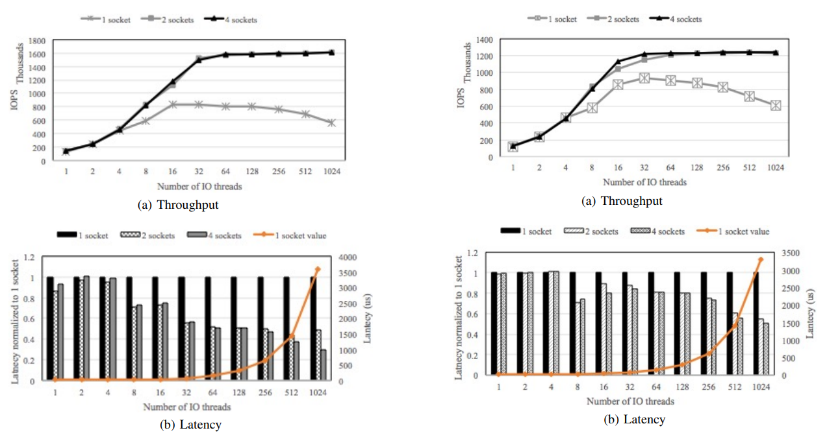
Two NVMe SSDs System
No remote access, but more contention penalty
More remote access, few contention penalty
More remote access, more contention penalty
few remote access, few contention penalty
~1600 IOPS
~800 IOPS
~1200 IOPS
~850 IOPS

Slide 11
NUMA Optimizations
NUMA Background
NVMe SSDs on NUMA
Energy-efficient I/O Scheduler (ESN)

Slide 12
Can we reduce latency?
YES!!
We can do a better scheduler!
Energy-efficient I/O Scheduler (ESN)
Before ESN...let's talk about scheduler

Slide 13
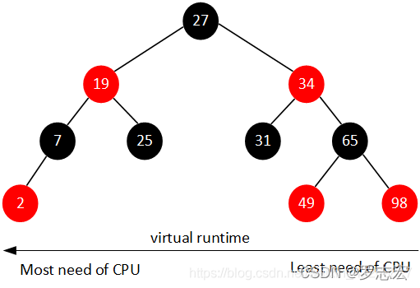
Default scheduler on Linux - CFS
CFS uses a red-black tree for task scheduling, prioritizing tasks with lower virtual runtime (vruntime).
Tasks with smaller vruntime are placed to the left, allowing for quick selection of the next task to run.
CFS ensures fair CPU time.
Ignoring memory access latency and inter-node bandwidth impacts performance in NUMA environments.

Slide 14
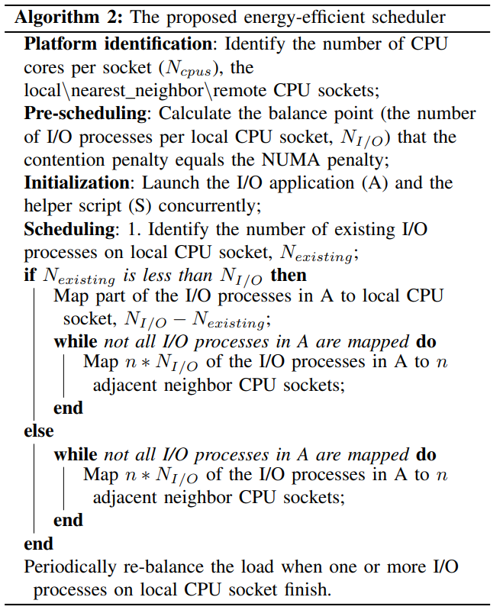

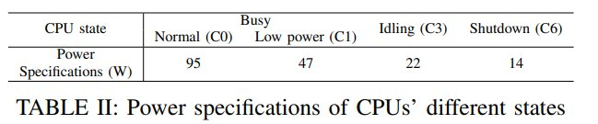
Energy-efficient I/O Scheduler (ESN)
N is the number of I/O processes
Notes:
In the 2017 study titled "Energy-efficient I/O Thread Schedulers for NVMe SSDs on NUMA", the authors proposed a new scheduler –ESN.
In this table here, you can see the different power consumption of different states of CPU, If we wanna reduce energy comsumption, we don't want all CPUs are at the Normal state. So the purpose of this algorithm is to map more I/O threads to the same CPU while taking into account performance issues. When all threads are mapped, then we can idling another cpus to reduce power consumptions.

Slide 15
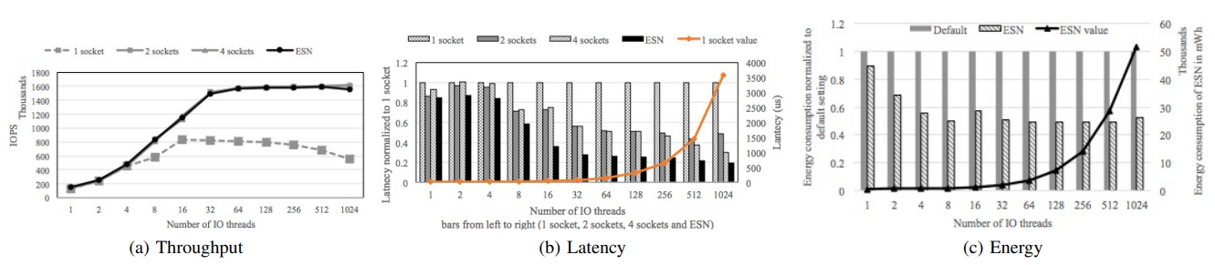
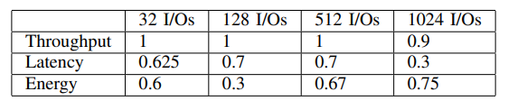
ESN Cont'd
ESN/CFS
Notes:
As compared to the default scheduler, ESN can deliver equivalent parallel I/O performance, while consuming up to 50% less energy by idling CPUs that cannot contribute to better throughput performance

Slide 16



DVFS Optimization
Mechanism of DVFS
Factor Affecting DVFS
Effectiveness of DVFS
Prediction Modeling
Mechanism
Effectiveness
Notes:
Thanks for Wei introducing how NUMA works. It's kinda cool uh. A single SSD could have an algorithm to make it more efficient! Now let me guide you dive into the world of DVFS, which I will talk about both hardware and software side.

Slide 17
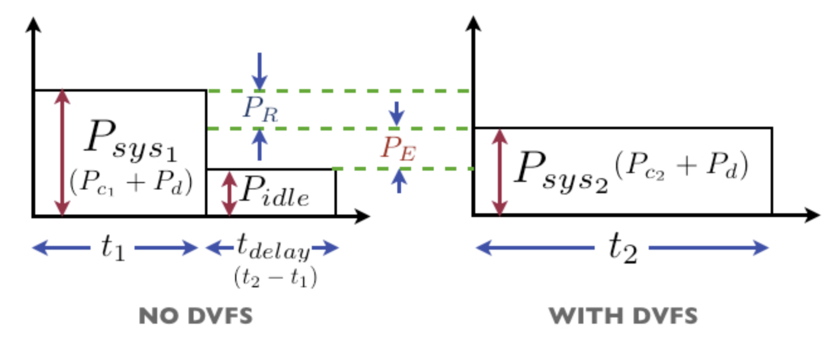
Mechanism of DVFS
Dynamic Voltage and Frequency Scaling (DVFS) operates on the principle of adjusting the voltage and frequency settings of a processor dynamically to match the processing demands of a system at any given time, leading to significant reductions in power consumption.
Notes:
DVFS stands for Dynamic Voltage and Frequency Scaling (DVFS).
Adjusting the voltage and frequency of a processor settings of dynamically to match the processing demands.
This tech leads to significant reduction in power consumption
See the image in the right side.
There are two systems, system is without DVFS, system has applied DVFS
I want to introduce several important parameter first.
The P stands for the power consumption /P c– cpu / Pd-other devices
-The t stands for the time
As we can see from the image, the area of the system represents the power consumption
So, if the area with DVFS is smaller than the regular system, that means there would be energy savings.
………………
Lower frequency will require more time to execute processes.

Slide 18
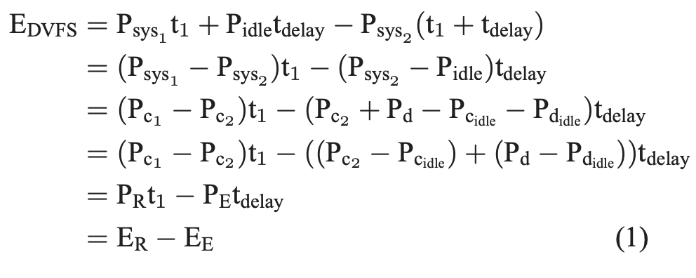
Mechanism of DVFS
The energy reduction (ER) comes from the reduction in CPU power consumption offset by the extra energy (EE) consumed due to increased execution time and additional device activity during this period.
It means even the processor uses DVFS but still requires enormous time to execute instructions, the effectiveness of DVFS will be less significant.
Notes:
Just like I said the energy savings comes from the difference of two area.
How could there be a difference between them?
The answer comes from the reduction in CPU power offset the extra energy.
Why there is extra energy?
Go back to the figure.
The increased executing time and additional device activities should be taken into account because they all consume power.
So the point is even though using DVFS could help save power, the long execution time will make the effectiveness of DVFS less significant.

Slide 19

Factors affecting DVFS
Performance Delay
– CPU Bound Task / Memory Bound Task
Notes:
Memory bound task means the cpu will access memory more frequently
Cpu bound task means the workload is largely depending on the CPU.
However, these tasks will be affected by using DVFS due to the lower cpu frequency.
It will take more time to execute the processes.
For the cpu bound task, due to the low frequency, the time of delay will be higher
Compaer to cpu bound task, memory bound task requires more memory access, depending more on the speed of I/O
The time of delay is not as significant as cpu bound task, which we will see the result later.

Slide 20

Factors affecting DVFS
Impact of Processor Features
-Lower memory latency
Lower Idle CPU Power Consumption
- C1 / C6 state
Power Consumption of Other System Components
-Software, External Devices, Ram, Hard Disk
Notes:
Lower memory latency would be great for the memory bound task, the delayed time could be lower.
APIC: Advanced Programmable Interrupt Controller, using to manage interrupt signals.
It’s originally from intel, but has applied on the modern processor universally.
C1 : Cores stops from executing instructions via software; bus interface unit and APIC are kept running at full speed.
C6 : Core has no power, the voltage is set to nearly 0.The cores stay in really low frequency. CPU restores state from SRAM (More advanced and save more energy) Once the frequency, the energy saving applying DVFS will be less significant.
External Devices: Mouse, portable SSD, keyboard

Slide 21
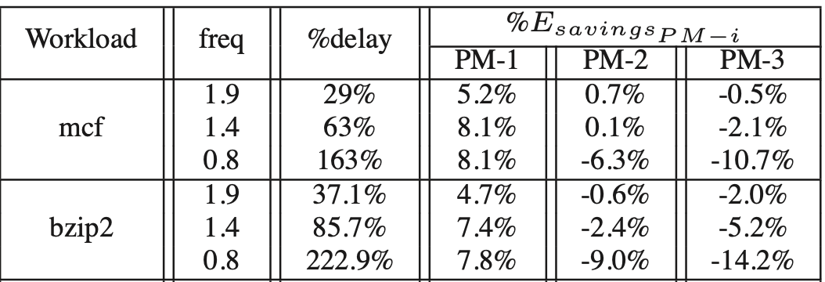
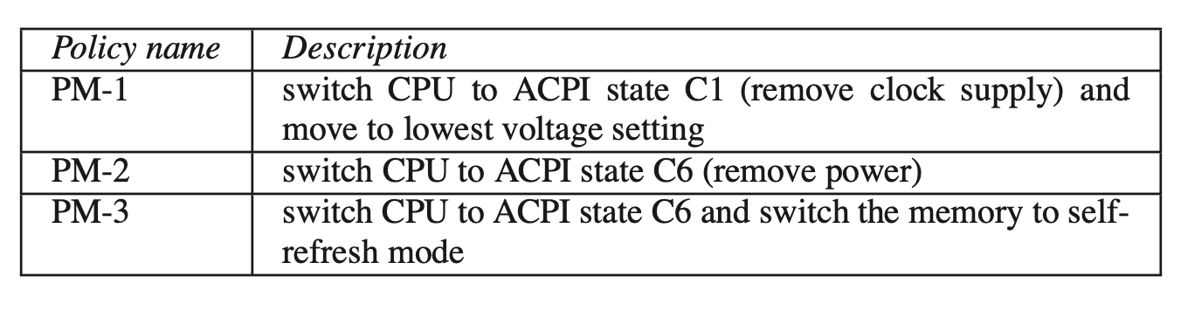
Effectiveness of DVFS
Notes:
For the effectiveness of DVFS, we should see the policy name of the experiment first.
For the workload mcf is memory bound task, bzip2 is CPU bound work load.
We’ll focus on PM-1 since the frequency in Pm2 and PM3 have been affected by the APIC state.
From PM-1, we could see there
So the effectiveness of DVFS is huge. But is there a better way?
Because lower frequency will be inefficient for programs demanding high performance.

Slide 22



What is Prediction Modeling in DVFS?
Notes:
Machine Learning + Shut down? How does it work Let’s figure it out

Slide 23
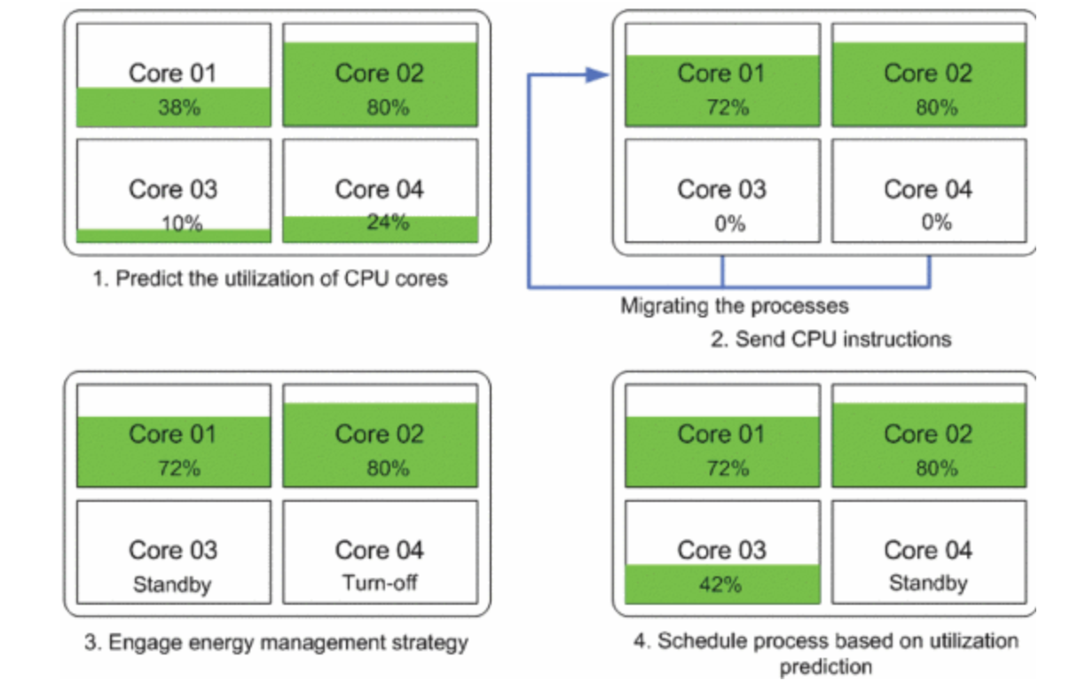
Prediction Modeling - Mechanism
The idea of the prediction mechanism is to predict the utilization of CPUs by using a migrator, which proactively mitigates the processes into available CPU cores, the idle cores will be shut down or standby and power consumption could be reduced.
Notes:
Using the model to predict the utilization of the processes
The migrator would migrate the processes to concentrate on specific cores. More cores could be released.
The technique is conducted by using Gaussian Process Regression (GPR), which is a powerful machine learning method used for predictive modeling. It operates under the principle that observations close to each other in input space will likely produce similar output values. Also, GPR is particularly notable for its ability to provide a measure of uncertainty or confidence in its predictions. This is achieved by modeling the target function as a Gaussian process, which is a collection of random variables, any finite number of which have a joint Gaussian distribution. GPR is often used for tasks where understanding the uncertainty of model predictions is crucial, such as in forecasting and optimization problems. In this way, it could accurately the utilization of every core.

Slide 24
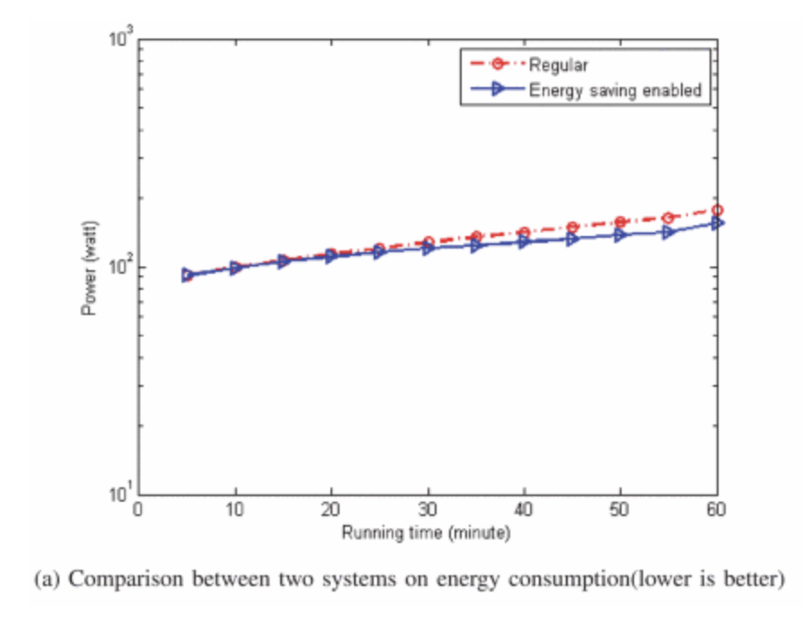
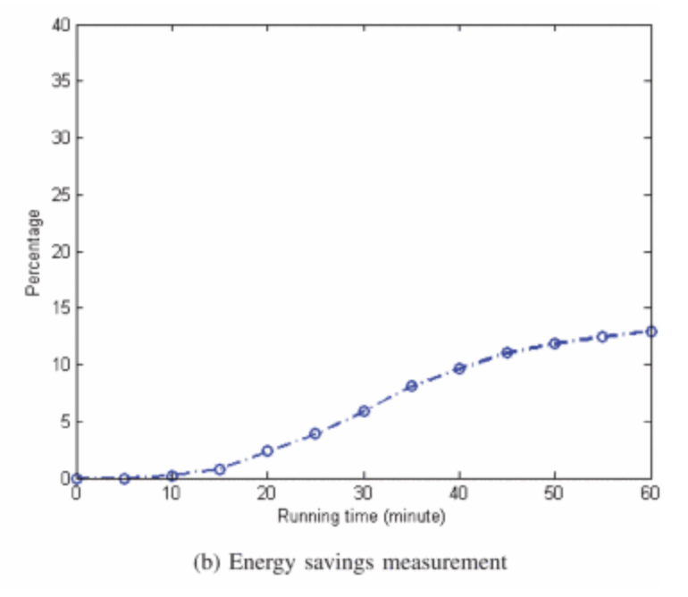

Effectiveness of Prediction Modeling
About 13%
Notes:
As we can see from these two results, from figure (a) there is slightly difference between the regular system and the prediction modeling system. Also,we could see from the image in right side, for the running time at sixty minute, it reaches 13% of energy saving. As the running goes, the saving energy could be significant. The prediction model is effective, which improve the weakness of DVFS that CPU would maintain at a low frequency, the performance will be reduced. However, with the prediction modeling technique, it could save energy and achieve high performance at the same time.

Slide 25
Discussion & Conclusion
NUMA Optimizations: It emphasizes the significance of optimizing for reduced remote access over minimizing CPU contention in NUMA systems for enhancing performance and energy efficiency.
DVFS Analysis: The paper discusses the limitations of Dynamic Voltage and Frequency Scaling (DVFS) due to advancements in CPU and platform architectures. It suggests that simple power management policies may offer better energy savings.
Predictive Models for Energy Savings: It highlights the potential of using machine learning-based predictive models to forecast system workload and dynamically adjust resources, thereby achieving significant energy savings.
Notes:
In modern computing systems, the emphasis on NUMA optimizations underscores the importance of strategically managing memory access patterns.
By prioritizing the reduction of remote accesses over CPU contention, these optimizations aim to enhance both performance and energy efficiency.
This approach mitigates the substantial penalties associated with remote memory accesses, highlighting the need for memory-aware scheduling.
Conversely, the analysis of Dynamic Voltage and Frequency Scaling (DVFS) reveals its limitations in the face of evolving CPU and platform architectures. The findings suggest that simpler power management strategies might yield better energy savings.
Furthermore, the potential of machine learning-based predictive models shows effectiveness for energy savings. By forecasting system workloads and dynamically adjusting resources, these models can significantly reduce energy consumption, offering a proactive solution to power management in computing systems.
Overall, the combined insights from NUMA optimizations, DVFS analysis, and predictive modeling point towards a more nuanced approach to energy efficiency in computing. This involves a blend of hardware-aware optimizations, strategic resource management, and intelligent predictive modeling, setting the stage for future advancements in sustainable computing practices.

Slide 26
References
[1] J. Qian, H. Jiang, W. Srisa-an, and S. Seth, "Energy-efficient I/O Thread Schedulers for NVMe SSDs on NUMA.",2017.
[2] D. Gaurav, K. –P. Kishore, R. Tajana, “Analysis of Dynamic Voltage Scaling for System Level Energy Management”, 2008
[3] D. -M. Bui, T. Huynh-The, S. Lee, Y. Yoon and S. Jun, ”Energy Savings in Processor Based on Prediction Technique," 2016.
[4] https://zhuanlan.zhihu.com/p/372441187

