Slide 1
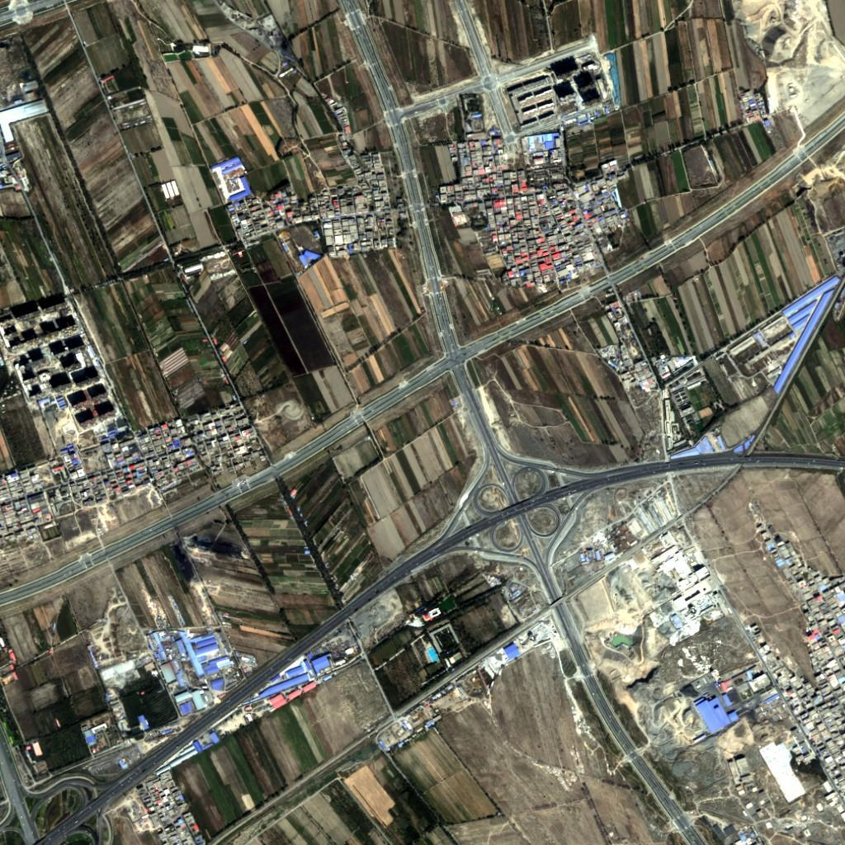
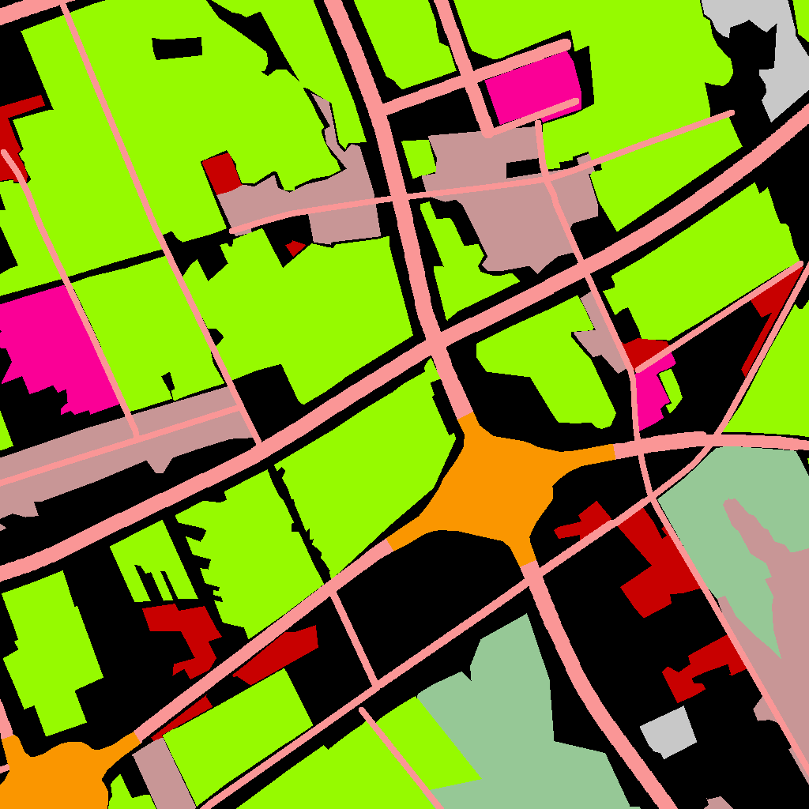
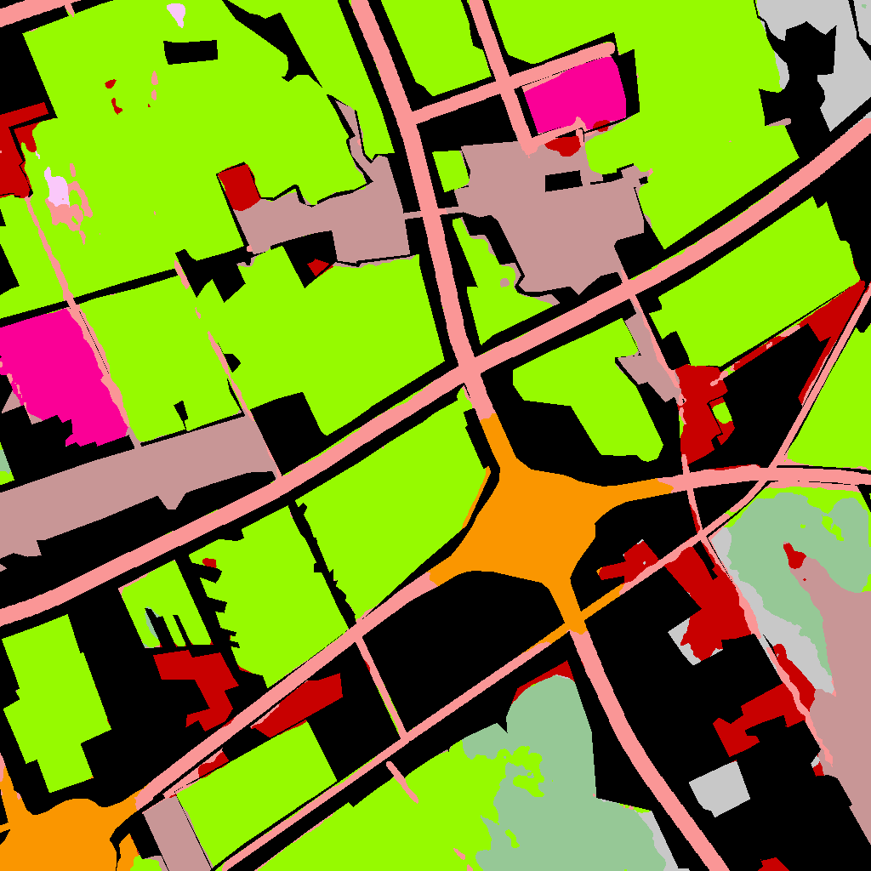
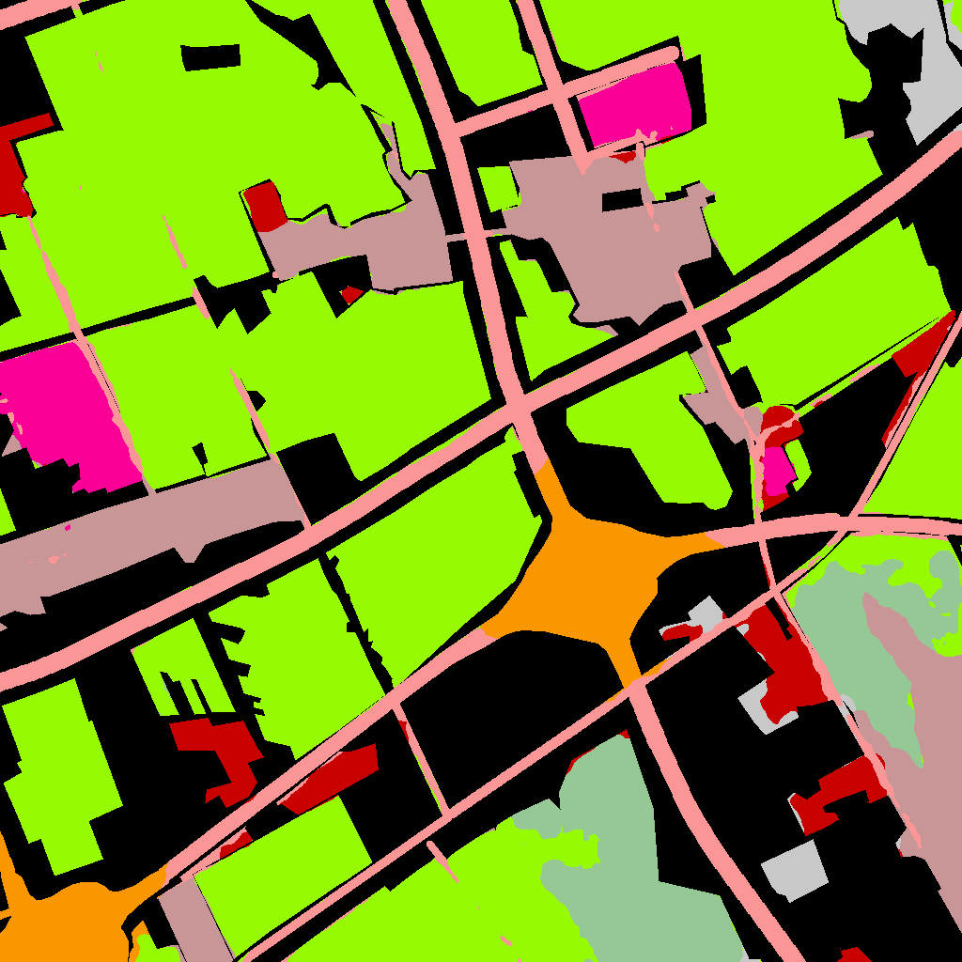
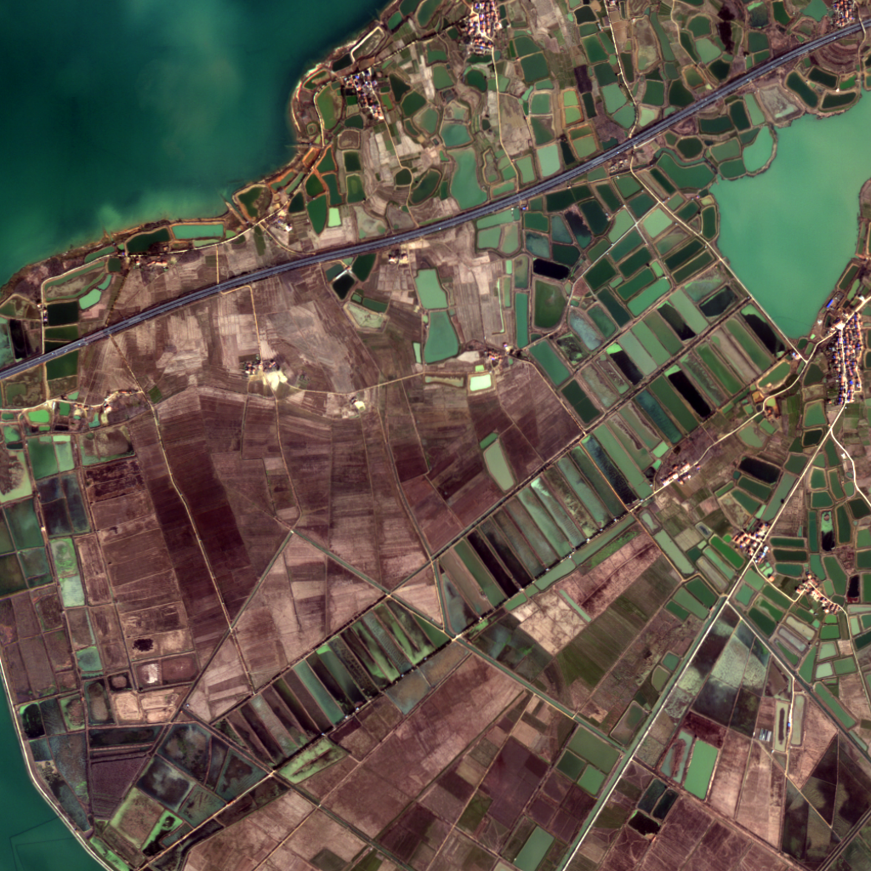
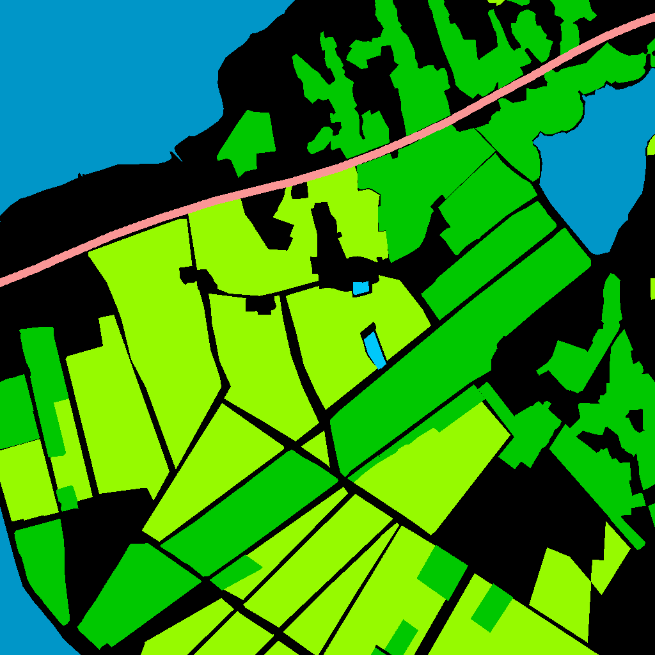
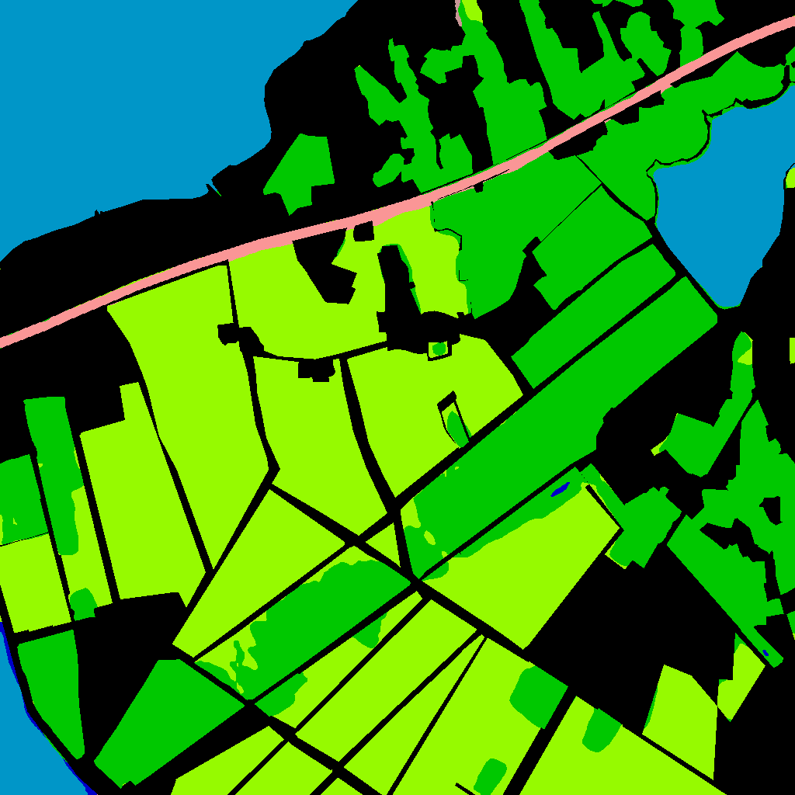

效果1：顾及地学异质性的隐私保护联邦学习遥感语义分割算法结果
industrial area
urban residential
rural residential
stadium
square
road
overpass
railway station
airport
paddy field
irrigated field
dry cropland
garden land
arbor forest
shrub forest
park
natural meadow
artificial meadow
river
lake
pond
fish pond
snow
bare land
（a）卫星影像 （b）真值标签 （c）Elastic提取结果（d）本专利提取结果
FBP 数据集-可视化结果

