Slide 1
Compiler Principle and Technology
Homework Answer
2020 Spring&Summer

Slide 2
2.1 Write regular expressions for the following character sets, or give reasons why no regular expression can be written:
(1) All strings of lowercase letters that begin and end in a.
(2) All strings of digits that contain no leading zeros.
(3) All strings of digits that represent even numbers.
Solution:
(1) a|a[a-z]*a
(2) [1-9][0-9]*
(3) [0-9]*[02468]

Slide 3
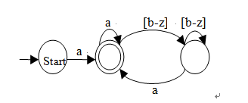
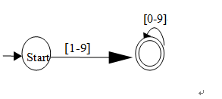
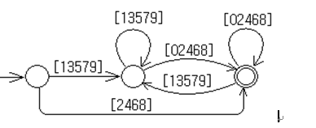
2.8 Draw DFAs for each of the sets of characters of (1,2,3) in 2.1, or state why no DFA exists.
(1) a|a[a-z]*a
(2) [1-9][0-9]*
(3) [0-9]*[02468]

Slide 4
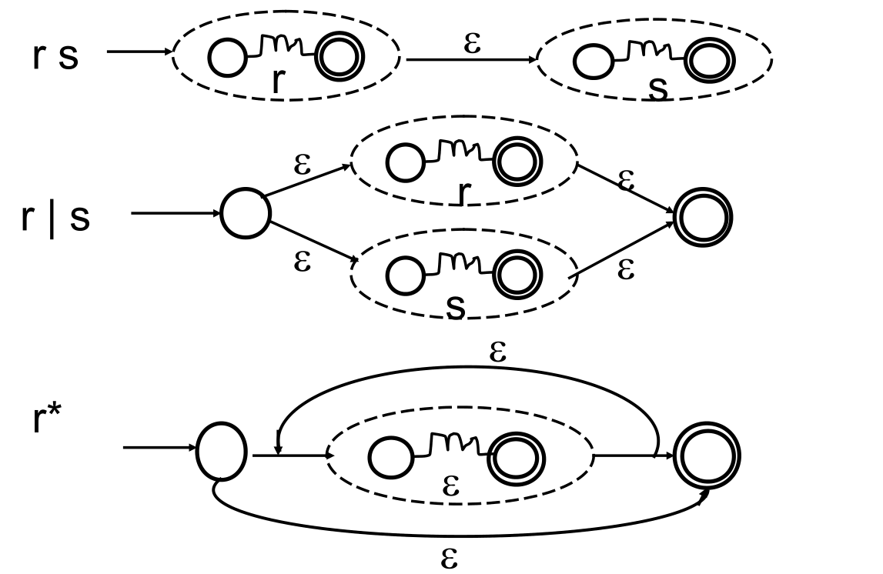
2.12 a.Use Thompson’s construction to convert the regular
expression (a|b)*a(a|b|ε) into an NFA

Slide 5
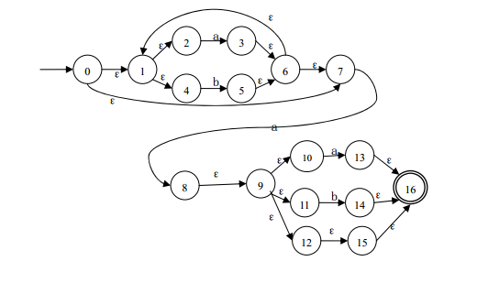
2.12 a.Use Thompson’s construction to convert the regular
expression (a|b)*a(a|b|ε) into an NFA

Slide 6
2.12 b.Convert the NFA of part (a) into a DFA using the subset
construction.
s
S′_{a}
S′_{b}
0 | 0,1,2,4,7 | 3,6,7,1,2,4,8,9,10,11,12,15,16 | 5,6,7,1,2,4
3,8 | 3,6,7,1,2,4,8,9,10,11,12,15,16 | 3,6,7,1,2,4,8,9,10,11,12,13,15,16 | 5,6,7,1,2,4,14, 16
5 | 5,6,7,1,2,4 | 3,6,7,1,2,4,8,9,10,11,12,15,16 | 5,6,7,1,2,4
3,8,13 | 3,6,7,1,2,4,8,9,10,11,12,13,15,16 | 3,6,7,1,2,4,8,9,10,11,12,13,15,16 | 5,6,7,1,2,4,14, 16
5,14 | 5,6,7,1,2,4,14, 16 | 3,6,7,1,2,4,8,9,10,11,12,15,16 | 5,6,7,1,2,4
S’

Slide 7
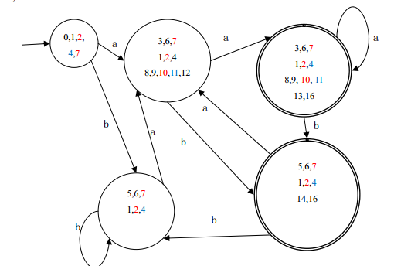
2.12 b.Convert the NFA of part (a) into a DFA using the subset
construction.
15,16
12 15

Slide 8
Quzz One Construct the NFA for the following regular expression, then convert it to a minimum-state DFA.
(a|b)*ba(ab)*
ε
2
a
3
ε
ε
0
ε
1
6
ε
7
ε
8
9
ε
10
11
b
a
ε
ε
4
5
b
ε
ε
ε
12
13
16
ε
17
14
15
ε
ε
b
a
ε

Slide 9
ε
Quzz One
ε
2
a
3
ε
0
ε
1
6
ε
7
ε
8
9
ε
10
11
b
a
ε
ε
(a|b)*ba(ab)*
4
5
ε
b
ε
ε
12
13
16
ε
17
ε
14
15
a
ε
b
S | S’ | S’a | S’b
0 | 0,1,2,4,7,8 | 3 | 5,9
3 | 3,6,1,2,4,7,8 | 3 | 5,9
5,9 | 5,6,1,2,4,7,8,9,10 | 3,11 | 5,9
3,11 | 3,6,1,2,4,7,8,11,12,13,17 | 3,14 | 5,9
3,14 | 3,6,1,2,4,7,8,14,15 | 3,14 | 5,9,16
5,9,16 | 5,6,1,2,4,7,8,9,10,16,13,17 | 3,11,14 | 5,9,16
3,11,14 | 3,6,1,2,4,7,8,11,12,13,17, 14,15 | 3,11,14 | 5,9,16
ε
1
2
3
4
5
6
7

Slide 10
Quzz One
S | S’ | S’a | S’b
0 | 0,1,2,4,7,8 | 3 | 5,9
3 | 3,6,1,2,4,7,8 | 3 | 5,9
5,9 | 5,6,1,2,4,7,8,9,10 | 3,11 | 5,9
3,11 | 3,6,1,2,4,7,8,11,12,13,17 | 3,14 | 5,9
3,14 | 3,6,1,2,4,7,8,14,15 | 3,14 | 5,9,16
5,9,16 | 5,6,1,2,4,7,8,9,10,16,13,17 | 3,11,14 | 5,9,16
3,11,14 | 3,6,1,2,4,7,8,11,12,13,17, 14,15 | 3,11,14 | 5,9,16
1
2
3
(a|b)*ba(ab)*
4
5
6
7
a
2
a
1
b
a
b
a
b
3
a
4
a
5
6
a
7
b
b
b
b

Slide 11
Quzz One
a
(a|b)*ba(ab)*
2
a
1
b
a
b
a
b
3
a
4
a
5
6
a
7
b
b
b
b
b
a
1
2
a
3
4
a|b
b
b
b
a

Slide 12
3.2 Given the grammar A -> AA | (A) | ε ,
1). Describe the language it generates,
2). Show that it is ambiguous.
(1) Generates a string of balanced parenthesis,including the empty string.
(2) So the grammar is ambiguous.
A
A
A
A
(
A
)
(
A
)
ε
ε

Slide 13
3.3Given the grammar:
Write down leftmost derivation, parse trees, and absctract syntax trees for the following expressions:
exp → exp addop term | term
addop → + | -
term → term mulop factor | factor
mulop → *
factor → (exp) | factor
The leftmost derivations for the expression
3+4*5-6;
exp=> exp addop term
=>exp addop term addop term
=>term addop term addop term
=>factor addop term addop term
=>3 addop trem addop term
=> 3+term addop term
=>3 + term mulop factor addop term
=>3 + factor mulop factor addop term
=> 3 + 4 mulop factor addop term
=>3 + 4*factor addop term
=>3 + 4*5 addop term
=>3 + 4*5 –term
=>3 + 4*5- factor
=> 3 + 4*5-6;
(a) 3+4*5-6

Slide 14
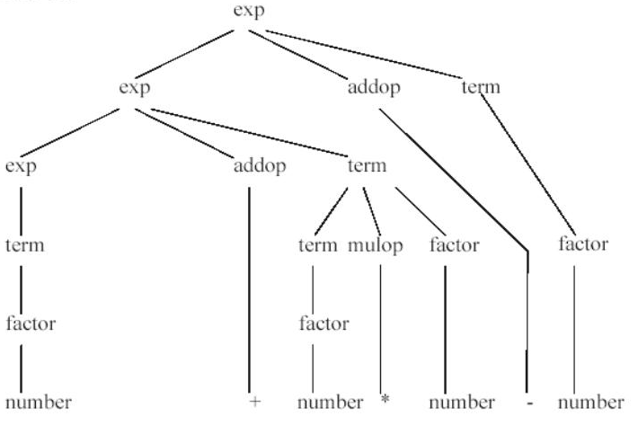
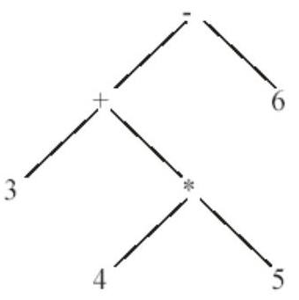
3.3Given the grammar:
exp → exp addop term | term
addop → + | -
term → term mulop factor | factor
mulop → *
factor → (exp) | factor

Slide 15
3.3Given the grammar:
exp → exp addop term | term
addop → + | -
term → term mulop factor | factor
mulop → *
factor → (exp) | factor
Write down leftmost derivation, parse trees, and absctract syntax trees for the following expressions:
(b) 3*(4-5+6)
(c) 3-(4+5*6)

Slide 16
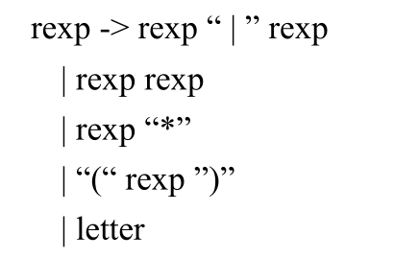
3.3The following grammar generates all regular expressions over
the alphabet of letters (we have used quotes to surround
operators,since the vertical bar is an operator as well as a
metasymbol):
a.Give a derivation for the regular expression (ab|b)* using this grammar.
rexp=>rexp*=>(rexp)*=>(rexp|rexp)*
=>(rexp rexp|rexp)*=>(a rexp|rexp)*
=>(ab|rexp)*=>(ab|b)*

Slide 17
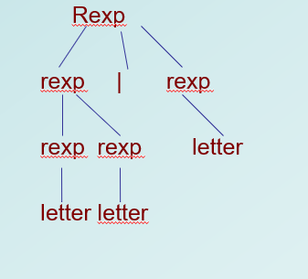
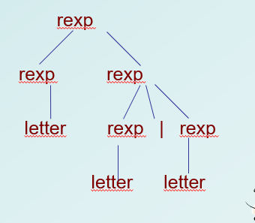
3.3
b.Show that this grammar is ambiguous.
Parse trees of ab|b:

Slide 18
3.3
c. Rewrite this grammar to establish the correct precedences for the operators.
rexp -> rexp “|” rexp1 | rexp1
rexp1 -> rexp1 rexp2 | rexp2
rexp2 -> rexp3 “*” | rexp3
rexp3 -> “(“rexp”)” | letter
d.What associativity does your answer in part (c) give to the binary operators? Why?
Left associativity .
A left recursive rule makes its operators associate on the left

Slide 19
4.8 Consider the grammar:
lexp → atom | list
atom → number | identifier
list → (lexp-seq)
list-seq → list-seq lexp | lexp
A → A α | β
A → βA’
A’ → α A’| ε
(1)Remove the left recursion
Solution:
lexp -> atom | list
atom -> number | identifier
list -> (lexp-seq)
lexp-seq -> lexp lexp-seq’
lexp-seq’ -> lexp lexp-seq’ | ε

Slide 20
4.8 Consider the grammar:
lexp -> atom | list
atom -> number | identifier
list -> (lexp-seq)
lexp-seq -> lexp lexp-seq’
lexp-seq’ -> lexp lexp-seq’ | ε
(b) Construct the First and Follow set of the nonterminals of the resulting grammar
first (lexp)= { number ,identifier,( }
first (atom)= { number, identifier }
first (list) = { ( }
first (lexp-seq)= { number ,identifier,( }
first (lexp-seq’)= { number ,identifier,( , ε}
follow(lexp)= { $,number,identifier,(,)}
follow (atom)= { $, number,identifier,( ,)}
follow (list) = {$, number,identifier,(,)}
follow (lexp-seq)= { )}
follow (lexp-seq’)= { )}
B→ α Aγ, then First(γ)-{ε}
B→α Aγ, such that ε in First(γ), then Follow(A)

Slide 21
4.8 Consider the grammar:
lexp -> atom | list
atom -> number | identifier
list -> (lexp-seq)
lexp-seq -> lexp lexp-seq’
lexp-seq’ -> lexp lexp-seq’ | ε
(c) Show that the resulting grammar is LL(1).
First(atom) ∩First(list) = Φ
First(number) ∩First(identifier) = Φ
First(lexp lexp-seq') ∩First(ε) = Φ
first (lexp)= { number ,identifier,( }
first (atom)= { number, identifier }
first (list) = { ( }
first (lexp-seq)= { number ,identifier,( }
first (lexp-seq’)= { number ,identifier,( , ε}
follow(lexp)= { $,),number,identifier,(}
follow (atom)= { $,), number,identifier,( }
follow (list) = {$,), number,identifier,(}
follow (lexp-seq)= { )}
follow (lexp-seq’)= { )}
对所有First集合中含有空串的非终结符，First集合和Follow集合无交集
Follow(lexp-seq') ∩Follow(lexp-seq) = Φ

Slide 22
4.8 Consider the grammar:
lexp -> atom | list
atom -> number | identifier
list -> (lexp-seq)
lexp-seq -> lexp lexp-seq’
lexp-seq’ -> lexp lexp-seq’ | ε
(d) Construct the LL(1) table for the resulting grammar.
first (lexp)= { number ,identifier,( }
first (atom)= { number, identifier }
first (list) = { ( }
first (lexp-seq)= { number ,identifier,( }
first (lexp-seq’)= { number ,identifier,( , ε}
follow(lexp)= { $,),number,identifier,(}
follow (atom)= { $,), number,identifier,( }
follow (list) = {$,), number,identifier,(}
follow (lexp-seq)= { )}
follow (lexp-seq’)= { )}
M[N,T] | number | identifier | ( | ) | $
lexp | lexp->atom | lexp->atom | lexp->list
atom | atom->number | atom->identifier
list |  |  | list -> (lexp-seq)
lexp-seq | lexp-seq -> lexp lexp-seq’ | lexp-seq -> lexp lexp-seq’ | lexp-seq -> lexp lexp-seq’
lexp-seq’ | lexp-seq’ -> lexp lexp-seq’ | lexp-seq’ -> lexp lexp-seq’ | lexp-seq’ -> lexp lexp-seq’ | lexp-seq’ -> ε

Slide 23
4.8 Consider the grammar:
(e) Show the actions of the corresponding LL(1) parser,given the input string(a (b (2)) (c)).
Step | Parsing | Input | Action
1 | $lexp | (a(b(2))(c))$ | lexp→list
2 | $list | (a(b(2))(c))$ | list -> (lexp-seq)
3 | $) lexp-seq( | (a(b(2))(c))$ | match
4 | $ ) lexp-seq | a(b(2))(c))$ | lexp-seq -> lexp lexp-seq’
5 | $ ) lexp-seq’ lexp | a(b(2))(c))$ | lexp -> atom
6 | $ ) lexp-seq’ atom | a(b(2))(c))$ | atom -> identifier
7 | $ ) lexp-seq’ identifier | a(b(2))(c))$ | match
8 | $ ) lexp-seq’ | (b(2))(c))$ | lexp-seq’ -> lexp lexp-seq’
9 | $) lexp-seq’ lexp-seq’ lexp-seq | (b(2))(c))$ | lexp→list
10 | $)lexp-seq’ lexp-seq’ list | (b(2))(c))$ | list -> (lexp-seq)
11 | $) lexp-seq’ lexp-seq’ ) lexp-seq( | (b(2))(c))$ | match
12 | $) lexp-seq’ lexp-seq’ ) lexp-seq | b(2))(c))$ | lexp-seq -> lexp lexp-seq’

Slide 24
4.8 Consider the grammar:
Step | Parsing | Input | Action
13 | $)lexp-seq’ lexp-seq’ ) lexp-seq’ lexp-seq | b(2))(c))$ | lexp -> atom
14 | $)lexp-seq’ lexp-seq’ ) lexp-seq’ atom | b(2))(c))$ | atom -> identifier
15 | $)lexp-seq’ lexp-seq’ ) lexp-seq’ identifier | b(2))(c))$ | match
16 | $ )lexp-seq’ lexp-seq’ ) lexp-seq’ | (2))(c))$ | lexp-seq’ -> lexp lexp-seq’
17 | $ ) lexp-seq’ lexp-seq’ ) lexp-seq’ lexp | (2))(c))$ | lexp→list
18 | $ ) lexp-seq’ lexp-seq’ ) lexp-seq’ list | (2))(c))$ | list -> (lexp-seq)
19 | $ ) lexp-seq’ lexp-seq’ ) lexp-seq’ ) lexp-seq( | (2))(c))$ | match
20 | $ ) lexp-seq’ lexp-seq’ ) lexp-seq’ ) lexp-seq | 2))(c))$ | lexp-seq -> lexp lexp-seq’
21 | $ ) lexp-seq’ lexp-seq’ ) lexp-seq’ ) lexp-seq’ lexp | 2))(c))$ | lexp -> atom
22 | $) lexp-seq’ lexp-seq’ ) lexp-seq’ ) lexp-seq’ atom | 2))(c))$ | atom -> number
23 | $ ) lexp-seq’ lexp-seq’ ) lexp-seq’ ) lexp-seq’ number | 2))(c))$ | match
24 | $ ) lexp-seq’ lexp-seq’ ) lexp-seq’ ) lexp-seq’ | ))(c))$ | lexp-seq’ -> ε
25 | $ ) lexp-seq’ lexp-seq’ ) lexp-seq’ ) | ))(c))$ | match
26 | $ ) lexp-seq’ lexp-seq’ ) lexp-seq’ | )(c))$ | lexp-seq’ -> ε
(e)

Slide 25
4.8 Consider the grammar:
Step | Parsing | Input | Action
27 | $ ) lexp-seq’ lexp-seq’ ) | )(c))$ | match
28 | $) lexp-seq’ lexp-seq’ | (c))$ | lexp-seq’ -> lexp lexp-seq’
29 | $)lexp-seq’ lexp-seq’ lexp | (c))$ | lexp→list
30 | $ )lexp-seq’ lexp-seq’ list | (c))$ | list -> (lexp-seq)
31 | $ ) lexp-seq’ lexp-seq’ ) lexp-seq( | (c))$ | match
32 | $ ) lexp-seq’ lexp-seq’ ) lexp-seq | c))$ | lexp-seq -> lexp lexp-seq’
33 | $ ) lexp-seq’ lexp-seq’ ) lexp-seq’ lexp | c))$ | lexp -> atom
34 | $ ) lexp-seq’ lexp-seq’ ) lexp-seq’ atom | c))$ | atom -> identifier
35 | $ ) lexp-seq’ lexp-seq’ ) lexp-seq’ identifier | c))$ | match
36 | $) lexp-seq’ lexp-seq’ ) lexp-seq’ | ))$ | lexp-seq’ -> ε
37 | $ ) lexp-seq’ lexp-seq’ ) | ))$ | match
38 | $ ) lexp-seq’ lexp-seq’ | )$ | lexp-seq’ -> ε
39 | $ ) lexp-seq’ | )$ | lexp-seq’ -> ε
40 | $ ) | )$ | match
41 | $ | $ | accept
(e)

Slide 26
4.12
Can an LL(1) grammar be ambiguous? Why or why not?
(2) Can an ambiguous grammar be LL(1)? Why or why not?
(3) Must an ambiguous grammar be LL(1)? Why or why not?
Answer:
1. There is only one production in each entry in the parsing table, so it is not ambiguous.
2. The parsing table of an ambiguous grammar contains at least an entry with more than one production, so it cannot be LL(1).
3. No, many reasons can fail to make a grammar to be LL(1). Some unambiguous left-recursive grammar is not LL(1).

Slide 27
Quizz Two
Consider the following grammar
S→A S→B A→e A→f
B→(C) C→SD D→SD D→ε
1. Calculate FIRST and FOLLOW for nonterminals in the grammar.
2. Construct the LL(1) parsing table for the grammar.
3. Show that the grammar is LL(1).
FIRST(S) = {e,f,(}
FIRST(A) = {e,f}
FIRST(B) = {(}
FIRST(C) = {e,f,(}
FIRST(D) = {e,f,(,ε}
FOLLOW(S) = {$,e,f,(,)}
FOLLOW(A) = {$,e,f,(,)}
FOLLOW(B) = {$,e,f,(,)}
FOLLOW(C) = {)}
FOLLOW(D) = {)}

Slide 28
Quizz Two
FIRST(S) = {e,f,(}
FIRST(A) = {e,f}
FIRST(B) = {(}
FIRST(C) = {e,f,(}
FIRST(D) = {e,f,(,ε}
FOLLOW(S) = {$,e,f,(,)}
FOLLOW(A) = {$,e,f,(,)}
FOLLOW(B) = {$,e,f,(,)}
FOLLOW(C) = {)}
FOLLOW(D) = {)}
Consider the following grammar
S→A S→B A→e A→f
B→(C) C→SD D→SD D→ε
M[N,T] | e | f | ( | ) | $
S | S→A | S→A | S→B
A | A→e | A→f
B |  |  | B→(C)
C | C→SD | C→SD | C→SD
D | D→SD | D→SD | D→SD | D→ε

Slide 29
5.8 Consider the following grammar
declaration → type var-list
type → int | float
var-list → identifier, var-list | identifier
a. Rewrite it in a form more suitable for bottom-up parsing.
Solution:
declaration → type var-list
type → int | float
var-list → var-list, identifier | identifier

Slide 30
5.8 b. Construct the LR(0) DFA for the rewritten grammar.
Solution:
8
0
decl
S->decl.
S->.decl
decl-> .type vlist
type->.int
type ->.float
decl -> type vlist
type -> int
type ->float
vlist -> vlist, id
vlist -> id
follow(decl)= { $ },
follow(type)= { id }
follow(vlist)= { $, , }
int
type->int.
6
float
type
type -> float.
7
1
decl -> type. vlist
vlist -> . vlist , id
vlist -> .id
vlist
decl -> type vlist.
vlist -> vlist. , id
,
2
id
vlist -> vlist, .id
4
3
vlist -> id.
id
vlist -> vlist, id.
5

Slide 31
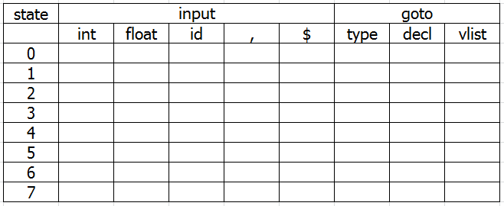
5.8 (c) Construct the SLR(1) parsing table for the rewritten grammar.
s6
s7
g1
g8
8
s3
g2
0
decl
S->decl.
s4
r1
S->.decl
decl-> .type vlist
type->.int
type ->.float
r5
r5
int
type->int.
6
s5
r4
r4
float
r2
type
type -> float.
7
r3
1)decl -> type vlist
2)type -> int
3)type ->float
4)vlist -> vlist, id
5)vlist -> id
follow(decl)= { $ },
follow(type)= { id }
follow(vlist)= { $, , }
1
decl -> type. vlist
vlist -> . vlist , id
vlist -> .id
vlist
decl -> type vlist.
vlist -> vlist. , id
,
2
id
vlist -> vlist, .id
4
3
vlist -> id.
id
vlist -> vlist, id.
5

Slide 32
5.12Show the following grammar is LR(1) but not LALR(1):
s → a A d | b B d | a B e | b A e
A → c
B → c
The augmented grammar is:
s’ →s
s→a A d | b B d | a B e | b A e
A→c
B→c
The LR(1) DFA is shown as follows

Slide 33
s’ →s·,$
5.12
s’ →·s,$
s→·a A d,$
s →·b B d ,$
s→· a B e,$
s→ ·b A e,$
6
A→c·, d
B→c·, e
8
A→c·, e
B→c·, d
c
b
a
c
There is a reduce-reduce conflict in this state, which shows that the grammar is not LALR(1).
s →b·B d ,$
s→ b·A e,$
A→·c, e
B→·c, d
s→a·A d,$
s→a·B e,$
A→·c, d
B→·c, e
A
s→aA·d,$
A
s→ bA·e,$
B
s→aAd·,$
B
s→aB·e,$
s→bAe·,$
s→aBe·,$
s→bB·d,$
s→bBd·,$
To construct LALR(1) DFA, state 6 and state 8 are combined to a new state:
A→c·, d/e
B→c·, d/e

Slide 34
Quiz Three Construct the LR(1) states for the following grammar, and give the LR(1) parsing table.
1.S’-> S$
2.S -> id
3.S -> V=E
4.V -> id
5.E -> V
6.E -> n
S’-> S.,$
1
S’-> .S,$
S->.id,$
S -> .V=E,$
V -> .id,=
S
0
S’-> id.,$
V -> id.,=
id
2
V
S’-> V.=E,$
3
S’-> V=E.,$
=
5
E
S’-> V=.E,$
E -> .V,$
E ->.n,$
V -> .id,=
4
E -> V.,$
V
6
n
E -> n.,$
id
7
V -> id.,=
8

Slide 35
Quiz Three Construct the LR(1) states for the following grammar, and give the LR(1) parsing table.
1.S’-> S$
2.S -> id
3.S -> V=E
4.V -> id
5.E -> V
6.E -> n
state | input |  |  |  | goto
 | n | id | = | $ | S | V | E
0 |  | S2 |  |  | 1 |  | 3
1 |  |  |  | r1
2 |  |  | r4 | r2
3 |  |  | S4
4 | S7 | S8 |  |  |  | 6 | 5
5 |  |  |  | r3
6 |  |  |  | r5
7 |  |  |  | r6
8 |  |  |  | r4
S’-> S.,$
1
S’-> .S,$
S->.id,$
S -> .V=E,$
V -> .id,=
S
0
S’-> id.,$
V -> id.,=
id
2
V
S’-> V.=E,$
3
S’-> V=E.,$
=
5
E
S’-> V=.E,$
E -> .V,$
E ->.n,$
V -> .id,$
4
E -> V.,$
V
6
n
E -> n.,$
id
7
V -> id.,$
8

Slide 36
6.7 Consider the following grammar for simple Pascal-style declarations:
decl
decl → var-list : type
var-list → var-list , id | id
type → integer | real
var-list
:
type
var-list
, id
real
Write an attribute grammar for the type of a variable.
Solution:
decl → var-list: type var-list.dtype = type.dtype
vsr-list₁ → var-list₂, id var-list₂.dtype = var-list₁.dtype
id.dtype = var-list₁.dtype
var-list → id id.dtype = var-list.dtype
type → integer type.dtype = int
type → real type.dtype = float

Slide 37
6.8 Consider the grammar of 6.7. Rewrite the grammar so that the type of a variable can be purely synthesized attribute, and give a new attribute grammar for the type has this property.
Solution:
decl → id var-list id.dtype = var-list.dtype
var-list₁ → , id var-list₂ var-list₁.dtype = var-list₂.dtype
id.dtype = var-list₂.dtype
var-list → : type var-list.dtype = type.dtype
type →integer type.dtype = int
type → real type.dtype = float

Slide 38
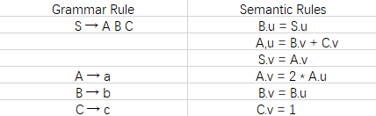
6.13 Consider the following attribute grammar:
Draw the parse tree for string abc, and draw the dependency graph for the associated attributes. Describe a correct order for the evaluation of the attributes.
Suppose that S.u is assigned the value of 3 before attribute evaluation begins. What is the value of S.v when the evaluation has finished?

Slide 39
6.13
S
Solution:
(a) The parse tree for the string abc is:
A
B
C
The dependency graph is:
a
b
c
u S v
u A v
u B v
u C v
c
a
b
(b) S.v = A.v = 2*A.u = 2*(B.v+C.v) = 2*(B.u+C.v) =2*(S.u+C.v) = 8

Slide 40
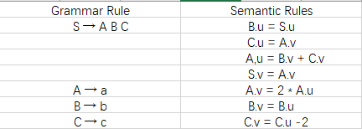
(c) Suppose the attribute equations are modified as follows:
What value does S.v have after attribute evaluation, if S.u=3 before evaluation begins?

Slide 41
6.13
(c) The dependency graph becomes as follows:
u S v
u A v
u B v
u C v
c
a
b
C.v=C.u-2=A.v-2=2*A.u-2=2(B.v+C.v)-2=2(B.u+C.v)-2=2(S.u+C.v)-2
C.v=2-2*S.u=-4
S.v=2(S.u+C.v)=-2
The dependency of C.v, A.u, A.v, C.u form a cycle, so the value S.v cannot be evaluated generally.

Slide 42
Quiz Four Write an attribute grammar for the following point value of a decimal number given by the following grammar
dnum → num.num num → num digit | digit digit → 0 | 1 | 2 | 3 | 4 | 5 | 6 | 7 | 8 | 9
dnum → num1.num2 | dnum.val = num1.val +num2.val/(10^num2.count)
num1 → num2 digit | num1.val = num2.val * 10 + digit.val num1.count = num2.count + 1
num2 →digit | num.val = digit.val num.count = 1
digit → 0 | 1 | 2 | 3 | 4 | 5 | 6 | 7 | 8 | 9 | digit .val = 0 | 1 | 2 | 3 | 4 | 5 | 6 | 7 | 8 | 9

Slide 43
7.4 Draw the stack of activation records for the following Pascal program , showing the control and access links , after the second call to procedure c.Describe how the variable x is accessed from within c.
program env;
procedure a;
var x: integer;
procedure b;
procedure c;
begin
x := 2;
b;
end;
begin (* b *)
c;
end;
begin (* a *)
b;
end;
begin (* main *)
a;
end.

Slide 44
7.4
program env;
procedure a;
var x: integer;
procedure b;
procedure c;
begin
x := 2;
b;
end;
begin (* b *)
c;
end;
begin (* a *)
b;
end;
begin (* main *)
a;
end.
Activation record of
main program
<no access link>
Control link
Return address
x
Activation record of
Call to a
access link
Control link
Return address
Activation record of
Call to b
access link
Control link
Return address
Activation record of
Call to c
access link
Control link
Return address
Activation record of
Call to b
access link
Control link
Return address
Activation record of
Call to c
fp
sp

Slide 45
7.15 Give the output for the following program(written in C syntax) using the four parameter passing methods discussed in Section 7.5..
#include <stdio.h>
int i=0;
void p(int x, int y)
{
x += 1;
i += 1;
y += 1;
}
main()
{
int a[2]={1,1};
p(a[i],a[i]);
printf(“%d %d\n”,a[0],a[1]);
return 0;
}
By value:
1, 1
By reference:
3 ,1
By value-result :
2 ,1
By name:
2 ,2
1
1
0
1

