Slide 1
Ch.8 Understanding Requirements

Slide 2
Requirements Engineering
Inception—ask a set of questions that establish …
  basic understanding of the problem
  the people who want a solution
  the nature of the solution that is desired, and
  the effectiveness of preliminary communication and collaboration between the customer and the developer
Elicitation—elicit requirements from all stakeholders
Elaboration—create an analysis model that identifies data, function and behavioral requirements
Negotiation—agree on a deliverable system that is realistic for developers and customers

Slide 3
Requirements Engineering (cont.)
Specification—can be any one (or more) of the following
  A written document
  A set of models
  A formal mathematical
  A collection of user scenarios (use-cases)
  A prototype
Validation—a review mechanism that looks for
  errors in content or interpretation
  areas where clarification may be required
  missing information
  inconsistencies (a major problem when large products or systems are engineered)
  conflicting or unrealistic (unachievable) requirements.
Requirements management

Slide 4
Inception
Identify stakeholders
  “who else do you think I should talk to?”
Recognize multiple points of view
Work toward collaboration
The first set of context-free questions
  Who is behind the request for this work?
  Who will use the solution?
  What will be the economic benefit of a successful solution
  Is there another source for the solution that you need?

Slide 5
Eliciting Requirements
meetings are conducted and attended by both software engineers and customers
rules for preparation and participation are established
an agenda is suggested
a "facilitator" (can
be a customer, a
developer, or an
outsider) controls
the meeting

Slide 6
Eliciting Requirements (cont.)
a "definition mechanism" (can be work sheets, flip charts, or wall stickers or an electronic bulletin board, chat room or virtual forum) is used
the goal is
  to identify the problem
  propose elements of the solution
  negotiate different approaches, and
  specify a preliminary set of solution requirements
The hardest single part of building a software
system is deciding what to build
Problem of scope
Problem of understanding
Problem of volatility

Slide 7
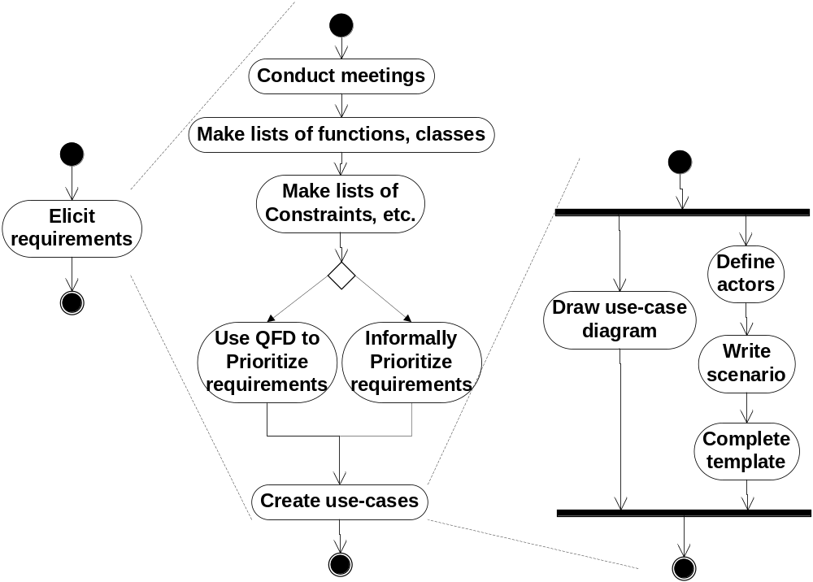
Eliciting Requirements
Formal prioritization
Yes
No

Slide 8
Quality Function Deployment
Function deployment determines the “value” (as perceived by the customer) of each function required of the system
Information deployment identifies data objects and events
Task deployment examines the behavior of the system
Value analysis determines the relative priority of requirements
It identifies three types of requirements
  Normal requirements
  Expected requirements
  Exciting requirements

Slide 9
Non-Functional Requirements
Non-Functional Requirment (NFR) – quality attribute, performance attribute, security attribute, or general system constraint. A two phase process is used to determine which NFR’s are compatible:
  The first phase is to create a matrix using each NFR as a column heading and the system SE guidelines a row labels
  The second phase is for the team to prioritize each NFR using a set of decision rules to decide which to implement by classifying each NFR and guideline pair as complementary, overlapping, conflicting, or independent

Slide 10
Elicitation Work Products
a statement of need and feasibility.
a bounded statement of scope for the system or product
a list of customers, users, and other stakeholders who participated in requirements elicitation
a description of the system’s technical environment.
a list of requirements (preferably organized by function) and the domain constraints that apply to each
a set of usage scenarios that provide insight into the use of the system or product under different operating conditions.
any prototypes developed to better define requirements

Slide 11
Use-Cases
A collection of user scenarios that describe the thread of usage of a system
Each scenario is described from the point-of-view of an “actor”—a person or device that interacts with the software in some way
Each scenario answers the following questions:
  Who is the primary actor, the secondary actor (s)?
  What are the actor’s goals?
  What preconditions should exist before the story begins?
  What main tasks or functions are performed by the actor?

Slide 12
Use-Cases
Each scenario answers the following questions (cont.)
  What extensions might be considered as the story is described?
  What variations in the actor’s interaction are possible?
  What system information will the actor acquire, produce, or change?
  Will the actor have to inform the system about changes in the external environment?
  What information does the actor desire from the system?
  Does the actor wish to be informed about unexpected changes?

Slide 13
A Example -- SafeHome
Our research indicates that the market for home security systems is growing at a rate of 40% per year. We would like to enter this market by building a microprocessor-based home security system that would protect against and/or recognize a variety of undesirable situations such as illegal entry, fire, flooding, and others. The product will use appropriate sensors to detect each situation, can be programmed by the homeowner, and will automatically telephone a monitoring agency when a situation is detected.

Slide 14

Use-Case Diagram
Arms/disarms
system
Accesses
System
Via internet
Homeowner
sensors
Responds to
Alarm event
Encounters
An error
condition
System
Administrator
Reconfigures
Sensors and
Related system
features

Slide 15
Building the Analysis Model
Elements of the analysis model
  Scenario-based elements
    Use-case and user-case diagram
    Sequence of activities within certain context
  Class-based elements
    Class diagram
  Behavioral elements
    State diagram
  Flow-oriented elements
    Data flow diagram

Slide 16
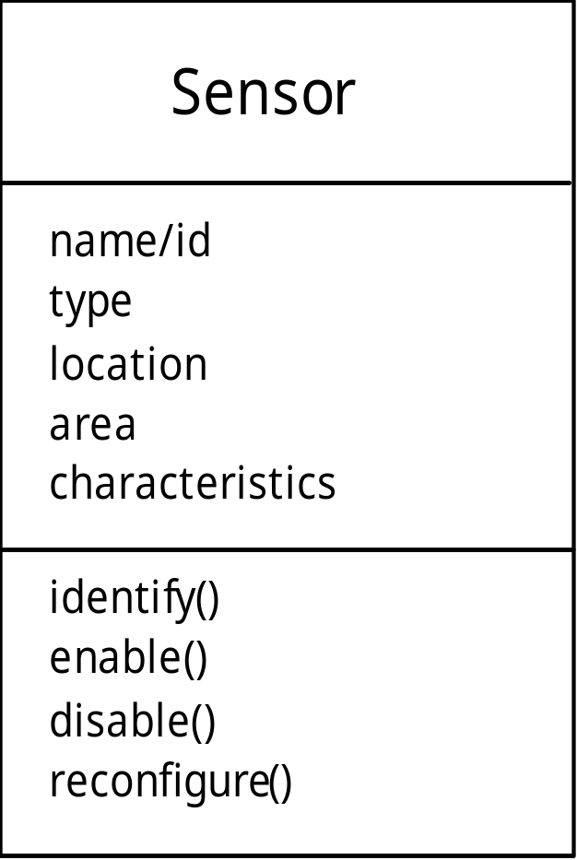
Class Diagram
From the SafeHome system …

Slide 17
State Diagram
Reading
Commands
State name
System status = “ready”
Display msg = “enter cmd”
Display status = steady
State variables
Entry/subsystems ready
Do: poll user input panel
Do: read user input
Do: interpret user input
State activities

Slide 18
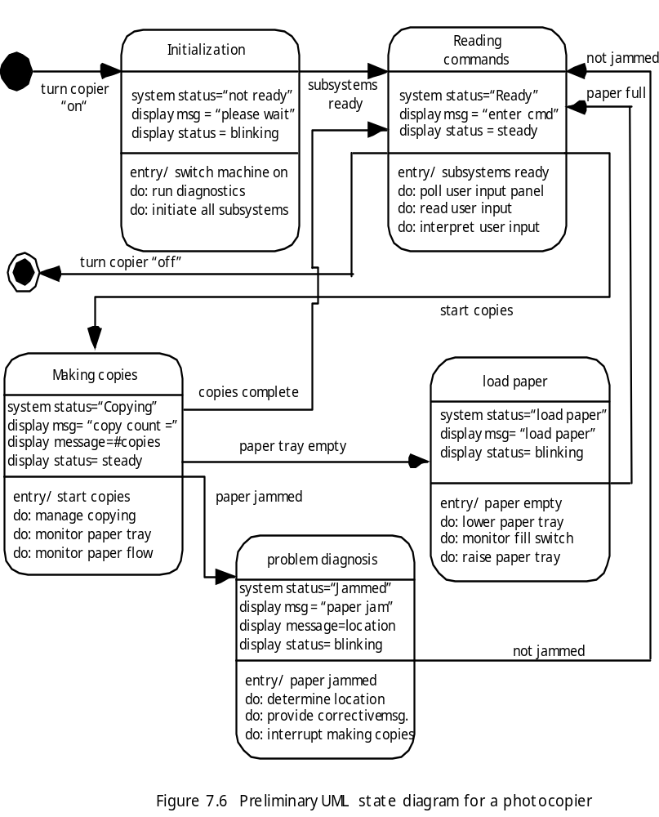
State Diagram

Slide 19
Analysis Patterns
  Pattern name: A descriptor that captures the essence of the pattern.
  Intent: Describes what the pattern accomplishes or represents
  Motivation: A scenario that illustrates how the pattern can be used to address the problem.
  Forces and context: A description of external issues (forces) that can affect how the pattern is used and also the external issues that will be resolved when the pattern is applied.
  Solution: A description of how the pattern is applied to solve the problem with an emphasis on structural and behavioral issues.

Slide 20
Analysis Patterns (cont.)
  Consequences: Addresses what happens when the pattern is applied and what trade-offs exist during its application.
  Design: Discusses how the analysis pattern can be achieved through the use of known design patterns.
  Known uses: Examples of uses within actual systems.
  Related patterns: One or more analysis patterns that are related to the named pattern because (1) it is commonly used with the named pattern; (2) it is structurally similar to the named pattern; (3) it is a variation of the named pattern.

Slide 21
Negotiating Requirements
Identify the key stakeholders
  These are the people who will be involved in the negotiation
Determine each of the stakeholders “win conditions”
  Win conditions are not always obvious
Negotiate
  Work toward a set of requirements that lead to “win-win”
If different customers/users cannot agree on requirements, the risk of failure is very high.

Slide 22
Requirements Monitoring
Especially needes in incremental development
Distributed debugging – uncovers errors and determines their cause
Run-time verification – determines whether software matches its specification
Run-time validation – assesses whether evolving software meets user goals
Business activity monitoring – evaluates whether a system satisfies business goals
Evolution and codesign – provides information to stakeholders as the system evolves

Slide 23
Validating Requirements
Is each requirement consistent with the overall objective for the system/product?
Have all requirements been specified at the proper level of abstraction? That is, do some requirements provide a level of technical detail that is inappropriate at this stage?
Is the requirement really necessary or does it represent an add-on feature that may not be essential to the objective of the system?

Slide 24
Validating Requirements (cont.)
Is each requirement bounded and unambiguous?
Does each requirement have attribution? That is, is a source (generally, a specific individual) noted for each requirement?
Do any requirements conflict with other requirements?
Is each requirement achievable in the technical environment that will house the system or product?
Is each requirement testable, once implemented?

Slide 25
Validating Requirements (cont.)
Does the requirements model properly reflect the information, function and behavior of the system to be built.
Has the requirements model been “partitioned” in a way that exposes progressively more detailed information about the system.
Have requirements patterns been used to simplify the requirements model. Have all patterns been properly validated? Are all patterns consistent with customer requirements?

