Slide 1
Ch.11 Requirements Modeling: Behavior, Patterns, and Web/Mobile Apps

Slide 2
Behavioral Modeling
The behavioral model indicates how software will respond to external events or stimuli. To create the model, the analyst must perform the following steps:
  Evaluate all use-cases to fully understand the sequence of interaction within the system.
  Identify events that drive the interaction sequence and understand how these events relate to specific objects.
  Create a sequence for each use-case.
  Build a state diagram for the system.
  Review the behavioral model to verify accuracy and consistency

Slide 3
Behavioral Modeling
In the context of behavioral modeling, two different characterizations of states must be considered:
  the state of each class as the system performs its function and
  the state of the system as observed from the outside as the system performs its function

Slide 4
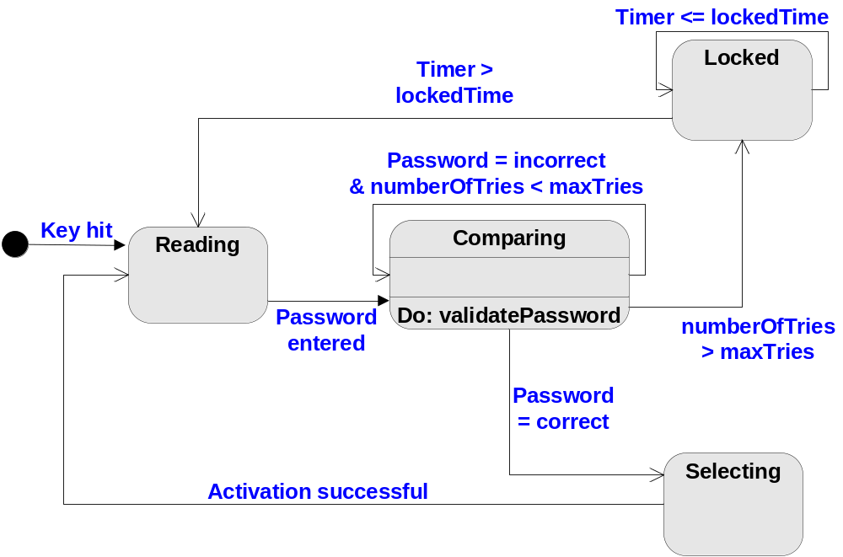
Behavioral Modeling
State Diagram
ControlPanel

Slide 5
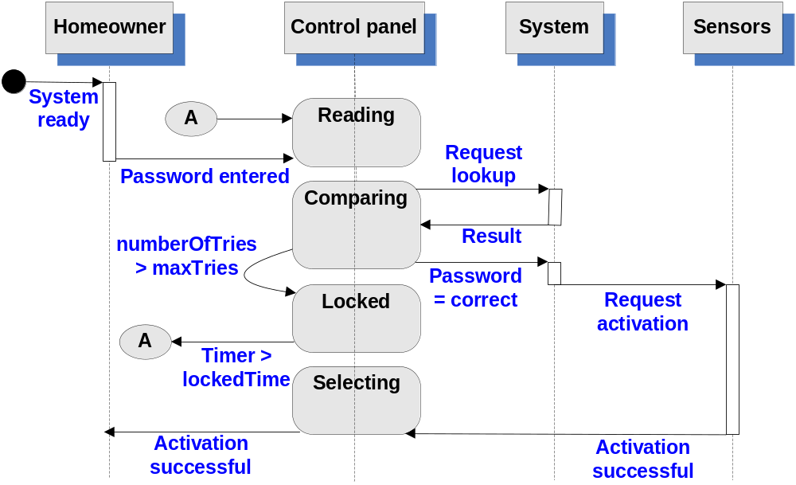
Behavioral Modeling
Sequence Diagram

Slide 6
Flow-Oriented Modeling
computer
based
system
input
output
System = data + function
Data Flow Diagram
Data
External Entity
Process
Data Stores

Slide 7
Flow-Oriented Modeling
Example: [ From《Fundamentals of Software Engineering》]
Information System of a Public Library
if { user requests a book (title, author, user’s name) }
{ Get a book }
→ book, and user’s list of books borrowed;
if { user searches a book by topics }
{ Search by topics }
→ list of book titles referring to the topic.
Notes:
Try it.

Slide 8
Flow-Oriented Modeling
Book
Book request by the user
Shelves
Title and author of requested book;
name of user
Author
List of Authors
Get a
book
Book
Book
reception
Title
Book title;
user name
List of titles
List of books borrowed
Title
Search
by topics
List of topics
Display of list of titles
List of titles
referring to the topic
Topic
Topic
Topic request by the user

Slide 9
Flow-Oriented Modeling
Refinement:
Book request = Find book position + Get a book
Book
Get a
book
Shelves
Book
Book
reception
Author
<shelf#, book#>
List of Authors
Find book
position
Title
Book title;
user name
List of titles
Title and author
of requested book;
name of the user
List of books borrowed
Book requested
by the user

Slide 10
Flow-Oriented Modeling
The Data Flow Hierarchy
a
b
x
P
y
level 0
a
c
P2
level 1
f
P1
P4
b
d
P5
P3
e
g
level 2
f
f1
f2
P4.1
P4.2
P4.5
g
e
e1
e2
P4.3
P4.4

Slide 11
Writing the Software Specification
Everyone knew
exactly what had to be
done until someone
wrote it down!

Slide 12
Specification Guidelines
use a layered format that provides increasing detail
as the "layers" deepen
use consistent graphical notation and apply textual
terms consistently (stay away from aliases)
be sure to define all acronyms
be sure to include a table of contents; ideally,
include an index and/or a glossary
write in a simple, unambiguous style
always put yourself in the reader's position, "Would
I be able to understand this if I wasn't intimately
familiar with the system?"

Slide 13
《Software Requirements Specification》
Due: 22:00 on April 19th, 2015
Minimum requirement of contents:
Introduction (2 points);
User Scenarios(8 points); Data Flow Diagram (7 points); State Diagrams(5 points); Class Diagrams(5 points) and CRC Cards (5 points);
Validation Criteria (15 points).
Concerned points:
The accuracy of the validation criteria: full marks can be obtained if more than 90% of the functions are covered. The acceptance testing of the subsystem version 1.0 will strictly go by the criteria.
The language and style of the document must be uniformed (3 points).
Grading: The full mark = 50 points × number of participants

Slide 14
Requirements Modeling for WebApps
When do we perform analysis?
  the Web or Mobile App to be built is large and/or complex
  the number of stakeholders is large
  the number of developers is large
  the development team members have not worked together before
  the success of the app will have a strong bearing on the success of the business

Slide 15
Requirements Modeling for WebApps
Content Analysis – describe
  text
  graphics and images
  video
  audio
Interaction Analysis – use-cases
Functional Analysis – use-cases that define
  the operations that will be applied to WebApp content
  imply other processing functions
Configuration Analysis – environment and infrastructure
Navigation Analysis – focus on overall requirements

Slide 16
Configuration Model
Server-side
  Server hardware and operating system environment must be specified
  Interoperability considerations on the server-side must be considered
  Appropriate interfaces, communication protocols and related collaborative information must be specified
Client-side
  Browser configuration issues must be identified
  Testing requirements should be defined

Slide 17
Navigation Modeling-I
Should certain elements be easier to reach (require fewer navigation steps) than others? What is the priority for presentation?
Should certain elements be emphasized to force users to navigate in their direction?
How should navigation errors be handled?
Should navigation to related groups of elements be given priority over navigation to a specific element?
Should navigation be accomplished via links, via search-based access, or by some other means?
Should certain elements be presented to users based on the context of previous navigation actions?
Should a navigation log be maintained for users?

Slide 18
Navigation Modeling-II
Should a full navigation map or menu (as opposed to a single “back” link or directed pointer) be available at every point in a user’s interaction?
Should navigation design be driven by the most commonly expected user behaviors or by the perceived importance of the defined WebApp elements?
Can a user “store” his previous navigation through the WebApp to expedite future usage?
For which user category should optimal navigation be designed?
How should links external to the WebApp be handled? overlaying the existing browser window? as a new browser window? as a separate frame?

