Slide 1
Ch.28 Formal Modeling and Verification

Slide 2
Formal Modeling and Verification
Cleanroom software engineering and formal methods
  Both demand a specialized specification approach and each applies a unique verification method.
  Both are quite rigorous and neither is used widely by the software engineering community.
For “bullet-proof” software
Notes:
问题: Is “orderly approach” really so good?

Slide 3
28.1 The Cleanroom Strategy
Increment #1
Box Structure
Specification
Formal
Design
Correctness
Verification
Code
Inspection
Requirements
Gathering
Statistical
Use
Testing
Certification
Test Planning
Increment #2
Box Structure
Specification
Formal
Design
Correctness
Verification
Code
Inspection
Software
Engineering
Requirements
Gathering
Statistical
Use
Testing
Certification
Test Planning
Increment #n
Box Structure
Specification
Formal
Design
Correctness
Verification
Code
Inspection
Requirements
Gathering
Statistical
Use
Testing
Certification
Test Planning

Slide 4
28.1 The Cleanroom Strategy
Increment Planning— adopts the incremental strategy
Requirements Gathering— defines a description of customer level requirements (for each increment)
Box Structure Specification— describes the functional specification
Formal Design— specifications (called “black boxes”) are iteratively refined (with an increment) to become analogous to architectural and procedural designs (called “state boxes” and “clear boxes,” respectively)
Correctness Verification— verification begins with the highest level box structure (specification) and moves toward design detail and code using a set of “correctness questions.” If these do not demonstrate that the specification is correct, more formal (mathematical) methods for verification are used
Code Generation, Inspection and Verification— the box structure specifications, represented in a specialized language, are transmitted into the appropriate programming language

Slide 5
28.1 The Cleanroom Strategy
Statistical Test Planning— a suite of test cases that exercise of “probability distribution” of usage are planned and designed
Statistical Usage Testing— execute a series of tests derived from a statistical sample (the probability distribution noted above) of all possible program executions by all users from a targeted population
Certification— once verification, inspection and usage testing have been completed (and all errors are corrected) the increment is certified as ready for integration.

Slide 6
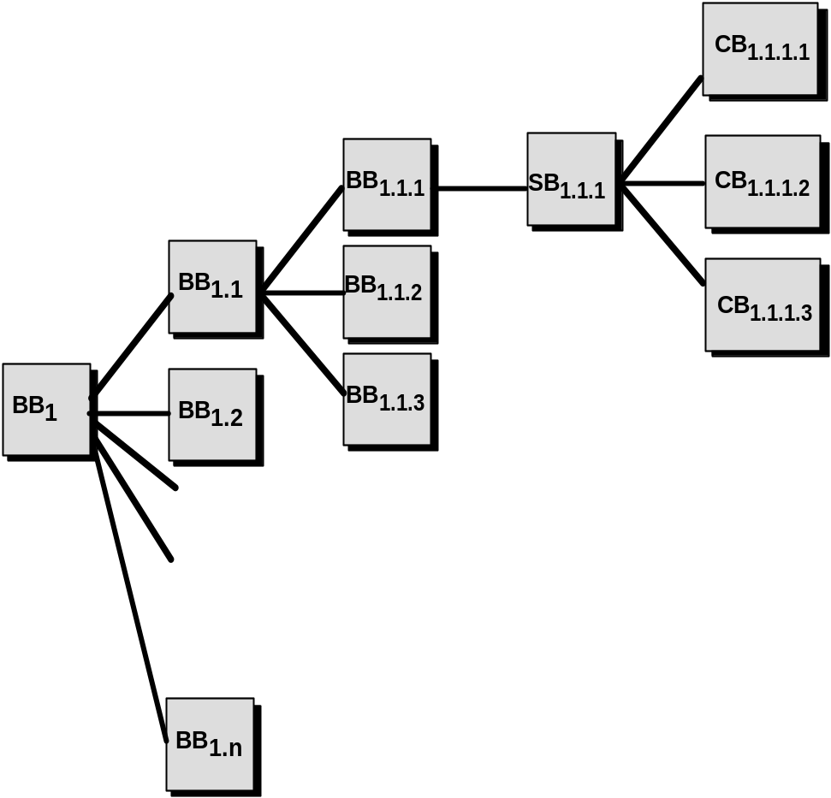
28.2 Functional Specification
S
f : S* R
R
black box
clear box
State
T
g
12
S
g
11
c
g1
R
g
13
state box
State
T
S
black box,
g
R

Slide 7
28.3 Cleanroom Design
Design Refinement
  If a function f is expanded into a sequence g and h, the correctness condition for all input to f is:
    Does g followed by h do f ?
  When a function f is refined into a conditional (if-then-else), the correctness condition for all input to f is:
    Whenever condition <c> is true does g do f and whenever <c> is false, does h do f ?
  When function f is refined as a loop, the correctness conditions for all input to f is:
    Is termination guaranteed?
    Whenever <c> is true does g followed by f do f, and whenever <c> is false, does skipping the loop still do f ?

Slide 8
28.3 Cleanroom Design
Design Verification
  It reduces verification to a finite process
  It lets cleanroom teams verify every line of design and code
  It results in a near zero defect level
  It scales up
  It produces better code than unit testing

Slide 9
28.4 Cleanroom Testing
Statistical Use Testing
  tests the actual usage of the program
  determine a “usage probability distribution”
    analyze the specification to identify a set of stimuli
    stimuli cause software to change behavior
    create usage scenarios
    assign probability of use to each stimuli
    test cases are generated for each stimuli according to the usage probability distribution

Slide 10
28.4 Cleanroom Testing
Certification
  Usage scenarios must be created
  A usage profile is specified
  Test cases are generated from the profile
  Tests are executed and failure data are recorded and analyzed
  Reliability is computed and certified

Slide 11
28.4 Cleanroom Testing
Certification
  Sampling model. Software testing executes m random test cases and is certified if no failures or a specified numbers of failures occur. The value of m is derived mathematically to ensure that required reliability is achieved
  Component model. A system composed of n components is to be certified. The component model enables the analyst to determine the probability that component i will fail prior to completion
  Certification model. The overall reliability of the system is projected and certified

Slide 12

28.5-6 Formal Methods
Formal methods used in developing computer systems are mathematically based techniques for describing system properties. Such formal methods provide frameworks within which people can specify, develop, and verify systems in a systematic, rather than ad hoc manner.
—— The Encyclopedia of Software Engineering [Mar01]
The Problem with conventional specs
  contradictions
  ambiguities
  vagueness
  incompleteness
  mixed levels of abstraction

Slide 13
28.5-6 Formal Methods
Formal Specification
  Desired properties— consistency, completeness, and lack of ambiguity —are the objectives of all specification methods
  The formal syntax of a specification language enables requirements or design to be interpreted in only one way, eliminating ambiguity that often occurs when a natural language (e.g., English) or a graphical notation must be interpreted
    The descriptive facilities of set theory and logic notation enable clear statement of facts (requirements)
  Consistency is ensured by mathematically proving that initial facts can be formally mapped (using inference rules) into later statements within the specification

Slide 14
28.5-6 Formal Methods
Concepts
  data invariant— a condition that is true throughout the execution of the system that contains a collection of data
  state
    Many formal languages, such as OCL (Appendix3) , use the notion of states, that is, a system can be in one of several states, each representing an externally observable mode of behavior
    The Z language (Appendix3) defines a state as the stored data which a system accesses and alters
  operation— an action that takes place in a system and reads or writes data to a state
    precondition defines the circumstances in which a particular operation is valid
    postcondition defines what happens when an operation has completed its action

