Slide 1
Computer Organization & Design The Hardware/Software Interface
Xiaohong Jiang
CourseWebsite：https://course.zju.edu.cn/
Email: jiangxh@zju.edu.cn

Slide 2
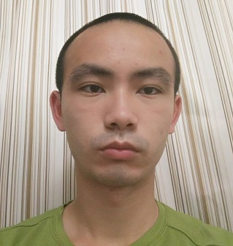
Teacher Info
Teacher: Jiang Xiaohong （姜晓红）
Office: room 520, CaoGuangBiao building
mobile: 13396550102
email: jiangxh@zju.edu.cn
Homepage: http://mypage.zju.edu.cn/jiangxh
courseweb: https://course.zju.edu.cn/
Ye Dayuan (叶大源)

Slide 3

Topics
Why we learn Computer Organization?
What we will learn ?
How to learn ?
Grading Policy

Slide 4
Why learn Computer Organization?程地位
Hardware Course Series
并行处理
Parallel Processing
高级计算机体系结构
Advanced CA
分布式系统
Distributed System
存储技术基础
Storage Technology Fundations
接口设计
Interface Design
计算机体系结构
Computer Architecture
嵌入式系统
Embedded System
多核程序设计
Multicore Programming
计算机组成
Computer Organization
逻辑与计算机设计基础
Logic and Computer Design Fundamentals
电子线路
Electronic Circuits
模拟线路
Simulation Circuis

Slide 5
Why learn Computer Organization?
编译系统
计算机网络
嵌入式系统
操作系统
计算机体系结构
汇编与接口
大学三年级
计算机组成
数据库系统
大学二年级
高级数据结构与算法分析
数字逻辑设计基础
数据结构基础
计算机系统概论
大学一年级
通识课程
C语言程序设计
大学计算机基础

Slide 6
Why learn Computer Organization?
One of the course in
Graduate Entrance Examination(GEE).
Data structure & Algorithm
Computer Organization,
Operating System,
Computer Network

Slide 7
What we learn in this course?
How the programs can be executed on the hardware ?
How does software instruct the hardware to perform needed functions?
What determines the performance of a program?
What techniques can be used to improve performance ?

Slide 8
What we learn in this course?
How does Hardware support HLL?
Arithmetic for Computers
Datapath and Control (CPU)
Exploiting Memory Hierarchy
Storage, Networks, and Other Peripherals

Slide 9
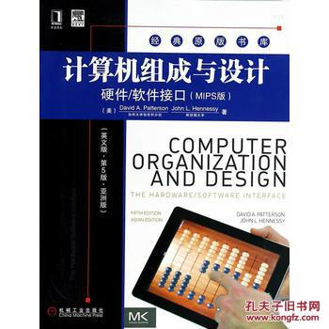
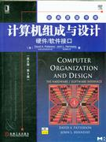
Text book
Computer Organization & Design
—The Hardware /Software Interface,
5th Edition (RISC V version)
John L. Hennessy Stanford University
David A. Patterson CU,Bereley
ISBN: 978-7-111-63111-8

Slide 10
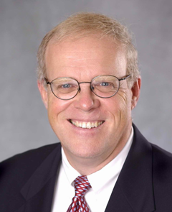

John L. Hennessy
Currently CEO of goole parent firm Alphabet
was serving as the 10th President of Stanford University （2000—2016）
In 1981, Hennessy initiated a project at Stanford that focused on a simpler computer architecture known as RISC. During a sabbatical leave in 1984-85 he cofounded MIPS Computer Systems, now known as MIPS Technologies, which specializes in the production of microprocessors.
Marc Andreessen called him "the
godfather of Silicon Valley."
2001 Eckert-Mauchly Award
2017 Turing award
Marc Andreessen
is an American entrepreneur, investor, and software engineer. He is the co-author of Mosaic, the first widely used Web browser; co-founder of Netscape;^{[3]} and co-founder and general partner of Silicon Valley venture capital firm Andreessen Horowitz. He founded and later sold the software company Opsware to Hewlett-Packard. Andreessen is also a co-founder of Ning, a company that provides a platform for social networking websites. He sits on the board of directors of Facebook, eBay, and Hewlett Packard Enterprise,^{[4]} among others. Andreessen was one of six inductees in the World Wide Web Hall of Fame announced at the First International Conference on the World-Wide Web in 1994.^{[5]}
Hennessy&Patterson获图灵奖后的电视采访
专访： 斯坦福如何培养学生？
Notes:
MIPS (originally an acronym for Microprocessor without Interlocked Pipeline Stages) is a RISC microprocessor architecture developed by MIPS Technologies.
In 1990’s it’s estimated that one of the three RISC chip were based on MIPS.
MIPS CPU architecture greatly influenced later RISC architectures. DEC alpha is one instrance.

Slide 11
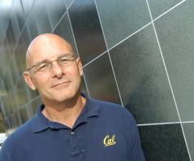
David A. Patterson (UC Berkeley )
He led the design and implementation of RISC I (the foundation of the SPARC architecture )
Leader of RAID
involved in the Network of Workstations (NOW) project
2008 Eckert-Mauchly Award
2017 Turing award
Born in 1947年11月16日
1967年 married
2016年 join Google TPU
对David Patternson的采访
http://archive.computerhistory.org/resources/access/text/2012/04/102658154-05-01-acc.pdf

Slide 12
处理器发展趋势
ISA is most important interface in computer system
where software meets hardware !
Z
开放
POWER
SPARC
众核
高端服务器
PA-RISC
POWER
内核数量大量增加，处理器互联。
Itanium
X86
X86
PC & 服务器
封闭架构
异构
MIPS
Moto 68K
ARM
CPU+GPGPU+FPGA
PPC
MIPS
NP
融合
嵌入式/
移动/消费
ARM
内存体系重构，CPU/内存深度融合，内存更贴近计算。
DSP
学习ARM，谋求复生
完全开放，生态良好
过去：架构众多，百花齐放
现在：生态成熟，架构垄断
未来：摩尔定律失效，寻求多方向突破
Notes:
IA：Intel Architecture 。
PPC：PowerPC 。

Slide 13



主流CPU发展路径
Intel
X86
4004
8008
8086
80286
386
486
pentium
pentiumII
pentiumIII
pentiumIV
Core
286
386
486
K5
K6
K7
K8
K10
POWER1
POWER2
POWER3
POWER4
POWER5
POWER6
PPC
IBM801
PowerPC600
PowerPC700
PowerPC9xx
BE(cell)
MPC750
MPC7400
e100/e200
e300/e500
e600
Pxxxx
MIPS
MIPS3k
MIPS4K
MIPS5K
MIPS10K
MIPS32/64
ARM
ARM7
ARM9
ARM10
ARM11
1970s
1980s
1990s
2000s

Slide 14
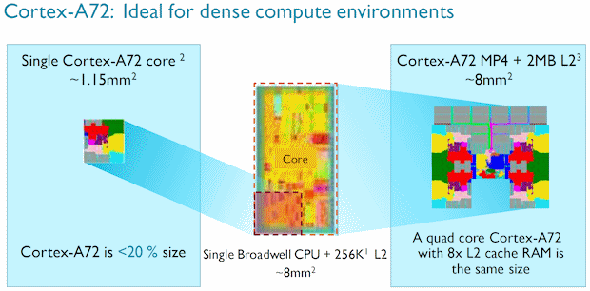

处理器芯片的发展趋势
工艺、主频遇到瓶颈后，开始通过增加核数的方式来提升性能；
芯片的物理尺寸有限制，不能无限制的增加；
ARM的众核横向扩展空间优势明显。
单个X86核面积
~8mm²
单核
多核
众核
单个ARM核面积
~1.15mm²
Notes:
一个ARM核的面积仅为X86核的1/7。
同样的芯片尺寸下，ARM的核数是X86的4倍以上。

Slide 15

ARM 服务器级别处理器一览
Hi1612
32C, 2.1GHz
16nm
Hi1616
32C,2.4GHz
16nm
48C,3.0GHz
7nm
Hi1620
CAVIUM
Thunder-X
48C,2.5GHz
28nm
Thunder-X2
32-54C,3.0GHz
14nm
2400
48Cores,2.2-2.6GHz
14nm
高通
X-Gene3
32C, 3.3GHz 16nm
飞腾
FT1500
16 Cores,1.6GHz
28nm
FT2000+
64Cores,2.3GHz
16nm
横轴代表性能

Slide 16
Open Interfaces work for software
Field | Open Standard | Free, Open Implement. | Proprietary Implement
Networking | Ethernet, TCP/IP | Many | Many
OS | Posix | Linux, FreeBSD | M/S Windows
Compilers | C | Gcc, LLVM | Intel icc, ARMcc
Databases | SQL | MySQL, PostgresSQL | Oracle 12C, M/S DB2
Graphics | OpenGL | Mesa3D | M/S DirectX
ISA | ?????? | -------- | X86, ARM, IBM360, AMD
Why not successful free & open standards and free & open
implementations, like other fields ?
Proprietary ISA fortunes tied to business fortunes and whims.

Slide 17
Today, many ISAs on one SoC
Application processor (usually ARM)
Graphics progcessors
Image processors
Radio DSPs
Audio DSPs
Security processors
Power-management processor
> dozen ISAs on some SoCs – each with unique software stack
Why ?
Apps processor ISA too big， inflexible for accelerators
IP bought from different place， each proprietary ISA
Engineers build home-grown ISA cores

Slide 18
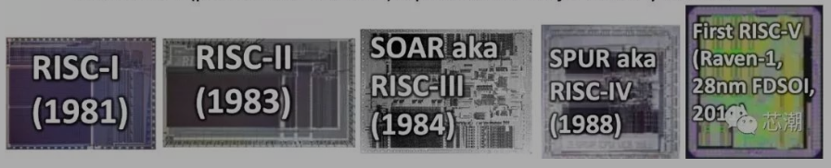
Why RISC V ? Open-source hardware ISA
What if there was one stable free and open ISA everyone could use for everything ?
In 2010， Archi group at UC Berkeley to choose ISA for next set of projects
-x86 impossible –too complex，
ARM mostly impossible –complex， no 64-bit in 2010，
2014， released frozen base user specification

Slide 19
RISC-V Foundation （2015-）
RISC –V Foundation is a non-profit entity serving members and the industry, aims at accelerate RISC-V adoption with shared benefit to the entire community of stake holders.
Drive progression of ratified specs, compliance suit, and other technical deliverables.
Grow the overall ecosystem /membership, promoting diversity while preventing fragmentation
Deepen community engagement and visibility

Slide 20
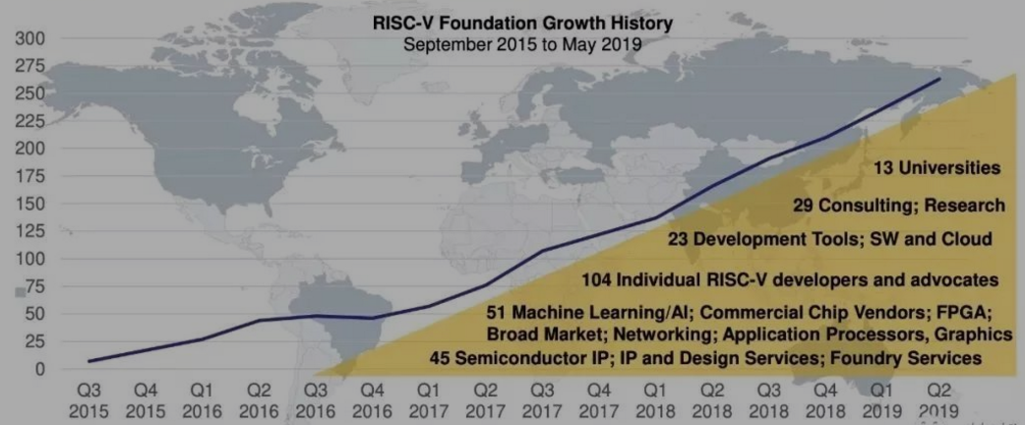
>250 RISC-V members in 28 countries in the world

Slide 21
周 | 理论课 | 对应章节 | 实验课 | 实验占分 | 作业
1 | Ch0 历史及课程简介 Ch1 计算机抽象层次系统 （2） 分层结构（top down) | 1.1—1.11 | Lab0: Introduction to Vivado 介绍和使用 multiplex 封装
2 | Ch3 ALU设计 乘/除法 (3) | 3.1—3.4 | Lab01：实验环境搭建 给IP核，总图，用Verilog代码搭建 | 3% | HW1 基本概念习题
3 | 浮点加法 | 3.5 | Lab02：warmup 32 Reg file，整数ALU部件，时钟 ， 有限状态机 | 3% | HW2 ALU相关习题
4 | Ch2 RISC V 指令集 指令、编程 | 2.1—2.10
5 | 汇编、反汇编 | 2.12—2.14 | Lab03： 复杂操作实现 乘法器/除法器，浮点加法器 | 2% | HW3 RISC编程习题
6 | Ch4 CPU设计实现 单周期CPU数据通路、 | 4.1—4.3 | Lab04：单周期CPU实现 datapath + controller + exception | 11%
7 | 控制器、中断/异常处理 | 4.4 |  |  | HW4 单周期CPU习题
8 | 流水线CPU设计实 | 4.6
9 | forwarding path | 4.7 | Lab05：流水线CPU实现 (只做stall） | 11% | HW5 流水线CPU习题
10 | 控制竞争 | 4.8, | 5 stage + stall
11 | Ch5 存储系统 Cache | 5.1-5.4
12 | Memory | 5.5 | Lab06：Data Cache （*bonus） | 5% | HW6 存储系统习题
13 | Virtual Memory | 5.6-5.9 | 2-way set associative, 4w/block, LRU
14 | Ch6 I/O 系统 trap, 中断
15 | 总线、pooling/Interruption/DMA | app. |  | app.
16 | Review

Slide 22
On GEE
试卷总分及考试时间
满分150分，考试时间180分钟(3小时)
答题方式
答题方式为闭卷、笔试
试卷内容分布
数据结构 45分
计算机组成原理 45分
操作系统 35分
计算机网络 25分
试卷题型结构
单项选择题 80分(40小题，每小题2分)
综合应用题 70分
一般
如应用题23分，则选择题11道
应用题型：简答5分一个，问答10分一个，简单设计10分一个，复杂设计15分

Slide 23
Something about Graduate Entrance Test
2015
Organization & Computer Architecture 49
Single choice 26
Assemble Language/Cache/ Disk 2.93/11
MemoryAddressing/Instruction
execution/pipeline 4.3/12
Data Structure & Algorithm 45=22+23
Operating System 31=16+7+8
Network 25=16+9

Slide 24
Graduate Entrance Test (2015/2016)
内容 | 数据结构 |  | 网络 | 计算机组成 |  | 操作系统 |  | 合计
题号 | 41 | 42 | 43 | 44 | 45 | 46 | 47
满分值 | 13 | 10 | 9 | 12 | 11 | 7 | 8 | 70
平均分 | 5.82 | 5.53 | 4.3 | 4.3 | 2.93 | 1.24 | 2.57 | 28.02
得分 | 44.7% | 55.3% | 47.7% | 35.8% | 26.6% | 18.1% | 32.1%
内容 | 数据结构 |  | 计算机组成 |  | 操作系统 |  | 网络 | 合计
题号 | 42 | 43 | 44 | 45 | 46 | 47 | 41
满分值 | 8 | 15 | 9 | 14 | 6 | 9 | 9 | 70
平均分 | 5.16 | 6.11 | 3.77 | 6.71 | 2.68 | 2.49 | 2.8 | 29.72
得分 | 64.5% | 40.7% | 41.9% | 47.9% | 44.7% | 27.7% | 31.1%

Slide 25
Graduate Entrance Test (2017/2018)
内容 | 数据结构 |  | 计算机组成 |  | 操作系统 |  | 网络 | 合计
题号 | 41 | 42 | 43 | 44 | 45 | 46 | 47
满分值 | 15 | 8 | 13 | 10 | 7 | 8 | 9 | 70
平均分 | 7.06 | 5.46 | 7.03 | 5.15 | 3.15 | 2.34 | 3.15 | 33.34
得分 | 50.7% | 68.3% | 54.1% | 51.5% | 45% | 29.3% | 35%
内容 | 数据结构 |  | 计算机组成 |  | 操作系统 |  | 网络 | 合计
题号 | 41 | 42 | 43 | 44 | 45 | 46 | 47
满分值 | 13 | 12 | 8 | 15 | 8 | 7 | 7 | 70
平均分 | 6.68 | 7.74 | 3.94 | 8.11 | 4.54 | 2.44 | 2.9 | 36.35
得分 | 51.4% | 64.5% | 49.3% | 54.1% | 56.8% | 34.9% | 41.4% | 51.9%

Slide 26
Graduate Entrance Test (2019/ 2020)
内容 | 数据结构 |  | 操作系统 |  | 计算机组成 |  | 网络 | 合计
题号 | 41 | 42 | 43 | 44 | 45 | 46 | 47
满分值 | 13 | 10 | 8 | 7 | 16 | 7 | 9 | 70
平均分 | 5.49 | 4.37 | 1.83 | 3.31 | 6.81 | 3.35 | 4.7 | 29.86
中位分 | 6 | 5 | 1 | 3 | 7 | 3 | 5 | 30
百分制平均分 | 42.23 | 43.7 | 22.87 | 47.28 | 42.56 | 47.86 | 52.22 | 42.66
内容 | 数据结构 |  | 计算机组成 |  | 操作系统 |  | 网络 | 合计
题号 | 41 | 42 | 43 | 44 | 45 | 46 | 47
满分值 | 15 | 8 | 15 | 8 | 7 | 8 | 9 | 70
平均分 | 6.48 | 5.04 | 7.34 | 3.81 | 3.23 | 4.41 | 2.94 | 33.27
中位分 | 4 | 6 | 8 | 4 | 3 | 4 | 2 | 31
百分制平均分 | 43.2 | 63.0 | 48.9 | 47.6 | 46.1 | 55.1 | 32.7 | 47.5

Slide 27
组成考查目标
理解单处理器系统中各部件的内部工作原理、组成结构及相互连接方式，具有完整的计算机系统整机概念。
以RISC V为主,本课程主要介绍的是RISC V, 补充CISC处理器(X86)，嵌入式系统ARM
理解计算机系统层次化结构概念，熟悉硬件与软件之间的界面，掌握指令集体系结构的基本知识和基本实现方法。
包括了汇编，本课程介绍RISC V 汇编；内容还涉及到部分计算机体系结构课程，
能运用组成的基本原理和基本方法，对有关计算机硬件系统中的理论和实际问题进行计算、分析，并能对基本部件进行简单设计。
这部分涉及了数字电路知识，由逻辑与计算机设计基础课程介绍

Slide 28
topic analysis
考纲涉及七大知识点
一、 计算机系统概述
二、 数据的表示和运算
三、 存储器层次机构
四、 指令系统
五、 中央处理器(CPU)
六、 总线
七、 输入输出(I/O)系统
contents of this course
一、introduction
二、 instruction system（RISC V）
三、computer algebra including data representatives and ALU design
四、processor including data path and controller
五、Memory hierarchy
六、I/O including bus
结论：在大知识点上，本课程覆盖大纲

Slide 29
How ?
Attitude:
天降大任于斯人也，必先苦其心志，劳其筋骨，饿其体肤，空乏其身，行指乱其所为，所以动心忍性，曾益其所不能。
——《孟子》
凡事都要脚踏实地去作，不弛于空想，不骛于虚声，而惟以求真的态度作塌实的工夫。以此态度求学，则真理可明，以此态度作事，则功业就。
—— 李大钊
古今中外，凡成就事业，对人类有作为的无一不是脚踏实地、艰苦攀登的结果。
—— 钱三强

Slide 30
How?
教学相长
授人以鱼不如授人以渔：
教学环节
课堂：引出知识点,引导方向，分析难点，讨论解决问题的途经，节省课余时间，提高自学的效率。
课后：自学、预习、复习、讨论
Homework
Pop quiz
Mid-term test
Final examination
Lab assignments

Slide 31
Grading Policy (Theory70%+lab 30%)
Theory (70%)
Quiz + 6 Homework 20%
Midterm test 10%
Final Examination 40%
English, Close-book test with one A4 memo.
Lab assignments 30%
Lab Bonus <=5%
Important:
Final grade = final exam (40%) + others (60%) (max 60)

Slide 32
Important Note about Grading
Don’t ask me for a higher score after the final examination no matter what reason you have !
Otherwise you get 10% off from your original score.
If you miss the quiz, you get Zero for the quiz, NO matter what reason !
Please contact TA in time once you find mistake of your grading on course website.

Slide 33
Assigments submission via Website
Group discussion is strongly encouraged, but you need to do and submit your homework individually.
Submission deadline will be announced on course website. Please note that homework need to be submitted in time.
Lab report should be submit by the deadline and only via the course website.

Slide 34
Lab Grading Policy
60% checking (submit your project )
+ 40% report (submit your lab report in doc or pdf)
Please finish your lab assignment before deadline
Please prepare carefully before checking, because you get your grade according the checking result.
You have only 2 chances to check for each Lab
Please be well prepared for checking, if you failed for the 1st check and pass through in the 2nd check, you can only get 90% of 100.
If you can present your lab results correctly and answer the questions without error, then you pass through the check.

Slide 35
Honesty Policy: Very important !
Discussion is greatly encouraged. But NO COPY ! Don’t look at others’ answer sheets !
Cheating is strictly prohibited ! Copy any file of other group or providing files to other group are considered cheating ! In both cases the two groups will get ZERO in homework.
Don't fail to do good even if it's small; don't engage in evil even if it's small.
勿以善小而不为，勿以恶小而为之

Slide 36
Course materials
Course Website
http://course.zju.edu.cn
Office : CaoGuangbiao Building, room520

Slide 37
Break Time !

