Slide 1
Chapter 2 Instructions: Language of the Computer

Slide 2
The process of compiling and assembling
Assembly Instruction
a symbolic representation of machine instructions

Slide 3
2.1 Introduction
Language of the machine
Instructions
Instruction set
Computer Designer goals
Find a language that makes it easy to build hardware and compiler.
Maximize performance
Minimize cost & energy
Clarity of its application
Simplicity: reduce design time
Our chosen instruction set: RISC V

Slide 4
MIPS & ARM & RISC V
Category | RISC V | MIPS | ARM
Arithmetic | ADD x5, x6, x7 | ADD $r1, $r2, $r3 | ADD r1, r2, r3
 | SUB x5, x6, x7 | SUB $r1, $r2, $r3 | SUB r1, r2, r3
Data Transfer | LW x5, 100(x6) | LW $r1, 100($r2) | LDR r1, [r2, #100]
 | SW x5, 100(x6) | SW $r1, 100($r2) | SDR r1, [r2, #100]
 | LH x5, 100(x6) | LH $r1, 100($r2) | LDRH r1, [r2, #100]
 | SH x5, 100(x6) | SH $r1, 100($r2) | SDRH r1, [r2, #100]
Logical | AND x5, x6, x7 | AND $r1, $r2, $r3 | AND r1, r2, r3
 | SLL x5, x6, x7 | SLL $r1, $r2, 10 | LSL r1, r2, #10
Conditional branch | BLT x5, x6, Lable | SLT $r1, $r2, $r3 | CMP r1, r2
 | BEQ x5, x6, 100 | Beq $r1, $r2, Lable | BEQ Lable
 | BNE x5, x6, 100 | Bne $r1, $r2, Lable
Unconditional branch | BEQ x0, x0, Lable | J Lable | B Label
 | JAL x1, 100 | JAL Lable | BL Label
 | JALR x1, 100(x5) | JR $ra | Mov PC LR

Slide 5
Von Neumann’ Computer
Today’s computers are built on 2 key principles: (Stored-program concept)
①Instruction are represented as numbers.
②Programs can be stored in memory to be read or written just like numbers.

Slide 6
Four Design Principles
1. Simplicity favors regularity
2. Smaller is faster
3. Good design demands good compromises
4. Make the common case fast

Slide 7
If you are asked to design the instruction set of computer, what will be the main elements ?

Slide 8
Contents of Chapter 2
2.1 Introduction
2.2 Operations of the Computer Hardware
2.3 Operands of the Computer Hardware
2.4 Signed and Unsigned Numbers （have introduced in ALU）
2.5 Representing Instructions in the Computer
2.6 Logical Operation
2.7 Instructions for Making Decisions
2.8 Supporting Procedures in Computer Hardware
2.9 Communicating with People
2.10 RISC-ＶAddressing for Wide Immediates and Addresses
Notes:
机器语言的特征：操作，符号数，表示形式
与算法语言基本相同，唯一不同是直接针对硬件。下面要针对硬件，上面要针对算法软件。

Slide 9
2.11 Parallelism and Instructions: Synchronization
2.12 Translanting and starting a Program
*How Compilers Optimize
*How Compilers Work
2.13 A C Sort Example to Put It All together
*Implementing an Object-Oriented Language
2.14 Arrays Versus Pointers
2.16 Real Stuff: MIPS Instructions
2.17 Real Stuff: x86 Instructions
2.18 Real Stuff: the rest of RISC-V Instruction Set
2.19 Fallacies and Pitfalls
2.20 Concluding Remarks
2.21 Historical Perspective and Further Reading
Notes:
算法语言和机器语言之间是怎么转换的

Slide 10
Instruction Set
Important design principles when defining the
instruction set architecture (ISA):
keep the hardware simple – the chip must only
implement basic primitives and run fast
keep the instructions regular – simplifies the
decoding/scheduling of instructions

Slide 11
Instruction characteristics
wide variety
Operators
Op
Operands
Type of internal storage in processer （Stack/Accu/GP register)
The number of the memory operand in the instruction
(0 ~ 3)
Operations in the instruction Set
Type and Size of Operands
Representation in the Computer
Encoding
Notes:
操作数有不同含义：一个直接就是操作数，还有一个是告诉操作数所在的位置，这就叫寻址。
不同的处理器架构在指令格式上也有不同的特征，主要体现在5个方面。
历史上允许的存储器操作数最多的是3个。X86允许存储器中的操作数有2个，mips，RISC-V是不允许的
运算指令，传输指令，转移指令
硬件直接支持的操作数类型和大小：80%以上的操作数32位，95%以上的操作数64位
RISC-V是定长的指令格式，Intel是不定长。
这5个特征是关于指令的，但是他们实质性地影响着处理器的具体架构。后期architecture还会深入介绍。

Slide 12
Type of internal storage in processer
Stack
Accumulator
General purpose register
Register-Memory
Register-Register：load/store
Notes:
1.堆栈现在用的很少，但是在一些外部设备，接口中还会用到。比如磁盘的一些参数（磁道，扇区等等）放入堆栈。堆栈一开始使用是为了方便高级算法语言ALGOL，但是不够灵活。堆栈不仅可以在存储器中，也可以在寄存器中。
2.累加器，现在也还用的比较多，有一个操作数在累加器中，一个在存储器中，运算结果放在累加器中。比堆栈结构灵活。
3.Intel构架在2和3之间，所以又叫累加器扩展器，一开始在第1版教材是作为反面例子介绍的。80年代初，RICS问世之后，反响很好，广泛地被工作站，服务器接受，但是台式机方面没有获得很大的成功。Intel号称自己有8个寄存器，但实际上通用的只有4个。
3.Motorola处理器，比较多的GPR寄存器：通用寄存器，没有任何限制的寄存器。

Slide 13
The number of the memory operand In the instruction
Register-Register
Maximum number of operands allowed 3
Number of memory addresses is 0
Register-memory
Maximum number of operands allowed 2
Number of memory addresses is 1
Memory-memory
Maximum number of operands allowed 2 or 3
Number of memory addresses is 2 or 3
Notes:
RISC-V是第一类

Slide 14
Variables difference
C
Int i； char f；
Instruction Set
Register
Memory address
Displacement
Immediate
Stack
Notes:
算法语言把硬件细节屏蔽起来，是一个抽象，用字母表示就可以了。
但是机器指令是指向硬件的，所以他的变量也是直接指向硬件的，他的变量直接就是变量存放的载体。
80%的寻址方式是偏移量。
数组，堆是用堆栈方式

Slide 15
2.2 Operations of the Computer Hardware
Every computer must be able to perform arithmetic:
Only one operation per instruction
Exactly three variables(add a, b, c # a=b+c)
Design Principle 1
Simplicity favors regularity(简单源自规整，指令包含3个操作数）
Example(p65) Compiling two C assignment statements into RISC-V
C code:
a = b + c;
d = a – e;
RISC-V code:
add a, b, c
sub d, a, e
Notes:
我们从最简单的指令看起，首先看下算术指令。
对于所有的计算机来说，最基本的操作就是算术操作。
要求每条指令有且只有三个操作数，实际三个操作数是三个寄存器。
符合硬件简单性的设计原则：简单源于规整。设计指令集架构时的原则：
keep the hardware simple – the chip must only implement basic primitives and run fast
keep the instructions regular – simplifies the decoding/scheduling of instructions
B,c是源操作数，
C code是赋值语句，但是risc-v code只是算术操作，还不完整，还要加上其他操作。

Slide 16
Example Compiling a complex C assignment
C code:
f = ( g + h ) – ( i + j );
RISC-V code:
add t0, g, h // temporary variable t0 contains g + h
add t1, i, j // temporary variable t1 contains i + j
sub f, t0, t1 // f gets t0 – t1
RISC-V assembly language
Category | Instruction | Example | Meaning | Comments
Arithmetic | add | add a,b,c | a←b+c | Always three operands
 | subtract | sub a,b,c | a←b-c | Always three operands
Notes:
再来看一条更复杂一些的C语言赋值语句。
高级语言的代码量更少

Slide 17
2.3 Operands of the Computer Hardware
Register Operands
Memory Operands
Constant or Immediate Operand

Slide 18
Register Operands
Arithmetic instructions operands must be registers or immediate
32 registers in RISC-V
64 bits for each register in RISC-V
Design Principle 2
Smaller is faster（越少越快，寄存器个数一般不超过32个）
RISC-v register operand
Size is 64 bits, which named doubleword （we use 32 bits)
Notes:
高级语言的操作数是变量
算术指令操作数是寄存器，寄存器操作数，这是最快的。
32个寄存器有一些特殊的，比如$zero就是专门存放0的。
寄存器不是越多越好，32个是比较平衡的个数。寄存器太多，电信号传输距离越远，传输时间越长，所以会延长时钟周期。
还有一个原因是指令格式的位数限制。

Slide 19
RISC-V register conventions
Name | Register name | Usage | Preserved On call?
x0 | 0 | The constant value 0 | n.a.
x1(ra) | 1 | Return address(link register) (ra) | yes
x2(sp) | 2 | Stack pointer (sp) | yes
x3(gp) | 3 | Global pointer (gp) | yes
x4(tp) | 4 | Thread pointer (tp) | yes
x5-x7 | 5-7 | Temporaries (t0~t2) | no
x8-x9 | 8-9 | Saved (s0~s1) | yes
x10-x17 | 10-17 | Arguments/results (a0~a7) | no
x18-x27 | 18-27 | Saved (s2~s11) | yes
x28-x31 | 28-31 | Temporaries (t3~t6) | no
Notes:
RISC-V约定在“x”后面跟一个编号来表示寄存器。

Slide 20
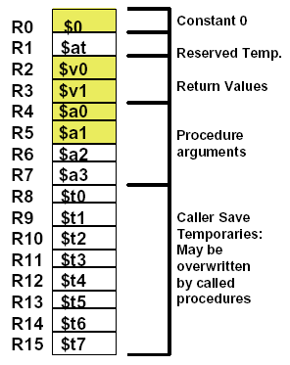
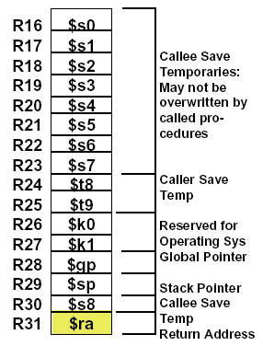
MIPS Register Conventions

Slide 21
RISC-V operands
Name | Example | Comments
32 registers | x0-x31 | Fast locations for data. In RISC-V, data must be in registers to perform arithmetic. Register x0 always equals 0.
2⁶¹ memory words | Memory[0], Memory[8] , …… , Memory[18446744073709551608] | Accessed only by data transfer instructions. RISC-V uses byte addresses, so sequential doubleword accesses differ by 8. Memory holds data structures, arrays, and spilled registers.
Notes:
2^64 – 1844674407370955161 【18446744073709551608， 最后一个字节】
Memory[0] 和 Memory[1] 差一个byte
Memory[8] 和 Memory[0] 差8个byte，doublewords
2^64寻址空间， 每一个doubleword是8个字节。
byte addresses： 每一个地址对应的是一个byte

Slide 22
Example(p67) Compiling a C statement using registers，suppose f,g,h,i,j are assigned x19~x23
C code
f = ( g + h ) – ( i + j ) ;
RISC-V code
add x5, x20, x21 // register x5 contains g + h
add x6, x22, x23 // register x6 contains i + j
sub x19, x5, x6 // f gets x5 – x6, which is ( g+h)–(i+j)
Notes:
这里只有运算，没有存取操作

Slide 23
Memory Operands
3
1
0
0
2
1
0
Advantage
Could save much more data
Save complex data structures
Arrays and structures
Data transfer instructions
Load: from memory to register; load world/doubleword ( lw/ld )
Store: from register to memory; store world/doubleword( sw/sd )
Memory addresses and contents at those locations
1
1
0
1
0
1
Address
D
a
t
a
Processor
Memory
Notes:
程序语言中，有些复杂的数据结构，比如数组和结构体（struct），这些复杂的数据结构可以包含比寄存器数量更多的数据，这些复杂的数据结构需要保存在内存中。
RISC-V算术运算指令只作用于寄存器，所以必须有数据传送指令。
Memory好比一个很大的一维数组，memory address相当于数组下标

Slide 24
Memory Operands
Memory is byte addressed
Each address identifies an 8-bit byte
RISC-V is Little Endian
Least-significant byte at least address of a word
c.f. Big Endian: most-significant byte at least address
RISC-V(or x86) does not require words to be aligned in memory
Unlike some other ISAs ( MIPS)

Slide 25
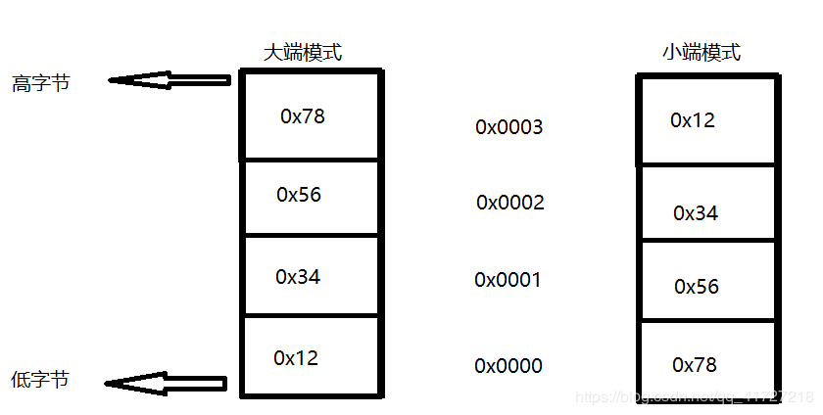
Endianness/byte order
Big endian：
数据的高字节存放在低地址；
数据的低字节存放在高地址
PowerPC
Little endian：
数据的高字节存放在高地址；
数据的低字节存放在低地址
RISC-V
E.g. : 32位机器上存放0x12345678，其大小端模式存储如下：
Notes:
小端模式便于机器处理, 大端模式方便人阅读
C/C++语言编写的程序里数据存储顺序是跟编译平台所在的CPU相关的，现在比较普遍的x86是小端
而JAVA编写的程序则唯一采用big endian方式来存储数据。
所有网络协议也都是采用big endian的方式来传输数据的。所以有时我们也会把big endian方式称之为网络字节序。
目前应该little endian是主流，因为在数据类型转换的时候（尤其是指针转换）不用考虑地址问题。

Slide 26
Memory Alignment: ( faster data transfer ) each variable stores at a word address
struct {
int a;
char b;
char c[2];
char d[3]
float e;
}
正确
e
Unused | D[2] | D[1] | D[0]
Unused | Unused | C[1] | C[0]
Unused | Unused | Unused | b
a
错误
错误
因为内存一次只能读出4字节内存中的一行
这样布局，e变量不能一次读出
Unused | e
e | D[2] | D[1] | D[0]

Slide 27
Data Transfer instruction
The format of a load instruction:
destination register
source address
lw $t0, 8($t3) ; $t0 ← MEM[ $t3 + 8 ]
any register
a constant that is added to the register in brackets
Could you explain “Sw $t0, 8($t3)” ?

Slide 28
Example(p69 ) Compiling with an operand in memory
A6
A5
A4
A3
A2
A1
A0
C code:
g = h + A[8] ; // A is an array of 100 doublewords ( Assume: g ---- x20 h ---- x21
base address of A ---- x22 )
RISC-V code:
ld x9, 64(x22) // temporary reg x9 gets A[8]
add x20, x21, x9 // g = h + A[8]
Offset:
the constant in a data transfer instruction → 64
Base register:
register added to form the address →64(x22)
Base Addr
Notes:
The operands for all arithmetic and logic operations are contained in registers. To operate on data in main memory, the data is first copied into registers. A load operation copies data from main memory into a register. A store operation copies data from a register into main memory .
这条语句只有一个运算，但是有一个操作数在存储器中，我们首先要讲A[8]传送到寄存器中。
除了讲变量与寄存器对应起来，complier还将数组和结构这样的数据结构分配到存储器中相应的位置，并且把起始地址放在数据传送指令中。
在load指令中，Base register，最初用于保存数组下标，这是偏移量表示数组的起始地址。因此，base register也叫做下标寄存器。现在存储器比以前大得多，所以把数组的基地址放到寄存器中
Alignment restriction (对齐限制)：在许多体系结构中，字的起始地址必须是4的倍数，双字的起始地址必须是8的倍数。

Slide 29
Example(p71) Compiling using load and store
C code:
A[12] = h + A[8] ; // A is an array of 100 double words ( Assume: h ---- x21 base address of A ---- x22 )
RISC-V code:
ld x9 , 64(x22) // temporary reg x9 gets A[8]
add x9, x21, x9 // temporary reg x9 gets h + A[8]
sd x9, 96(x22) // stores h + A[8] back into A[12]
Notes:
这是一个完整的赋值语句。
偏移量加基址寻址的方式非常适用于数组和结构体。寄存器可以指向结构的起始地址，偏移量可以选择所需的元素。后面我们还会专门讲解这种例子。

Slide 30
Discussion：How to represent?
g = h + A[i]
( Assume: g, h, i – x18, x19, x20 base address of A – x22 )

Slide 31
Example 2.6: g = h + A[i]
Example 2.6 Compiling using a variable array index
C code:
g = h + A[i] ; // A is an array of 100 doublewords ( Assume: g, h, i – x18, x19, x20 base address of A – x22 )
RISC-V code:
add x5, x20, x20 # temp reg x5 = 2 * i
add x5, x5, x5 # temp reg x5 = 4 * i
add x5, x5, x5 # temp reg x5 = 8 * i
add x5, x5, x22 # x5 = address of A[i] (8 * i + x22)
ld x6, 0(x5) # temp reg x6 = A[i]
add x18, x19, x6 # g = h + A[i]
Notes:
所以我们也知道机器语言是怎么样支持数组的，对数组一定会分配连续的一段空间，一定会有一个首地址，数组的基地址。存取数据的时候需要计算偏移量。

Slide 32
Registers vs. Memory
Registers are faster to access than memory
Operating on memory data requires loads and stores
More instructions to be executed
Compiler must use registers for variables as much as possible
Spilling registers -- Putting less commonly used variables (or those needed later) into memory
Register optimization is important!
Notes:
寄存器更快，而且寄存器可以同时读取两个寄存器，并对它们进行操作并写入结果。
而数据传输指令只能读取或写一个操作数，并且不对其进行操作。所以寄存器和存储器相比，不仅访问时间短，而且吞吐率高。为了获得最高的性能，必须有效地使用寄存器。
Spilling register: 许多程序的变量个数比寄存器多，编译器会尽量将常用的变量保存在寄存器中，不常用的变量放到存储器中，这个过程就是寄存器换出。
有些高级语言有寄存器变量，尽量不要用，用了之后就减少了一个寄存器的使用，特别是x86, 寄存器Ax-Dx（通用）, BP, SI, DI（有一些专属的）
根据2015的技术，寄存器的访问速度大概是DRAM的200倍，这些巨大的差异导致了缓存的出现。

Slide 33
What if many variables ?
Spilling registers:
Putting less commonly used variables (or those needed later) into memory.

Slide 34
Discussion：How to represent?
Constant
g = h + 55
Many time a program
will use a constant in an operation
Notes:
有超过一半的算术指令有一个常数操作数。

Slide 35
Constant or Immediate Operands
Many time a program will use a constant in an operation
Incrementing index to point to next element of array
Add the constant 4 to register x22
Assuming AddrConstants 4 is address pointer of constant 4
ld x9, AddrConstant4(x3) // x9=constant 4
add x22, x22, x9
Immediate: Other method for adding constant 4 to x22
Avoids the load instruction
Offer versions of the instruction
addi x22, x22, 4 // x22= x22+ 4
x3
….
AddrConstants 4
4
功能测试程序生成常数方式非常累赘，可以用此方法代替。前提是要初始化
Notes:
只使用目前介绍过的指令，我们需要在程序加载的时候就把常数放在内存中，把常量放到存储器中是操作系统和编译器共同完成。
在程序执行的时候把常数从内存中取出来才能使用。
和从存储器中取出常数相比，立即数指令速度更快，能耗更低。

Slide 36
Immediate Operands
Constant data specified in an instruction
addi x22, x22, 4
Design Principle 3：Make the common case fast
Small constants are common
Immediate operand avoids a load instruction
Constant zero: a register x0
Notes:
常数0是经常使用的，0的有效使用可以简化指令系统结构。例如，利用x0求一个数的相反数。因此，有一个专用寄存器x0硬连线到常数0

Slide 37
2.4 signed and unsigned numbers
Bits are just bits (no inherent meaning): conventions define relationship between bits and numbers
Binary numbers (base 2) 0000 0001 0010 0011 0100 0101 0110 0111 1000 1001... decimal: 0...2^{n}-1
Of course it gets more complicated: numbers are finite (overflow) fractions and real numbers negative numbers
How do we represent negative numbers? which bit patterns will represent which numbers?

Slide 38
Unsigned Binary Integers
Given an n-bit number
Range: 0 to +2^{n} – 1
Example
0000 0000 0000 0000 0000 0000 0000 1011₂ = 0 + … + 1×2³ + 0×2² +1×2¹ +1×2⁰ = 0 + … + 8 + 0 + 2 + 1 = 11₁₀
Using 64 bits
0 to 2⁶⁴ -1(18,446,774,073,709,551,615)
Notes:
最低有效位（least significant bit）: 最右边
最高有效位（most significant bit）：最左边

Slide 39
2’s-Complement Signed Integers
Given an n-bit number
Range: –2^{n – 1} to +2^{n – 1} – 1
Example
1111 1111 1111 1111 1111 1111 1111 1100₂ = –1×2³¹ + 1×2³⁰ + … + 1×2² +0×2¹ +0×2⁰ = –2,147,483,648 + 2,147,483,644 = –4₁₀
Using 64 bits
–9,223,372,036,854,775,808 to + 9,223,372,036,854,775,807
Notes:
取反+1

Slide 40
2’s-Complement Signed Integers
Bit 63 is sign bit in a 64-bits integer
1 for negative numbers
0 for non-negative numbers
–(–2^{n – 1}) can’t be represented
Non-negative numbers have the same unsigned and 2s-complement representation
Some specific numbers
0: 0000 0000 … 0000
–1: 1111 1111 … 1111
Most-negative: 1000 0000 … 0000
Most-positive: 0111 1111 … 1111

Slide 41
Signed Negation
Complement and add 1
Complement means 1 → 0, 0 → 1
Example: negate 2
+2 = 0000 0000 … 0010₂
–2 = 1111 1111 … 1101₂ + 1 = 1111 1111 … 1110₂

Slide 42
Sign Extension
Representing a number using more bits
Preserve the numeric value
Replicate the sign bit to the left
c.f. unsigned values: extend with 0s
Examples: 8-bit to 16-bit
+2: 0000 0010 => 0000 0000 0000 0010
–2: 1111 1110 => 1111 1111 1111 1110
In RISC-V instruction set
lb: sign-extend loaded byte
lbu: zero-extend loaded byte

Slide 43
Other representations
text characters
ASCII,GB2312,Unicode(UTF-8)
Floating point numbers
numeric calculations
Different grades of precision
Single precision (IEEE)
Double precision (IEEE)
Quadruple precision
Instructions in the Computer

Slide 44
2.5 representing Instructions in the computer
All information in computer consists of binary bits
Instructions are encoded in binary
Called machine code
Mapping registers into numbers
map registers x0 to x31 onto numbers 0 to 31
RISC-V instructions
Encoded as 32-bit instruction words
Small number of formats encoding operation code (opcode), register numbers, …
Regularity!
Notes:
每条指令的各个部分都可以被视为一个单独的数，把这些数字并排拼到一起便形成了指令。

Slide 45
Example(p81) Translating assembly into machine instruction
RISC-V code
add x9, x20, x21
Decimal version of machine code
| 0 | 21 | 20 | 0 | 9 | 51 |
Binary version of machine code
| 0000000 | 10101 | 10100 | 000 | 01001 | 0110011 |
7 bits 5 bits 5 bits 3 bits 5 bits 7 bits
0000 0001 0101 1010 0000 0100 1011 0011_{two} = 015A04B3₁₆
Notes:
一条指令的每一段称为一个字段。每个字段有固定的长度。指令的这种分段设计叫做指令格式 (format)
0，0，51这三个字段组合起来指明要进行加法操作。
指令的符号表示叫汇编语言，数字表示叫机器语言（机器码），
二进制字串太冗长，我们通常用16进制表示。

Slide 46
RISC-V R-format Instructions
R-type or R-format
| funct7 | rs2 | rs1 | funct3 | rd | opcode |
7 bits 5 bits 5 bits 3 bits 5 bits 7 bits
opcode : basic operation and format of an instruction.
rd : the register destination operand.
funct3: an additional opcode field.
rs1: the first register source operand.
rs2: the second register source operand.
funct7: an additional opcode field.
Notes:
Question: Why aren’t opcodeand funct7and funct3 a single 17-bit field?–We’ll answer this later
对齐其他field，节省硬件
To speed up decoding, the base RISC-V ISA puts the most important fields in the same place in every instruction. As you can see in the instruction formats table, The major opcode is always in bits 0-6.The destination register, when present, is always in bits 7-11. The first source register, when present, is always in bits 15-19.The second source register, when present, is always in bits 20-24.
Add, sub指令都是这种格式，这种指令格式称为R-type
32个寄存器，5位就够了
但是对于ld或者addi指令，偏移量如果被限制在5位字段（最大数是31），就太小了，我们需要更长的字段。

Slide 47
Design Principle 4
Good design demands good compromises
All instructions in RISC-V have the same length
Conflict: same length ←--→ single instruction
Notes:
课本84页
有些地方需要3寄存，有些地方需要2寄存器，寄存器的寻址范围比较有限
所有指令保持相同长度和单一的指令格式之间就产生了矛盾。
折中方案是保持所有指令长度相同，对于不同的指令，使用不同的指令格式。
VLIW：(Very Long Instruction Word，超长指令字)一种非常长的指令组合，它把许多条指令连在一起，增加了运算的速度。 超长指令字(VLIW)是指令级并行，超线程(Hyper-Threading)是线程级并行，而多内核则是芯片级并行。这三种方式都是提高并行计算性能的有效途径。

Slide 48
RISC-V I-format Instructions
I-format
| immediate | rs1 | funct3 | rd | opcode |
12 bits 5 bits 3 bits 5 bits 7 bits
Immediate arithmetic and load instructions
rs1: source or base address register number
immediate: constant operand, or offset added to base address
2’-complement, sign extended
ld x9, 64(x22)
| 64 | 22 | 011 | 9 | 0000011 |
12 bits 5 bits 3 bits 5 bits 7 bits
Notes:
I型的偏移量：12位的2^11个字节或者2^8个双字, 12位的常数字段表示范围：-2^11 到 2^11-1
x86可以支持比较长的立即数。

Slide 49
RISC-V S-format Instructions
S-format
Different immediate format for store instructions
rs1: base address register number
rs2: source operand register number
immediate: offset added to base address
Split so that rs1 and rs2 fields always in the same place
sd x9, 64(x22)
| 2 | 9 | 22 | 011 | 0 | 0100011 |
7 bits 5 bits 5 bits 3 bits 5 bits 7 bits
31 25 | 24 20 | 19 15 | 14 12 | 11 7 | 6 0
imm[11:0] | rs2 | rs1 | funct3 | imm[4:0] | opcode
7bits | 5bits | 5bits | 3bits | 5bits | 7bits
S_imm = {{20{inst[31]}}, Inst[31:25], inst[11:7]};
Notes:
64=2^6 = 1 0 00000

Slide 50
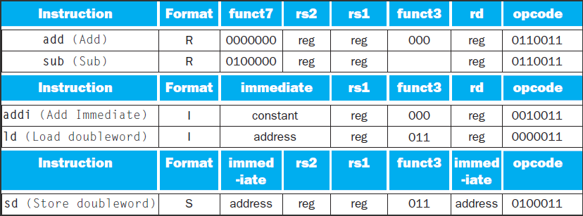
Summary of R-, I-, S-type instruction format
Notes:
指令格式由第一个字段的值来区分。每种格式的第一个字段(op)都被分配了一套不同的值。
Add, sub op=51
Addi op = 19
Ld op = 3
Sd op = 35
有addi, 没有subi, 因为immediate字段表示的是二进制补码整数，所以addi可以用来做减法。

Slide 51
Example(p85) Translating assembly into machine instruction
C code:
A[30] = h + A[30] + 1 ; ( Assume: h ---- x21 base address of A ---- x10 )
RISC-V assembly code:
ld x5, 240(x10) // temporary reg x5 gets A[30]
add x5, x21, x5 // temporary reg x5 gets h + A[30]
addi x5, x5, 1 // temporary reg x5 gets h + A[30] + 1
sd x5, 240(x10) // stores h + A[30] + 1 back into A[30]

Slide 52
RISC-V machine language code: Decimal version
| immediate | rs1 | funct3 | rd | opcode |
240 10 3 9 3
ld x9, 240(x10)
add x9, x21, x9
addi x9, x9, 1
sd x9, 240(x10)
| funct7 | rs2 | rs1 | funct3 | rd | opcode |
0 9 21 0 9 51
| immediate | rs1 | funct3 | rd | opcode |
1 9 0 9 19
| im[11:5] | rs2 | rs1 | funct3 | im[4:0] | opcode |
7 9 10 3 16 35
Notes:
240 = 0000 1111 0000

Slide 53
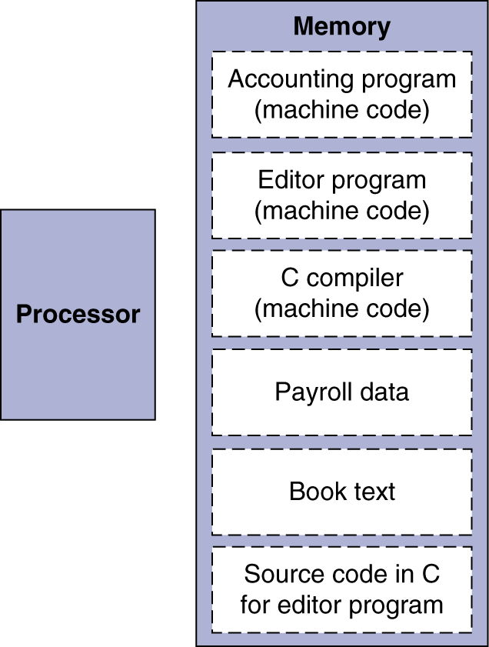
Stored-program
Two key principles of today’s computers
Instructions are represented as numbers
Programs can be stored in memory like numbers
Instructions represented in binary, just like data
Instructions and data stored in memory
Programs can operate on programs
e.g., compilers, linkers, …
Binary compatibility allows compiled programs to work on different computers
Standardized ISAs
Notes:
计算机构造基于两个关键性的原则：1.指令以数据形式表示。2. 和数据一样，程序存储在存储器中，并且可以读写。这就是存储程序的概念，也开创了计算机构造的新纪元。这个图显示了存储程序的强大功能：
存储程序的强大功能：存储器可以存放一个程序的源代码，还可以存放与之对应的机器代码，编辑程序使用的文本，甚至是编译器。
存储程序使得一台用于记账的计算机可以变成一台具有文本编辑功能的计算机，只要将程序和数据调入存储器，并告诉计算机从存储器的哪个位置开始执行。
将指令当成数字的一个结果就是程序被当作二进制数字文件来发行。这样的一个好处就是兼容性：计算机可以继承已经做好的并于该指令集兼容的软件。
将指令和数据以相同的方式进行处理，极大地简化了存储器硬件和计算机系统中的软件。特别是针对数据的存储技术同样适用于程序；而且，像编译器这样的程序，能够将那些用易于人类使用的符号翻译成机器能理解的代码。

Slide 54
Trojan 最简单例子-密码窃取
main() {
char password[256], crypt_pw[256];
scanf(“%s”,password);
crypt(password, crypt_pw);
if ( strcmp(crypt_pw, “xxxxxx”)!=0 )
printf(“password error\n”);
else
;
}
Input: 123456
Trojan read memory variable “password”
a.exe
123456
password
abcdef
Crypt_pw
trojan

Slide 55
问题：如果这是一个执行程序拳击游戏，该行指令表示您挨打，血(t0)在减少(s2为负数)，当血小于等于0，KO。
用ultraedit将该二进制执行文件修改，让自己不损血，怎么改？
000000 | 01000 | 10010 | 01000 | 00000 | 100000
op rs rt rd shamt funct
add $t0, $t0 , $s2,
Memory addr: 0x40000008
00000001000100100100000000100000
main() {
int *p;
p=0x40000008;
*p+=2
}
000000 | 01000 | 10010 | 01000 | 00000 | 100010
sub $t0, $t0 , $s2

Slide 56
Demo: Edit the execute file and memory
Change the program info(static)
Use hex edit tools
Eg:use ultraedit, change title
Leapftp -> leepftp
Change the program info(run time)
Use memory edit tools
Eg:use 金山游侠, change data

Slide 57
Shell (脱壳)
一个执行程序，有判断是否为盗版，问如何crack
查找判断之处，找到后看变量作用位置
找到惩罚处，将该处的二进制代码改成noop
main() {
int expired=false;
calculate expired；
if (expired) {
printf(“软件过期了\n”);
exit(1); -> “;” -> noop
}
else ..
}

Slide 58
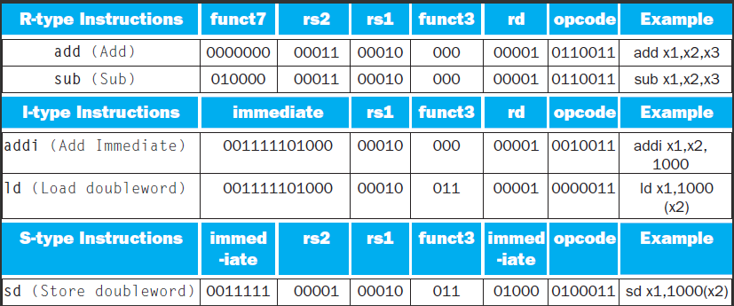
RISC-V instruction encoding
Name | Format | Example |  |  |  |  |  | Comment
add | R | 0 | 3 | 2 | 0 | 1 | 51 | add x1, x2, x3
sub | R | 32 | 3 | 2 | 0 | 1 | 51 | sub x1, x2, x3
addi | I | 1000 |  | 2 | 0 | 1 | 19 | addi x1,x2,1000
ld | I | 1000 |  | 2 | 3 | 1 | 3 | ld x1, 1000(x2)
sd | S | 31 | 1 | 2 | 3 | 8 | 35 | sd x1, 1000(x2)
Notes:
Sd 31 （01 1111‬）和 8 （01000）

Slide 59
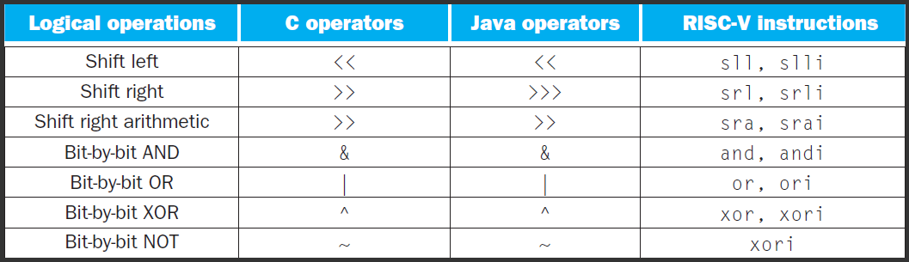
2.6 logical operations
Instructions for bitwise manipulation
Operating some bits within word or individual bit
Useful for extracting and inserting groups of bits in a word
Notes:
计算机的操作主要是针对整字的，但是一些能够对字里特定字段进行操作，甚至是对单个位进行操作也很有用。这些操作就是逻辑操作。
第一类就是移位指令，逻辑移位，空位填0
逻辑左移=算数左移，右边统一添0
逻辑右移，左边统一添0
算数右移，左边添加的数和符号有关
左移只适用于无符号数，没有逻辑或算术之分
注意RISC-V里面没有NOT指令，用（xor）取代 not
取反，也用xor, 其中一个操作数为全1 （FFFF FFFF FFFF FFFF）

Slide 60
Shift Operations
Shift operator
Move all the bits in a word to left or right, filling emptied bits with 0
Shifting left by i is same result as multiplying by 2^{i}
0000 0000 0000 0000 0000 0000 0000 1001 (9)₁₀
Shift left 4
0000 0000 0000 0000 0000 0000 1001 0000 (9×16=144)₁₀
slli x11, x19, 4 // reg x11=reg x19 << 4 bit
Funct6 | immediate | rs1 | funct3 | rd | opcode
0 | 4 | 19 | 1 | 11 | 19
Why?
6 bits
6 bits
5 bits
3 bits
5 bits
7 bits
Notes:
这些移位指令使用I型格式。因为寄存器64位，最多移动63位，所以12位的immediate字段只有低6位被使用，高6位被重新用作额外的操作码，funct6

Slide 61
And Operations
AND operator
Useful to mask bits in a word
Select some bits, clear others to 0
It is bit-by-bit (bitwise-AND)
Result=1 : both bits of the operands are 1
and x9,x10,x11
x10
00000000 00000000 00000000 00000000 00000000 00000000 00001101 11000000
x11
00000000 00000000 00000000 00000000 00000000 00000000 00111100 00000000
x9
00000000 00000000 00000000 00000000 00000000 00000000 00001100 00000000
Notes:
掩码：当源操作数某位是0，可以将目标数对应位设置为0

Slide 62
OR Operations
Useful to include bits in a word
Set some bits to 1, leave others unchanged
or x9,x10,x11
x10
00000000 00000000 00000000 00000000 00000000 00000000 00001101 11000000
x11
00000000 00000000 00000000 00000000 00000000 00000000 00111100 00000000
x9
00000000 00000000 00000000 00000000 00000000 00000000 00111101 11000000

Slide 63
XOR Operations
Differencing operation
Set some bits to 1, leave others unchanged
xor x9,x10,x12
xori x10,x10,-1 // == NOT x10
x10
00000000 00000000 00000000 00000000 00000000 00000000 00001101 11 000000
x12
11111111 11111111 11111111 11111111 11111111 11111111 11111111 11111111
x9
11111111 11111111 11111111 11111111 11111111 11111111 11110010 00111111
Notes:
Not只有一个操作数，为了保持双操作数的模式，用xor代替
Not(A)= = A xor 111…..111
在与立即数进行逻辑操作时，立即数的高位补0，
而addi，立即数进行符号扩展。

Slide 64
2.7 Instructions for making decisions
Branch instructions
beq register1, register2, L1
bne register1, register2, L1
Example Compiling an if statement to a branch
( Assume: f ~ j ---- x19 ~ x23 )
C code:
if ( i = = j ) f = g + h ; else f = g – h;
RISC-V assembly code:
bne x22, x23, ELSE // go to ELSE if i != j
add x19, x20, x21 // f = g + h ( skipped if i not equals j )
beq x0, x0, EXIT // as jump (unconditional branch)
ELSE: sub x19, x20, x21 // f = g - h ( skipped if i equals j )
EXIT:
i==j?
i ≠ j
Yes
No
F=g+h
F=g - h
Exit:
Notes:
计算机与计算器不同的地方就在于他能进行决策，根据输入的数据或者中间计算结果执行不同的指令。
高级语言一般用if语句表示分支，再加上goto和label配合使用，risc-v包括两条分支指令，beq, bne，相当于带goto的if语句。
条件转移指令：beq, bne, slt
下面我们就看一个例子，if语句编译后形成的汇编代码是什么
无条件分支：beq x0, x0, exit
编译器产生分支指令和标号，但它们在高级语言中并不出现。这也是高级语言编码效率高的原因之一。
像lw, sw指令计算数据地址一样，分支地址也要进行计算，是由汇编器完成的。
有没有可能减少一个branch呢

Slide 65
Conditional branch
Which is better ?
C code1 :
if ( cond ) A ; else B;
RISC-V assembly code:
bne/beq/blt/bge x22, x23, ELSE // go to ELSE
B // not taken branch
beq x0, x0, EXIT // as jump (unconditional branch)
ELSE: A // taken branch
EXIT:
Cond
Yes
No
A
B
Exit:
C code 2:
if (! cond) B else A
RISC-V assembly code:
beq/bne/bge/blt x22, x23, ELSE // go to ELSE
A // not taken branch
beq x0, x0, EXIT // as jump (unconditional branch)
ELSE: B // taken branch
EXIT:

Slide 66
More Conditional Operations
Pseudo Instruction
blt rs1, rs2, L1
if (rs1 < rs2) branch to instruction labeled L1
bge rs1, rs2, L1
if (rs1 >= rs2) branch to instruction labeled L1
Example
C code: if (a > b) a += 1;
RISC V: assume a in x22, b in x23
bge x23, x22, Exit // branch if b >= a
addi x22, x22, 1
Exit:
BGT rs1, rs2, L1
if (rs1 > rs2) goto L1
Blt rs2, rs1, L1
BLE rs1, rs2, L1
if (rs1 <= rs2) goto L1
BGE rs2, rs1, L1
Notes:
除了判断相等或者不等之外，判断一个变量是否小于另一个变量也很有用。比如一个for循环需要判断下标变量是否小于0

Slide 67
slt（Set on less than）instruction
If the first reg. is less than second reg. then sets third reg to 1
slt x2, x3, x4 # if x3 < x4 then x2=1 else x2=0
Example: Compiling a less than test
( Assume: a – x6 b – x7 )
C code:
if (a < b), goto Less
Use blt:
blt x6, x7, Less
Use slt:
slt x5, x6, x7 # x5 = 1 if x6 < x7 ( a < b)
bne x5, x0, Less # go to Less if x5 != 0 (that is, if a < b)
……
Less:
Notes:
MIPS里进行分支判断是用slt根据比较结果设置寄存器，然后用beq或者bne来进行分支判断，blt, bge这些指令是作为伪指令。MIPS的这种方法可以使处理器数据通路简单一些，但是需要更多的指令来执行程序。
Mips体系结构没有包括专门的“小于时分支”指令，因为它太复杂了，不符合“设备简单性”：它不仅会延长时钟周期，也会增加平均执行每个指令的周期数。两条更快的指令（beq, bne）更有用。
$zero专门存放0的寄存器，所以为什么t0和0比较，不和1比较。

Slide 68
Signed vs. Unsigned
Signed comparison: blt, bge
Unsigned comparison: bltu, bgeu
Example
x22 = 1111 1111 1111 1111 1111 1111 1111 1111
x23 = 0000 0000 0000 0000 0000 0000 0000 0001
x22 < x23 // signed
–1 < +1
x22 > x23 // unsigned
+4,294,967,295 > +1
Notes:
不同的比较指令运行到同一个操作数上，结果也是不一样的

Slide 69
Compare operations
Different compare operations required for both number types
Signed integer
slt ：Set on less than
slti ：Set on less than immediate
Unsigned integer
sltu： Set on less than
sltiu： Set on less than immediate
Notes:
Slt还有与立即数的比较
Slt, slti针对有符号数，sltu sltiu针对无符号数
不同的比较指令运行到同一个操作数上，结果也是不一样的
将有符号数作为无符号数来处理，是检验0<=x<y的低开销方法，常用于检查数组的下标是否越界。

Slide 70
Example for Compare
Register x2
1111 1111 1111 1111 1111 1111 1111 1111
Register x3
0000 0000 0000 0000 0000 0000 0000 0001
Compared Operations
slt x1, x2, x3
sltu x1, x2, x3
Results
x1 = 1 (-1 < 1)
x1 = 0 (4,294,967,295_{ten} > 1_{ten})
used to generate 1
Notes:
不同的比较指令运行到同一个操作数上，结果也是不一样的

Slide 71
Bounds check Shortcut
Reduce an index-out-of-bounds check
If (x20>=x11 or x20<0) goto IndexOutofBounds
RISC-V version:
bgeu x20, x11, IndexOutofBounds
MIPS version:
sltu $t0, $a1, $t2 ; x20 < x11
beq $t0, $zero, IndexOutofBounds
Notes:
index-out-of-bounds：索引越界
将有符号数当作无符号数处理，给我们提供了一种低成本的方式检查是否0<=x<y，常用于检查数组下标是否越界。
无符号数比较x<y，在检测x<y的同时，也检测了x是否为负数。

Slide 72
Loop statements
Example Compiling a while loop
( Assume: i and k---- x22 and x23 base of save ---- x10 )
C code:
while ( save[i] = = k )
i += 1 ;
RISC-V assembly code:
Loop: slli x28, x22, 3 // Temp reg x28 = i * 8
add x28, x10, x28 // Temp reg x28 = address of save[i]
ld x29, 0(x28) // Temp x29 = save[i]
bne x29, x23, Exit // go to Exit if save[i] != k
addi x22, x22, 1 // i += 1
beq x0, x0, Loop // go to Loop
Exit:
Notes:
这段代码的物理含义? 找到第一个不为k的数 的 index
循环程序中也要使用分支跳转,if语句中是二选一，而循环程序中用于重复计算，但是分支指令是相同的
Note: 取数组元素的方式

Slide 73
Case/Switch
used to select one of many alternatives
Example
Compiling a switch using jump address table
( Assume: f ~ k ---- x20 ~ x25 x5 contains 4 )
C code:
switch ( k ) {
case 0 : f = i + j ; break ; /* k = 0 */
case 1 : f = g + h ; break ; /* k = 1 */
case 2 : f = g - h ; break ; /* k = 2 */
case 3 : f = i - j ; break ; /* k = 3 */
}
Notes:
Case/switch根据某个变量的不同取值，选择不同的分支。
实现switch的一种方法是借助一个条件判断序列,把switch转化为一系列的if-then-else
另一种更有效的方法是通过编码形成一个转移地址表，就是分支指令序列地址表；程序通过查找转移地址表来获取目标地址，并跳转到相应的分支指令序列。

Slide 74
Jalr
Jump-and-link register
jalr x1,100(x6)
jump address table
 | …………
P1 address | Program 1
 | …………
P2 address | Program 2
 | …………
P3 address | Program 3
 | …………
P4 address | Program 4
 | …………
K=0 | P1 address
K=1 | P2 address
K=2 | P3 address
K=3 | P4 address
x6
Notes:
转移地址表就是一个字数组，数组中的元素对应于代码中各个标号的地址。
为支持这种情况，有一条间接跳转指令，jalr, 无条件地转移到某个寄存器指定的地址。
x6是地址转移表的起始地址

Slide 75
Case/Switch
RISC-V assembly code:
blt x25, x0, Exit // test if k < 0
bge x25, x5, Exit // if k >= 4, go to Exit
slli x7, x25, 3 // temp reg x7 = 8 * k
add x7, x7, x6 // x7 = address of JumpTable[k]
ld x7, 0(x7) // x7 gets JumpTable[k]
jalr x1, 0(x7) // jump entrance
Exit:
jump address table
L0: add x20, x23, x24 // k = 0 so f gets i + j
jalr x0, 0(x1) // end of this case so go to Exit
L1: add x20, x21, x22 // k = 1 so f gets g + h
jalr x0, 0(x1) // end of this case so go to Exit
L2: sub x20, x21, x22 // k = 2 so f gets g - h
jalr x0, 0(x1) // end of this case so go to Exit
L3: sub x20, x23, x24 // k = 3 so f gets i - j
jalr x0, 0(x1) //end of switch statement
L0:address
L1:address
L2: address
L3:address
Notes:
jalr x0, 0(x1)

Slide 76
Basic Blocks
A basic block is a sequence of instructions with
No embedded branches (except at end)
No branch targets (except at beginning)
A compiler identifies basic blocks for optimization
An advanced processor can accelerate execution of basic blocks
Notes:
以上这些以分支指令结束的指令序列，这种指令序列对编译技术而言非常简单，有个专用术语叫基本块。
编译的最初阶段就是将程序分成基本块。

Slide 77
2.8 Supporting Procedures in Computer Hardware
Procedure/function --- be used to structure programs
A stored subroutine that performs a specific task based on the parameters with which it is provided
easier to understand, allow code to be reused
Six steps
Place Parameters in a place where the procedure can access them （in registers x10~x17）
Transfer control to the procedure
Acquire the storage resources needed for the procedure
Perform the desired task
Place the result value in a place where the calling program can access it
Return control to the point of origin (address in x1)
Notes:
过程和函数是程序员进行结构化编程的一种工具，都有助于提高程序的可读性和代码的可重用性。
过程使用参数将过程和其余的程序、数据分开，从而集中精力执行一个子任务。只允许传递值和结果。
过程是用软件进行抽象的一种方式。
第6条，注意一个过程可能由一个程序的几个点调用。

Slide 78
Procedure Call Instructions
PC+4→x1
Procedure call: jump and link
jal x1, ProcedureLabel
Address of following instruction put in x1
Jumps to target address
Procedure return: jump and link register
jalr x0, 0(x1)
Like jal, but jumps to 0 + address in x1
Use x0 as rd (x0 cannot be changed)
Can also be used for computed jumps
e.g., for case/switch statements
Notes:
无条件跳转： jal x0, Label，因为x0硬连线到0，效果等同于丢弃返回地址。

Slide 79
Using More Registers
Registers for procedure calling
x10~ x17: 8 argument registers to pass parameters or return values
x1: one return address register to return to origin point
Stack：Ideal data structure for spilling registers
Push, pop
Stack pointer (sp): x2
Stack grow from higher address to lower address
Push: sp= sp-8
Pop: sp = sp+8
Notes:
寄存器是保存数据最快的存储位置，在过程调用的时候尽量多的使用寄存器，
如果一个过程需要多于8个参数寄存器，就需要换出寄存器到存储器。并且在过程完成后，所用的寄存器必须恢复到调用之前的值。
最理想的数据结构就是栈—后进先出队列。把数据放入栈叫push，移除数据称为出栈,pop，栈指针，一个特殊的寄存器，sp（x2)，用于保存被调用者所需的寄存器。栈是内存里的一块存储结构，栈底是高地址，栈增长是地址从高到低，push的时候，sp减小，pop, sp增大

Slide 80
FFFF FFFF
int i;
int A[3];
int j;
i
PUSH
STACK
A
POP
j
0000 0000

Slide 81
int i,A[3], j;
…
j=A[3];
The result j=?
i
A[3]
A[2]
A[1]
A
A[0]

Slide 82
Leaf Procedure Example
C code:
long long int leaf_example ( long long int g, long long int h, long long int i, long long int j) { long long int f; f = (g + h) - (i + j); return f; }
Arguments g, …, j in x10, …, x13
f in x20
temporaries x5, x6
Need to save x5, x6, x20 on stack
Notes:
在32位的系统中： `short`与`int`占两个字节， `long` 占四个字节， `long long` 占八个字节； 在64位的系统中： `short`占两个字节， `int` 与 `long` 占四个字节， `long long` 占八个字节。
4个参数所在的寄存器不用保存，过程体还需要两个临时寄存器，因此，需要保存3给寄存器，首先是保存过程中使用的寄存器

Slide 83
Leaf Procedure Example
RISC-V code:
leaf_example:
addi sp,sp,-24
sd x5,16(sp)
sd x6,8(sp)
sd x20,0(sp)
add x5,x10,x11
add x6,x12,x1
sub x20,x5,x6
addi x10,x20,0
ld x20,0(sp)
ld x6,8(sp)
ld x5,16(sp)
addi sp,sp,24
jalr x0,0(x1)
// Save x5, x6, x20 on stack
// x5 = g + h
// x6 = i + j
// f = x5 – x6
// copy f to return register
// Restore x5, x6, x20 from stack
Return to caller
Notes:
x10：返回值

Slide 84
Local Data on the Stack
High address
sp
sp
Content of register x5
Content of register x6
sp
Content of register x20
Low address
a
.
b
.
c
.
Notes:
栈指针总是指向栈顶，或者说栈中的最后一个双字。

Slide 85
Register Usage
x5 – x7, x28 – x31: temporary registers
Not preserved by the callee
x8 – x9, x18 – x27: saved registers
If used, the callee saves and restores them
Notes:
先前使用了临时寄存器，并假设其旧值必须被保存和恢复。为了避免保存和恢复一个其值从未被使用过的寄存器（临时寄存器），RISC-V将19个寄存器分为2组。这样可以减少寄存器换出。
上诉例子中，x5, x6不需要保存，但是x20需要保存

Slide 86
Non-Leaf Procedures
Procedures that call other procedures
For nested call, caller needs to save on the stack:
Its return address
Any arguments and temporaries needed after the call
Restore from the stack after the call
Caller save： return address
arguments
important temporaries(t registers) that will be used after call
Callee save： any S registers used for local variables
Notes:
没有调用其他过程的过程叫做叶过程。实际上，很多时候过程还要调用其他过程。更进一步，过程调用自身，这就是递归。过程调用时，必须小心保存寄存器，一个解决方法是将其他所有必须保存的寄存器压栈，我们规定调用者将所有调用后还需要的参数寄存器（x10-x17）或临时寄存器（x5~x7, x28~x31）压栈。被调用者将返回地址寄存器（x1）和被调用者使用的保存寄存器（x8,x9,x18~x27）压栈。

Slide 87
Summerise of procedure
The jal instruction is used to jump to the procedure and
save the current PC+4 into the return address register X0
Arguments are passed in $a0-$a3; return values in $v0-$v1
Since the callee may over-write the caller’s registers,
relevant values may have to be copied into memory
Each procedure may also require memory space for
local variables – a stack is used to organize the memory
needs for each procedure

Slide 88
Six steps of Function
Place Parameters in a place where the procedure can access them （in registers x10~x17）
Transfer control to the procedure
Acquire the storage resources needed for the procedure, save the callee save registers.
Perform the desired task
Place the result value in a place where the calling program can access it. Release the resources. Restored saved registers.
Return control to the point of origin (address in x1)

Slide 89
A
x: xp1
y: xp2
temp：xt3
Jal B
B
C
i: x18
j: x19
Jal C
Note： B is callee to A, but caller to C.
B：
Addi x2, x2, -40 ;apply space
Push x1, x10, x11 ;caller save
Push x18, x19, ;callee save
Addi x2, x2, … ;space for local array
B-func1 or structure
Jal x1, C ; B-function
B-func2
Pop x19, x18,
Pop x11, x10, x1
Addi x2, x2, … ;release space of local
Addi x2, x2, +40 ;release ST space
Move x17, ? ;return value
Jalr x0, 0(x1)
A:
move x10, xp1
move x11, xp2
move x18, xt3
Jal x1, B
use x17
move xt3, x18 ;restore xt3
caller save $t0 ~ $t6 if the content is important and not want to be modified.

Slide 90
Nested Procedure
Example Compiling a recursive procedure that computes n!,
suppose argument n is in x10, and results in x10
long long fact ( long long n )
{
if ( n < 1 ) return ( 1 ) ;
else return ( n * fact ( n - 1 ) ) ;
}
RISC-V assembly code
fact: addi sp, sp, 16 // adjust stack for 2 items
sd x1, 8(sp) // save the return address
sd x10, 0(sp) // save the argument n
addi x5, x10, -1 // x5 = n - 1
bge x5, x0, L1 // if n >= 1, go to L1(else)
addi x10, x0, 1 // return 1 if n <1
addi sp, sp, 16 // Recover sp (Why not recover x1and x10 ?)
jalr x0, 0(x1) // return to caller
Notes:
X10存储了n， X1存了返回的地址
从栈中弹出两项之前，我们本应该载入x1和x10, 因为n<=1时，它们都没有发生变化，所有就跳过这两条指令。

Slide 91
L1: addi x10, x10, -1 // n >= 1: argument gets ( n - 1 )
jal x1, fact // call fact with ( n - 1 )
add x6, x10, x0
ld x10, 0(sp) // restore argument n
ld x1, 8(sp) // restore the return address
addi sp, sp, 16 // adjust stack pointer to pop 2 items
mul x10, x10, x6 // return n*fact ( n - 1 )
jalr x0, 0(x1) // return to the caller
Why x10 is saved? Why x1 is saved?
Preserved things across a procedure call
Saved registers, stack pointer register( sp ),
return address register( x1 ), stack above the stack pointer
Not preserved things across a procedure call
Temporary registers, argument registers( x10 ~ x17),
return value registers ( x10 ~ x17), stack below the stack pointer
Notes:
下面是n>1的情况，n=n-1, 再次调用fact。因为再次调用fact的时候，x1和x10的值变了，当fact执行完返回时，我们需要把原先的参数和返回地址取出来。

Slide 92
Disadvantages of recursion
Use too much resource，to protect the processor status，recursion may result in stack overflow.
Need push and pop，takes a lot of memory space leading to inefficient usage of memory.
How to avoid ? use loop instead of recursion （tail call）.

Slide 93
RISC-V register conventions
Name | Register name | Usage | Preserved On call?
x0 | 0 | The constant value 0 | n.a.
x1(ra) | 1 | Return address(link register) | yes
x2(sp) | 2 | Stack pointer | yes
x3(gp) | 3 | Global pointer | yes
x4(tp) | 4 | Thread pointer | yes
x5-x7 | 5-7 | Temporaries | no
x8-x9 | 8-9 | Saved | yes
x10-x17 | 10-17 | Arguments/results | no
x18-x27 | 18-27 | Saved | yes
x28-x31 | 28-31 | Temporaries | no
Notes:
这里总结了RISC-V中对寄存器的约定。这个规定也是体现“make the common case fast”的一个例子：大多数过程可以使用多达8个参数寄存器、12个保留寄存器和7个临时寄存器而无须进入内存。
如果参数超过8个怎么办？RISC-V约定将栈中额外的参数放在帧指针的上方。可以通过帧指针寻址。帧指针的方便性在于对过程中栈内变量的所有引用都具有相同的偏移。但是，帧指针不是必需的。RISC-V编译器仅在改变了栈指针的过程中使用帧指针。

Slide 94
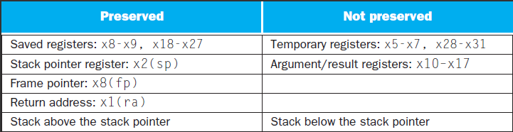
What is and what is not preserved across a procedure call
Notes:
有些方案也保存了栈，以确保调用者在弹栈时取回与压栈时相同的数据。Sp以上的栈通过确保被调用者不在其上进行写入来保存；sp本身就是由被调用者将其被减去的值重新加上来保存的，并且其他寄存器通过将它们保存到栈（若被使用）并从栈中将其恢复来进行保存。

Slide 95
A
x: xp1
y: xp2
temp：xt3
Jal B
B
C
i: x18
j: x19
Jal C
Note： B is callee to A, but caller to C.
B：
Addi x2, x2, -40 ;apply space
Push x1, x10, x11 ;caller save
Push x18, x19, ;callee save
Addi x2, x2, … ;space for local array
B-func1 or structure
Jal x1, C ; B-function
B-func2
Pop x19, x18,
Pop x11, x10, x1
Addi x2, x2, … ;release space of local
Addi x2, x2, +40 ;release ST space
Move x17, ? ;return value
Jalr x0, 0(x1)
A:
move x10, xp1
move x11, xp2
move x18, xt3
Jal x1, B
use x17
move xt3, x18 ;restore xt3
caller save $t0 ~ $t6 if the content is important and not want to be modified.

Slide 96
Storage class of C variables
automatic
static
Procedure frame and frame pointer ( x8 or fp )
The importance of fp
automatic
Global pointer ( x3 or gp )
static
Notes:
C变量通常指一个存储位置，其解释取决于其类型（type）和存储方式（storage class）。示例类型包括整型和字符型。C语言有两种存储方式：动态和静态的。
C变量的两种存储方式：动态（过程中的变量，过程结束就失效）和静态（始终存在，在过程之外声明，以及用static声明的变量）
静态数据用gp（x3)来访问
Type 和 storage class
There are four storage classes in C they are as follows:
Automatic Storage Class
Register Storage Class
Static Storage Class
External Storage Class
All variables defined within a function or block by default belong to automatic storage class if no storage class is mentioned.

Slide 97
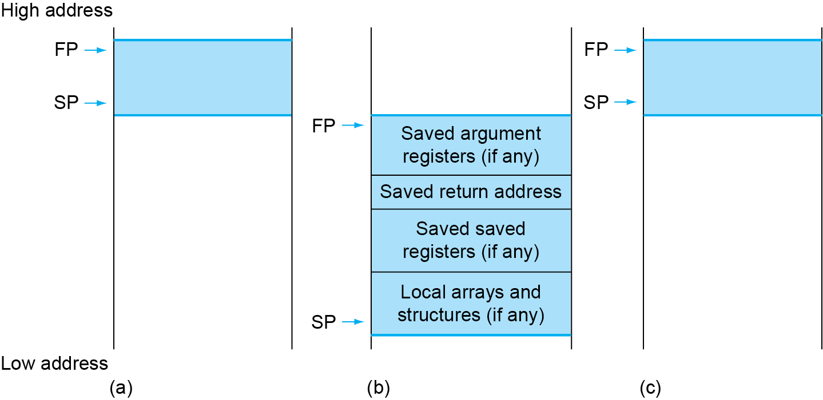
Local Data on the Stack
Frame
do the pushes by a caller
do the pushes by a callee
Local data allocated by callee
e.g., C automatic variables
Procedure frame (activation record)
Used by some compilers to manage stack storage
Notes:
栈还需要存储一些局部变量，例如局部数组或结构, 这些变量时局部于过程，不适用于寄存器，而是保存在栈中。栈中包含过程保存的寄存器和局部变量的段称为过程帧(frame)或者活动记录(activation record)。
在过程中栈指针可能改变，如果利用栈指针和地址运算来完成对局部变量的引用，非常不方便。因此，定义一个帧指针fp(x8)，指向过程帧的第一个双字，这样帧指针就提供了一个稳定的基寄存器，对局部变量的引用就变得非常简单。如果过程中栈内没有局部变量，编译器一般不设置和不恢复帧指针以节省时间。当使用帧指针时，在调用中使用sp来进行初始化，且可以使用fp恢复sp.
注意，不管是否使用显式的帧指针，栈上都会显示一条活动记录。我们可以通过维护稳定的sp来减少对fp的使用

Slide 98
The Concept : procedure Frame/activation record
Procedure Frame: the segment of the stack containing a procedure’s saved registers and local variables
fp (x8) -- start (bottom) sp(x2) -- end (top)
Why fp
stable pointer for programmers to reference variables easily
What’s in the Frame:
saved argument registers
Saved return address [ saved fp ]
Local arrays and structures or variables
1. What fp points to in reality ？
2. What could you do if you have more parameters than 8 ?

Slide 99
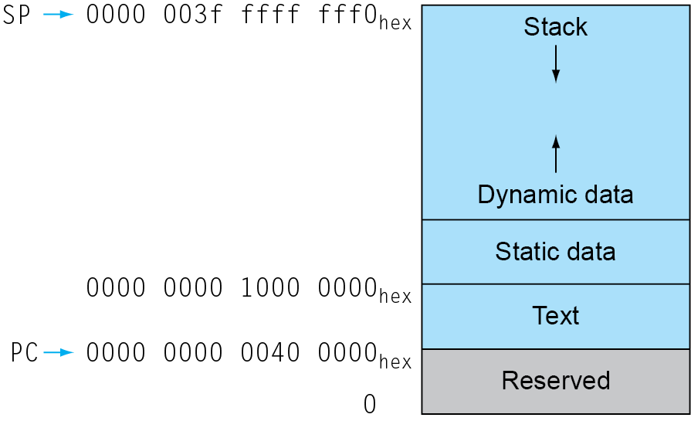
Memory Layout
Text: program code
Static data: global variables
e.g., static variables in C, constant arrays and strings
x3 (global pointer) initialized to address allowing ±offsets into this segment
Dynamic data: heap
E.g., malloc in C, new in Java
Stack: automatic storage
gp → 0000 0000 1000 8000 _{hex}
TWO Bugs:
1） forget to free space
2) Free space too early
Notes:
除了动态变量，C程序员还需要为静态变量和动态数据结构分配内存空间。这个图展示了运行linux OS时程序和数据在RISC-V内存分配的约定。这些地址只是一种软件规定，并不是RISC-V体系结构的一部分。
栈由内存高地址开始，向下增长。内存低地址段先是保留区域，然后时机器代码的存储区域，称为正文段，之上是静态数据段，用于存储常量和其他静态变量的空间。
类似链表的数据结构通常会随着生命期增长或者缩短，这类数据结构对应的段称为堆(heap),它放在内存中。位于静态数据之后。
栈和堆相互增长，在两个段此消彼长的过程中达到内存的高效使用。
C语言通过显示函数malloc(), free()分配和释放空间，容易导致漏洞。忘记释放会导致“内存泄漏”（消耗掉太多内存导致操作系统崩溃），过早的释放会导致“悬空指针”（指针指向程序从未访问的位置）。Jave使用自动内存分配和垃圾回收机制来避免这类错误。

Slide 100
2.9 communication with people
Byte-encoded character sets
ASCII: 128 characters
95 graphic, 33 control
Latin-1: 256 characters
ASCII, +96 more graphic characters
Unicode: 16-bit/32-bit character set
Used in Java, C++ wide characters, …
Most of the world’s alphabets, plus symbols
UTF-8, UTF-16: variable-length encodings
Notes:
计算机的发明是为了数字计算，但很快就被用于文本处理，就需要处理字符。大多数计算机使用字节来表示字符。
ASCII ((American Standard Code for Information Interchange): 美国信息交换标准代码）是基于拉丁字母的一套电脑编码系统，主要用于显示现代英语和其他西欧语言。它是最通用的信息交换标准，并等同于国际标准ISO/IEC 646。ASCII第一次以规范标准的类型发表是在1967年，最后一次更新则是在1986年，到目前为止共定义了128个字符
0x30 （48） 字符0， 0x41 （65） 字符A ， 0x61 （97） 字符a， 0x00 （0） null
ASCII码对比二进制数：１. 存储需要更多位。２. 硬件上进行计算也困难

Slide 101
Byte/Halfword/Word Operations
RISC-V byte/halfword/word load/store
Load byte/halfword/word: Sign extend to 64 bits in rd
lb rd, offset(rs1)
lh rd, offset(rs1)
lw rd, offset(rs1)
Load byte/halfword/word unsigned: Zero extend to 64 bits in rd
lbu rd, offset(rs1)
lhu rd, offset(rs1)
lwu rd, offset(rs1)
Store byte/halfword/word: Store rightmost 8/16/32 bits
sb rs2, offset(rs1)
sh rs2, offset(rs1)
sw rs2, offset(rs1)
Notes:
Lb从内存中读出一个字节，放在寄存器的最右边8位。Sb同样。

Slide 102
String
Three choices for representing a string
Place the length of the string in the first position
An accompanying variable has the length
A character in the last position to mark the end of a string
Java uses the first choice
C uses the third choice
Terminate a string with a byte whose value is 0 ( null in ASCII )
Notes:
多个字符连接起来成为字符串，字符串长度不是固定的，而是可变的。
Java uses the first choice, Java包含一个给出字符串长度的字，类似于Java数组。

Slide 103
String Copy Example
( Assume: i -- x19， x’s base --x10, y’s base ----x11)
C code: Null-terminated string Y→X
void strcpy ( char x[ ] , char y[ ] )
{
size_t i ;
i = 0 ;
while ( ( x[ i ] = y[ i ] ) != ‘\ 0’ ) /* copy and test byte */
i += 1 ;
}
RISC-V assembly code:
strcpy: addi sp, sp, -8 // adjust stack for 1 doubleword
sd x19, 0(sp) // save x19
add x19, x0, x0 // i = 0
L1: add x5, x19, x11 // address of y[ i ] in x5
lbu x6, 0(x5) // x6 = y [ i ]
add x7, x19, x10 // address of x[ i ] in x7
sb x6, 0(x7) // x[ i ] = y[ i ]
Notes:
本质就是数组访问
注意到 y和x 都是一个byte 数组，所以不需要乘8

Slide 104
beq x6, x0, L2 // if y[ i ] == 0, go to L2
addi x19, x19, 1 // i = i + 1
jal x0, L1 // go to L1
L2: ld x19, 0(sp) // restore x19
addi sp, sp, 8 // pop 1 doubleword off stack
jalr x0, 0(x1) // return
Optimization for example
strcpy is a leaf procedure
Allocate i to a temporary register x28
For a leaf procedure
The compiler exhausts all temporary registers
Then use the registers it must save
Notes:
叶子程序，使用临时变量，没有其他程序会用到本程序所调用的变量
尽可能使用临时变量， 尽量不去使用stack 去缓存
C中字符串复制通常使用指针，而不是数组，避免对i的操作。

Slide 105
2.10 RISC-V Addressing for Wide Immediate & Addresses
Most constants are small
12-bit immediate is sufficient
For the occasional 32-bit constant
lui rd, constant
Copies 20-bit constant to bits [31:12] of rd
Extends bit 31 to bits [63:32]
Clears bits [11:0] of rd to 0
| imm[31:12] | rd | opcode |
20bits 5 bits 7 bits
U-type format
lui x19, 976 // 0x003D0
31 12 | 11 7 | 6 0
0000 0000 0011 1101 0000 | 10011 | 011 0111
Instruction
Filling zero
Register
0000 0000 0011 1101 0000 | 00000 | 0000000
Notes:
Lui用于将20位常数加载到寄存器的第31位到第12位，低12位填充0

Slide 106
32-bit Constants
Example 2.19 Loading a 32-bit constant
The 32-bit constant:
0000 0000 0011 1101 0000 1001 0000 0000 (976*16³ + 2304=4000000)₁₀
RISC V code:
lui s3, 976 # 976 decimal = 0000 0000 0011 1101 0000 binary
(The value of s3 afterward is: 0000 0000 0011 1101 0000 0000 0000 0000)
addi s3, s3, 2304 # 2304 decimal = 1001 0000 0000 binary
The value of s3 afterward is:
Note：Why does it need two steps?
0000 0000 0000 0000
0000 0000 0000 0000
0000 0000 0011 1101 0000
1001 0000 0000
Notes:
用addi, 把16位立即数按照有符号数拓展，所以最高位是0没有问题，最高位是1就不对了，用ori 没有这个问题，也可以用addiu，或者先用lui 在第12位添加1，然后再用addi加上低16位。

Slide 107
Branch Addressing
Branch instructions specify
Opcode, two registers, target address
Most branch targets are near branch
Forward or backward
SB-type: bne x10, x11, 2000， //2000 = 0111 1101 0000
PC-relative addressing
Target address = PC + branch offset
0 | 111110 | 01011 | 01010 | 001 | 1000 | 0 | 1100011
imm[12] | imm[10:5] | rs2 | rs1 | funct3 | imm[4:1] | imm[11] | opcode
inst[31:0]
Inst[31] signextension | Inst[7] | Inst[30:25] | Inst[11:8] | 1’B0
imm[31:0]
Notes:
条件分支的操作码是1100011，bne的funct3是001，
SB-type:
Bne, 后面的必须是偶数。 The address uses unusual encoding
2000 = （11111010000）bin = （0111，1101，0000）bin
PC 相对偏移表示分支和目标指令之间的半字数。
Jal指令中的20位地址字段可以寻址当前指令的前后1M字节范围，条件分支指令的12位字段可以寻址当前指令的前后4K字节范围。
注意到这两个地址空间是不是一样的。 Bne 是12， 0 0 111110 1000
jal 是20

Slide 108
Jump Addressing
Jump and link (jal) target uses 20-bit immediate for larger range
UJ format: jal x0, 2000 //2000 = 0111 1101 0000
For long jumps, eg, to 32-bit absolute address
lui: load address[31:12] to temp register
jalr: add address[11:0] and jump to target
0 | 1111101000 | 0 | 00000000 | 00000 | 1101111
imm[20] | imm[10:1] | imm[11] | imm[19:12] | rd | opcode
inst[31:0]
Inst[31] signextension | Inst[19:12] | Inst[20] | Inst[30:21] | 1’B0
imme[31:0]
Notes:
Jal 是唯一的一条UJ-type指令 （the unconditional jump-and-link instruction）
后面的必须是偶数

Slide 109
Show branch offset in machine language
Example (p116) Show branch offset in machine language
C language (p94):
while (save[i]==k) i=i+1;
RISC-V assembler code :
Loop: slli x10, x22, 3 // temp reg x10 = 8 * i
add x10, x10, x25 // x10 = address of save[i]
ld x9, 0(x10) // temp reg x9 = save[i]
bne x9, x24, Exit // go to Exit if save[i] != k
addi x22, x22, 1 // i = i + 1
beq x0, x0, Loop // go to Loop
Exit:

Slide 110
Instructions Addressing and their Offset
 |  | instructions Code with Binary |  |  |  |  |  | Hex
 | Address | fun7 | rs2 | rs1 | fun3 | rd/offset | OP
Loop：slli | 80000 | 0000000 | 00011 | 10110 | 001 | 01010 | 0010011 | 003B1513
add | 80004 | 0000000 | 11001 | 01010 | 000 | 01010 | 0110011 | 01950533
ld | 80008 | 0000000 | 00000 | 01010 | 011 | 01001 | 0000011 | 00053483
bne | 80012 | 0000000 | 11000 | 01001 | 001 | 01100 | 1100011 | 01849663
addi | 80016 | 0000000 | 00001 | 10110 | 000 | 10110 | 0010011 | 001B0B13
beq | 80020 | 1111111 | 00000 | 00000 | 000 | 01101 | 1100011 | FE0006E3
Exit： | 80024 | ……
Modification:
All RISC-V instructions are 4 bytes long
PC-relative addressing refers to the number of halfwords
The address field at 80012 above should be 6 instead of 12
-10 = 11110110
6 =0110
-20 = 80000 - 80020
PC + offset ： 12 = 80024 - 80012
Notes:
前面的例子转成二进制
相对转移还有一个优点：程序放到哪里都可以执行，绝对地址就不行。
注意到用的是相对的offset （除非跳转到非常远的地方）

Slide 111
While branch target is far away
Inserts an unconditional jump to target
Invert the condition so that the branch decides whether to skip the jump
Example (p117) Branching far away
Given a branch:
beq x10, x0, L1
Rewrite it to offer a much greater branching distance:
bne x10, x0, L2
jal x0, L1
L2:
Notes:
跳到一个12bit 地址长之外的 地址
X10 等于0， 然后跳转到 L1 Beq的地址空间是 12bit
如果X10 不等于0， 跳转到L2
如果X10 等于0， 就执行下一句。 下一句是 Jal 【Jal 的地址空间是 20 bit】

Slide 112
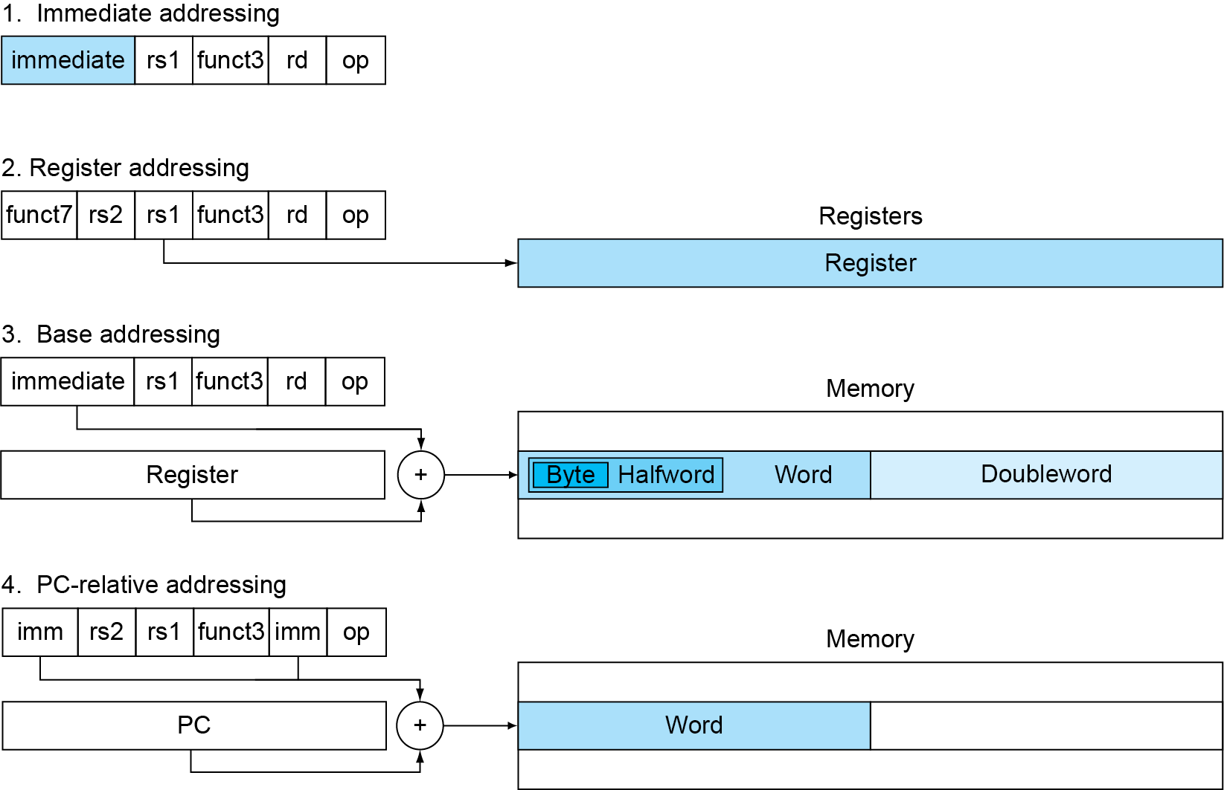
RISC-V Addressing Summary
Immediate addressing:
addi x5,x6,4
Register addressing:
add x5,x6,x7
Base addressing:
ld x5,100(x6)
PC-relative addressing:
beq x5,x6,L1
Notes:
立即数寻址：操作数是指令本身的常量
寄存器寻址：操作数在寄存器中
基址寻址：操作数在内存中，其地址是寄存器和指令中的常量（字节）之和
PC相对寻址：分支地址是PC和指令中常量（半字）之和
PC-relative addressing: 其中的L1是相对寻址

Slide 113
RISC-V operands
Name | Example | Comments
32 registers | x0-x31 | Fast locations for data. In RISC-V, data must be in registers to perform arithmetic. Register x0 always equals 0.
2⁶¹ memory words | Memory[0], Memory[8], …, Memory[18,446,744,073,709,551,608]] | Accessed only by data transfer instructions. RISC-V uses byte addresses, so sequential double word accesses differ by 8. Memory holds data structures, arrays, and spilled registers.
Name | Register no. | Usage | Preserved on call
x0(zero) | 0 | The constant value 0 | n.a.
x1(ra) | 1 | Return address(link register) | yes
x2(sp) | 2 | Stack pointer | yes
x3(gp) | 3 | Global pointer | yes
x4(tp) | 4 | Thread pointer | yes
x5-x7(t0-t2) | 5-7 | Temporaries | no
x8(s0/fp) | 8 | Saved/frame point | Yes
x9(s1) | 9 | Saved | Yes
x10-x17(a0-a7) | 10-17 | Arguments/results | no
x18-x27(s2-s11) | 18-27 | Saved | yes
x28-x31(t3-t6) | 28-31 | Temporaries | No
PC | - | Auipc(Add Upper Immediate to PC) | Yes
Notes:
K0，k1：26-27

Slide 114
RISC-V assembly language
Category | Instruction | Example | Meaning | Comments
Arithmetic | add | add x5,x6,x7 | x5=x6 + x7 | Add two source register operands
 | subtract | sub x5,x6,x7 | x5=x6 - x7 | First source register subtracts second one
 | add immediate | addi x5,x6,20 | x5=x6+20 | Used to add constants
Data transfer | load doubleword | ld x5, 40(x6) | x5=Memory[x6+40] | doubleword from memory to register
 | store doubleword | sd x5, 40(x6) | Memory[x6+40]=x5 | doubleword from register to memory
 | load word | lw x5, 40(x6) | x5=Memory[x6+40] | word from memory to register
 | load word, unsigned | lwu x5, 40(x6) | x5=Memory[x6+40] | Unsigned word from memory to register
 | store word | sw x5, 40(x6) | Memory[x6+40]=x5 | word from register to memory
 | load halfword | lh x5, 40(x6) | x5=Memory[x6+40] | Halfword from memory to register
Category | Instruction | Example | Meaning | Comments
Data transfer | load halfword, unsigned | lhu x5, 40(x6) | x5=Memory[x6+40] | Unsigned halfword from memory to register
 | store halfword | sh x5, 40(x6) | Memory[x6+40]=x5 | halfword from register to memory
 | load byte | lb x5, 40(x6) | x5=Memory[x6+40] | byte from memory to register
 | load word, unsigned | lbu x5, 40(x6) | x5=Memory[x6+40] | Unsigned byte from memory to register
 | store byte | sb x5, 40(x6) | Memory[x6+40]=x5 | byte from register to memory
 | load reserved | lr.d x5,(x6) | x5=Memory[x6] | Load;1st half of atomic swap
 | store conditional | sc.d x7,x5,(x6) | Memory[x6]=x5; x7 = 0/1 | Store;2nd half of atomic swap
 | Load upper immediate | lui x5,0x12345 | x5=0x12345000 | Loads 20-bits constant shifted left 12 bits

Slide 115
RISC-V assembly language
Category | Instruction | Example | Meaning | Comments
Logical | and | and x5, x6, 3 | x5=x6 & 3 | Arithmetic shift right by register
 | inclusive or | or x5,x6,x7 | x5=x6 | x7 | Bit-by-bit OR
 | exclusive or | xor x5,x6,x7 | x5=x6 ^ x7 | Bit-by-bit XOR
 | and immediate | andi x5,x6,20 | x5=x6 & 20 | Bit-by-bit AND reg. with constant
 | inclusive or immediate | ori x5,x6,20 | x5=x6 | 20 | Bit-by-bit OR reg. with constant
 | exclusive or immediate | xori x5,x6,20 | X5=x6 ^ 20 | Bit-by-bit XOR reg. with constant
Shift | shift left logical | sll x5, x6, x7 | x5=x6 << x7 | Shift left by register
 | shift right logical | srl x5, x6, x7 | x5=x6 >> x7 | Shift right by register
 | shift right arithmetic | sra x5, x6, x7 | x5=x6 >> x7 | Arithmetic shift right by register
 | shift left logical immediate | slli x5, x6, 3 | x5=x6 << 3 | Shift left by immediate
Category | Instruction | Example | Meaning | Comments
Shift | shift right logical immediate | srli x5,x6,3 | x5=x6 >> 3 | Shift right by immediate
 | shift right arithmetic immediate | srai x5,x6,3 | x5=x6 >> 3 | Arithmetic shift right by immediate
Conditional branch | branch if equal | beq x5, x6, 100 | if(x5 == x6) go to PC+100 | PC-relative branch if registers equal
 | branch if not equal | bne x5, x6, 100 | if(x5 != x6) go to PC+100 | PC-relative branch if registers not equal
 | branch if less than | blt x5, x6, 100 | if(x5 < x6) go to PC+100 | PC-relative branch if registers less
 | branch if greater or equal | bge x5, x6, 100 | if(x5 >= x6) go to PC+100 | PC-relative branch if registers greater or equal
 | branch if less, unsigned | bltu x5, x6, 100 | if(x5 >= x6) go to PC+100 | PC-relative branch if registers less, unsigned
 | branch if greater or equal, unsigned | bgeu x5, x6, 100 | if(x5 >= x6) go to PC+100 | PC-relative branch if registers greater or equal, unsigned
Category | Instruction | Example | Meaning | Comments
Unconditional branch | jump and link | jal x1, 100 | x1 = PC + 4; go to PC+100 | PC-relative procedure call
 | jump and link register | jalr x1, 100(x5) | x1 = PC + 4; go to x5+100 | procedure return; indirect call
Notes:
SLLI (Shift Left Logical Immediate).
SRLI (Shift Right Logical Immediate).
SRAI (Shift Right Arithmetic Immediate).

Slide 116
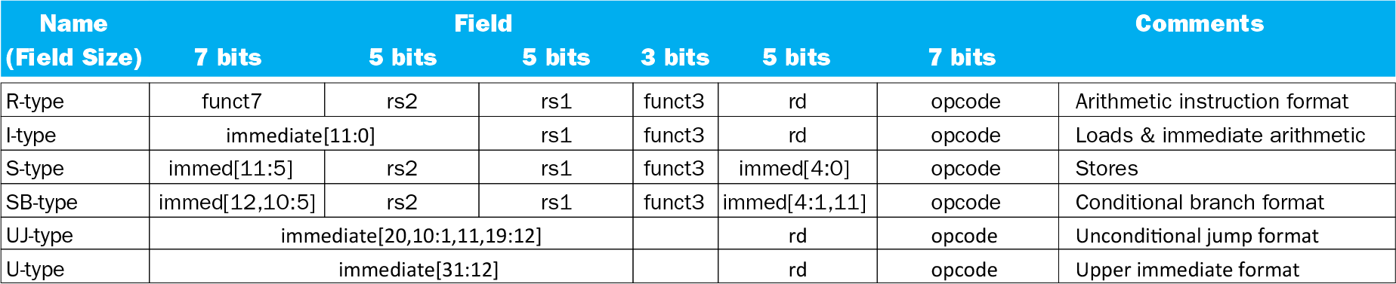
RISC-V encoding summary

Slide 117
Summary of RISC-V instruction encoding
Format | Instruction | Opcode | Funct3 | Funct6/7
R-type | add | 0110011 | 000 | 0000000
 | sub | 0110011 | 000 | 0100000
 | sll | 0110011 | 001 | 0000000
 | xor | 0110011 | 100 | 0000000
 | srl | 0110011 | 101 | 0000000
 | sra | 0110011 | 101 | 0000000
 | or | 0110011 | 110 | 0000000
 | and | 0110011 | 111 | 0000000
 | lr.d | 0110011 | 011 | 0001000
 | sc.d | 0110011 | 011 | 0001100

Slide 118
Format | Instruction | Opcode | Funct3 | Funct6/7
I-type | lb | 0000011 | 000 | n.a.
 | lh | 0000011 | 001 | n.a.
 | lw | 0000011 | 010 | n.a.
 | ld | 0000011 | 011 | n.a.
 | lbu | 0000011 | 100 | n.a.
 | lhu | 0000011 | 101 | n.a.
 | lwu | 0000011 | 110 | n.a.
 | addi | 0010011 | 000 | n.a.
 | slli | 0010011 | 001 | 000000
 | xori | 0010011 | 100 | n.a.
 | srli | 0010011 | 101 | 000000
 | srai | 0010011 | 101 | 010000
 | ori | 0010011 | 110 | n.a.
 | andi | 0010011 | 111 | n.a.
 | jalr | 1100111 | 000 | n.a.

Slide 119
Format | Instruction | Opcode | Funct3 | Funct6/7
S-type | sb | 0100011 | 000 | n.a.
 | sh | 0100011 | 001 | n.a.
 | sw | 0100011 | 010 | n.a.
 | sd | 0100011 | 111 | n.a.
SB-type | beq | 1100011 | 000 | n.a.
 | bne | 1100011 | 001 | n.a.
 | blt | 1100011 | 100 | n.a.
 | bge | 1100011 | 101 | n.a.
 | bltu | 1100011 | 110 | n.a.
 | bgeu | 1100011 | 111 | n.a.
U-type | lui | 0110111 | n.a. | n.a.
UJ-type | jal | 1101111 | n.a. | n.a.
Notes:
load upper immediate LUI

Slide 120
Decoding Machine Language
Example (p120)
Machine instruction (0x00578833)
0000 0000 0101 0111 1000 1000 0011 0011
Decoding
Determine the operation from opcode
opcode: 0110011 → R-type arithmetic instruction
| funct7 | rs2 | rs1 | funct3 | rd | opcode |
0000000 00101 01111 000 10000 0110011
funct7 and funct3 are all 0 → add instruction
Determine other fields
rs2: x5; rs1: x15; rd: x16
Show the assembly instruction
add x16, x15, x5 (Note: add rd,rs1,rs2)

Slide 121
2.11 Parallelism and Instructions: Synchronization
cause
multiprocessors
task preemption
interrupt
result
data race
resources race
Critical region
solution
synchronization
mutual exclusion、semaphore …
hardware level
atomic exchange or atomic swap (instructions in RISC-V: lr.d and sc.d)
Notes:
121

Slide 122
Synchronization in RISC-V
Load reserved: lr.d rd,(rs1)
Load from address in rs1 to rd
Place reservation on memory address
Store conditional: sc.d rd,(rs1),rs2
Store from rs2 to address in rs1
Succeeds if location not changed since the lr.d
Returns 0 in rd
Fails if location is changed
Returns non-zero value in rd

Slide 123
Synchronization in RISC-V
Example 1: atomic swap (to test/set lock variable)
again: lr.d x10,(x20)
sc.d x11,(x20),x23 // X11 = status
bne x11,x0,again // branch if store failed
addi x23,x10,0 // X23 = loaded value
Example 2: lock
addi x12,x0,1 // copy locked value
again: lr.d x10,(x20) // read lock
bne x10,x0,again // check if it is 0 yet
sc.d x11,(x20),x12 // attempt to store
bne x11,x0,again // branch if fails
Unlock:
sd x0,0(x20) // free lock

Slide 124
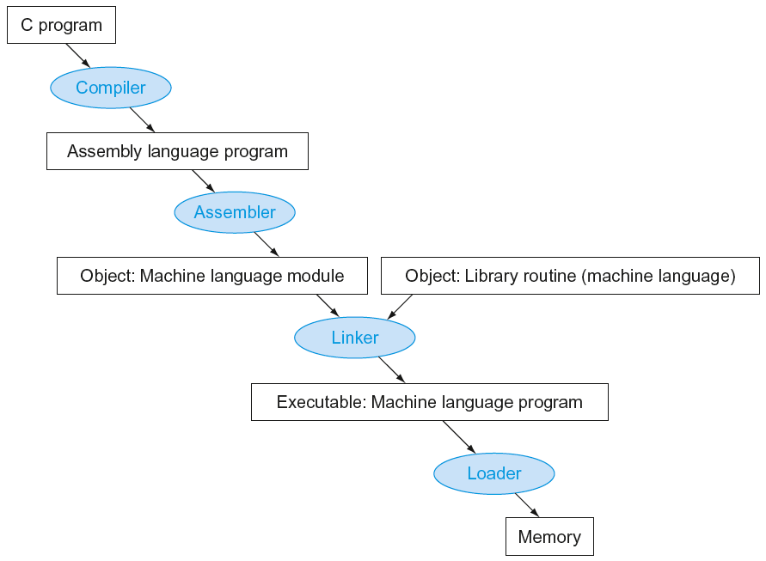
2.12 Translating and Starting a Program
Many compilers produce object modules directly
Static linking
Notes:
汇编器：Convert pseudo-instructions into actual hardware instructions –a separate object file (x.o) is created for each C file (x.c)
compute the actual values for instruction labels
maintain info on external references and debugging information
链接器：Stitches different object files into a single executable
动态链接库（.dll, .so）静态链接库（.lib, .a）
可执行文件还有一些未确定的因素，比如jump 地址，开辟空间等等

Slide 125
Start a C program in a file on disk to run
object file
Compiling
C program → assembly language program
Assembling
Assembly language program → machine language module
pseudoinstructions
mv x10,x11 // register x10 gets register x11
add x10, x11, x0
Symbol table
A table that matches name of lables to the addresses of the memory words that instructions occupy.
Producing an object file of UNIX (six distinct pieces)
Notes:
伪指令：pseudo-instrs make it easier to program in assembly – examples: “move”, “blt”, 32-bit immediate operands, etc.
汇编器接受不同基数的数字
汇编器需要处理所有标记对应的地址，将分支和数据传输指令对应的标记放入符号表中

Slide 126
Object file
object file header—size and position of the other pieces
Text segment
static data segment and dynamic data
The relocation information ----identifies absolute addresses of instruction and data words when the program is loaded into memory
symbol table
Debugging information
Object file header
 | Name | Procedure A
 | Text size | 100_{hex}
 | Data size | 20_{hex}
Text segment | Address | instruction
 | 0 | ld x10, 0(gp)
 | 4 | jal x1, 0
 | …… | --
Data segment | 0 | (X)
 | …… | ……
Relocation information | Address | Instruction type | Dependency
 | 0 | ld | X
 | 4 | jal | B
Symbol table | label | Address
 | X | --
 | B | --
Notes:
.com文件没有文件头信息，约定必须从哪里开始执行。
Text:100, data:20，操作系统会申请120个空间
Lw指令有$gp，还有jal，都是需要重新定向

Slide 127
Linking Object modules
Object modules(including library routine) → executable program
3 step of Link
Place code and data modules symbolically in memory
Determine the addresses of data and instruction labels
Patch both the internal and external references (Address of invoke)
Could leave location dependencies for fixing by a relocating loader
But with virtual memory, no need to do this
Program can be loaded into absolute location in virtual memory space
RISC-v memory allocation for program and data
sp
7fff fffc_{hex}
Stack
Dynamic data
gp
1000 8000_{hex}
Static data
1000 0000_{hex}
Text
PC
0040 0000_{hex}
Reserved
0
Notes:
链接器使用每个目标模块的重定位信息和符号表，来解析所有的未定义标记，产生可执行文件。这个文件与目标文件具有相同的格式，但是不包含未解决的引用。
不过可能仍含有未解决的地址。
静态数据通过$gp访问，动态数据通过$sp访问
作业汇编器最终交上来的是可执行代码，必须是链接好的。

Slide 128
Loading a Program
Load from image file on disk into memory
1. Read header to determine segment sizes
2. Create virtual address space
3. Copy text and initialized data into memory
Or set page table entries so they can be faulted in
4. Set up arguments on stack
5. Initialize registers (including sp, fp, gp)
6. Jump to startup routine
Copies arguments to x10, … and calls main
When main returns, do exit syscall
Notes:
可执行文件在磁盘中，加载器将其读到内存中启动执行。

Slide 129
Dynamic Linking
Only link/load library procedure when it is called
Requires procedure code to be relocatable
Avoids image bloat caused by static linking of all (transitively) referenced libraries
Automatically picks up new library versions

Slide 130
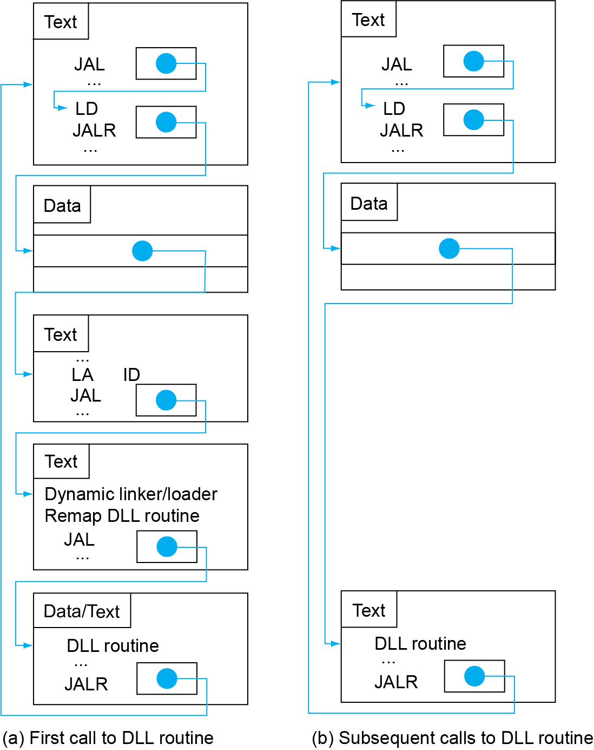
Lazy Linkage
Indirection table
Stub: Loads routine ID, Jump to linker/loader
Linker/loader code
Dynamically mapped code

Slide 131
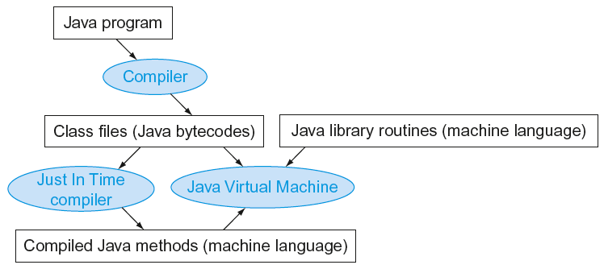
Starting Java Applications
Simple portable instruction set for the JVM
Compiles bytecodes of “hot” methods into native code for host machine
Interprets bytecodes

Slide 132
执行文件与进程
132
执行文件
在硬盘上，非执行态
如病毒样本
进程
转载到内存
可以细分为多个可以并发执行的线程
如激活态病毒
如何看线程: 任务管理器

Slide 133
计算机任何动作都是程序设计的
133
病毒
组成：感染能力（自我复制），隐藏，破坏能力
一个简单的
感染：看到一个执行程序，就把病毒程序拷贝到执行程序最后，程序启动时加一条无条件跳转指令，跳到病毒处，病毒程序执行完成跳回首地址后
隐藏：把执行程序拆封为n个，运行时组装为一体
破坏：随便
程序都需要消耗内存
System idle 也是程序，也消耗内存

Slide 134
EXE文件加密
输入密码才能执行该文件？
普通的方法，先读密码，验证后判断是否继续
问题：简单的修改执行文件即可破解
一般方法：
第一段代码是密码验证
若通过，则解密后续代码
解密后长度=加密前，简单
随便压缩
高级方法：
分段加密，前一段的中间结果作为后续的解密用的密钥
134

Slide 135
2.13 A C Sort Example To Put it All Together
Three general steps for translating C procedures
Allocate registers to program variables
Produce code for the body of the procedures
Preserve registers across the procedures invocation
Procedure swap
C code
void swap ( long long v[ ] , size_t k )
{
long lon temp ;
temp = v[ k ] ;
v[ k ] = v[ k + 1 ] ;
v[ k + 1 ] = temp ;
}
Notes:
排序是一个经典例子
主要是为了讲解在循环过程当中是怎么编译的汇编语言，特别是在循环中调用其他函数

Slide 136
Register allocation for swap
v ---- x10 k ---- x11 temp ---- x5
swap is a leaf procedure, nothing to preserve
RISC-V code for the procedure swap
Procedure body
swap: slli x6, x11, 3 // x6 = k * 8
add x6, x10, x6 // x6 = v + ( k * 8 )
ld x5, 0(x6) // x5 ← v[ k ]
ld x7, 8(x6) // x7 ← v[ k + 1 ]
sd x7, 0(x6) // v[k+1] → v[ k ]
sd x5, 8(x6) // v[k] → v[ k + 1 ]
Procedure return
jalr x0, 0(x1) // return to calling routine

Slide 137
Procedure sort
C code
void sort (long long v[ ] , size_t n )
{
size_t i , j ;
for ( i = 0 ; i < n ; i + = 1 ) {
for ( j = i - 1 ; j >= 0 && v[j] > v[j+1] ; j -= 1 )
swap ( v , j ) ;
}
}
Register allocation for sort
v ---- x10 n ---- x11 i ---- x19 j ---- x20
Passing parameters in sort
Preserving registers in sort
x1 , x19, x20, x21, x22
If V[0]> V[1]
V[0]
V[1]
V[2]
……
V[n-1]

Slide 138
RISC V Code for the procedure sort
Saving registers
sort: addi sp, sp, -40 // make room on stack for 5 registers
sd x1, 32(sp) // save return address on stack
sd x22, 24(sp) // save x22 on stack
sd x21, 16(sp) // save x21 on stack
sd x20, 8(sp) // save x20 on stack
sd x19, 0(sp) // save x19 on stack
Procedure body{Outer loop {Inner loop} }
Restoring registers
exit1: ld x19, 0(sp) // restore x19 from stack
ld x20, 8(sp) // restore x20 from stack
ld x21, 16(sp) // restore x21 from stack
ld x22, 24(sp) // restore x22 from stack
ld x1, 32(sp) // restore return address from stack
addi sp, sp, 40 // restore stack pointer
Procedure return
jalr x0, 0(x0) // return to calling routine

Slide 139
Code for Procedure body
Outer loop—first for loop
for ( i = 0 ; i < n ; i + = 1 ) {
Move parameters
mv x21, x10 // copy parameter x10 into x21
mv x22, x11 // copy parameter x11 into x22
Outer loop
li x19, 0 // i = 0
for1tst: bge x19, x22, exit1 // go to exit1 if i >= n
………………
（body of first for loop is second for loop）
………………
exit2: addi x19, x19, 1 # i = i + 1
j for1tst # jump to test of outer loop
exit1:

Slide 140
Inner loop-- second for loop is body of first for loop
for ( j = i - 1 ; j >= 0 && v[j] > v[j+1] ; j- = 1 ){
addi x20, x19, -1 // j = i - 1
for2tst: blt x20, x0, exit2 // go to exit2 if j < 0
slli x5, x20, 3 // x5 = j * 8
add x5, x21, x5 // x5 = the address of v[j]
ld x6, 0(x5) // x6 = v[j]
ld x7, 8(x5) // x7 = v[j + 1]
blt x6, x7, exit2 // go to exit2 if v[j] < v[j+1]
………………
（body of first for loop ）
………………
addi x20, x20, -1 // j = j - 1
j for2tst // jump to test of inner loop
exit2:

Slide 141
body of first for loop
Pass parameters and call
mv x10，x21 // first swap parameter v
mv x11，x20 // second swap parameter j
Call function swap
jal x1, swap
Notice: 1.Why are x10 and x11 saved? x10 is the base of the array v. x10 will be used repeatedly and might be(actually not here) changed by the procedure swap. x11 is the size of the array v. x11 will be used repeatedly and changed before the procedure swap is called.
2.Why are they not pushed to stack?
Register variable is faster

Slide 142
Effect of Compiler Optimization
Compiled with gcc for Pentium 4 under Linux

Slide 143
Effect of Language and Algorithm

Slide 144
Lessons Learnt
Instruction count and CPI are not good performance indicators in isolation
Compiler optimizations are sensitive to the algorithm
Java/JIT compiled code is significantly faster than JVM interpreted
Comparable to optimized C in some cases
Nothing can fix a dumb algorithm!

Slide 145
2.14 Arrays versus Pointers
Array indexing involves
Multiplying index by element size
Adding to array base address
Pointers correspond directly to memory addresses
Can avoid indexing complexity

Slide 146
Example: Clearing an Array
clear1(int array[], int size) { int i; for (i = 0; i < size; i += 1) array[i] = 0; } | clear2(int *array, int size) { int *p; for (p = &array[0]; p < &array[size]; p = p + 1) *p = 0; }
li x5,0 // i = 0 loop1: slli x6,x5,3 // x6 = i * 8 add x7,x10,x6 // x7 = address // of array[i] sd x0,0(x7) // array[i] = 0 addi x5,x5,1 // i = i + 1 blt x5,x11,loop1 // if (i<size) // go to loop1 | mv x5,x10 // p = address // of array[0] slli x6,x11,3 // x6 = size * 8 add x7,x10,x6 // x7 = address // of array[size] loop2: sd x0,0(x5) // Memory[p] = 0 addi x5,x5,8 // p = p + 8 bltu x5,x7,loop2 // if (p<&array[size]) // go to loop2
This code works as long as size is greater than 0.
This code works as long as size is greater than 0.
Notes:
数组：This code works as long as size is greater than 0. (In this case,the loop will be executed once even though the value of the size parameter is invalid. Actually,size >0 must be checked at first)

Slide 147
Comparison of Array vs. Ptr
Multiply “strength reduced” to shift
Array version requires shift to be inside loop
Part of index calculation for incremented i
c.f. incrementing pointer
Compiler can achieve same effect as manual use of pointers
Induction variable elimination
Better to make program clearer and safer
Notes:
Compare the two versions
Array version has the “multiply” and add inside loop
Pointer version reduces instructions/iteration from 5 to 3
For modern compliers,both ways are the same.
P比较array最后一个元素的下一个
指针效率高一点，在循环里面不需要计算array的索引
Java里面没有指针，java的一个特点是跨平台，不针对任何硬件。预编译的时候编译到一个中间层，执行的时候硬件和Java虚拟机对接。效率不高。

Slide 148
2.16 Real Stuff: MIPS Instructions
MIPS: commercial predecessor to RISC-V
Similar basic set of instructions
32-bit instructions
32 general purpose registers, register 0 is always 0
32 floating-point registers
Memory accessed only by load/store instructions
Consistent use of addressing modes for all data sizes
Different conditional branches
For <, <=, >, >=
RISC-V: blt, bge, bltu, bgeu
MIPS: slt, sltu (set less than, result is 0 or 1)
Then use beq, bne to complete the branch

Slide 149
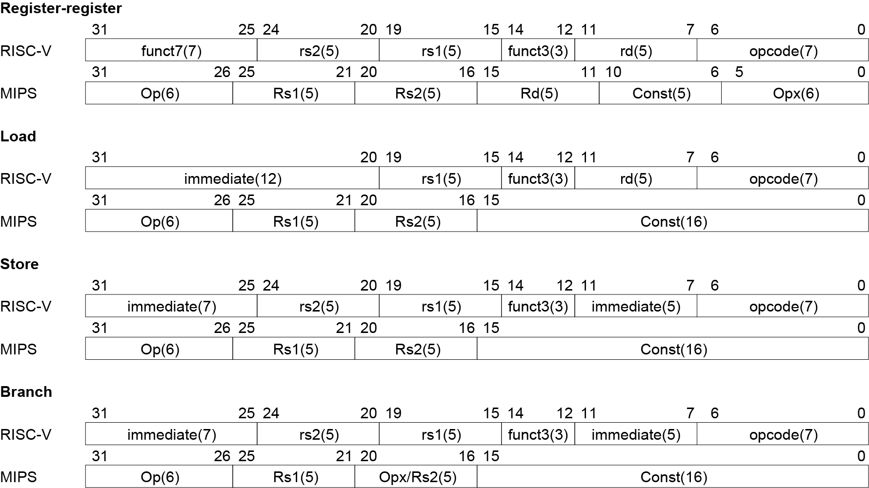
Instruction Encoding

Slide 150
2.17 Real Stuff: The Intel x86 ISA
Evolution with backward compatibility
8080 (1974): 8-bit microprocessor
Accumulator, plus 3 index-register pairs
8086 (1978): 16-bit extension to 8080
Complex instruction set (CISC)
8087 (1980): floating-point coprocessor
Adds FP instructions and register stack
80286 (1982): 24-bit addresses, MMU
Segmented memory mapping and protection
80386 (1985): 32-bit extension (now IA-32)
Additional addressing modes and operations
Paged memory mapping as well as segments

Slide 151
The Intel x86 ISA
Further evolution…
i486 (1989): pipelined, on-chip caches and FPU
Compatible competitors: AMD, Cyrix, …
Pentium (1993): superscalar, 64-bit datapath
Later versions added MMX (Multi-Media eXtension) instructions
The infamous FDIV bug
Pentium Pro (1995), Pentium II (1997)
New microarchitecture (see Colwell, The Pentium Chronicles)
Pentium III (1999)
Added SSE (Streaming SIMD Extensions) and associated registers
Pentium 4 (2001)
New microarchitecture
Added SSE2 instructions

Slide 152
The Intel x86 ISA
And further…
AMD64 (2003): extended architecture to 64 bits
EM64T – Extended Memory 64 Technology (2004)
AMD64 adopted by Intel (with refinements)
Added SSE3 instructions
Intel Core (2006)
Added SSE4 instructions, virtual machine support
AMD64 (announced 2007): SSE5 instructions
Intel declined to follow, instead…
Advanced Vector Extension (announced 2008)
Longer SSE registers, more instructions
If Intel didn’t extend with compatibility, its competitors would!
Technical elegance ≠ market success
Notes:
后面的接口和汇编课程主要是x86

Slide 153
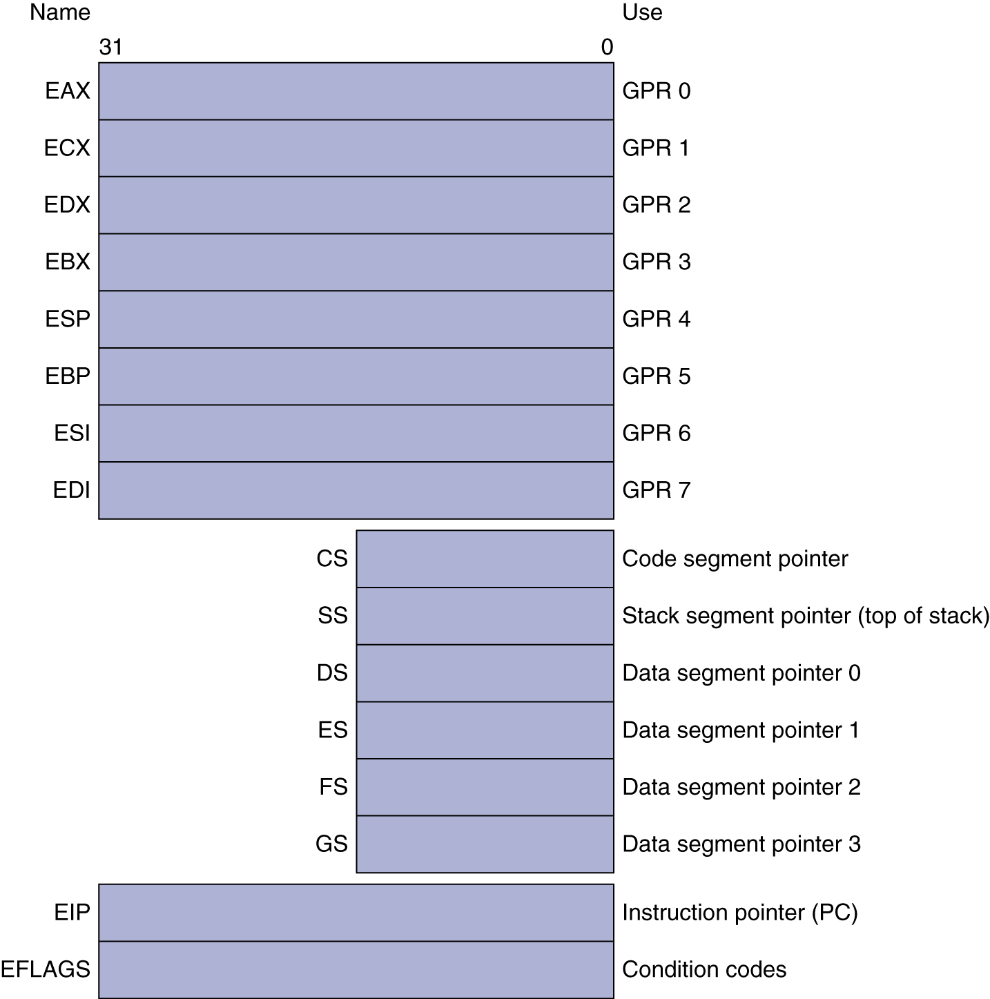
Basic x86 Registers

Slide 154
Basic x86 Addressing Modes
Two operands per instruction
Source/dest operand | Second source operand
Register | Register
Register | Immediate
Register | Memory
Memory | Register
Memory | Immediate
Memory addressing modes
Address in register
Address = R_{base} + displacement
Address = R_{base} + 2^{scale} × R_{index} (scale = 0, 1, 2, or 3)
Address = R_{base} + 2^{scale} × R_{index} + displacement

Slide 155
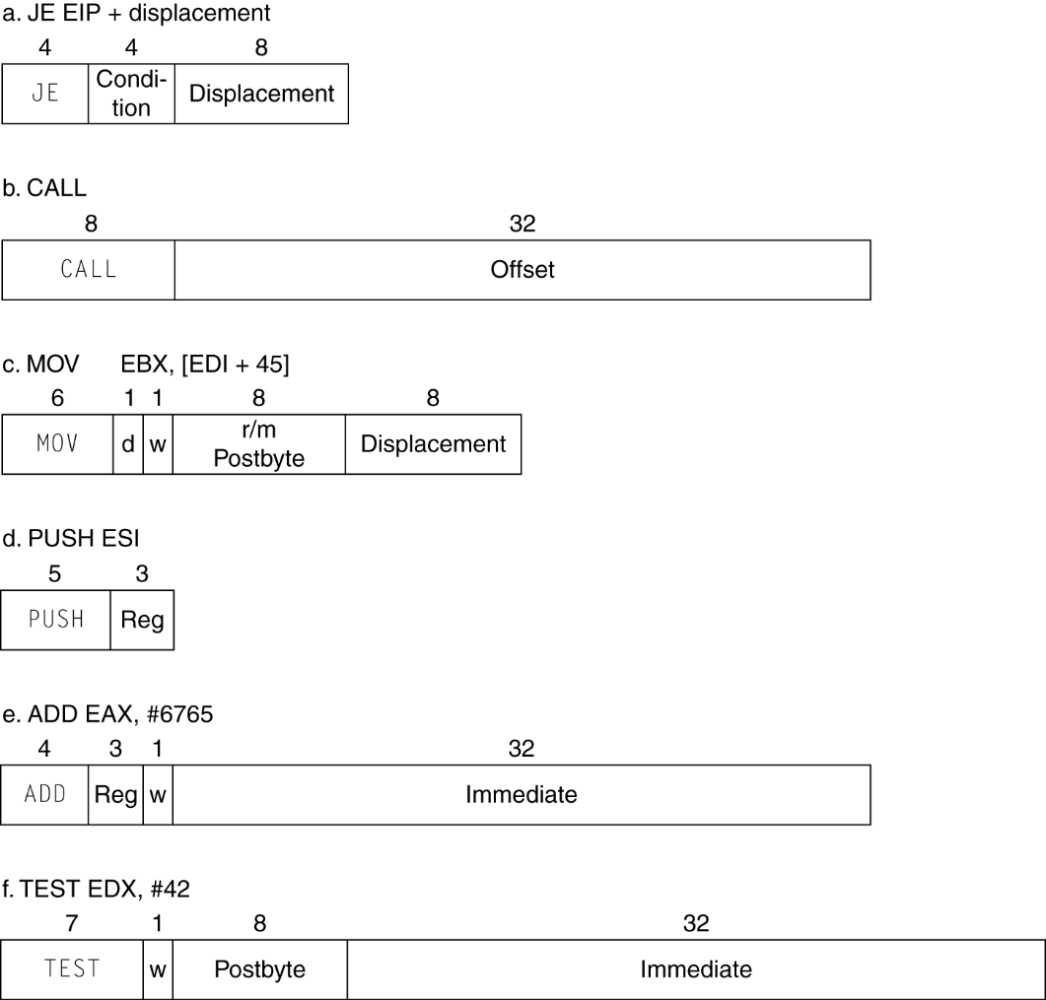
x86 Instruction Encoding
Variable length encoding
Postfix bytes specify addressing mode
Prefix bytes modify operation
Operand length, repetition, locking, …

Slide 156
Implementing IA-32
Complex instruction set makes implementation difficult
Hardware translates instructions to simpler microoperations
Simple instructions: 1–1
Complex instructions: 1–many
Microengine similar to RISC
Market share makes this economically viable
Comparable performance to RISC
Compilers avoid complex instructions

Slide 157
2.18 Other RISC-V Instructions
Base integer instructions (RV64I)
Those previously described, plus
auipc rd, immed // rd = (imm<<12) + pc
follow by jalr (adds 12-bit immed) for long jump
slt, sltu, slti, sltui: set less than (like MIPS)
addw, subw, addiw: 32-bit add/sub
sllw, srlw, srlw, slliw, srliw, sraiw: 32-bit shift
32-bit variant: RV32I
registers are 32-bits wide, 32-bit operations

Slide 158
Instruction Set Extensions
M: integer multiply, divide, remainder
A: atomic memory operations
F: single-precision floating point
D: double-precision floating point
C: compressed instructions
16-bit encoding for frequently used instructions

Slide 159
Summary
Two principles of stored-program computers
Use instructions as numbers
Use alterable memory for programs
Four design principles
Simplicity favors regularity
Smaller is faster
Good design demands good compromises
Make the common case fast
RISC –V Instruction Set

