Slide 1
Computer Organization & Design —The Hardware/ Software Interface
Chapt3_1
Arithmetic for computer

Slide 2
Contents
3.1 Introduction
3.2 Signed and Unsigned Numbers-Possible Representations
3.3 Arithmetic--Addition & subtraction and ALU
3.4 Multiplication
3.5 Division
3.6 Floating point numbers

Slide 3
3.1 Introduction
Computer words are composed of bits; thus words can be represented as binary numbers.
What about fractions and other real numbers?
What happen if an operations creates a number bigger than can be represented
And underlying these questions is a mystery: How does hardware really multiply or divide numbers?

Slide 4
Introduction
Computer words are composed of bits;
words can be represented as binary numbers.
There are 32bits/word or 64bits/word in RISC V
Simplified to contain only in course:
memory-reference instructions: lw, sw,
arithmetic-logical instructions: add, sub, and, or,xor, sll, srl,sra,slt, sltu
control flow instructions: beq,bne, blt, bge, jal, jalr
Generic Implementation:
use the program counter (PC) to supply instruction address
get the instruction from memory
read registers
use the instruction to decide exactly what to do
All instructions use the ALU after reading the registers Why? memory-reference? arithmetic? control flow?

Slide 5
Numbers
Bits are just bits (no inherent meaning)— conventions define relationship between bits and numbers
Binary numbers (base 2) 0000 0001 0010 0011 0100 0101 0110 0111 1000 1001... decimal: 0...2^{n}-1
Of course it gets more complicated: numbers are finite (overflow) fractions and real numbers negative numbers e.g., no MIPS subi instruction; addi can add a negative number)
How do we represent negative numbers?

Slide 6
Do you know ?
What is this about following digital ?
00110011110111100000000100000000₂
Ah, Why ?
Because different occasions have different meanings
The possible meaning is
IP address
Machine instructions
Values of Binary number：
Integer
Fixed Point Number
Floating Point Number

Slide 7
For binary integer
The following 4-bit binary integer What does it mean?
1001₂
Don’t know!
Ah, still do not know for?
Integer representation of different methods have different meaning
Unsigned 1001₂=9₁₀
Signed 1001₂=-1₁₀ or -7₁₀ ?
Do not know, is the right answer !

Slide 8
3.2 Signed and Unsigned Numbers Possible Representations
Sign Magnitude: One's Complement Two's Complement 000 = +0 000 = +0 000 = +0 001 = +1 001 = +1 001 = +1 010 = +2 010 = +2 010 = +2 011 = +3 011 = +3 011 = +3 100 = -0 100 = -3 100 = -4 101 = -1 101 = -2 101 = -3 110 = -2 110 = -1 110 = -2 111 = -3 111 = -0 111 = -1
Issues: number of zeros, ease of operations
Which one is best? Why?
Issues：number of zeros， ease of operations

Slide 9
Numbers and their representation
Number systems
Radix based systems are dominating
decimal, octal, binary,…
b: value of the digit, k: radix, n: digits left of radix point, m: digits right of radix point
Alternatives, e.g. Roman numbers (or Letter)
Decimal (k=10) -- used by humans
Binary (k=2) -- used by computers
0≤b≤K
(N)_{k}＝(A_{n－1}A _{n－2}A _{n－3}…A ₁A ₀ • A₋₁A _{-２}A…A _{–m+1}A _{– m})_{k}
MSB
LSB

Slide 10
Numbers and their representation
Representation
ASCII - text characters
Easy read and write of numbers
Complex arithmetic (character wise)
Binary number
Natural form for computers
Requires formatting routines for I/O
* ASCII--American Standard Code for Information Interchange

Slide 11
Number types
Integer numbers, unsigned
Address calculations
Numbers that can only be positive
Signed numbers
Positive
Negative
Floating point numbers
numeric calculations
Different grades of precision
Singe precision (IEEE)
Double precision (IEEE)
Quadruple precision

Slide 12
Number formats
Sign and magnitude
2's complement
1's complement
similar to 2's complement, + 0 & - 0
Biased notation
1000 0000 = minimal negative value(-2⁷)
0111 1111 = maximal positive value (2⁷-1)
Representation
Binary
Decimal
Hexadecimal ( help to remember and write)
Notes:
移码，加上2^n

Slide 13
Signed number representation
First idea:
Positive and negative numbers
Take one bit (e.g. 31) as the sign bit
Problem
0 0000000 = 0 positive zero!
1 0000000 = 0 negative zero!
Each comparison to 0 requires two steps
1's complement
2's complement

Slide 14
Two's Complement Operations
Negating a two's complement number:
invert all bits and add 1 with end
remember: “negate” and “invert” are quite different!
Defining : Assume:x＝±0.x₋₁x_{-２}x_{-３}…x_{-m} OR x＝±x_{n－1}x_{n－２}x_{n－３}x_{n－4}…x₀
Converting n bit numbers into numbers with more than n bits:
MIPS 16 bit immediate gets converted to 32 bits for arithmetic
copy the most significant bit (the sign bit) into the other bits 0010 -> 0000 0010 1010 -> 1111 1010
Ｘ 0≤X<1
２＋Ｘ＝2－|Ｘ| -1≤X<0
fraction
[X]_{C}＝
Ｘ 0≤X<2^{n}
2^{n+1}＋Ｘ＝2^{n+1}－|Ｘ| -2^{n}≤X<0
integer

Slide 15
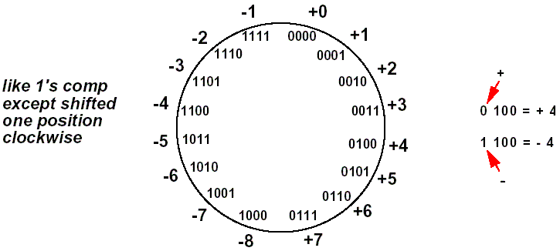
2's complement for n=3
Only one representation for 0
All numbers less than zero has the MSB = 1
One more negative number than positive number
Ex2: 37: 0 0 1 0 0 1 0 1
1 1 0 1 1 0 1 0
1 1 1 1 1 1 1 1
+ 1 → 1101 1011 (-37)
0 0 0 0 0 0 0 0
2^{n+1}＋Ｘ＝2^{n+1}-|Ｘ|
＝ 2⁴ －8
＝(10000-1000)₂
＝ 01000

Slide 16
If x<0, how to know its IxI ?
Ex2: -37: 1 1 0 1 1 0 1 1
0 0 1 00 1 0 0
1 1 1 1 1 1 1 1
+ 1 → 00100101 (37)
0 0 0 0 0 0 0 0

Slide 17
Why use 2’s complement ? -----natural way to present
Ex1: one sign bit 1’s comlement 2’s complement
+5 0 1 0 1 0 1 0 1 0101
-5 1 1 0 1 1 0 1 0 1011
0 0 0 1 0(2) 1 1 1 1 (-0) 0000 (good)
Problem for 1’s complement
0001 0011 19
− 1111 1100 −3
1 0001 0111 23 —An end-around borrow is produced.
− 0000 0001 1 —Subtract end-around borrow from result.
0001 0110 22 —The correct result is 19 − (−3) = 22.

Slide 18
Another good thing for 2’s complement
We don’t need subtraction
EX:
1’s complement 2’s complement
------------------------- --------------------------
0001 0011 19 x= -3 0001 0011 19
- 1111 1100 −(x) - 1111 1101 -(x)
1 0001 0111 23 1 0001 0110 22
0001 0011 19 0001 0011 19
+ 0000 0011 +(-X) + 0000 0011 +(-X)
0001 0110 22 0001 0110 22

Slide 19
More common: use of 2's complement---- negatives have one additional number
(0000 0000 0000 0000 0000 0000 0000 0000)₂ =(0)₁₀
(0000 0000 0000 0000 0000 0000 0000 0001)₂ =(1)₁₀
………… ………
(0111 1111 1111 1111 1111 1111 1111 1101)₂ =( 2，147，483，645)₁₀
(0111 1111 1111 1111 1111 1111 1111 1110)₂ =( 2，147，483，646)₁₀
(0111 1111 1111 1111 1111 1111 1111 1111)₂ =( 2，147，483，647)₁₀
(1000 0000 0000 0000 0000 0000 0000 0000)₂ =(-2，147，483，648)₁₀
(1000 0000 0000 0000 0000 0000 0000 0001)₂ =(-2，147，483，647)₁₀
(1000 0000 0000 0000 0000 0000 0000 0010)₂ =(-2，147，483，646)₁₀
………… ………
(1111 1111 1111 1111 1111 1111 1111 1101)₂ =(-3)₁₀
(1111 1111 1111 1111 1111 1111 1111 1110)₂ =(-2)₁₀
(1111 1111 1111 1111 1111 1111 1111 1111)₂ =(-1)₁₀

Slide 20
Two's Biased notation
Negating Biased notation number:
invert all bits and add 1 with end
Defining : Assume: x＝±x_{-(n-1)}x_{-(n-２)}x_{-(n-３)}x_{-(n-4)}…x₋₀
X=＋1011 [X]_{b}=11011 sign bit “1” Positive X=－1011 [X]_{b}=00101 sign bit “0” Negative
2's Biased notation VS 2's complement
Only reverse sign bit
e.g.
X=＋1011 [X]c=01011 [X]b=11011
X=－1011 [X]c=10101 [X]b=00101
[X]_{b}＝ 2^{n}＋Ｘ -2^{n}≤X ≤ 2^{n}
[0]b ＝100000…(2^{n})
biase
IEEE 754: [X]_{b}＝ 2^{n}-1＋Ｘ

Slide 21
sign extension (lbu vs. lb)
Sign Extension
e.g. 16 bit numbers to 32 bit numbers
Required for operations with registers(32 bits) and immediate operands (16 bits)
Sign extension
Take the lower 16 bits as they are
Copy the highest bit to the remaining 16 bits
0000 0000 0000 0010 → 2
0000 0000 0000 0000 0000 0000 0000 0010
1111 1111 1111 1110 → -2
1111 1111 1111 1111 1111 1111 1111 1110

Slide 22
Compare operations
Different compare operations required for both number types
Signed integer
slt Set when less than
slti Set when less than immediate
Unsigned integer
sltu Set when less than
sltiu Set when less than immediate

Slide 23
Example for Compare
Register $s0
1111 1111 1111 1111 1111 1111 1111 1111
Register $s1
0000 0000 0000 0000 0000 0000 0000 0001
Compared Operations
slt $t0, $s0, $s1
sltu $t0, $s0, $s1
Results
$t0 = 1 (-1 < 1)
$t0 = 0 (4,294,967,295_{ten} > 1_{ten})

Slide 24
3.3 Arithmetic
Addition and Subtraction
Logical operations
Constructing a simple ALU
Multiplication
Division
Floating point arithmetic
Adding all parts to get an ALU

Slide 25
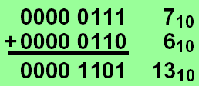
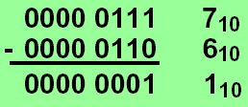
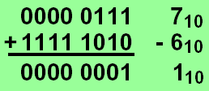
Addition & subtraction
Adding bit by bit, carries -> next digit
Subtraction
Directly
Addition of 2's complement

Slide 26
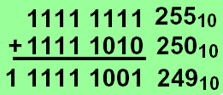
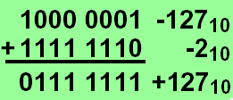
Overflow
The sum of two numbers can exceed any representation
The difference of two numbers can exceed any representation
2's complement:
Numbers change
sign and size

Slide 27
Overflow conditions
General overflow conditions
Reaction on overflow
Ignore ?
Reaction of the OS
Signaling to application (Ada, Fortran,...)
Operation | Operand A | Operand B | Result overflow
A+B | ≧0 | ≧0 | <0 (01)
A+B | <0 | <0 | ≧0 (10)
A-B | ≧0 | <0 | <0 (01)
A-B | <0 | ≧0 | ≧0 (10)

Slide 28
Overflow process
Hardware detection in the ALU
Generation of an exception (interrupt)
Save the instruction address (not PC) in special register EPC
Jump to specific routine in OS
Correct & return to program
Return to program with error code
Abort program

Slide 29
Which instructions cause Overflow
Overflows in signed arithmetic instructions cause exceptions:
add
add immediate (addi)
subtract (sub)
Overflows in unsigned arithmetic instructions don’t cause exceptions
add unsigned (addu)
add immediate unsigned (addiu)
Subtract unsigned (subu)
Handle with care!

Slide 30
New RISC V instructions
Byte instructions
lbu: load byte unsigned
Loads a byte into the lowest 8 bit of a register
Fills the remaining bits with '0'
Lb: load byte (signed)
Loads a byte into the lowest 8 bit of a register
Extends the highest bit into the remaining 24 bits
Set instructions for conditional branches
sltu: set on less than unsigned
slti: set on less than immediate
sltiu: set on less than unsigned immediate

Slide 31
Logical operations
Logical shift operations
right (srl)
left (sll)
The machine instruction for the instruction slli x11, x19, 4 (slli rd, rs1, immediate)
x19: 0000 0000 0000 0000 1100 1000 0000 1111
x11: 0000 0000 0000 0110 0100 0000 0111 0000
Filled with '0'
funct6 | immediate | Rs1 | func3 | Rd | Opcode
0 | 4 | 19 | 1 | 11 | 19

Slide 32
Logical operations
AND→bit-wise AND between registers
and register1, register2, register3
OR →bit-wise OR between registers
or register1, register2, register3
Example:
and $3, $10, $16
or $4, $10, $16
R16: 0000 0000 0000 0000 1100 1000 0000 1111
R10: 0000 0000 0000 0110 0100 0000 0111 1000
R3: 0000 0000 0000 0000 0100 0000 0000 1000
R4: 0000 0000 0000 0110 1100 1000 0111 1111

Slide 33
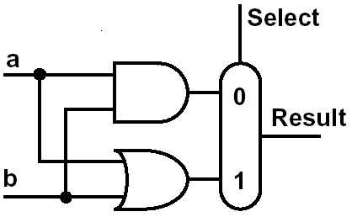
Constructing an ALU
Two methods constitute the ALU
Extended the adder
Parallel redundant select
Step by step:
build a single bit ALU
and expand it to the desired width
First function:
logic AND and OR

Slide 34
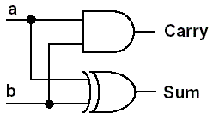
A half adder
Sum = a b + a b
Carry = a b

Slide 35
A full adder
Accepts a carry in
Sum = A xor B xor CarryIn
CarryOut = B CarryIn + A CarryIn + A B
Inputs |  |  | Outputs |  | Comments (two)
A | B | CarryIn | CarryOut | Sum
0 | 0 | 0 | 0 | 0 | 0+0+0=00
0 | 0 | 1 | 0 | 1 | 0+0+1=01
0 | 1 | 0 | 0 | 1 | 0+1+0=01
0 | 1 | 1 | 1 | 0 | 0+1+1=10
1 | 0 | 0 | 0 | 1 | 1+0+0=01
1 | 0 | 1 | 1 | 0 | 1+0+1=10
1 | 1 | 0 | 1 | 0 | 1+1+0=10
1 | 1 | 1 | 1 | 1 | 1+1+1=11

Slide 36
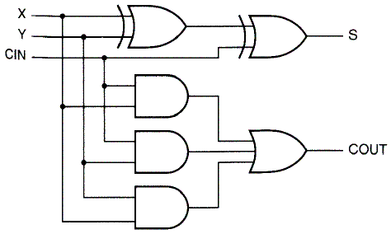
Full adder
Full adder in 2-level design
+

Slide 37
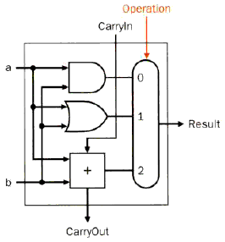
1 bit ALU
ALU
AND
OR
ADD
Cascade Element

Slide 38
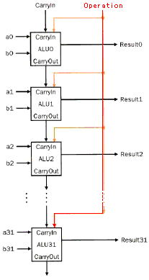
Basic 32 bit ALU
Inputs parallel
Carry is cascaded
Ripple carry adder
行波进位加法器
Slow, but simple
1st Carry In = 0

Slide 39
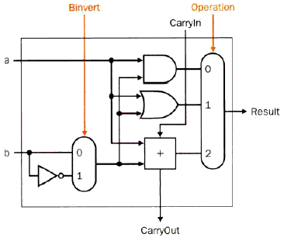
Extended 1 bit ALU
Subtraction
a - b
a-b = a + (~b+1)
=a + (-b)
Inverting b
1st CarryIn= 1

Slide 40
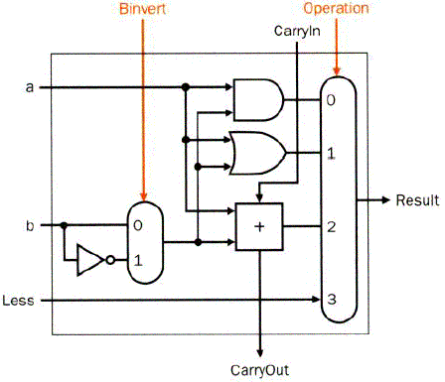
Extended 1 bit ALU to RISC V ALU
Functions
AND、OR、
Add、SUB
SLT、
Missing: comparison
Slt rd, rs1, rs2
If rs1 < rs2, rd=1, else rd=0
All bits = 0 except the least significant
Subtraction (rs1 – rs2), if the result is negative -> rs1 < rs2
Use of sign bit as indicator

Slide 41
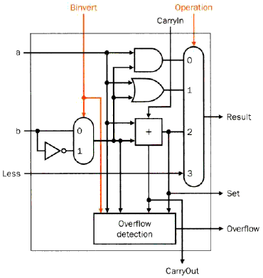
Most significant bit
Set for comparison
Overflow detect
Operation | Operand A | Operand B | Result overflow
A+B | ≧0 | ≧0 | <0 (01)
A+B | <0 | <0 | ≧0 (10)
A-B | ≧0 | <0 | <0 (01)
A-B | <0 | ≧0 | ≧0 (10)
least
significant bit
Most
significant bit

Slide 42
Complete ALU
Input
A
B
Control lines
Operation
Binvert
Carryin
Output
Result
Overflow

Slide 43
Complete ALU
Add a Zero detector

Slide 44
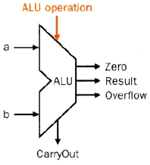
ALU symbol & control
Function table
Symbol of the ALU
ALU Control Lines | Function
000 | And
001 | Or
010 | Add
110 | Sub
111 | Set on less than

Slide 45
ALU Hardware Code
module alu(A, B, ALU_operation, res, zero, overflow );
input [31:0] A, B;
input [2:0] ALU_operation;
output [31:0] res;
output zero, overflow ;
wire [31:0] res_and,res_or,res_add,res_sub,res_nor,res_slt;
reg [31:0] res;
parameter one = 32'h00000001, zero_0 = 32'h00000000;
assign res_and = A&B;
assign res_or = A|B;
assign res_add = A+B;
assign res_sub = A-B;
assign res_slt =(A < B) ? one : zero_0;
always @ (A or B or ALU_operation)
case (ALU_operation)
3'b000: res=res_and;
3'b001: res=res_or;
3'b010: res=res_add;
3'b110: res=res_sub;
3'b100: res=~(A | B);
3'b111: res=res_slt;
default: res=32'hx;
endcase
assign zero = (res==0)? 1: 0;
endmodule
How do you write with overflow code ?
What is the difference The codes in the Synthesize?
always @ (A or B or ALU_operation)
case (ALU_operation)
3'b000: res=A&B;
3'b001: res=A|B;
3'b010: res=A+B;
3'b110: res=A-B;
3'b100: res=~(A | B);
3'b111: res=(A < B) ? one : zero_0;
default: res=32'hx;
endcase
Notes:
综合结果是一样的
Overflow要自己写

Slide 46

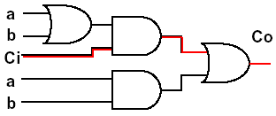
Speed considerations
A_{i}
Previously used: ripple carry adder
Delay for the sum: two units
Delay for the carry: two - three units
B_{i}
G_{i}
P_{i}
C_{i}
C_{i+1}
S_{i}

Slide 47
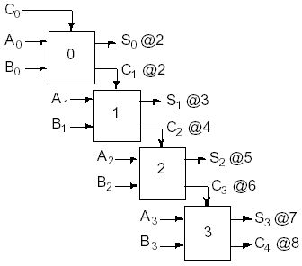
Speed considerations
Delay of one adder
2 time units
Total delay for
stages:
2n unit delays
Not appropriate for
high speed application

Slide 48
Fast adders
All functions can be represented in 2-level logic.
But:
The number of inputs of the gates would drastically rise
Target:
Optimum between speed and size

Slide 49
Fast adders
Carry look-ahead adder
Calculating the carries before the sum is ready
Carry skip adder（进位跳跃加法器）
Accelerating the carry calculation by skipping some blocks
Carry select adder（进位选择加法器）
Calculate two results and use the correct one
...

Slide 50
Carry Lookahead Adder (CLA)
Given Stage i from a Full Adder, we know that there will be a carry generated when A_{i} = B_{i} = "1", whether or not there is a carry-in
Alternately, there will be a carry propagated if the “half-sum” is "1" and a carry-in, C_{i} occurs, then C_{i+1}=1
These two signal conditions are called
generate, denoted as G_{i}
propagate, denoted as P_{i}
A_{i}
B_{i}
G_{i}
P_{i}
C_{i}
C_{i+1}
S_{i}
Notes:
gi = ai * bi
pi = ai + bi

Slide 51
Addition formula in CLA
In the ripple carry adder:
G_{i}, P_{i}, and S_{i} are local to each cell of the adder
C_{i} is also local each cell
In the carry lookahead adder, in order to reduce the length of the carry chain, Ci is changed to a more global function spanning multiple cells
Defining the equations for the Full Adder in term of the P_{i} and G_{i}:
P
=
A
⊕
B
G
=
A
B
i
i
i
i
i
i
S
=
P
⊕
C
C
=
G
+
P
C
i
i
i
i
+
1
i
i
i

Slide 52
Four bit carry look ahead adder
c1 = g0 + (p0 * c0)
c2 = g1 + p1*c1 = g1 + (p1 * g0) + (p1 * p0 * c0)
c3 = g2 + p2*c2 = g2 + (p2 * g1) + (p2 * p1 * g0) + (p2 * p1 * p0 * c0)
c4 = g3 + p3*c3 = g3 + (p3 * g2) + (p3 * p2 * g1)
+(p3 * p2 * p1 * g0) + (p3 * p2 * p1 * p0 * c0)
COMMENT:
This kind of adder will be faster than the ripple carry adder, and smaller than the adder with the tow-level logic.
PROBLEM:
If the number of the adder bits is very large, then this kind of adder will be too large. So we must seek more efficient ways.

Slide 53
Four bit carry look ahead adder
Then we get:
c4=G0+P0*c0 ; c8=G1+P1*c4
c12=G2+P2*c8 ; c16=G3+P3*c12
Assume: C1=c4, C2=c8, C3=c12, C4=c16
Then:
C1=G0+P0*c0 ; C2=G1+P1*C1
C3=G2+P2*C2 ; C4=G3+P3*C3
And,we can further get:
C1=G0+P0*c0 ;
C2= G1+P1*C1 = G1+P1*G0+ P1* P0*c0
C3=G2+P2*C2 = G2+P2*G1 + P2* P1*G0+ P2* P1* P0*c0
C4=G3+P3*C3= G3+P3*G2+P3*P2*G1+P3*P2*P1*G0+P3*P2*P1*P0*c0

Slide 54
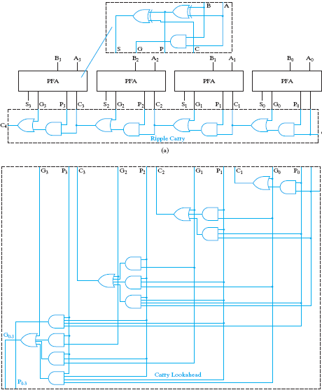
Carry Lookahead Adder
partial full adder
G
0
−
3
=
G
3
+
P
3
G
2
+
P
3
P
2
G
1
+
P
3
P
2
P
1
P
0
G
0
P
0
−
3
=
P
3
P
2
P
1
P
0

Slide 55
16 bit carry look ahead adder
Let’s consider a 16-bit adder.
Divide 16 bits into 4 groups. Each group has 4 bits.
As we know:
c4 = g3 + p3*g2 + p3*p2*g1 + p3*p2*p1*g0 + p3*p2*p1*p0*c0
So,we can get the following:
c8 = g7 + p7*g6 + p7*p6*g5 + p7*p6*p5*g4 + p7*p6*5*p4*c4
c12 = g11+p11*g10+p11*p10*g9+p11*p10*p9*g8+p11*p10*p9*p8*c8
c16=g15+p15*g14+p15*p14*g13+p15*p14*p13*g12+p15*p14*p13*p12*c12
Assume: G0= g3 + p3*g2 + p3*p2 *g1 +p3*p2*p1*g0
G1= g7 + p7*g6 + p7*p6*g5 + p7*p6*p5*g4
G2= g11+p11*g10+p11*p10*g9+p11*p10*p9*g8
G3= g15+p15*g14+p15*p14*g13+p15*p14*p13*g12
P0= p3 * p2 * p1 * p0
P1= p7 * p6 * p5 * p4
P2= p11 * p10 * p9 * p8
P3= p15 * p14 * p13 * p12

Slide 56
Group Carry Lookahead Logic
Last slide show shows the implementation of these equations for four bits. This could be extended to more than four bits; in practice, due to limited gate fan-in, such extension is not feasible.
Instead, the concept is extended another level by considering group generate (G₀₋₃) and group propagate (P₀₋₃) functions:
Using these two equations:
Thus, it is possible to have four 4-bit adders use one of the same carry lookahead circuit to speed up 16-bit addition
G
0
−
3
=
G
3
+
P
3
G
2
+
P
3
P
2
G
1
+
P
3
P
2
P
1
P
0
G
0
P
0
−
3
=
P
3
P
2
P
1
P
0
C
4
=
G
0
−
3
+
P
0
−
3
C
0

Slide 57
Extended Example: 16 carry lookahead adder
C₄ = G₃ + P₃G₂ + P₃P₂G₁ + P₃P₂P₁G₀ + P₃P₂P₁P₀C₀ = G_{0~3}+ P_{0~3}C₀
C₈ = G₇ + P₇G₆ + P₇P₆G₅ + P₇P₆P₅G₄ + P₇P₆P₅P₄C₄ = G_{4~7}+ P_{4~7}C₄
C₁₂ =G₁₁+P₁₁G₁₀+P₁₁P₁₀G₉+P₁₁P₁₀P₉G₈+P₁₁P₁₀P₉P₈C₈ = G_{8~11}+ P_{8~11}C₈
C₁₆=G₁₅+P₁₅G₁₄+P₁₅P₁₄G₁₃+P₁₅P₁₄P₁₃G₁₂+P₁₅P₁₄P₁₃P₁₂C₁₂ = G_{12~15}+ P_{12~15}C₁₂
= G_{12~15}+ P_{12~15}(G_{8~11}+ P_{8~11}(G_{4~7}+ P_{4~7}(G_{0~3}+ P_{0~3}C₀)))
G_{0~3} = G₃ + P₃G₂ + P₃P₂ G₁ +P₃P₂P₁G₀
G_{4~7} = G₇ + P₇G₆ + P₇P₆G₅ + P₇P₆P₅G₄
G_{8~11} = G₁₁+P₁₁G₁₀+P₁₁P₁0G₉+P₁₁P₁₀P₉G₈
G_{12~15}= G₁₅+P₁₅G₁₄+P₁₅P₁₄G₁₃+P₁₅P₁₄P₁₃G₁₂
P_{0~3} = P₃ P₂ P₁ P₀
P_{4~7} = P₇ P₆ P₅ P₄
P_{8~11} = P₁₁ P₁₀ P₉ P₈
P_{12~15}= P₁₅ P₁₄ P₁₃ P₁₂
C₄ = G₃ + P₃G₂ + P₃P₂G₁ + P₃P₂P₁G₀ + P₃P₂P₁P₀ C₀
CLA
CLA
CLA
CLA
CLA

Slide 58
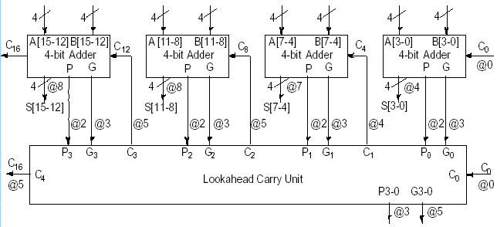
Hybrid CLA + Ripple carry
Realisation:
Ripple carry adders and
Carry look ahead logic

Slide 59
Carry-Skip Adders
With CMOS Implementation – Carry Skip Adder’s speed Comparable to CLA
Less Area/Power
Based on Observation that Carry Process Can “Skip” Stage for Which x_{i} ≠ y_{i} (that is p_{i} = x_{i}⊕y_{i} = 1)
Adder of n stages Divided into Stages of Selected Lengths
With Simple Ripple Carry
Each Group Generates “Group Carry-Propagate”=1 if all p_{i}=1 This Signal Allows Incoming Carry to “Skip” Stages within Group and Generate Carry-out

Slide 60
What does it mean if ALL Pi = 1 ?
c1 = g0 + (p0 * c0)
c2 = g1 + p1*c1 = g1 + (p1 * g0) + (p1 * p0 * c0)
c3 = g2 + p2*c2 = g2 + (p2 * g1) + (p2 * p1 * g0) + (p2 * p1 * p0 * c0)
c4 = g3 + p3*c3 = g3 + (p3 * g2) + (p3 * p2 * g1)
+(p3 * p2 * p1 * g0) + (p3 * p2 * p1 * p0 * c0)
gi = ai * bi pi= ai + bi
If Pi = 1 then it can be know that Gi = 0
So, c4 = g3 + p3*c3 = g3 + (p3 * g2) + (p3 * p2 * g1)
+(p3 * p2 * p1 * g0) + (p3 * p2 * p1 * p0 * c0)
= c0

Slide 61
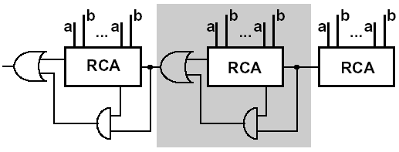
Carry skip adder
Accelerating the carry by skipping the interior blocks
Optimal speed with no-equal distribution of block length

Slide 62
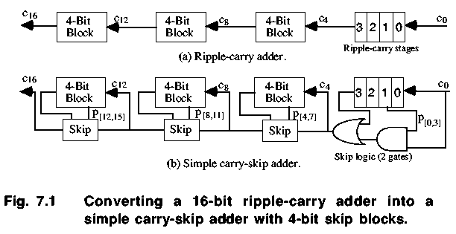
Fixed Block Width Carry-Skip Adders

Slide 63
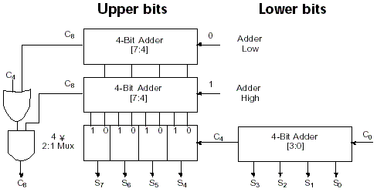
Carry Select Adder (CSA)

Slide 64
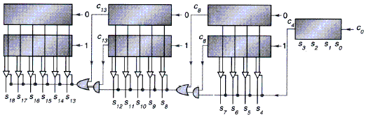
Carry Select Adder
Carry selection by nibbles

Slide 65
3.4 Multiplication
Binary multiplication
Multiplicand * Multiplier
example： 1000 * 1001
1000
1001
1000
0000
0000
_1000_____
Product 1001000
Look at current bit position
If multiplier is 1
then add multiplicand
Else add 0
shift multiplicand left by 1 bit

Slide 66
Multiplier V1
32 bits: multiplier
64 bits: multiplicand, product, ALU
0010*0011
M
u
l
t
i
p
l
i
c
a
n
d
0000 0010
S
h
i
f
t
l
e
f
t
6
4
b
i
t
s
0011
M
u
l
t
i
p
l
i
e
r
6
4
-
b
i
t
A
L
U
S
h
i
f
t
r
i
g
h
t
3
2
b
i
t
s
P
r
o
d
u
c
t
C
o
n
t
r
o
l
t
e
s
t
0000 0110
W
r
i
t
e
6
4
b
i
t
s

Slide 67
Multiplier V 1
Requires 32 iterations
Addition
Shift
Comparison
Almost 100 cycles
Very big, Too slow!

Slide 68
Multiplier V 2
Real addition is performed only with 32 bits
Least significant bits of the product don't change
New idea:
Don’t shift the multiplicand
Instead,shift the product
Shift the multiplier
ALU reduced to 32 bits!

Slide 69
Multiplier V 2
Diagram of the V2 multiplier
Only left half of product register is changed

Slide 70
Multiplier V 2
Addition performed
only on left half of
product register
Shift of product register

Slide 71
Revised 4-bit example
Multiplicand x multiplier: 0001 x 0111
Multiplicand: 0001
Multiplier: 0111
00000000 #Initial value for the product
00010000 #After adding 0001
00001000 #After shifting right the product one bit
0001
00011000
00001100 #After shifting right the product one bit
0001
00011100
00001110 #After shifting right the product one bit
0000
00001110
00000111 #After shifting right the product one bit

Slide 72
Multiplier V 3
Further optimization
At the initial state the product register contains only '0'
The lower 32 bits are simply shifted out
Idea:
use these lower 32 bits for the multiplier

Slide 73
Multiplier V 3

Slide 74
Multiplier V 3
Set product
register to '0'
Load lower
bits of product
register with
multiplier
Test least
significant bit
of product
register

Slide 75
Example
Multiplicand x multiplier: 0001 x 0111
Multiplicand: 0001
Multiplier: 0111
00000111 #Initial value for the product
00010111 #After adding 0001
00001011 #After shifting right the product one bit
0001
00011011
00001101 #After shifting right the product one bit
0001
00011100
00001110 #After shifting right the product one bit
0000
00001110
00000111 #After shifting right the product one bit

Slide 76
Signed multiplication
Basic approach:
Store the signs of the operands
Convert signed numbers to unsigned numbers
(most significant bit (MSB) = 0)
Perform multiplication
If sign bits of operands are equal
sign bit = 0, else
sign bit = 1
Improved method:
Booth's Algorithm
Assumption: addition and subtraction are available

Slide 77
Booth’s Principle -- Decomposable multiplication
Assumes： Z=y×10111100
Z=y(10000000+111100+100-100)
=y(1×2⁷+1000000-100)
=y(1×2⁷+1×2⁶-2²)
=y(1×2⁷+1×2⁶+0×2⁵+0×2⁴+0×2³+0×2²+0×2¹+0×2⁰ -1×2² )
= y(1×2⁷+1×2⁶+0×2⁵+0×2⁴+0×2³+0×2²-1×2² +0×2¹+0×2⁰)
= y×2⁷+y×1×2⁶+0×2⁵+0×2⁴+0×2³ +0×2²-y×2² +0×2¹+0×2⁰)
add
Only shift
sub
Only shift
1 01 111 10 00

Slide 78
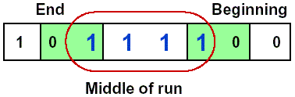
Booth's Algorithm
Idea: If you have a sequence of '1's
subtract at first '1' in multiplier
shift for the sequence of '1's
add where prior step had last '1‘
Result:
Possibly less additions and more shifts
Faster, if shifts are faster than additions

Slide 79
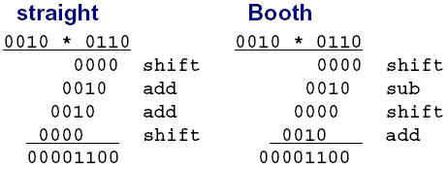
Booth's Algorithm
Example
Logic required identifying the run

Slide 80
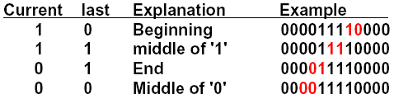
Booth's Algorithm
Analysis of two consecutive bits
Action
1 0 subtract multiplicand from left
1 1 no arithmetic operation
0 1 add multiplicand to left half
0 0 no arithmetic operation
Bit₋₁ = '0'
Arithmetic shift right:
keeps the leftmost bit constant
no change of sign bit !

Slide 81
Example with negative numbers
2 * (-3) = - 6
0010 * 1101 = 1111 1010
iteration | step | Multiplicand | product
0 | Initial Values | 0010 | 0000 1101 0
1 | 1.c:10→Prod=Prod-Mcand | 0010 | 1110 1101 0
 | 2: shift right Product | 0010 | 1111 0110 1
2 | 1.b:01→Prod=Prod+Mcand | 0010 | 0001 0110 1
 | 2: shift right Product | 0010 | 0000 1011 0
3 | 1.c:10→Prod=Prod-Mcand | 0010 | 1110 1011 0
 | 2: shift right Product | 0010 | 1111 0101 1
4 | 1.d: 11 → no operation | 0010 | 1111 0101 1
 | 2: shift right Product | 0010 | 1111 1010 1

Slide 82
13 * (-11) = - 143 -13= +10011 01101 * 10101 = 11011 10001-->00100 01111
 | step | Multiplicand | product
0 | Initial Values | 01101 | 00000 10101 0
1 | 1.c:10→Prod=Prod-Mcand | 01101 | 10011 10101 0
 | 2: shift right Product | 01101 | 11001 11010 1
2 | 1.b:01→Prod=Prod+Mcand | 01101 | 00110 11010 1
 | 2: shift right Product | 01101 | 00011 01101 0
3 | 1.c:10→Prod=Prod-Mcand | 01101 | 10110 01101 0
 | 2: shift right Product | 01101 | 11011 00110 1
4 | 1.d:01→Prod=Prod+Mcand | 01101 | 01000 00110 1
 | 2: shift right Product | 01101 | 00100 00011 0
 | 1.e:10→Prod=Prod-Mcand | 01101 | 10111 00011 0
 | 2: shift right Product | 01101 | 11011 10001 1

Slide 83
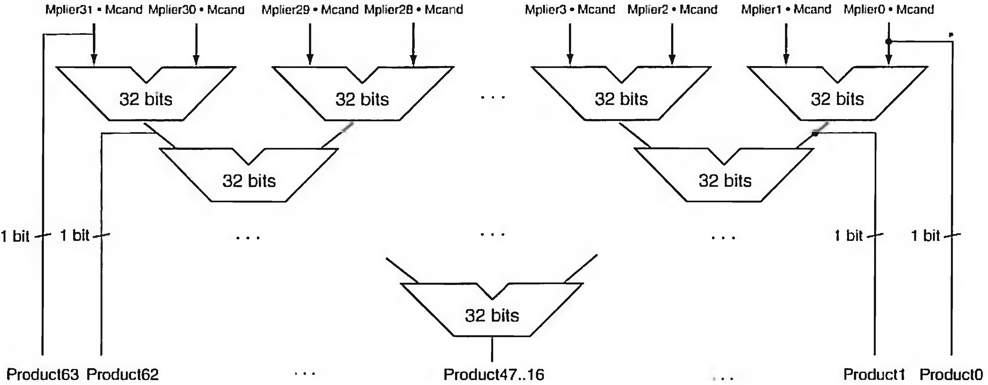
Faster Multiplication

Slide 84
END

