Slide 1
Review for Compiler Principle
Prof. Dongming LU
Jun. 10th, 2024

Slide 2
Content
1. Introduction
2. Lexical Analysis
3. Parsing
4. Abstract Syntax
5. Semantic Analysis
6. Activation Record
7. Translating into Intermediate Code
8. Basic Blocks and Traces
9. Instruction Selection
10. Liveness Analysis
11. Register Allocation
13. Garbage Collection
14 Object-Oriented Languages
18. Loop Optimizations

Slide 3
1 Introduction

Slide 4
Main Topics
The important concepts：phases, interfaces, modules
The descriptions of compiler phases
Two useful abstractions: CFG(Context Free Grammar), RE(Regular Expression)
Intermediate Representation: Tree Representation
Tree data structures: Definition for the simple language

Slide 5
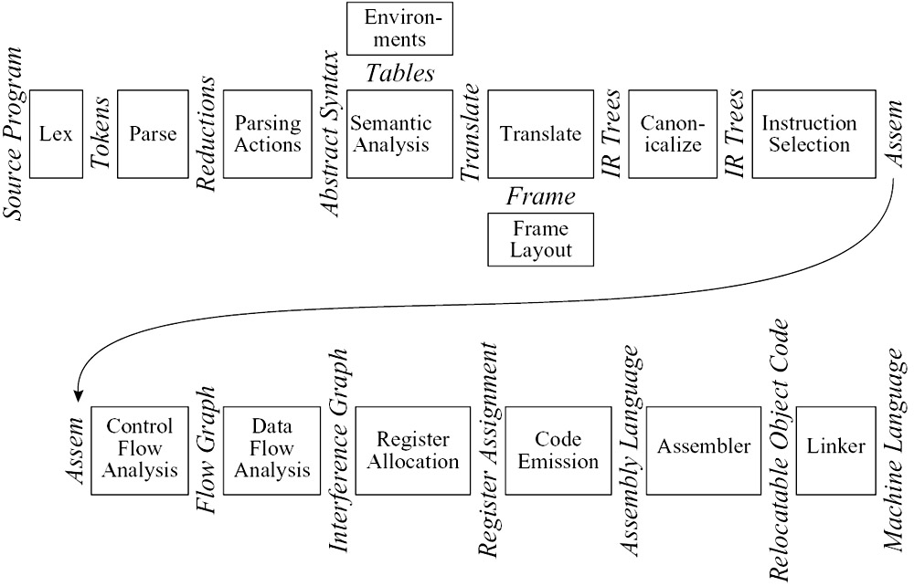
The phases and interfaces in a typical compiler

Slide 6
2 Lexical Analysis

Slide 7
Main Topics
The task of a lexical analyzer and the concept of token
The concept and notations for regurlar expression
Two important disambigulation rules for regurlar expression
longest match, rule priority
Encode the DFA machine：a transition matrix

Slide 8
Main Topics
The definitions: FA, DFA, NFA
The conversion algorithm: from RE to NFA
Making a DFA from the NFA: DFA construction algorithm, minimized DFA
Some concepts: ∊-closure, edge(s, c)，closure(S)，DFAedge(d, c)

Slide 9
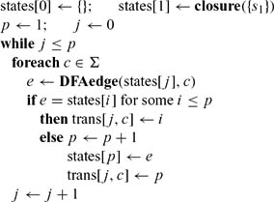
DFA construction with closure and DFAedge algorithms.
The DFA start state d1 is just closure(s1)
There is an edge from di to dj labeled with c if dj = DFAedge(di, c).
Let Σ be the alphabet, DFA construction is as follows:

Slide 10
3 Parsing

Slide 11
Main Topics
The defintion of CFG: more powerful than RE
The concepts: derivation, parse tree, ambigous grammar
Definition of the Recursive-Descent Parser: problems
The concepts and computing : Nullable sets, First set, Follow set
The parsing table and building algorithm
LL(1): definition, parsing process(match-generate)

Slide 12
Main Topics
Left-recursion, left factoring and eliminating methods
Error recovery: Recursive-descent, LL(1) parsing
Bottom-Up parsing and LR parsing engine(shift-reduce)
Parser generator: LR(0), SLR
LR(1) item and parser generator: LR(1), LALR
Yacc specification and Yacc generator

Slide 13
Compute X is Nullable by iteration:
Initialization:
Nullable := { }
if (X := ) then Nullable := Nullable U {X}
While Nullable different from last iteration do:
for all X,
if (X := ABC...) and A, B, C, ... are all Nullable then Nullable := Nullable U {X}

Slide 14
First(X) is specified like this:
base case:
if T is a terminal symbol then First (T) = {T}
inductive case:
if X is a non-terminal and (X:= ABC...) then
First (X) = First (ABC...)
where First(ABC...) = F1 U F2 U F3 U ... and
F1 = First (A)
F2 = First (B), if A is Nullable; emptyset otherwise
F3 = First (C), if A is Nullable & B is Nullable; emp...
...

Slide 15
Follow(X) is computed iteratively
base case:
Initially, assume nothing in particular follows X
(when computing, Follow (X) is initially { })
inductive case:
if (Y := s1 X s2) for any strings s1, s2 then
Follow (X) = Follow(X) U First (s2)
if (Y := s1 X s2) for any strings s1, s2 then
Follow (X) = Follow(x) U Follow(Y), if s2 is Nullable

Slide 16
Bottom-up Parsing
Parser keeps track of
Position in current input (what input to read next)
A stack of terminal & non-terminal symbols representing the “parse so far”
Based on next input symbol & stack, parser table indicates
shift: push next input on to top of stack
reduce R:
top of stack should match RHS of rule
replace top of stack with LHS of rule
error
accept (we shift EOF & can reduce what remains on stack to start symbol)

Slide 17
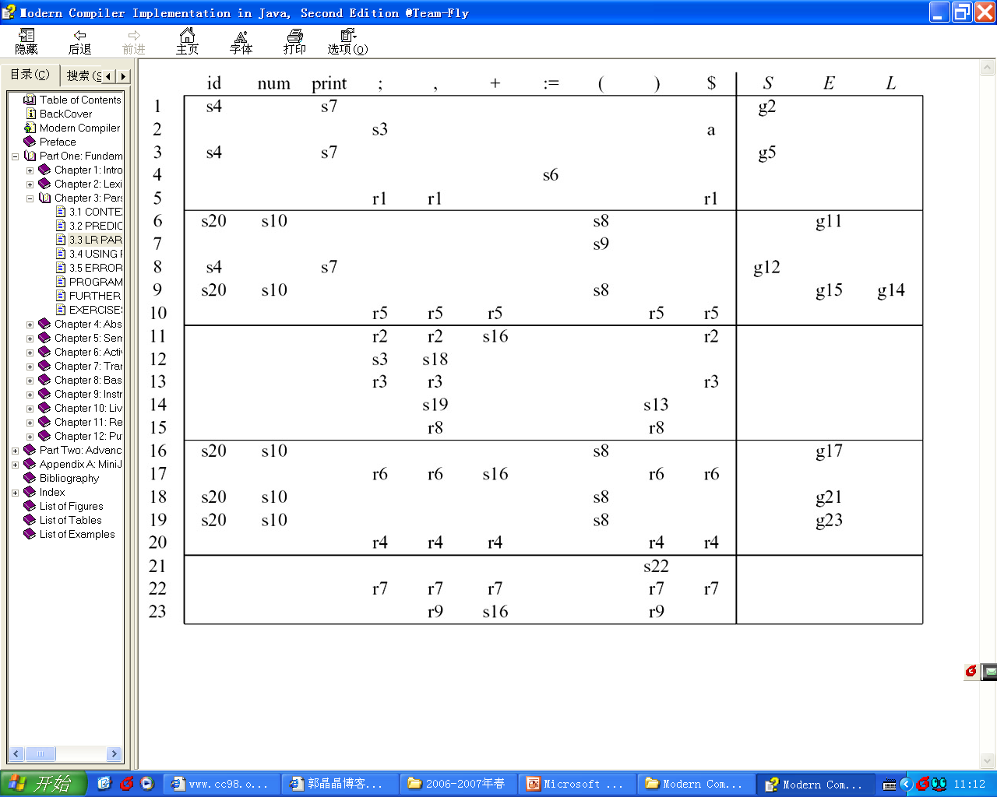
LR Parsing Engine
a :Accept; Error :
(denoted by a blank entry in the table).
sn :Shift into state n;
gn :Goto state n;
rk: Reduce by rule k;

Slide 18
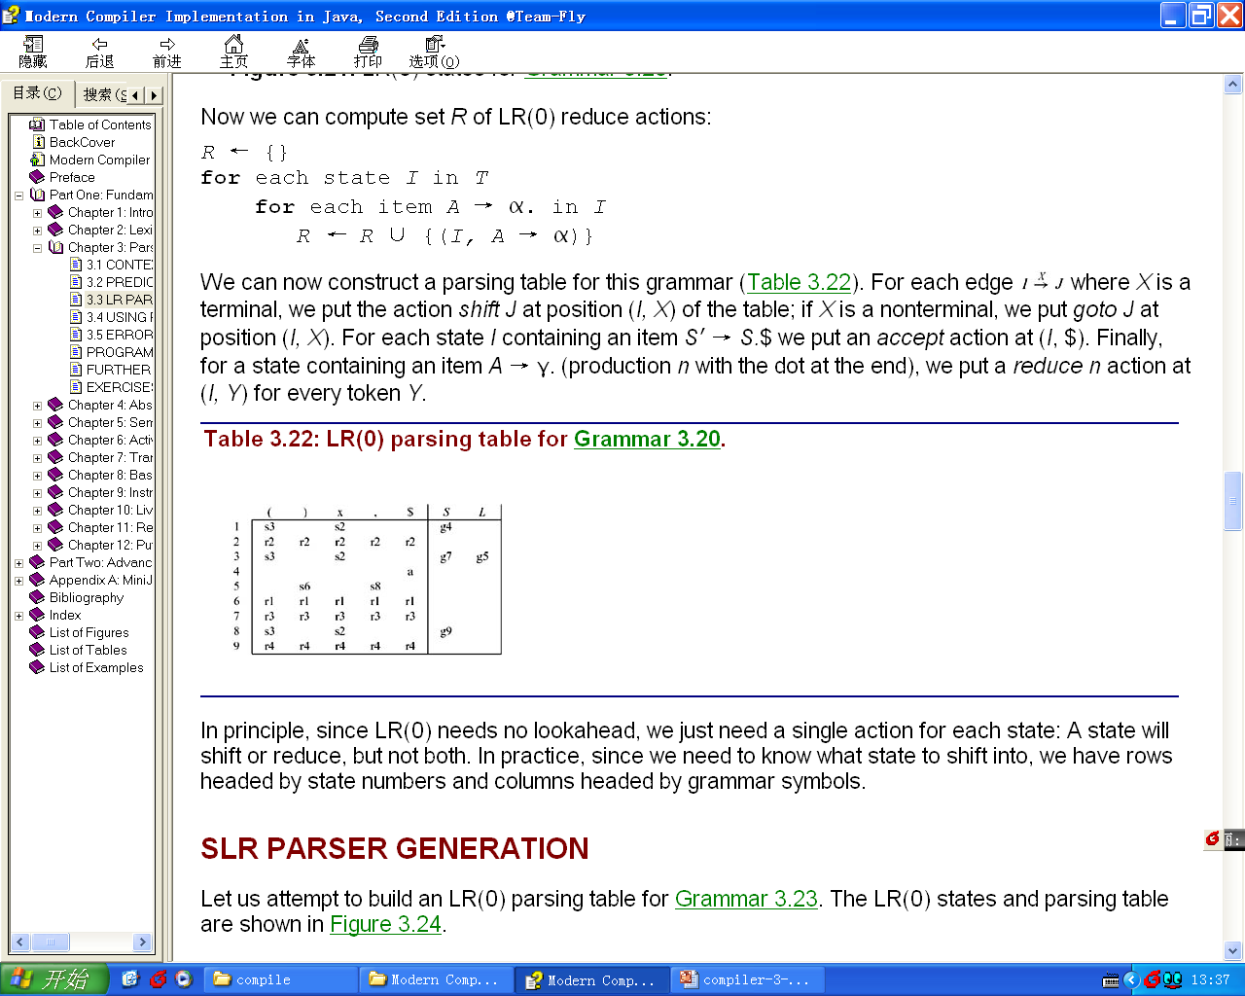
LR(0) Parser Generation
Closure(I) =
repeat
for any item A → α.Xβ in I
for any production X → γ
I ← I ∪ {X → .γ}
until I does not change.
return I
Goto(I, X) =
set J to the empty set
for any item A → α.Xβ in I
add A → αX.β to J
return Closure(J)
Items and States

Slide 19
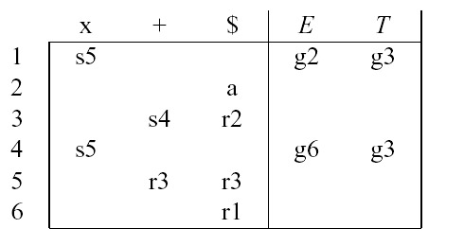
SLR Parser Generation
Put reduce actions into the table only where indicated by the FOLLOW set.
R ← {}
for each state I in T
for each item A → α. in I
for each token X in FOLLOW(A)
R ← R ∪ {(I, X, A → α)}

Slide 20
Generate LR(1) Parsing Table
Closure(I) =
repeat
for any item (A → α.Xβ, z) in I
for any production X → γ
for any w ∈ FIRST(βz)
I ← I ∪ {(X → .γ, w)}
until I does not change
return I
The start state is the closure of the item (S′ → .S $, ?)
Goto(I, X) =
J ← {}
for any item (A → α.Xβ, z) in I
add (A → αX.β, z) to J
return Closure(J).
R ← { }
for each state I in T
for each item (A → α., z) in I
R ← R ∪{(I, z, A → α)}

Slide 21
LALR(1) Parsing Tables
LR(1) parsing tables can be very large, with many states.
A smaller table can be made by merging any two states whose items are identical except for lookahead sets.
The result parser is called an LALR(1) parser.

Slide 22
4 Abstract Syntax

Slide 23
Main Topics
The role of semantic actions
Implemantetion of semantic actions: Recursve-descent, Yacc-generated parser
The abstract syntax vs the concrete parse tree

Slide 24
5 Semantic Analysis

Slide 25
Main Topics
The task of semantic analysis: connect, check translate
Environment definition: a set of bindings
Environment management: imperative, functional
Implementation of environment: hash table
Classification of type equavilence: structural, name, declaration

Slide 26
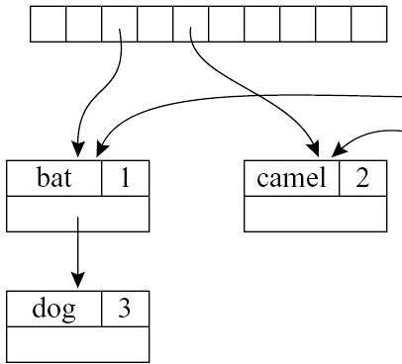
EFFICIENT IMPERATIVE
Using hash tables to implement the Imperative environments efficiently.
M1 = { bat ↦ 1,camel ↦ 2,dog ↦3 }
Table
Bucket list

Slide 27
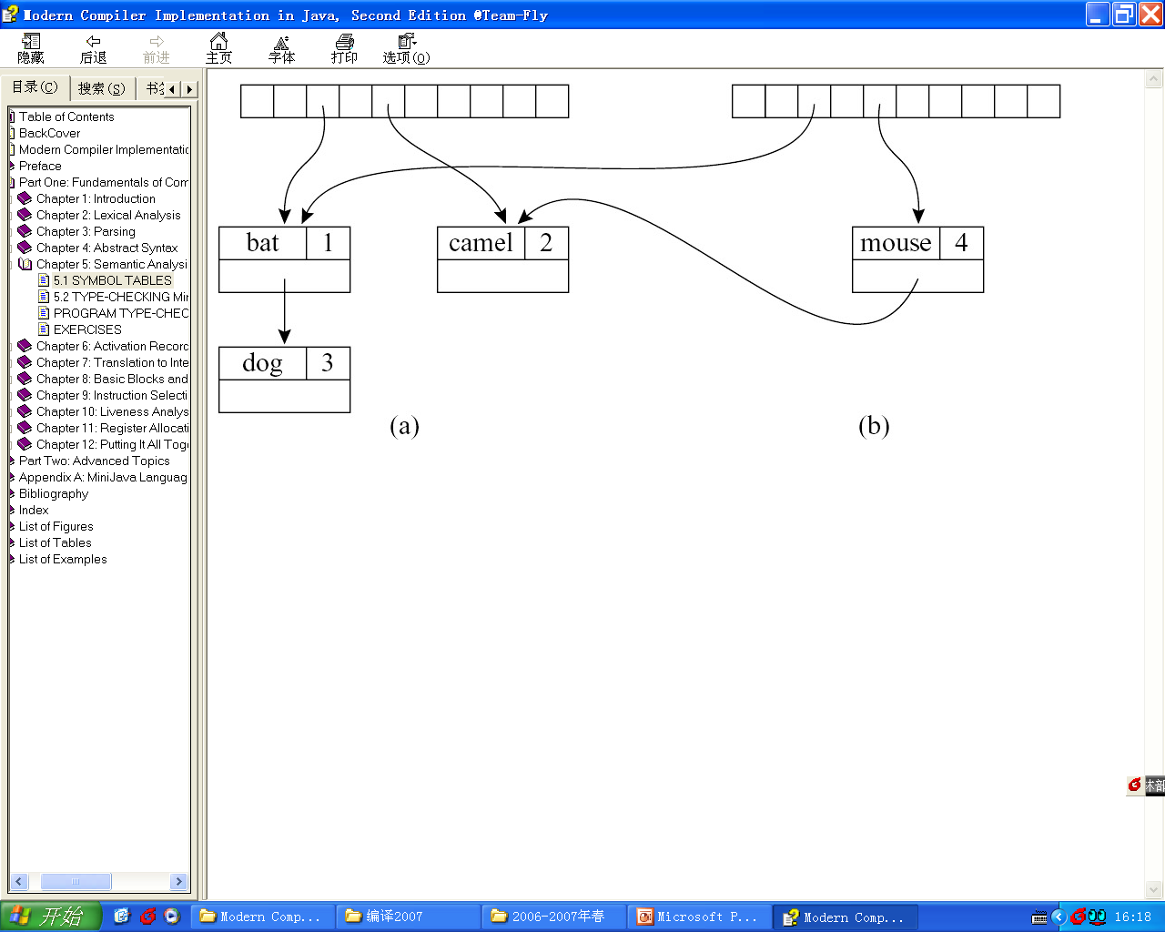
EFFICIENT FUNCTIONAL
M1 = { bat ↦ 1,camel ↦ 2,dog ↦3 }
add the binding mouse ↦4

Slide 28
6 Activation Record

Slide 29
Main Topics
The function call behave: first-in last-out fashion
The stack frame: concept and layout
Important concepts related with a frame: frame pointers, registers parameters, return address, variables, static link

Slide 30
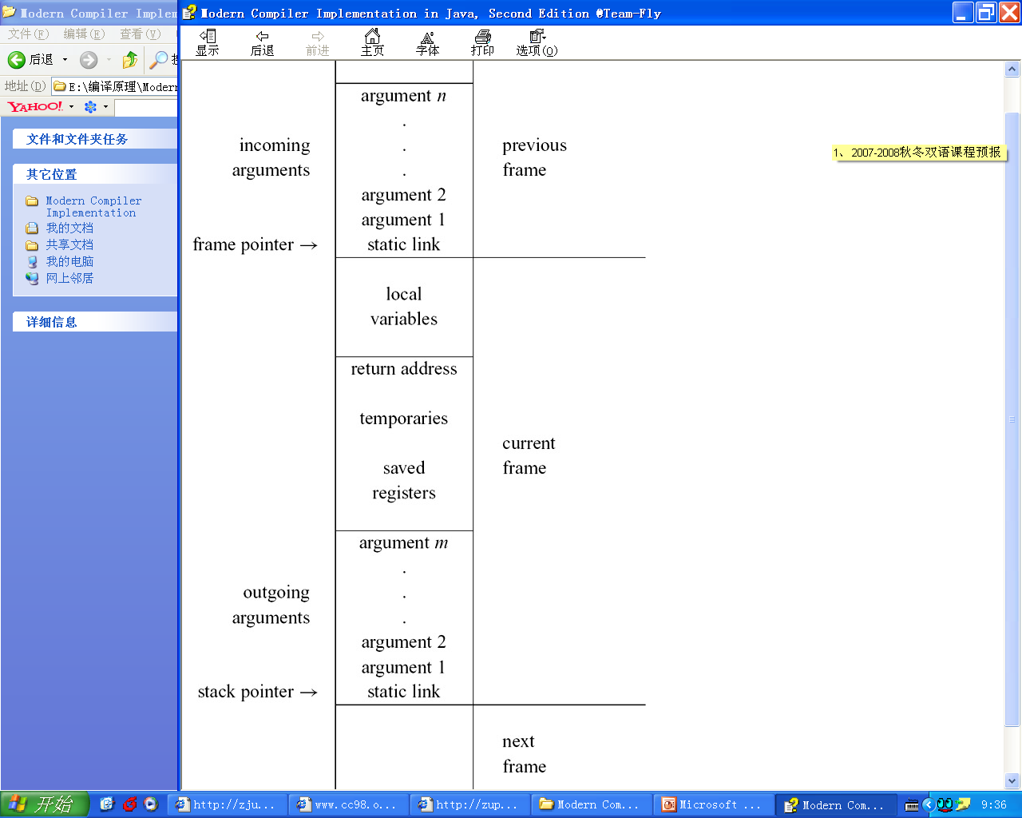
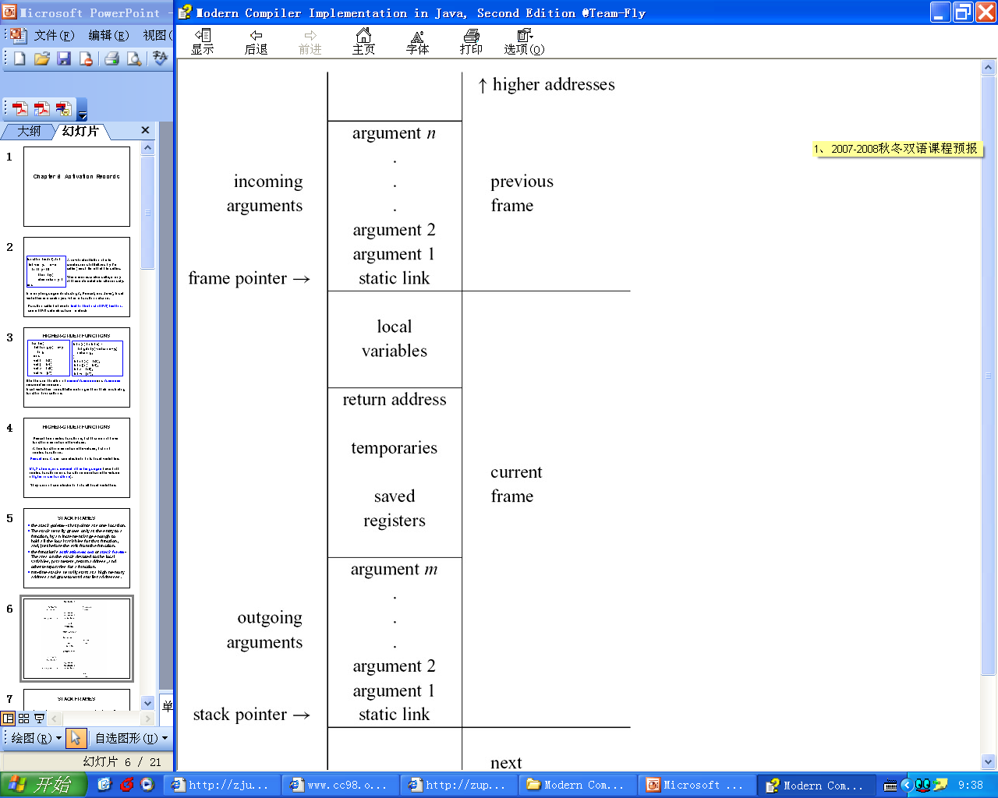
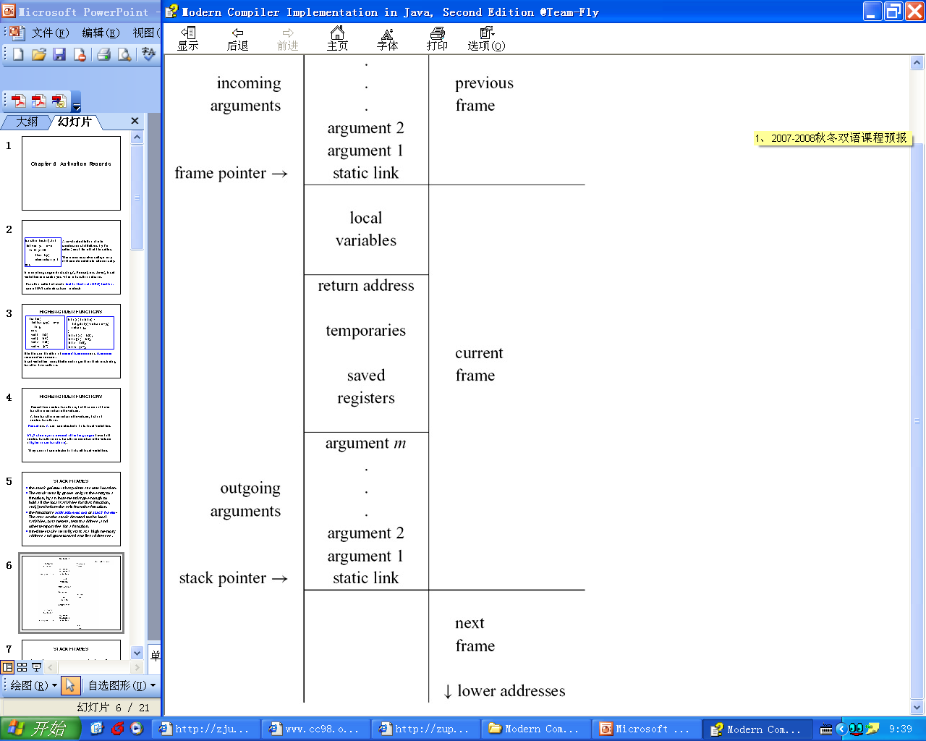
STACK FRAMES
The area on the stack devoted to the local variables, parameters, return address, and other temporaries for a function.
Run-time stacks usually start at a high memory address and grow toward smaller addresses.

Slide 31
STACK FRAMES
The stack pointer - that points at some location.
The stack usually grows only at the entry to a function, by an increment large enough to hold all the local variables for that function, and, just before the exit from the function.

Slide 32
STACK FRAMES
incoming arguments：passed by the caller
return address ： created by the CALL instruction
some local variables are in stack frame ,
other temporary local variables are saved in registers
outgoing argument space ： pass parameters.
static link

Slide 33
7 Translating into Intermediate Code

Slide 34
Main Topics
The IR: motivations, kinds, requirements
Translation: the abstract syntax expression into intermediate tree
Kinds of expression and conversion between equavilent expressions
Interface between semant and translate: simple varables, static link, array variable, structured l-value, subsripting and fields, arithmetic, conditional, for loop
Declaration: variables definition, functions definiton

Slide 35
Simple variables
The function F_Exp is used by Translate to turn a F_access into the Tree expression
The T_exp argument is the address of the stack frame that the F_access lives in
T_exp F_exp(F_access acc, T_exp framePtr);
An access a such as InFrame(k):
F_Exp(a,T_Temp(F_FP( )))
Returns
MEM(BINOP(PLUS,TEMP(FP),CONST(k)))

Slide 36
Following Static Links
A variable x is declared at an outer level of static scope, static links will be used.
MEM(+(CONST Kn, MEM(+(CONST Kn-1,…
MEM(+(CONST K1, TEMP FP))…))))
To fetch static links from all frames between the level of use and the level of definition

Slide 37
Subscripting and Field Selection
IR tree of a[i] is
MEM
+
MEM
BINOP
MUL
i
CONST
e
W
MEM(+(MEM(e),BINOP(MUL, i, CONST W)))
MEM means
store (when used as the left child of a MOVE)
fetch (when used elsewhere).

Slide 38
Conditionals
if x < 5 then a > b else 0
x < 5 translates into Cx(s1)
a > b will be translated as Cx(s2)
SEQ
SEQ
CJUMP
LT
x
CONST
z
f
LABEL
CJUMP
z
GT
a
b
t
f
5
SEQ(S1(z,f),SEQ(LABEL Z,s2(t,f)))

Slide 39
For Loops
A straightforward approach:
rewrite the abstract syntax into the abstract syntax of the while statement shown.
for i:= lo to hi
do body
let var i := lo
var limit := hi
in while I<= limit
do (body; i:= i+1)
end
Exception:
If limit=maxint Then i + 1 will overflow;

Slide 40
Function Definition
A function is translated into a prologue, a body, and an epilogue.
A prologue contains
(1) pseudo-instructions to mark the beginning of a function;
(2) a label definition for the function name;
(3) an instruction to adjust the stack pointer
(4) instructions to save "escaping" arguments into the frame, and to move nonescaping arguments into fresh temporary registers;
(5) store instructions to save any callee-save registers - including the return address register

Slide 41
Function Definition
The epilogue contains
(7) an instruction to move the return value (result of the function) to the register;
(8) load instructions to restore the callee-save registers;
(9) an instruction to reset the stack pointer;
(10) a return instruction;
(11) pseudo-instructions, as needed, to announce the end of a function.

Slide 42
8 Basic Blocks and Traces

Slide 43
Main Topics
Some mismatchs: trees and machine languages
Three stages of tranformations
Definition of canonical trees
Transform on ESEQ and rewrite rules
Move calls to the top level
Linearize the tree
Definitions of basic blocks and traces

Slide 44
General Rewriting Rules
For each kind of Tree statement or expression, similar rules can be made to pull ESEQs out of the statement or expression.
s commute with e1, e2
[e1, e2, ESEQ(s, e3)]
(s; [e1, e2, e3])
e2 not commute with s
(SEQ(MOVE(t1, e1), SEQ(MOVE(t2, e2), s)); [TEMP(t1), TEMP(t2), e3])
e2 commutes with s
but e1 does not
(SEQ(MOVE(t1, e1), s); [TEMP(t1), e2, e3])

Slide 45
Move CALLs to Top Level
The idea is to assign each return value immediately into a fresh temporary register
CALL(fun, args) →
ESEQ(MOVE(TEMP t, CALL(fun,args)), TEMP t)

Slide 46
Basic Blocks
The algorithm
The sequence is scanned from beginning to end;
Whenever a LABEL is found, a new block is started (and the previous block is ended);
Whenever a JUMP or CJUMP is found, a block is ended (and the next block is started).
If this leaves any block not ending with a JUMP or CJUMP, then a JUMP to the next block's label is appended to the block.
If any block has been left without a LABEL at the beginning, a new label is invented and stuck there.

Slide 47
Traces
The algorithm (make a set of traces that covers the program and each block is in one trace):
It starts with some block and follows a chain of jumps,
Marking each block and appending it to the current trace.
Eventually it comes to a block whose successors are all marked,
So it ends the trace and picks an unmarked block to start the next trace.

Slide 48
Optimal Traces
Any frequently executed sequence of instructions (such as the body of a loop) should occupy its own trace.
This helps to minimize the number of unconditional jumps.
This helps with other kinds of optimizations.
Register allocation
Instruction scheduling
…

Slide 49
9 Instruction Selection

Slide 50
Main Topics
The concept of tree patterns and Jouette architecture
Tiling the IR tree: tiny, optimal, optimum
The algorithm for instruction selections: Maximal munch, dynamic programming, tree grammar; fast matching
The problems and solutions for CICS

Slide 51
MAXIMAL MUNCH
Main idea:
Starting at the root of the tree, find the largest tile that fits.
Cover the root node and perhaps several other nodes near the root with this tile, leaving several subtrees.
Now repeat the same algorithm for each subtree.
The maximal munch algorithm generates the instructions in reverse order.
If two tiles of equal size match at the root, then the choice between them is arbitrary.

Slide 52
DYNAMIC PROGRAMMING
Maximal munch vs dynamic programming
Maximal munch: not necessarily an optimum
Dynamic programming: can find the optimum based on the optimum solution of each sub-problem
This algorithm works bottom-up.
The one with the minimum-cost match is chosen.

Slide 53
10 Liveness Analysis

Slide 54
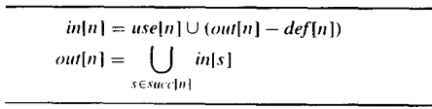
Main Topics
The concepts: out-edges, in-edges, pred[n], succ[n], defs, uses
Calculation of liveness: data flow equation
Static vs dynamic liveness: conservative approximation
Interference graphs

Slide 55
CALCULATION OF LIVENESS
Dataflow equations for liveness analysis
Computation of liveness by iteration
for each n
in[n] {}; out[n] {}
repeat
for each n
in′[n] → in[n]; out′[n] ← out[n]
in[n] ← use[n] ∪ (out[n] − def[n])
out[n] ← ∪s∈succ[n]in[s]
until in′[n] = in[n] and out′[n] = out[n] for all n

Slide 56
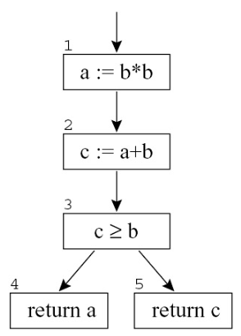
STATIC VS. DYNAMIC LIVENESS
"Smarter" equations would permit a and c to be assigned the same register.

Slide 57
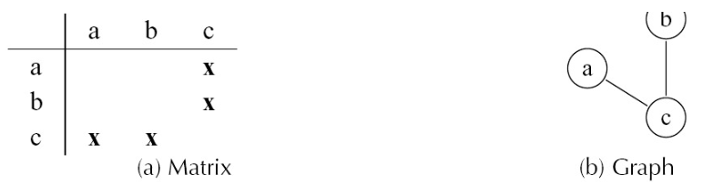
INTERFERENCE GRAPHS
A set of temporaries a, b, c,… that must be allocated to registers r1,…, rk. A condition that prevents a and b from being allocated to the same register is called an interfere
Two types of interferences:
Overlapping live ranges
When a must be generated by an instruction that cannot address register r1, then a and r1 interfere.
The expression of interference:

Slide 58
11 Register Allocation

Slide 59
Main Topics
Register allocation: coloring on interference graph
The algorithm: build, simplify, coalesce, freeze, spill(potential), selcet, spill(actual), rebuild
Coalescing strategies: Briggs, George
Pre-colored nodes: caller-save, callee-save

Slide 60
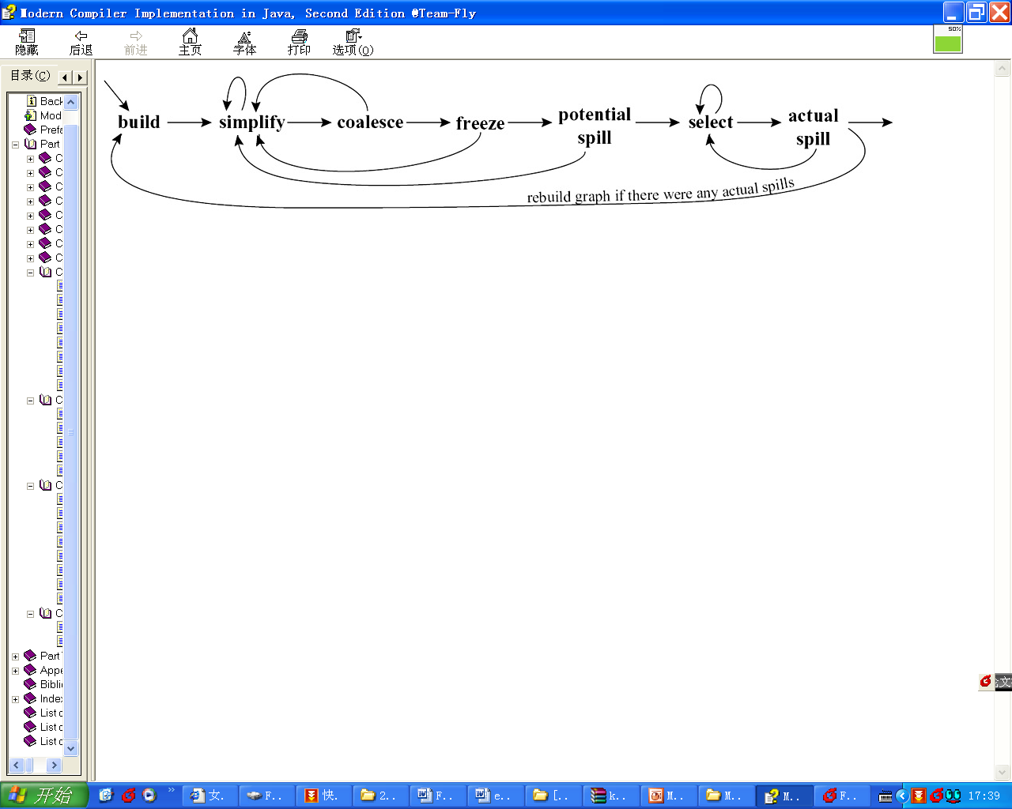
Coloring with Coalescing

Slide 61
Coalescing
Briggs: Nodes a and b can be coalesced if the resulting node ab will have fewer than K neighbors of significant degree (i.e., having ≥ K edges).
The coalescing is guaranteed not to turn a K -colorable graph into a non-K -colorable graph.

Slide 62
Coalescing
George: Nodes a and b can be coalesced if for every neighbor t of a, either t already interferes with b or t is of insignificant degree.
Reason:
Let S be the set of insignificant-degree neighbors of a in the original graph.
If the coalescing were not done, simplify could remove all the nodes in S, leaving a reduced graph G1.
If the coalescing is done, then simplify can remove all the nodes in S, leaving a graph G2.
But G2 is a subgraph of G1 (the node ab in G2 corresponds to the node b in G1), and thus must be at least as easy to color.

Slide 63
Program
Procedure Main() loops (via tail recursion) until no spills are generated.
procedure Main()
LivenessAnalysis()
Build() MakeWorklist()
repeat
if simplifyWorklist ≠ {} then Simplify()
else if worklistMoves ≠ {} then Coalesce()
else if freezeWorklist ≠ {} then Freeze()
else if spillWorklist ≠ {} then SelectSpill()
until simplifyWorklist = {} ∧ worklistMoves = {}
∧ freezeWorklist = {} ∧ spillWorklist = {}
AssignColors()
if spilledNodes ≠ {} then
RewriteProgram(spilledNodes)
Main()

Slide 64
13 Garbage Collection

Slide 65
Main Topics
Mark-and-sweep collection: directed graph, DFS, Explicit stack, pointer reversal
Reference counts: advantages and disadvantages
Copying collection: from-space and to-space, Cheney’s algorithm(BFS), locality of reference
Interface to compiler: generating code, describing data layout, pointer map, derived pointers

Slide 66
ALGORITHM 13.3: Mark-and-sweep garbage collection.
Mark phase：
Sweep phase：
for each root v
DFS(v)
p ← first address in heap
while p< last address in heap
if record p is marked
unmark p
else let f1 be the first field in p
p. f1 ← freelist
freelist ← p
p ← p+(size of record p)

Slide 67
Using an Explicit Stack
ALGORITHM 13.5: Depth-first search using an explicit stack
function DFS(x)
if x is a pointer and record x is not marked
mark x
t ← 1
stack[t] ← x
while t > 0
x ← stack[t]; t ← t - 1
for each field f_{i} of record x
if x. f_{i} is a pointer and record x.fi is not marked
mark x. f_{i}
t ← t + 1; stack[t] ← x. f_{i}

Slide 68
Pointer reversal
x.fi can be used to store one element of the stack itself
function DFS(x)
if x is a pointer and record x is not marked
t ← nil
mark x; done[x] =0
while true
i ← done[x]
if i < # of fields in record x
y ← x. fi
if y is a pointer and record y is not marked
x. fi ← t; t ← x; x ← y
mark x; done[x]= 0
else
done[x] ← i + 1
else
y ← x; x ← t
if x = nil then return
i ← done[x]
t ← x. fi; x. fi ← y
done[x] ← i + 1
ALGORITHM 13.6: Depth-first search using pointer reversal

Slide 69
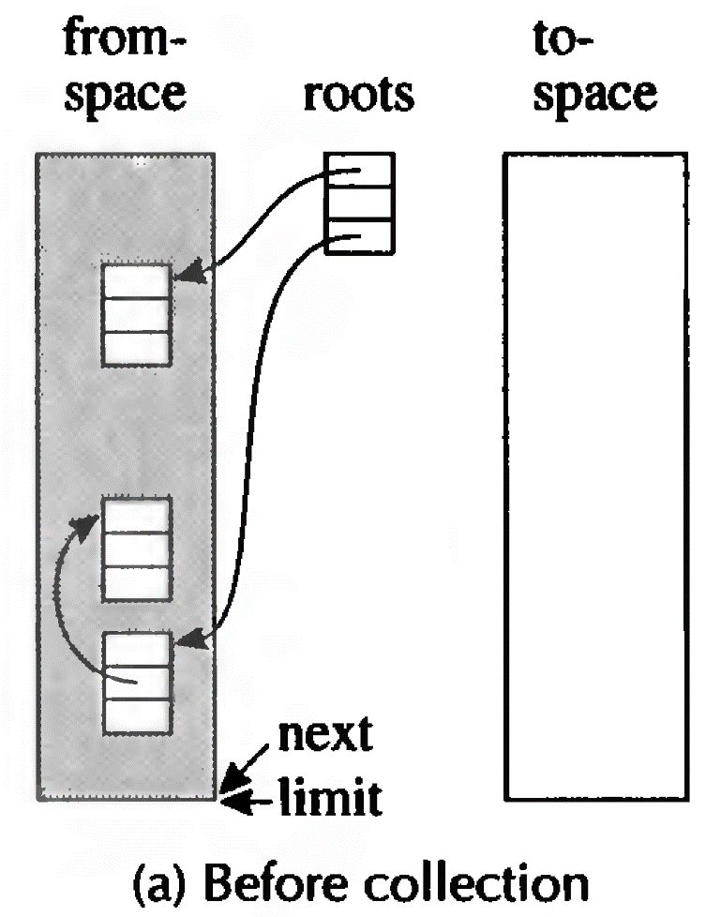
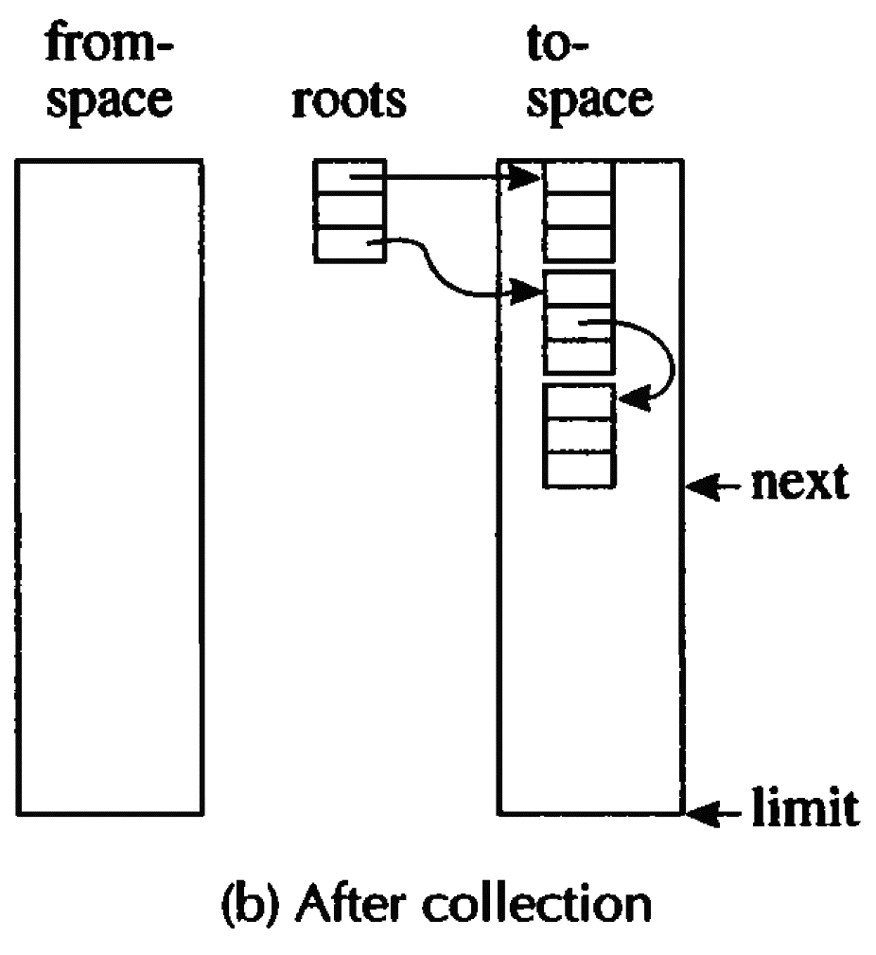
Copying Collection
No space to allocate

Slide 70
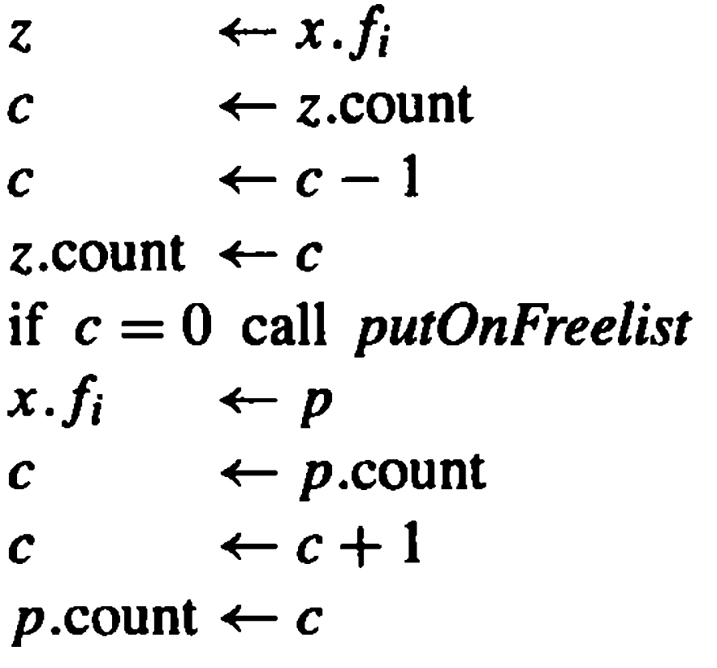
Incrementing the reference counts is very expensive.
In place of the single machine instruction x. fi ← p, the program must execute

Slide 71
Cheney's algorithm
A collection algorithm using breadth-first search to transverse reachable data.
scan ← next ← beginning of to-space
for each root r
r ← Forward(r)
while scan < next
for each field fi of record at scan
scan. fi ← Forward(scan. fi)
scan ← scan+ size of record at scan
ALGORITHM 13.9: Breadth-first copying garbage collection

Slide 72
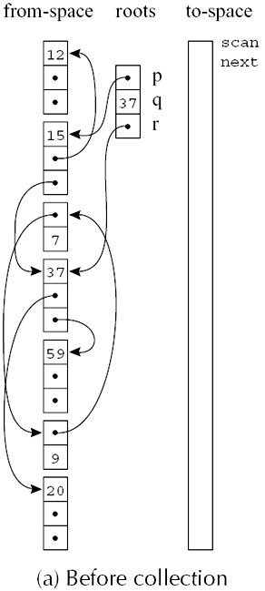
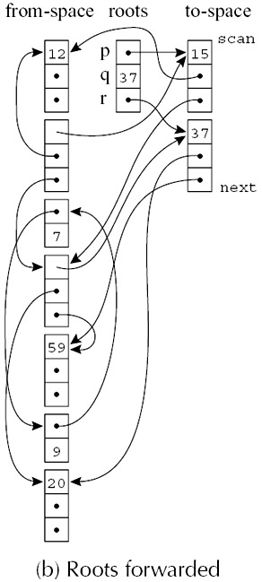
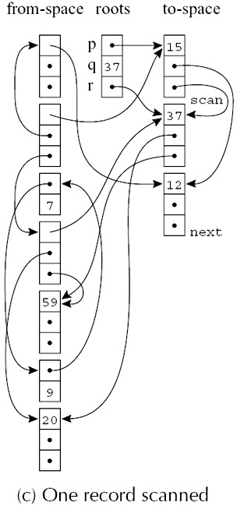
Example
Figure 13.10: Breadth-first copying collection

Slide 73
14 Object-Oriented Languages

Slide 74
Main Topics
Object-Tiger：extend the Tiger language with new declaration syntax to create classes
Single-inheritance of data fields. Static method VS Dynamic method
Multiple-inheritance of data fields. Global graphic-coloring for fields offsets in descriptors, hashing
Facilities for type testing and safe casting. Using a display of parent classes, type coercions

Slide 75
Main Topics
Varieties of privacy and protection. statically enforced by compile-time type-checking for class-based languages
Classless languages. Type-checking dynamic instead of static, Objects are created by cloning, similar to the class-based language with multiple inheritance and dynamic linking
Optimizing Object-oriented programs. do global program analysis, the dynamic method call replaced by a static function call

Slide 76
18 Loop Optimizations

Slide 77
Main Topics
The technical definition of loop and the concept for the reducible flow graphs
The algorithms for finding loops. Definition for Dominator and the algorithm of finding dominators, Immediate dominator and dominator tree, constructing a loop-nested tree of loops, loop preheader
Loop-invariant computations. The definition of loop invariant within a loop, the criteria for hoisting a loop-invariant

Slide 78
Main Topics
Induction variables. The basic induction variable and derived induction variables, detecting algorithm for induction variables, strength reduction and elimination
Array-bounds checks. Safe programming languages, the criteria for eliminating a bounds check in a loop
Loop unrolling. The basic method for unrolling loop, using information about induction variables, agglomerate the increments and loop-exit tests

Slide 79
The end of Review

