Slide 1
Discrete Mathematics and
Its Applications course code: 211B0010
Spring & Summer, 2022
Instructor: Yanlin Weng
weng@cad.zju.edu.cn

Slide 2
Chapter 1
The Foundations: Logic and Proofs
1.1 Propositional Logic
1.2 Applications of Propositional Logic
1.3 Propositional Equivalences
1.4 Predicates and Quantifiers
1.5 Nested Quantifiers
1.6 Rules of Inference
1.7 Introduction to Proofs
1.8 Proof Methods and Strategy

Slide 3
Proposition
【Definition】A proposition is a declarative sentence that is either true or false, but not both.命题是一个陈述语句，它或真或假，但不能既真又假。
Examples
  Where am I?
  Cheer up!
  X+1=2
  1+1=2
  Hangzhou is the capital of China.
  The teacher exclaimed, “Don’t come into class late again!”
不是命题的几种典型反例
command 命令 (e.g. Read it loud!)
question 疑问 (e.g. What time is it?)
paradox 悖论 (e.g. This statement is false.)
equation with unknowns 含有未知数的等式 (e.g. x + y = z)使用字母来表示命题变元(propositional variables)
x
x
x
√
√
√

Slide 4
Propositional Logic
Propositional Logic (Calculus) Propositional variables逻辑变量: p, q, r, s …
  Truth value: T (true proposition), F (false proposition)
  Logical operators (Connectives): be used to form compound propositions from existing propositions
  Negation operator否定 ¬ (NOT)
  Conjunction operator 合取∧ (AND)
  Disjunction operator析取 ∨ (OR)
  Exclusive or operator异或 ⊕ (XOR)
  Conditional operator → (IF--THEN)
  Biconditional operator ↔ (IF AND ONLY IF)
or, but not both

Slide 5
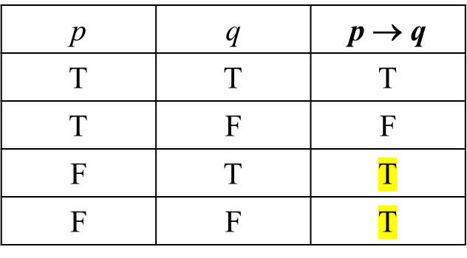
Conditional Operator (If--then) Implication蕴含
【Definition】Let p and q be propositions. The conditional statement (implication) p → q, is the proposition “if p,then q. ”
Example:
  p: Today is Wednesday.
  q: It is raining.
  p → q: If today is Wednesday, then it is raining.
Truth table
The conditional statement is false only when p is true and q is false

Slide 6
Conditional Statement
p → q
Examples:
    If today is Wednesday, then 1+1=2.
    If today is Wednesday, then 1+1=3.
    If today is Monday, then 1+1=2.
    If today is Monday, then 1+1=3.
p | q | p → q
T | T | T
T | F | F
F | T | T
F | F | T
Hypothesis (Premise)
Conclusion (Consequence)
√
X
√
√
Note: 再次注意，自然语言和逻辑语言是有区别的，生活中的逻辑也不要强行带入
e.g. If the moon is made of green cheese, then I have more money than Bill Gates. 这句话的真值为T

Slide 7
等价形式
If p, then q
p implies q
If p, q
q if p
q when p
q follows from p
q whenever p
p is a sufficient condition for q 充分条件
q is a necessary condition for p
p only if q = p no unless q
q unless ¬p
翻译这类语句的话，只要注意一下通顺就好
p ->q
注意这几个p，q是反过来的

Slide 8
Converse 逆命题
Conditional Statement: p → q
Converse: q → p
Example:
  p → q : If I am going to town, then it is raining.
  q → p : If it is raining, then I am going to town.
Truth table
p | q | p → q | q → p
T | T | T | T
T | F | F | T
F | T | T | F
F | F | T | T

Slide 9
Inverse 反命题
Conditional statement: p → q
Inverse: ¬p → ¬q
Example:
  p → q : If I am going to town, then it is raining.
  ¬p → ¬q : If I am not going to town, then it is not raining.
Truth table
p | q | p → q | ¬p → ¬q
T | T | T | T
T | F | F | T
F | T | T | F
F | F | T | T

Slide 10
Contrapositive逆否命题
Conditional statement: p → q
Contrapositive: ¬q → ¬p
Example:
  p → q : If I am going to town, then it is raining.
  ¬q → ¬p : If it is not raining, then I am not going to town.
Truth table
逆命题与否命题 等价， 原命题与逆否命题 等价
p | q | p → q | ¬q → ¬p
T | T | T | T
T | F | F | F
F | T | T | T
F | F | T | T

Slide 11
Biconditional Operator (if and only if) 双条件
【Definition】Let p and q be propositions. The biconditional statement p ↔ q, is the proposition “p if and only if (iff) q.”
is necessary and sufficient
Equivalent expressions:
  p,q相同，则语句为真
p | q | p ↔ q
T | T | T
T | F | F
F | T | F
F | F | T

Slide 12
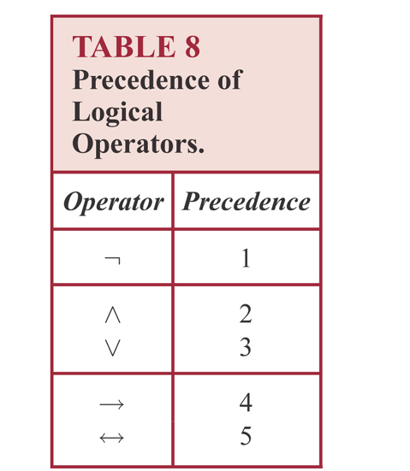
逻辑运算优先级
先交再并
Examples:
  p ∧ q ∨ r means (p ∧ q) ∨ r, not p ∧ (q ∨ r )
  p ∨ q → r means (p ∨ q) → r

Slide 13
Bitwise Operations
A bit string is a sequence of zero or more bits.
The length of this string is the number of bits in the string.
Bitwise operations位操作 are bit operations extended to bit strings.
Bitwise operations of two strings of the same length相同长度:
  bitwise OR
  bitwise AND
  bitwise XOR
用 1 代替 T, 用 0 代替 F
Bit: a symbol with two possible values , namely, 0 and 1
Boolean variable: one whose value is either true or false

Slide 14
Translating English sentences
  “You can access the Internet from campus only if you are a computer science major or you are not a freshman.”
Solution:
Let a: “you can access the Internet from campus,”
c: “you are a computer science major,”
f: “you are a freshman.”
This sentence can be represented as
a → (c ∨ ¬ f)

Slide 15
Consistent System Specifications
【Definition】 A list of propositions is consistent if it is possible to assign truth values to the proposition variables so that each proposition is true.
Example: Are these specifications consistent?
  “The diagnostic message is stored in the buffer or it is retransmitted.”
  “The diagnostic message is not stored in the buffer.”
  “If the diagnostic message is stored in the buffer, then it is retransmitted.”
Solution:
Let p: “The diagnostic message is stored in the buffer”
q: “The diagnostic message is retransmitted”
p ∨ q, p→ q, ¬p
When p is false and q is true all three statements are true. So these specifications are consistent.

Slide 16
Logic Puzzles
Example: An island has two kinds of inhabitants, knights, who always tell the truth, and knaves, who always lie. You go to the island and meet A and B.
  A says “B is a knight.”
  B says “The two of us are of opposite types.”
What are the types of A and B?
Solution:
Let p: “A is a knight”
q: “B is a knight”
p ↔ q, q ↔(p ∧ ¬ q)∨ (¬ p ∧ q)

Slide 17
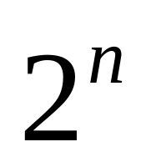
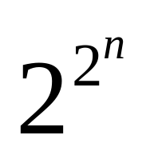

真值表
How many rows are there in a truth table with n propositional variables?
With n propositional variables, we can construct ( ) distinct (i.e., not equivalent) propositions
稍加解释一下，有n个命题变量时，真值表就有了 种情况，而每一个命题对于每一种情况，它都可以有T和F两个值（注意，如果两个命题在这 个情况之下真值完全相同，则它们被视为完全等价的两个命题，即在这里被算为一个）那么此时，就有了 种不同的真值组合，对应 种不同的命题

Slide 18
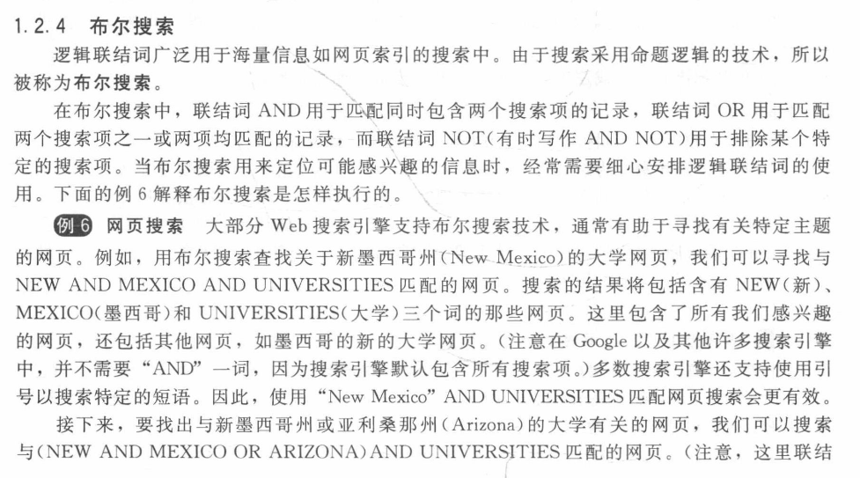
布尔搜索

Slide 19
Chapter 1
The Foundations: Logic and Proofs
1.3 Propositional Equivalences

Slide 20
Classification of Compound Propositions
真值表相同就说 Equivalent Propositions 等价命题
命题分类：
    p ∧ ¬p
    p ∨ ¬p
-- Contradiction永假 （矛盾式）
-- Tautology永真 （重言式）
-- Contingency 可能式

Slide 21
Logical Equivalences
【 Definition】p and q are called logically equivalent；逻辑等价 if p ↔ q 永真
Notation: p ≡ q or p ⇔ q
    Example: Show that ¬(p ∨ q) and ¬ p ∧ ¬q are logically equivalent.
Solution:
¬(p ∨ q) ≡ ¬ p ∧ ¬q
证明：这两者真值表相同，或者用代数运算
p | q | ¬ p | ¬ q | p ∨ q | ¬ (p∨q) | ¬ p∧¬q
T | T | F | F | T | F | F
T | F | F | T | T | F | F
F | T | T | F | T | F | F
F | F | T | T | F | T | T
De Morgan law

Slide 22
Logical Equivalences
Name | Equivalence
Identity laws | p ∧ T ≡ p p ∨ F ≡ p
Domination laws | p ∨ T≡ T p ∧ F ≡ F
Idempotent laws | p ∨ p ≡ p p ∧ p ≡ p
Double negation law | ¬(¬p) ≡ p
Commutative laws | p ∨ q ≡ q ∨ p p ∧ q ≡ q ∧ p
Associative laws | (p ∨ q) ∨ r ≡ p ∨ (q ∨ r) (p ∧ q) ∧ r ≡ p ∧ (q ∧ r)
Distributive laws | p ∨ (q ∧ r) ≡ (p ∨ q) ∧ (p ∨ r) p ∧ (q ∨ r) ≡ (p ∧ q) ∨ (p ∧ r)
De Morgan's laws | ¬(p ∧ q) ≡ ¬ p ∨ ¬ q ¬(p ∨ q) ≡ ¬ p ∧ ¬ q

Slide 23
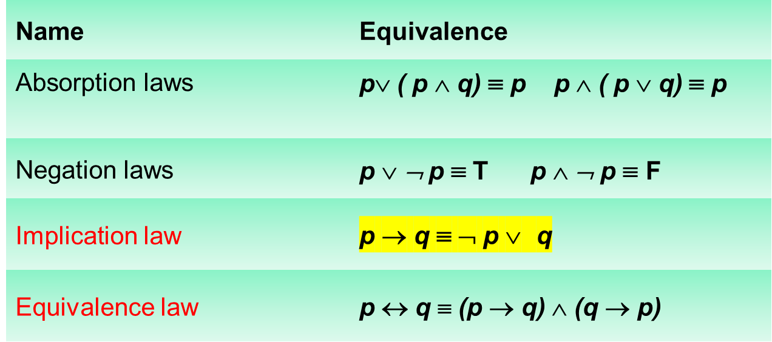
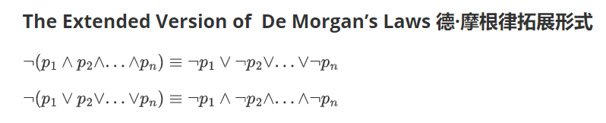
Logical Equivalences

Slide 24





Logical Equivalences
Examples:
Show that ¬( p∨(¬ p ∧ q)) and ¬p ∧¬ q are logically equivalent.
Solution:
by the De Morgan’s law
by the De Morgan’s law
by the double negation law
by the distributive law
by the negation law
by the identity law

Slide 25


Logical Equivalences
Examples:
2. Show that is a tautology
Solution:

Slide 26


Logical Equivalences
Examples:
3. Show that and are not logically equivalent.
Hint:
To show these are not logically equivalent, we need only find one assignment of truth values to p, q, r, s for which the truth values of the two propositions differ.

Slide 27
Exercises
Find a compound proposition involving the propositional variables p, q, r that is true when exactly two of p, q, and r are true and is false otherwise.
Solution:
    p ∧ q ∧ ¬r
    p ∧ ¬ q ∧ r
    ¬ p ∧ q ∧ r
    ( p ∧ q ∧ ¬r ) ∨ (p ∧ ¬ q ∧ r ) ∨ (¬ p ∧ q ∧ r)

Slide 28
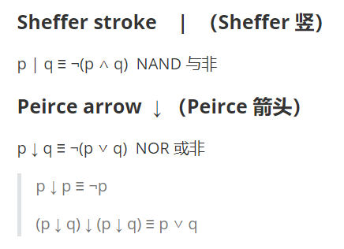
Exercises
The proposition p NOR q is true when both p and q are false, and it is false otherwise. The operator ↓ is called Peirce arrow.
(a) show that p ↓ p is logically equivalent to ¬ p
(b) show that (p ↓ q) ↓ (p ↓ q) is logically equivalent to p ∨ q

Slide 29
Propositional Satisfiability
A compound proposition is satisfiable可满足的if there is an assignment of truth values to its variables that make it true.一个复合命题是satisfiable如果对它的变量赋值使它为真。(成真赋值)When no such assignments exist, the compound proposition is unsatisfiable.
一个复合命题是不可满足的当且仅当它的否定永真
Examples:
使得命题为真的一组赋值被称为解

Slide 30
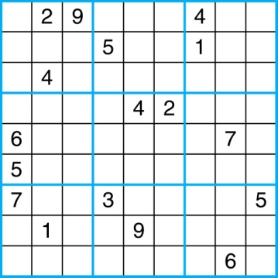
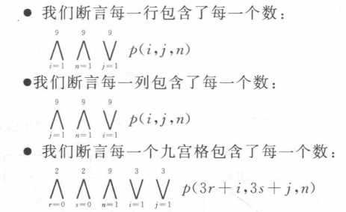
Sudoku数独
N*N的矩阵中，每个位置都需填数字，并且保证每行每列都有N个数字
数独解唯一并且可以通过逻辑推理求解
Let p(i, j, n) ，当(i,j)处为数字n，命题p为真
There are 9×9 × 9 = 729 such propositions.

Slide 31
Encoding as a Satisfiability Problem
对9*9来说

Slide 32
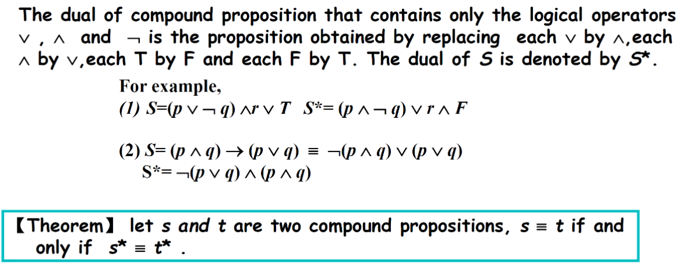
补码
AND， OR换一下，运算顺序不变（同数逻）

