Slide 1
Chapter 1 The Foundations: Logic and Proofs
1.4 Predicates and Quantifiers
1.5 Nested Quantifiers

Slide 2
Predicate谓词
【Definition】A predicate (propositional function命题函数) is a statement that contains variables. Once the values of the variables are specified, the function has a truth value.
: n-place (n-ary) predicate n位谓词
Examples
Let Q(x, y) denote the statement “x < y.” What are the truth values of Q(4, 3) and Q(2, 7) ?
Q(4, 3) =“4 < 3” F
Q(2, 7) = “2 < 7” T

Slide 3
Universal Quantification全称量词
【Definition】A universal quantification of P(x), denoted by ∀ x P(x), is the statement “P(x) for all values of x in the domain. ”
∀ : universal quantifier
Domain (domain of discourse / universe of discourse):域 An element for which P(x) is false is called a counterexample反例 of ∀ x P(x)
Example:
Let P(x) be the statement “x>0.” In the domain of all integers, x= -1 is a counterexample for ∀ x P(x).
Remark: Given the domain as ,

Slide 4
Universal Quantification
Many ways to express universal quantification:
For all
For every
All of
For each
Given any
For arbitrary
For any

Slide 5
Universal Quantification
Examples:
What is the truth value of if the domain consists of all real numbers? What is the truth value of this statement if the domain consists of all integers?
Solution:
If the domain consists of all real numbers.
Because , is false
If the domain consists of all integers.
is true

Slide 6
Universal Quantification
Examples:
Express the following statement as a universal quantification: “All lions are fierce.”
Solution:
Let Q(x) denote the statement “x is fierce”.
Assuming that the domain is the set of all lions.
Assuming that domain is the set of all creatures.
Let P(x) denote the statement “x is a lion”.

Slide 7
Existential Quantification存在量词
【Definition】An existential quantification of P(x), denoted by ∃ x P(x), is the statement “There exists an element x in the domain such that P(x). ”
∃ : existential quantifier
Other expressions:
For some x P(x)
There is an x such that P(x)
There is at least one x such that P(x)
Conjunctions and Disjunctions 合取、析取
Remark: Given the domain as ,

Slide 8
Existential Quantification
Examples:
Express the following statement as an existential quantification. “Some real numbers are rational numbers. ”
Solution:
Let Q(y): y is a rational number
Assuming that the domain is the set of all real numbers.
(2) Assuming that the domain is the set of all complex numbers. Let R(y): y is a real number

Slide 9
Quantifiers
Statement | When true? | When false?
∀x P(x) | P(x) is true for every x. | There is an x for which P(x) is false.
∃x P(x) | There is an x for which P(x) is true. | P(x) is false for every x.
Other Quantifiers
Uniqueness quantifier唯一存在: ∃! or ∃₁
∃! P(x)or ∃₁P(x): There exists a unique x such that P(x) is true.

Slide 10
Quantifiers with Restricted Domains
Example: What do the statements ∀ x<0 ( x²>0), ∃ y>0 (y²=2) mean, where the domain in each case consists of the real numbers?
后面有个（）表示约束的范围
Solution:
∀ x<0 ( x²>0)
For every real number x with x<0, x²>0
∃ y>0 (y²=2)
There exists a real number y with y>0 such that y²=2

Slide 11
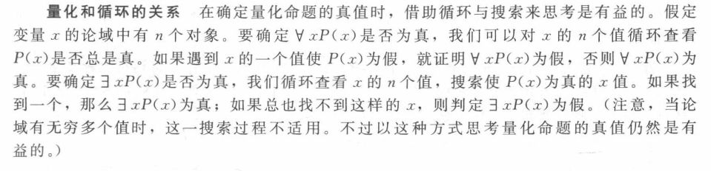
量词有最高优先级
The quantifiers ∃ and ∀ have higher precedence than all logical operators from propositional calculus.
Example:
√
X

Slide 12
Binding Variables量词绑定
a variable is bound if it is quantified 有量词作用
Free variable: 没有被量词约束，同时不是一个特定的值
All the variables in a propositional function must be quantified or set equal to a particular value to turn it into a proposition.

Slide 13
Logical Equivalences Involving Quantifiers
【Definition】 Statements involving predicates and quantifiers are logically equivalent S≡T iff they have the same truth
for every predicate substituted 对任意量词
for every domain of discourse used 对任意论域

Slide 14
Logical Equivalences Involving Quantifiers
x is not occurring in A.
Proof:
Proof:

Slide 15
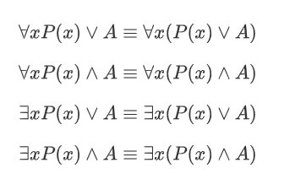
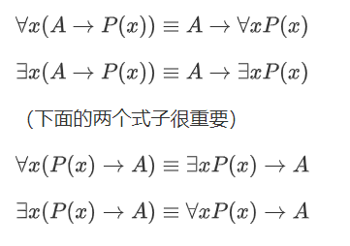
量词辖域扩展收缩
辖域扩展
辖域收缩

Slide 16
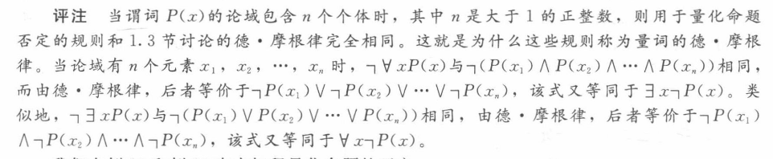
De Morgan’s Laws for Quantifiers
Negation | Equivalent Statement | When is Negation True? | When False?
¬∃x P(x) | ∀x ¬P(x) | P(x) is false for every x | There is an x for which P(x) is true
¬∀x P(x) | ∃x ¬P(x) | There is an x for which P(x) is false | P(x) is true for every x

Slide 17
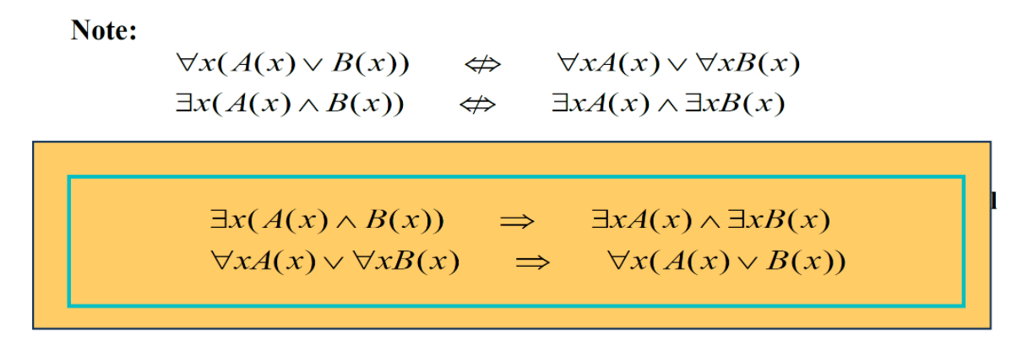
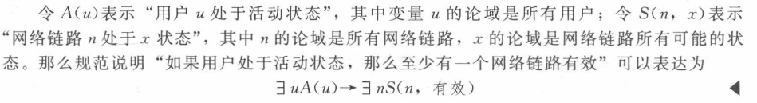

Slide 18
Translating from English into Logical Expressions
第一步是确定域
“Every student in this class has taken a course in Java.”
First decide on the domain U.
Solution 1
If U is all students in this class, define a propositional function J(x) denoting “x has taken a course in Java” and translate as ∀x J(x).
Tips
All S(x) are O(x) : ∀x (S(x) → O(x))
No S(x) are O(x) : ∀x (S(x) → ¬ O(x))
Some S(x)’s are O(x) : ∃x (S(x) ∧ O(x))
Some S(x) are not O(x) : ∃x (S(x) ∧ ¬ O(x))
Where S(x) and O(x) are propositional functions of variable x

Slide 19
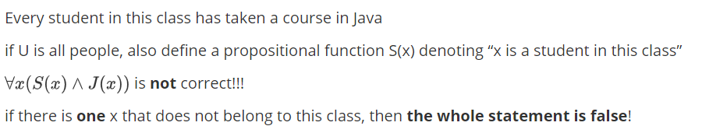
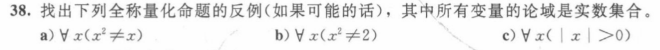


Slide 20
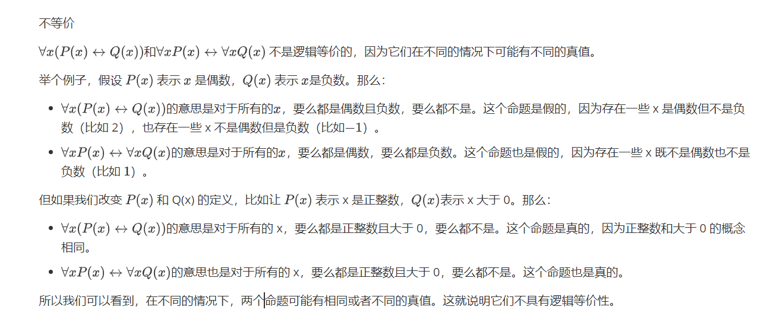

Slide 21
Chapter 1 The Foundations: Logic and Proofs
1.5 Nested Quantifiers
嵌套量词

Slide 22
Translating English into Logical Expressions
Examples
Express the statement “Everyone has exactly one best friend” as a logical expression with a domain consisting of all people.
Solution:
Rewrite the original statement as
“For every person x , x has exactly one best friend.”
“There is a person y who is the best friend of x, and furthermore, that for every person z, if z is not y, then z is not the best friend of x.”
Let B(x, y) be the statement “y is the best friend of x.”

Slide 23
Translating English into Logical Expressions
Examples
Express the statement “If a person is female and is a parent, then this person is someone’s mother” as a logical expression with a domain consisting of all people.
Solution:
Rewrite the original statement as
“For every person x, if x is female and x is a parent, then there exists a person y such that x is the mother of y.”
Let F(x): “x is female,”
P(x): “x is a parent,”
M(x, y): “x is the mother of y.”

Slide 24
Translating English into Logical Expressions
Examples
Express the definition of a limit using quantifiers.
Solution:
The definition of the limit is:
“For every real number ε>0 there exists a real number δ>0 such that ”
Assume the domain for the variables ε, δ, and x consist of
all real numbers, we have

Slide 25
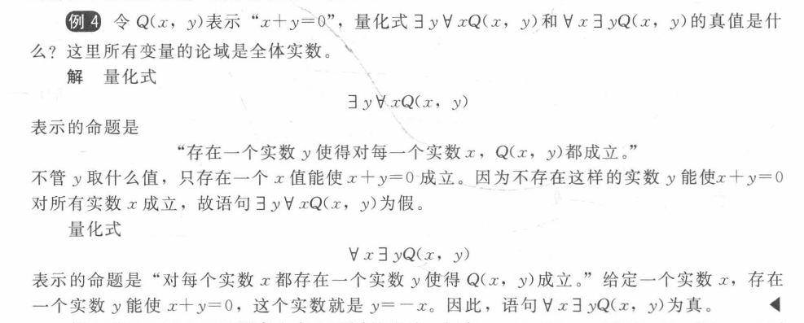
The Order of Quantifiers
The order of nested quantifiers matters if quantifiers are of different types
is not the same as
按照中文逐词翻译后看看对不对

Slide 26
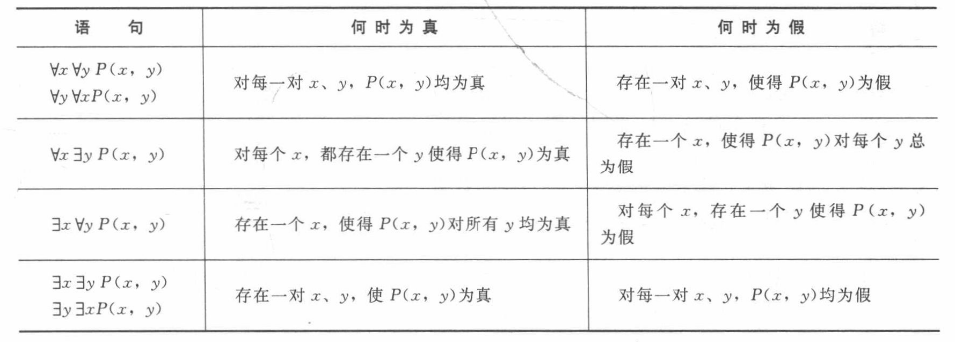
Quantifications of Two Variables

Slide 27
嵌套量词的否定
Negating nested quantifiers by successively applying the rules for negating statements involving a single quantifier
Examples:
Express the negation of the statement ∀x ∃ y (xy=1) so that no negation precedes a quantifiers.
一层层进去
Solution:
¬(∀x ∃ y (xy=1))
≡ ∃ x(¬ ∃ y (xy=1))
≡ ∃ x∀ y (¬ (xy=1))
≡ ∃ x∀ y (xy≠1)

Slide 28
Negating Nested Quantifiers
Negating nested quantifiers by successively applying the rules for negating statements involving a single quantifier
Examples:
Use quantifiers and predicates express the fact that
does not exist.
Solution:

Slide 29
Functionally Complete
【Definition】 A set of logical operators is called functionally complete if every compound proposition is logically equivalent to a compound proposition involving only this set of logical operators.
∧, ∨, and ¬ form a functionally complete set of operators.
∧ (∨) and ¬ form a functionally complete set of operators.

Slide 30
Propositional Normal Forms
Literal文字: p or ¬p
【Definition】由一个或多个文字所构成的析取（合取）式称作 析取（合取）子句
Examples:
q ∨ r
¬ q ∧ p
p ∧ q ∨ r
Disjunctive clause析取子句
Conjunctive clause合取子句
Not a clause

Slide 31
Conjunctive Normal Form (CNF)
【Definition】A conjunction with one or more disjunctive clauses as its conjuncts is said to be in conjunctive normal form.
(A₁₁ ∨ … ∨ A_{1n1}) ∧ … ∧ (A_{k1} ∨ … ∨ A_{knK})
Examples:
p ∧ (q ∨ r)
¬ q ∧ p
p ∧ ((p ∧ q) ∨ r)
√
√
x

Slide 32
Disjunctive Normal Form (DNF)
【Definition】A disjunction with one or more conjunctive clauses as its disjuncts is said to be in disjunctive normal form.
(A₁₁ ∧ … ∧ A_{1n1}) ∨ …∨ (A_{k1} ∧…∧ A_{knK})
Examples:
(p ∧ q) ∨ (p ∧¬q)
p ∨ (q ∧ r)
¬p ∨ T
¬(p ∧ q) ∨ r
√
√
√
x

Slide 33
More Examples
DNF & CNF
p
¬p ∨ q
¬p ∧ q ∧ ¬r
¬p ∨ (q ∧ ¬r)
¬p ∧ (q ∨ ¬r) ∧ (¬q ∨ r)
DNF & CNF
DNF & CNF
DNF
CNF

Slide 34
Recall
Find a compound proposition involving the propositional variables p, q, r that is true when exactly two of p, q, and r are true and is false otherwise.
Solution:
p ∧ q ∧ ¬r
p ∧ ¬ q ∧ r
¬ p ∧ q ∧ r
( p ∧ q ∧ ¬r ) ∨ (p ∧ ¬ q ∧ r ) ∨ (¬ p ∧ q ∧ r)

Slide 35
How to Obtain Normal Forms
Use logical Equivalences
p → q ⇔ ¬p ∨ q
p ↔ q ⇔ (¬p ∨ q) ∧ (p ∨ ¬q)
p ↔ q ⇔ (p ∧ q) ∨ (¬p ∧ ¬q)
¬¬p ⇔ p
¬(p₁ ∧ … ∧ p_{n}) ⇔ ¬p₁ ∨ … ∨ ¬p_{n}
¬(p₁ ∨ … ∨ p_{n}) ⇔ ¬p₁ ∧ … ∧ ¬p_{n}
p ∧ (q₁ ∨ … ∨ q_{n}) ⇔ (p ∧ q₁) ∨…∨ (p ∧ q_{n}) (q₁ ∨ … ∨ q_{n}) ∧ p ⇔ (p ∧ q₁) ∨…∨ (p ∧ q_{n})
p ∨ (q₁ ∧ … ∧ q_{n}) ⇔ (p ∨ q₁) ∧ … ∧ (p ∨ q_{n}) (q₁ ∧ … ∧ q_{n}) ∨ p ⇔ (p ∨ q₁) ∧ … ∧ (p ∨ q_{n})

Slide 36
How to Obtain Normal Forms
Use logical Equivalences
By (1)–(3) we eliminate → and ↔.
By (4)–(6) we eliminate ¬, ∧, ∨, from the scope of ¬ such that any ¬ has only a literal as its scope.
By (7) we eliminate ∨ from the scope of ∧.
By (8) we eliminate ∧ from the scope of ∨.
This method leads to obtaining the disjunctive or conjunctive normal forms.

Slide 37
How to Obtain Normal Forms
Examples
Convert the following formula into a conjunctive normal form.
¬((p ∨ ¬q) ∧ ¬r)
Solution:
¬((p ∨ ¬q) ∧ ¬r)
⇔ ¬(p ∨ ¬q) ∨ ¬¬r De Morgan’s Law
⇔ ¬(p ∨ ¬q) ∨ r Double negation
⇔ (¬p ∧ ¬¬q) ∨ r De Morgan’s Law
⇔ (¬p ∧ q) ∨ r Double negation
⇔ (¬p ∨ r) ∧ (q ∨ r) Distributive law

Slide 38
How to Obtain Normal Forms
Examples
Convert the following formula into conjunctive and disjunctive normal forms.
Remark: Formulas (*) is in CNF and formulas (**) is in DNF.
Solution:

Slide 39
Full Disjunctive Normal Form
【Definition】 A minterm is a conjunction of literals in which each variable is represented exactly once.
Example:
If a Boolean function has the variables p, q, r, then
p∧ ¬q∧ r is a minterm, but p∧ ¬q and p∧ ¬p∧ r are not.
Question:
If a formula has n variables, how many minterms are there?
【Definition】 If a formula is expressed as a disjunction of minterms, it is said to be in full disjunctive normal form.
Example:
2 ^{n}

Slide 40
Transforming to Full Disjunctive Normal Form
Obtain disjunctive normal form,
Make use of negation laws and distributive laws to obtain full disjunctive normal form.
Example
Convert the following formula into full disjunctive normal form.
Solution:

Slide 41
Full Disjunctive Normal Form from Truth Table
p | q | r | f
T | T | T | T
T | T | F | T
T | F | T | F
T | F | F | F
F | T | T | T
F | T | F | F
F | F | T | T
F | F | F | F

Slide 42
Full Disjunctive Normal Form from Truth Table
p | q | ¬ p ∧ ¬q | ¬ p ∧ q | p ∧ ¬q | p ∧ q
T | T | F | F | F | T
T | F | F | F | T | F
F | T | F | T | F | F
F | F | T | F | F | F
Each minterm is true for exactly one assignment.
If A and B are two distinct minterms, then A ∧ B ⇔F.
A disjunction of minterms is true only if at least one of its constituent minterms is true.

Slide 43
Full Disjunctive Normal Form from Truth Table
Example
Find the full disjunctive normal form for f given by the table.
p | q | r | f
T | T | T | T
T | T | F | F
T | F | T | T
T | F | F | F
F | T | T | F
F | T | F | F
F | F | T | T
F | F | F | F

Slide 44
Full Disjunctive Normal Form
Questions:
Using the full disjunctive normal form,
how to determine whether two statements are logical equivalent?
how to determine whether a given statement is tautology, contradiction or contingency?
how to find the assignments for which a given statement is true?

Slide 45
Prenex Normal Form
【Definition】A statement is in prenex normal form iff it is of the
form , where is and the
predicate B is quantifier free.
A formula with no quantifiers is regarded as a trivial case of a prenex normal form.
Examples:
∀xP(x) ∨ ∀xQ(x)
∀x∀y¬(P(x)→Q(y)
∀x∃yR(x,y)
¬∀xR(x)
X
√
√
X

Slide 46
Transforming to Prenex Normal Form
Any expression can be converted into a prenex normal form.
Eliminate all occurrences of → and ↔ from the formula in question;
Move all negations inward such that, in the end, negations only appear as part of literals;
Rename the variables (when necessary);
The prenex normal form can now be obtained by moving all quantifiers to the front of the formula.

Slide 47
Transforming to Prenex Normal Form
Step 1:
A → B ⇔ ¬A ∨ B
A ↔ B ⇔ (¬A ∨ B) ∧ (A ∨ ¬B)
A ↔ B ⇔ (A ∧ B) ∨ (¬A ∧ ¬B)
Step 2:
¬¬A ⇔ A
¬∃xA(x) ⇔ ∀x¬A(x)
¬∀xA(x) ⇔ ∃x¬A(x)

Slide 48
Transforming to Prenex Normal Form
Step 3: Rename all variables in the statement
Example:
∀x(P(x)→Q(x)) ∧ ∃xQ(x) ∧ ∃zP(z) ∧ ∃z(Q(z)→R(x))
Solution:
Use y for x in ∀x, u for x in ∃xQ(x), and w for z in ∃zP(z):
∀y(P(y)→Q(y)) ∧ ∃uQ(u) ∧ ∃wP(w) ∧ ∃z(Q(z)→R(z))

Slide 49
Transforming to Prenex Normal Form
Step 4:
A ∧ ∃xB(x) ⇔ ∃x (A ∧ B(x))
A ∧ ∀xB(x) ⇔ ∀x (A ∧ B(x))
A ∨ ∃xB(x) ⇔ ∃x (A ∨ B(x))
A ∨ ∀xB(x) ⇔ ∀x (A ∨ B(x))
∀x∀y A(x,y) ⇔ ∀y∀x A(x,y)
∃x∃y A(x,y) ⇔ ∃y∃x A(x,y)
Q₁xA(x) ∧ Q₂yB(y) ⇔ Q₁xQ₂y(A(x) ∧ B(y))
Q₁xA(x) ∨ Q₂yB(y) ⇔ Q₁xQ₂y(A(x) ∨ B(y))

Slide 50
Transforming to Prenex Normal Form
Example: Convert the following formulas into prenex normal form.
Solution:

Slide 51
Prenex CNF and DNF
Step1: Prenex normal form
Step 2: Prenex DNF or CNF

Slide 52
HW (Due on Mar. 9)
1. Give the simplest DNF and CNF of the following statements:
1) ((p → q) ↔ (¬q → ¬p)) ∧ r
2) p ∨ (¬p ∨ (q ∧ ¬q))
3) (p ∧ (q ∧ s)) ∨ (¬p ∧ (q ∧ s))
2. Give the full DNF of the following statements:
1) (¬p ∨ ¬q) → (p ↔ ¬q)
2) (¬r ∧ (q → p)) → (p → (q ∨ r))
3) (p → (q ∧ r)) ∧ (¬p → (¬q ∧ ¬r))

Slide 53
HW (Due on Mar. 9)
3. Give the prenex normal forms of the following statements:
1) ∀x(P(x) → ∃yQ(x,y))
2) ∀x∀y((∃zP(x,y,z) ∧ ∃uQ(x,u)) → ∃vQ(y,v))
4. Give the prenex DNF and CNF of the following statements:
1) (∃xP(x) ∨ ∃xQ(x)) → ∃x (P(x) ∨ Q(x))
2) ∀x∀ y (P(x) → Q(x,y)) → ∃y(P(y) ∧ ∃zQ(y,z))

