Slide 1
CHAPTER 3 Algorithms
3.1 Algorithms
3.2 The Growth of Function
3.3 Complexity of Algorithms

Slide 2
Computational Complexity
3.3 Complexity of Algorithms
There are two important aspects of the computational complexity of an algorithm:
Space Complexity: gives the approximate amount of memory required to solve a problem of size n.
  - Often tied in with the particular data structures used to implement the algorithm
Time Complexity: gives the approximate number of operations required to solve a problem of size n.

Slide 3
Time Complexity
3.3 Complexity of Algorithms
Time complexity is usually expressed in terms of the number of basic operations (comparisons, arithmetic operations, etc.) rather than the actual computer time used.
Basic operations:
  - searching algorithms - key comparisons
  - sorting algorithms - list component comparisons
  - numerical algorithms - floating point ops. (flops) -
  multiplications/divisions and/or additions/subtractions.

Slide 4




3.3 Complexity of Algorithms
ALGORITHM 1 Finding the Maximum Element in
a Finite Sequence.
Procedure max( : integers)
max : =
For i : = 2 to n
If max then max
{ max is the largest element}
〖Example 1〗Describe the time complexity of algorithm for finding the maximum element in a set.
Solution:
The number of comparisons will be used as the measure of the time complexity of the algorithm.
There are exactly 2(n-1)+1=2n-1 comparisons are used whenever this algorithm is applied.
Hence, the algorithm for finding the maximum element in a set of n elements has time complexity Θ(n).

Slide 5


3.3 Complexity of Algorithms
ALGORITHM 2 The Linear Search Algorithm.
Procedure linear search (x: integer, : distinct integers)
i : = 1
While ( )
i : = i+ 1
if then location : = i
else location : = 0
{location is the subscript of term that equals x ,or is 0 if x
is not found}
a
,
a
,
☹
,
a
1
2
n
〖Example 2〗Describe the time complexity of linear search algorithm.
Solution:
The number of comparisons will be used as the measure of the time complexity of the algorithm.
If x=a_{j}, 2j+1 comparisons are used.
The most comparisons, 2n+2 are required when the element is not in the list.
Hence, linear search algorithm requires at most O(n) comparisons.

Slide 6
Different types of analysis
3.3 Complexity of Algorithms
Worst-case analysis
  - Maximum number of operations
  - Is a guarantee over all inputs of a given size
Best-case analysis
  - Minimum number of operations
  - Not very practical
Average-case analysis
  - Average number of operations assuming an input probability distribution
  - An average over all the possible inputs of a given size
  - Can be complicated

Slide 7
Table 1 Commonly used Terminology for the Complexity of Algorithms
3.3 Complexity of Algorithms
Complexity Terminology
O(1) constant complexity
O(log n) logarithmic complexity
O(n) linear complexity
O(n log n) n log n complexity
O(n^{b}) polynomial complexity
O(b^{n}) exponential complexity(b>1)
O(n!) factorial complexity

Slide 8
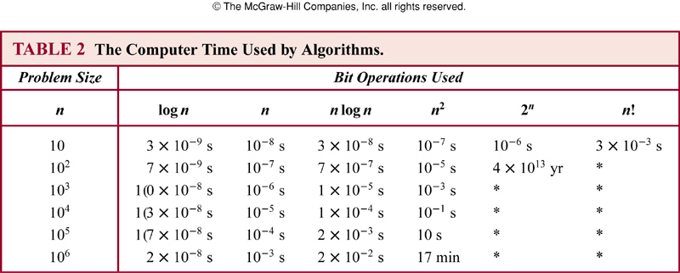

Slide 9
* Understanding the complexity of algorithm
3.3 Complexity of Algorithms
Tractable: A problem is solvable using an algorithm with polynomial worst-case complexity.
Intractable: A problem cannot be solved using an algorithm with worst-case polynomial time complexity.
Solvable:
Unsolvable: Some problems even exist for which it can be shown that no algorithm exists for solving them.
  Halting problem: given a program and an input to the program, whether the program will eventually halt when run with that input.
  K = { (i, x) | program i will eventually halt if run with input x}

Slide 10
* Understanding the complexity of algorithm
3.3 Complexity of Algorithms
Class P: tractable problems
Class NP (nondeterministic polynomial time): problems for which a solution can be checked in polynomial time.
NP-complete: an important class of problems with the property that if any of these problems can be solved by a polynomial worst-case time algorithm, then all can be solved by polynomial worst-case time algorithms.
  The satisfiability problem: the problem of determining if the variables of a given Boolean formula can be assigned in such a way as to make the formula evaluate to TRUE

Slide 11
Homework (Due on March 30)
Ver. 8 & Ver. 7
Sec. 3.3 7, 10

