Slide 1
Chapter3 Advanced compiler techniques for exploring ILP
In Appendix H， 6th edition

Slide 2
Why software pipeling ?
1 LD F0, 0(R1)
2 stall
3 ADDD F4, F0, F2
4 stall
5 stall
6 SD 0(R1), F4
7 SUBI R1, R1, #4
8 stall
9 BNEZ R1, LOOP
10 stall
1 LD F0, 0(R1)
2 ADDD F4, F0, F2
3 SD 0(R1), F4
4 SUBI R1, R1, #4
5 BNEZ R1, LOOP
Loop Parallelism lost !

Slide 3
Software Pipelining
Observation: if iterations from loops are independent, then can get more ILP by taking instructions from different iterations
Software pipelining: reorganizes loops so that each iteration is made from instructions chosen from different iterations of the original loop (­ Tomasulo in SW)

Slide 4
Software Pipelining Example
Before: Unrolled 3 times
1 LD F0,0(R1)
2 ADDD F4,F0,F2
3 SD 0(R1),F4
4 LD F6,-8(R1)
5 ADDD F8,F6,F2
6 SD -8(R1),F8
7 LD F10,-16(R1)
8 ADDD F12,F10,F2
9 SD -16(R1),F12
10 SUBI R1,R1,#24
11 BNEZ R1,LOOP
After: Software Pipelined
1 SD 0(R1),F4 ; Stores M[i]
2 ADDD F4,F0,F2 ; Adds to M[i-1]
3 LD F0,-16(R1); Loads M[i-2]
4 SUBI R1,R1,#8
5 BNEZ R1,LOOP
SW Pipeline
overlapped ops
Time
Loop Unrolled
Symbolic Loop Unrolling
Maximize result-use distance
Less code space than unrolling
Fill & drain pipe only once per loop vs. once per each unrolled iteration in loop unrolling
Time
5 cycles per iteration

Slide 5
Code after reorganized
1 LD F0,0(R1)
1 ADDD F4,F0,F2 start-up
2 LD F0, -8(R1)
Loop: 1 SD 0(R1),F4 ; Stores M[i]
2 ADDD F4,F0,F2 ; Adds to M[i-1]
3 LD F0,-16(R1); Loads M[i-2]
4 SUBI R1,R1,#8
5 BNEZ R1,LOOP
2 SD -8(R1), F4
1 ADDD F4,F0,F2 clear-up
1 SD -16(R1), F4

Slide 6
Software Pipelining with loop unrolling in VLIW
Memory Memory FP FP Int. op/ Clock
reference 1 reference 2 operation 1 op. 2 branch
LD F0,-48(R1) ST 0(R1),F4 ADDD F4,F0,F2 1
LD F6,-56(R1) ST -8(R1),F8 ADDD F8,F6,F2 SUBI R1,R1,#24 2
LD F10,-40(R1) ST 8(R1),F12 ADDD F12,F10,F2 BNEZ R1,LOOP 3
Software pipelined across 9 iterations of original loop
In each iteration of above loop, we:
Store to m,m-8,m-16 (iterations I-3,I-2,I-1)
Compute for m-24,m-32,m-40 (iterations I,I+1,I+2)
Load from m-48,m-56,m-64 (iterations I+3,I+4,I+5)
9 results in 9 cycles, or 1 clock per iteration
Average: 3.3 ops per clock, 66% efficiency
Note: Need less registers for software pipelining
(only using 7 registers here, was using 15)

Slide 7
Global code motion
The loop unrolling and software pipelining work well with straight forward loop.
What about a loop with internal control flow ?
Global code scheduling : Effective scheduling of a loop body with internal control flow by moving instructions across branches.

Slide 8
Trace Scheduling
Parallelism across IF branches vs. LOOP branches
Two steps:
Trace Selection
Find likely sequence of basic blocks (trace) of (statically
predicted or profile predicted) long sequence of straight-line code
Trace Compaction
Squeeze trace into few VLIW instructions
Need bookkeeping code in case prediction is wrong
This is a form of compiler-generated speculation
Compiler must generate “fixup” code to handle cases
in which trace is not the taken branch
Needs extra registers: undoes bad guess by discarding
Subtle compiler bugs mean wrong answer vs. poorer performance; no hardware interlocks

Slide 9
Example of Trace Scheduling

Slide 10
Example

Slide 12
Superblock
A form of extended basic block that are restricted to have a single entry point but allow multiple exits.
Easier to compact a superblock than a trace.

Slide 13
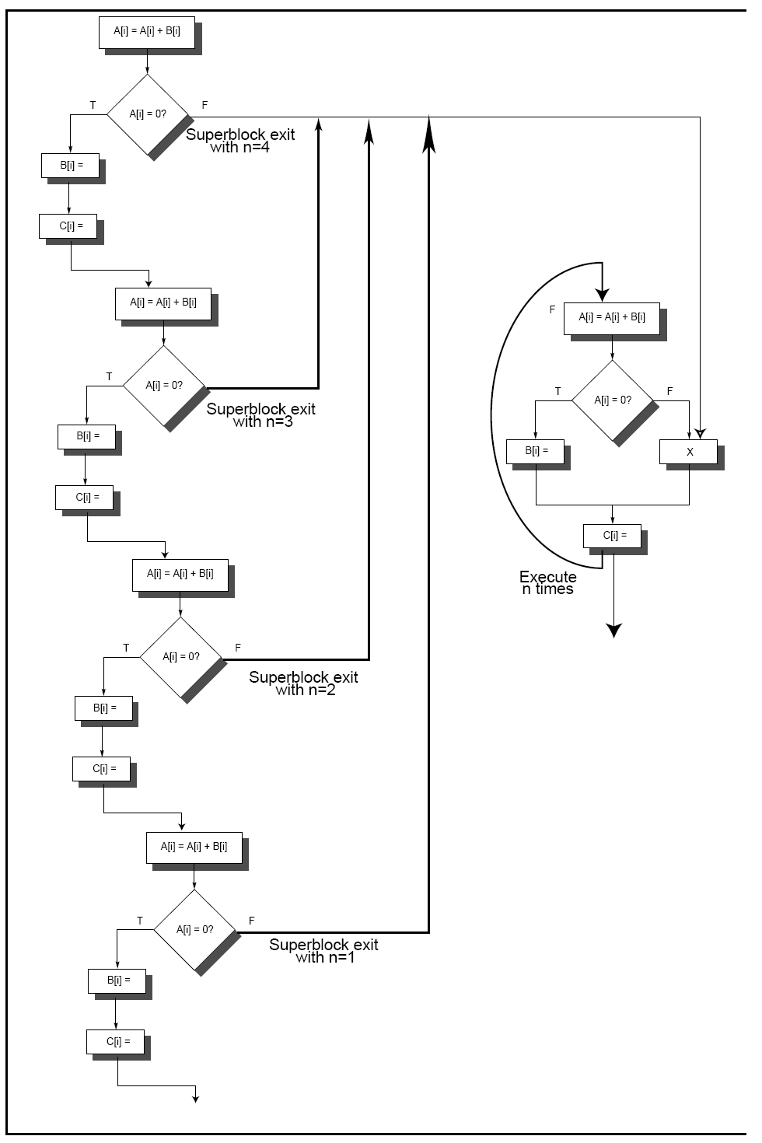

Slide 14
Hardware Support for Expoilting ILP at compile time
Conditional Instruction (predicated instruction)
A conditional instruction refers to a condition which is evaluated as part of the instruction execution,
Example:
If (A==0) {S=T} BNEZ R1, L CMOV R2,R3, R1
ADDU R2, R3, R0
L: ……
the CPU always executes the instruction but writes the result only if the condition is met.
A conditional branch changes a control dependence into a data dependence.

Slide 15
Example: improving scheduloing performance using Conditional Inst.
1st inst.
2nd inst
LW R1, 40(R2) ADD R3, R4, R5
ADD R6,R3, R7
BEQZ R10, L
LW R8, 0(R10)
LW R9, 0(R8)

Slide 16
Using conditional instruction
LMC Rx, D(Ry), Rz
Load Rx, D(Ry) if Rz != 0
Nop if Rz == 0

Slide 17
Conditional instructions in real computer

Slide 18
hyper block: --super block + prediction
No branch ,No prediction No throw away ,But an extra source code field.

Slide 19
Block-Structure
Basic idea:
Block substitute instruction as atomic unit running in computer.
One block is always executed in whole or entirely, but not just half or part of it.
Additional mechanism need to solve the exception that happens in the middle of the basic block.
If the intermediate result of the basic block is not used by other blocks, then we can use linkage within the block but not the register (that is used by the software) to connect the producer and consumer, which can save space and power.

Slide 20
Block-Structure
Block is produced by a compiler as trace cache segment.
If an exception happens at the middle of the block, then all the block work have done will be throw away and go to another block.
The hardware can find more concurrency in one block.

Slide 21
Block-structure: Example

