Slide 1
Ch5-2 Cache coherence
Snooping protocol
Directory protocol

Slide 2
Centralized Shared-Memory Architecture
Characteristics of SMP
Limited processors nodes----small scale, share single physical memory connected by a shared bus.
Large cache ----provide a sufficient amount of memory bandwidth.
Increase bandwidth versus bus/memory
Reduce latency of access
Valuable for both private data and shared data
UMA----uniform memory access time.

Slide 3
Major issues for Shared Memory
Cache coherence ( Value, same location)
“Common Sense”
P1 Read[X] => P1 Write[X] => P1 Read[X] will return X
P2 Read[X] => P1 Write[X] => will return value written by P1
P1 Write[X] => P2 Write[X] => Serialized (all processor see the writes in the same order)
Synchronization
Atomic read/write operations
Memory consistency Model ( order, different locations)
In what order must a processor observe the data writes of another processor ?
What properties must be enforced among reads and writes to different locations by different processors?
These are not issues for message passing systems
Why?

Slide 4
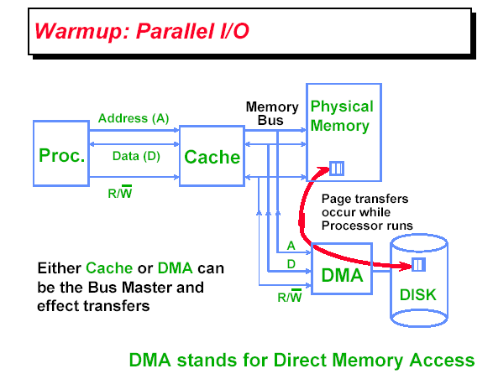
What is Multiprocessor Cache Coherence?

Slide 5
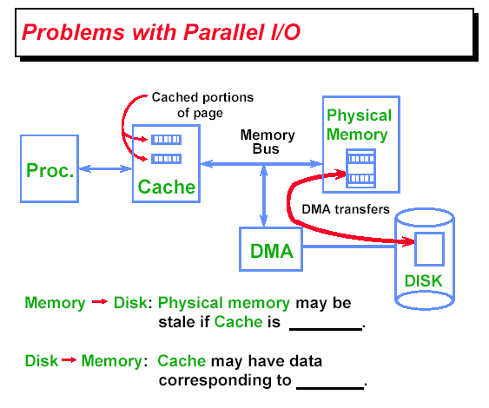
Cache coherence in uniprocessor

Slide 6
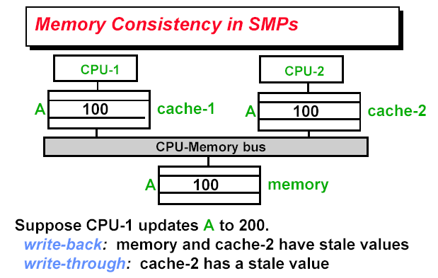
Cache Coherence in Multiprocessor

Slide 7
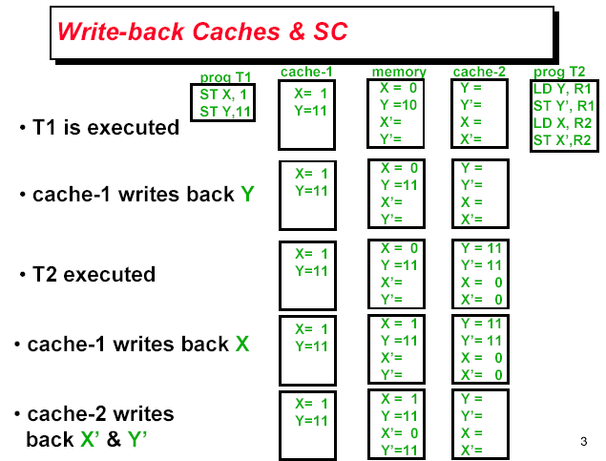
Cache incoherence due to write

Slide 8
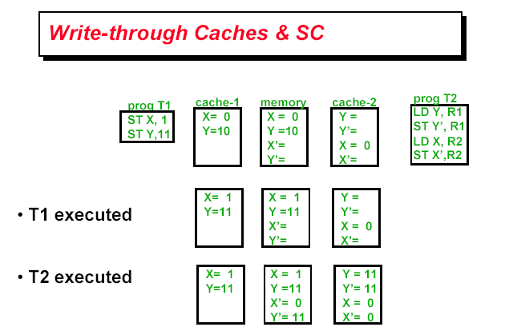
Cache incoherence due to write

Slide 9
What Does Coherency Mean?
Informally:
“Any read must return the most recent write”
Too strict and too difficult to implement
Better:
“Any write must eventually be seen by a read”
All writes are seen in proper order (“serialization”)
Two rules to ensure this:
“If P writes x and P1 reads it, P’s write will be seen by P1 if the read and write are sufficiently far apart”
Writes to a single location are serialized: seen in one order
Latest write will be seen
Otherewise could see writes in illogical order (could see older value after a newer value)

Slide 10
Definition of Cache coherence
Cache coherence
P1 Read[X] => P1 Write[X] => P1 Read[X] will return X
P2 Read[X] => P1 Write[X] => will return value written by P1
P1 Write[X] => P2 Write[X] => Serialized (all processor see the writes in the same order)

Slide 11
HW Coherence Protocols
Snooping Solution (Snoopy Bus):
Send all requests for data to all processors
Processors snoop to see if they have a copy and respond accordingly
Requires broadcast, since caching information is at processors
Works well with bus (natural broadcast medium)
Dominates for small scale machines (most of the market)
Directory-Based Schemes (discuss later)
Keep track of what is being shared in 1 centralized place (logically)
Distributed memory => distributed directory for scalability (avoids bottlenecks)
Send point-to-point requests to processors via network
Scales better than Snooping
Actually existed BEFORE Snooping-based schemes

Slide 12
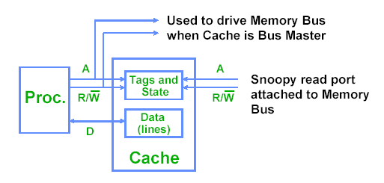
Snooping solution
Every cache that has a copy of the data from a block of physical memory also has a copy of the sharing status of the block, but no centralized state is kept.

Slide 13
Basic Snoopy Protocols
Write Invalidate Protocol:
Multiple readers, single writer
Write to shared data: an invalidate is sent to all caches which snoop and invalidate any copies
Read Miss:
Write-through: memory is always up-to-date
Write-back: snoop in caches to find most recent copy
Write Broadcast Protocol (typically write through):
Write to shared data: broadcast on bus, processors snoop, and update any copies
Read miss: memory is always up-to-date
Write serialization: bus serializes requests!
Bus is single point of arbitration

Slide 14
EX: write back Cache, write invalidate
Mechanics
Broadcast address of cache line to invalidate
All processor snoop, then invalidate if in local cache
policy can be used to service cache misses in write-back caches

Slide 15
Ex: Write back Cache, update(Broadcast)

Slide 16
Bus-based protocols (Snooping)
Snooping
All caches see and react to all bus events
Protocol relies on global visibility of events (ordered broadcast)
The serialization of access by the bus forces serialization of writes.
Events:
Processor (events from own processor)
Read (R), Write (W), Writeback (WB)
Bus Events (events from other processors)
Bus Read (BR), Bus Write (BW)

Slide 17
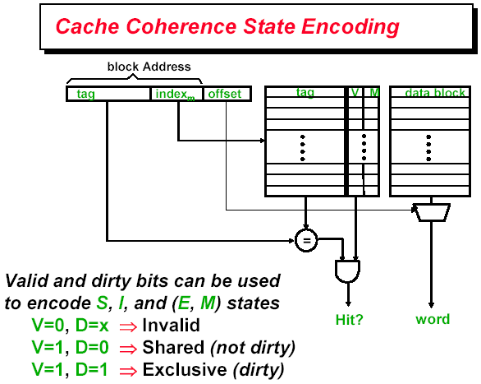
Implementation of snooping protocols

Slide 18
5 snooping protocols

Slide 19
Simple write-invalidate protocol
Three states
Invalid, Shared, exclusive
Events
CPU-R, CPU-W
BUS-R, BUS-W

Slide 20
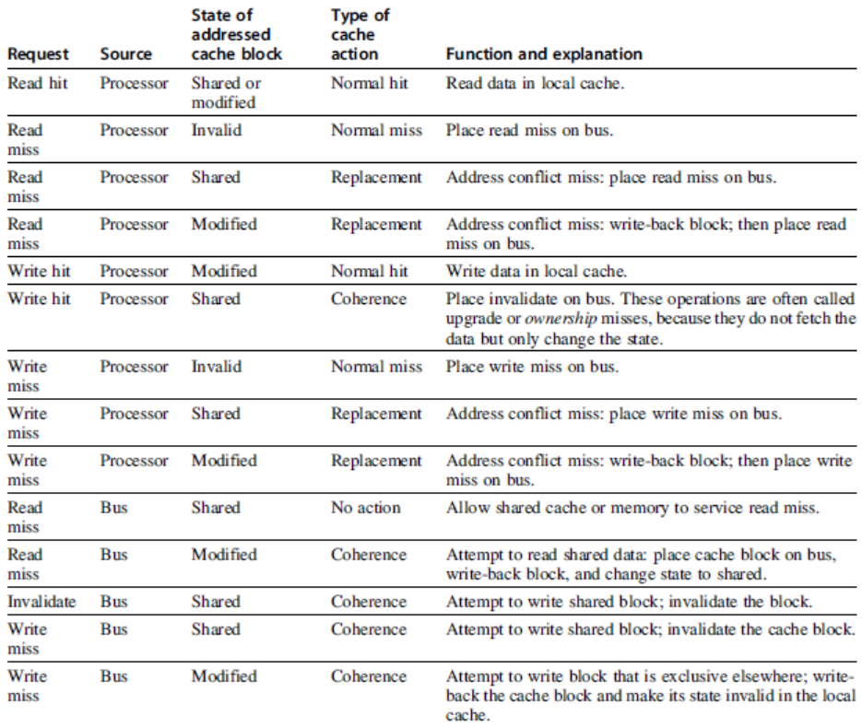
Snoopy Coherence Protocols

Slide 21
Snoopy-Cache State Machine-I
State machine for CPU requests for each cache block
CPU Read hit
CPU Read
Shared
(read/only)
Invalid
Place read miss
on bus
CPU Write
Place Write Miss on bus
CPU read miss
Write back block,
Place read miss
on bus
CPU Read miss
Place read miss
on bus
CPU Write
Place Write Miss on Bus
Cache Block
State
Exclusive
(read/write)
CPU read hit
CPU write hit
CPU Write Miss
Write back cache block
Place write miss on bus
Notes:
Invalid:
read => shared
write => dirty
shared looks the same

Slide 22
Snoopy-Cache State Machine-II
State machine for bus requests for each cache block
Write miss for this block
Invalid
Shared
(read/only)
Write miss for this block
Write Back
Block; (abort
memory access)
Read miss for this block
Write Back
Block; (abort
memory access)
Exclusive
(read/write)

Slide 23
Snoopy-Cache State Machine-III
CPU Read hit
State machine for CPU requests for each cache block and for bus requests for each cache block
Write miss for this block
CPU Read
Shared
(read/only)
Invalid
Place read miss
on bus
CPU Write
Place Write Miss on bus
Write miss for this block
CPU read miss
Write back block,
Place read miss
on bus
CPU Read miss
Place read miss
on bus
Write Back
Block; (abort
memory access)
CPU Write
Place Write Miss on Bus
Read miss for this block
Write Back
Block; (abort
memory access)
Cache Block
State
Exclusive
(read/write)
CPU read hit
CPU write hit
CPU Write Miss
Write back cache block
Place write miss on bus
Notes:
Invalid:
read => shared
write => dirty
shared looks the same

Slide 24
Example
Assumes A1 and A2 map to same cache block,
initial cache state is invalid

Slide 25
Example: step 1
Remote Write
CPU Read hit
Assumes initial cache state
is invalid and A1 and A2 map to same cache block,
but A1 != A2.
Invalid
Shared
Read miss on bus
Write miss on bus
Remote
Write
Write Back
CPU Write
Place Write Miss on Bus
Remote Read Write Back
Exclusive
CPU read hit
CPU write hit
Notes:
Assumes initial cache state
is invalid and A1 and A2 map to same cache block,
but A1 != A2.

Slide 26
Example: step 2
Remote Write
CPU Read hit
Invalid
Shared
Read miss on bus
Write miss on bus
Remote
Write
Write Back
CPU Write
Place Write Miss on Bus
Remote Read Write Back
Exclusive
CPU Write Miss
Write Back
CPU read hit
CPU write hit

Slide 27
Example:step 3
Remote Write
CPU Read hit
Invalid
Shared
Read miss on bus
Write miss on bus
Remote
Write
Write Back
CPU Write
Place Write Miss on Bus
Remote Read Write Back
Exclusive
CPU read hit
CPU write hit
CPU Write Miss
Write Back

Slide 28
Example: step4
Remote Write
CPU Read hit
Invalid
Shared
Read miss on bus
Write miss on bus
Remote
Write
Write Back
CPU Write
Place Write Miss on Bus
Remote Read Write Back
Exclusive
CPU read hit
CPU write hit

Slide 29
Example:step 5
Remote Write
CPU Read hit
Invalid
Shared
Read miss on bus
Write miss on bus
Remote
Write
Write Back
CPU Write
Place Write Miss on Bus
Remote Read Write Back
Exclusive
CPU read hit
CPU write hit
CPU Write Miss
Write Back
Notes:
Why write miss first?
Because in general, only write a piece of block, may need to read it first so that can have a full vblock; therefore, need to get
Write back is low priority event.

Slide 30
x 所在的block (w x y z)
i 所在的block ( h i j k )
写x, miss
取入整个 w x y* z

Slide 31
Snooping Cache Variations
Basic Protocol
Exclusive
Shared
Invalid
Berkeley Protocol
Owned Exclusive
Owned Shared
Shared
Invalid
Illinois Protocol
Private Dirty
Private Clean
Shared
Invalid
MESI Protocol
Modfied (private,!=Memory)
eXclusive (private,=Memory)
Shared (shared,=Memory)
Invalid
Owner can update via bus invalidate operation
Owner must write back when replaced in cache
If read sourced from memory, then Private Clean
if read sourced from other cache, then Shared
Can write in cache if held private clean or dirty

Slide 32
MESI (Illinois protocol) (write back cache)
CPU Read hit / CPU read miss
place read miss
on bus
CPU Read
Place read miss on Bus
Invalid
Shared
(read/only)
Remote Write
CPU read miss
Write back block
Place read miss on bus
Remote Read
Place Data on Bus
Remote Read
Write back
block
Remote Write
Write back block
Read-for-ownership
Place read miss on bus
Read-for-ownership
Place read miss on bus
Modified
(read/write)
Exclusive (read/only)
CPU read hit
CPU write hit
CPU Write
No need to Place Write Miss on Bus
CPU Write miss
Write back Place Write Miss on Bus
CPU Read hit

Slide 33
Snoopy Coherence Protocols
Complications for the basic MSI protocol:
Operations are not atomic
E.g. detect miss, acquire bus, receive a response
Creates possibility of deadlock and races
One solution: processor that sends invalidate can hold bus until other processors receive the invalidate
Extensions:
Add exclusive state to indicate clean block in only one cache (MESI protocol)
Prevents needing to write invalidate on a write
Owned state

Slide 34
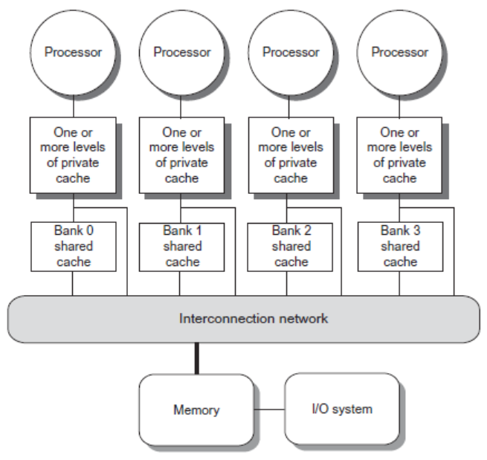
Coherence Protocols: Extensions
Shared memory bus and snooping bandwidth is bottleneck for scaling symmetric multiprocessors
Duplicating tags
Place directory in outermost cache
Use crossbars or point-to-point networks with banked memory

Slide 35
Coherence Protocols
Every multicore with >8 processors uses an interconnect other than bus
Makes it difficult to serialize events
Write and upgrade misses are not atomic
How can the processor know when all invalidates are complete?
How can we resolve races when two processors write at the same time?
Solution: associate each block with a single bus

Slide 36
Performance
Coherence influences cache miss rate
Coherence misses
True sharing misses
Write to shared block (transmission of invalidation)
Read an invalidated block
False sharing misses
Read an unmodified word in an invalidated block

Slide 37
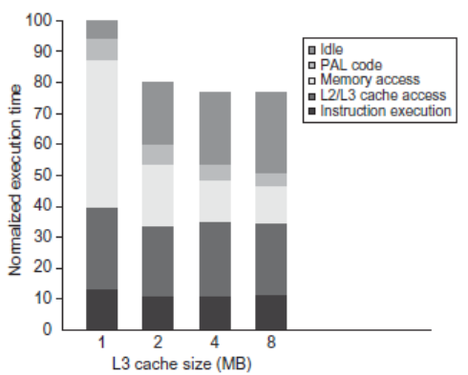
Performance Study: Commercial Workload

Slide 38
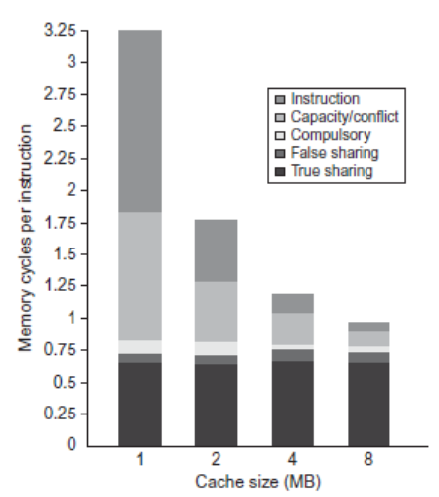
Performance Study: Commercial Workload

Slide 39
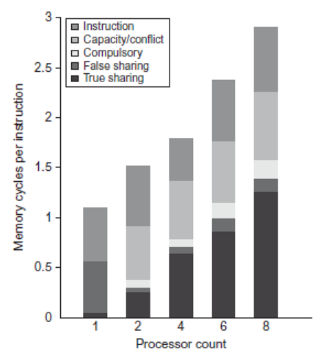
Performance Study: Commercial Workload

Slide 40
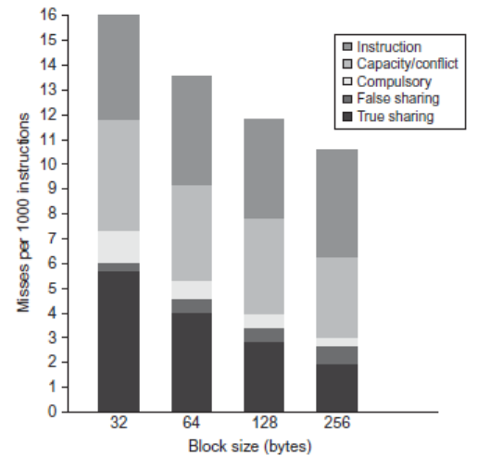
Performance Study: Commercial Workload

Slide 41
Directory-based Cache coherence

Slide 42
Distributed Shared Memory
Each node has a local memory and cache
Local or remote memory access via memory controller
Nov. 12 2008

Slide 43
Directory protocol
Directory: track state of every block in memory, and change the state of block in cache according to directory.
Information in directory
Status of Every block: shared/uncached/exclusive
Which processors have copies of the block: bit vector
Whether the block is dirty or clean
Directory protocol can be implemented with a distributed memory
Directory protocol can be applied to a centralized memory organized into banks

Slide 44
Distributed Directory MPs
Nov. 12 2008
Notes:
44

Slide 45
Directory protocol implementation
Block status
Shared: ≥ 1 processors have data, memory up-to-date
Uncached (no processor hasit; not valid in any cache)
Exclusive: 1 processor (owner) has data; memory out-of-date
Directory size = f (entry number * entry size)
Each memory block has an entry in directory / only keep the entries for cached blocks
Every processor has one bit / Limited processor bits in bit vector
Directory can be distributed along with the memory to avoid becoming the bottleneck
Assumptions to Keep it simple:
Writes to non-exclusive data => write miss
Processor blocks until access completes
Assume messages received and acted upon in order as sent
Nov. 12 2008

Slide 46
Directory Protocol
No bus and don’t want to broadcast:
Interconnect means no longer single arbitration point
all messages have explicit responses
Terms: typically 3 processors involved
Local node where a request originates
Home node where the memory location of an address resides
Remote node has a copy of a cache block, whether exclusive or shared
Example messages on next slide: P = processor number, A = address
Nov. 12 2008
Notes:
46

Slide 47
Message type Source Destination Msg Content
Read miss Local cache Home directory P, A
Processor P reads data at address A; make P a read sharer and arrange to send data back
Write miss Local cache Home directory P, A
Processor P has a write miss at address A; make P the exclusive owner and arrange to send data back
Invalidate Local cache Home directory A
Request to send invalidates to all remote caches that are caching the block at address A
Invalidate Home directory Remote caches A
Invalidate a shared copy at address A.
Fetch Home directory Remote cache A
Fetch the block at address A and send it to its home directory
Fetch/Invalidate Home directory Remote cache A
Fetch the block at address A and send it to its home directory; invalidate the block in the cache
Data value reply Home directory Local cache Data
Return a data value from the home memory (read miss response)
Data write-back Remote cache Home directory A, Data
Write-back a data value for address A (invalidate response)
Notes:
47

Slide 48
State Transition Diagram for an Individual Cache Block in a Directory Based System
States identical to snoopy case; transactions very similar.
Transitions caused by read misses, write misses, invalidates, data fetch requests
Generates read miss & write miss msg to home directory.
Write misses that were broadcast on the bus for snooping => explicit invalidate & data fetch requests.
Note: on a write, a cache block is bigger, so need to read the full cache block
Notes:
48

Slide 49
CPU -Cache State Machine
State machine for CPU requests for each memory block
Invalid state if in memory
Shared
(read/only)
Invalid
CPU Read
Send Read Miss
Directory:
Uncached: Send Rp; S→ shared;
share = {p}
Shared: Send Rp;
share + = {p}
Exclusive: Send Fetch to R.N.
get reply back from R.N.
Send RP;
→ Shared
share + = {p}
Directory:
Uncached: Send Rp; S→ Exclusive
share = {p}
Shared: Send invalidate;
Send Rp;
S→ Exclusive
share = {p}
Exclusive: Send Fetch/invalidate to R.N.
get reply back from R.N.
Send RP to P; S→Exclusive
share = {p}
CPU Write: Send Write Miss
to h.d.
Exclusive
(read/writ)
Notes:
49
Invalid:
read => shared
write => dirty
shared looks the same

Slide 50
CPU -Cache State Machine
CPU Read hit
State machine for CPU requests for each memory block
Invalid state if in memory
Invalidate
Shared
(read/only)
Invalid
CPU Read
CPU read miss:
Send Read Miss
Send Read Miss
CPU Write: Send Write Miss
to h.d.
CPU Write hit:Send invalidate to home directory
CPU Write miss:Send Write Miss to home directory
Exclusive
(read/writ)
Notes:
50
Invalid:
read => shared
write => dirty
shared looks the same

Slide 51
CPU -Cache State Machine
CPU Read hit
State machine for CPU requests for each memory block
Invalid state if in memory
Invalidate
Shared
(read/only)
Invalid
CPU Read
Send Read Miss
CPU read miss:
Send Read Miss
CPU Write: Send Write Miss
to h.d.
CPU Write hit:Send invalidate to home directory
Fetch/Invalidate
Data Write Back
CPU Write miss:Send Write Miss to home directory
Fetch: Data Write Back to home directory
CPU read miss:
Data Write Back and
Send read miss to home directory
Exclusive
(read/writ)
CPU read hit
CPU write hit
CPU write miss:
Data Write Back
and send Write Miss to home
directory
Nov. 12 2008
Notes:
51
Invalid:
read => shared
write => dirty
shared looks the same

Slide 52
CPU -Cache State Machine
CPU Read hit
State machine for CPU requests for each memory block
Invalid state if in memory
Invalidate
Shared
(read/only)
Invalid
CPU Read
Send Read Miss
CPU read miss:
Send Read Miss
CPU Write: Send Write Miss
to h.d.
CPU Write hit:Send invalidate to home directory
Fetch/Invalidate
Data Write Back
CPU Write miss:Send Write Miss to home directory
Are these write back
the same ?
Fetch: Data Write Back to home directory
CPU read miss:
Data Write Back and
Send read miss to home directory
Exclusive
(read/writ)
CPU read hit
CPU write hit
CPU write miss:
Data Write Back
and send Write Miss to home
directory
Nov. 12 2008
Notes:
52
Invalid:
read => shared
write => dirty
shared looks the same

Slide 53
State Transition Diagram for the Directory
Same states & structure as the transition diagram for an individual cache
2 actions: update of directory state & send msgs to statisfy requests
Tracks all copies of memory block.
Also indicates an action that updates the sharing set, Sharers, as well as sending a message.
Notes:
53

Slide 54
Directory State Machine
State machine for Directory requests for each memory block
Uncached state if in memory
Read miss:
Sharers = {P}
send Data Value
Reply
Shared
(read only)
Uncached
Write Miss:
Data Value Reply
Sharers = {P};
Exclusive
(read/writ)
Notes:
54
Invalid:
read => shared
write => dirty
shared looks the same

Slide 55
Directory State Machine
Read miss:
Data Value Reply
Sharers += {P};
State machine for Directory requests for each memory block
Uncached state if in memory
Read miss:
Sharers = {P}
send Data Value
Reply
Shared
(read only)
Uncached
Write Miss:
Data Value Reply
Sharers = {P};
Write Miss/ Invalidate:
Send Invalidate to R.N;
Sharers = {P};
(Data Value Reply)
Exclusive
(read/writ)
Notes:
55
Invalid:
read => shared
write => dirty
shared looks the same

Slide 56
Directory State Machine
Read miss:
Data Value Reply
Sharers += {P};
State machine for Directory requests for each memory block
Uncached state if in memory
Read miss:
Sharers = {P}
send Data Value
Reply
Shared
(read only)
Uncached
Write Miss:
Data Value Reply
Sharers = {P};
Write Miss/Invalid:
Invalidate ;
Sharers = {P};
Data Value Reply
Data Write Back:
Sharers = {}
Read miss:
Send Fetch to R.N.;
Get Data from R. N.
Reply Back to local processor
Sharers += {P};
Write Miss:
Fetch/Invalidate;
Receive Date from R.N
Data Value Reply
to local Node
Sharers = {P};
Exclusive
(read/writ)
Nov. 12 2008
Notes:
56
Invalid:
read => shared
write => dirty
shared looks the same

Slide 57
Directory State Machine
Read miss:
Data Value Reply
Sharers += {P};
State machine for Directory requests for each memory block
Uncached state if in memory
Read miss:
Sharers = {P}
send Data Value
Reply
Shared
(read only)
Uncached
Write Miss:
Data Value Reply
Sharers = {P};
Write Miss:
Invalidate ;
Sharers = {P};
Data Value Reply
Data Write Back:
Sharers = {}
Read miss:
Fetch;
Data Value Reply
msg to remote cache
Sharers += {P};
Write Miss:
Fetch/Invalidate;
Data Value Reply
msg to remote cache
Sharers = {P};
Exclusive
(read/writ)
Nov. 12 2008
Notes:
57
Invalid:
read => shared
write => dirty
shared looks the same

Slide 58
Example Directory Protocol
Message sent to directory causes two actions:
Update the directory
More messages to satisfy request
Block is in Uncached state: the copy in memory is the current value; only possible requests for that block are:
Read miss: requesting processor sent data from memory &requestor made only sharing node; state of block made Shared.
Write miss: requesting processor is sent the value & becomes the Sharing node. The block is made Exclusive to indicate that the only valid copy is cached. Sharers indicates the identity of the owner.
Block is Shared => the memory value is up-to-date:
Read miss: requesting processor is sent back the data from memory & requesting processor is added to the sharing set.
Write miss: requesting processor is sent the value. All processors in the set Sharers are sent invalidate messages, & Sharers is set to identity of requesting processor. The state of the block is made Exclusive.
Notes:
58

Slide 59
Example Directory Protocol
Block is Exclusive: current value of the block is held in the cache of the processor identified by the set Sharers (the owner) => three possible directory requests:
Read miss: owner processor sent data fetch message, causing state of block in owner’s cache to transition to Shared and causes owner to send data to directory, where it is written to memory & sent back to requesting processor. Identity of requesting processor is added to set Sharers, which still contains the identity of the processor that was the owner (since it still has a readable copy). State is shared.
Data write-back: owner processor is replacing the block and hence must write it back, making memory copy up-to-date (the home directory essentially becomes the owner), the block is now Uncached, and the Sharer set is empty.
Write miss: block has a new owner. A message is sent to old owner causing the cache to send the value of the block to the directory from which it is sent to the requesting processor, which becomes the new owner. Sharers is set to identity of new owner, and state of block is made Exclusive.
Notes:
59

Slide 60
Case Study: p1 write 888 to x
P1
P2
X=111
P3
X=111
Cache X: E, 888
Cache X: I
Cache:X: S
Cache:X: I
Cache:X: I
Cache: X: S
Direct: X: S, {P2,P3}
Direct: X: E, {P1}
P4
P5
X’HOME
111
P6
P1(local) P5(home) P2(remote) P3(remote)
WriteMiss X
Invalidate X
Invalidate X
Ack
Ack
Reply X=111

Slide 61
P2 write 999 to X
P1
X=888
P2
P3
X: I
X: E, 888
X: S
X: S
X: I
X: I
X: E, {P1}
X: S, {P2,P3}
P4
P5
X’HOME
111
P6
P1(remote) P5(home) P2(local) P3(remote)

Slide 62
Answer for P2 write 999 to X
P1
X=888
P2
P3
X: I
X: E, 888
X: I
X: S
X: S
X: I
X: E, 999
X: I
X: E, {P1}
X: S, {P2,P3}
X: E,｛P2}
P4
P5
X’HOME
111
P6
888
P1(remote) P5(home) P2(local) P3(remote)
WriteMiss
Fetch/Invalidate
How about P2 read x？
Write back X 888
Data reply X 888

Slide 63
More Cases for Cache Coherence of Directory Protocol

Slide 64
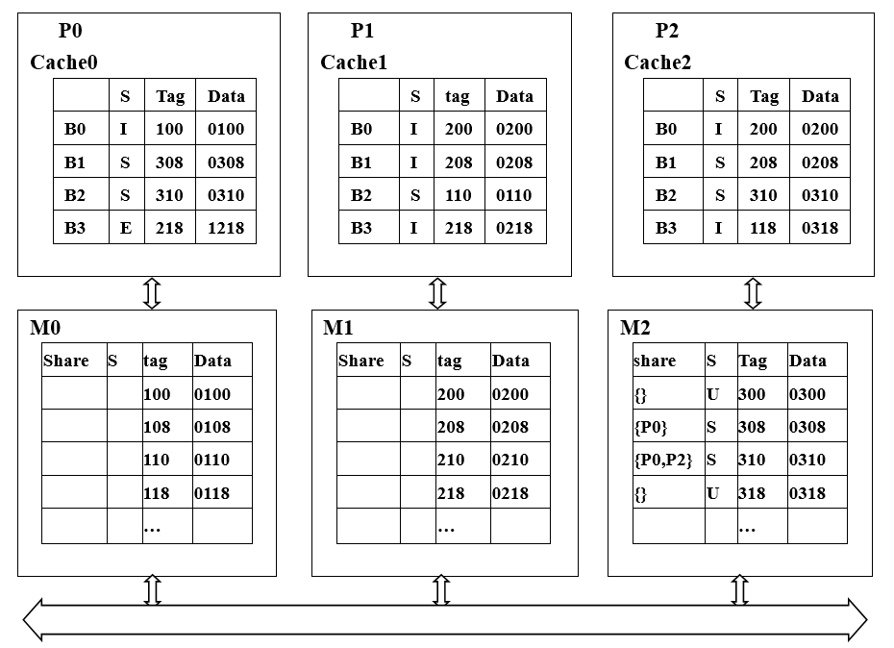
Could you feel the blanks to complete the directories ?

Slide 65
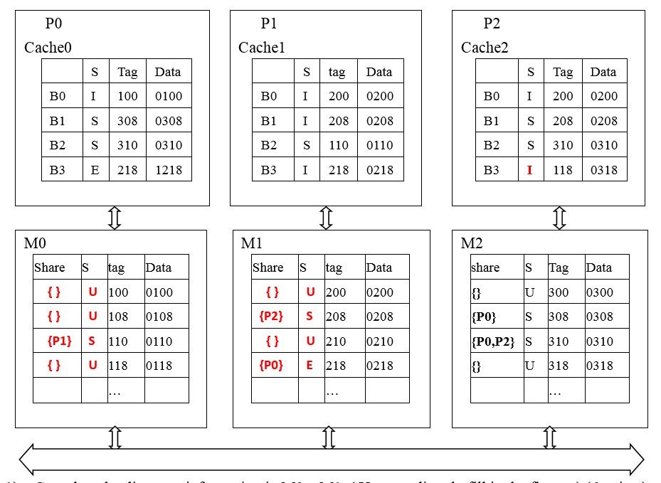
I
P0 read 300

Slide 66
ReadMiss 300
DataReply 300(0300)
S 300 0300
I
P0 read 300
{P0} S 300 0300
What operations will do when P0 read 300 ?

Slide 67
P0 read 300
P0(local node) P2(home node)
ReadMiss for Tag=300
M2, 300, {}, U → {P0}, S
DataReply 0300
Cach0,
B0: I, 100, 0100→
S, 300, 0300

Slide 68
Fetch(218)
ReadMiss(218)
Writeback 218(1218)
DataReply 218(1218)
I
S 218 1218
S
P0 read 300
{P0,P2} S 218 1218
Modify Directory
What operations will do when P2 read 218 ?

Slide 69
P2 read 218
P2(local node) P1(home node) P0(remote node)
ReadMiss for Tag=218
Fetch Tag=218
Cach0,
B3: E, 218, 1218→
S, 218, 1218
WriteBack218(1218)
M1,
218, {P0}, E, 0218→
{P1,P0}, S, 1218
DataReply 218(1218)
Cach2,
B3: I, 118, 0318→
S, 218, 1218

Slide 70
invalidate 310
ACK
invalidate 310
WriteMiss(310)
ACK
DataReply 310(0310)
E 310 0310
E 310 0888
I
I
I
P0 read 300
{P1} E
What operations will do when P1 write 0888 into 310 ?

Slide 71
P1 write 0888 into 310
P1(local node ) P2(home node) P0. P2 (remote node)
WriteMiss for Tag=310
Invalidate Tag=310
Cach0, Cache2
B2: S, 310, 0310→
I, 310, 0310
Ack
M2,
310,{P0,P2},S,0310→
{P1}, E, 0310
DataReply 0310
Cache1,
B2:S, 110, 0110→
E, 310, 0888
Anything UNcomfortable ?

Slide 72
WriteMiss(310)
I
{ } U
P0 read 300
The directory is outdated
with wrong info.
How to solve it?
What operations will do when P1 write 0888 into 310 ?

Slide 73
P1 write 0888 into 310
P1(local node ) P2(home node) P0(remote node)
Kickout 110
M0,
110,{P1},S,0110→
{ }, U, 0110
WriteMiss for Tag=310
Invalidate Tag=310
Cach0, {Cache2}
B2: S, 310, 0310→
I, 310, 0310
Ack
M2,
310,{P0,P2},S,0310→
{P1}, E, 0310
DataReply 0310
Cache1,
B2:S, 110, 0110→
E, 310, 0888

Slide 74
Example 1: initial
Processor 1
Processor 2
Interconnect
Directory
Memory
A1 and A2 map to the same cache block
Notes:
74

Slide 75
Example: P1 write 10 to A1
Processor 1
Processor 2
Interconnect
Directory
Memory
A1 and A2 map to the same cache block
Notes:
75

Slide 76
Example: P1 read A1, P2 read A1
Processor 1
Processor 2
Interconnect
Directory
Memory
A1 and A2 map to the same cache block
Notes:
76

Slide 77
Example: P2 write 20 to A1
Processor 1
Processor 2
Interconnect
Directory
Memory
A1
A1 and A2 map to the same cache block
Notes:
77

Slide 78
Example: P2 write 40 to A2
Processor 1
Processor 2
Interconnect
Directory
Memory
A1
A1 and A2 map to the same cache block
Notes:
78

Slide 79
Implementation of Directory-base Coherence

Slide 80
Implementation issues
Nonatomic operations
Write serialization
Without Broadcast

Slide 81
Assumptions for implementation simplicity
Network provides point-to-point in-order delivery of message
Network has unlimited buffering
Network delivers all messages within a finite time.
Coherence controller is duplicated for each cache block.
A transition only completes when a message has been transmitted and a data value reply received.
Omit the pending status
Outgoing message can be transmitted before the next incoming message is accepted.

Slide 82
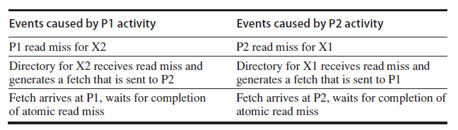
Deadlock example
Assume P1 and P2 each have exclusive copies of cache blocks X1 and X2 that have different home directories.
Resolve: duplicate coherence controller for each block

Slide 83
CPU -Cache State Machine
CPU Read hit
State machine for CPU requests for each memory block
Invalid state if in memory
Invalidate
Shared
(read/only)
Invalid
CPU Read
Send Read Miss
CPU read miss:
Send Read Miss
CPU Write: Send Write Miss
to h.d.
CPU Write hit:Send invalidate to home directory
Fetch/Invalidate
Data Write Back
CPU Write miss:Send Write Miss to home directory
Fetch: Data Write Back to home directory
CPU read miss:
Data Write Back and
Send read miss to home directory
Exclusive
(read/writ)
CPU read hit
CPU write hit
CPU write miss:
Data Write Back
and send Write Miss to home
directory
Nov. 12 2008
Notes:
83
Invalid:
read => shared
write => dirty
shared looks the same

Slide 84
How to assure write serialization ?
Serialization exclusive access by Home directory
Buffer all the request (write miss/ invalidate );
Process the request in order;
Only start to process the new request until complete the previous one.

Slide 85
How to solve the “race” ?
How does the processor know who is the winner?
Get acknowledgement message from home directory
Date Reply (For write miss)
Explicit ACK (For invalidate)
About the loser:
Simplest: home directory send a NAK to loser.
How to know the invalidations are completed?
1. Directory collect and count ACK messages from remote nodes, and then send confirmation to requester.
2. Home node collect and count ACK messages from remote nodes directly.

Slide 86
Buffer requirement
Large amount of buffers required
A write miss may produce a large amount invalidate message
Prefetch scheme might be used
Multiple outstanding misses
Limited buffer in practice

Slide 87
Avoid deadlock with limited buffering
Deadlock arises from three properties
More than one resource is needed to complete a transaction
Buffers for request, reply, and accept message
Resources are held until a nonatomic transaction completes
There is no global partial order on the acquisition of resource

Slide 88
Resolution
Strategy: Try to ensure that the resources will always be available.
Separate network is used for request and replies.
Every request need a reply allocate the space to accept reply when the request is generated.
Replier can free the reply buffer.
Any controller can reject any request with a NAK, but never NAK a reply.
Any request that receives a NAK is simply retried.

Slide 89
Multithreaded directory to handle multiple blocks
Directory controller must be reentrant.
Handle incoming requests for independent blocks before the previous one finished.
Control state need be saved and restored while a fetch(or fetch//invalidate) is outstanding
Owner node can provide the data directly to the requester as well as to the home node to reduce latency.
Can limit the outstanding transaction numbers via NAK to new requests.

Slide 90
How to deal with NAK ?
How to know which is the original transaction ?
1. processor keep track of its outstanding requests
2. Pack the original request into NAK.
3. The buffer holding the return slot for the request can also hold info about the request.
So that when receives NAK, the processor know to resend the request.

Slide 91
Summary
Caches contain all information on state of cached memory blocks
Snooping and Directory Protocols similar; bus makes snooping easier because of broadcast (snooping => uniform memory access)
Directory has extra data structure to keep track of state of all cache blocks
Distributing directory => scalable shared address multiprocessor => Cache coherent, Non uniform memory access
Nov. 12 2008

Slide 92
How about write through cache with write invalidate?
PW
[ BW miss on bus]
BR, PR
PW
[send BW]
Valid
Invalid
PR
[ BR miss on bus]
BW
Nov. 12 2008

Slide 93
**Thinking： Are Coherence Protocol States Vulnerable to Information Leakage?

Slide 94

Review: Cache Coherence Protocols
MSI Coherence Protocol
MESI Coherence Protocol
Exclusive State
Accelerate write-after-read accesses!
Notes:
Cache coherence should be preserved on any multicore system such that different cores can access the same value for the same memory location.
In this paper, We focus mainly on directory-based coherence protocols as modern processors often adopt this design
The MSI protocol is seminal and all coherence protocols deployed on modern multicore chips inherit its three states—Modified, Shared, and Invalid
To optimize MSI protocol, The MESI protocol introduces an Exclusive state to make the S state more fine-grained and save coherence traffic.
So, Why the introduction of E state could be an optimization?
The E state helps accelerate write-after-read accesses [46], [65].
With E state, the cache knows it’s the only owner of the block, so it can write the cache line without notifying other cores.
However, Without the E state, MSI marks a clean data block with the S state. To serve a subsequent write request targeting the S-state block, the core needs to request ownership. This triggers further invalidation commands to other cores for avoiding potential stale copies.

Slide 95
Review: Coherence-based Timing Channel
E-state coherence request
S-state coherence request
core A
core B
core C
core A
core B
core C
E
X
S
X
S
X
❶
❸
❷
❶
❷
Directory
E
X
Directory
S
X
❶ Core A request directory for memory location X
❶ Core A requests Directory for memory location X
❷ Directory forwards request to Core B
❷ LLC sends response to Core B
❸ Core B sends response to Core A
[HPCA’18] Are Coherence Protocol States Vulnerable to Information Leakage?
Notes:
However, the optimization of E state brings security vulnerabilities: there is a coherence-based timing channel
it arises from different access latencies for fetching data blocks in E state and S state upon a cache miss.
Here we present the process to access an E-state or S-state block for memory location X in the LLC.
Firstly E state.
Since Core A has no copy of data in iits private caches, it sends a request to the directory (step 1).
The directory finds that the X-addressed data block is exclusively cached on core B.
Although the LLC also has a copy for X, the E state makes the directory hard to ensure whether the value in the LLC is obsolete. Therefore, the directory forwards the request to the owner—Core B (step 2). Upon receiving the forwarded request, Core B responds Core A with data.
In contrast, when the requested data block is in the S state , the directory ensures that the copy in the LLC holds the same value with that of other copies cached in some core’s private caches.
The directory thus more quickly returns the requested data block from the LLC.

Slide 96
Review: S-MESI
1. write X
Private
Cache
2b. transition
4. transition
M
E
X
X
X
EM^{A}
2a. upgrade
3a. ack
LLC
E
X
3b. transition
M
X
Directory
Directory
Notes:
To defend against this attack, the state-of-the-art countermeasure, we name it S-MESI, returns the requestd data in both states E and S from the LLC
However, this nullifies the silent upgrade effect from E to M that the E state is supposed to offer.
When traditional silent upgrade updates the E-state block in private caches into state M, its corresponding copy in the LLC stays in state E.
Directly returning E-state data from the LLC likely results in accessing stale data.
Therefore, SMESI revokes silent upgrade and enforces the M state to be synchronized across both private caches and the LLC.
Let’s see the process
Upon receiving a write request for a private data block in state E (step 1)
the core sends a coherence request to the LLC for privilege upgrade (step 2a) and transits state E to a transient EMA state (step 2b).
It then waits for the LLC’s acknowledgement (step 3a)
The acknowledgement from the LLC triggers private caches to update the EMA state to the M state

Slide 97

SwiftDir: Overview
We observe that
The coherence attack exploits only shared data.
S-MESI nullifies state E and complicates the E→M transition for all data.
So SwiftDir
Shrink protection scope to exploitable shared data which is actually write-protected.
Remove their redudant E state from coherence.
Chenlu Miao, Kai Bu, Mengming Li, Shaowu Mao, Jianwei Jia: SwiftDir: Secure Cache Coherence without Overprotection. MICRO 2022: 662-677
Notes:
We observe that the inevitable overhead by nullifying the E state arises from overprotection.
Since the coherence attack exploits only shared data, protecting only shared data is sufficient.
However, S-MESI nullifies state E and complicates the E→M transition for unshared data.
We are motivated to minimize the protection scope.
We find that exploitable shared data belong to write-protected data, whose E state is redundant.
We can simply remove their E state from coherence to fundamentally throttle the exploited E/S timing difference.

Slide 98
SwiftDir: Design
Identification of Shared Memory
Exploited Shared Memory is Write-protected
Write-protected Manifests in PTE R/W Field
Argumentation of Sharing Status
Modification of Coherence Protocol
Notes:
We leverage the MMU to identify exploitable shared memory
It’s based on two observations.
First, we find that exploited shared memory is write-protected.
The coherence attack generates shared memory in two ways, first by using shared library, and the second by using memory deduplication. They are all write-protected.
Then, we find that write-protected manifests in page table entry’s read/write field.

Slide 99
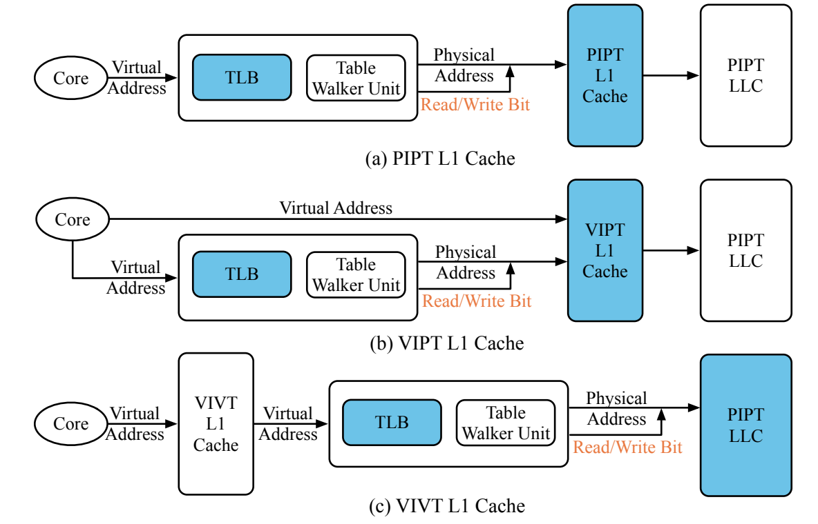
SwiftDir: Design
Identification of Shared Memory
Argumentation of Sharing Status
PIPT/VIPT/VIVT L1
Modification of Coherence Protocol
Notes:
With the write-protected information, next SwiftDir hitchhikes address translation to transmit the write-protected information from the MMU to the cache hierarchy for coherence maintenance.
Different cache architectures lead to respective complexities to this hitchhiking method.
VIVT, for example. It allows the core to send a virtual address to the L1 cache even prior to address translation. To address such a concern, we thoroughly investigate all the three cache architectures in commercial use—PIPT, VIPT, and VIVT
We find that SwfitDir suffices for the LLC to obtain the write-protected information of the requested data until the request arrives at the LLC. This requirement can be easily satisfied regardless of cache architecture, simply because that the LLC is a physical cache and address translation should have taken place before accessing the LLC

Slide 100
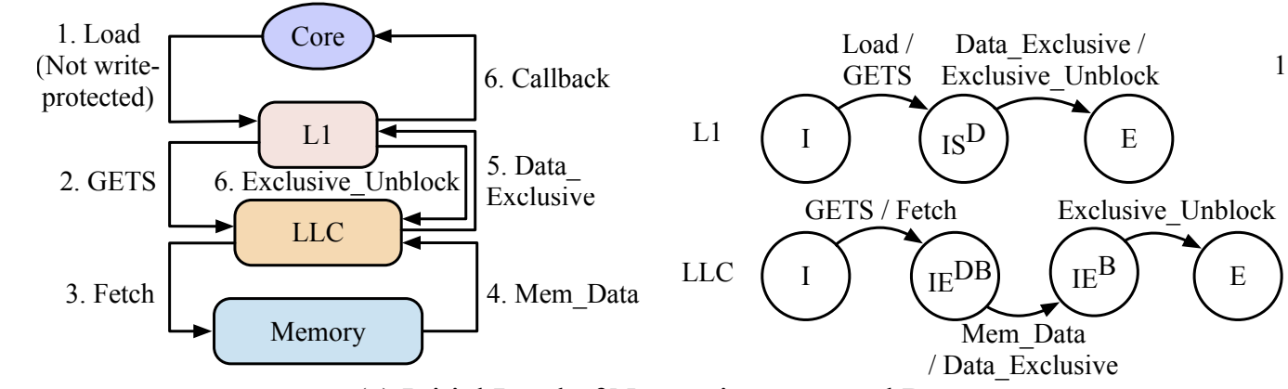
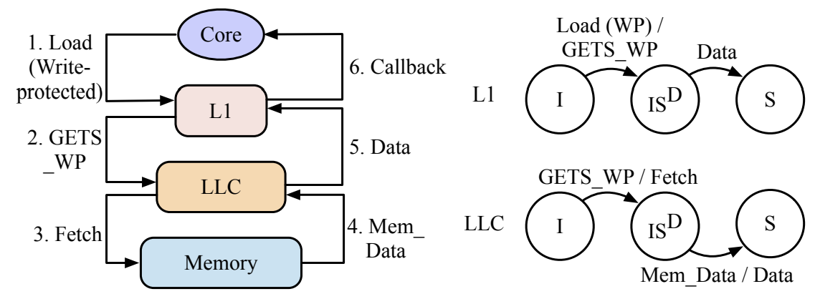
SwiftDir: Design
Identification of Shared Memory
Argumentation of Sharing Status
Modification of Coherence Protocol
Notes:
Finally, it’s about modification of coherence protocol.
SwiftDir imposes minimum modification on existing coherence protocols by narrowing down the protection scope to only write-protected data
Motivated by the observation that write-protected data are not supposed to be written, we consider it less necessary to maintain their E state.
SwiftDir thus directly sets an initial load of write-protected data in the S state instead of the E state
This way, write-protected data no longer transit to the E state and are immune from timing-channel attacks

Slide 101
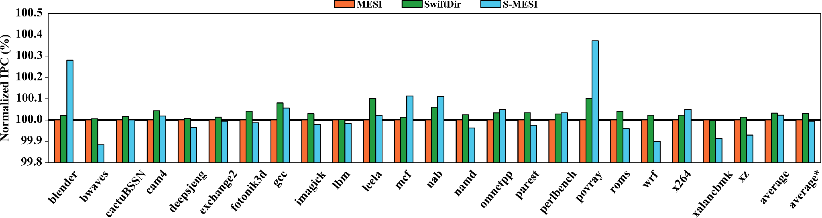
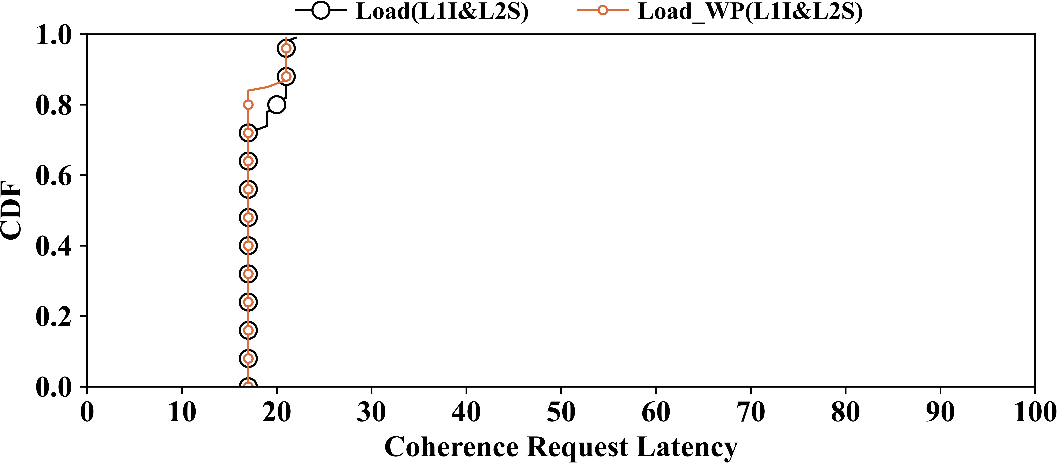
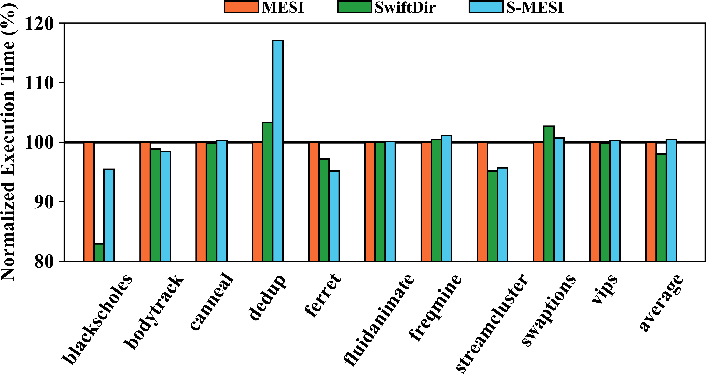
Evaluation
Notes:
We did a series of experiments to evaluate the SwiftDir.
First for security issue, We measure the access latency of traditionally vulnerable shared data to show that SwiftDir successfully prevents the timing channel
This figure reports the cumulative distribution function (CDF) of Load WP(L1I&L2S) by SwiftDir, in comparison with that of Load(L1I&L2S) by MESI.
It can been seen that it leaves the attacker with no timing difference to exploit.

Slide 102
Conclusion
SwiftDir is the first attempt to secure cache coherence with performance gains.
This promises a way of protection by simplification rather than complication.
Notes:
We make the conclusion:
SwiftDir is the first attempt to secure cache coherence with performance gains.
This promises a way of protection by simplification rather than complication.

