Slide 1
Notes on Labs
Lab submission：
Lab report: submit by deadline individually, clear specify your
group member.
Lab check: submit your zip file of source code after checking,
with a updated lab report specifying group member.
Second check with a highest score of 90.
Learn to write emulation code, check your lab result with the emulation result.

Slide 2
Chapt 2-1: Memory hierarchy
Memory hierarchy
The basic of cache
Organization of main memory
2

Slide 3
Chapter B & 2: Memory Hierarchy
Memory Hierarchy ABC
Memory Technology and Optimizations
Optimizations of Cache performance
Virtual Memory and Virtual Machines
The Design of Memory Hierarchies
Memory Hierarchies in the ARM and intel core i7 6700

Slide 4
2.1 Introduction
Why do designers need to know about memory technology?
Processor performance is usually limited by memory bandwidth
As IC densities increase, lots of memory will fit on processor chip
Application requirements:
Unlimited amounts of memory
Faster memory, higher bandwidth
Lower price per byte
If for embedded systems: lower power comsumption
These requirements are contradictory.
The bigger, more difficult to make it fast
The faster, more expensive
The faster will consume much more power.

Slide 5
Memory Technologies
Random Access Memories
DRAM: Dynamic Random Access Memory
High density, low power, cheap, slow
Dynamic: needs to be “refreshed” regularly
SRAM: Static Random Access Memory
Low density, high power, expensive, fast
Static: content will last “forever”(until lose power)
What gets used where?
Main memory is DRAM: you need it big, so you need it cheap
CPU cache memory is SRAM: you need it fast, so it’s more expensive, so it’s smaller than you would usually want due to resource limitations
Relative performance
Size: DRAM/SRAM: 4-8x bigger for DRAM
Cost/Cycle time: SRAM/DRAM: 8-16x faster, more $$$ for SRAM

Slide 6
Memory Hierarchy: a natural Solution
How can we provide a memory with small access time, big capacity and lower price ?
The first principle: make the common case fast !
What is the common case ?
Recall: the principle of locality of reference !
Program access a relatively small portion of the address space at any instant of time.
Ok, we should make these accesses more quickly.
We can hold the recently accessed items in a fast memory.
Yeah: Smaller memories will be faster !
We can use more expensive and smaller memories to hold the most recently used items.
The cost and power impact is lessoned for small size.

Slide 7
What is Memory Hierarchy ?
Memory hierarchy is organized into several levels:
Each smaller, faster, and more expensive per byte than the next lower level.
Temporal Locality (Locality in Time):
⇒ Keep most recently accessed data items closer to the processor
Spatial Locality (Locality in Space):
⇒ Move blocks consists of contiguous words to the faster levels
Notes:
Y-axis is performance
X-axis is time
Latency
Cliché:
Not e that x86 didn’t have cache on chip until 1989

Slide 8
Memory Hierarchy
Goal:To provide a memory system with cost most almost as low as the cheapest level of memory and speed almost as fast as the fastest level.
Solution：
Entire addressable memory space available in largest, slowest memory
Incrementally smaller and faster memories, each containing a subset of the memory below it, proceed in steps up toward the processor
Processor
Control
Secondary
Storage
(Disk)
Second
Level
Cache
(SRAM)
Main
Memory
(DRAM)
Datapath
On-Chip
Cache
Registers
Compiler
Hardware
Speed:
Fastest
Operating System
Slowest
Size:
Smallest
Biggest
Cost:
Highest
Lowest

Slide 9
Different concerns for desktops, servers, and embedded computers
Desktop computers:
primarily running one application for single user
concerned more with average latency from the memory hierarchy.
Servers computers:
May have hundreds of users running potentially
dozens of applications simultaneously.
concerned about memory bandwidth.
Embedded computers:
Used for real-time applications, so worst-case performance is a focus
Power and battery life, may NOT choose hardware optimizations
Running only one application using very simple OS, so protection role of memory is often diminished.
Notes:
1st generation
Latency 1/2
but Clock rate 3X and IPC is 3X
Now move to other 1/2 of industry

Slide 10
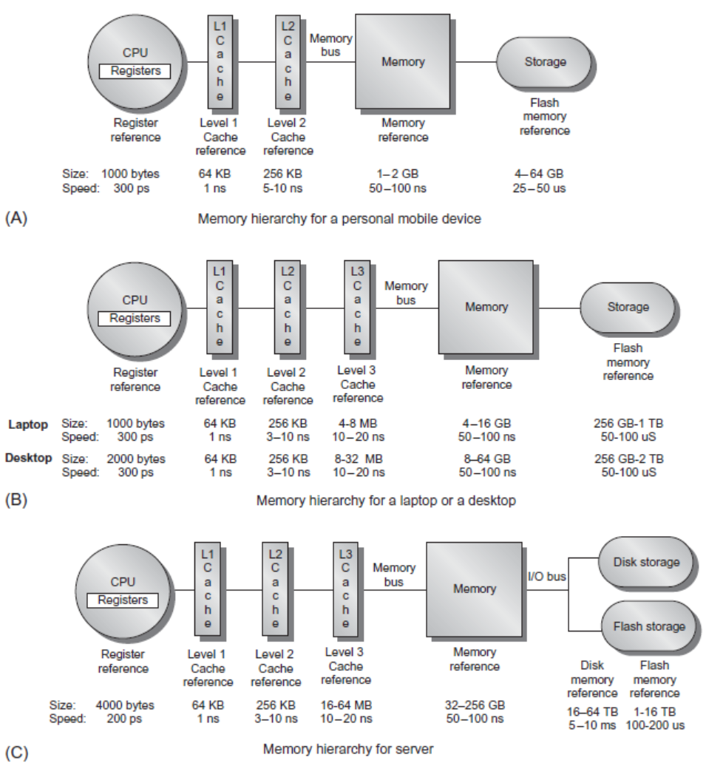
Memory Hierarchy

Slide 11
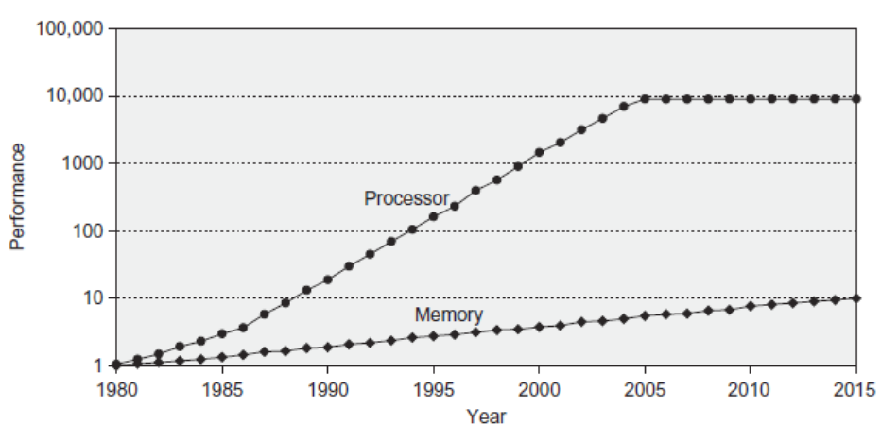
Memory Performance Gap
Processor-Memory
Performance Gap: (grows 50% / year)
1980: no cache in µproc;
1989 first Intel µproc with a cache on chip
2001: 2-level cache on chi

Slide 12
Memory Hierarchy Design
Memory hierarchy design becomes more crucial with recent multi-core processors:
Aggregate peak bandwidth grows with # cores:
Intel Core i7 can generate two references per core per clock
Four cores and 3.2 GHz clock
25.6 billion 64-bit data references/second +
12.8 billion 128-bit instruction references/second
= 409.6 GB/s!
DRAM bandwidth is only 8% of this (34.1 GB/s)
Requires:
Multi-port, pipelined caches
Two levels of cache per core
Shared third-level cache on chip

Slide 13
Performance and Power
High-end microprocessors have >10 MB on-chip cache
Consumes large amount of area and power budget

Slide 14
Review of the ABCs of Caches
36 terms of Cache
Cache Virtual memory
data cache Instruction cache unified cache
block page tag field
Block address index field block offset
full associative set associative direct mapped
n-way set associative set address trace
misses per instruction Memory stall cycles miss penalty
Valid bit dirty bit locality
cache hit hit time
cache miss miss rate page fault
Write through write back write allocate
random replacememt least-recently used no-write allocate
Average memory access time write buffer write stall

Slide 15
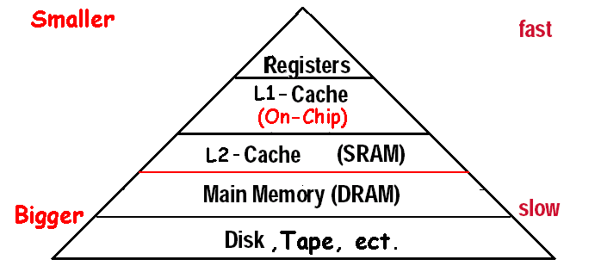
What is a cache?
Small, fast storage used to improve average access time to slow memory.
In computer architecture, almost everything is a cache!
Registers “a cache” on variables – software managed
First-level cache a cache on second-level cache
Second-level cache a cache on memory
Memory a cache on disk (virtual memory)
TLB a cache on page table
Branch-prediction a cache on prediction information?

Slide 16
Four Questions for Memory Hierarchy Designers
Q1: Where can a block be placed in the upper level?
(Block placement)
Fully Associative, Set Associative, Direct Mapped
Q2: How is a block found if it is in the upper level? (Block identification)
Tag/Block
Q3: Which block should be replaced on a miss? (Block replacement)
Random, LRU,FIFO
Q4: What happens on a write? (Write strategy)
Write Back or Write Through (with Write Buffer)

Slide 17
Q1: Block Placement
Direct mapped
Block can only go in one place in the cache
Usually (address) MOD (Number of blocks in cache)
Fully associative
Block can go anywhere in cache.
Set associative
Block can go in one of a set of places in the cache.
A set is a group of blocks in the cache.
(Block address) MOD (Number of sets in the cache)
If sets have n blocks, the cache is said to be n-way set associative.
Note that direct mapped is the same as 1-way set associative, and fully associative is m-way set-associative (for a cache with m blocks).

Slide 18
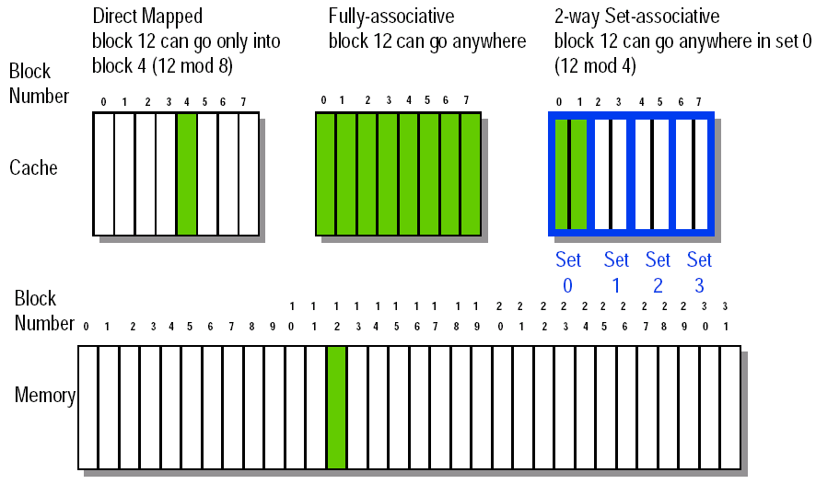
8-32 Block Placement

Slide 19
Q2: Block Identification
Every block has an address tag that stores the main memory address of the data stored in the block.
When checking the cache, the processor will compare the requested memory address to the cache tag -- if the two are equal, then there is a cache hit and the data is present in the cache
Often, each cache block also has a valid bit that tells if the contents of the cache block are valid

Slide 20
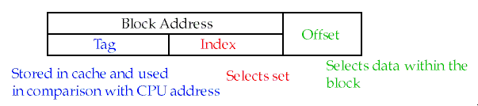
The Format of the Physical Address
The Index field selects
The set, in case of a set-associative cache
The block, in case of a direct-mapped cache
The Byte Offset field selects
The byte within the block
Has as many bits as log₂(size of block)
The Tag is used to find the matching block within a set or in the cache
Has as many bits as
(AddressSize) – (IndexSize) – (ByteOffsetSize)

Slide 21
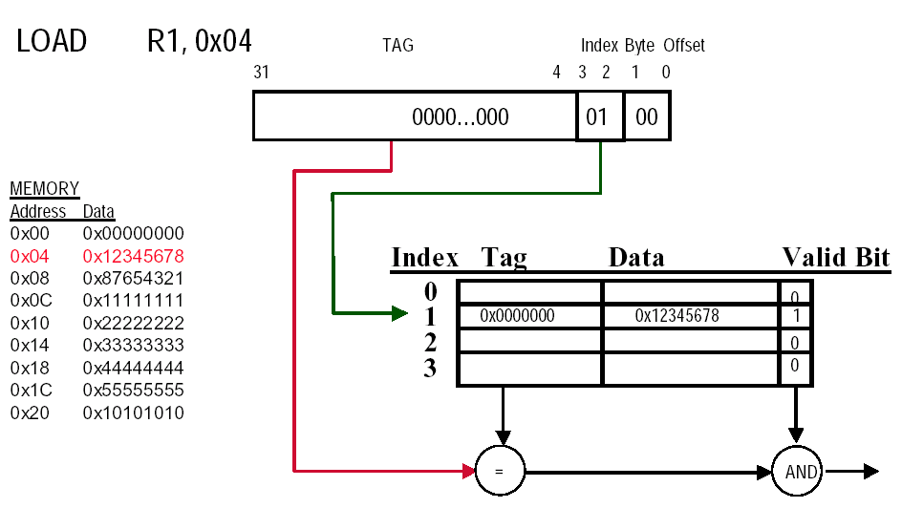
Direct-mapped Cache Example (1-word Blocks)

Slide 22
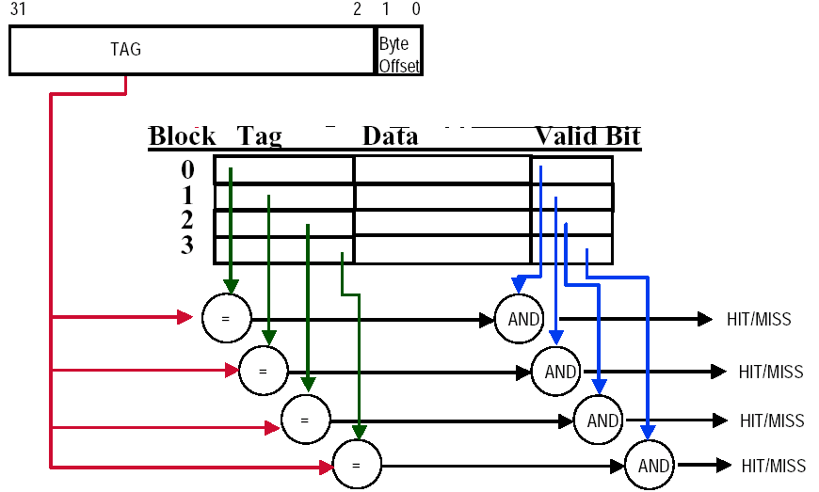
Fully-Associative Cache example (1-word Blocks)
Assume cache has 4 blocks

Slide 23
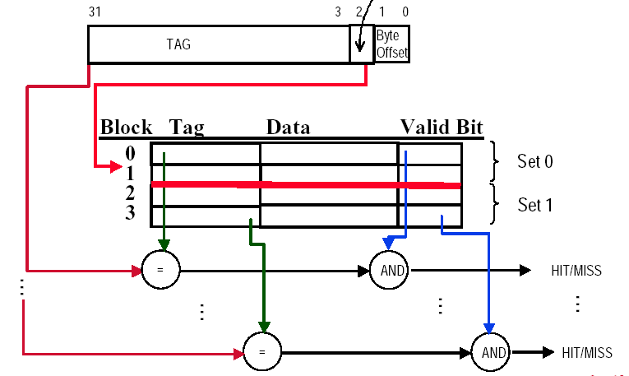
2-Way Set-Associative Cache
Assume cache has 4 blocks and each block is 1 word
2 blocks per set, hence 2 sets per cache
index

Slide 24
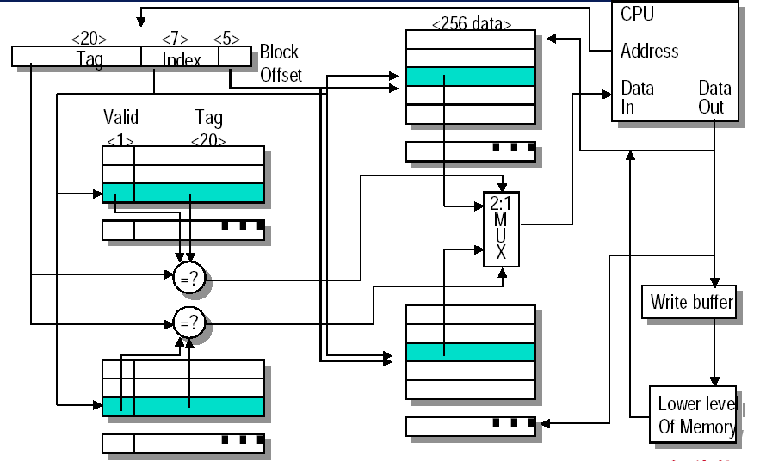
Example: set associate cache
Memory size: 4G, Cache 8K, 2-way set associate

Slide 25
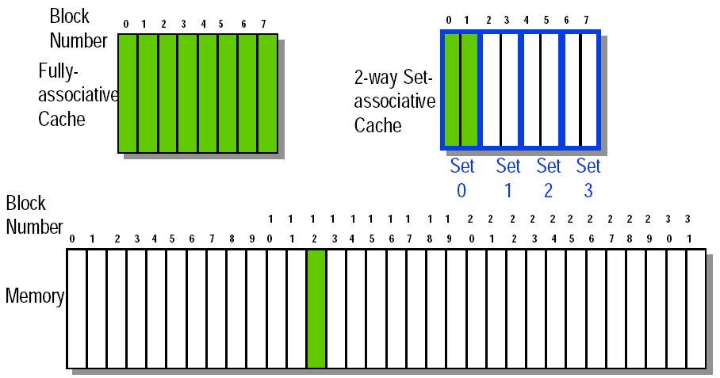
Q3: Block Replacement
In a direct-mapped cache, there is only one block that can be replaced
In set-associative and fully-associative caches, there are N blocks (where N is the degree of associativity

Slide 26
Strategy of block Replacement
Random replacement - randomly pick any block
Easy to implement in hardware, just requires a random number generator
Spreads allocation uniformly across cache
May evict a block that is about to be accessed
Least-recently used (LRU) - pick the block in the set which was least recently accessed
Assumed more recently accessed blocks more likely to be referenced again
This requires extra bits in the cache to keep track of accesses.
First in,first out(FIFO)-Choose a block from the set which was first came into the cache

Slide 27
Implementation of Replacement
Psedo LRU
Example:
V NV
A 1 0
B 0 1
C 0 0
D 0 0
When Miss:
Kick out the Victim,
Make the NextVictim to be Victim,
and select one from the left two blocks to be the NextVictim

Slide 28
Another psedo LRU
3 bit for a set ( 4-way )
One bit for which is the LRU in AB
One bit for which is the LRU in CD
One bit for which is the LRU in AB / CD

Slide 29
Q4: Write Strategy
When data is written into the cache (on a store), is the data also written to main memory?
write-through : The information is written to both the block in the cache and to the block in the slower memory
Cache control bit: only a valid bit
memory (or other processors) always have latest data
Always combined with write buffers so that don’t wait for slow memory
write-back:The information is written only to the block in the cache. The modified cache block is written to main memory only when it is replaced
Cache control bits: both valid and dirty bits
much lower bandwidth, since No writes to slow memory for repeated write accesses

Slide 30
Pros and Cons for write strategy
Write-through adv:
Read misses don't result in writes,
memory hierarchy is consistent and it is simple to implement.
Write back adv:
Writes occur at speed of cache
main memory bandwidth is smaller when multiple writes occur to the same block.

Slide 31
Write stall
Write stall ---When the CPU must wait for writes to complete during write through
Write buffers
A small cache that can hold a few values waiting to go to main memory,to avoid stalling on writes
This buffer helps when writes are clustered.
It does not entirely eliminate stalls since it is possible for the buffer to fill if the burst is larger than the buffer.

Slide 32
Write Through via Buffering
Cache
Processor
DRAM
Write Buffer
Processor writes data into the cache and the write buffer
Memory controller writes contents of the buffer to memory
Increased write frequency can cause saturation of write buffer
If CPU cycle time too fast and/or too many store instr. in a row:
Store buffer will overflow no matter how big you make it
The CPU Cycle Time get closer to DRAM Write Cycle Time
Write buffer saturation can be handled by installing a second level (L2) cache
Cache
L2
Cache
Processor
DRAM
Write Buffer

Slide 33
Write buffers
CPU
in out
Write Buffer
write
buffer
DRAM
(or lower mem)

Slide 34
Write policy when misses
If a miss occurs on a write (the block is not present), there are two options.
Write allocate
The block is loaded into the cache on a miss before anything else occurs.
Write around (no write allocate)
The block is only written to main memory
It is not stored in the cache.
In general, write-back caches use write-allocate , and write-through caches use write-around .

Slide 35
Example
Assume a fully associative wtrie-back cache with many cache entries that starts empty. Below is a sequence of five memory operations(the address is in square brackets):
1 write Mem[100];
2 write Mem[100];
3 Read Mem[200];
4 write Mem[200];
5 write Mem[100];
What are the number of hits and misses when using no-write allocate versus write allocate?
Answer :
for no-write allocate misses: 1,2,3,5
hit : 4
for write allocate misses: 1,3
hit : 2,4,5

Slide 36
Split vs. unified caches
Unified cache
All memory requests go through a single cache.
This requires less hardware, but also has lower hit rate
Split I & D cache
A separate cache is used for instructions and data.
This uses additional hardware, though there are some simplifications (the I cache is read-only).
Proc
Unified
Cache-1
I-Cache-1
Proc
D-Cache-1
Unified
Cache-2
Unified
Cache-2

Slide 37
Split vs. mixed cache
Miss per 1000 instructions for 2-way associate cache.
Average miss rate = Inst% × MRinst. + Data% ×MRdata
Split : remove the misses due to conflicts between inst. blocks and data blocks , but has fixed cache space for both instructions and data.

Slide 38
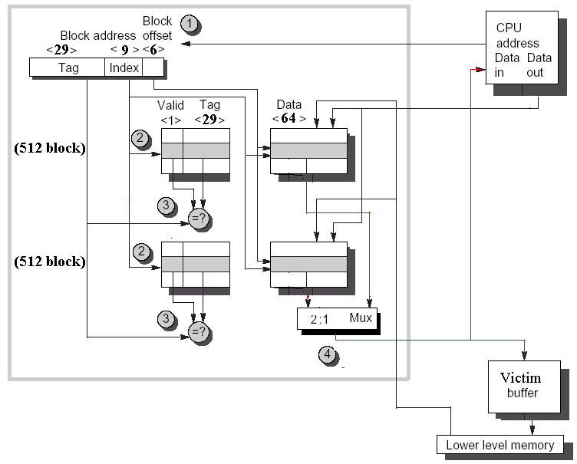
Example:Alpha 21264 data cache

Slide 39
Superviser cache / User cache
Instruction Cache
Supervisor/ User Space Bit
1: Supervisor access only
0: Supervisor / User access

Slide 40
5.3 Cache performance
CPU Execution time=
=(CPU clock cycles + Memory stall cycles)×Clock cycle time
CPI_{Execution} includes ALU and Memory instructions

Slide 41
Average Memory Access Time
Whole accesses time
Average Memory Access Time＝
All memory accesses in program
Accesses time on hitting+ Accesses time on
＝
All memory accesses in program
＝ Hit time + (Miss Rate × Miss Penalty)

Slide 42
Cache performance metrics
Miss rate
Independent of the speed of hardware.
Average memory access time( AMAT)
Better than miss rate , but
Indirect measure of performance
CPUtime

Slide 43
Ex1: Impact on Performance
Suppose a processor executes at
Clock Rate = 200 MHz (5 ns per cycle), Ideal (no misses) CPI = 1.1
50% arith/logic, 30% ld/st, 20% control
Suppose that 10% of memory operations get 50 cycle miss penalty
Suppose that 1% of instructions get same miss penalty
Calculate the AMAT and real CPI.
Answer:CPI = ideal CPI + average stalls per instruction = 1.1(cycles/ins) + [ 0.30 (DataMops/ins) x 0.10 (miss/DataMop) x 50 (cycle/miss)] +
1 (InstMop/ins) x 0.01 (miss/InstMop) x 50 (cycle/miss)] = (1.1 + 1.5 + .5) cycle/ins = 3.1
64% of the time the proc is stalled waiting for memory!
AMAT=(1/1.3)x[1.1+0.01x50]+(0.3/1.3)x[1.1+0.1x50]
=2.54

Slide 44
Ex2: Impact on Performance
Assume : Ideal CPI=1 (no misses)
L/S’s structure . 50% of instructions are data accesses
Miss penalty is 25 clock cycles
Miss rate is 2%
How faster would the computer be if all instructions were cache hits?
Answer: first compute the performance for always hits:
CPU_{time} =(CPU clock cycles+memory stall cycles)×clock cycle
=(IC ×CPI+0) ×Clock cycle
=IC ×1.0 ×clock cycle

Slide 45
Answer for example 2 (cont.)
Now for the computer with the real cache,first compute memory stall cycles:
The total performance is thus:
CPU execution time cache =(IC ×1.0+IC ×0.75) ×Clock cycle
=1.75 ×IC ×Clock cycle
The performance ratio is the inverse of the execution times
CPU execution time _{cache} 1.75 ×IC ×Clock cycle
CPU execution time 1.0 × IC ×clock cycle
The computer with no cache misses is 1.75 time faster.
＝

Slide 46
Ex3: Impact on Performance
Assume : unified caches: 32K unified cache
Split cache: 16K D-cache and 16K I-cache
36% of the instructions are data transfer instructions
A hit takes 1 colck cycle
The miss penalty is 100 clock cycles
A load/store take 1 extra clock cycle on a unified cache
Write-through with a write-buffer
and ignore stalls due to the write buffer
What is the average memory access time in each case?

Slide 47
MissRate for Uni.cache & split cache
Miss per 1000 instructions for 2-way associate cache.

Slide 48
Answer for example 3
Answer : first let’s convert misses per 1000 instructions into miss rate.
Misses
1000 Instructions
/1000
Miss rate=
Memory accesses
Instructions
Since every instruction access has exactly one memory access to fetch the instruction, according as Figure 5.8 the instruction miss rate is
Since 36% of the instructions are data transfers, according as Figure 5.8 the data miss rate is
3.82/1000
Miss rate _{16KB instruction}＝
＝0.0038
1.0
40.9/1000
Miss rate _{16KB data}＝
＝0.1136
0.36

Slide 49
Answer for example 3 (cont.)
Form Figure 5.8 The unified miss rate needs to account for instruction and data accesses:
43.3/1000
Miss rate _{32KB unified}＝
＝0.0318
1.00+0.36
Basing on Figure 2.32 on page 138 there is 74% instruction references in split cache. The average miss rate for the split cache is:
(74%×0.0038)+(26% × 0.1136)=0.0323
Thus ,a 32KB unified cache has a slightly lower effective miss rate than two 16KB caches.

Slide 50
Answer for Example3 (cont.)
The average memory access time can be divided into instruction and data accesses:
Therefore,the time for each organization is
Average memory access time_{split}
=74%×(1+0.0038×100)+ 26%×(1+0.1136×100)
=(74%×1.38)+(26%×12.36)=1.021+3.214=4.25
Average memory access time_{unified}
=74%×(1+0.0318×100)+ 26%×(1+1+0.0318×100)
=(74%×4.18)+(26%×5.18)=3.093+1.347=4.40

Slide 51
Ex4: Impact on Performance
Assume: in-order execution computer, such as the Ultra SPARC Ⅲ.
Miss penalty: 100 clock cycles
Miss rate : 2%
Memory references Per instruction: 1.5
Average cache misses per 1000 instructions: 30
CPI ＝1.0(ignoring memory stalls)
What is the impact on performance when behavior of the cache is included (Calclate the impact using both misses per instruction and miss rate.)?

Slide 52
Answer for example 4
Answer : The performance, including cache misses, is
CPU time _{with cache} ＝
＝IC×(1.0+(30/1000×100)) × Clock cycle time
＝IC × 4.00 × Clock cycle time
Now caculating performance using miss rate:
CPU time _{with cache} ＝
＝IC×(1.0+(1.5×2%×100)) × Clock cycle time
＝IC × 4.00 × Clock cycle time

Slide 53
Answer for example 4 (cont.)
The clock cycles time and instruction count are the same, with or without a cache. Thus, CPU time increases fourfold, with CPI from 1.00 a “perfect cache” to 4.00 with a cache that can miss.
Without any memory hierarchy at all the CPI would increase again to 1.0+100×1.5 or 151—factor of almost 40 time longer than a system with a cache.

Slide 54
Cache misses have a double-barreled impact on a CPU
The lower the CPI_{execution}, the higher the relative impact of a fix number of cache miss clock cycle.
When calculating CPI, the cache miss penalty is measured in CPU clock cycles for a miss. Therefore, even if memory hierarchies for two computers are identical, the CPU with the higher clock rate has a larger number of clock cycles per miss and hence a higher memory portion of CPI.

Slide 55
Ex5: Impact on Performance
Assume: CPI=2 (perfect cache) clock cycle time＝1.0 ns
MPI(memory reference per instruction)＝1.5
Size of both caches is 64K and size of bath block is 64 bytes
One cache is direct mapped and other is two-way set associative. the former has miss rate of 1.4%, the latter has miss rate 1.0%
The selection multiplexor forces CPU clock cycle time to be stretched 1.25 times
Miss penalty is 75ns,and hit time is 1 clock cycle
What is the impact of two diffect cache organizations on performance of CPU (first,calculate the average memory access time and then CPU performance.)?

Slide 56
Answer for example 5
Answer : Average memory access time is
Average memory access time＝Hit time+Miss rate×miss penalty
Thus, the time for each organization is
Average memory access time_{1-way}＝1.0+(0.014×75)＝2.05 ns
Average memory access time_{2-way}＝1.0×1.25 +(0.01 ×75)
＝2.00 ns
The average memory access time is better for the 2-way set-associative cache.

Slide 57
Answer for example 5 (cont.)
CPU performance is
Substituting 75 ns for (miss penalty×Clock cycle time), the performance of each cache organization is
CPU time_{1-way}＝IC×(2×1.0+(1.5 ×0.014 ×75))＝3.58 ×IC
CPU time_{2-way}＝IC×(2×1.0×1.25+(1.5 ×0.010 ×75))＝3.63 ×IC

Slide 58
Answer for example 5 (cont.)
Relative performance is
In contrast to the results of average memory access time, the direct-mapped lesds to slighly better average performance. Since CPU time is our bottom-line evaluation.

Slide 59
Miss penalty and Out-of-order Execution Processors
How do you define “miss penalty”?
Is it the full latency of the miss to memory, or
is it just the “exposed” or nonoverlapped latency when the processor must stall?
To In-order processor, there is out of question, but here is out of the question.
Refine memory stalls to lead to a new definition of miss penalty as nonoverlapped latency :

Slide 60
Two definition
Length of memory latency –What to consider as the start and the end of a memory operation in an out-of-order processor.
Length of latency overlapped—What is the start of overlap with the processor(or equivalently, when do we say a memory operation is stalling the processor)

Slide 61
Ex6: Performance on out-of-order processor
Assume: 30% of the 75 ns (52.5) miss penalty can be overlapped; Another parameters are same with example 5 (above example)
What is the impact of performance for out-of-order (OOO) CPU in direct-mapped cache?
Answer: Average memory access time for the OOO computer is:
Average memory access time_{1-way,OOO}＝1.0*1.25+(0.014×52.5)
＝1.74 ns
The performance of the OOO cache is:
CPU time_{1-way,OOO}＝IC×(2×1.0 *1.25+ (1.5×0.014×52.5))
＝3.10 ×IC
Hence, despite a much slower clock cycle time and the higher miss rate of a direct-mapped cache, the OOO computer can be slightly faster if it can hide 30% of the miss penalty.

Slide 62
Memory Hierarchy Basics
Six basic cache optimizations:
Larger block size
Reduces compulsory misses
Increases capacity and conflict misses, increases miss penalty
Larger total cache capacity to reduce miss rate
Increases hit time, increases power consumption
Higher associativity
Reduces conflict misses
Increases hit time, increases power consumption
Higher number of cache levels
Reduces overall memory access time
Giving priority to read misses over writes
Reduces miss penalty
Avoiding address translation in cache indexing
Reduces hit time

Slide 63
How to Improve Cache Performance?
AMAT = HitTime + MissRate×MissPenalty
Reduce hit time(4)
Small and simple first-level caches, Way prediction
avoiding address translation, Trace cache
Increase bandwidth(3)
Pipelined caches, multibanked caches, non-blocking caches
Reduce miss penalty(5)
multilevel caches, read miss prior to writes,
Critical word first, merging write buffers, and victim caches
Reduce miss rate(4)
larger block size, large cache size, higher associativity
Compiler optimizations
Reduce miss penalty or miss rate via parallelization (1)
Hardware or compiler prefetching

