Slide 1
Computer Architecture
----A Quantitative Approach
College of Computer Science & Technology
Jiang, Xiaohong
2023.fall

Slide 2
Instructor & TA
Instructor： Jiang Xiaohong
Office : Room520, Bld. of CaoGuangBiao,
Mobile(short): 529114
Email: jiangxh@zju.edu.cn
Homepage:
http://mypage.zju.edu.cn/jiangxh
TA：Lan Haoxuan（兰浩轩）
Course Website：
course.zju.edu.cn

Slide 3
Why we learn Computer Architecture?
Hardware Course Series
并行处理
Parallel Processing
高级计算机体系结构
Advanced CA
分布式系统
Distributed System
存储技术基础
Storage Technology Fundations
接口设计
Interface Design
计算机体系结构
Computer Architecture
嵌入式系统
Embedded System
多核程序设计
Multicore Programming
计算机组成
Computer Organization
逻辑与计算机设计基础
Logic and Computer Design Fundamentals
电子线路
Electronic Circuits
模拟线路
Simulation Circuis

Slide 4
Why we learn Computer Architecture?
编译系统
计算机网络
嵌入式系统
操作系统
计算机体系结构
汇编与接口
大学三年级
计算机组成
数据库系统
大学二年级
高级数据结构与算法分析
数字逻辑设计基础
数据结构基础
计算机系统概论
大学一年级
通识课程
C语言程序设计
大学计算机基础

Slide 5
Different from Organization
Part & Whole
Bottom up & Top down
How & Why

Slide 6
Course Objectives
The objective of this course
systemically learn the fundamental concepts and design approaches of computer architecture using quantitative approaches from the view of the whole computer system.
Learn the ideas and approaches to improve the performance of computer system via exploring ILP, DLP, and TLP.
Grasp the hardware design tools and environment, design and implement the hardware with Verilog language in vivado environment on FPGA board.
Notes:
This course is opended for both the sinor undergraduate students and MD graduate students.
The objective of this course is to introduce the fundamental techniques on which high-performance computing is based, and to develop the foundations for analyzing the benefits of design options in computer architecture.

Slide 7
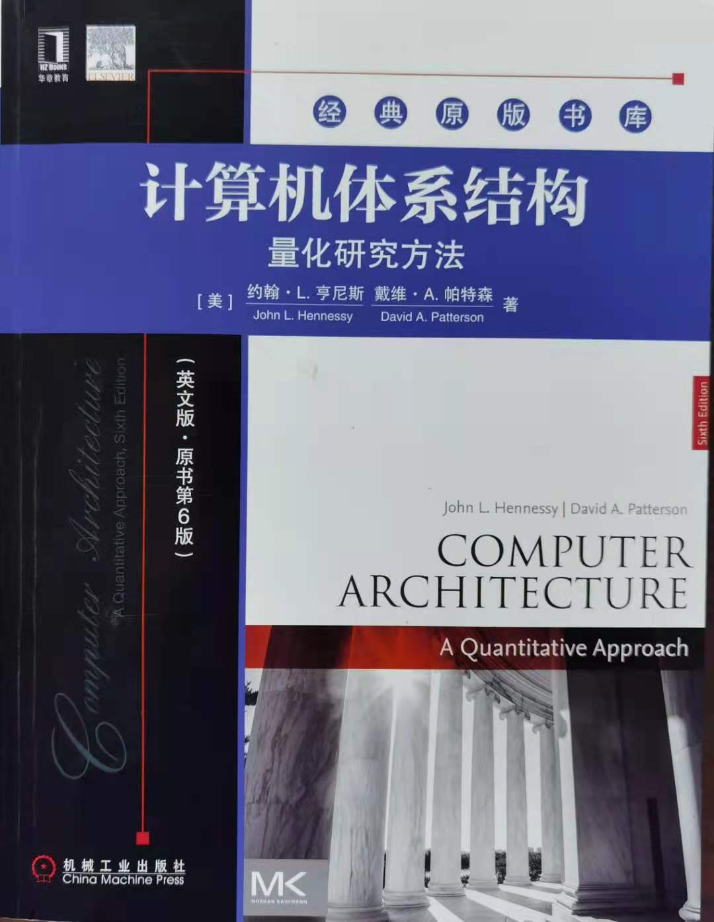
Textbook
David A. Patterson, John L. Hennessy,
《Computer Architecture
– A Quantitative Approach》
6th Edition. July , 2019.
China Machine Press,
ISBN: 978-7-111-63110-1

Slide 8
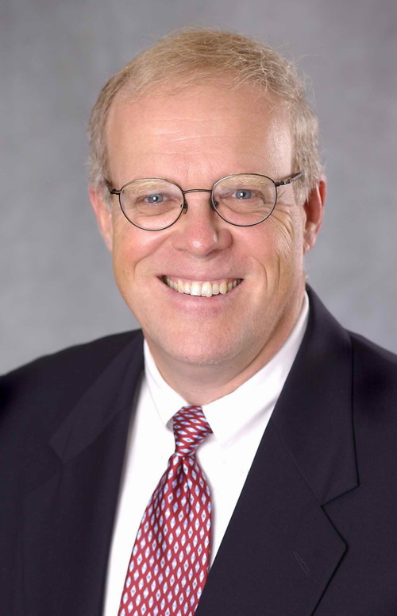
John L. Hennessy （Stanford）
Former President of Stanford University during 2000 – 2016 （17 billion）
Current Alphabet Chairman
"Godfather of Silicon Valley,“
In 1981, Hennessy initiated a project at Stanford that focused on a simpler computer architecture known as RISC. During a sabbatical leave in 1984-85 he cofounded MIPS Computer Systems, now known as MIPS Technologies, which specializes in the production of microprocessors SPARC.
Received Eckert-Mauchly Award in 2001
Received Turing Award in 2017
https://engineering.stanford.edu/people/john-hennessy
Notes:
MIPS (originally an acronym for Microprocessor without Interlocked Pipeline Stages) is a RISC microprocessor architecture developed by MIPS Technologies.
In 1990’s it’s estimated that one of the three RISC chip were based on MIPS.
MIPS CPU architecture greatly influenced later RISC architectures. DEC alpha is one instrance.

Slide 9
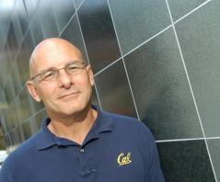
David A. Patterson （ UC Berkeley）
UC Berkeley （ 1976 – 2016 ）
Currently Google TPU
He led the design and implementation of RISC I (the foundation of the SPARC architecture )
Inventor of RAID
involved in the Network of Workstations (NOW) project
Research Accelerator for Multiple Processors (RAMP)
Received ACM Eckert-Mauchly Award in ISCA 2008
Received Turing Award in 2017
https://people.eecs.berkeley.edu/~pattrsn/
Notes:
RISC: Reduced Instruction Set Computer
emphasizing the insight that simplified instructions which "do less" may still provide for higher performance if this simplicity can be utilized to make instructions execute very quickly.
RISC families include DEC Alpha, ARM, MIPS, PA-RISC, Power Architecture (including PowerPC), SuperH, and SPARC.
SPARC: Scalable Processor Architecture, RISC microa-rchitecture Instruction Set Arcthitecture designed by SUN microsystem in 1985.
RAID: Redundant Array of Independent Disks. Inexpensive.
A Case for Redundant Arrays of Inexpensive Disks, 1988, two key design goals: increased data reliability and increased input/output performance.
NOW: Network of Workstation.
The RAMP Gold project is a new effort to produce fully parameterized manycore emulations using FPGAs to help accelerate hardware and software research
ISCA: International Symposium on Computer Architecture.

Slide 10
Text book evolution
1-3 edition
4-5th edtion
6th edtion
MIPS
ILP （Instruction Level Parallelism）
Cost / Performance
PC
MIPS / ARM
ILP （Instruction Level Parallelism）
DLP (Data Level Parallelism）
TLP（Thread Level Parallelism）
• Cost / Performance
dependability / power
• PC
embedded system
Server
• RISC V
• ILP （Instruction Level Parallelism）
DLP (Data Level Parallelism）
TLP（Thread Level Parallelism）
RLP（Request Level Parallelism）
• dependability
Cost / Performance/power
• PC
Personal mobile device
warehouse-scale computers
domain-specific architecture
Notes:
Most significant change is
Due to computer technology evolvement, the first three editions focused primarily on Instruction level Parallelism, But the 4th edition have a equal focus on Thread level parallelism. And Data-level parallelim.
Put more emphasis on Dependability and topics of power, because power becomes the dominant factor in determine how much circus can be placed on a chip.
Because the book size of 3rd edition is already large enough. The 4th edition would become unacceptable if the book size are too large. Some contents and materials are moved to companion CD.

Slide 11
Updated Course Contents
教材： 6th Edition
教材： 5th Edition
Contents in 2021 | 备注
Ch1 Fundamentals of computer design | 1.1 ~ 1.13
Ch2 Memory Hierarchy Design | 2.1 ~ 2.9, app B3
Ch3 ILP and its expoloitation | App C2-C6 , 3.1 ~ 3.14 Branch prediction Dynamic scheduling Speculation
Ch4 DLP in Vector, SIMD, GPU | 4.1~ 4.9 Vector. SIMD. GPU
Ch5 Thread Level Parallelism | 5.1~ 5.11 Multiprocessor Cache coherence Synchronization
Ch6 Warehouse-scale computer to explore RLP & DLP | 选讲
Ch7 Domain-specific Architecture | 选讲
Contents in 2020 | 备注
Ch1 Fundamentals of computer design
AppA Instruction Set Principles | MIPS
AppC Pipelining: Basic and Intermediate Concepts | Pipeline CPU
AppB Review of Memory Hierarchy
Ch2 Memory Hierarchy Design | Improve cache perf.
AppD Storage Systems
AppI Basic concepts of Multiprocessor

Slide 12
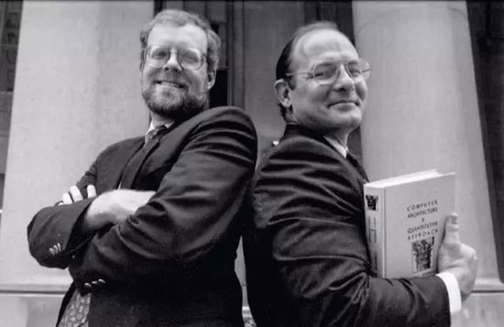

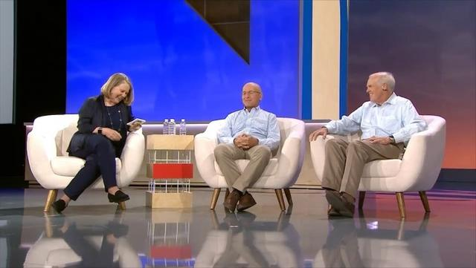
2018 interview
For pioneering a systematic, quantitative approach to the design and evaluation of computer architecture with enduring impact on the microprocessor industry.
This book is essential reading for those tasked with leading any complex enterprise in the academic, not-for-profit, or for-profit sector.
https://baijiahao.baidu.com/s?id=1607140815624945357&wfr=spider&for=pc
Notes:
This is the picture taken when he received the Eckert-Mauchly Award on ISCA’2008.

Slide 13
How ?
Concepts, Ideas and Principles
Quantitative approaches
Hit the problem and right way to solve problem
As a man sows, so he shall reap.
一分耕耘一分收获

Slide 14
Grading Policy:
16-20%: written homework
8-12%: pop quiz 2-3 times
32%: Lab assignments
5-10%: Bonus
lab grade = report (50%) + check(50%)
40%: Final exam
(close-book test with one A4 memo)
Final grade = 40%(Final exam）+ 60% (other <=100)
28%
60% ( <=60 )

Slide 15
Lectures vs. Labs
Week | Theory(lectures) | Labs | %
1 | Ch0: Course Introduction. | Lab1: Enhance CPU with forwarding and predict-NT | 6
2 | Ch1-1: CA design Lifecycle
3 | Ch1-2: trends of CA engineering
4 | Ch2-1: cache optimization | Lab2: Adding exception to CPU in Lab1 | 4
5 | Ch2-2: VM and VA
6 | Ch3-0: ILP--supporting multicycle OP | Lab3: implement a 2-way set associative cache | 3
7 | Ch3-1: scoreboard
8 | Ch3-2: Tomasulo | Lab4: adding cache to CPU of Lab2 | 4
9 | Ch3-3: hardware-based speculation
10 | Ch3-4: multiple issue processor | Lab5：expending CPU to support multicycle OP | 7
11 | Ch4-1: DLP—vector processor
12 | Ch4-2: SIMP，GPU
13 | Ch5-1: TLP-multiprocessor | Lab6：implement dynamic scheduling: scoreboard/Tomasulo | 8
14 | Ch5-2: cache coherence
15 | Ch5-3: synchronization
16 | Review

Slide 16
Homeworks (16-20%)
Total 4-5 times, once per chapter
Submission deadline will be normally one week after assigned, and will be announced on course website.
For doing homework, discussion is greatly encouraged, but every student is required to Do and Submit the homework individually on time.
Submission Naming rule
StID_name_hw1.doc

Slide 17
Lab assignments
Lab1----Implement pipelined CPU with forwarding paths and prediction-not-taken supporting RISC V 32i instructions.
Lab2----Implement Interruption and Exception on CPU of Lab 1).
Lab3----Implement a 2-way associative cache
Lab4----Adding the cache into the pipelined CPU in Lab 2).
Lab5----Expend the pipelined CPU to support multi-cycle operations: integer multiplier, integer divider / remainder operation, issue in order and complete out of order, detecting pipeline hazards ( WAW, RAW)
Lab6----Implement the Dynamic Scheduling (Scoreboard or Tomasulo), implement a dynamic scheduling pipelined CPU.

Slide 18
Labs ( 32%)
Grading (report 50% + check 50%)/per lab
Lab1 3 weeks, 6% personally
Lab2 2 weeks, 4% personally
Lab3 1 weeks, 3% personally
Lab4 2 weeks, 4% personally
Lab5 3 weeks, 7% in group of 2 members
Lab6 4 weeks, 8% in group of 2 members
Top 2 labs of best performance(fastest, lower cost) will get 5% bonus
Each lab have up to 2 times to be checked. The 2nd check will have score <= 90.

Slide 19
Submission Policy:
All the homeworks (individually) and lab reports (in group) are required to be submitted to the course website on time.
Lab report and lab code are required to submit separately using different links under different deadline.
Submission deadline will be announced on course website.
All assignments in this course should be turned in by the specified due date. Late assignment is NOT accepted.

Slide 20
Honest Policy
Be HONEST in your work!
Found copy & be copied in the homework or lab report ，you get ZERO for one submission and also get 10% off in the final grade !

Slide 21
Q&A
??

