Slide 1
Randomized Algorithms

Slide 2

Randomized Algorithms
What to Randomize?
The world behaves randomly – randomly generated input solved by traditional algorithm
Average-case Analysis
The algorithm behaves randomly – make random decisions as the algorithm processes the worst-case input
Randomized Algorithms

Slide 3
Randomized Algorithms
Why Randomize?
Efficient deterministic algorithms that always yield the correct answer are a special case of –
efficient randomized algorithms that only need to yield the correct answer with high probability
randomized algorithms that are always correct, and run efficiently in expectation
Symmetry-breaking among processes in a distributed system
Simpler

Slide 4

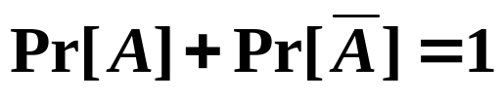
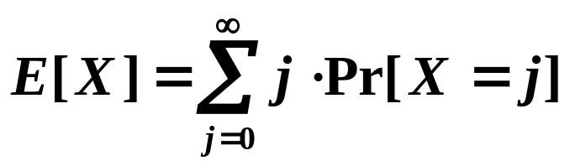
Randomized Algorithms
▪ A Quick Review
Pr[ A ] := the probability of the event A
:= the complementary of the event A (A did not occur )
E[ X ] := the expectation (the “average value”) of the
random variable X

Slide 5

Randomized Algorithms
〖Example〗 The Hiring Problem
Hire an office assistant from headhunter
Interview a different applicant per day for N days
Interviewing Cost = C_{i} << Hiring Cost = C_{h}
Analyze interview & hiring cost instead of running time
Assume M people are hired.
Total Cost:

Slide 6

Randomized Algorithms
Naïve Solution
int Hiring ( EventType C[ ], int N )
{ /* candidate 0 is a least-qualified dummy candidate */
int Best = 0;
int BestQ = the quality of candidate 0;
for ( i=1; i<=N; i++ ) {
Qi = interview( i ); /* C_{i} */
if ( Qi > BestQ ) {
BestQ = Qi;
Best = i;
hire( i ); /* C_{h} */
}
}
return Best;
}
Worst case:
The candidates come in increasing quality order

Slide 7

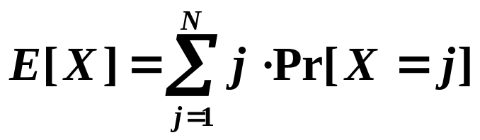
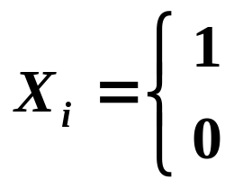
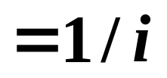
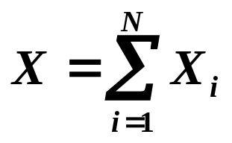
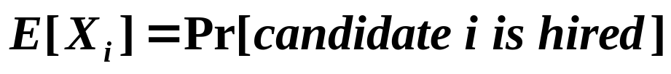
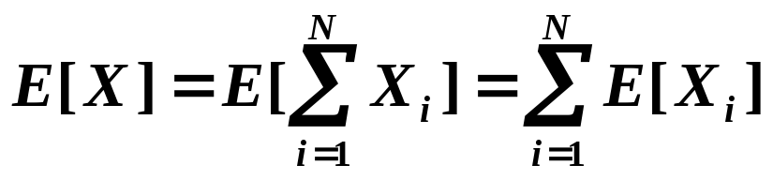
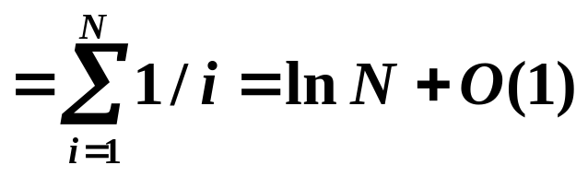
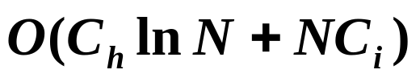
Randomized Algorithms
☞ Assume candidates arrive in random order
X = number of hires
Randomness assumption: any of first i candidates is equally likely to be best-qualified so far
?
if candidate i is hired
if candidate i is NOT hired
?

Slide 8
Randomized Algorithms
Radomized Algorithm
int RandomizedHiring ( EventType C[ ], int N )
{ /* candidate 0 is a least-qualified dummy candidate */
int Best = 0;
int BestQ = the quality of candidate 0;
randomly permute the list of candidates;
for ( i=1; i<=N; i++ ) {
Qi = interview( i ); /* C_{i} */
if ( Qi > BestQ ) {
BestQ = Qi;
Best = i;
hire( i ); /* C_{h} */
}
}
 takes time
 no longer need to assume that candidates are presented in random order

Slide 9

Randomized Algorithms
Radomized Permutation Algorithm
Target : Permute array A[ ]
 Assign each element A[ i ] a random priority P[ i ],
and sort
void PermuteBySorting ( ElemType A[ ], int N )
{
for ( i=1; i<=N; i++ )
A[i].P = 1 + rand()%(N³);
/* makes it more likely that all priorities are unique */
Sort A, using P as the sort keys;
}
Claim: PermuteBySorting produces a uniform random permutation of the input, assuming all priorities are distinct.

Slide 10
Randomized Algorithms
Online Hiring Algorithm – hire only once
int OnlineHiring ( EventType C[ ], int N, int k )
{
int Best = N;
int BestQ = - ∞ ;
for ( i=1; i<=k; i++ ) {
Qi = interview( i );
if ( Qi > BestQ ) BestQ = Qi;
}
for ( i=k+1; i<=N; i++ ) {
Qi = interview( i );
if ( Qi > BestQ ) {
Best = i;
break;
}
}
return Best;
}
☞ What is the probability
we hire the best qualified
candidate for a given k?
☞ What is the best value of
k to maximize above
probability?

Slide 11
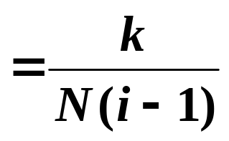
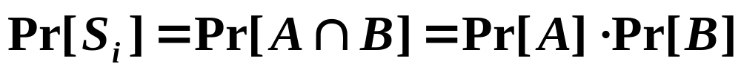


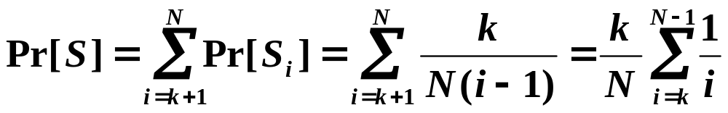
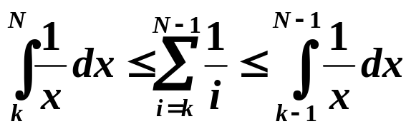
Randomized Algorithms
Online Hiring Algorithm
S_{i} := the ith applicant is the best
What needs to happen for S_{i} to be TRUE?
independent
{ A:= the best one is at position i }
∩ { B:= no one at positions k+1 ~ i–1 are hired }
Discussion 18: Prove

Slide 12

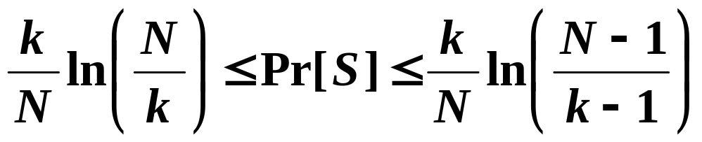
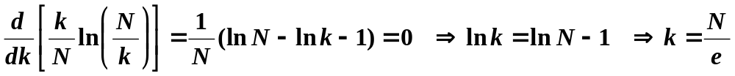
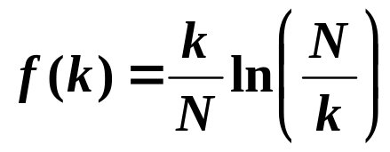

Randomized Algorithms
☞ What is the probability we hire the best qualified
candidate for a given k?
☞ What is the best value of k to maximize the above
probability?
Discussion 19: What is the maximum value
of ? And what is the best k?
☞ Succeed in hiring the best-qualified applicant with
probability at least

Slide 13
Randomized Algorithms
〖Example〗 Quicksort
▪ Deterministic Quicksort
☞ Θ(N²) worst-case running time
☞ Θ(N log N) average case running time, assuming
every input permutation is equally likely
 How about choosing the pivot uniformly at random?
Central splitter := the pivot that divides the set so that each side contains at least n/4
Modified Quicksort := always select a central splitter before recursions

Slide 14
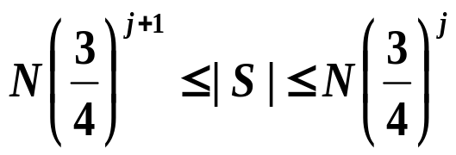
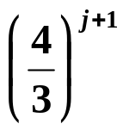
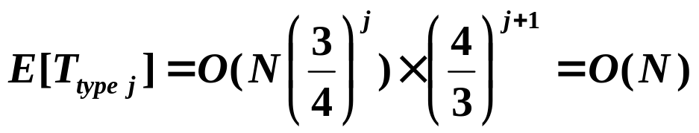


Randomized Algorithms
Claim: The expected number of iterations needed until we find a central splitter is at most 2.
N/4
N/4
N/2 central splitters
Pr[ find a central splitter ] = 1/2
✓
Type j : the subproblem S is of type j if
Claim: There are at most subproblems of type j.
Number of different types =

Slide 15

Research Project 6
Skip Lists (26)
Skip list is a data structure that supports both searching and insertion in O(logN) expected time.
This project requires you to introduce the skip lists, and to implement insertion, deletion, and searching in skip lists.
Detailed requirements can be downloaded from
https://pintia.cn/

Slide 16
Reference:
Introduction to Algorithms, 3rd Edition: Ch.5, p.114 -145； Thomas H. Cormen, Charles E. Leiserson, Ronald L. Rivest and Clifford Stein. The MIT Press. 2009
Data Structure and Algorithm Analysis in C (2nd Edition)：Ch.10，p.399-401；M.A.Weiss著、陈越改编，人民邮件出版社，2005

