Slide 1
Computer Organization & Design —The Hardware/Software Interface
Chapt3_2
Arithmetic for Computer

Slide 2
3.5 Division
Dividend = quotient * divisor + remainder
Remainder < divisor
Iterative subtraction
Result:
Greater than 0: then we get a 1
Smaller than 0: then we get a 0

Slide 3
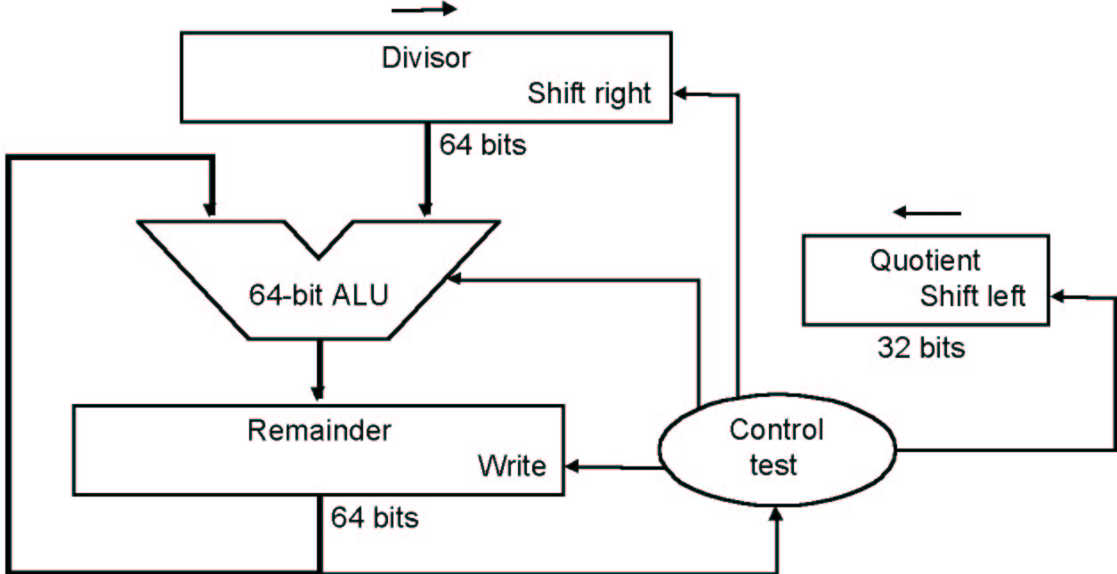
Division V1
At first the divisor is in the left half of the divisor register, the dividend is in the right half of the remainder register.
Shift right the divisor register each step
quotient
divisor
dividend
- divisor
remainder
- divisor
remainder
…………

Slide 4
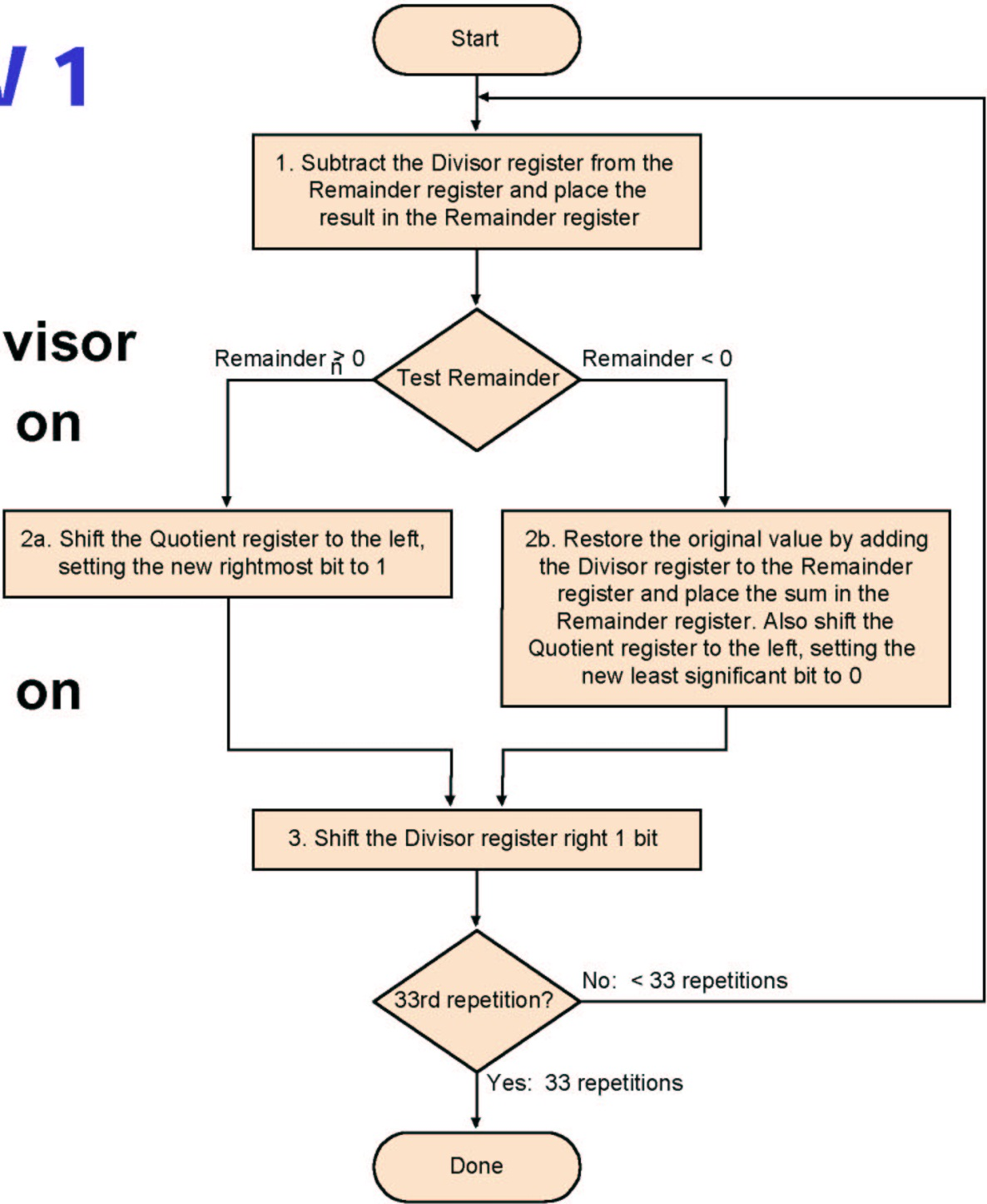
Algorithm V 1
Each step:
Subtract divisor
Depending on Result
Leave or
Restore
Depending on Result
Write '1' or
Write '0'

Slide 5
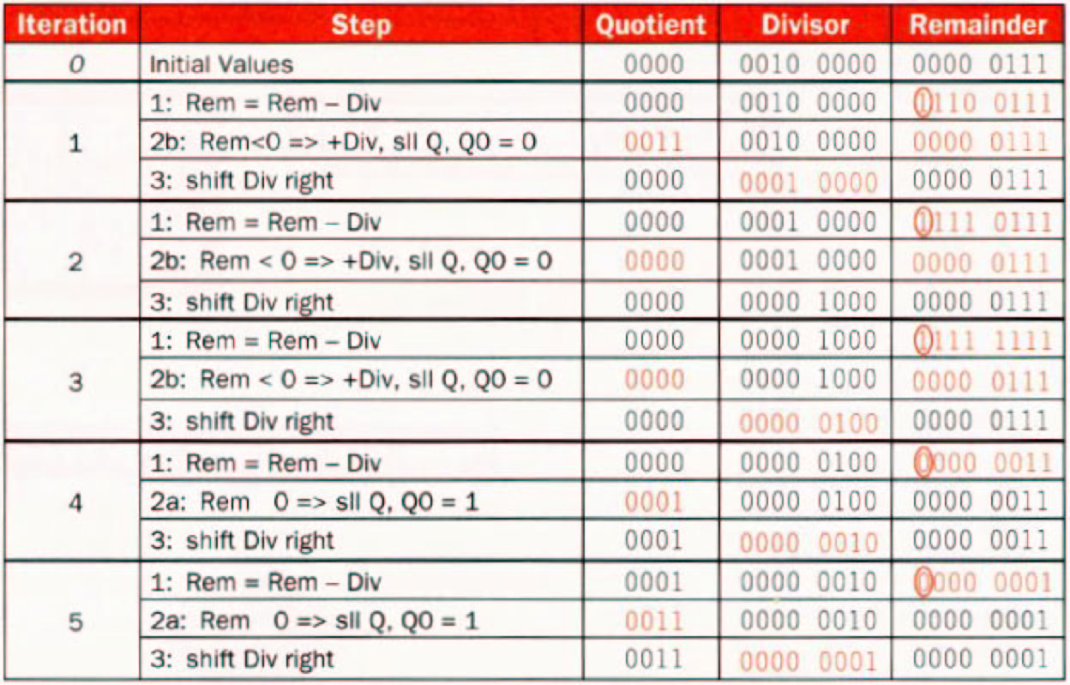
Example (7÷ 2) 00000111 ÷0010
0000

Slide 6
Two questions
1.Why should the divisor be shifted right one bit each time?
2.Why should the divisor be placed in the left half of the divisor register, and the dividend be placed in the right half of the remainder register at first ?
quotient
divisor
dividend
- divisor
remainder
- divisor
remainder
…………

Slide 7
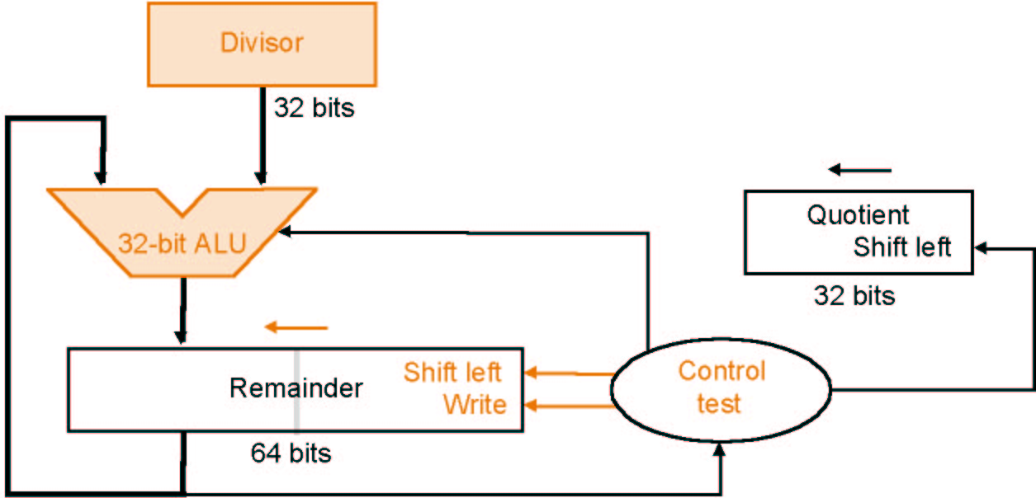
Division V2
Reduction of Divisor and ALU width by half
Shifting of the remainder
Saving 1 iteration

Slide 8
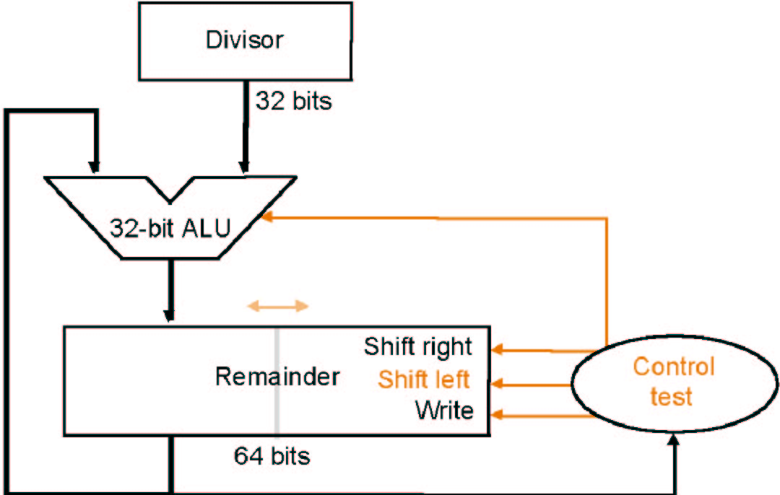
Division V3
Remainder register keeps quotient No quotient register required

Slide 9
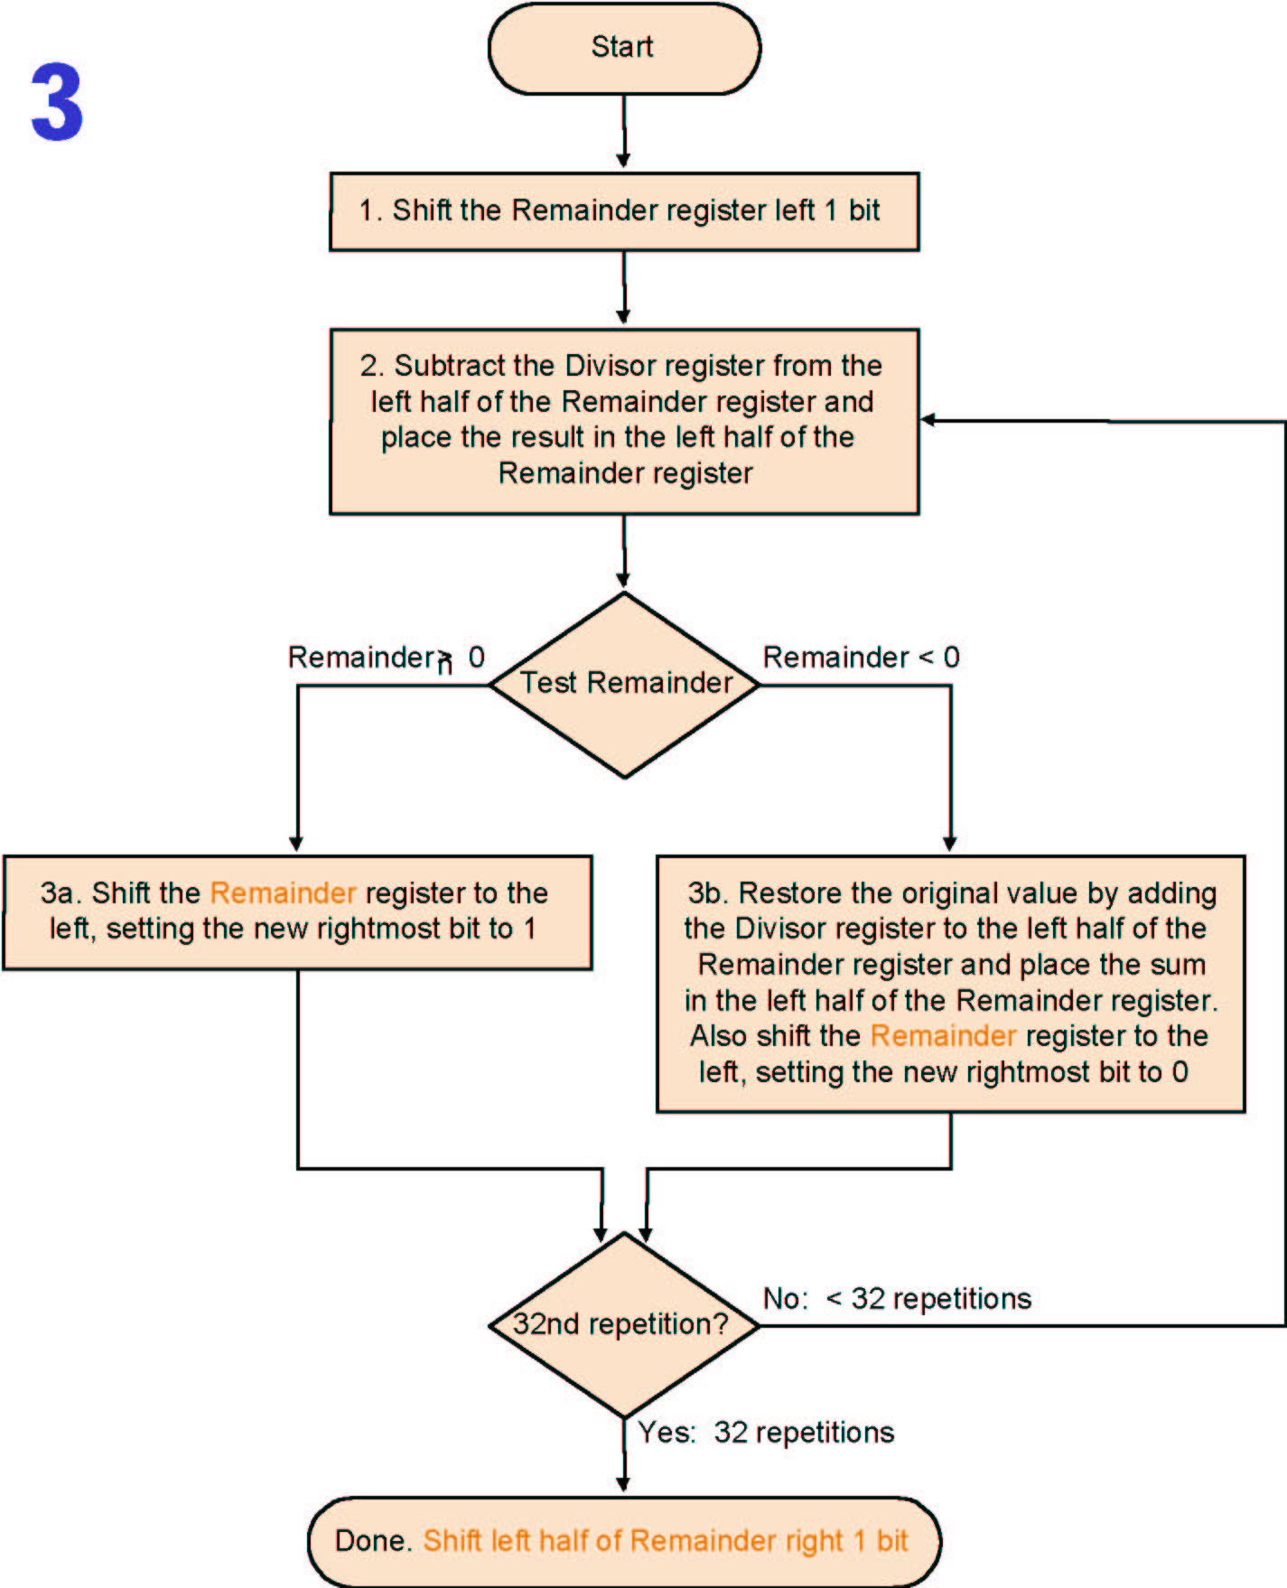
Algorithm V3 3
Much the
same than
the last one
Except
change of
register
usage
What does it mean if remainder > 0 with the first subtract without shift left 1 bit ?

Slide 10
Example 7/2 for Division V3
iteration | step | Divisor | Remainder
0 | Initial Values | 0010 | 0000 0111
 | Shift Rem left 1 | 0010 | 0000 1110
1 | 1.Rem=Rem-Div | 0010 | 1110 1110
 | 2b: Rem<0 →+Div,sll R,R₀=0 | 0010 | 0001 1100
2 | 1.Rem=Rem-Div | 0010 | 1111 1100
 | 2b: Rem<0 →+Div,sll R,R₀=0 | 0010 | 0011 1000
3 | 1.Rem=Rem-Div | 0010 | 0001 1000
 | 2a: Rem>0 →sll R,R₀=1 | 0010 | 0011 0001
4 | 1.Rem=Rem-Div | 0010 | 0001 0001
 | 2a: Rem>0 →sll R,R₀=1 | 0010 | 0010 0011
 | Shift left half of Rem right 1

Slide 11
Signed division
Keep the signs in mind for Dividend and Remainder
(+ 7) ÷( + 2) = + 3 Remainder = +1
7 = 3 × 2 + (+1) = 6 + 1
(- 7 ) ÷(+ 2) = - 3 Remainder = -1
-7 = -3 × 2 + (-1) = - 6 - 1
(+ 7 ) ÷( - 2) = - 3 Remainder = +1
(- 7 ) ÷( - 2) = + 3 Remainder = -1
One 64 bit register : Hi & Lo
Hi: Remainder, Lo: Quotient
Instructions: div, divu
Divide by 0 / overflow : Check by software
7 / 2 | 3 | 1
-7 / 2 | -3 | -1
7 / -2 | -3 | 1
-7 / -2 | 3 | -1
sign of Quotient = x sign⊕ y sign
sign of remainder = x sign

Slide 12
3.6 Floating point numbers
Reasoning
Larger number range than integer rage
Fractions
Numbers like e (2.71828) and π(3.14159265....)
Representation
Sign
Significand
Exponent
More bits for significant: more accuracy
More bits for exponent: increases the range

Slide 13
Floating point numbers
Form
Arbitrary 363.4 • 10³⁴ Normalised 3.634 • 10³⁶
Binary notation
Normalized 1.xxxxxx • 2^{yyyyy}
Standardized format IEEE 754
Single precision 8 bit exp, 23 bit significant
Double precision 11 bit exp, 52 bit significant
Both formats are supported by MIPS
31 | 30 …… 23 | 22 …… 0
S | exponent | fraction
1 bit | 8 bits | 23 bits
Single precision
31 | 30 …… 20 | 19 …… 0
S | exponent | fraction
1bit | 11 bits | 20 bits
31 fraction (continued) 0
Double precision
32 bits

Slide 14
IEEE 754 standard
Leading '1' bit of significand is implicit
->saves one bit
Exponent is biased(移码）:
00...000 smallest exponent
11...111 biggest exponent
Bias 127 for single precision
Bias 1023 for double precision
Summary:
(-1)^{sign} • (1 + significand) • 2^{exponent - bias}

Slide 15
Limitations
Overflow:
The number is too big to be represented
|+ exponent | is too larger
Underflow:
The number is too small to be represented
|- exponent | is too larger

Slide 16
IEEE 754 standard
00... 00_{two} represents 0;
instead of interrupting on a divide by 0, software can set the result to a bit pattern representing +∞ or -∞;
NaN: Not a Number.
±∞ - represented by f=0, E=255, S=0,1 - must obey all mathematical conventions: F+∞=∞, F/∞=0
Unnormalized numbers - represented by E=0 -values smaller than smallest normalized number - lowering probability of exponent underflow
Single precision |  | Double precision |  | Object represented
Exponent | Fraction | Exponent | Fraction
0 | 0 | 0 | 0 | 0
0 | Nonzero | 0 | Nonzero | Unnormalized number
1-254 | Anything | 1-2046 | Anything | Floating-point number
255 | 0 | 2047 | 0 | infinity
255 | Nonzero | 2047 | Nonzero | NaN (Not a Number)

Slide 17
NaN (E=255)
f≠0 - large number of values
Two kinds - signaling (or trapping), and quiet (nontrapping) - differentiated by most significant bits of fraction - remaining bits contain system-dependent information
Example of a signaling NaN - uninitialized variable
It sets Invalid operation exception flag when arithmetic operation on this NaN is attempted ; Quiet NaN - does not
Turns into quiet NaN when used as operand if Invalid operation trap is disabled (avoid setting Invalid Op flag later)
Quiet NaN produced when invalid operation (0 ⋅ ∞) attempted - this operation had already set the Invalid Op flag once. Fraction field may contain a pointer to offending code line
Quiet NaN as operand will produce quiet NaN result and not set exception. For example, NaN+5=NaN. If both operands are quiet NaNs, the result is the NaN with smallest significand.

Slide 18
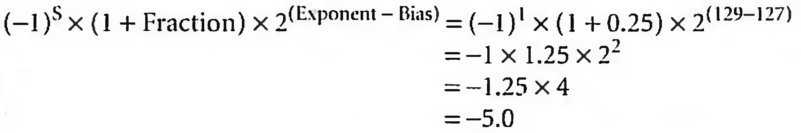
Converting Binary to Decimal Floating Point
31 | 30 …… 23 | 22 …… 0
1 | 1000 0001 | 010 0000 0000 0000 0000 0000
1 bit | 8 bits | 23 bits

Slide 19
Floating point addition
Alignment
The proper digits have to be added
Addition of significant
Normalization of the result
Rounding
Example in decimal
system precision 4 digits
What is 9.999 • 10¹ + 1.610 • 10⁻¹ ?

Slide 20
Example for Decimal
Aligning the two numbers
9.999 •10¹
0.01610 •10¹ → 0.016 •10¹ Truncation
Addition
9.999 • 10¹
+ 0.016 • 10¹
10.015 • 10¹
Normalization
1.0015 • 10²
Rounding
1.002 • 10²

Slide 21
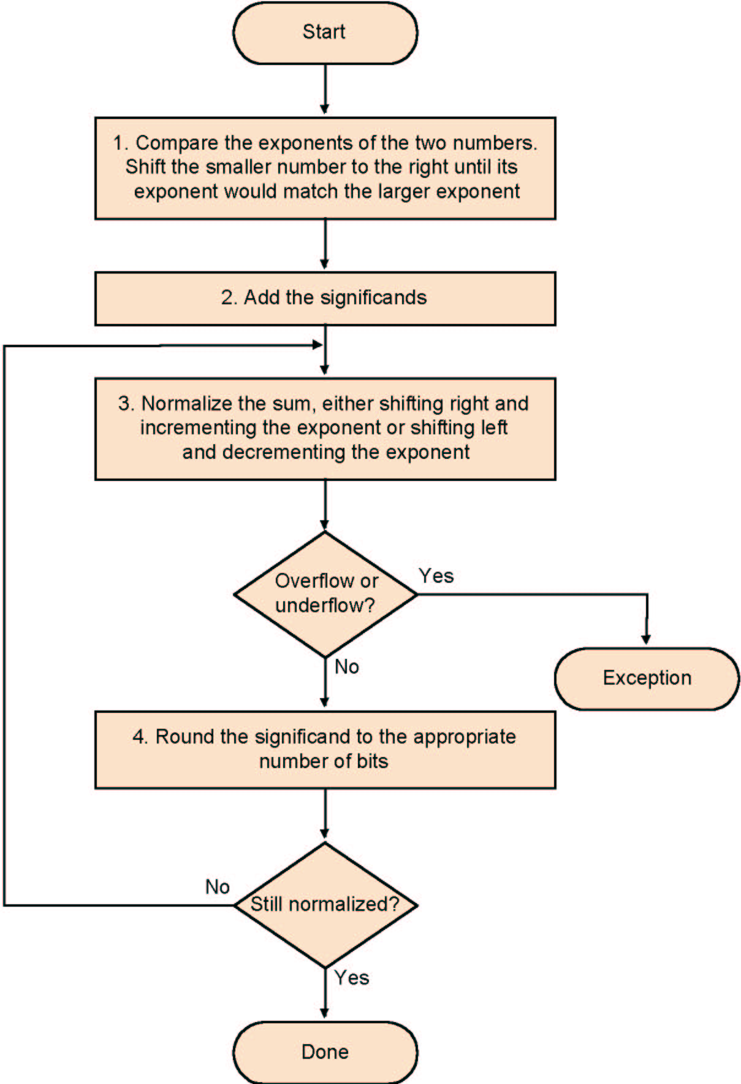
FP addition
Normalize significant
Add the significand
Normalize the sum
Over/underflow
Rounding
Normalization

Slide 22
Example: y=0.5+(-0.4375) in binary
0.5₁₀ = 1.000₂×2⁻¹
-0.4375₂=-1.110₂×2⁻²
Step1:The fraction with lesser exponent is shifted right until matches
-1.110₂×2⁻² → -0.111₂×2⁻¹
Step2: Add the significands
1.000₂×2⁻¹
+) - 0.111₂×2⁻¹
0.001₂×2⁻¹
Step3: Normalize the sum and checking for overflow or underflow
0.001₂×2⁻¹ → 0.010₂×2⁻² → 0.100₂×2⁻³ → 1.000₂×2⁻⁴
Step4: Round the sum
1.000₂×2⁻⁴ = 0.0625₁₀

Slide 23
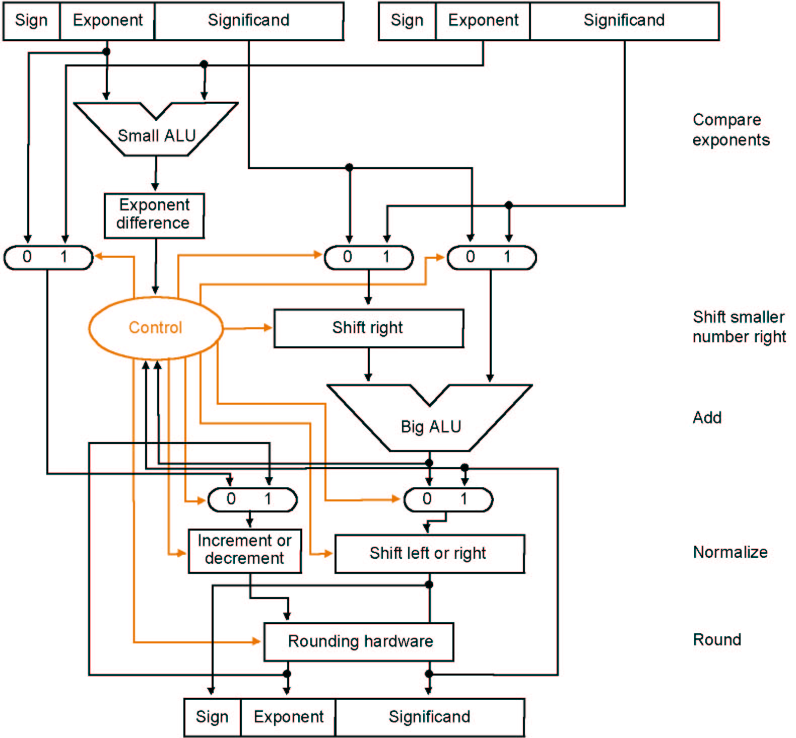
Algorithm

Slide 24
Multiplication
Composition of number from different parts → separate handling
(s1 • 2^{e1}) • (s2 • 2^{e2}) = (s1 • s2) • 2^{e1+ e2}
Example
1 10000010 000 0000 0000 0000 0000 0000 = -1 × 2³
0 10000011 000 0000 0000 0000 0000 0000 = 1 × 2⁴
Both significands are 1 → product = 1 →Sign=1
Add the exponents, bias = 127
10000010
+10000011
110000101
Correction: 110000101-01111111=10000110=134=127+3+4
The result: 1 10000110 000 0000 0000 0000 0000 0000 = -1 × 2⁷

Slide 25
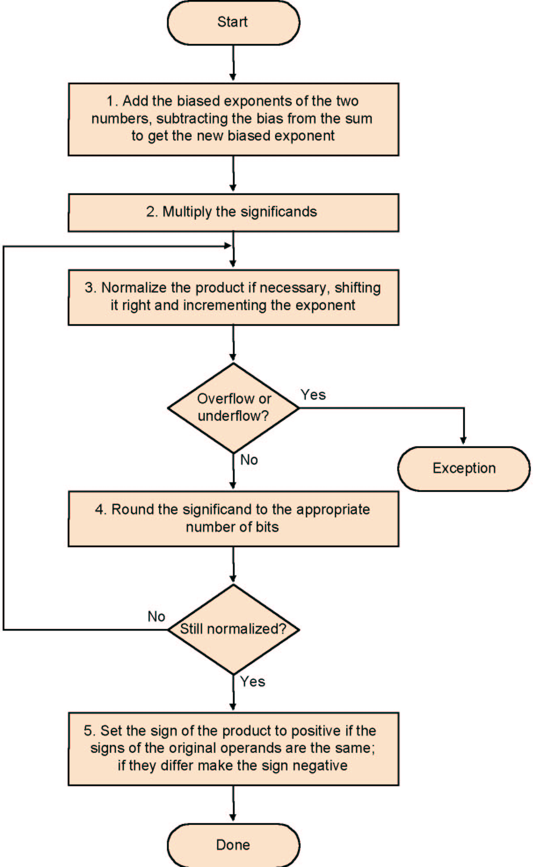
FP Multiplication
Add exponents
Multiply the significands
Normalize
Over- underflow
Rounding
Sign

Slide 26
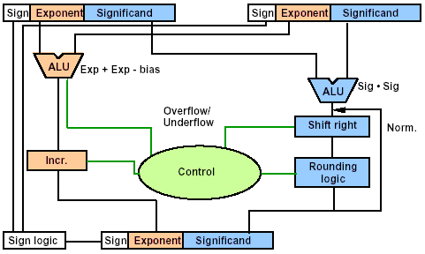
Data Flow

Slide 27
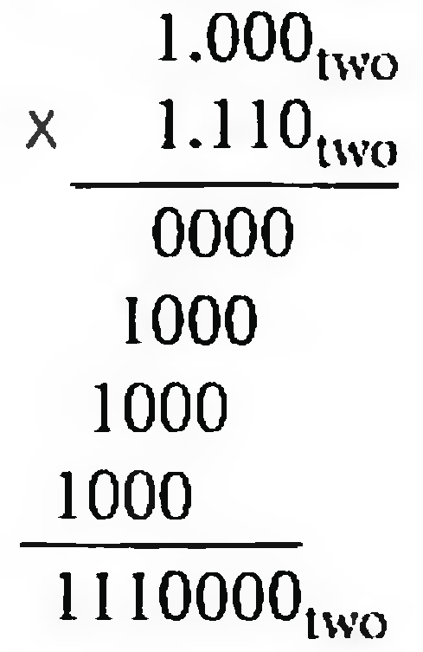
multiplying the numbers 0.5_{ten} and -0.4375_{ten} →1.000_{two}x 2⁻¹ by -1.110_{two}x 2⁻²
Step1:Adding the exponents without bias or using the biased
-1 + (-2)=-3
(-1 + 127) + (-2 + 127) - 127 = (-1 - 2) + (127 + 127-127) =-3+127 = 124
Step 2. Multiplying the significands
1.110000_{two}x2⁻³
Step 3. normalize
127 ≥ -3 ≥ -126, no overflow or underflow.
Step 4. Rounding
1.110_{two}x2⁻³
Step 5. sign
-1.110_{two}x2⁻³ =-0.21875_{ten}

Slide 28
Division-- Brief
Subtraction of exponents
Division of the significants
Normalisation
Runding
Sign

Slide 29
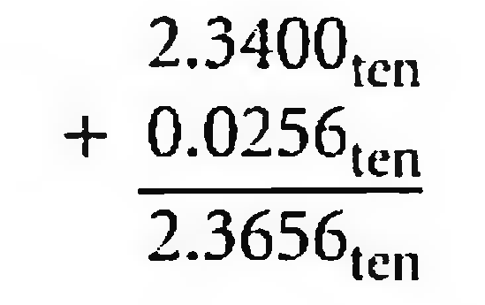
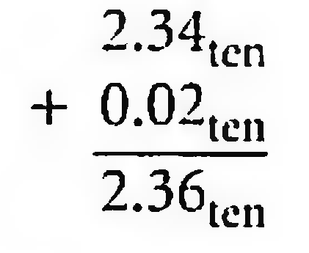
Accurate Arithmetic
IEEE 754 always keeps two extra bits on the right during intermediate additions, called guard and round
Rounding with Guard Digits
Add 2.56_{ten} x 10⁰ to 2.34_{ten} x 10²
The guard digit holds 5 and the round digit holds 6.
Sum=2.37_{ten} x 10².
Rounding without Guard Digits
Sum=2.36_{ten} x 10²

Slide 30
IEEE 754 round modes
Rounding: four rounding modes
Round to 0
Round to +∞
Round to -∞
Round to next even number (default)

Slide 31
Round modes
y | round down (towards −∞) | round up (towards +∞) | round towards zero | round away from zero | round to nearest
+23.67 | +23 | +24 | +23 | +24 | +24
+23.50 | +23 | +24 | +23 | +24 | +23 or +24
+23.35 | +23 | +24 | +23 | +24 | +23
+23.00 | +23 | +23 | +23 | +23 | +23
0 | 0 | 0 | 0 | 0 | 0
−23.00 | −23 | −23 | −23 | −23 | −23
−23.35 | −24 | −23 | −23 | −24 | −23
−23.50 | −24 | −23 | −23 | −24 | −23 or −24
−23.67 | −24 | −23 | −23 | −24 | −24

Slide 32
ULP and Lsb
ULP
Unit in the Last Place or unit of least precision
相邻浮点数之间的距离
If ULP(x) is less than or equal to 1, then x + 1 > x. Otherwise, x + 1 = x.
Lsb
the value the least significant bit
determining whether the number is even or odd

Slide 33
sticky bit
A bit used in rounding in addition to guard and round that is set whenever there are nonzero bits to the right of the round bit.
allows the computer to see the difference between 0.50 ... 00_{ten} and 0.50 ... 0l_{ten} when rounding.
examples in the floating point format with guard, round and sticky bits

Slide 34
Examples for guard, round, and sticky bit
g r s
1.11000000000000000000100 0 0 0
1.11000000000000000000100 (mantissa used, exact representation)
1.11000000000000000000000 1 1 0
1.11000000000000000000001
1.11000000000000000000000 0 1 0
1.11000000000000000000000
1.11000000000000000000000 1 1 1
1.11000000000000000000001
1.11000000000000000000000 0 0 1
1.11000000000000000000000
1.11000000000000000000000 1 0 0 (the “halfway” case) 1.11000000000000000000000 （LSB=0）
1.11000000000000000000001 1 0 0 (the “halfway” case) 1.11000000000000000000010（LSB=1）

Slide 35
IEEE 754-1985 formats
Name | Common name | Base | Digits | E min | E max | Notes | Decimal digits | Decimal E max
binary16 | Half precision | 2 | 10+1 | −14 | +15 | storage, not basic | 3.31 | 4.51
binary32 | Single precision | 2 | 23+1 | −126 | +127 |  | 7.22 | 38.23
binary64 | Double precision | 2 | 52+1 | −1022 | +1023 |  | 15.95 | 307.95
binary128 | Quadruple precision | 2 | 112+1 | −16382 | +16383 |  | 34.02 | 4931.77
decimal32 |  | 10 | 7 | −95 | +96 | storage, not basic | 7 | 96
decimal64 |  | 10 | 16 | −383 | +384 |  | 16 | 384
decimal128 |  | 10 | 34 | −6143 | +6144 |  | 34 | 6144

Slide 36
Parallelism and Computer Arithmetic: Associativity
if x + (y+ z) = (x + y) + z ?
x = -1.5_{ten} x 10³⁸, y= 1.5_{ten} X 10³⁸, and z = 1.0
x + (y + z) = 0.0
(x+y) + z = 1.0

Slide 37
Observe
#include <stdio.h>
int main(int argc, char *argv[])
{
int i;
dwrd m;
for(;;){
scanf("%f", &u.f); if(u.f==-100)break;
//可以输入一个大数：//12345678901234567890123456789012345678.1234567
//(38位整数差不多正好，再多便INF无穷。但精度只有7位数左右)
//u.d=0xFF800000; //直接创造一个无穷
printf("%70.40f\n", u.f);
m=0x80000000;
for(i=0; i<32; i++){
if(m&u.d)printf("1");
else printf("0");
m>>=1;
} printf("\n");
}
printf("Hello, world\n");
return 0;
}
typedef unsigned long dwrd;
union {
float f;
dwrd d;
}u;

Slide 38
Example
已知F(n) = Σ2^{i} = 2^{n+1} -1 = 111…1B, n+1个1
计算F(n)的C语言函数f1如下，
int f1（ unsigned n)
{ int sum = 1, power = 1;
for ( unsigned i=0; i<=n-1; i++ )
{ power * = 2;
sum += power;
}
return sum;
}

Slide 39
将f1中的int都改为float，可得到计算f(n)的另一个函数f2.假设unsigned和int型数据都占32位，float采用IEEE 754单精度标准。回答一下问题：
当n=0时，f1会出现死循环，为什么？若将f1中变量i和n都定义为int型，则f1是否还会出现死循环？为什么？
f1(23)和f2(23) 的返回值是否相等？机器数各是什么（用十六进制表示）？
f1(24)和f2(24)的返回值分别为33554431和33554432.0，为什么不相等？
f(31) = 2³² -1, 而f1(31)的返回值却为-1，为什么？若使f1(n)的返回值与f(n)相等，最大的n是多少？
f2(127)的机器数为7F80 0000H，对应的值是什么？若使f2(n)的结果不溢出，则最大的n是多少？若使f2(n)的结果精确（无舍入），则最大的n是多少？

Slide 40
Anwser to the example
条件i<=n-1永真，所以死循环。若i和n改为int类型，不会死循环。
n=0时，n-1的值为-1，故i<=n-1 不成立，退出循环
f1(23) 和f2(23)的返回值相等。00FFFFFH, 4B7FFFFFH。
当n=24时，f(24)=11….1B,float只有24位有效位，舍入后数值增大，所以f2(24)比f1(24)大1.
F(31)超出int数据的表示范围，用f1(31)实现时得到机器数为32个1，作为int解释时其值为-1；因为int最大可表示数为0后跟31个1，所以f1(n)的返回值与f(n)相等的最大n值是30。
IEEE用“阶码全1、尾数为0”表示无穷大。F2返回值为float，机器数为 7F80 0000H对应的值是+∞
n=126时，对应阶码为253，尾数部分舍入后阶码加1，最终阶码为254，不溢出的最大n值为126.
N=23时，f(23)为24位1，float有24位有效位，所以不需舍入，结果精确。故使f2获精确结果的最大n值为23.

Slide 41
3.7 Real Stuff: Floating Point in the x86
the x86 floating-point operands on the stack are 80 bits wide
The Intel Streaming SIMD Extension 2 (SSE2) Floating-Point Architecture
SSE 4.2 in core 2

Slide 42
END

