Slide 1
随堂练习

Slide 2
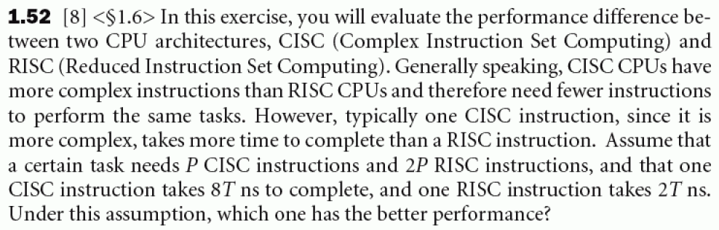
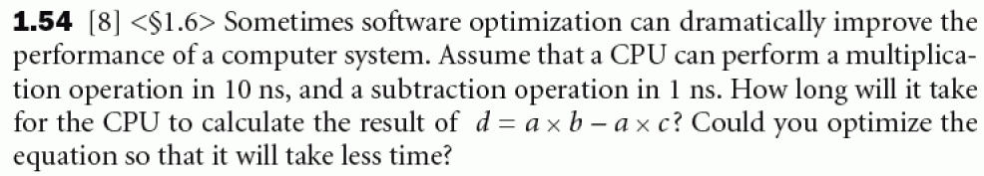
1
2

Slide 3
3
Consider three different processors p1,p2,p3 executing the same instruction set with the clock rates and CPIs given in the following table:
Processor clock rate CPI
P1 2 Ghz 1.5
P2 1.5 GHz 1.0
P3 3 GHz 2.5
Which processor has the highest performance
If the processors each execute a program in 10 seconds, find the number of cycles and the number of instructions

Slide 4
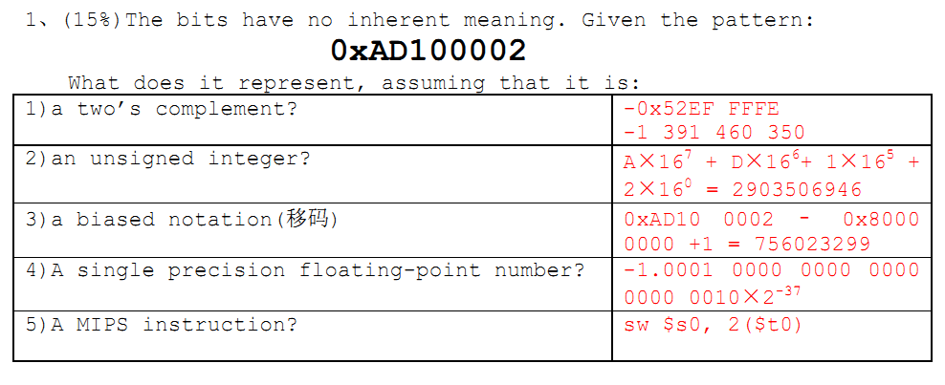
4
最后一小题不做
5

Slide 5
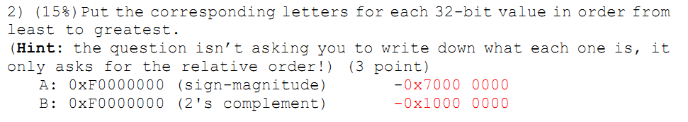
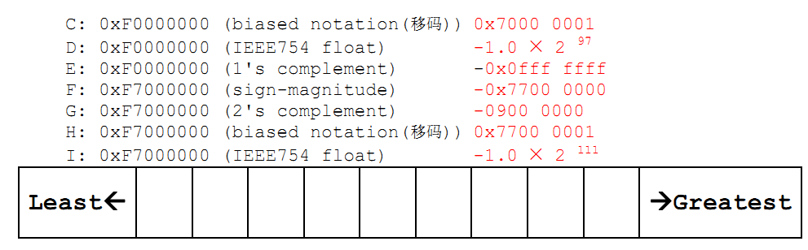
6

Slide 6
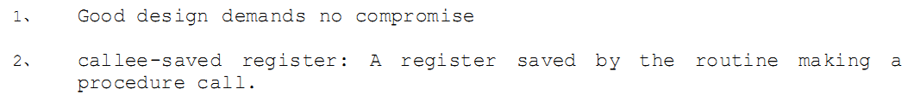

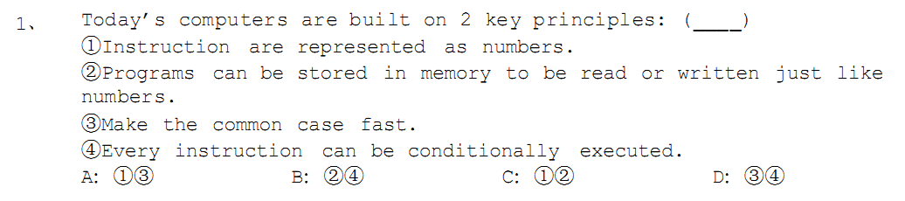
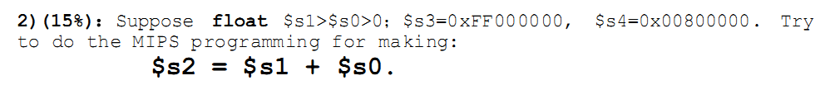
7
(1)
(2)
(3)
8
Do the RISC_V programming

Slide 7
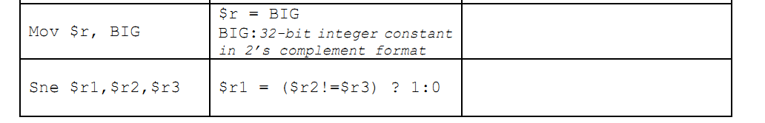
9
RISC-V instruction

Slide 8
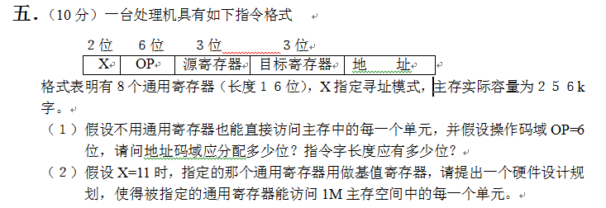
10
11
6、The address is the sum of the PC and a constant in the instruction.
A: Register addressing B: Immediate addressing
C: PC-relative addressing D: Base or displacement addressing

Slide 9
12、(15%)Convert the C function below to RISC-V assembly language. Make sure that your assembly language code could be called from a standard C program.
void main(int*z, int x, int y)
{
*z=sub(x, y);
}
int sub(int n, int m)
{
return m-n;
}

Slide 10
13 Give hexadecimal encodings(machine language) for the following instructions:
ld x12, 8(x10)
loop: bne x12, x13, label
sll x13, x12, 4
jal x0, loop
label: jal x0, 0(x1)
Assuming the start address of memory is 0x0040 0000.

Slide 11
14
单时钟周期中，IM与DM合成为一个MEM，可以吗？若可以，画出LW与SW指令的数据通道。若不可以，为什么？
(2) 已知单时钟周期cpu，IM/DM读访问周期2ns，IM/DM写访问周期1.5ns，REGDST等信号由控制器产生需要延时为4.6ns，ALU延时1.7ns，寄存器组访问延时为1.3ns。问最佳的时钟周期。
指令类型 | 对应指令所使用的功能
R-format | 取指令 | 访问寄存器 | ALU | 访问寄存器
LW | 取指令 | 访问寄存器 | ALU | 访问存储器 | 访问寄存器
SW | 取指令 | 访问寄存器 | ALu | 访问寄存器
Branch | 取指令 | 访问寄存器 | ALU
Jump | 取指令

Slide 12
(3) 写出单时钟周期数据通道下，时钟周期的计算方法。已知IM,加4的加法器，控制器，寄存器组，ALU，DM各有延时，为T_{IM},T_{加4的加法器}，T_{控制器}，T_{寄存器组}，T_{ALU}，T_{DM}。其他开关、符号扩展、左移逻辑，门及控制器不考虑时延。

Slide 13
(4)已知有指令寻址方式为“变址寻址”，对数组操作特别有效。若add $3，($1+$2)指令，表示$3=$3+MEM($1+$2)。指令为R型指令。该指令能否使用单时钟周期来完成（可以增加必要的器件）？如果可以，写出该指令使用单时钟周期实现时的数据通道(仅仅实现该指令)。如果不可以，为什么？

Slide 14
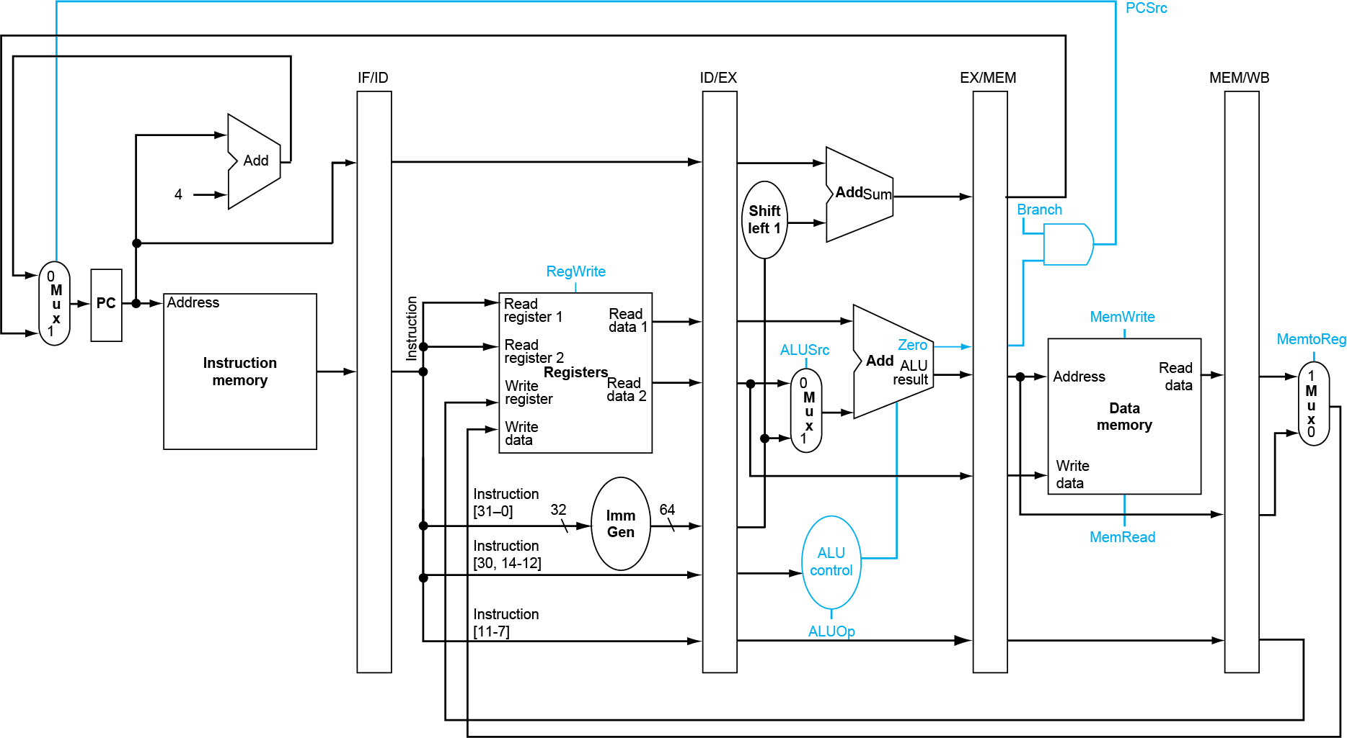
15 Pipeline CPU Design

Slide 15
(1) For the above single-cycle datapath, answer the questions:
When execute sub instruction, the control signals PCSrc, ALUSrc, MemWrite, RegWrite, and MemtoReg generated by the controller are respectively (________________________________).

Slide 16
Assuming that the following codes are executed on the above five-stage pipelined datapath:
xori a1, a2, 10
add a3, a1, a2
addi t1, a1, 15
sub t2, a3, a2
(2) If there is no forwarding or hazard detection, insert NOPs to ensure correct execution.

Slide 17
(3) If the processor has forwarding, but we forgot to implement the hazard detection unit, redo (2)
(4) If there is forwarding (shown in following figure), for the first seven cycles, specify the forwarding signals for each cycle.

Slide 18
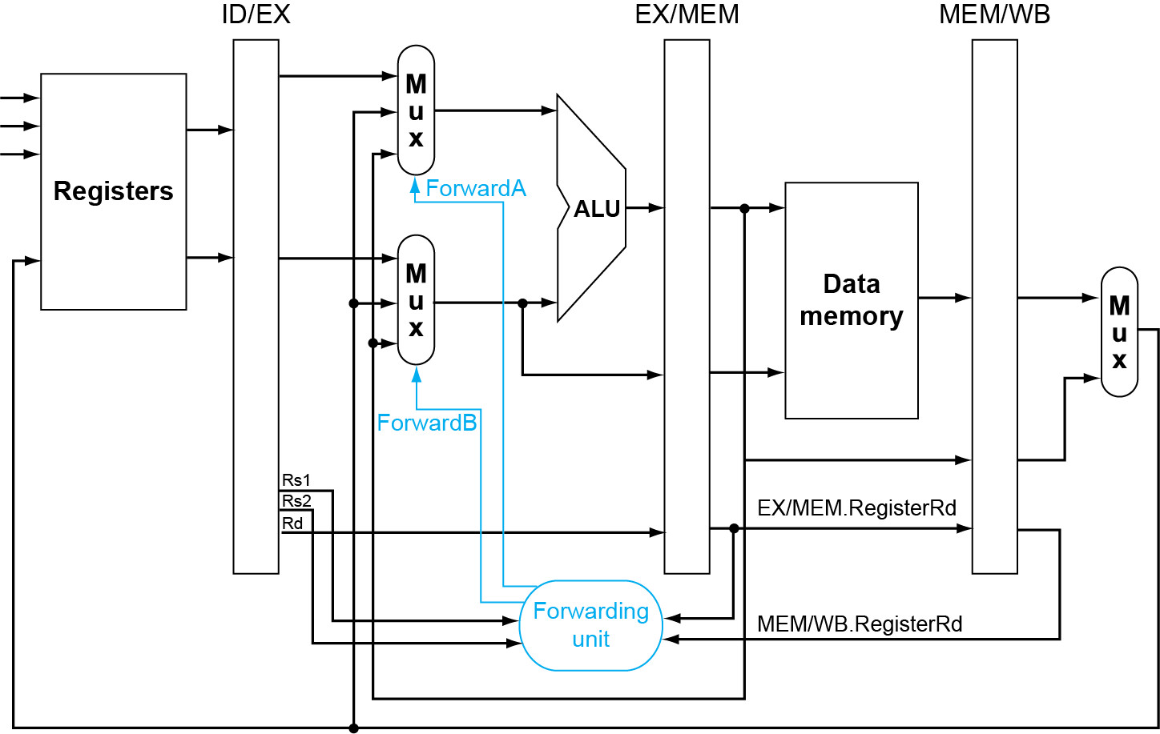
cycle | ForwardA | ForwardB
1 | X (don’t care) | X (don’t care) | No instruction in EX stage yet
2
3
4
5
6
7

