Slide 1
1 引论
2 插值法
3 函数逼近
4 数值微分与积分
5 解线性方程组的直接法
6 解线性方程组的迭代法
7 非线性方程与方程组的数值解法
8 矩阵的特征值计算
9 常微分方程初值问题数值解法

Slide 2
题型
矩阵不会超过三阶，一般是二阶
30分填空，70分的6道大题

Slide 3
Solution of Equations
Problem:
a. what is the fixed points of the following iterative equation?
b. If starting from , what value will the equation converge to?
c. If starting from , what value will the equation converge to?

Slide 4
Least Squares
Problem:
Given a function , find and so that it fits the following data and weights in a least-squares manner?
x | 1.0 | 2.0 | 3
y | 5.0 | 16.0 | 24
w | 1.0 | 2.0 | 1.0

Slide 5
Least Squares
For a_{k}, we have the following formula:
注意是否要线性化
n
m
m
2
Σ
a
Σ
x
j
+
k
−
Σ
y
x
k
=0
j
i
i
i
j
=
0
i
=
1
i
=
1
We thus compute the matrix :

Slide 6
Eigen value of small matrix
Make use of characteristic polynomial to compute the eigen value of a matrix:
For a matrix A, its characteristic polynomial is
the determinant of matrix λI-A, denoted by |λI-A|. The eigen values of A is the roots of its characteristic polynomial.

Slide 7
Eigen value of small matrix
Problem:
Compute the eigen values of Matrix
The characteristic polynomial is:
Then:
are its two eign values.

Slide 8
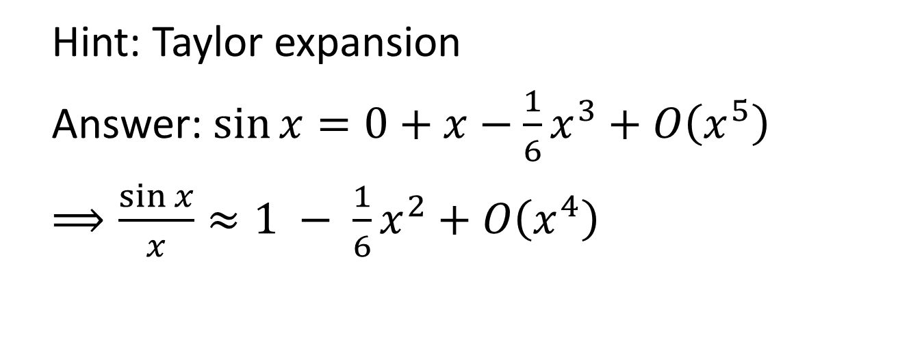
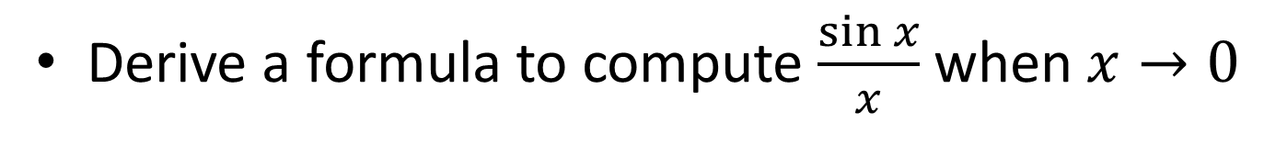
Round-off Error
Derive a formula to compute $\frac{\sin{x}}{x}$ when $x→0$
Hint: Taylor expansion
Answer: $\sin{x}=0+x−\frac{1}{6}x^{3}+O\left(x^{5}\right)$
$⟹\frac{\sin{x}}{x}≈1 − \frac{1}{6}x^{2}+O\left(x^{4}\right)$

Slide 9
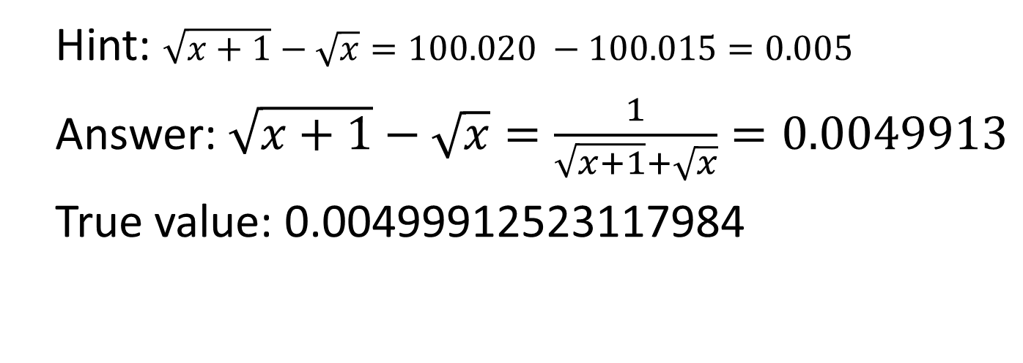
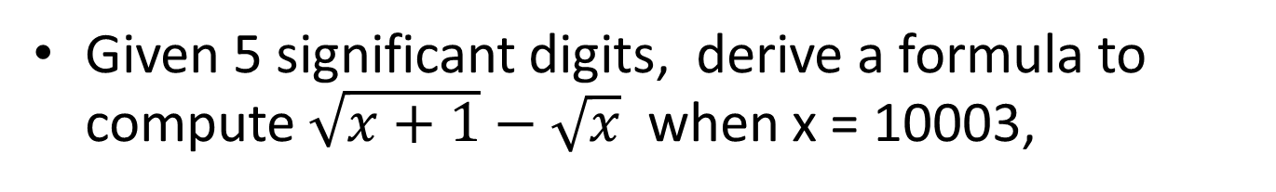
Round-off Error
Given 5 significant digits, derive a formula to compute $\sqrt{x+1}−\sqrt{x}$ when x = 10003,
Hint: $\sqrt{x+1}−\sqrt{x}=100.020 −100.015=0.005$
Answer: $\sqrt{x+1}−\sqrt{x}=\frac{1}{\sqrt{x+1}+\sqrt{x}}=0.0049913$
True value: 0.00499912523117984
推一个公式，使得舍入误差尽可能小

Slide 10
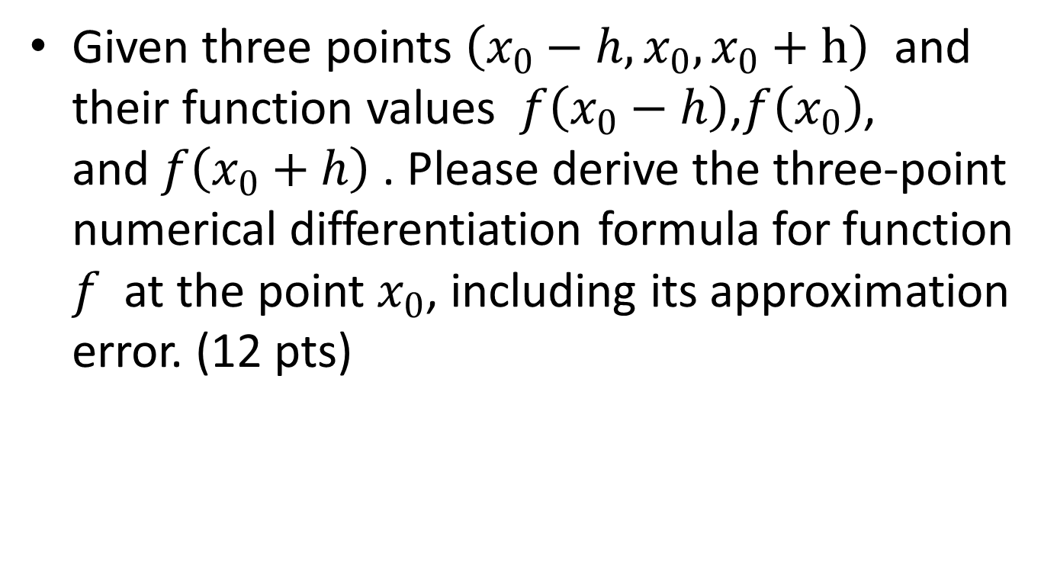
Numerical Differentiation
Given three points $\left(x_{0}−h,x_{0}, x_{0}+h\right)$ and their function values $f\left(x_{0}−h\right)$,$f\left(x_{0}\right)$, and$f\left(x_{0}+h\right)$ . Please derive the three-point numerical differentiation formula for function $f$at the point $x_{0}$, including its approximation error. (12 pts)

Slide 11
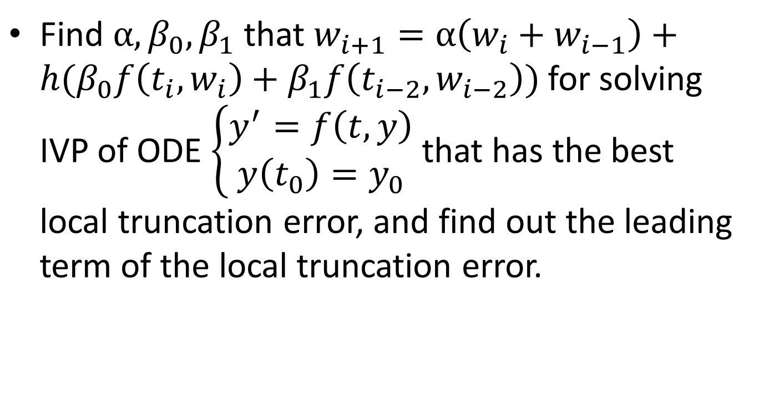
IVP Problem
Find $α,β_{0},β_{1}$ that $w_{i+1}=α\left(w_{i}+w_{i−1}\right)+h(β_{0}f\left(t_{i},w_{i}\right)+β_{1}f\left(t_{i−2},w_{i−2}\right))$ for solving IVP of ODE $\left\{\begin{matrix}y^{′}=f\left(t,y\right) \\ y\left(t_{0}\right)=y_{0}\end{matrix}\right.$ that has the best local truncation error, and find out the leading term of the local truncation error.

Slide 12
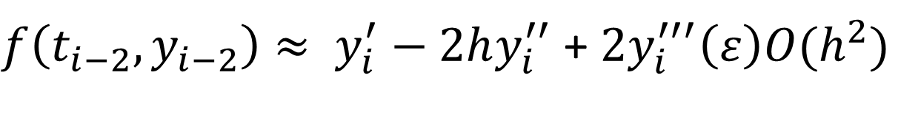


IVP Problem
Hint: Taylor expansion
$y_{i+1}≈ {y_{i}+hy}_{i}^{′}+ \frac{1}{2}h^{2}y_{i}^{′′}+\frac{1}{6}$ $y_{i}^{′′′}\left(ε\right){O(h}^{3})$
$y_{i−1}≈ {y_{i}−hy}_{i}^{′}+ \frac{1}{2}h^{2}y_{i}^{′′}−\frac{1}{6}$ $y_{i}^{′′′}\left(ε\right){O(h}^{3})$
$$f\left(t_{i},y_{i}\right)= y_{i}^{′}$$
$f\left(t_{i−2},y_{i−2}\right)≈ y_{i}^{′}−2hy_{i}^{′′}$ + ${2y}_{i}^{′′′}\left(ε\right){O(h}^{2})$
$⟹α= \frac{1}{2},$ $β_{0}=\frac{13}{8},$ $β_{1}=−\frac{1}{8}$

Slide 13
What do we analyze for in NA?
Chapter 5:
Initial value problem
Euler, Runge-kutta, multi-step
Chapter 8: approximation
Orthogonal polynomials
Least squares
Chebyshev polynomial
Chapter 6&7:
Direct Matrix Solver
Iterative Matrix Solver
Chapter 4:
Numerical differentiation
Numerical integration
Chapter 1:
Mean value theorem
Taylor expansion
Roundoff error
Chapter 2:
Solution of equations with one variable
Chapter 3: interpolation
Lagrange polynomial
Piecewise polynomial
Interpolation and approximation
Basic Knowledge
Solution of Equations
Convergence + Stability
Error
1/12

Slide 14

How many kinds of errors we analyze in NA?
Roundoff errors due to computer arithmetic Chap 1
The error between current solution and true solution used in convergence in iterative equation solver: , Chapter 2,7
Truncation error used in interpolation and approximation, Chapter 3,4,8,5.
Lagrange polynomial
Taylor expansion

