Slide 1
Selenium
Josh Hicks

Slide 2
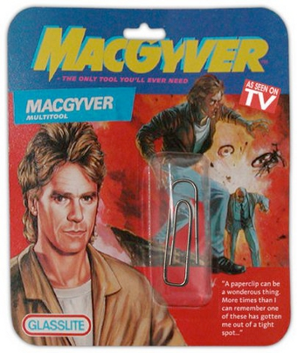
What is Selenium?
Notes:
Browser Automation Framework
Started as JS library – ran into JS sandbox issues
Google started Webdriver – added native support in browser
Now supported by all major browsers
Working to make it a W3C standard

Slide 3
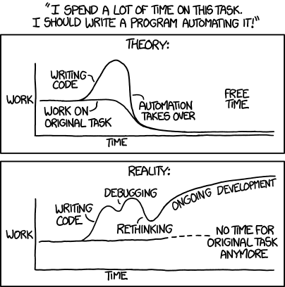
Uses
Automation / Web Scraping
Web Testing
Pen Testing
Obligatory XKCD

Slide 4
Demo
Chrome
PhantomJS

