Slide 1
Earthquake Data Analysis and Prediction System
Speaker: RuqianZHANG
Group members:
MC564826 AiwenLI
MC567431 XinweiZENG
MC564892 ZiyiCAI
MC567468 RuqianZHANG

Slide 2
Content
Prologue:
Motivation of the Project
Roles and Responsibilities of the Team
Project:
What Have We Done
About the Dataset
Details
Conclusions and Findings

Slide 3
Motivation of the Project
Our choice stems primarily from a natural scientific curiosity and its scientific significance: earthquakes, as an unsolved mystery, are among the deadliest natural disasters. In the 21st century alone, earthquakes have caused over 800,000 deaths. Earthquake prediction is considered the "holy grail" of Earth science. While we know we cannot "solve" this problem, systematically analyzing data and searching for patterns is itself a process of scientific exploration.
We can't help but ask: Are these earthquakes isolated or interconnected? Why do large earthquakes seem to "cluster" together? Are there global earthquake triggering mechanisms that we don't yet understand? Do these regions correspond to the approximate directions of known seismic zones? Can we use algorithms to automatically identify them?
Furthermore, the spatiotemporal "clustering patterns" of this narrative-rich data also intrigue us: Do earthquakes, like weather, have "active seasons" and "quiet seasons"? Are there predictable temporal patterns in seismic activity? For example, are earthquakes more likely to occur at certain times of day or in certain months of the year? The data itself tells a complex story about Earth's dynamics.
Notes:
About motivation of the project.
We’re digging into quake data because we’re plain curious: do big shakes talk to each other, cluster like weather, or follow hidden seasons? We know we can’t predict them yet, but hunting for patterns is still a cool scientific treasure hunt.

Slide 4
Roles and Responsibilities of the Team
Topic choosing: All Members;
Data Scraping: XinweiZENG;
Data Processing: XinweiZENG, AiwenLI;
Model Construction: AiwenLI;
Data Analysis: AiwenLI, XinweiZENG;
Data Visualization: AiwenLI；
Readme File Making: ZiyiCAI;
PPT Making: RuqianZHANG, ZiyiCAI;
Presentation Making: RuqianZHANG
Notes:
here shows the roles and responsibilities of the team.(ppt停顿两秒)

Slide 5
What have we done?
Train multiple machine learning models
using historical earthquake data
to predict whether a strong earthquake will occur in the future and its magnitude, and compare the model performance.
Notes:
About what we have done.
We trained multiple machine learning models using historical earthquake data to predict whether a strong earthquake will occur in the future and its magnitude, and compare the model performance.

Slide 6
About the dataset
We personally crawled the raw, unprocessed earthquake details data from the China Earthquake Networks Center.
https://www.cenc.ac.cn/earthquake-manage-publish-web/designated-catalogue

Slide 7
Details: Feature Extraction
Explain: Feature extraction is the process of transforming raw data into a set of measurable characteristics/features that better represent the underlying problem and improve model performance.
Notes:
Feature Extraction was one of the most important part in our project.
Feature extraction is the process of transforming raw data into a set of measurable characteristics or features that better represent the underlying problem and improve model performance.

Slide 8
Details: Models We Have Used
Classification Models:
Logistic Regression
Random Forest
Decision Tree
SVM
KNN
XGBoost Classifier
LightGBM Classifier
Gradient Boosting Classifier
AdaBoost Classifier
Naive Bayes
MLP
Regression Models:
Linear Regression
Ridge Regression
Lasso Regression
ElasticNet
Random Forest Regressor
Decision Tree Regressor
SVR
KNN
XGBoost Classifier
LightGBM Classifier
Gradient Boosting Classifier
MLP
Clustering Models:
DBSCAN
K-Means
Notes:
These are the models we have used.
There are three types of models: classification models, regression models and clustering models.
（ppt停顿两秒）

Slide 9
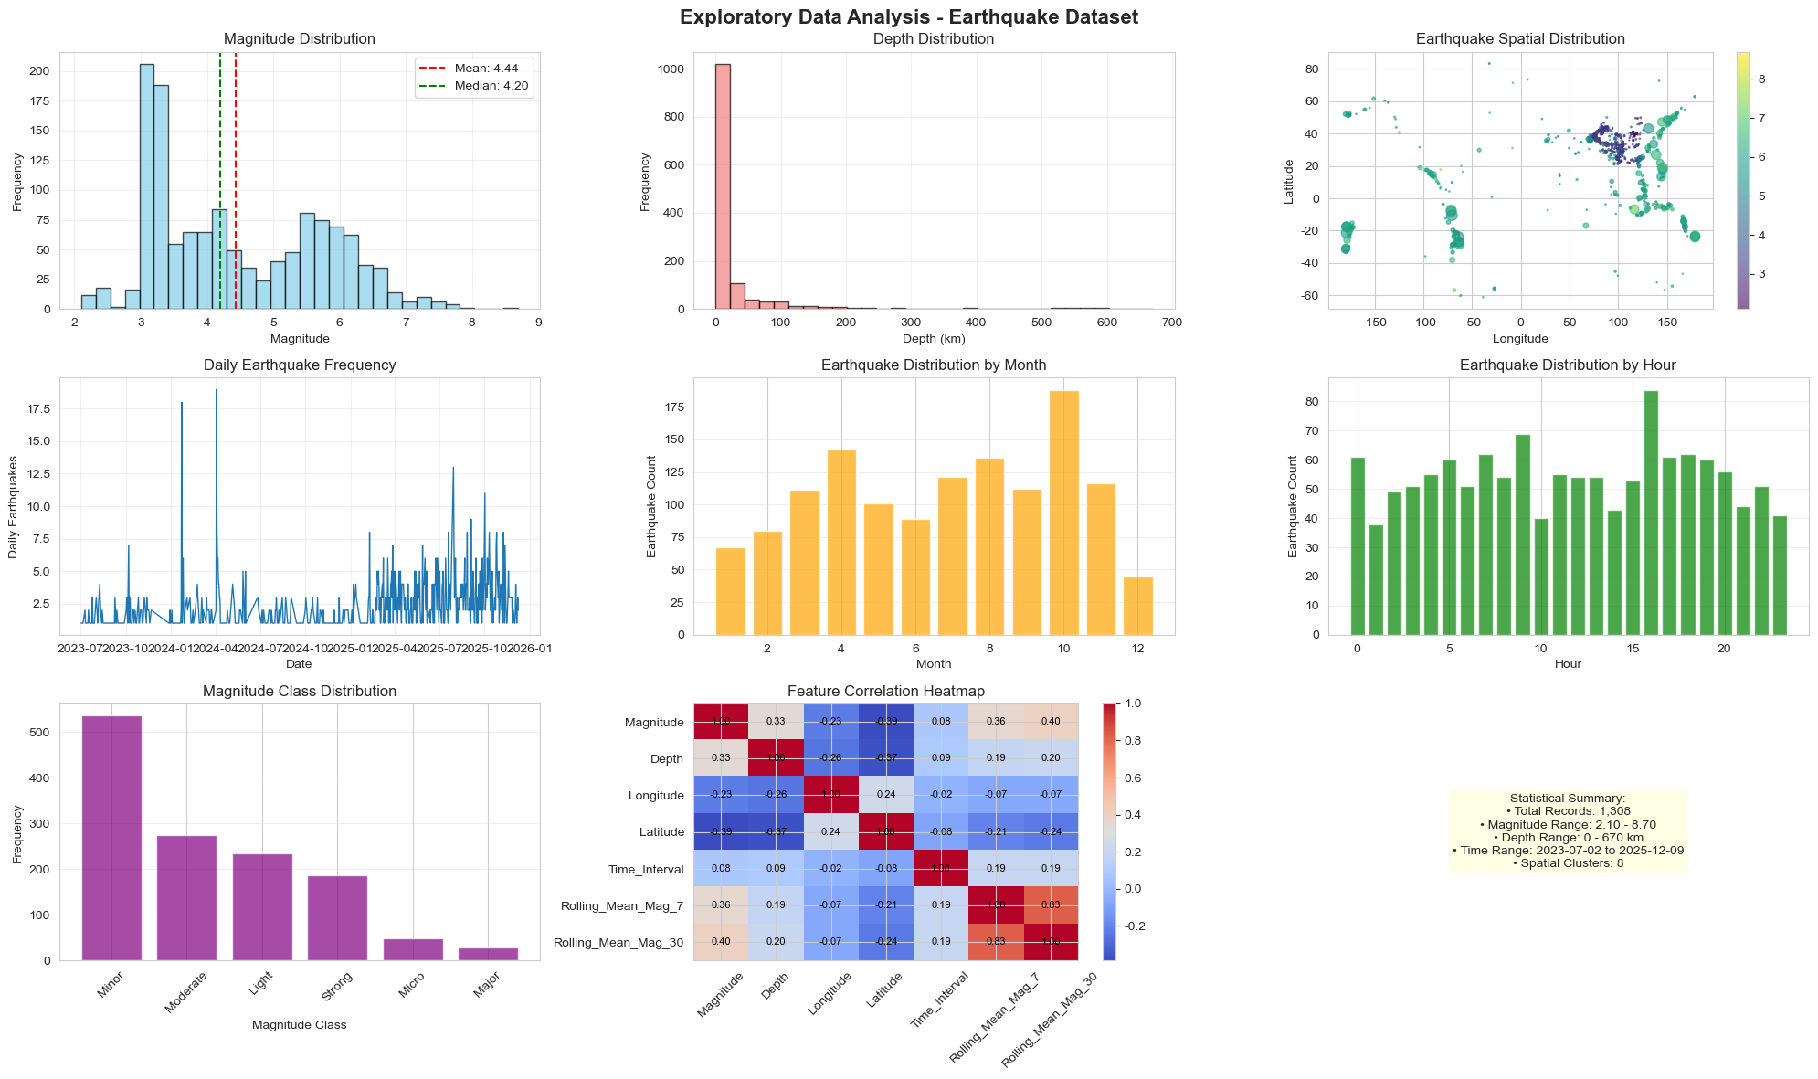
Details: An Overall View
Notes:
This is an overall view.
This exploratory analysis summarizes the earthquake data: magnitudes are predominantly small having the mean value of 4.44, depths are concentrated in shallow ranges, and events cluster in spatial hotspots. Daily and hourly frequencies fluctuate without a clear temporal pattern. Feature correlations—such as magnitude lag terms—provide a foundation for subsequent modeling.

Slide 10
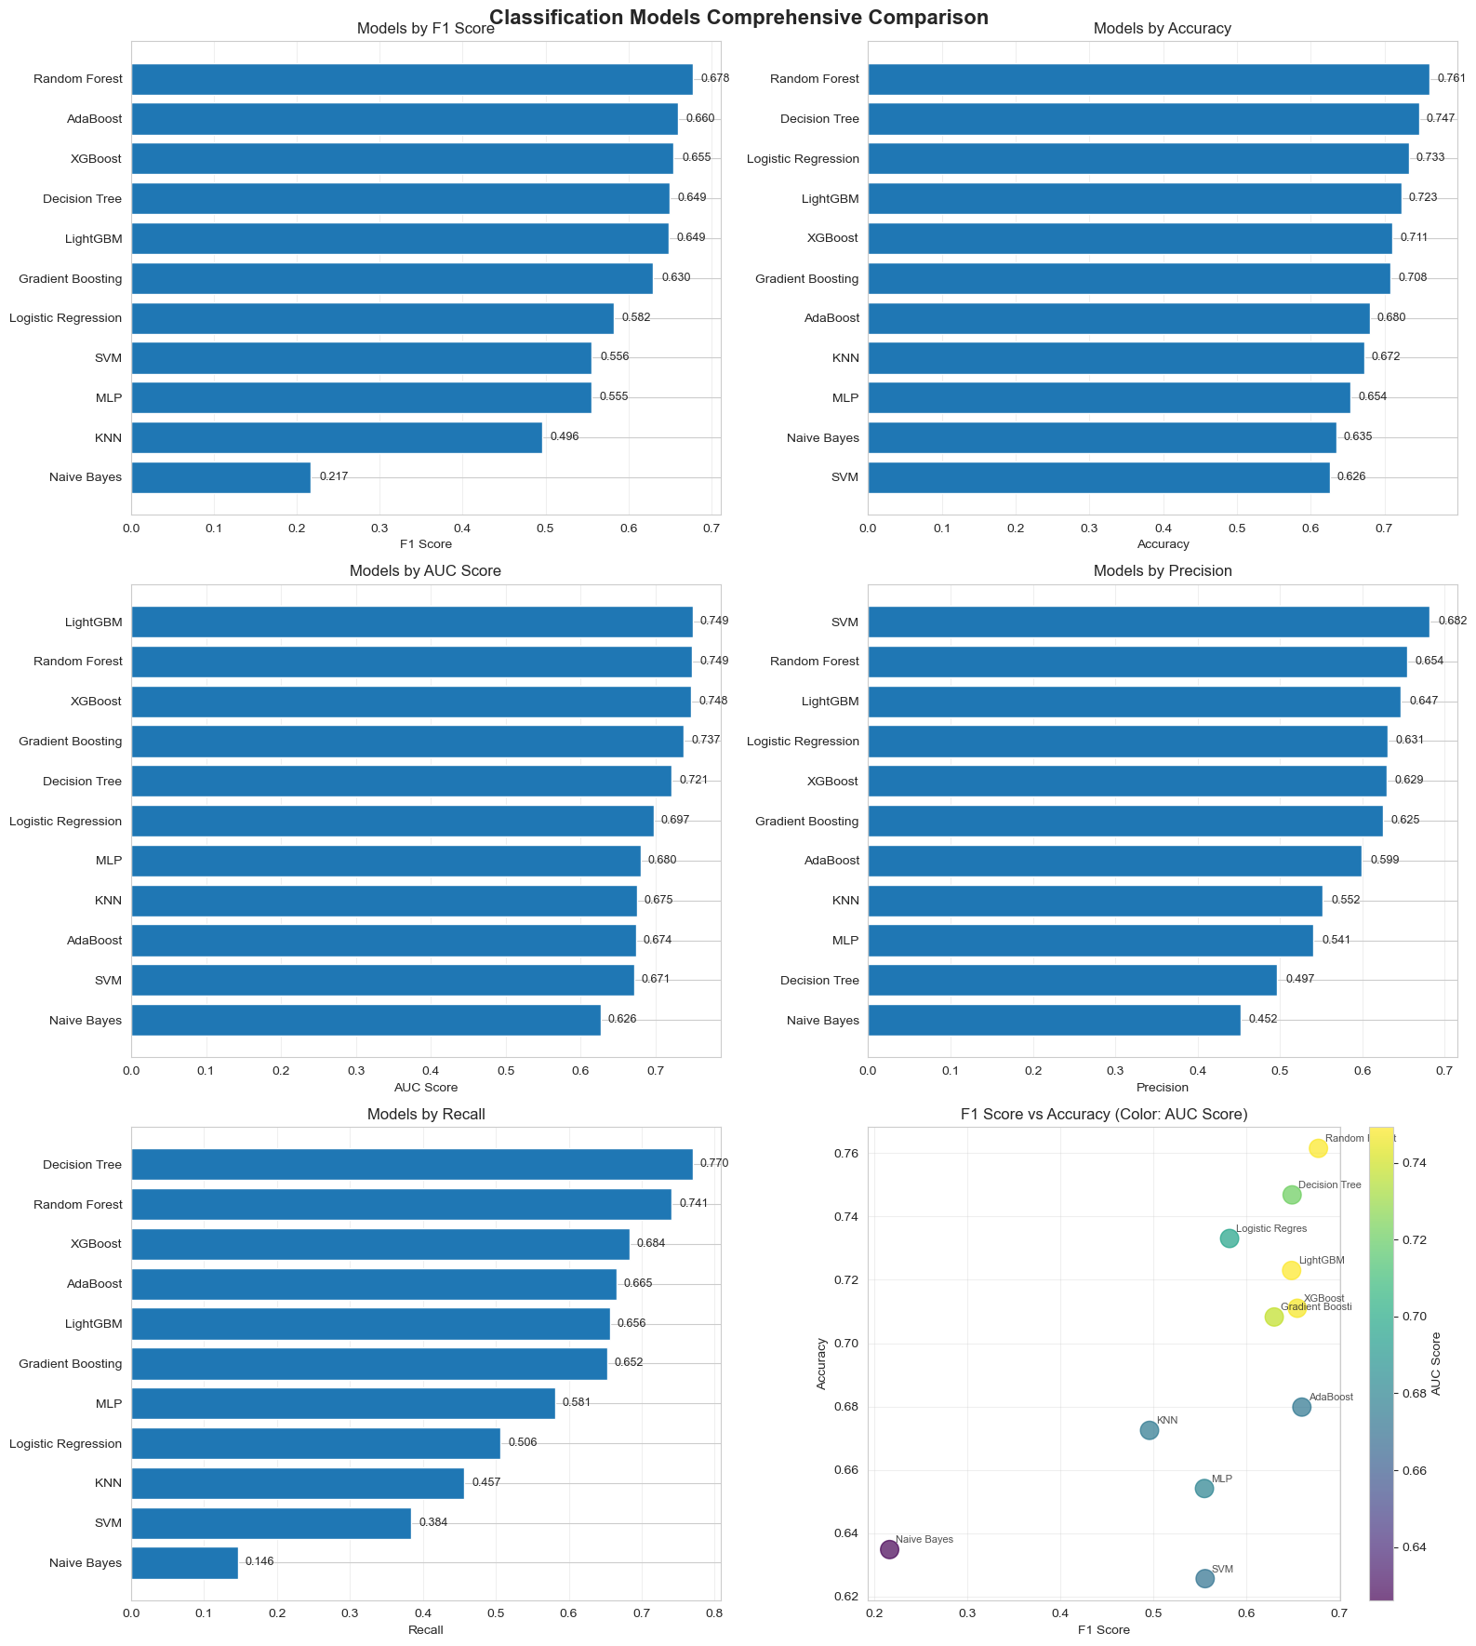
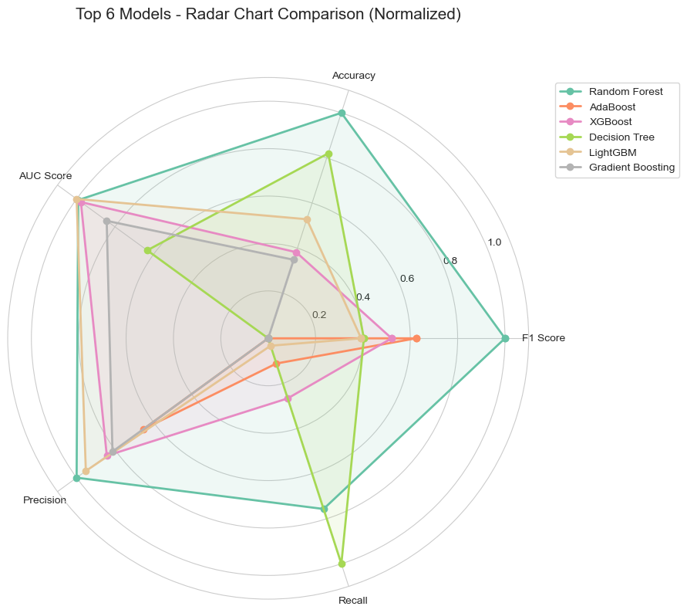
Details: Classification Models
Notes:
Here shows classification models.
These results stem from evaluating 11 classification models, such as Random Forest, XGBoost, on the task of predicting “strong earthquakes” which means its magnitude was higher than 4.5. Time-series cross-validation was used to prevent data leakage, and models were scored with F1 score, accuracy, AUC, precision, and recall. Random Forest performed best, as it’s shown: F1 equals to 0.678 and accuracy equals to 0.761, because its ensemble approach captures nonlinear patterns—such as spatial clusters and seismic lag features—better than linear models like logistic regression whose F1 score equals to 0.508. Tree-based models, such as XGBoost, LightGBM, also ranked high, whereas simpler models such as Naïve Bayes, KNN, suffered from class imbalance because of the few strong-quake samples, and intricate feature interactions. The radar chart shows Random Forest is the most balanced and reliable choice across all metrics.

Slide 11
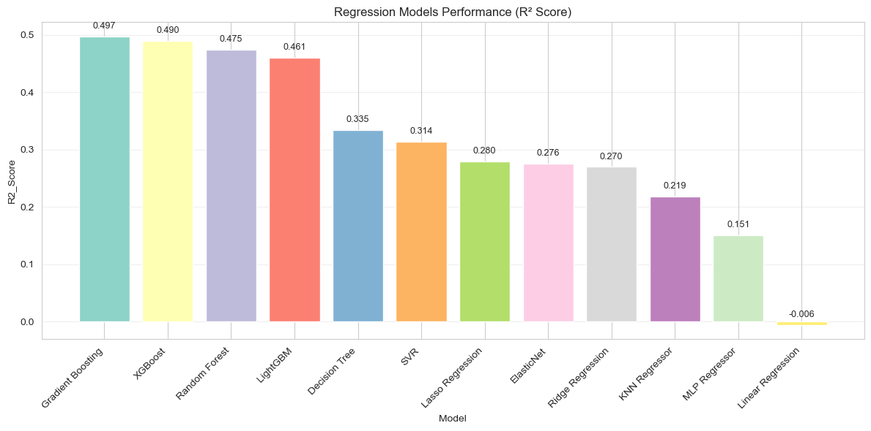
Details: Regression Models
Notes:
Here shows regression models.

Slide 12
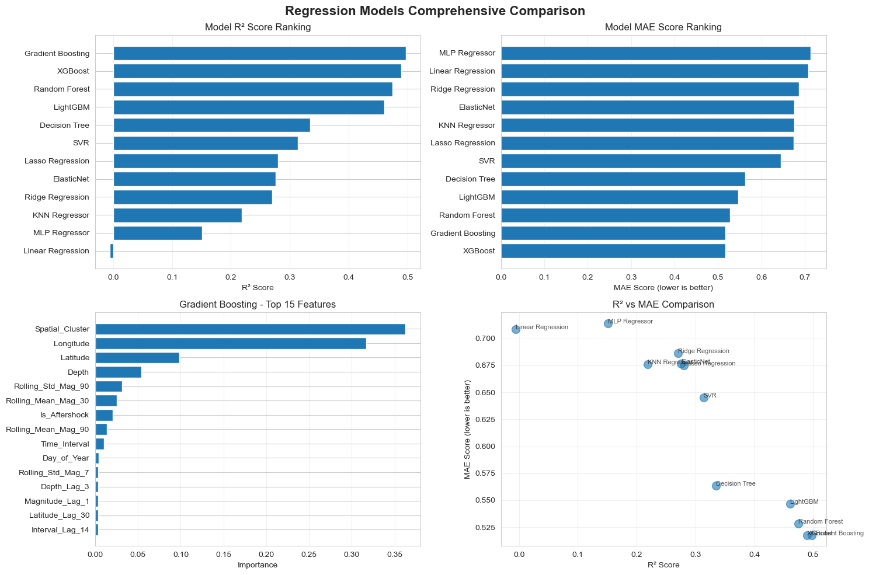
Details: Regression Models
Notes:
These results benchmark 12 regression models for predicting earthquake magnitude, evaluated by R² and MAE. Gradient Boosting tops the list having the R² equals to 0.497 and low MAE, outperforming XGBoost and Random Forest. Tree-based ensembles excel because they capture nonlinear links between features—spatial clusters, seismic lags—and magnitude, whereas linear models such as Linear Regression cannot fit such complex seismo-patterns. Feature-importance analysis shows spatial clusters and rolling statistics, that is, 90-day magnitude trend, are the most predictive. Key contributors are “Rolling_Std_Mag_90”, that is, 90-event standard deviation, and “Depth_Lag_1”, that is, lagged focal depth, underscoring the value of recent seismic volatility and depth variations. Yet the best R² reaches only 0.497, reflecting magnitude’s intrinsic randomness and unmeasured geologic drivers such as fault mechanics.

Slide 13
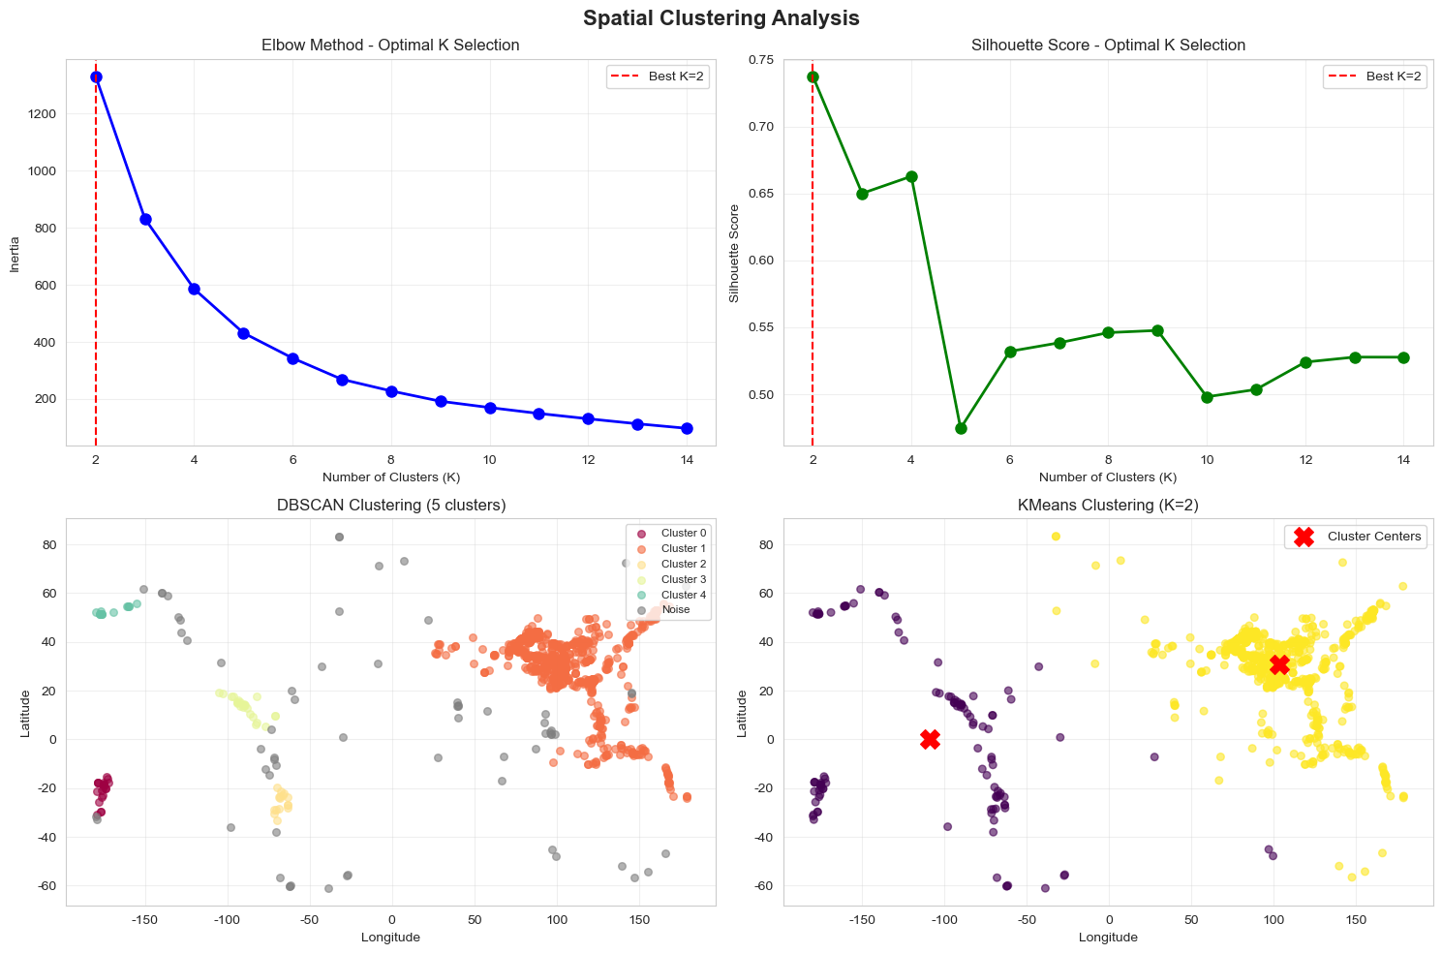
Details: Clustering Models
Notes:
Here shows clustering models.

Slide 14
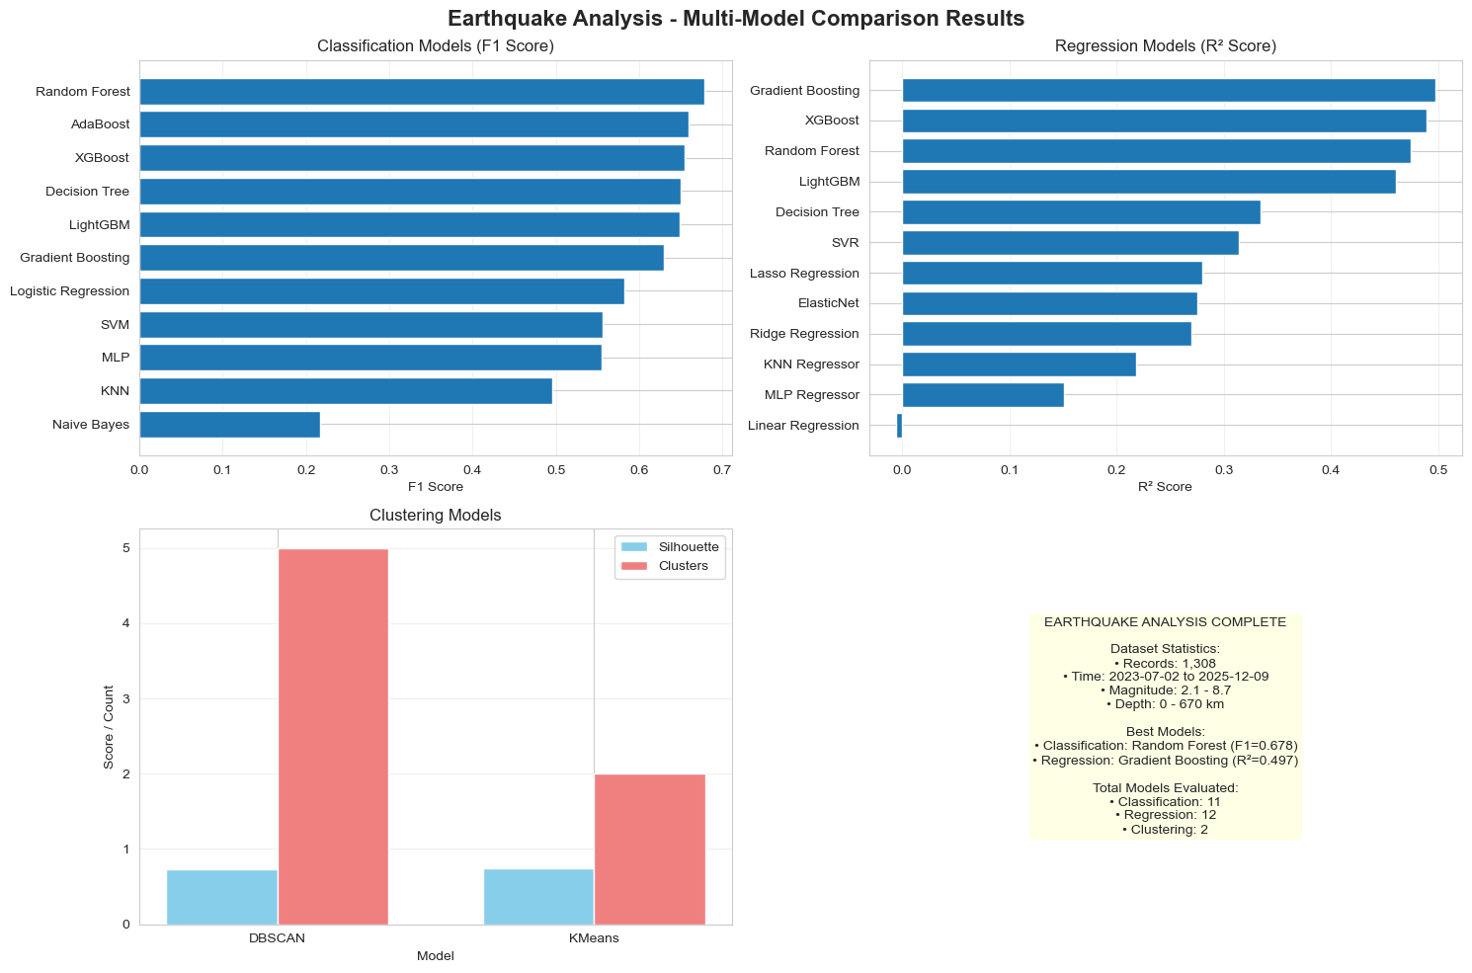
Details: Clustering Models
Notes:
These results derive from spatial clustering of earthquake locations, that is, DBSCAN and KMeans. The optimal number of clusters for KMeans was chosen via the elbow method and silhouette score. DBSCAN identified 5 clusters including noise by aggregating dense spatial regions, suitable for detecting natural seismic clusters such as tectonic belts. KMeans splits the data into two large regions based on centroid distance, simplifying the spatial pattern. Each approach has its merits: DBSCAN accommodates irregular cluster shapes common in geology, whereas KMeans produces balanced clusters. Both reveal spatial aggregation; for instance, the dense yellow cluster in KMeans and the large orange cluster in DBSCAN align with observed seismic hotspots. Clustering shows the primary high-risk zone lies at 50 to 150 degrees east and 0–80 degrees north which can be seen in the yellow cluster in KMeans, orange cluster in DBSCAN; the secondary high-risk zone is at 100 to 150 degrees west and 0 to 40 degrees south which can be seen in the purple cluster in KMeans. Earthquakes elsewhere are comparatively scattered, you can see gray noise points in DBSCAN. These findings accord with the real-world rule that earthquakes concentrate along plate boundaries.

Slide 15
Conclusions: Results Summary
This project performed end-to-end analysis of earthquake data, including data cleaning, feature engineering, EDA, multi-model comparison (classification, regression), and spatial clustering.
Classification Model: To predict whether "major earthquakes" (magnitude ≥4.5), Random Forest achieved the best performance (F1=0.678, AUC=0.649).
Regression Model: To predict earthquake magnitude, Gradient Boosting performed best (R²=0.497, MAE≈0.5).
Clustering Model: Spatial analysis (DBSCAN/KMeans) identified 5–8 seismic clusters, with KMeans (K=2) showing clearer spatial patterns.
Notes:
Here is the results summary.
About the Classification Model: it is to predict whether "major earthquakes”. Random Forest achieved the best performance.
About the Regression Model: it is to predict earthquake magnitude. Gradient Boosting performed best.
About the Clustering Model, it is Spatial analysis identified 5 to 8 seismic clusters, with KMeans showing clearer spatial patterns.

Slide 16
Conclusions: Key Findings
Model Performance:
Tree-based ensemble models (Random Forest, Gradient Boosting, XGBoost) outperform linear models (Logistic Regression, Linear Regression) and simple models (KNN, Naive Bayes) in both classification and regression.
Feature importance analysis shows spatial clusters, lagged magnitude/depth, and rolling statistics (e.g., 7/30-day average magnitude) are critical for predictions.
Spatial Patterns:
Earthquakes concentrate in specific regions (e.g., high-density clusters in the 0–50° longitude range), consistent with known tectonic zones.
Aftershock identification (time difference <24h, distance <50km) helps improve model accuracy.
Notes:
Here comes to the key findings.
We find that tree ensembles beat linear models; space clusters, lagged magnitude and depth and rolling stats matter most. Quakes pile up along 0 to 50 degrees north, matching plate edges; flagging after-shocks sharpens accuracy.

Slide 17
Conclusions: Limitations
Data Constraints:
1. The dataset size (1,308 records) is relatively small, limiting the generalization ability of complex models.
2. Missing features (e.g., tectonic plate boundaries, historical seismic activity) reduce prediction accuracy.
Model Limitations:
1. The best R² (0.497) for magnitude prediction is low—earthquake magnitude is inherently stochastic, and current features cannot fully capture its variability.
2. Classification models struggle with imbalanced data (few major earthquakes), leading to suboptimal recall.
Methodological Gaps:
1. Time-series splitting (TSCV) was used, but no external validation dataset was available to test real-world performance.
2. Spatial clustering did not integrate geological context (e.g., fault lines), so cluster interpretation is purely data-driven.
Notes:
Here comes to the limitation:
There have Tiny data, missing geology, low R², rare big-quake labels, and geology-blind clusters keep models humble; also no external test set proves they work beyond this spreadsheet.

Slide 18
Thank you!
Notes:
Thank you for your watching and listening.

