Slide 1

Zend Framework and Dojo Toolkit
Zend Framework and Dojo announce a partnership to deliver an out-of-the-box solution for building Ajax-based Web applications with Zend Framework.
an out-of-the-box solution for building Ajax-based Web applications with Zend Framework.

Slide 2
What is the partnership?
Zend Framework and Dojo are announcing a strategic partnership
to deliver an integrated solution
for building modern PHP-based
Web applications. In order to deliver an out-of-the-box experience,
Zend Framework will bundle the Dojo Toolkit and will feature
Dojo-specific components.

Slide 3
Why Zend Framework and Dojo?
There are many synergies and similarities between the two projects, including:
Licensing
IP Purity
Design Affinity
JSON Formats
Comprehensive Ajax Solution
Use of Standards
Support
Community

Slide 4
What if I don't use Dojo?
Zend Framework will remain use-at-will; use of other Javascript toolkits will continue to work as it does currently.
Dojo integration is expected to serve as a blueprint for community contributions targeting other Javascript toolkits.

Slide 5
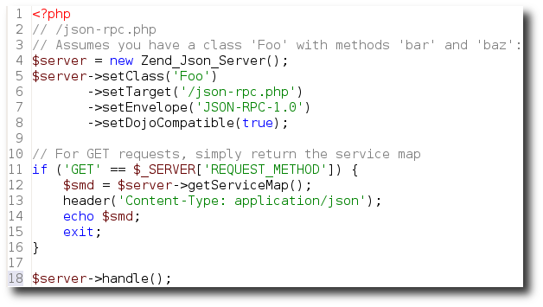
What will the integration be?
JSON-RPC server:

Slide 6
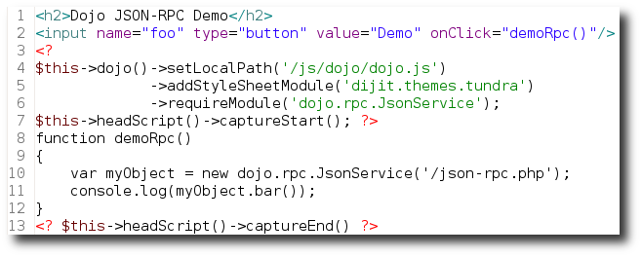
What will the integration be?
dojo() view helper, for setting up Dojo-related scripts and stylesheets:

Slide 7
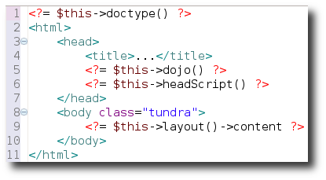
What will the integration be?
dojo() view helper (cont.; layout usage):

Slide 8
What will the integration be?
dojo.data compatibility (for use with XHR requests, grids, and more)
Zend_Form elements that utilize Dijit, Dojo’s widget collection and platform. (Note: Zend_Form's design is already highly compatible with Dojo.)‏

Slide 9
I have more questions
Subscribe to fw-mvc@lists.zend.com (http://framework.zend.com/archives)
#zftalk and #dojo IRC channels
Dojo community (http://dojotoolkit.org/community)‏

Slide 10

Thank you!

