Slide 1
Support Vector Machine (SVM) Intro
Che Xiao
2016/8/29

Slide 2
Table of Contents
Maximal Margin Classifier
Support Vector Classifier
Support Vector Machine

Slide 3
Table of Contents
Maximal Margin Classifier
Support Vector Classifier
Support Vector Machine

Slide 4
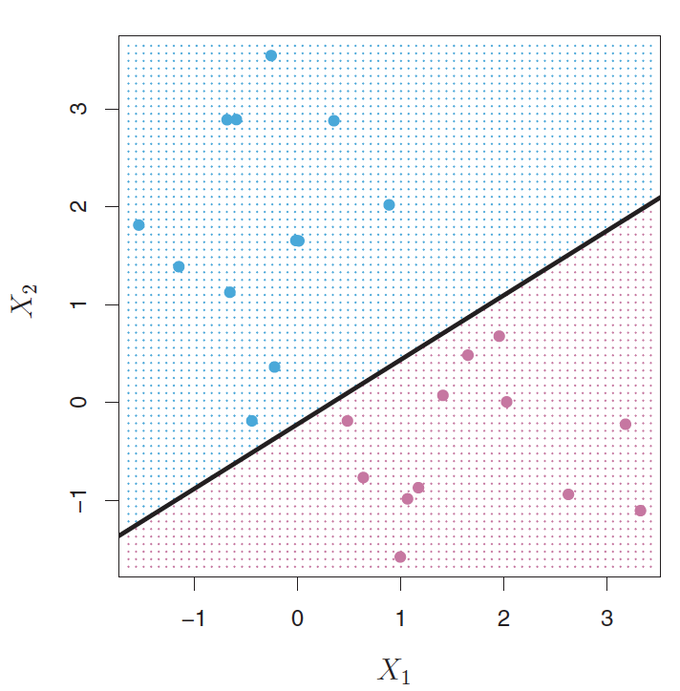
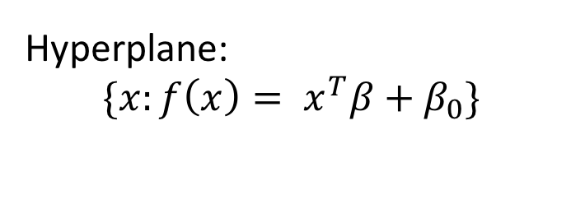
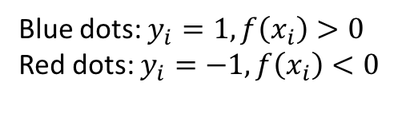

Maximal Margin Classifier
Goal
Find a plane that separate the classes the feature space
Hyperplane:
$$\{x:f\left(x\right)= x^{T}β+β_{0}\}$$
Blue dots: $y_{i}=1, f\left(x_{i}\right)>0$
Red dots: $y_{i}=−1, f\left(x_{i}\right)<0$
$$y_{i}{f(x}_{i})>0$$

Slide 5
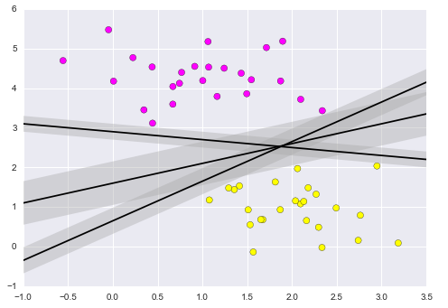
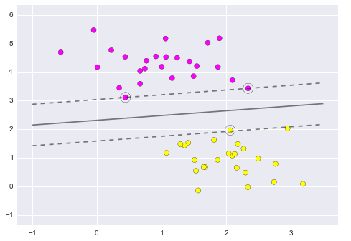
The idea of margin
More than one hyperplane works
Support vectors
Hyper-plane
Margin

Slide 6
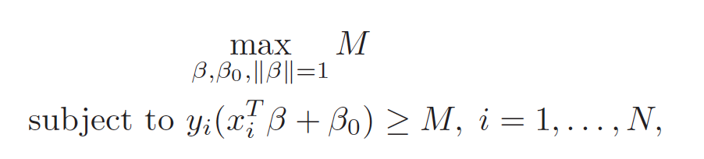
Math behind Maximal Margin Classifier
Solve the optimization problem

Slide 7
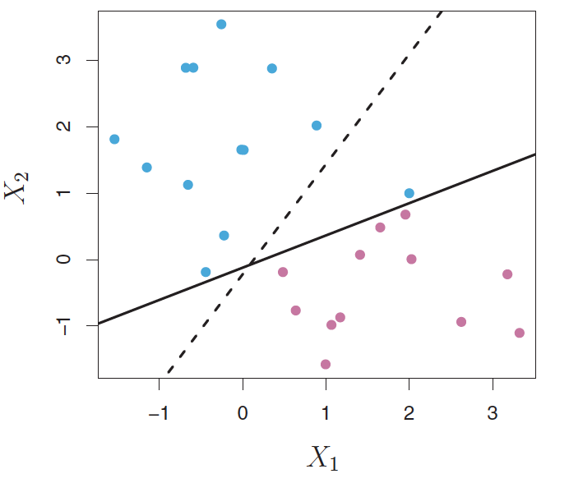
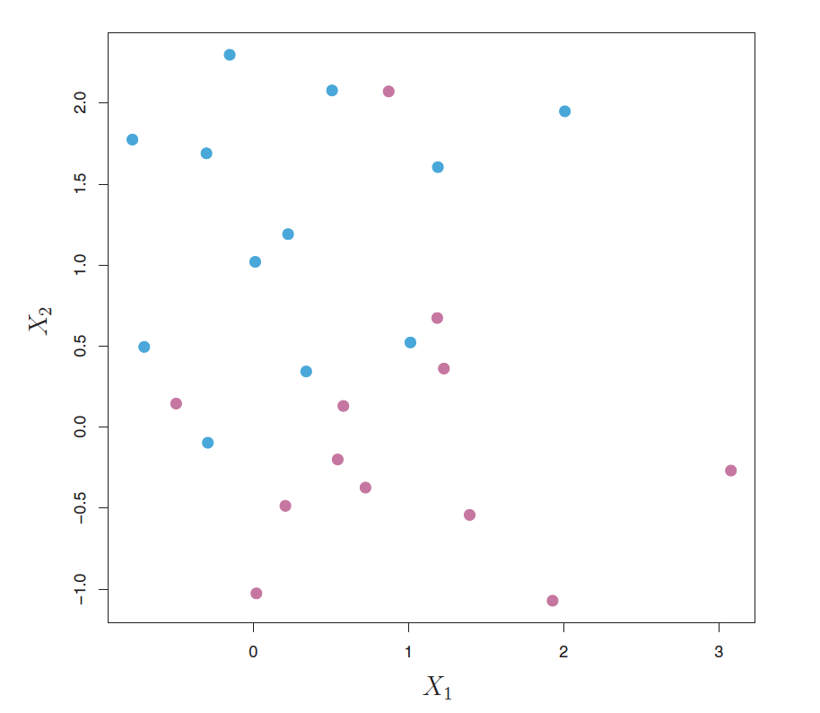
Limitation of Maximal Margin Classifier
Overfit the training data
Cannot exactly separate two classes

Slide 8
Table of Contents
Maximal Margin Classifier
Support Vector Classifier
Support Vector Machine

Slide 9
Support Vector Classifier
Goal:
Greater robustness to individual observations
Better classification of most of the training observations
Methods
Allow violation of margin

Slide 10
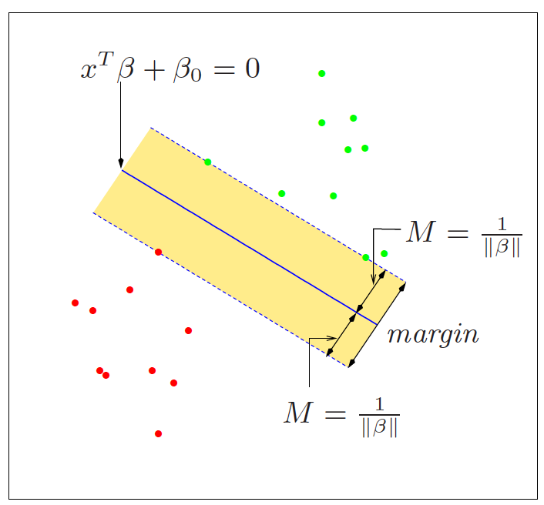
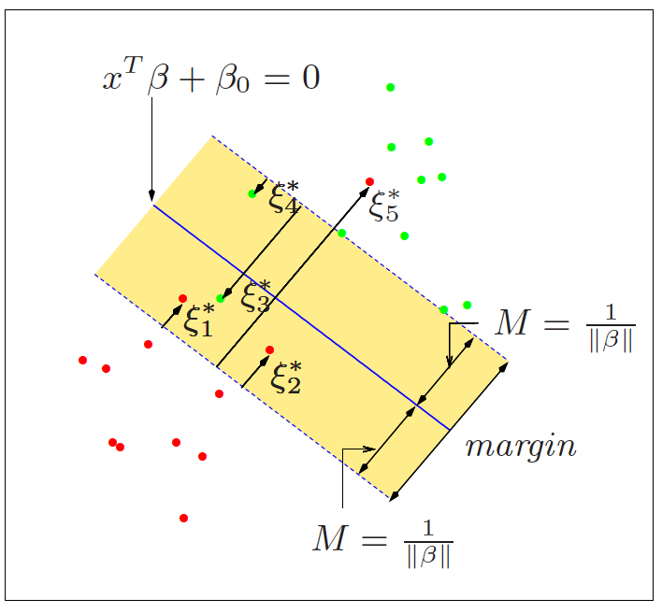
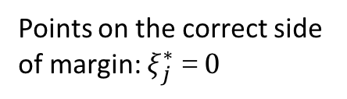
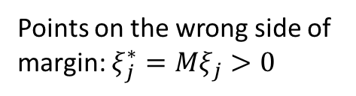
Visual demonstration
Separable case
Points on the correct side of margin: $ξ_{j}^{∗}＝0$
non-separable case
Points on the wrong side of margin: $ξ_{j}^{∗}={Mξ}_{j}>0$

Slide 11
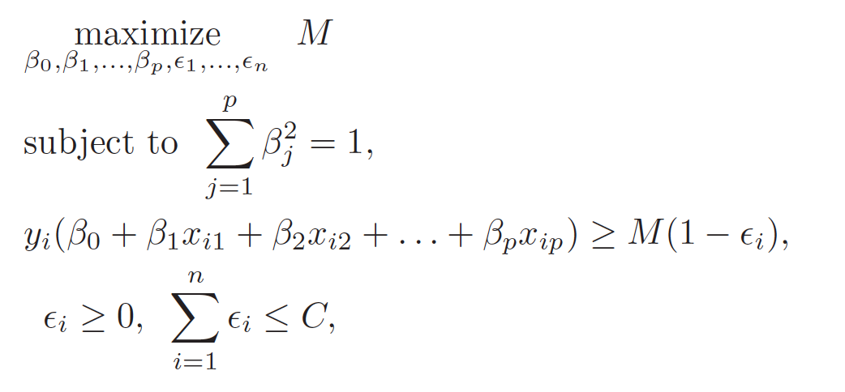
In mathematical words…
Solution to the optimization problem
C: nonnegative tuning parameter; M: width of the margin

Slide 12
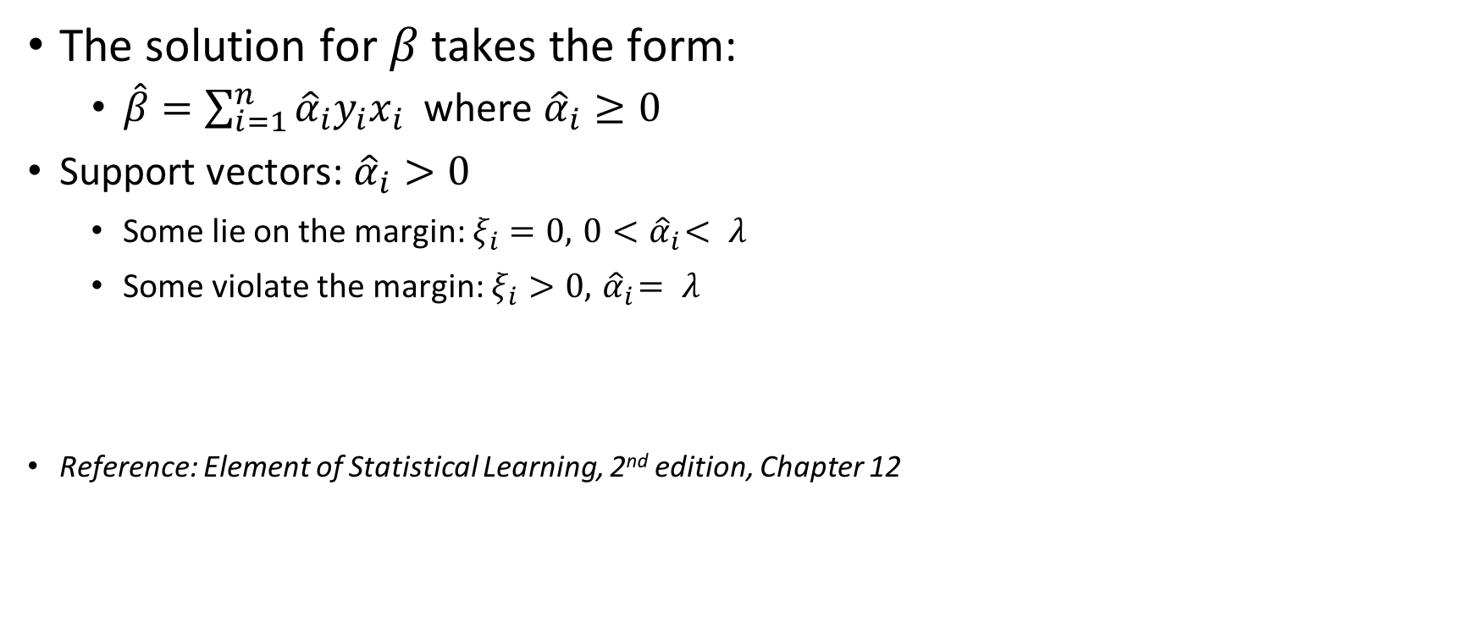
Properties of Support Vectors
The solution for $β$takes the form:
$\hat{β}=\sum_{i=1}^{n}{{\hat{α}}_{i}y_{i}x_{i}}$ where ${\hat{α}}_{i}≥0$
Support vectors: ${\hat{α}}_{i}>0$
Some lie on the margin: $ξ_{i}=0, { 0<\hat{α}}_{i}< λ$
Some violate the margin: $ξ_{i}>0, { \hat{α}}_{i}= λ$
Reference: Element of Statistical Learning, 2nd edition, Chapter 12

Slide 13
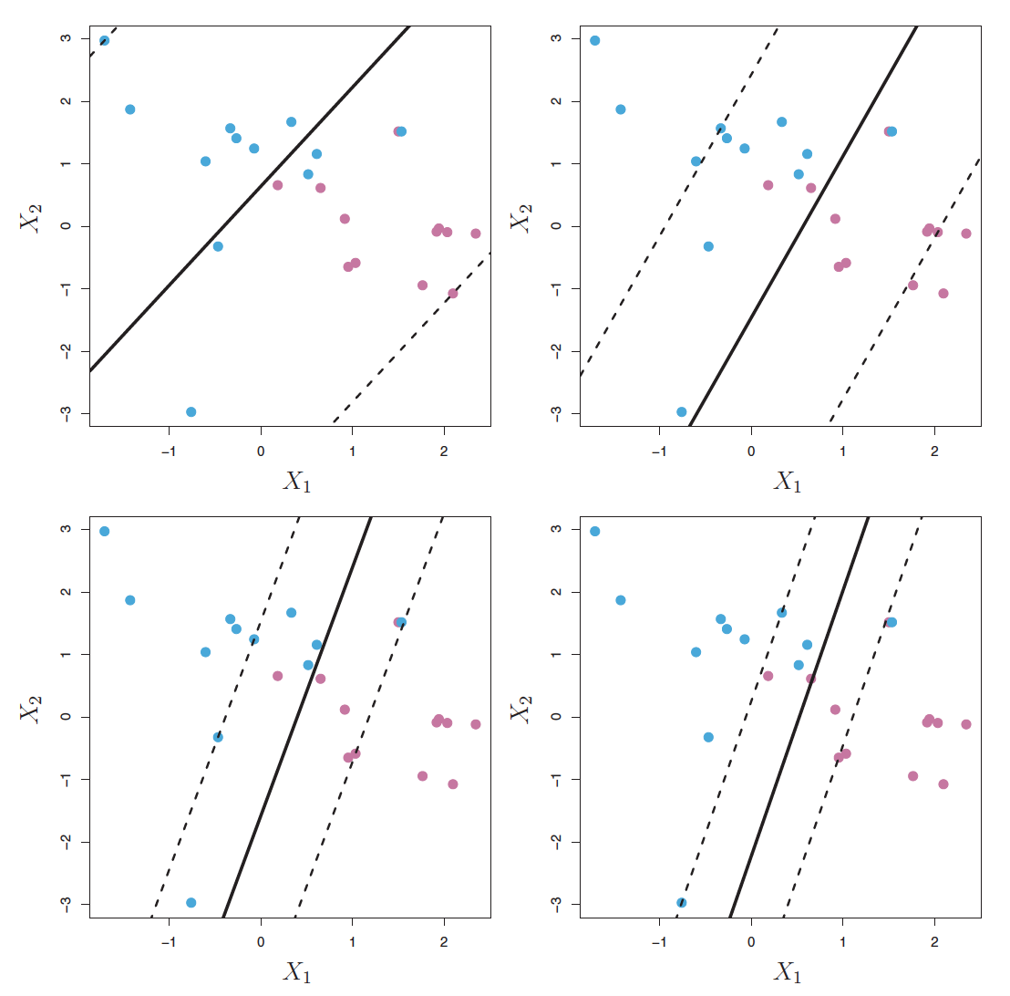
Effects of tuning parameter
Largest C
Smallest C

Slide 14
Table of Contents
Maximal Margin Classifier
Support Vector Classifier
Support Vector Machine

Slide 15
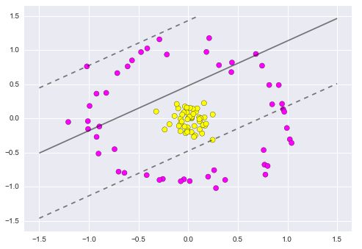
What if the decision boundary is non-linear?
Use Kernel

Slide 16
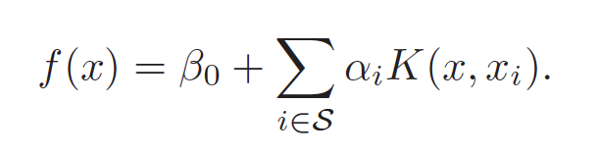
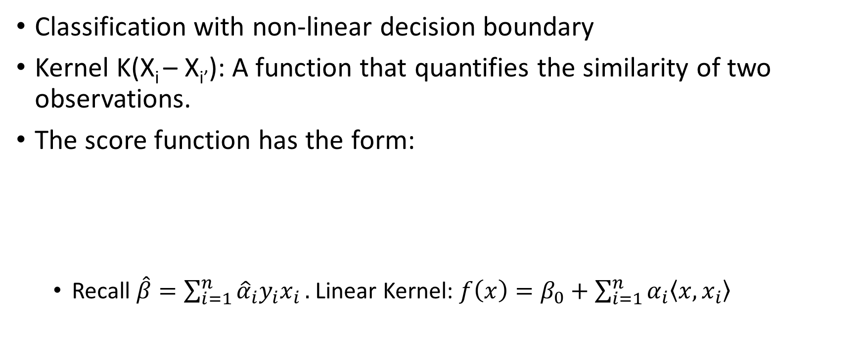
Support Vector Machine
Classification with non-linear decision boundary
Kernel K(X_{i} – X_{i’}): A function that quantifies the similarity of two observations.
The score function has the form:
Recall $\hat{β}=\sum_{i=1}^{n}{{\hat{α}}_{i}y_{i}x_{i}}.$ Linear Kernel: $f\left(x\right)=β_{0}+\sum_{i=1}^{n}{α_{i}\left\langle x, x_{i}\right\rangle }$

Slide 17
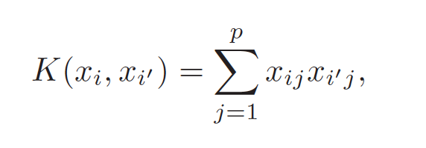
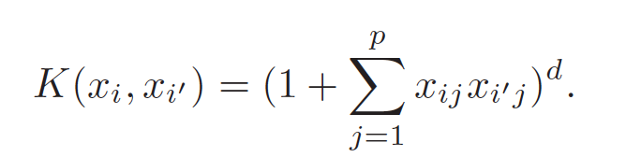
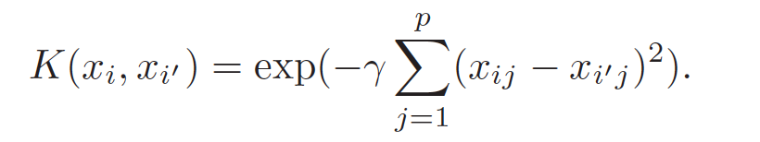
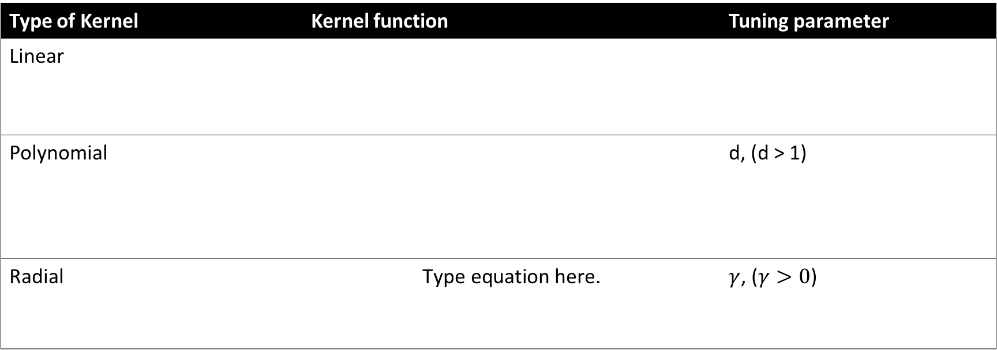
Different types of Kernel
Type of Kernel | Kernel function | Tuning parameter
Linear
Polynomial |  | d, (d > 1)
Radial |  | $γ$, ($γ>0$)

Slide 18
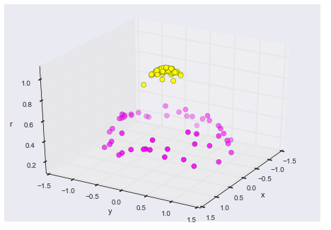
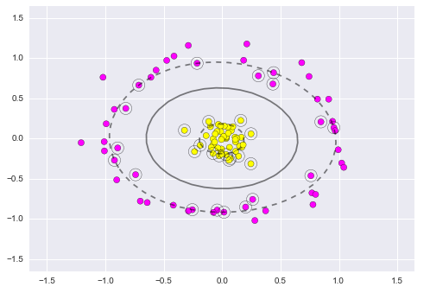
Radial Kernel
Project to a new dimension
Apply SVM, Radial Kernel

Slide 19
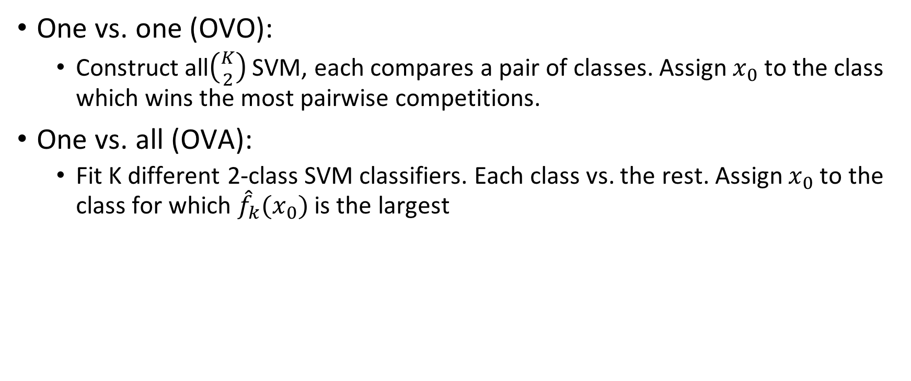
How to deal with more than K classes (K>2)?
One vs. one (OVO):
Construct all$\left({K \atop 2}\right)$SVM, each compares a pair of classes. Assign $x_{0}$ to the class which wins the most pairwise competitions.
One vs. all (OVA):
Fit K different 2-class SVM classifiers. Each class vs. the rest. Assign $x_{0}$ to the class for which ${\hat{f}}_{k}(x_{0})$ is the largest

Slide 20
Extension
How to deal with inbalanced dataset?
Reference: http://machinelearningmastery.com/tactics-to-combat-imbalanced-classes-in-your-machine-learning-dataset/

Slide 21
Weighted samples on SVM
The sample weighting rescales the C parameter, which means that the classifier puts more emphasis on getting these points right.

Slide 22
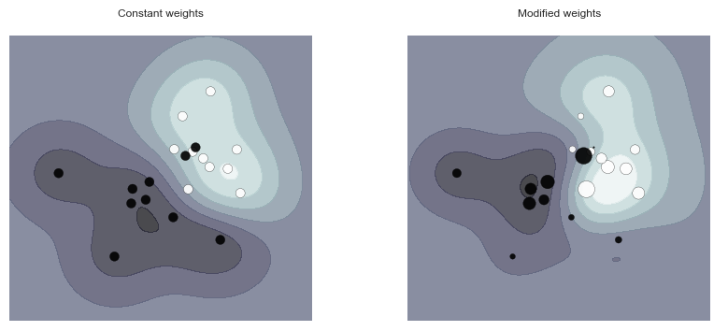
Weighted samples
Plot decision function of a weighted dataset, where the size of points is proportional to its weight.

Slide 23
Reference
The Element of Statistical Learning, 2nd Edition, Chapter 12. Hastie, Tibshirani and Friedman
An Introduction to Statistical Learning with application in R. Chapter 9. James, Witten, Hastie, Tibshirani.
LIBSVM website: https://www.csie.ntu.edu.tw/~cjlin/libsvm/
Scikit-learn website: http://scikit-learn.org/stable/modules/svm.html

