Slide 1
Real or Not? NLP with Disaster Tweets
Jinyi Shang YuanGao
Weifei Wang Yu Cao

Slide 2
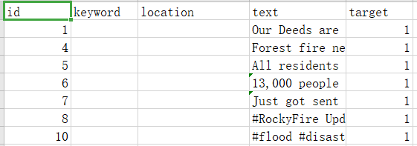
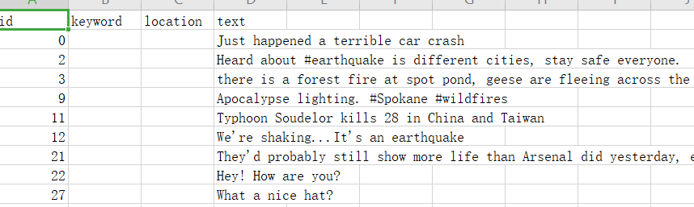
binary classification problem
train：
7613
test：
3264

Slide 3
train test text
preprocess
Mislabel
CONTRACTION_MAP
@/#/http
Repetitive Letter
Abbreviation,
Lowercase
punctuation
Stopwords
Keywords Variable
KNN
SVM
DT
Logistic
Bayes
Random Forest
ML
matrix
bert as service
Accuracy
Roc Curve
PR Curve
result
clean text

Slide 4
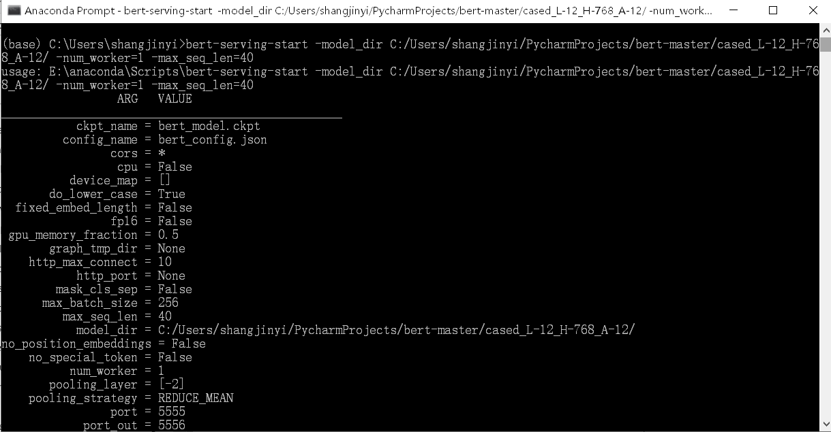
bert as service

Slide 5
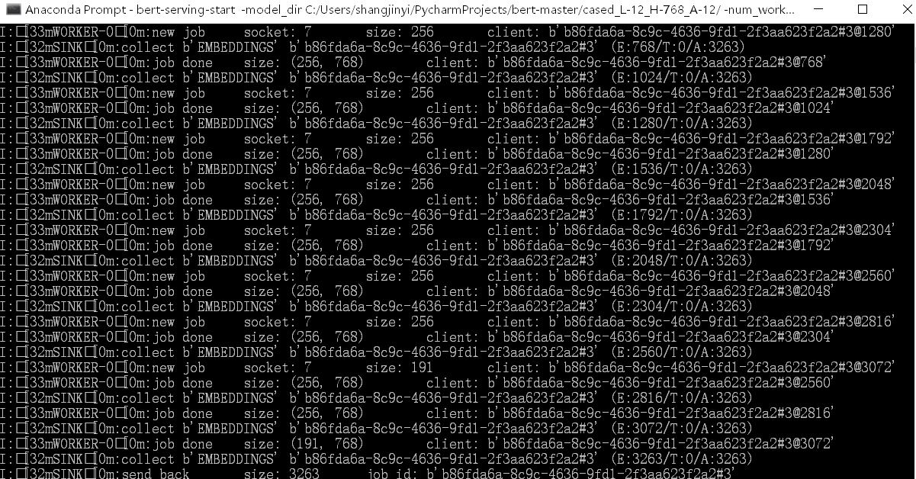

Slide 6
K-Nearest Neighbors (KNN)

Slide 7
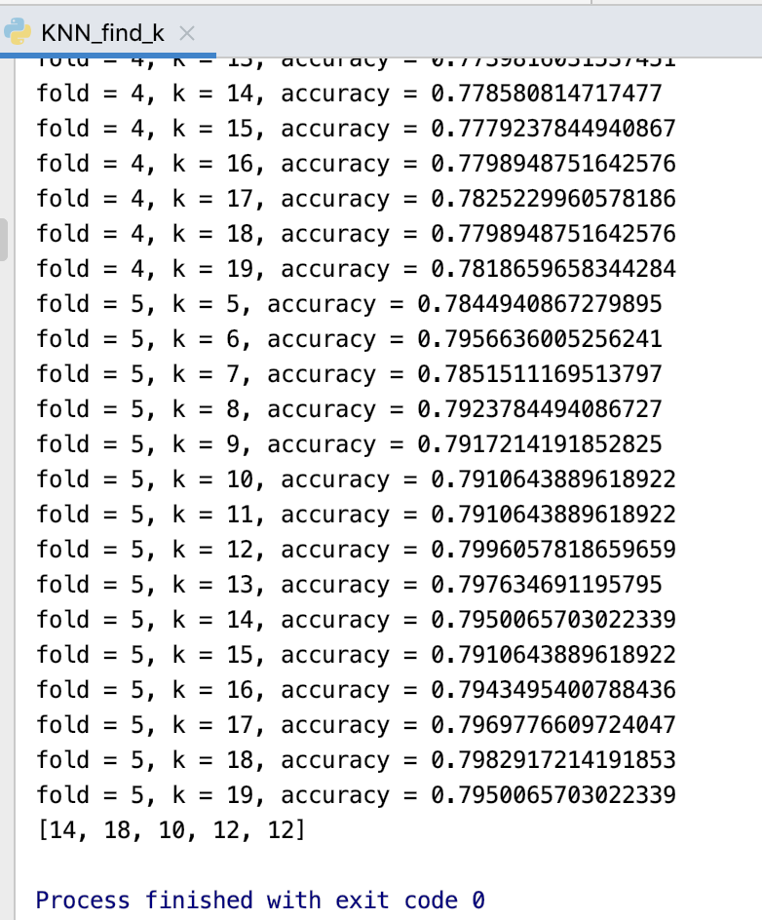
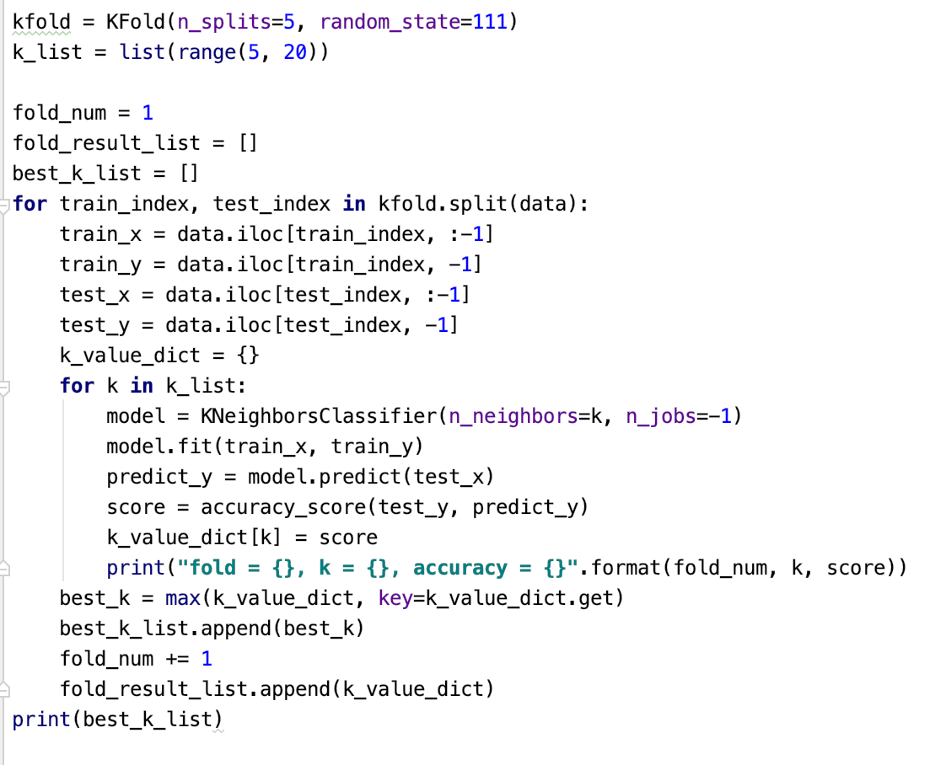
Parameter tuning- k
Compared the score of accuracy in each fold. Then, we got 5 best k for 5 different folds and we picked the best k by majority rule. Thus, the best k is 12.

Slide 8
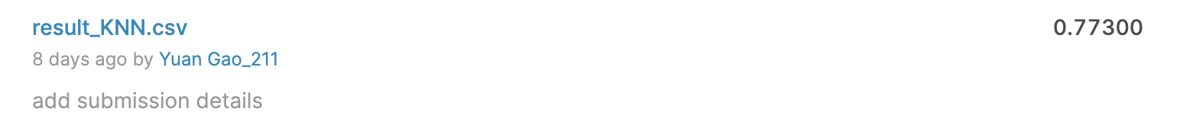
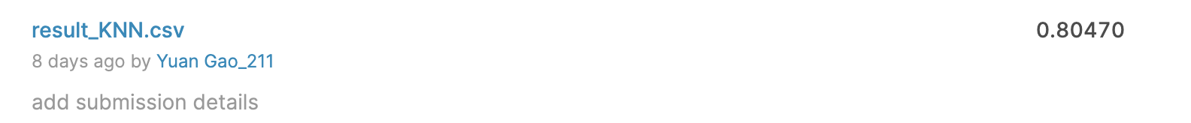
Baseline:
0.77300 is the accuracy score the of KNN’s performance with default.
0.80470 is the Kaggle Accuracy Score of KNN (k=12). . Compare the two scores, we find that the accuracy has been improved by 3%.

Slide 9
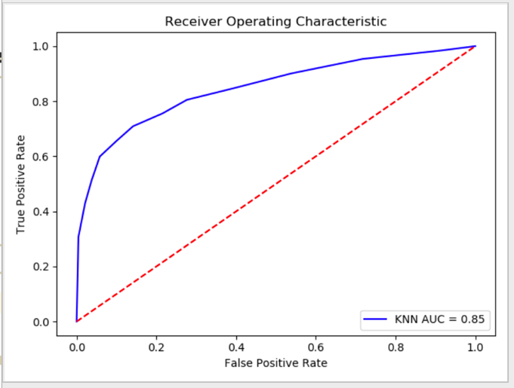
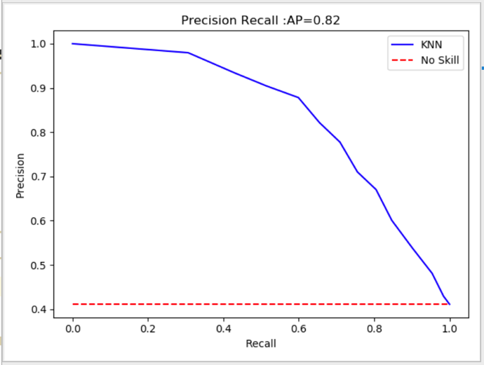
ROC Curve and P-R Curve of KNN Model

Slide 10
For KNN model, the accuracy score is 0.80470 which increased 3% when making k =12. Besides，both the ROC curve and PR curve display that KNN model performs well.

Slide 11
Logistic Regression

Slide 12
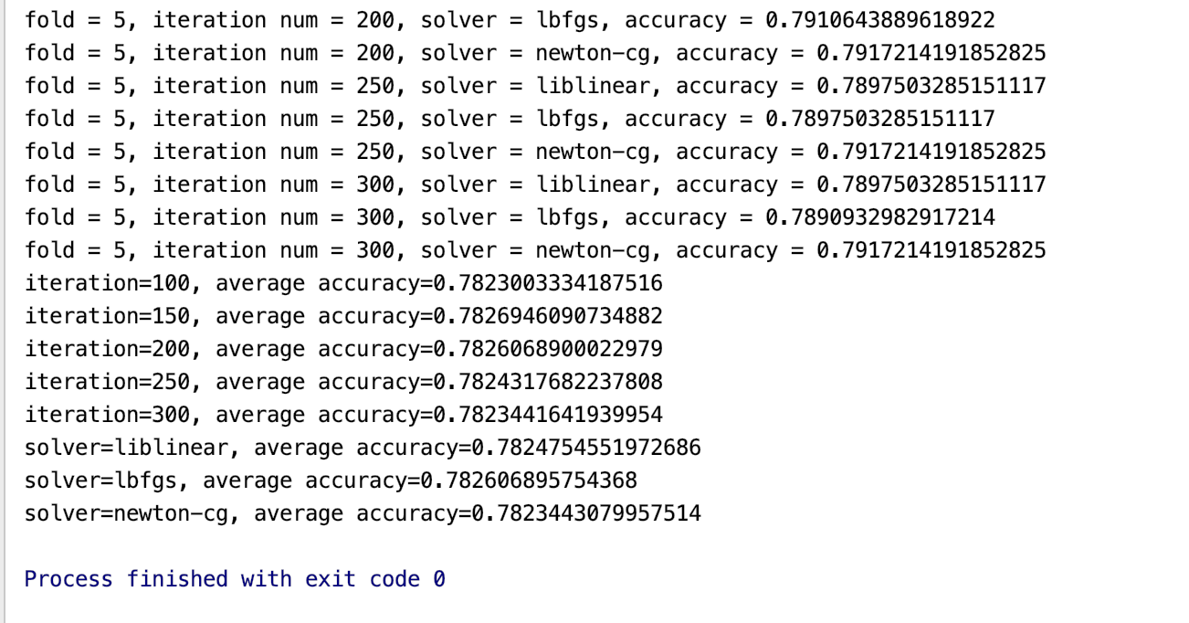
Parameter tuning- iteration num and solver
The parameter for LR Model. “Iteration=150” and “solver= ldfgs” performed best among these parameters.

Slide 13
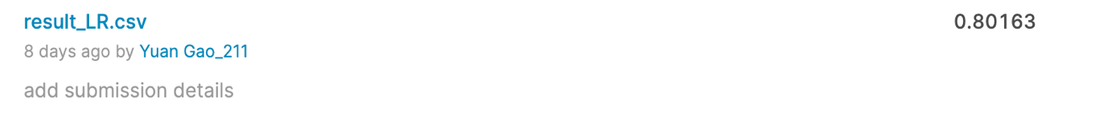
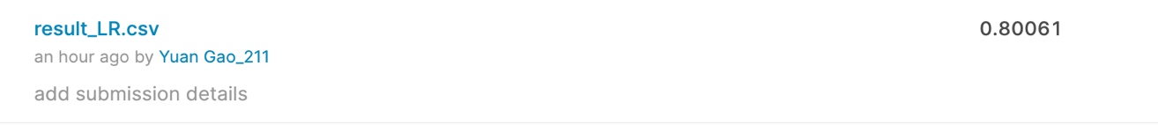
Kaggle Accuracy Score of Logistic Regression (with default).
Kaggle Accuracy Score of Logistic Regression (iteration=150, solver= “ldfgs”). By submitting the Logistic Regression test csv file to Kaggle, it returns the score. The score =0.80061 shows that the parameter changing didn't work well.

Slide 14
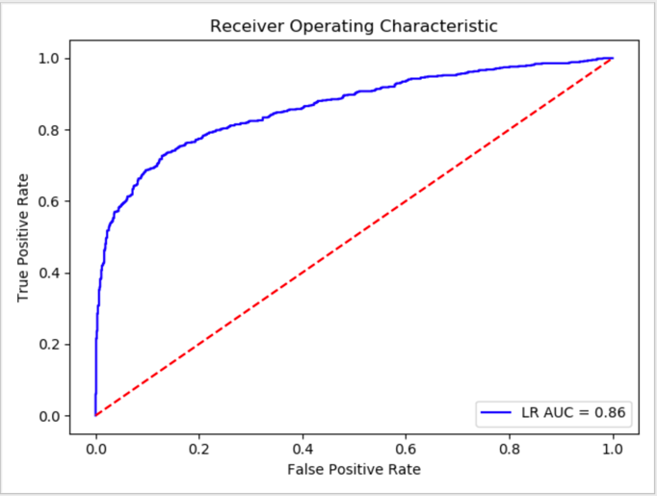
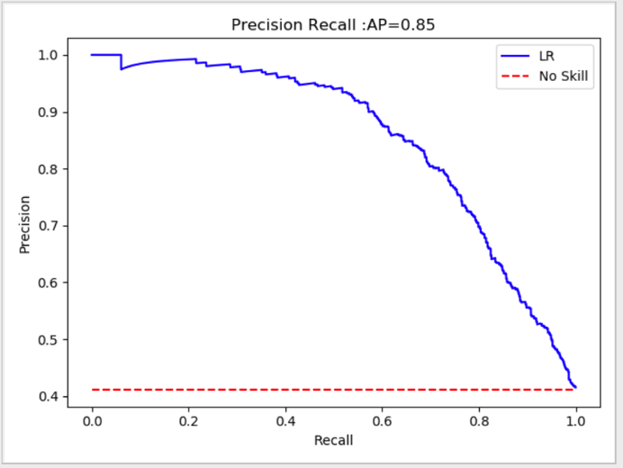
ROC Curve and P-R Curve of Logistic Regression Model

Slide 15
For LR model, unfortunately, the accuracy rate does not increase after changing the default setting, which may indicate two things:
One is that the LR model overfitted for our data. It shows a better performance for fold 2 than other fold which will influence the average score and misleading us for parameters.
The other is that the accuracy score of around 0.80 has shown all the potential for the pre-processed data we worked on.

Slide 16
Decision Tree

Slide 17
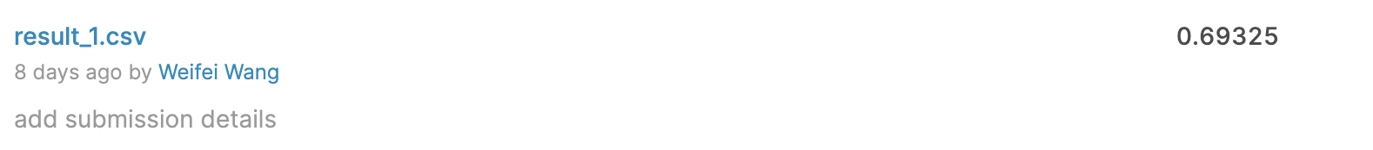
Decision Tree—result1 all train, test predict
Result from Kaggle:
Accuracy is 0.69325

Slide 18
Modify the Parameters of Decision Tree
-Max depth:
-the maximum depth of the tree. No matter how many features can be branched when the depth of the tree reaches max depth, the decision tree will stop computing.
-Max leaf nodes:
-the maximum number of leaf nodes.
-Kfold
-a cross validation method which can evaluate machine learning models and has a single parameter called k that can divide given data into k groups.

Slide 19
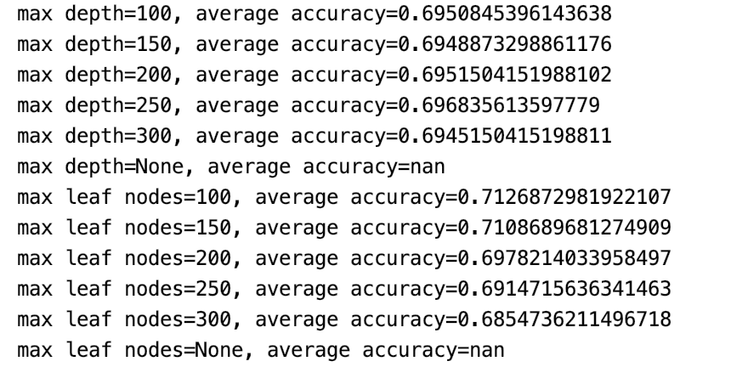
Results of the Modified Parameters
max depth = 250 and max leaf nodes = 100

Slide 20
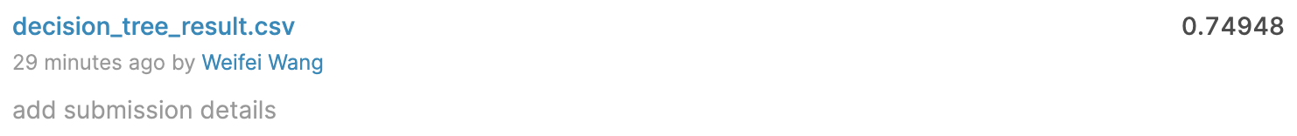
Results
Before
After

Slide 21
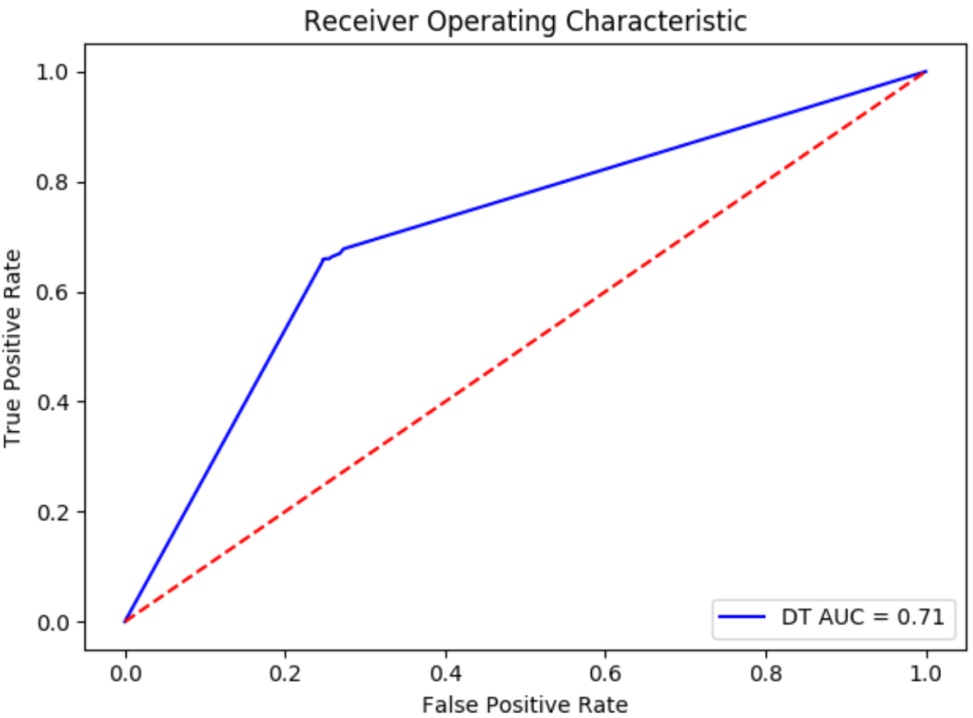
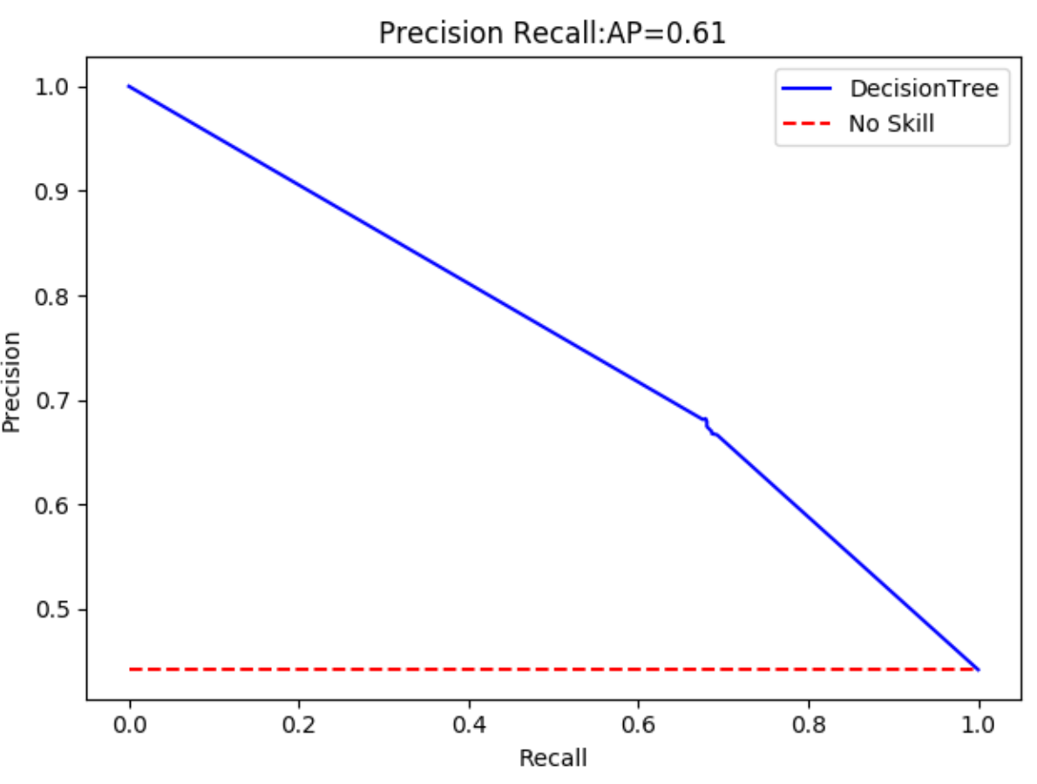
ROC Curve and P-R Curve of Decision Tree Model

Slide 22
Support Vector Machine

Slide 23
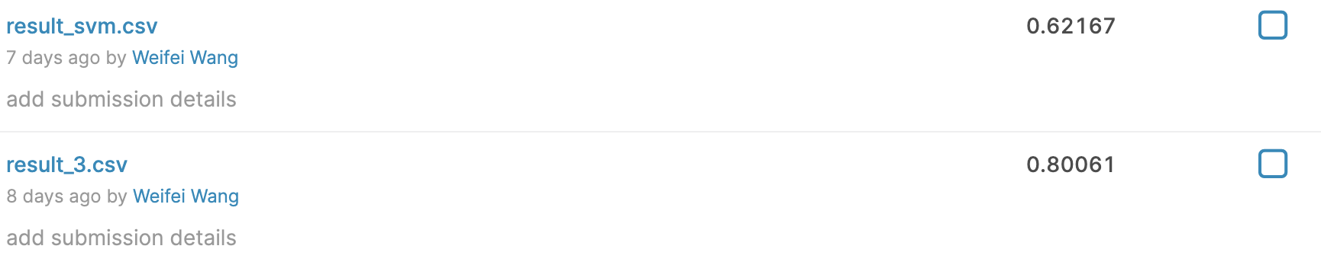
Support Vector Machine—result1 all train, test predict
Result from Kaggle:
Accuracy is 0.62167

Slide 24
Modify the Parameters of Support Vector Machine
-‘C’
-C is the penalty coefficient, that is, tolerance for errors. The higher the c, the more intolerable the error is, and it is easy to overfit.
-‘gamma’
-Determines the distribution of data after mapping into a new feature space. The larger the gamma, the fewer the support vectors, and the smaller the gamma value, the more the support vectors.

Slide 25

Results of the Modified Parameters

Slide 26
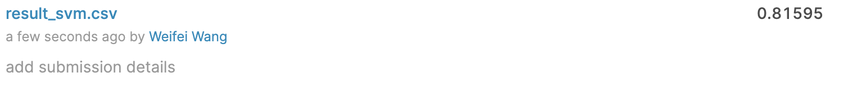
Results
Before
After

Slide 27
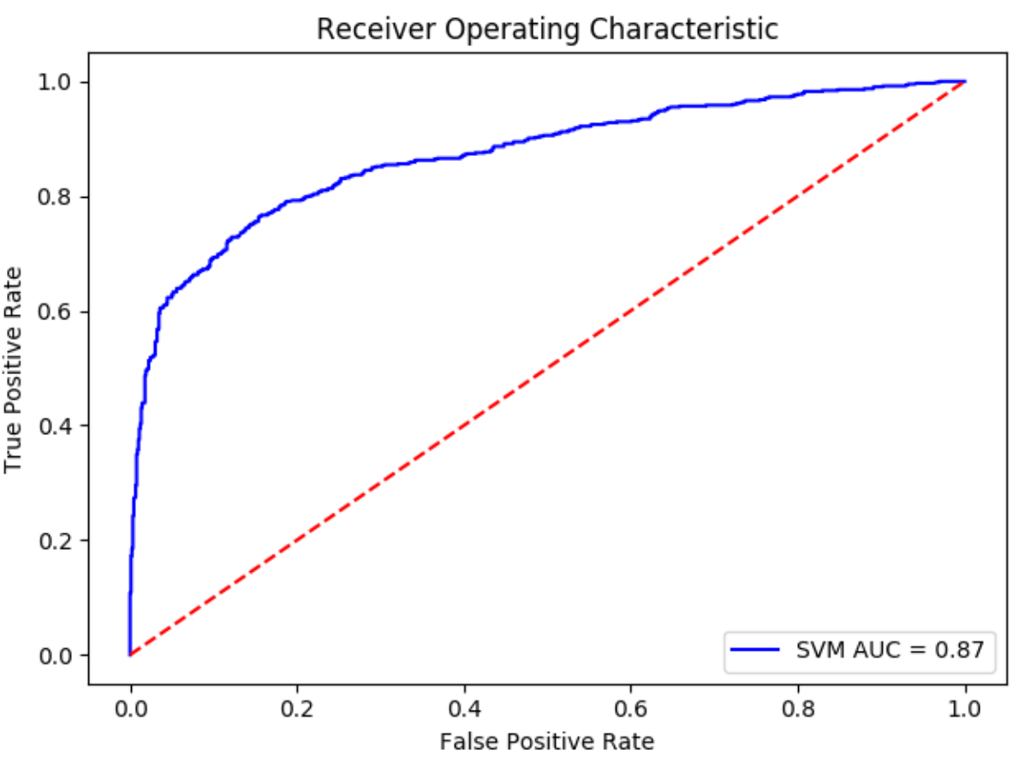
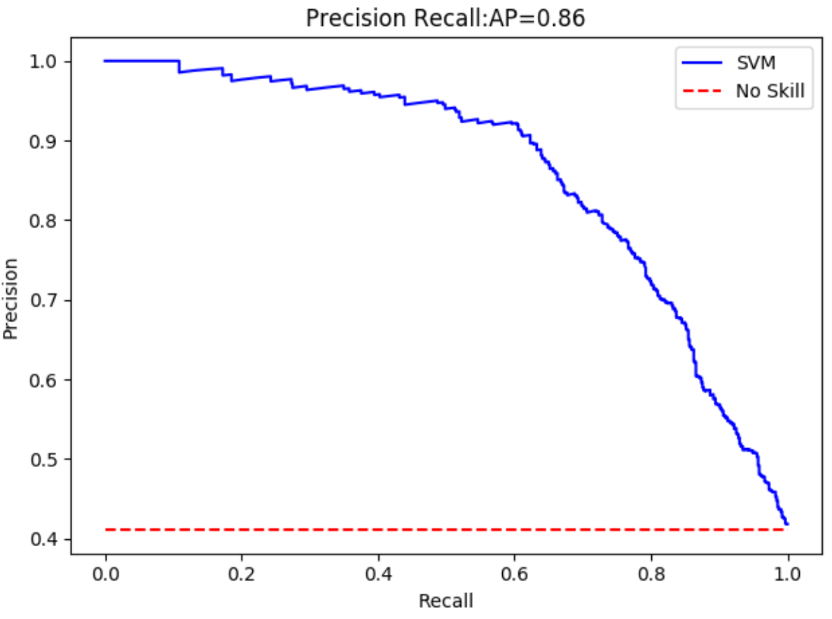
ROC Curve and P-R Curve of Support Vector Machine Model

Slide 28
Random Forest

Slide 29
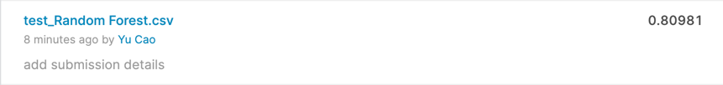
Random Forest—result1 all train, test predict
Result from Kaggle:
Accuracy is 0.80981

Slide 30
Random Forest—result2 only train
1). Accuracy: 0.815
2). Confusion matrix is:
3). Classification:
N = 1523 | Predicted: Yes | Predicted: No
Actual: Yes | 794 | 80
Actual: No | 202 | 447
 | precision | recall | f1-score | support
0 | 0.80 | 0.91 | 0.85 | 874
1 | 0.85 | 0.69 | 0.76 | 649
accuracy |  |  | 0.81 | 1523
macro avg | 0.82 | 0.80 | 0.80 | 1523
weighted avg | 0.82 | 0.81 | 0.81 | 1523

Slide 31
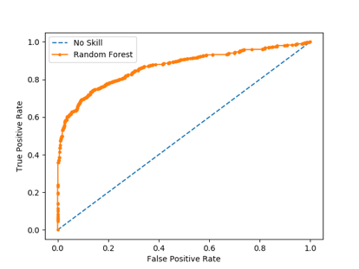
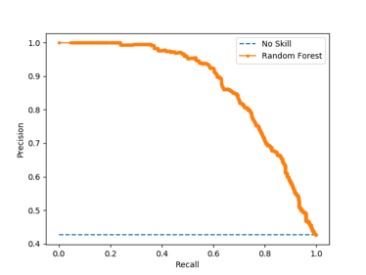
Random Forest—result2 only train
ROC curve and P-R curve:
No Skill: ROC AUC=0.500
Random Forest: ROC AUC=0.866. Random Forest: f1=0.760, P-R AUC=0.870

Slide 32
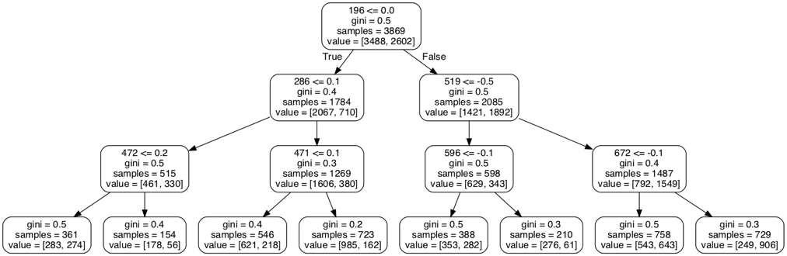
Random Forest—result2 only train
Visualizing a single Decision Tree (Too large to show here)
A smaller tree (max_depth=3) :

Slide 33
Naïve Bayes

Slide 34
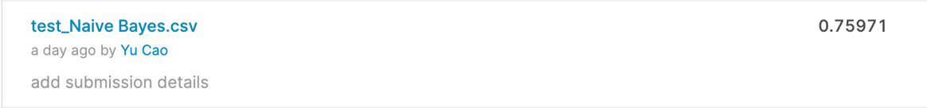
Naïve Bayes—result1 all train, test predict
Result from Kaggle:
Accuracy is 0.75971

Slide 35
Naïve Bayes—result2 only train
1). Accuracy: 0.759
2). Confusion matrix is:
3). Classification:
N = 1523 | Predicted: Yes | Predicted: No
Actual: Yes | 683 (TP) | 191 (FN)
Actual: No | 176 (FP) | 473 (TN)
 | precision | recall | f1-score | support
0 | 0.80 | 0.78 | 0.79 | 874
1 | 0.71 | 0.73 | 0.72 | 649
accuracy |  |  | 0.76 | 1523
macro avg | 0.75 | 0.76 | 0.75 | 1523
weighted avg | 0.76 | 0.76 | 0.76 | 1523

Slide 36
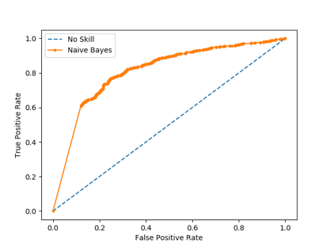
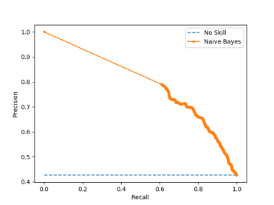
Naïve Bayes—result2 only train
ROC curve and P-R curve:
No Skill: ROC AUC=0.500
Naïve Bayes: ROC AUC=0.810. Naïve Bayes: f1=0.720, P-R AUC=0.794

Slide 37
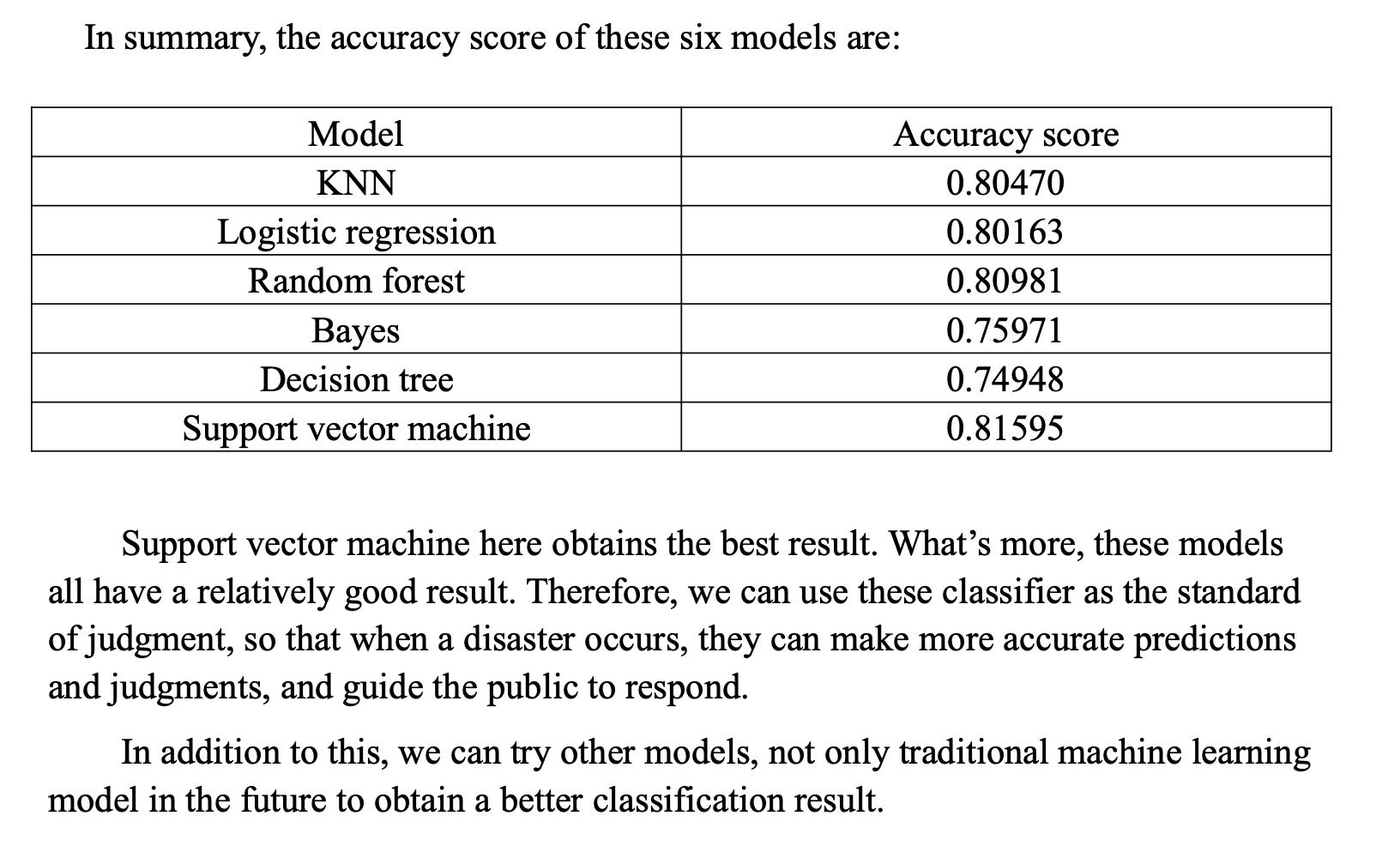
Conclusion

Slide 38
Group Three Presentation
Thanks
Group members：Jinyi Shang, Weifei Wang
Yuan Gao, Yu Cao

Slide 39


Slide 40
Random Forest--parameters
n_estimators: the maximum number of iterations of the weak learner. Default is 10. Generally, the accuracy of the model is higher while ‘number of sub-models’ is larger.
bootstrap: samples be replaced? (True)
oob score: use out-of-bad samples to evaluate the quality of model? (False)
criterion: the evaluation criteria for features when tree is divided. (Gini coefficient)

Slide 41
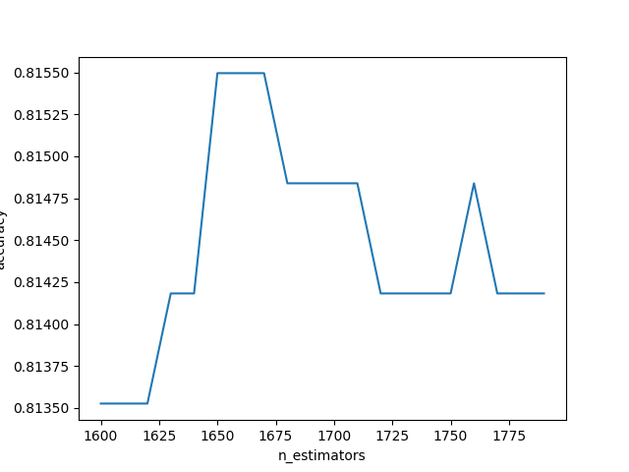
n_estimators
Choose: n_estimators as 1660

