Slide 1
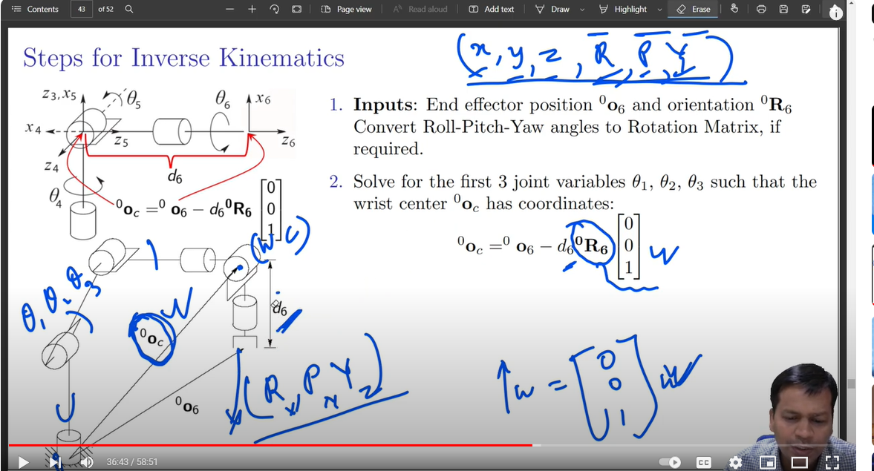

Slide 2
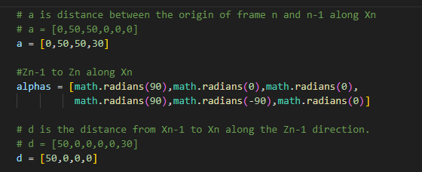
MCK Robot DH coordination and parameters
a2
d4
X₃
Link ID | a | d | Alpha | Theta
1 | 0 | 50 | 90 | 0
2 | 50 | 0 | 0 | 0
3 | 0 | 0 | 90 | 90
4 | 0 | 50 | 90 | -180
5 | 0 | 0 | 90 | 90
6 | 0 | 30 | 0 | 0
Z₃
Y₅
X₅
Y₁
Y₂
Y₃
θ₃
θ₄
θ₅
Z₅
θ₂
X₁
X₂
Y₄
Z₁
Z₂
Z₄
X₄
d6
d1
θ₁
θ₆
Z₀
Y₆
X₆
Y₀
X₀
Z₆

Slide 3
MCK Robot DH coordination and parameters
a2
d4
Y₆
X₆
X₃
Link ID | a | d | Alpha | Theta
1 | 0 | 50 | 90 | 0
2 | 50 | 0 | 0 | 0
3 | 0 | 0 | 90 | 90
4 | 0 | 50 | 90 | -180
5 | 0 | 0 | 90 | 90
6 | 0 | 30 | 0 | 0
Z₃
Y₅
X₅
Y₃
θ₆
Z₆
Y₁
Y₂
θ₃
θ₄
Z₅
θ₂
X₁
X₂
θ₅
Y₄
Z₁
Z₂
Z₄
X₄
d6
d1
θ₁
Z₀
Y₀
X₀
TCP

Slide 4
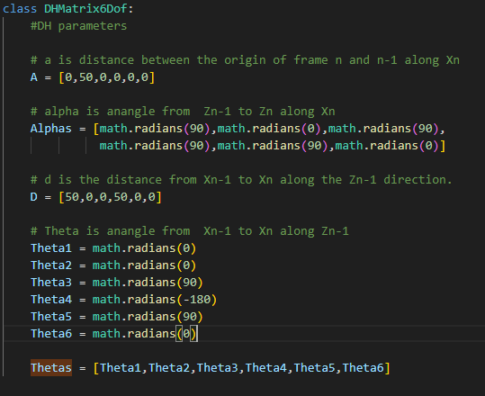


MCK Robot DH coordination and parameters
a2
d4
Y₆
X₆
X₃
Link ID | a | d | Alpha | Theta
1 | 0 | 50 | 90 | 0
2 | 50 | 0 | 0 | 0
3 | 0 | 0 | 90 | 90
4 | 0 | 50 | 90 | -180
5 | 0 | 0 | 90 | 90
6 | 0 | 30 | 0 | 0
Z₃
Y₅
X₅
Y₃
θ₆
Z₆
Y₁
Y₂
θ₃
θ₄
Z₅
θ₂
X₁
X₂
θ₅
Y₄
Z₁
Z₂
Z₄
X₄
d6
d1
θ₁
Z₀
Y₀
X₀
TCP

Slide 5
Pflange
TFlangeTCP
Ptcp
Tb2f
Tbtcp

Slide 6
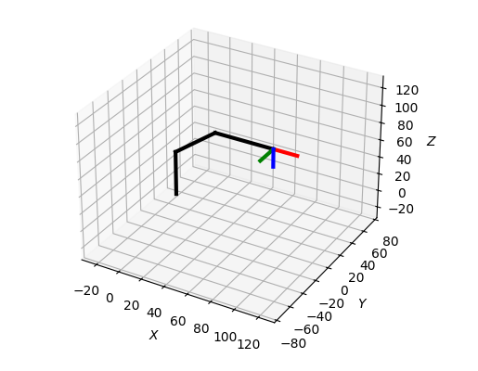
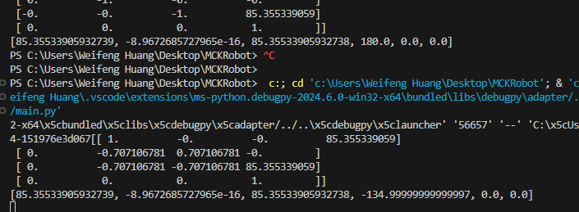
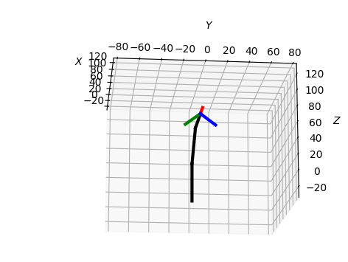
J4-6 are 0
J4 45

