Slide 1
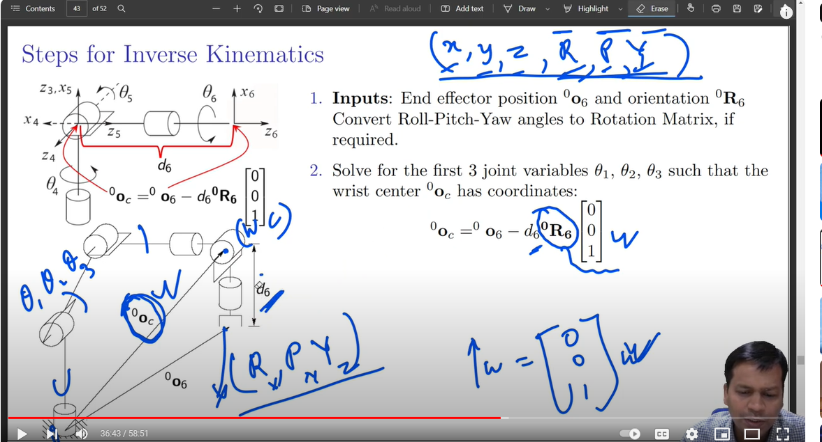

Slide 2
a1
a2
Y₁
Y₁
Y₂
X₃
X₁
θ₂
θ₃
θ₄
X₁
X₂
Z₃
Z₁
Z₁
Z₂
Y₃
d1
Y₀
θ₁
Z₀
X₀
Y₀
Z₀
X₀

Slide 3
https://www.mecademic.com/academic_articles/space-orientation-euler-angles/

