Slide 1



Fast Segmented Sort on GPUs
Kaixi Hou†, Weifeng Liu‡, Hao Wang†, Wu-chun Feng†
†{kaixihou, hwang121, wfeng}@vt.edu
‡ weifeng.liu@nbi.ku.dk
ACM ICS 2017, Chicago, IL, USA
Notes:
Good morning, everyone. Thanks for the introduction.

Slide 2
Segmented Sort (SegSort)
Perform a segment-by-segment sort on a given array composed of multiple segments
seg_ptr =
0
3
5
7
input =
4
1
2
11
8
1
6
5
Segmented sort
output =
1
2
4
8
11
1
6
5

Slide 3
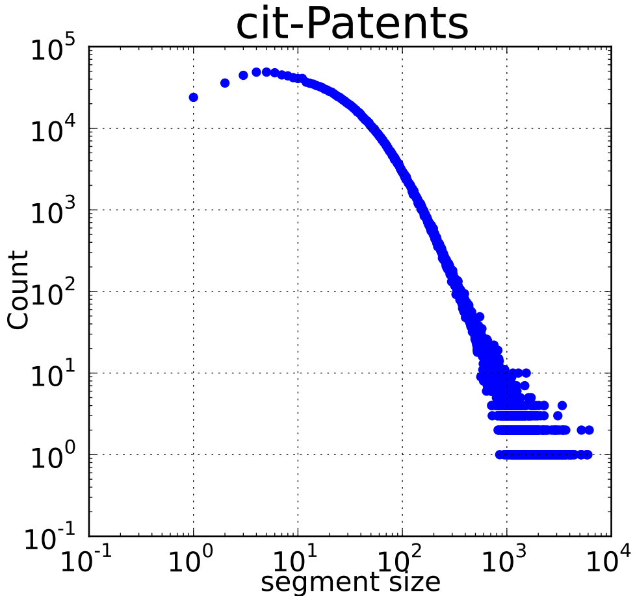
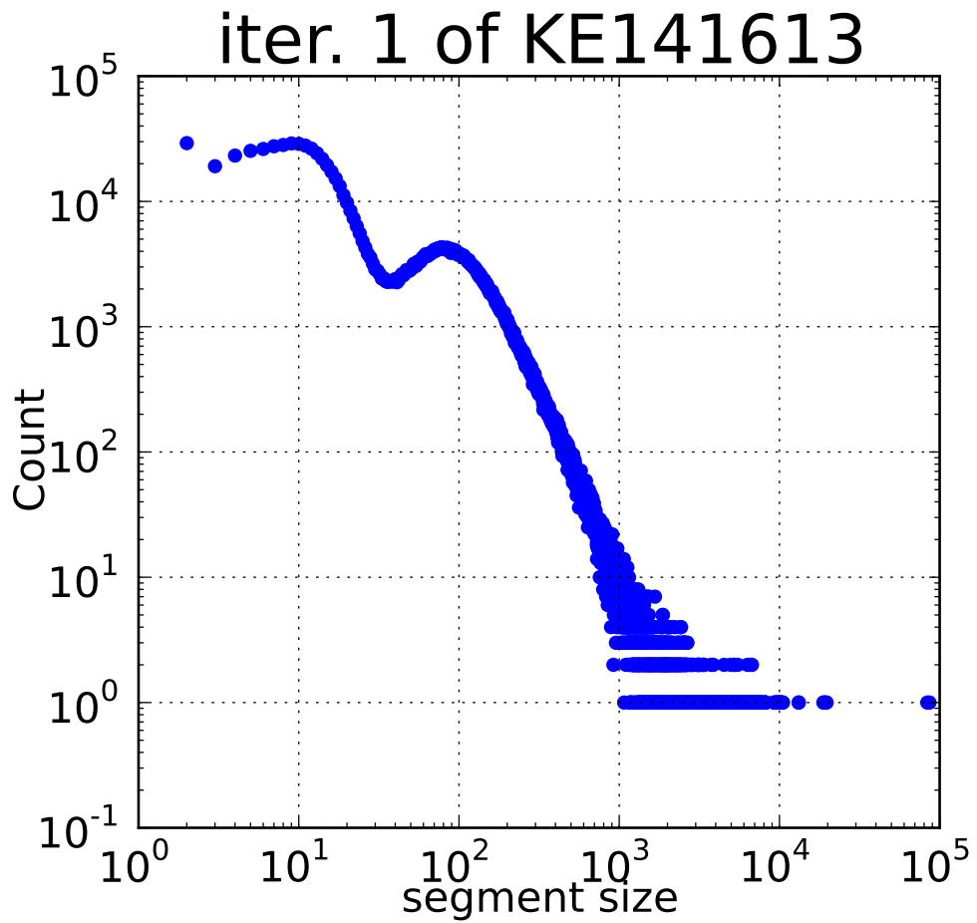
Why Segmented Sort?
Many applications need to process (e.g., sort) a large amount of independent arrays, due to: (1) dataset properties, (2) algorithm characteristics
We need an efficient way to deal with the large amount of independent short arrays.
Affected by datasets
Affected by algorithm
Segment statistics from squaring one matrix in SpGEMM*
Segment statistics from 1st iteration in SAC*
* SpGEMM: Sparse General Matrix-Matrix Multiplication; SAC: Suffix Array Construction
Notes:
SpGEMM processes many NON-ZERO values grouped by their column or row indices. As we know, many real-world sparse matrices follow power-low distribution, which causes these grouped values are also power-law distributed, which we can see from this figure. In addition, a majority of them are very short. (Actually, you might notice that yesterday one speaker from OSU also mentioned that they can efficiently solve short segments by using so-called ESC method, which we also use and will be discussed later.)
SAC processes lots of substrings of DNA sequences. Some algorithms need to split the substrings in each iteration, leading to many short segments.

Slide 4

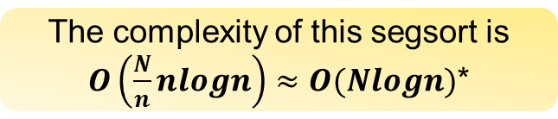
Existing Segmented Sort
Global sort has received much more fanfare!
Many tools are evolved from global sort; however, there are also problems
Problem 1: Time complexity
n
n
n
n
n
n
n
n
n
n
input
N
N
solved by
The complexity of this segsort is $O\left(\frac{N}{n}nlogn\right)≈O(Nlogn)$*
The complexity of the global sort is $O(NlogN)$*
SegSort, evolved from global sort, usually exhibits higher complexity, e.g., segsort from modernGPU and CUSP
* For generality, the sorting algorithms are all comparison-based.

Slide 5
Existing Segmented Sort
Global sort has received much more fanfare!
Many tools are evolved from global sort; however, there are also problems
Problem 1: Time complexity
Problem 2: Runtime boundary checking overhead
input
Every thread needs to check boundary of segments for every comparison
thread blocks
Some SegSort needs to perform runtime boundary checking, causing additional overhead, e.g., segsort from modernGPU

Slide 6
Existing Segmented Sort
Global sort has received much more fanfare!
Many tools are evolved from global sort; however, there are also problems
Problem 1: Time complexity
Problem 2: Runtime boundary checking overhead
Problem 3: Underutilized resources
input
Many threads might be idle, especially when the segments are generally short
…
thread blocks
Some SegSort simply assigns each segment to each thread block, leading to idle resources, e.g., segsort from CUB

Slide 7
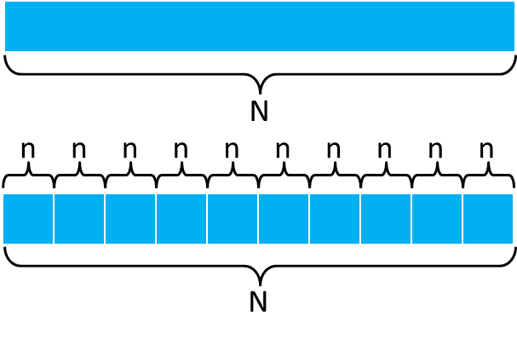
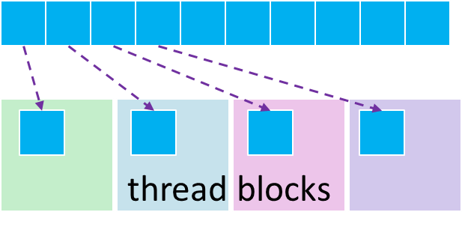
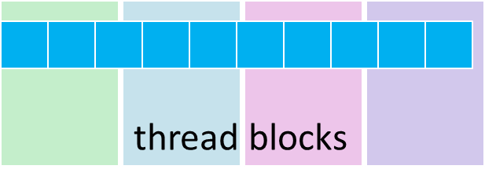
Fast Segmented Sort (this work)
High complexity
Checking overhead
Idle resources
We propose an adaptive segmented sort mechanism for GPUs: (1) differentiated methods for different segments, (2) an algorithm supporting variable data-thread binding and thread communication.
Notes:
So for, …

Slide 8
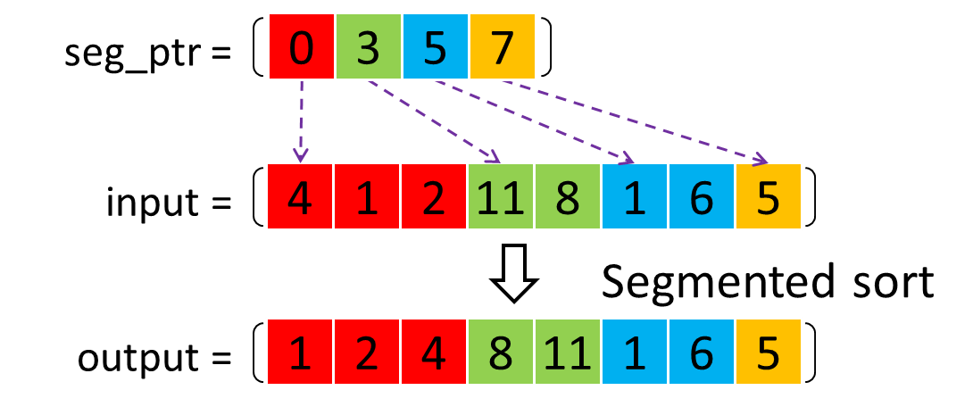
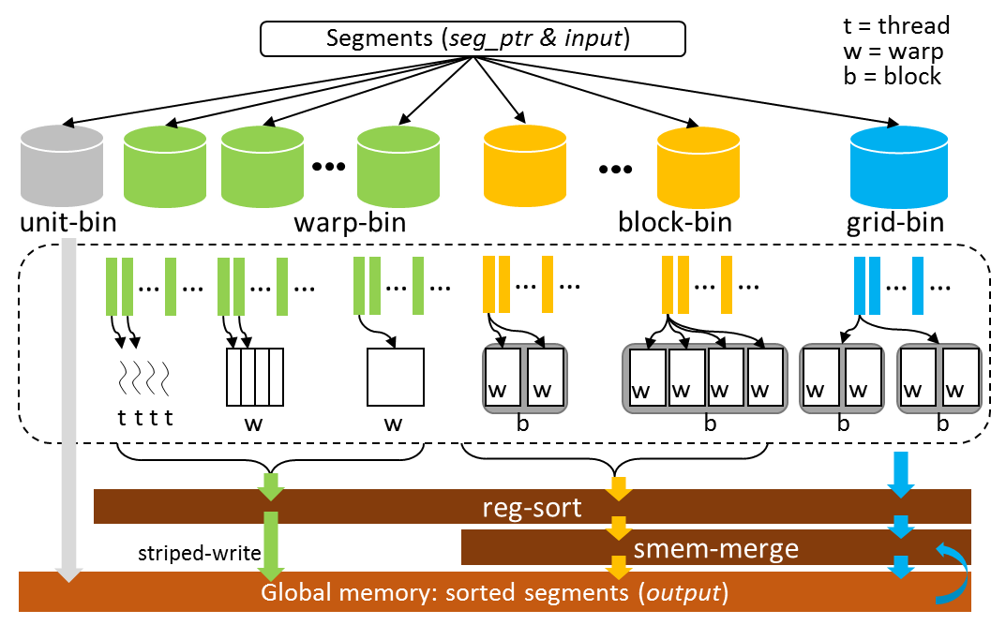
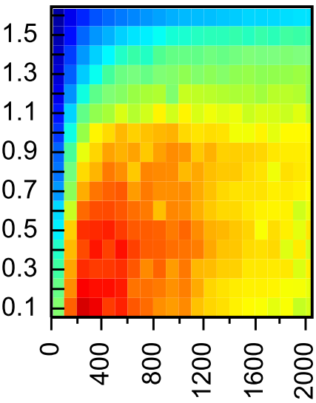
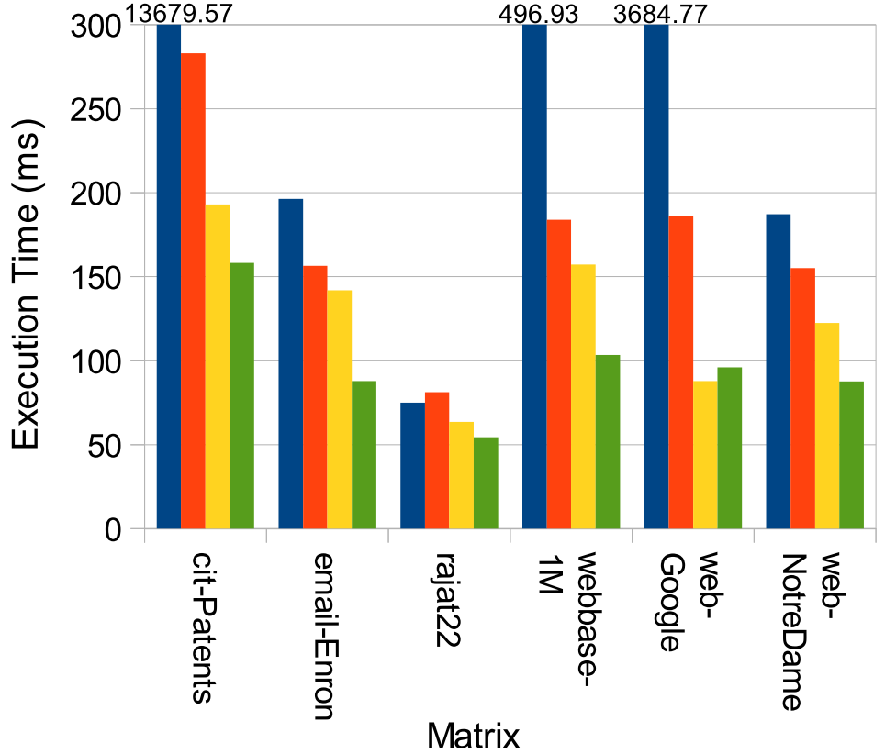
Outline
Introduction
Motivation
Our Method
GPU SegSort Mechanism
GPU Register-based Sort
Other Techniques & Opt.
Evaluation
Kernel Performance
Kernel in Real Applications

Slide 9
Adaptive GPU SegSort Mechanism
Overview of our proposed GPU SegSort design
Hierarchical binning (register/smem/gmem levels)
t = thread
w = warp
b = block
Segments (seg_ptr & input)
unit-bin
Directly copy segments to the result in global memory
block-bin
grid-bin
warp-bin
…
…
…
…
…
…
…
…
…
…
…
…
Only use registers as “cache”
Data-thread binding/exchange
Memory access optimization
Use registers + smem as “cache”
MergePath algorithm for load balance
w
w
w
w
w
w
w
w
w
w
t
t
t
t
w
w
b
b
b
b
reg-sort
striped-write
smem-merge
Global memory: sorted segments (output)
Notes:
Binning
Different parallel strategies, warp-level (e.g., sub-warp), block-level, grid-level
Grid bin solution reuses the previous kernels of register or smem.

Slide 10
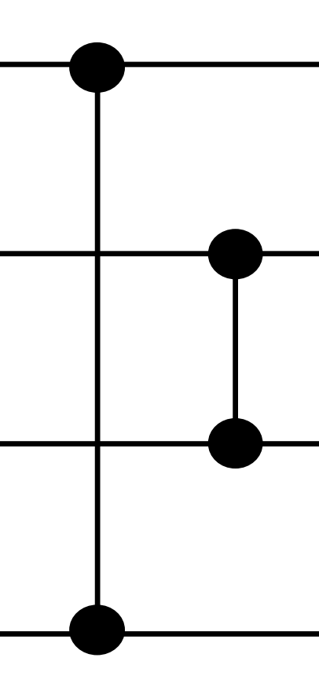
GPU Register-based Sort
Sorting networks usually serve as building blocks of efficient parallel sort
How to bind the data items (operands) to different threads?
rg0
Each thread uses too many registers (high register pressure)
rg1
tid=0
rg2
7
0
rg3
3
1
1
2
Both need to figure out data exchange patterns among registers and threads
2
3
unsorted
sorted
6
4
0
5
rg0
tid=0
5
6
Each comparison is performed twice (wasted computing resources)
rg0
tid=1
4
7
rg0
tid=2
rg0
tid=3

Slide 11
GPU Register-based Sort
Propose a general way to solve the data-thread binding problem at GPU register level
Primitive pattern
Two data items are bound to each thread
Tells which thread swaps registers
_exch_primitive(rg0, rg1, tmask, swbit)
Tells how threads communicate
_exch_primtive(rg0,rg1,0x1,0)
Implementation Details
rg0
(4)
(1)
rg0(4)
(4)
(1)
(1)
(1)
tid=0
rg1
(3)
(2)
rg1(3)
(1)
(4)
(4)
(2)
rg0
(2)
(3)
rg0(2)
(2)
(2)
(3)
(3)
tid=1
rg1
(1)
(4)
rg1(1)
(3)
(3)
(2)
(4)
①
②
③
④
① _shuf_xor(rg1, 0x1); // Shuffle data in rg1
② cmp_swp(rg0, rg1); // Compare data of rg0 & rg1 locally
③ if( bfe(tid,0) ) swp(rg0, rg1); // Swap data of rg0 & rg1 if 0 bit of tid is set
④ _shuf_xor(rg1, 0x1); // Shuffle data in rg1
Notes:
Our proposed primitive pattern follows this form: two data items are bound to each thread, tmask tells which thread is the destination thread, swbit tells which thread needs to swap registers to avoid register conflict.

Slide 12
GPU Register-based Sort
Other patterns, then, can be solved by transformation and the primitive patterns
Intersecting Pattern
Any number of data items are bound to each thread
Tells which thread swaps registers
_exch_intxn(rg0, rg1, …, rgk-1, tmask, swbit)
Tells how threads communicate
Transforming via swapping
rg0
rg0
rg1
rg1
Applying primitive patterns on related pairs
t0
rgk-2
rgk-2
rgk-1
rgk-1
rg0
rg0
t1
rg1
rg1
rgk-2
rgk-2
rgk-1
if(bfe(tid,swbit))
swp(rg0,rgk-2)
swp(rg1,rgk-1)
…
rgk-1

Slide 13
GPU Register-based Sort
Other patterns, then, can be solved by transformation and the primitive patterns
Parallel Pattern
Any number of data items are bound to each thread
Tells which thread swaps registers
_exch_paral(rg0, rg1, …, rgk-1, tmask, swbit)
Tells how threads communicate
Transforming via swapping
rg0
rg0
rg1
rg1
Applying primitive patterns on related pairs
t0
rgk-2
rgk-2
rgk-1
rgk-1
rg0
rg0
rg1
rg1
t1
rgk-2
rgk-2
rgk-1
if(bfe(tid,swbit))
swp(rg0,rg1)
swp(rg2,rg3)
…
rgk-1

Slide 14
GPU Register-based Sort
Also, we can solve patterns without thread communication
“Communication” only occurs between registers
Local Pattern
Any number of data items are bound to each thread
_exch_local(rg0, rg1, …, rgk-1, rmask)
Tells how registers compare with each other
rg0
rg1
t0
rgk-2
rgk-1
rg0
t1
rg1
rgk-2
rgk-1

Slide 15
GPU Register-based Sort: An Example
Represent the sorting network by using our generalized patterns
reg_sort(data items=8, thread num=4)
①
②
③
④
⑤
⑥
rg0
t0
①_exch_local(rg0,rg1);
②_exch_intxn(rg0,rg1,0x1,0);
③_exch_local(rg0,rg1);
④_exch_intxn(rg0,rg1,0x3,1);
⑤_exch_paral(rg0,rg1,0x1,0);
⑥_exch_local(rg0, rg1);
rg1
rg0
t1
rg1
rg0
t2
rg1
rg0
t3
rg1
Read our paper and see more details of (1) how to automatically decide which patterns to use, (2) how to order the patterns, (3) how to compute the parameters (e.g., tmask)

Slide 16
Other Techniques & Optimizations
A hierarchical binning
Using warp vote function __balloc() and __popc() at warp level
Using shared memory at thread-block level
Better locality by optimizing access pattern
Transforming striped write to coalesced memory access
Shared memory based merge solution
MergePath algorithm [`12] for load balance
Striped-access
Coalesced-access
Stride=1
Stride=2
rg0
rg1
swap
exchange
swap
swap
exchange
swap
t0
1
2
1
2
1
3
1
3
1
3
1
5
1
5
t1
3
4
4
3
4
2
2
4
2
4
2
6
2
6
t2
5
6
5
6
5
7
5
7
7
5
7
3
3
7
t3
7
8
8
7
8
6
6
8
8
6
8
4
4
8
input
shuf_xor(rg1,0x1)
shuf_xor(rg1,0x2)
output

Slide 17
Outline
Introduction
Motivation
Our Method
GPU SegSort Mechanism
GPU Register-based Sort
Other Techniques & Opt.
Evaluation
Kernel Performance
Kernel in Real Applications

Slide 18
Experiment Platforms
nVidia Tesla K80 (Kepler-GK210), 2496 CUDA cores @ 824 MHz, 240 GB/s bandwidth
nVidia TitanX (Pascal-GP102), 3584 CUDA cores @ 1531 MHz, 480 GB/s bandwidth
We compare our SegSort to other tools from libraries of
ModernGPU v.2.0 (boundary checking, global sort based)
CUSP* v.0.5.0 (global sort based)
CUB v.1.6.4 (segment per block)
Generating datasets to mimic different segment distributions
We compare SAC and SpGEMM optimized by our SegSort to
cuDPP v.2.3 for SAC
cuSPARSE [`16], CUSP [`14], bhSPARSE [`14] for SpGEMM
Using real input datasets from NCBI library and UF matrix collection
* CUSP performs segmented sort by using THRUST sort twice. We extract this as a stand-alone function.
Notes:
1:30s

Slide 19
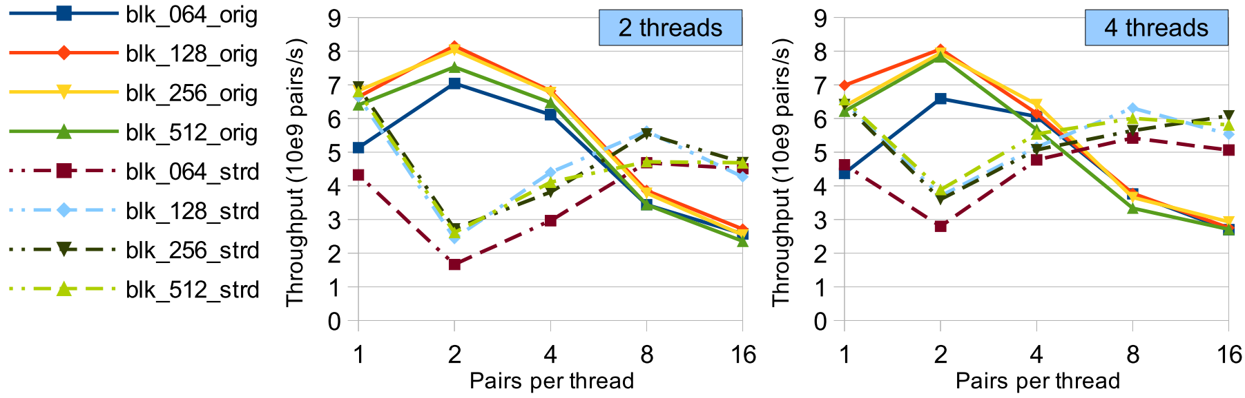
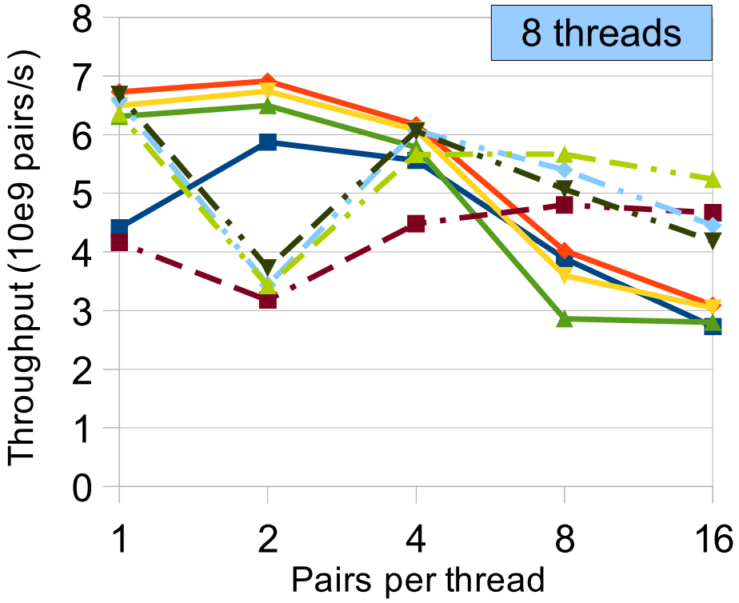
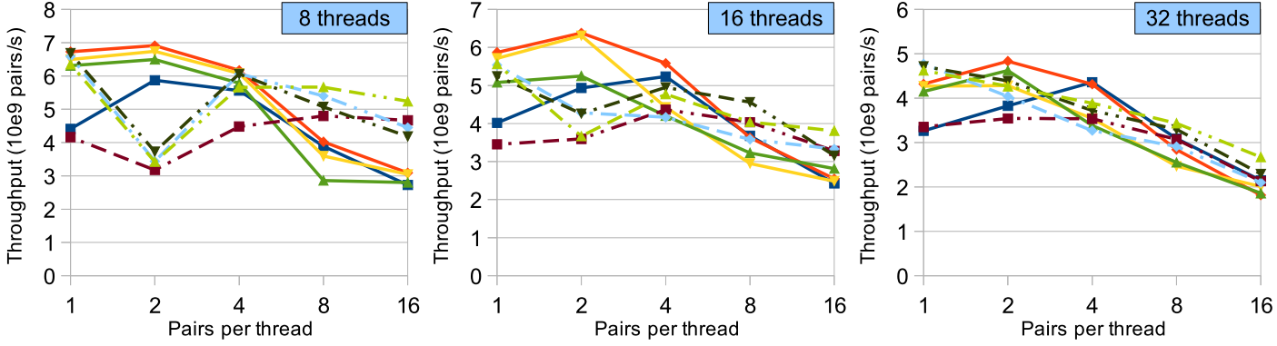
Kernel Performance Tuning
Binding different number of data items to threads (reg_sort)
Kepler GPU
Striped access
Coalesced access
Notes:
Before talking about the complete segmented sort kernels, I want to first share two slides about how we tune the performance by using different number of data items to different number of threads.
X-axis = different data items per thread, y-axis = performance in throughput (higher is better)
In addition, we vary the number of blocks and different data access patterns.
If we bind more data items in one thread, coalesced access is more required, which is shown in the dashed lines.
Also, the performance is sensitive to how many data items are bound to each thread.

Slide 20
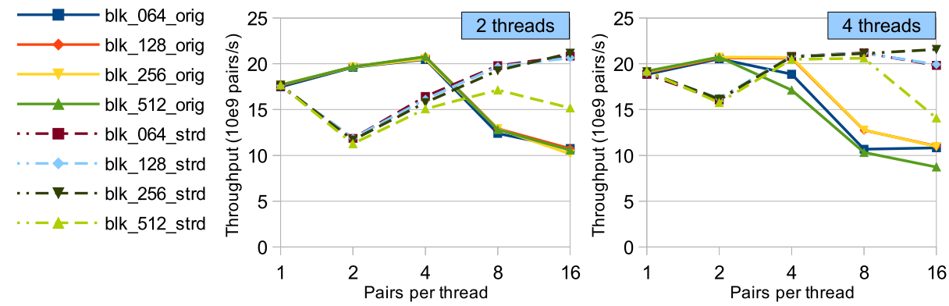
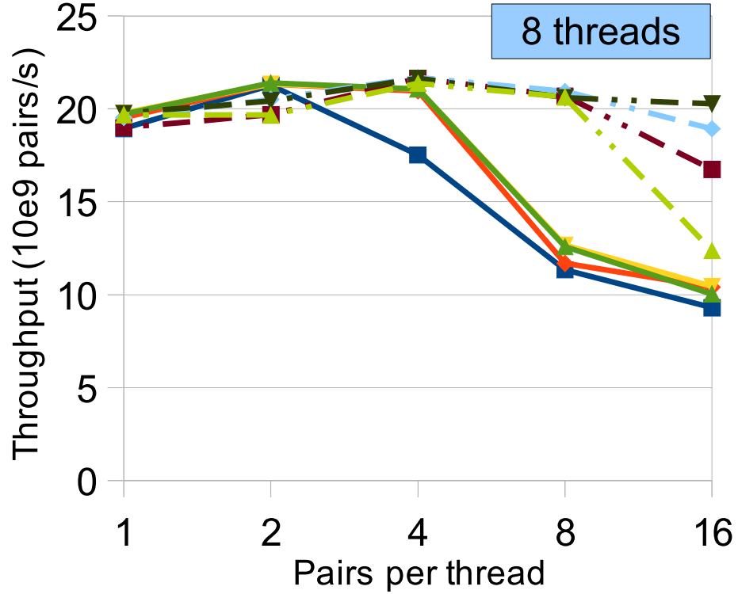
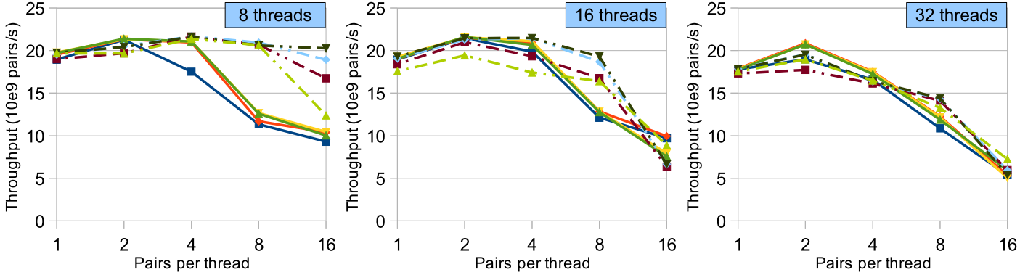
Kernel Performance Tuning
Binding different number of data items to threads (reg_sort)
Pascal GPU
Striped access
Coalesced access
Notes:
Similarly, the coalesced access is more essential for the performance, which is shown in the dashed lines.
Also, the performance is not that sensitive to how many data items are bound to each thread. This is because that Pascal has more registers for each thread to use, since Pascal shrinks its core numbers in each streaming multiprocessor.

Slide 21
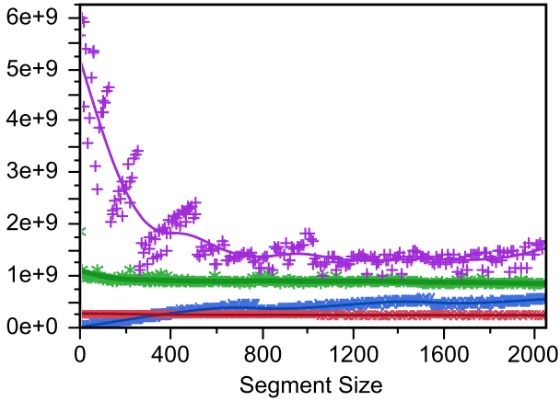
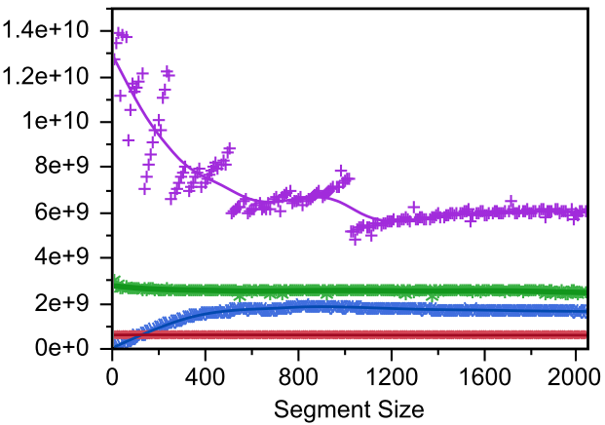

SegSort Performance
Fixing total data size w/ variable segment number and size
Our SegSort is proficient in solving a large amount of segments, achieving an average of 3.2x speedups over the better performed baseline mgpu-segsort on Pascal
The performance of SegSorts, evolved from global sort, is more affected by the total array size
Kepler GPU
Pascal GPU
(268m)
(671k)
(336k)
(224k)
(168k)
(134k)
(268m)
(671k)
(336k)
(224k)
(168k)
(134k)
Segment size (segment number)

Slide 22
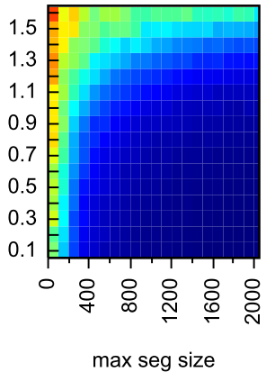
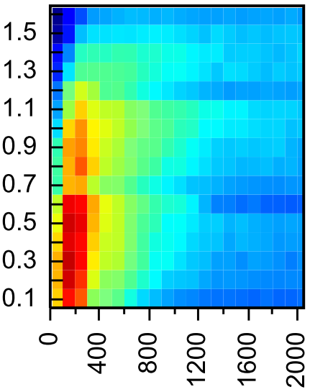
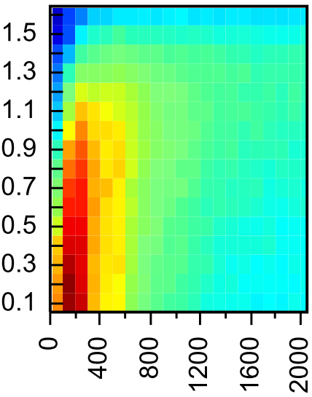

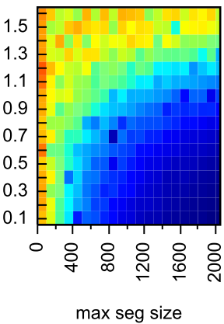
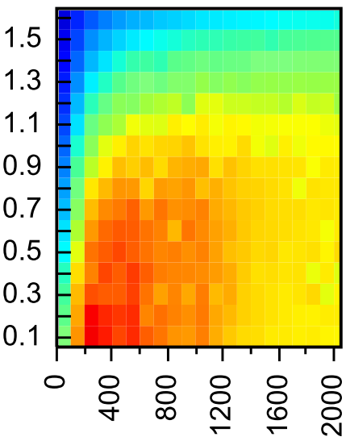
SegSort Performance
Fixing total data size w/ segments of power-law distribut.
Speedups
vs. CUB
vs. CUSP
vs. ModernGPU
64.0
13.0
3.0
48.5
10.6
2.5
Kepler GPU
33.0
8.3
2.0
Alpha
17.4
5.9
1.5
CUSP conducts global sort twice
We can achieve up to 17x speedups
ModernGPU has runtime boundary checking overhead
We can achieve up to 4x speedups
CUB is limited by processing only 65536 segments
We can achieve up to 87x speedups
1.9
3.5
1.0
87.0
17.0
4.0
67.4
13.7
3.2
More small segments
47.8
10.5
2.5
Pascal GPU
28.2
7.2
1.7
8.5
4.0
1.0
Larger max length
Max Segment Size
Notes:
Add summary

Slide 23
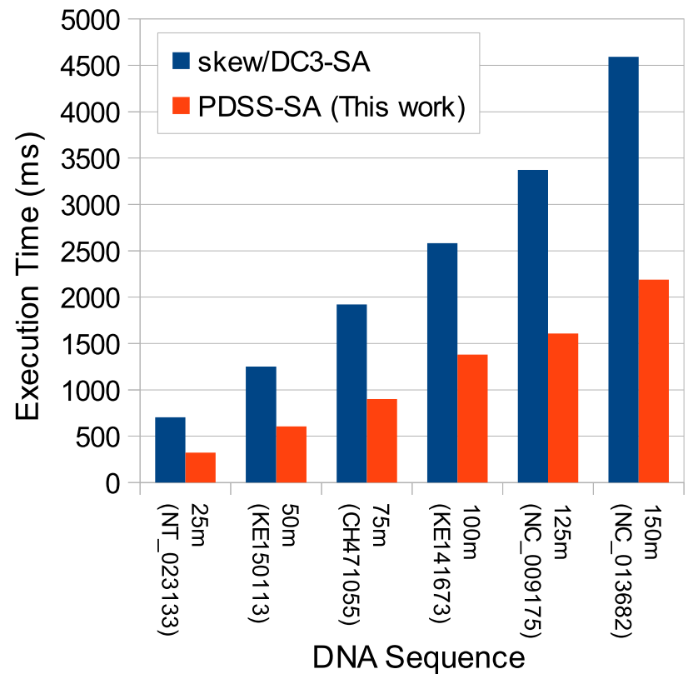
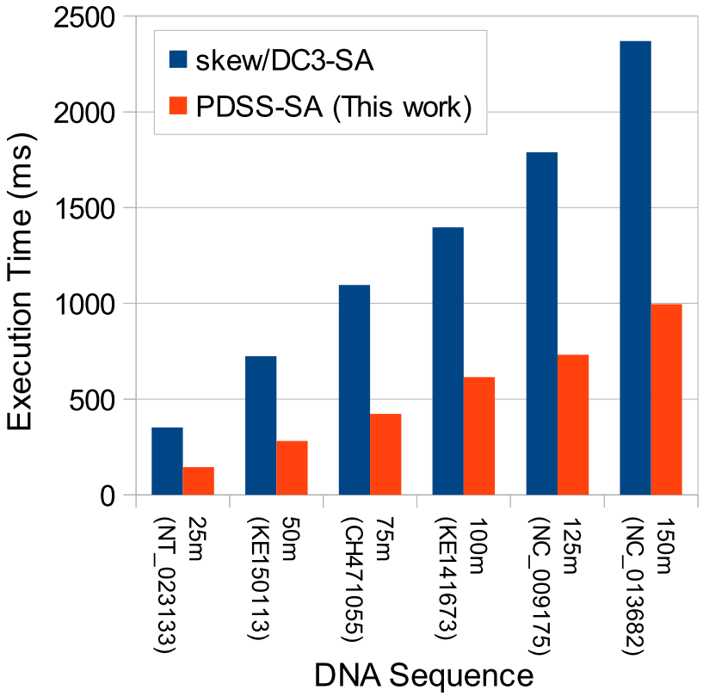
SegSort in Real-world Applications
Suffix Array: store lexicographically sorted indices of all suffixes of a given sequence
Our method is based on the prefix doubling algorithm [`93]
Deducing the orders of 2h strings from the calculated orders of h strings
Kepler GPU
Pascal GPU

Slide 24
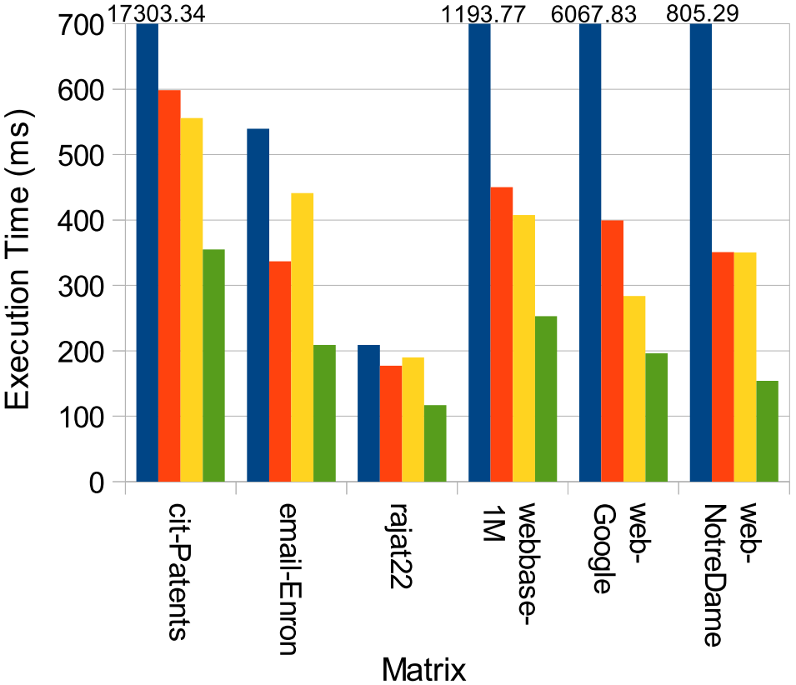

SegSort in Real-world Applications
Sparse Matrix-Matrix Multiplication (SpGEMM): multiply a sparse matrix A with another sparse matrix B and obtains a resulting sparse matrix C
Our method is using the Expansion, Seg-Sorting and Compression (ESSC) algorithm [`12]
Sorting an intermediate sparse matrix $\hat{C}$ by its indices of rows and columns
Kepler GPU
Pascal GPU

Slide 25

Conclusion
We identified the importance of segmented sort on various applications, and proposed efficient approaches on GPUs
Our GPU segmented sort method outperforms other state-of-the-art approaches in libraries of CUB, CUSP, ModernGPU
We can see that the capacity of registers is important for segmented sort in modern GPUs
Please visit our GIT repo
https://github.com/vtsynergy
Thank you!
Email to kaixihou@vt.edu
More from synergy.cs.vt.edu

