Slide 1
BiOL425 Comp Mol Bio Part 1. Git & Unix
Professor Weigang Qiu
Hunter College of CUNY
Spring 2023

Slide 2
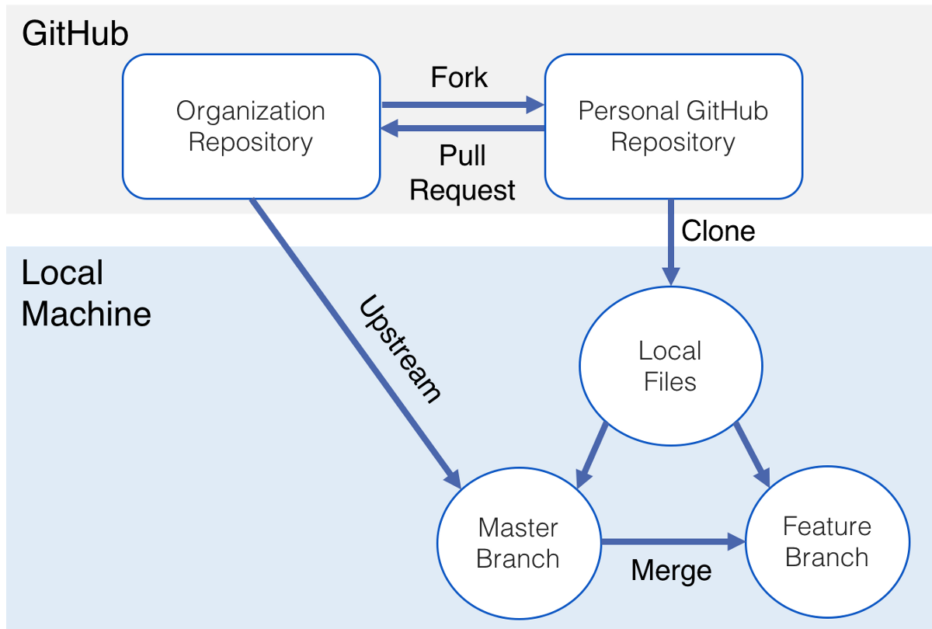
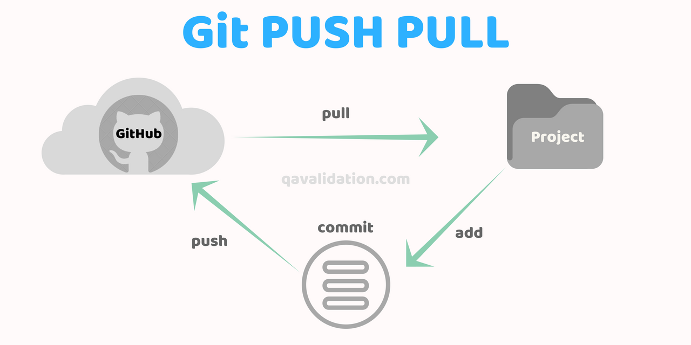
Version Control with Git (Chapter 2)
CSB
CSB-BIO425
I will use it to share files (e.g., slides), as an alternative to Blackboard
Later (hopefully), students will be able to upload files
Your Laptop
Download course repository
git clone https://github.com/weigangq/CSB-BIOL425.git
Pull the latest versions
git pull
Upload/Update file (ignore; not yet working; we will work on it later)
git add <filename> # add a new file
git commit –m “message”
git push

Slide 3
UNIX Basics (Chapter 1)
Directory listing & shorthand
ls –lrth # long, reverse, timestamp, human-readable
pwd # present working directory
~ # home directory
. # current directory
.. # parent directory
Keyboard shorthand (for command editing)
Ctrl-a # go to the beginning
Ctrl-e # go to the end
Ctrl-l # clear the screen
Ctrl-u # clear text before the cursor
Ctrl-k # clear text after the cursor
Ctrl-c # kill the (stalled) command
Directory navigation
cd ~/CSB-BIOL425/python/data # absolute path
Cd ../../unix/data # relative path
cd - # toggle 2 directories
Use auto-completion
Tab # NEEVER type out a full filename
ls bad\ file\ name.txt # NEEVER use spaces in filenames

Slide 4
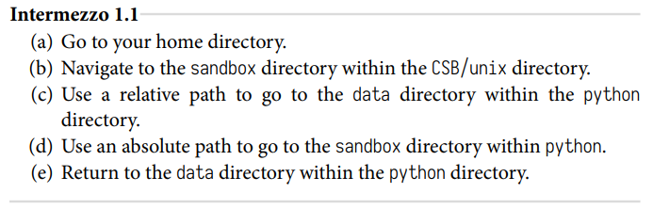
Exercise 1

Slide 5
UNIX Basics (Cont’d)
Copy files and directories
cp ~/CSB-BIOL425/unix/data/Buzzard2015_about.txt ~/CSB-BIOL425/unix/sandbox/ # use absolute path
cd ~/CSB-BIOL425/unix/sandbox/
cp ../data/Buzzard2015_about.txt . # use relative path
cp ../data/Buzzard2015_about.txt ./Buzzard2015_about2.txt # copy & rename
cp -r ../data . # recursive copy
Move or rename a file
mv Buzzard2015_about2.txt ../data/ # move file to a different directory
mv ../data/Buzzard2015_about2.txt ../data/Buzzard2015_about_new.txt # move and rename
Remove file or directory
touch new_file.txt # create an empty file (and update timestamp)
rm –i new_file.txt # Proceed with caution; EXTREMELY destructive
mkdir –p d1/d2/d3 # make nested directories
rm –r d1 # recursively remove a directory (and its sub-directories)
View & filter text files
cd ~/CSB-BIOL425/unix/data
less Marra2014_data.fasta # spacebar to page down; b to page up; Q to quit
cat *.txt # concatenate all “.txt” files
wc *.txt # word count (all “.txt” files)
head Gesquiere2011_data.csv # show top lines
tail –n 2 Gesquiere2011_data.csv # show tail two lines
sort Gesquiere2011_data.csv # sort lines in a file (alphabetically)
sort –n Gesquiere2011_data.csv # sort lines numerically

Slide 6
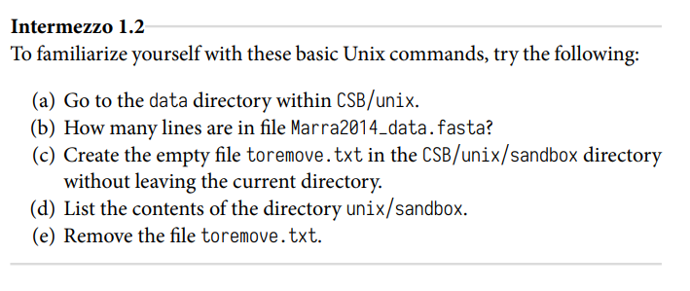
Exercise 2

