Slide 1
BiOL425 Comp Mol Bio Part 1. Git & Unix
Professor Weigang Qiu
Hunter College of CUNY
Spring 2023

Slide 2
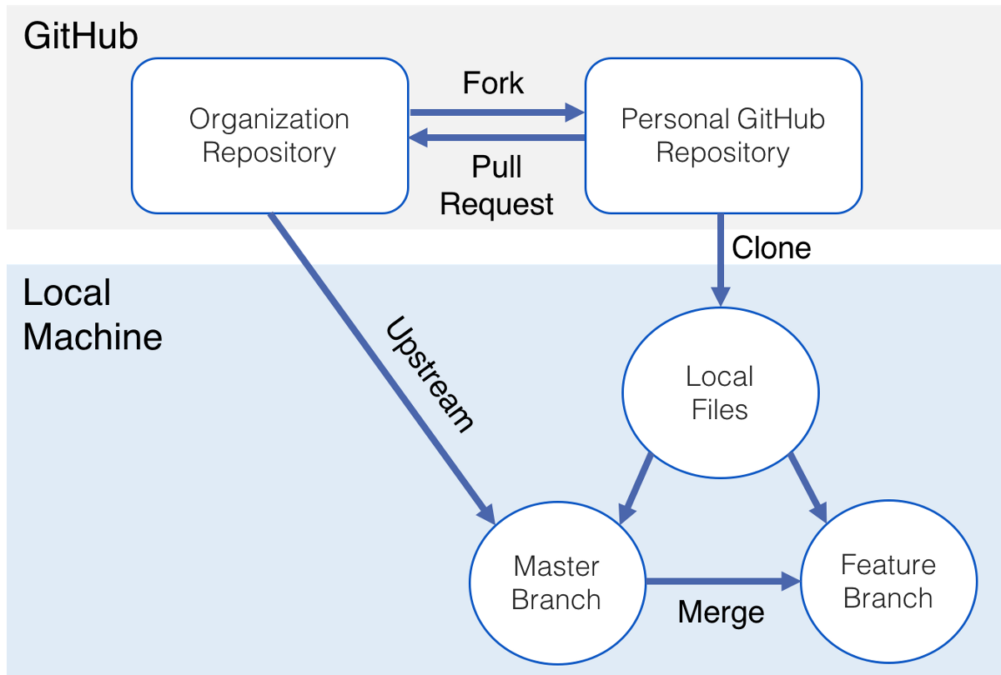
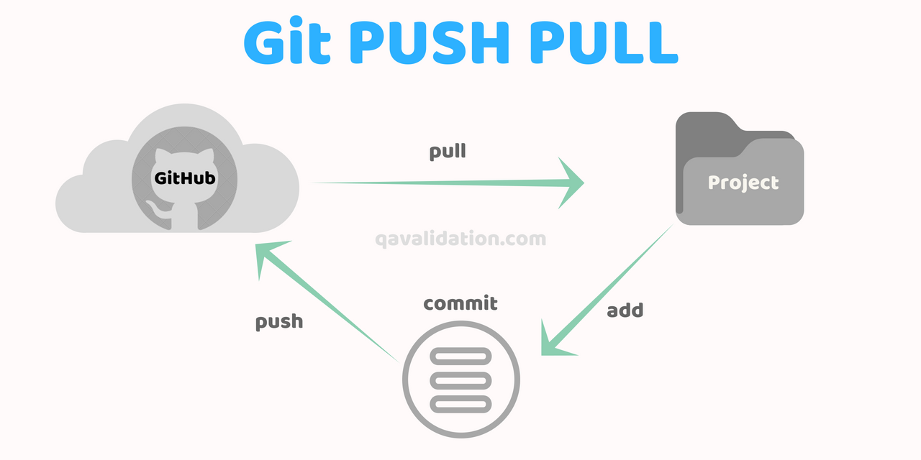
Version Control with Git (Chapter 2)
CSB
CSB-BIO425
I will use it to share files (e.g., slides), as an alternative to Blackboard
Later (hopefully), students will be able to upload files
Your Laptop
Download course repository
git clone https://github.com/weigangq/CSB-BIOL425.git
Pull the latest versions
git pull
Upload/Update file (ignore; not yet working; we will work on it later)
git add <filename> # add a new file
git commit –m “message”
git push

Slide 3
UNIX Basics (Chapter 1)
Directory listing & shorthand
ls –lrth # long, reverse, timestamp, human-readable
pwd # present working directory
~ # home directory
. # current directory
.. # parent directory
Keyboard shorthand (for command editing)
Ctrl-a # go to the beginning
Ctrl-e # go to the end
Ctrl-l # clear the screen
Ctrl-u # clear text before the cursor
Ctrl-k # clear text after the cursor
Ctrl-c # kill the (stalled) command
Directory navigation
cd ~/CSB-BIOL425/python/data # absolute path
Cd ../../unix/data # relative path
cd - # toggle 2 directories
Use auto-completion & command history
Tab # NEVER type out a full filename
Arrow keys # EDIT & NEVER retype a command
ls bad\ file\ name.txt # NEVER use spaces in filenames

Slide 4
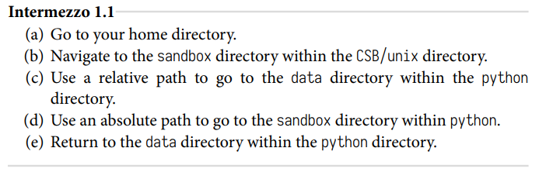
Exercise 1

Slide 5
UNIX Basics (Cont’d)
Copy files and directories
cp ~/CSB-BIOL425/unix/data/Buzzard2015_about.txt ~/CSB-BIOL425/unix/sandbox/ # use absolute path
cd ~/CSB-BIOL425/unix/sandbox/
cp ../data/Buzzard2015_about.txt . # use relative path
cp ../data/Buzzard2015_about.txt ./Buzzard2015_about2.txt # copy & rename
cp -r ../data . # recursive copy
Move or rename a file
mv Buzzard2015_about2.txt ../data/ # move file to a different directory
mv ../data/Buzzard2015_about2.txt ../data/Buzzard2015_about_new.txt # move and rename
Remove file or directory
touch new_file.txt # create an empty file (and update timestamp)
rm –i new_file.txt # Proceed with caution; EXTREMELY destructive
mkdir –p d1/d2/d3 # make nested directories
rm –r d1 # recursively remove a directory (and its sub-directories)
View & filter text files
cd ~/CSB-BIOL425/unix/data
less Marra2014_data.fasta # spacebar to page down; b to page up; Q to quit
cat *.txt # concatenate all “.txt” files
wc *.txt # word count (all “.txt” files)
head Gesquiere2011_data.csv # show top lines
tail –n 2 Gesquiere2011_data.csv # show tail two lines
sort Gesquiere2011_data.csv # sort lines in a file (alphabetically)
sort –n Gesquiere2011_data.csv # sort lines numerically

Slide 6
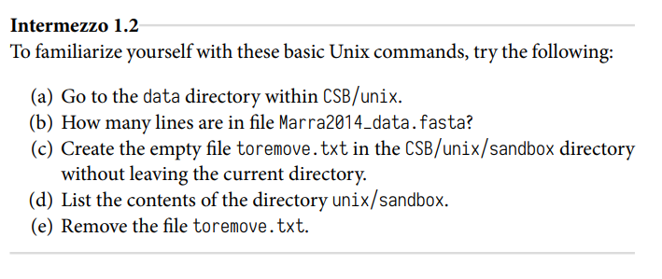
Exercise 2

Slide 7
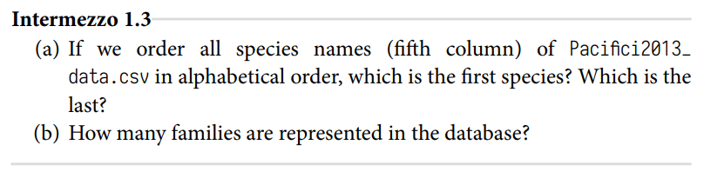
UNIX Advanced: “cut”
Redirect output (save output to file)
cd ~/CSB-BIOL425/unix/sandbox
echo “My first line” > test.txt # redirect echo output to a new file
echo “My second line” >> test.txt # append a second line
cat test.txt # show file content
ls –lrt ../data/Saavedra2013 > filelist.txt # list files and save the list to a file
cat filelist.txt # show file
ls ../data/Saavedra2013 | wc -l # use pipe (|) to count # of files
Select columns using “cut”
cd ~/CSB-BIOL425/unix/data
head Pacifici2013_data.csv # show top 10 lines
head Pacifici2013_data.csv | cut -d ";" -f 1 # select 1st field, delimited by “;”
head Pacifici2013_data.csv | cut -d ";" -f 1-4 # select columns 1-4
cut -d ";" -f 2 Pacifici2013_data.csv | tail –n +2 # select 2nd column, skip header (1st line)
cut -d ";" -f 2 Pacifici2013_data.csv | tail –n +2 | sort | uniq # show unique lines

Slide 8
UNIX Advanced: “tr” & “sed”
Character substitutions with “tr”
echo “ACtGGcAaTT” | tr ‘actg’ ‘ACTG’ # lower to upper cases
echo “ACtGGcAaTT” | tr 'a-z' 'A-Z' # same as above
echo “aaacttGGcaa” | tr –d ‘a’ # delete all ‘a’
echo “aaacttGGcaa” | tr –s ‘a’ # squeeze consecutive ‘a’
Exercise: build a single command for the following tasks
cd ~/CSB-BIOL425/unix/sandbox
Remove header from the file “../data/Pacifici2013_data.csv”
Select columns 2-6 (Order, Family, Genus, Scientific_name, AdultBodyMass_g)
Substitute ‘:’ with a Tab (“\t”)
Sort by body mass, larger values first
Save to a file “BodyM.tsv”
String substitution with “sed”
cd ~/CSB-BIOL425/unix/data
cat Bb-filelist.txt | sed "s/Borreliella/Borrelia/“ # substitute a word
cat Bb-filelist.txt | sed "s/Borreliella/Borrelia/g“ # substitute globally
cat Bb-filelist.txt | sed "s/ NCBI //“ # remove a string
Use wildcards to process multiple files
cd ~/CSB-BIOL425/unix/data/miRNA
wc –l *.fasta # count # lines for all “.fasta” files
head –n 2 pp* # show top two lines for all files starts with “pp”
file *.??? # find file types for files with 3-letter extensions
Exercise: find file type for all FASTA files; remove the string “_miR” from each line

Slide 9
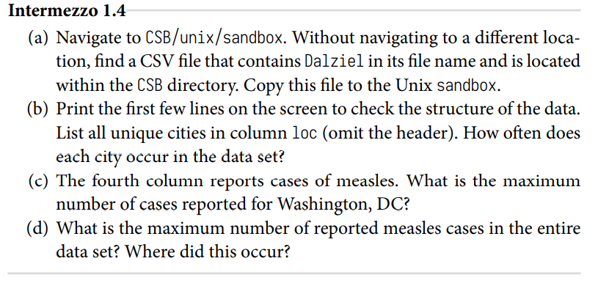
UNIX Advanced: “grep”
cd ~/CSB-BIOL425/unix/sandbox
grep “Vombatidae” BodyM.tsv # filter lines containing a term
grep –c “Vombatidae” BodyM.tsv # count # of lines containing term
grep –w “Bos” BodyM.tsv # match only a full word
grep –i “Bos” BodyM.tsv # case-insensitive match
grep -B 2 -A 2 "Gorilla gorilla" BodyM.tsv # include two lines before and after
grep -n "Gorilla gorilla" BodyM.tsv # show line number of the match
grep Gorilla BodyM.tsv | grep -v gorilla # show lines without a match (reverse)
grep -w "Gorilla\|Pan" BodyM.tsv # “\|” to match any of multiple strings

Slide 10
UNIX Advanced: “for” loops & BASH scripting
Loop through files, strings, and numbers
cd ~/CSB-BIOL425/unix/data/miRNA # microRNA data
for file in *.fasta; do head –n 2 $file; done # show top 2 lines for each fasta file
# find three miRNA across fasta files and save each to a new fasta file:
for miR in miR-208a miR-564 miR-3170; do grep $miR –A1 *.fasta > $miR.fasta; done
# increment an index:
for i in {1..10}; do echo $i; done # increment by 1
for i in {1..10..2}; do echo $i; done # increment by 2
BASH scripting
Download, install & start an editor (vi, emacs, gedit, NotePad++)
cd ~/CSB-BIOL425/unix/sandbox
Paste the following & save as “extract_body_mass.bash”: tail -n +2 ../data/Pacifici2013_data.csv | cut -d ";“ -f 2-6 | tr “;” “\t" | sort -r -n -k 6 > BodyM.tsv
bash extract_body_mass.bash # Run script
Add the bash path to the beginning & save: #!/usr/bin/env bash
chmod +x extract_body_mass.bash # change permission to make executable
./extract_body_mass.bash # Run script again
Make input and output filenames as arguments; Add comments (see next slide)
./extract_body_mass.bash ../data/Pacifici2013_data.csv BodyM.tsv

Slide 11
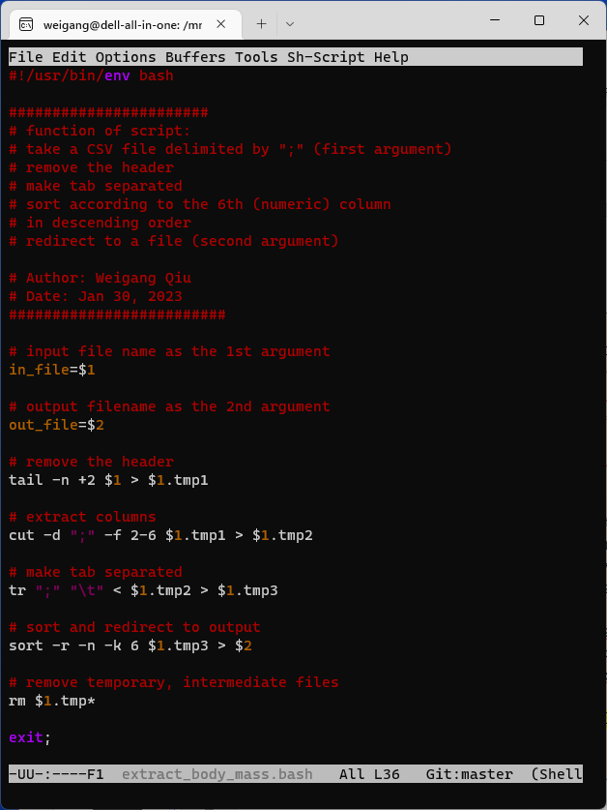
Add the bash interpreter path as the first line
Add comments as documentation
Make input and output as arguments (Do not hard-code filenames within a script)
# save; make it executable
chmod +x extract_body_mass.bash
# Run with arguments:
./extract_body_mass.bash ../data/Pacifici2013_data.csv BodyM.tsv

Slide 12
Build a (Complex) Unix Command
# The following command identifies modified CpG bases from sequencing reads (FAST4 format) obtained using Nanopore technology
./ont-guppy/bin/guppy_basecaller # program (with path)
-i Haplochromis_genome/fast5 # input folder
-s mod_out # output folder
-c ont-guppy/data/dna_r9.4.1_450bps_modbases_5mc_hac.cfg
# configuration file specifying CpG model
-x 'cuda:all’ # use GPUs (instead of CPUs)
--bam_out # output in BAM format
--compress # compress the output BAM files
--align_ref Haplochromis_genome/GCF_018398535.1_NCSU_Asbu1_genomic.fna
# reference genome (with path)
& # run in the background
NEVER type out a full path or filename. Tab for auto completion
NEVER retype a command. Arrow keys to retrieve command history

Slide 13
summary
Run “git pull” to get the latest files from the course repository
Unix command line interface (CLI):
$ command [--options] [arguments]
High efficiency (faster than Python)
Faster than graphic user interface (GUI, point-and-click)
No need for programming for most of the text-wrangling
Next week: Quiz #1, based on the following 4 exercises
1.10.1 Next generation sequencing data
1.10.2 Hormone levels in Baboons
1.10.3 Plant-pollinator networks
1.10.4. Data explorer

